Slide 1
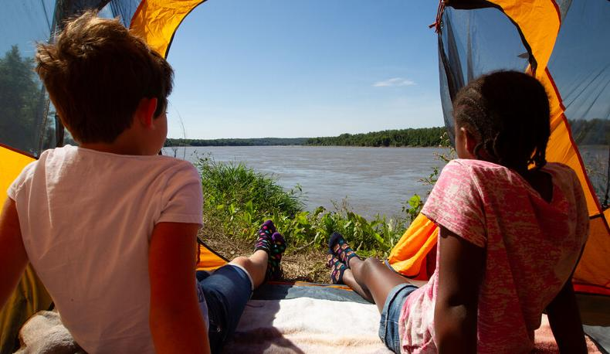

Life and Land in
MISSOURI
1D: Seeds and Socks

Slide 2
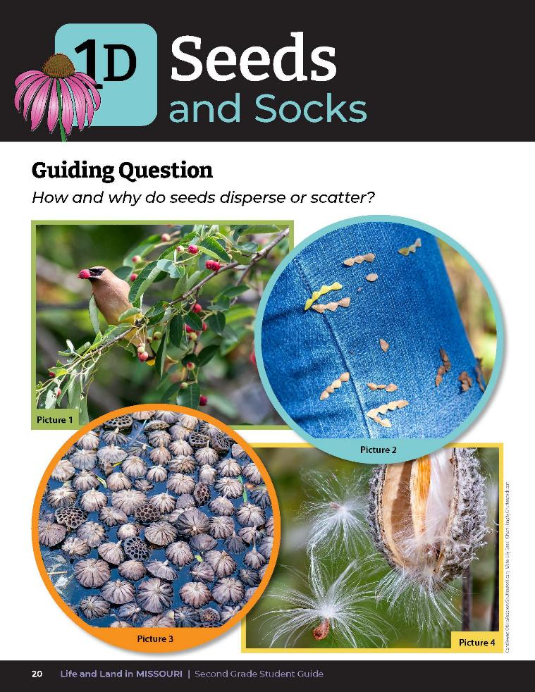
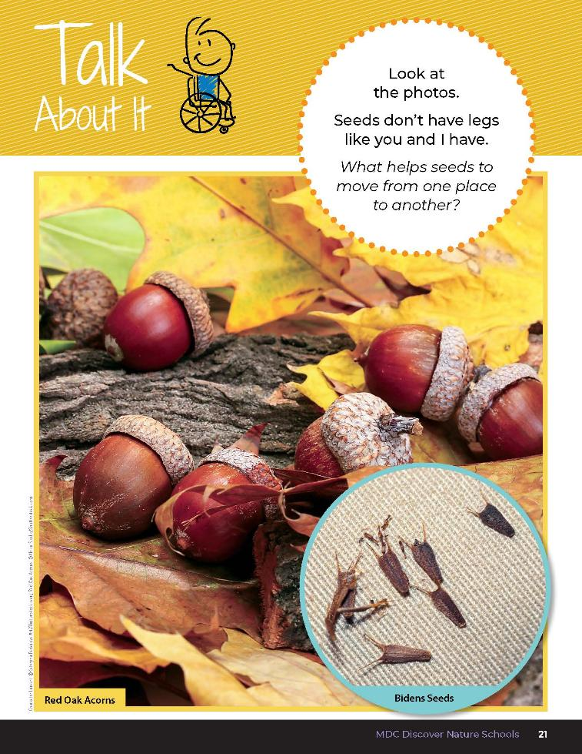
1D
Life and Land in Missouri – 1D Seeds and Socks: Engage
2
Notes:
Guiding Question: How and why do seeds disperse or scatter?
Have students open student guide to the Lesson 1D Seeds and Socks introduction on pages 20-21. Read the guiding question together. How and why do seeds disperse or scatter?

Slide 3
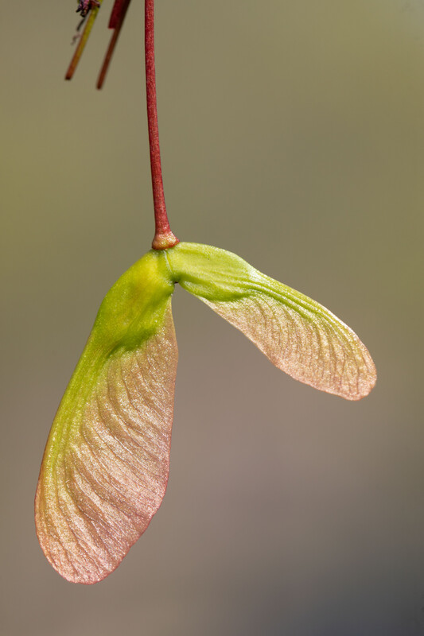
What helps seeds move from one place to another?
1D
Life and Land in Missouri – 1D Seeds and Socks: Engage
3
Notes:
Plant in Picture: Maple Tree seeds

Slide 4
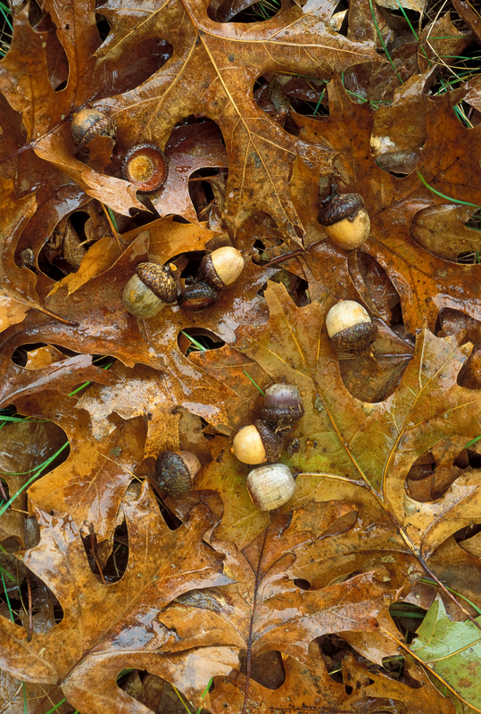
An oak tree makes thousands of acorns that drop to the ground in autumn.
Acorns are the seeds of the oak tree and each acorn can grow into a new oak tree.
1D
Life and Land in Missouri – 1D Seeds and Socks: Engage
4
Notes:
Take the class outside and set a hula hoop in an open area. Choose one student to be the “oak tree.” Explain to students the oak tree makes thousands of acorns that drop to the ground in autumn. Acorns are the seed of the oak tree and each acorn can grow into a new oak tree.
Plant in picture: Shumard Oak tree leaves and acorns

Slide 5
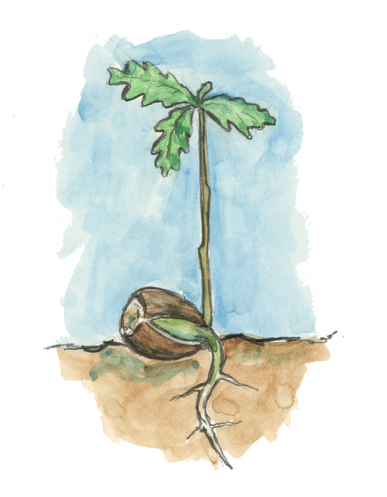
Who wants to be an acorn that grows into a new oak tree?
1D
Life and Land in Missouri – 1D Seeds and Socks: Engage
5
Notes:
Have the first student volunteer stand in the hula hoop to become a new oak tree. Call students up one by one to be a new oak tree until there is no room in the circled area. Encourage students to try and fit in the space near the original oak tree, even if there is no room.
By this time the students will most likely be squishing together and falling out of the marked space.

Slide 6
Why can’t you all fit?
1D
Life and Land in Missouri – 1D Seeds and Socks: Engage
6
Notes:
(They have run out of space.)
Explain to students that they were acorns and now small oak trees and that they need to move away from the big oak tree and spread out.

Slide 7
Can you grow tall now?
What helped you grow taller?
1D
Life and Land in Missouri – 1D Seeds and Socks: Engage
7
Notes:
(Space.)

Slide 8
So, what do plants need in order to survive again?
1D
Life and Land in Missouri – 1D Seeds and Socks: Engage
8
Notes:
(Air, water, soil, sunlight, and space.)

Slide 9
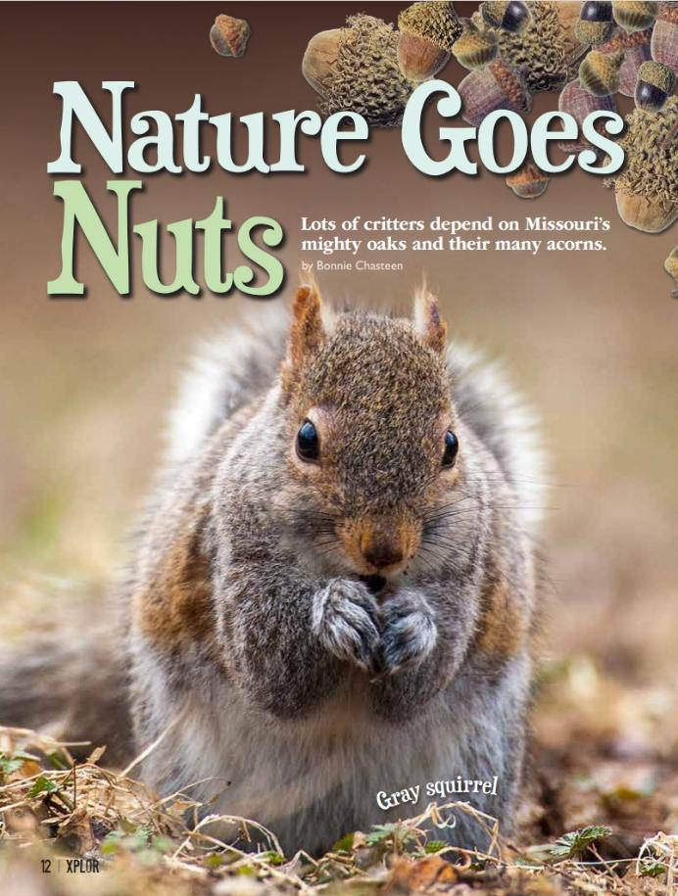
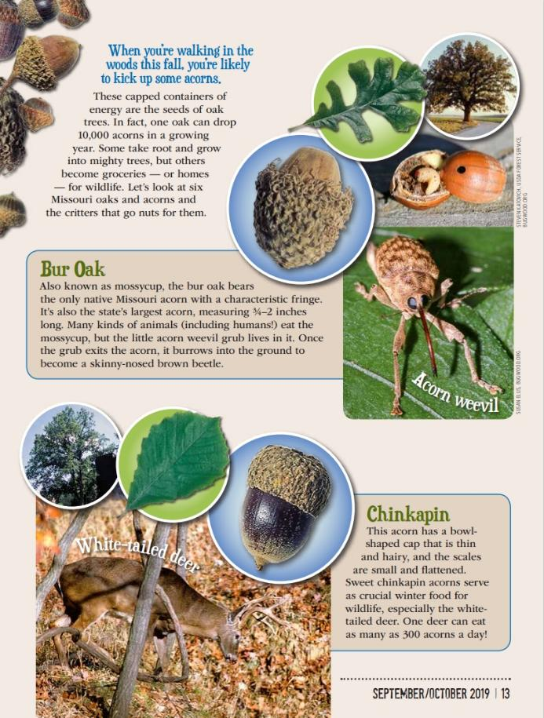
Link to Article:
1D Nature Goes Nuts Xplor Article.pdf
1D
Life and Land in Missouri – 1D Seeds and Socks: Engage
9
Notes:
From the MDC Teacher Portal, display or distribute copies of Nature Goes Nuts by Bonnie Chasteen from the September/October 2019 issue of Xplor. Look at the different types of acorns that oaks produce.

Slide 10
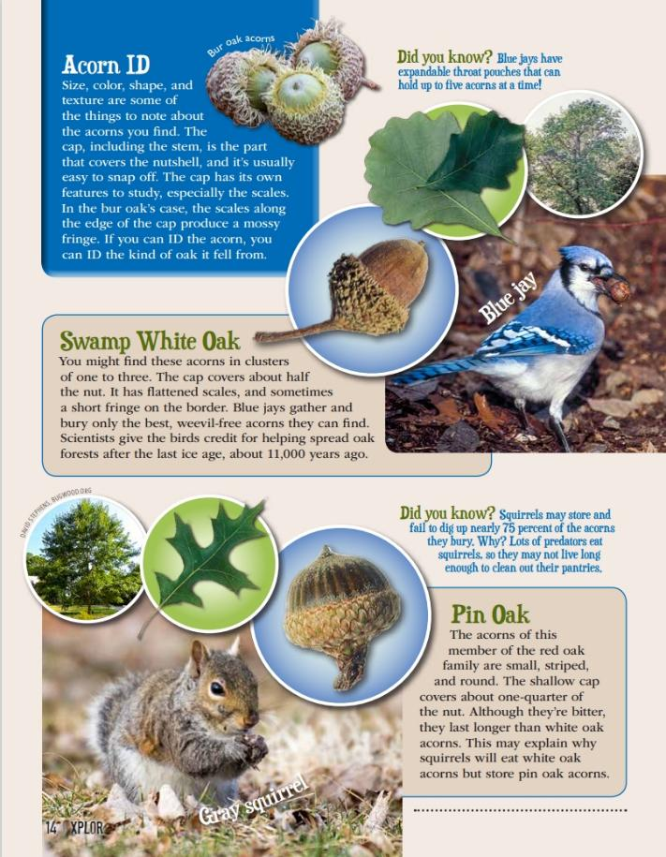
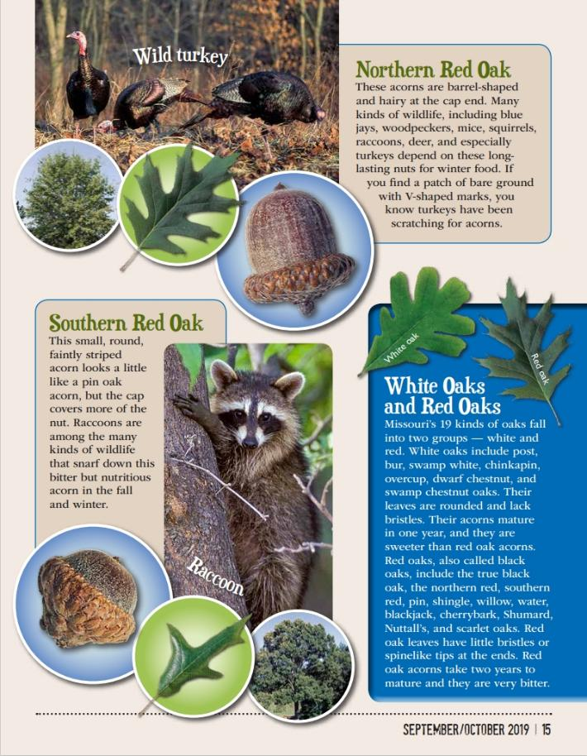
1D
Life and Land in Missouri – 1D Seeds and Socks: Engage
10

Slide 11
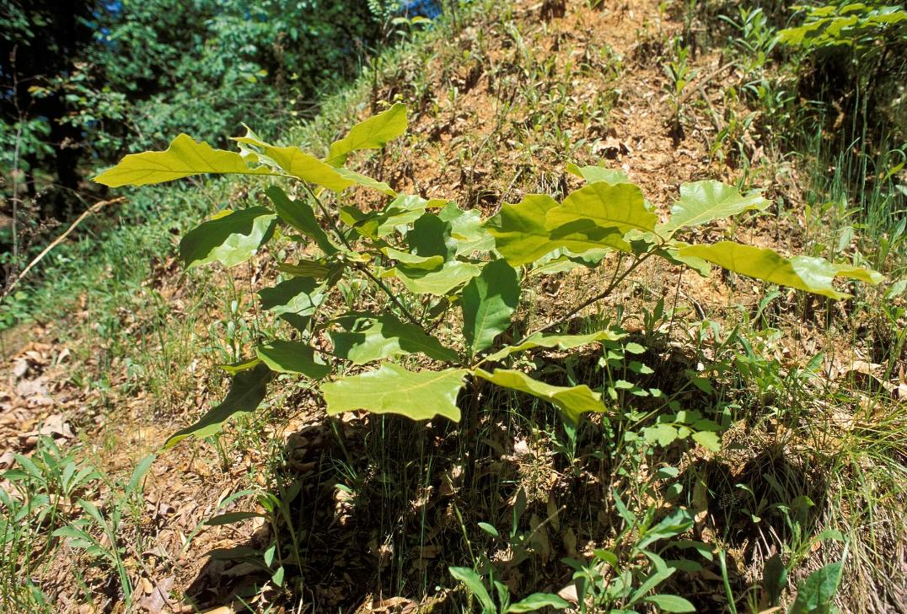
What do plants need to survive?
1D
Life and Land in Missouri – 1D Seeds and Socks: Engage
11
Notes:
(Air, water, soil, sunlight.)
Plant in Picture: Black Oak seedling

Slide 12
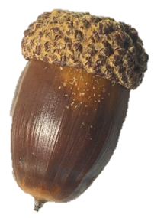
What would happen if seeds, like the different types of acorns we read about, stayed in the same spot?
1D
Life and Land in Missouri – 1D Seeds and Socks: Engage
12
Notes:
Plant in Picture: White oak acorn (seed)

Slide 13
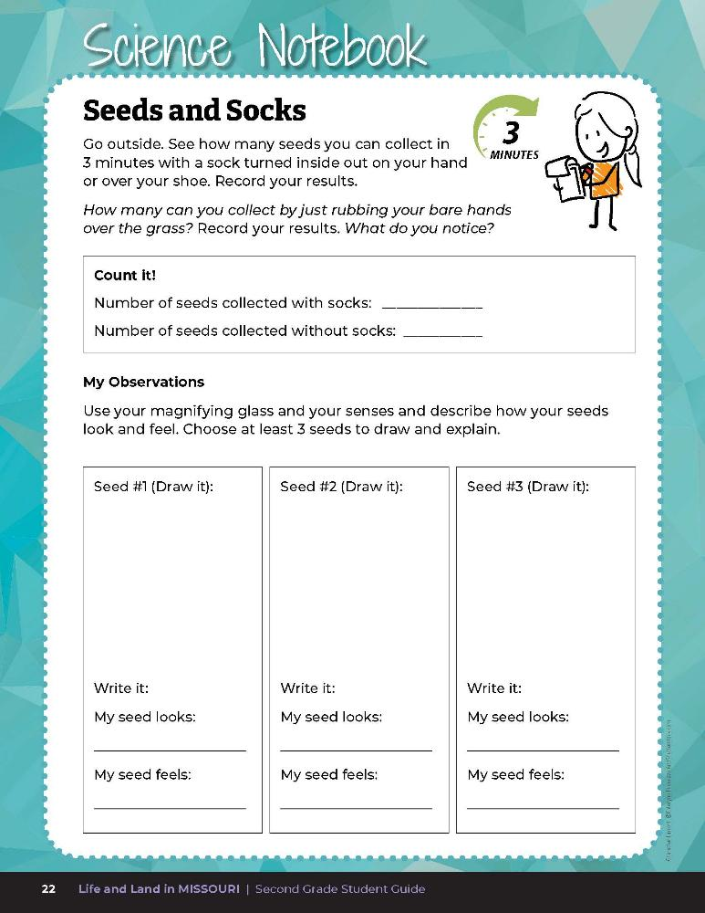

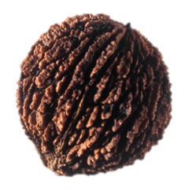

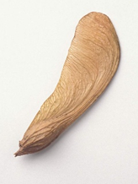
Let’s explore different types of seeds!
1D
Life and Land in Missouri – 1D Seeds and Socks: Explore
13
Notes:
This activity can be a field experience or classroom activity. Bring paper bags and magnifying glasses for students to use as they explore the different types of seeds.
Field Experience – Plan a trip to take students to collect seeds at a local park, wooded area, prairie, or even an area neat the school that has grasses and trees. Unmowed areas are best for collecting seeds. Make sure students are wearing closed-toed shoes and long pants. When you arrive at the seed collection area, give each student an old sock to put over one show. Also, give each student (or groups of students) a plastic or paper bag to collect any seeds they find. Take a nature walk through the area. (Encourage a few students to put their sock on wrong side out.)
Classroom Setting – If you are unable to take students outdoors, use seeds collected in lesson 1C Seedy Sorting or contact your local conservation educator for native seeds. Spread seeds out evenly on trays. Give each student a sock to put on one hand. Instruct each student to put their socked hand flat on the tray with the seeds and see if any seeds stick to their sock. Next, have the students gently place their hand or shoe on the tray with seeds and see if any seeds stick to their hand.
Collect seeds on socks for 3 minutes and collect seeds without socks for 3 minutes. After students have an opportunity to collect seeds on their socks, instruct students to compare their foot (or hand) with the sock on it and their foot (or hand) without the sock.
Plant in Picture: Shingle Oak acorn, Pecan nut, Black Walnut Tree seed, Silver Maple seed

Slide 14

Count and record how many seeds were collected with the socks and compare it to how many seeds were collected either using your bare hand or shoe.
1D
Life and Land in Missouri – 1D Seeds and Socks: Explore
14
Notes:
Have students record observations in Science Notebook 1D Seeds and Socks on Page 22. Count and record how many seeds were collected with the socks and compare it to how many seeds were collected using either their bare hand or shoe.
Ask students to share their observations. Students should observe that the sock collected several seeds.

Slide 15
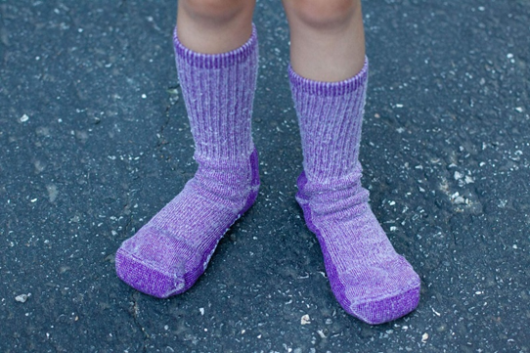
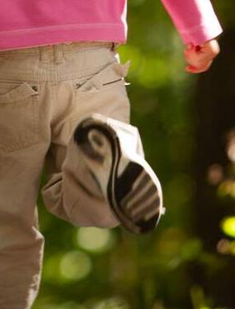
Which collected more seeds, the sock or the bottom of the shoe/bare hand?
1D
Life and Land in Missouri – 1D Seeds and Socks: Explore
15
Notes:
Students should share that the material the sock is made of allows some seeds to stick to them. Shoe soles are smooth rubber and seeds don’t stick to them.

Slide 16

Read the book Flip, Float, Fly: Seeds on the Move by JoAnn Early Macken
Read Aloud:
https://youtu.be/qPnPGoxNG40?si=UB7g3-mhwDLfKink
1D
Life and Land in Missouri – 1D Seeds and Socks: Explain
16
Notes:
Read the book Flip, Float, Fly: Seeds on the Move by JoAnn Early Macken.

Slide 17
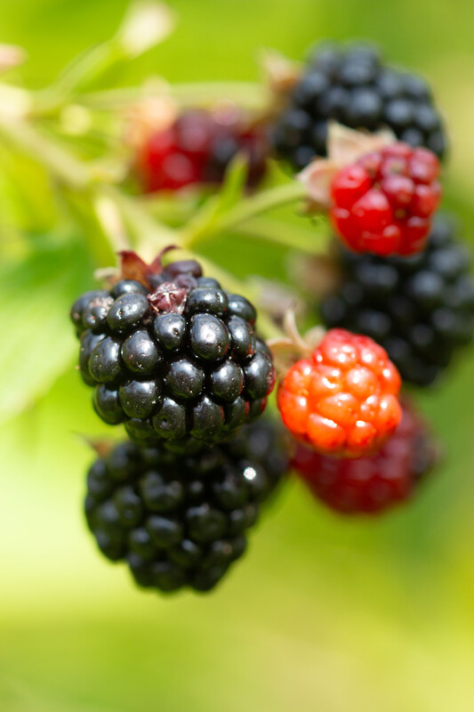
Where do seeds come from?
1D
Life and Land in Missouri – 1D Seeds and Socks: Explain
17
Notes:
(Plants make seeds. Seeds are found in fruits, nuts, or flowers.)
Plant in Picture: blackberries

Slide 18
Do seeds stay by their parent plant or disperse (spread out)?
How many ways do seeds disperse?
1D
Life and Land in Missouri – 1D Seeds and Socks: Explain
18
Notes:
As a class, brainstorm was seeds might disperse. Create a classroom list on the white board.

Slide 19
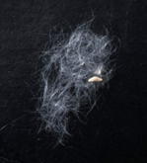
Why is seed dispersal so important?
1D
Life and Land in Missouri – 1D Seeds and Socks: Explain
19
Notes:
(Without dispersing seeds, the plants will grow too close together and they will have to compete for light, water, and nutrients from the soil.)

Slide 20
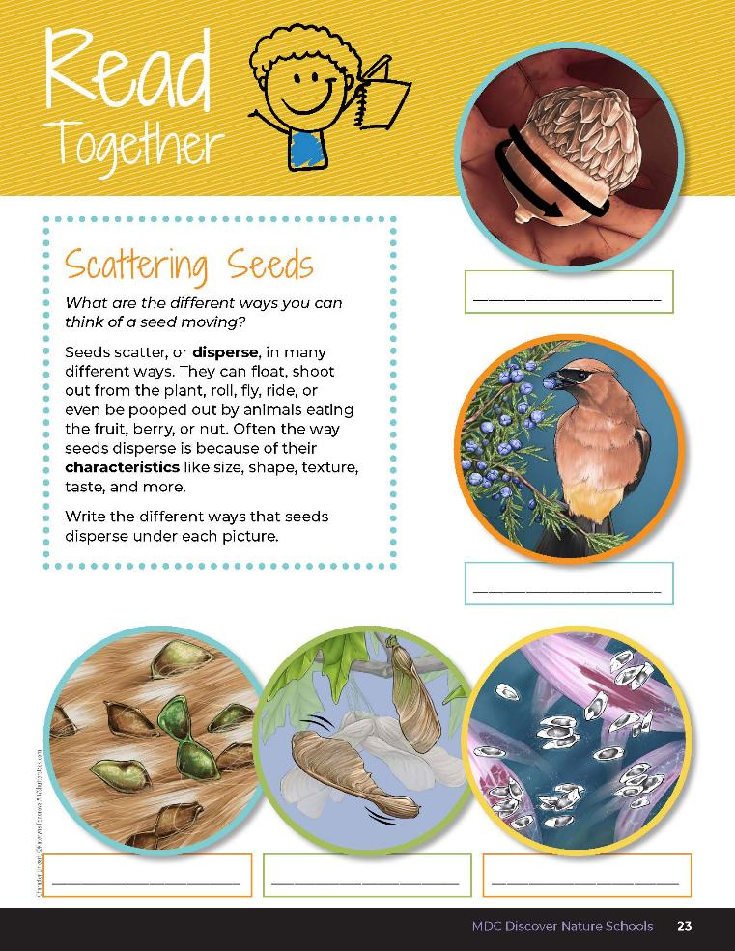

Scattering Seeds
What are the different ways you can think of a seed moving?
Seeds scatter, or disperse, in many different ways. They can float, shoot out from the plant, roll, fly, ride, or even be pooped out by animals eating the fruit, berry, or nut.
1D
Life and Land in Missouri – 1D Seeds and Socks: Explain
20
Notes:
Have students read the Read Together Scattering Seeds page.

Slide 21
Scattering Seeds
Often the way seeds disperse is because of their characteristics like size, shape, texture, taste, and more.
Write the different ways that seeds disperse under each picture.
1D
Life and Land in Missouri – 1D Seeds and Socks: Explain
22
Notes:
Have students read the Read Together Scattering Seeds page.

Slide 22
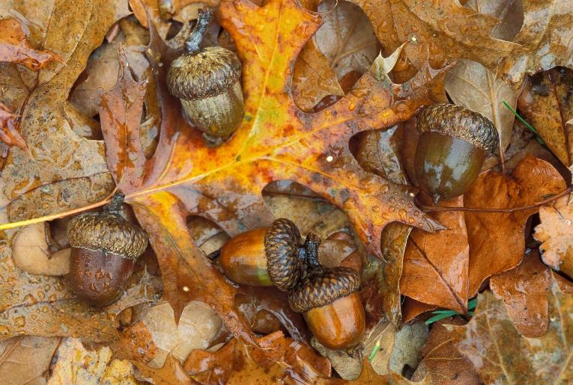
Seed Dispersal Role Play Activity
1D
Life and Land in Missouri – 1D Seeds and Socks: Explain
23
Notes:
Choose three to five students to demonstrate seed dispersal to the class, and instruct each student which of following dispersal roles below they will be playing.
Teacher Note: Tell each student privately about their role and the suggested ways to perform it.
Flying by wind
Demonstration: Have student demonstrate wind by blowing air and waving arms, pretending to scatter or disperse seeds as they move.
Explanation: The wind can blow seeds that are dry, light, and small. Some seeds blown by the wind have wing-like or parachute-like structures.
Examples are maple, sycamore, and ash trees, and milkweed and dandelion plants.
Floating on water
Demonstration: Have student demonstrate water by doing a full body wave, pretending to scatter or disperse seeds as they move.
Explanation: Water can carry seeds that have a waterproof outer layer and that can float in water.
Examples are lotus, cattail, horse chestnut, and burdock.
Animals eating it
Demonstration: Have student demonstrate animal dispersal role by eating and then eliminating the seeds after digestion. Discretion should be suggested in this portion of animal excreting seeds.
Explanation: Often the fruit containing seeds is juicy and tasty. Seeds in fruit and nuts have a fragrant (good) smell and are brightly colored, such as berries and plums. Birds and mammals eat fruit containing seeds and nuts. When the animal eliminates waste (poops), the seed gets left behind and can grow. Some animals like squirrels collect and bury nuts and acorns.
Riding on an animal
Demonstration: Have student role play being an animal that has seeds on their fur and carry seeds to a new location.
Explanation: Some seeds have hooks called barbs that stick to the fur of mammals. Other seeds have stiff hairs that stick to fur also.
Examples are cockleburs and beggar lice.
Shooting out seeds
Demonstration: Have student demonstrate being a parent plant by having arms open wide and then shooting open to release and scatter seeds.
Explanation: Some seed casings (pods) dry up and split open suddenly when they ripen. The seeds are then forcefully pushed out.
Examples are peas, violets, jewel weed, and witch hazel.
Rolling
Demonstration: Have student demonstrate by rolling around classroom and stopping.
Explanation: Some seeds are round or oval-shaped and can roll easily when they fall from a tree or roll downhill.
Examples are acorns, hickory nuts, and walnuts
Tree in Picture: Shumard Oak acorns and leaves

Slide 23
Have you ever seen any seeds that disperse in these ways?
What happens to seeds that are dispersed?
1D
Life and Land in Missouri – 1D Seeds and Socks: Explain
23
Notes:
(They grow into a new plant in a new location.)

Slide 24
If you were a small oak tree, could you really spread out?
Could you walk away?
1D
Life and Land in Missouri– 1D Seeds and Socks: Explain
24
Notes:
(Students should answer that the trees could not just spread out because they have roots.)
Explain that when plants start growing, they make roots. Plants and trees that are rooted cannot travel or move around. That is why seeds need to be dispersed before they sprout and grow roots.

Slide 25
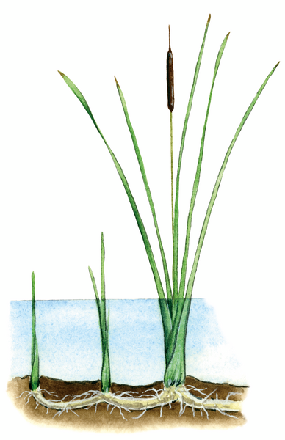
What do roots do for a plant?
1D
Life and Land in Missouri– 1D Seeds and Socks: Explain
25
Notes:
(Roots absorb water and nutrients for the plant, roots anchor [hold] the plant in place, and roots keep the plant from moving away.)
Plant in Illustration: Cattail

Slide 26
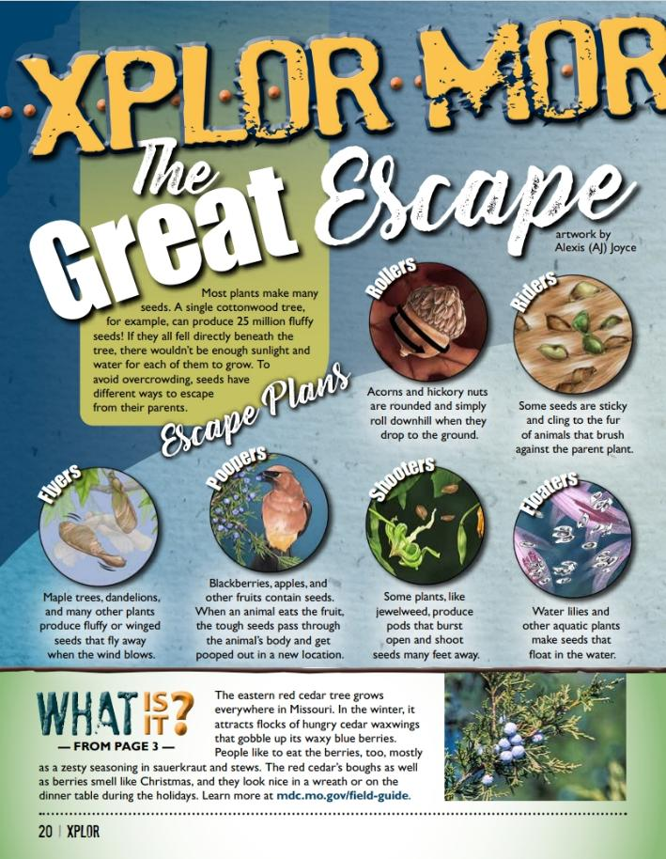
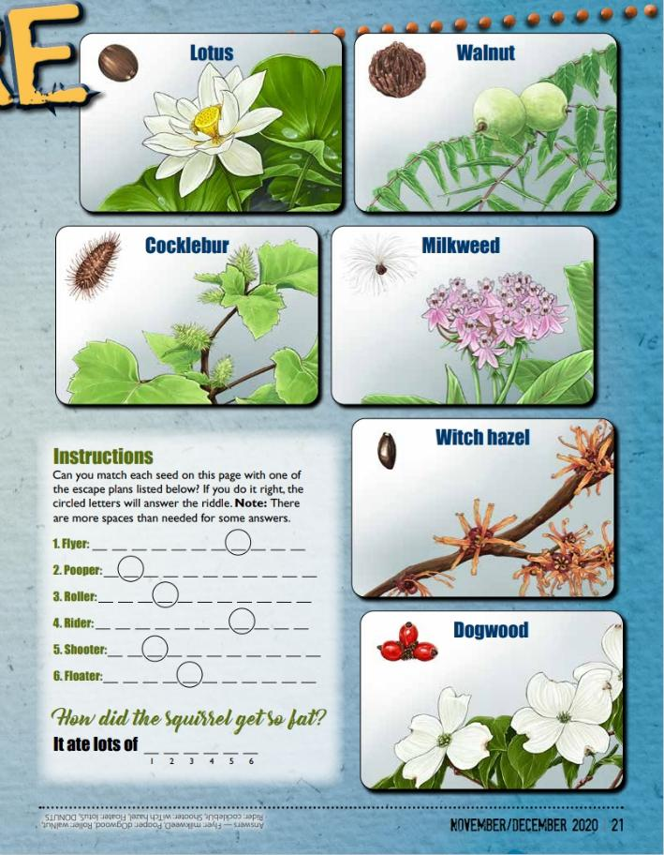
Link to Article:
1D The Great Escape Xplor Article.pdf
1D
Life and Land in Missouri– 1D Seeds and Socks: Elaborate
26
Notes:
From the MDC Teacher Portal, display or distribute copies of The Great Escape from the November/December 2020 issue of Xplor from pages 22-23. After reading the differences of seed dispersal between a flyer, pooper, roller, rider, shooter, and floater, have students try to complete the puzzle at the end.

Slide 27
Looking at the three different seeds you drew, how do you think they would disperse? Why?
1D
Life and Land in Missouri– 1D Seeds and Socks: Elaborate
27
Notes:
Have students revisit their seed drawings from Science Notebook 1D Seeds and Socks on Page 22.

Slide 28
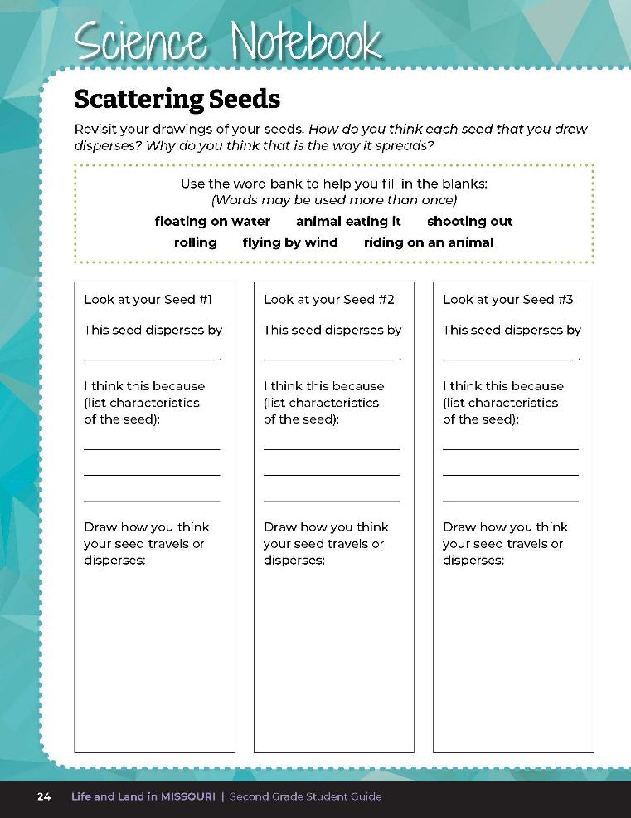
How do you think each seed that you drew disperses?
Why do you think that is the way it spreads?
1D
Life and Land in Missouri– 1D Seeds and Socks: Elaborate
28
Notes:
Have them complete Science Notebook 1D Scattering Seeds on Page 24.

Slide 29
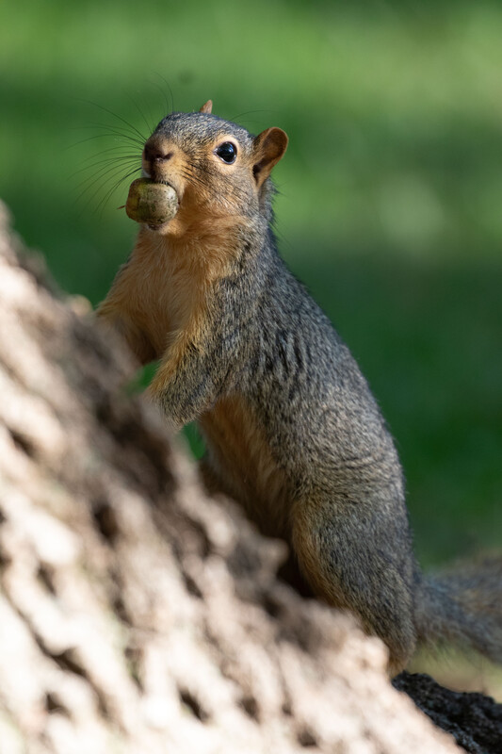
How do you think an oak tree’s seed, the acorn, could be dispersed?
Is there more than one way an acorn could disperse?
1D
Life and Land in Missouri– 1D Seeds and Socks: Elaborate
29
Notes:
Think back to the beginning of the lesson. How do you think an oak tree’s seed, the acorn, could dispersed? Is there more than one way an acorn could disperse? (Students should give answers such as squirrels may carry them off and bury them. Wind may blow them [but not far], water may carry them away after a heavy rain if they are near a stream or river.)
Teacher Note: If you were able to receive native seeds, find a bare spot of soil in your school yard and plant them. Be sure to mark the boundary of the plot so others can enjoy the process of your native wildflower plot growing!
Animal in Picture: Fox squirrel

Slide 30
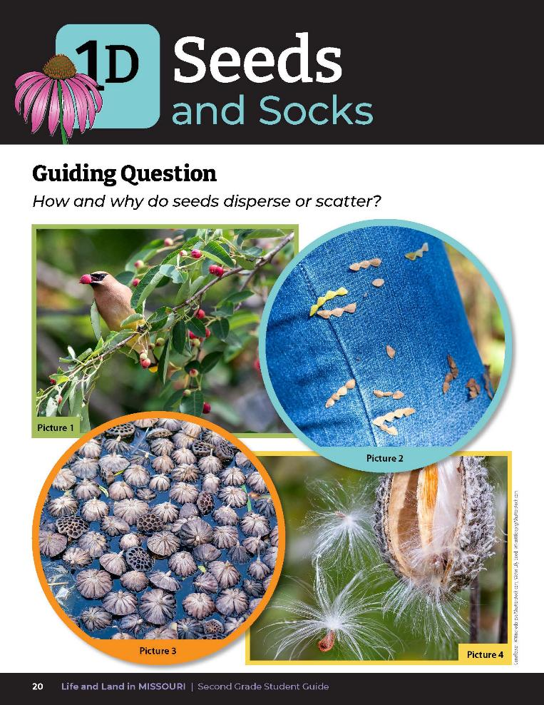
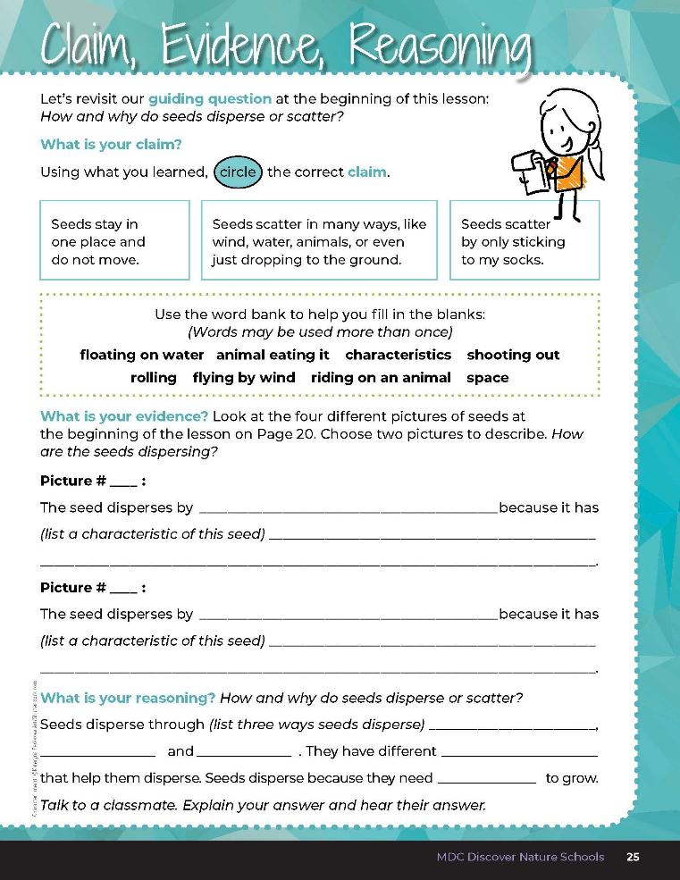
1D
Life and Land in Missouri– 1D Seeds and Socks: Evaluate
30
Notes:
After exploring the concept of how seeds disperse, have students open their student guides to the 1D Claim, Evidence, Reasoning section on Page 25. Guide students through the page by reviewing each section as a class and revisiting the scientific concepts learned to help answer each section.
Guiding Question: How and why do seeds disperse or scatter?

Slide 31
characteristics
space
1D
Life and Land in Missouri– 1D Seeds and Socks: Evaluate
31
Notes:
Rubric:
4 (Exceeds) – Student circles the correct claim and writes the correct evidence into the blanks and provides the correct reasoning by filling in all the blanks correctly.
3 (Meets) – Student circles either the correct claim or writes the correct evidence into the blanks and/or provides the correct reasoning by filling in all the blanks correctly.
2 (Partially meets) – Student circles either the correct claim or somewhat writes the correct evidence into the blanks and does not provide the correct reasoning.
1 (Doesn’t meet) – Student does not provide the correct claim or evidence and does not provide the correct reasoning.

