Slide 1


Life and Land in
MISSOURI
1C: Seedy Sorting

Slide 2
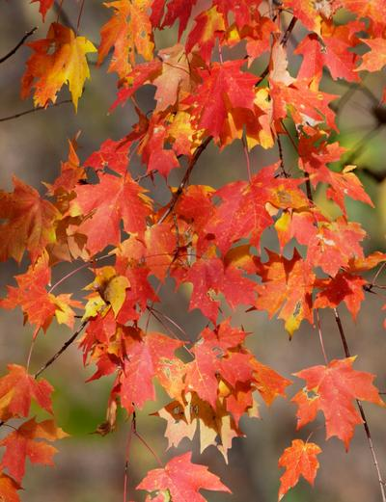
Guiding Question:
How are seeds different?
How are leaves different?
1C
Life and Land in Missouri – 1C Seedy Sorting: Engage
2
Notes:
Plant in picture: Sugar Maple Tree

Slide 3
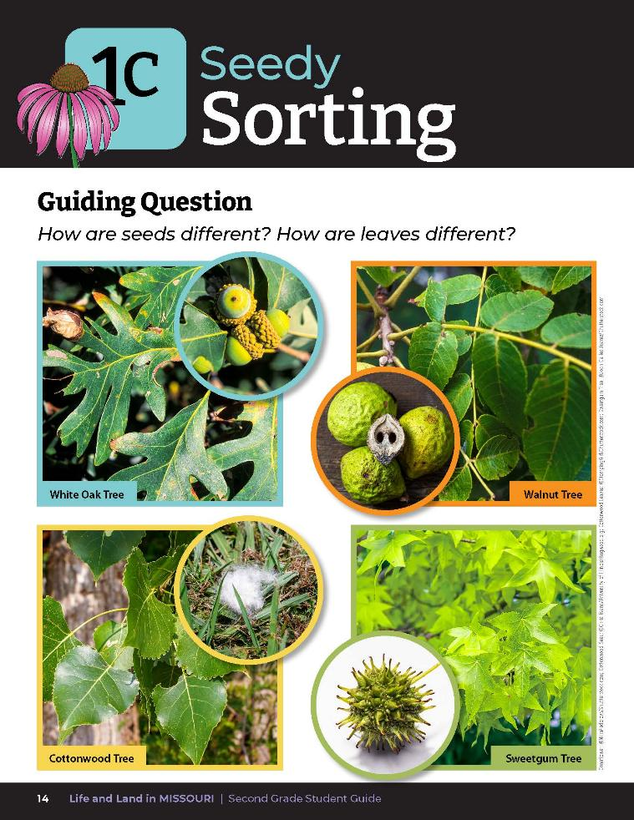
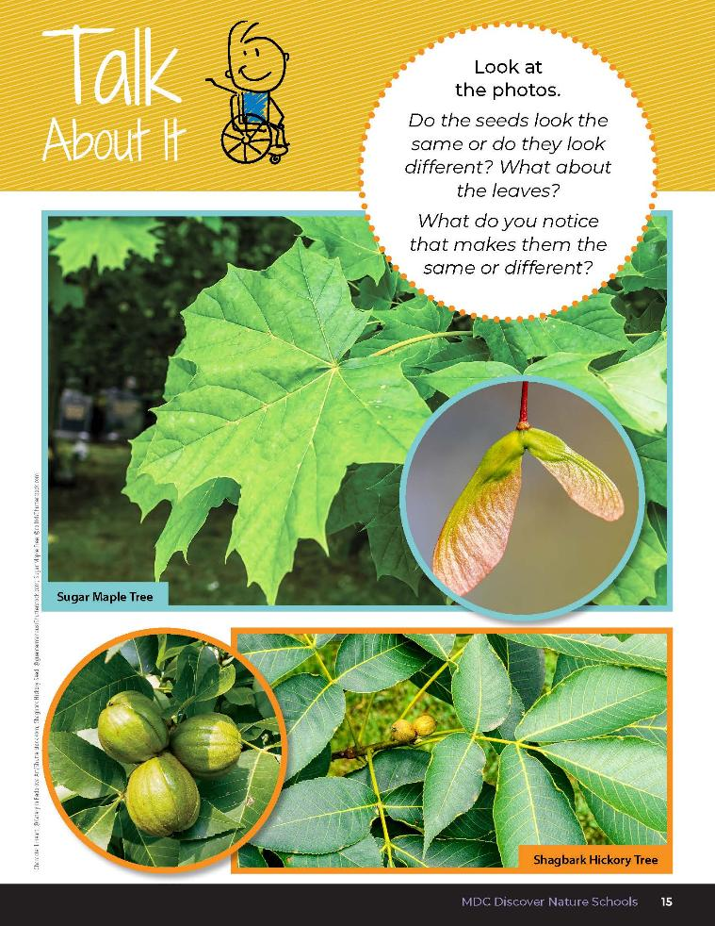
1C
Life and Land in Missouri – 1C Seedy Sorting: Engage
3
Notes:
Have students open student guide to Lesson 1C Seedy Sorting introduction on pages 14-15.
Read the guiding question together. Discuss the Talk About It as a class. Reference the pictures of different types of Missouri seeds. Discuss how the seeds from different trees look different.

Slide 4
What do you observe about the acorns?
What is their shape?
1C
Life and Land in Missouri – 1C Seedy Sorting: Engage
5
Notes:
Hold up a seed or display pictures of seeds from the Lesson 1C Seedy Sorting introduction section. Look at the picture of the acorns.

Slide 5
What color is the seed?
How do you think it would feel?
1C
Life and Land in Missouri – 1C Seedy Sorting: Engage
6

Slide 6
What size is it?
What do you think it smells like?
1C
Life and Land in Missouri – 1C Seedy Sorting: Engage
7

Slide 7
How else could you describe the seed?
1C
Life and Land in Missouri – 1C Seedy Sorting: Engage
8

Slide 8

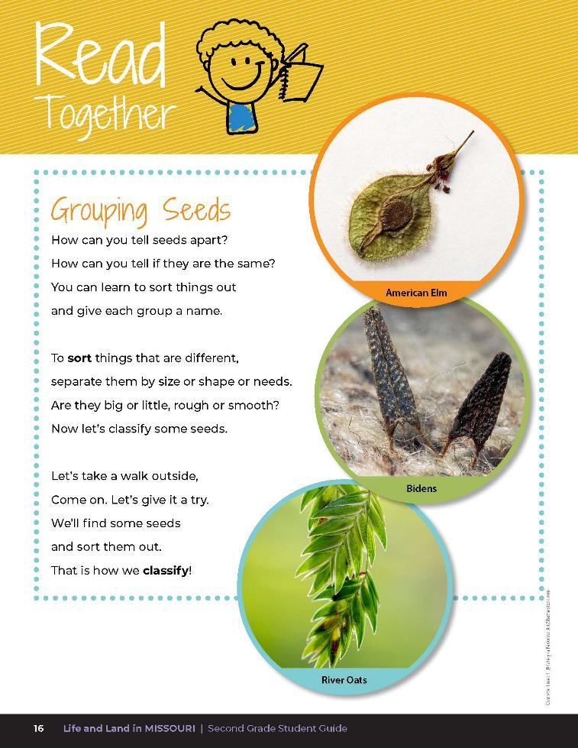
Grouping Seeds
How can you tell seeds apart?
How can you tell if they are the same?
You can learn to sort things out and give each group a name.
1C
Life and Land in Missouri – 1C Seedy Sorting: Engage
9
Notes:
Write student observations on the board. Have students read aloud the poem from student guide Read Together 1C Grouping Seeds section on Page 16.

Slide 9
Grouping Seeds
To sort things that are different, sperate them by size or shape or needs.
Are they big or little, rough or smooth?
Now let’s classify some seeds.
1C
Life and Land in Missouri – 1C Seedy Sorting: Engage
9
Notes:
Write student observations on the board. Have students read aloud the poem from student guide Read Together 1C Grouping Seeds section on Page 16.

Slide 10
Grouping Seeds
Let’s take a walk outside, come on. Let’s give it a try.
We’ll find some seeds and sort them out.
That is how we classify.
1C
Life and Land in Missouri – 1C Seedy Sorting: Engage
10
Notes:
Write student observations on the board. Have students read aloud the poem from student guide Read Together 1C Grouping Seeds section on Page 16.

Slide 11
Let’s go on a nature walk!
Collect as many different seeds as possible in you paper bag.
1C
Life and Land in Missouri – 1C Seedy Sorting: Explore
11
Notes:
Go outside for a nature walk around the school and have students collect as many different types of seeds as possible in their paper bags. Have students practice using their magnifying glasses to look at differences in seeds.
Collect a wide variety of seeds, enough for each group of students to have seeds to sort later, including seed pods, acorns, etc. Alternatively, students can collect and bring seed pods, acorns, and nuts from home, or you can contact your local conservation educators for information on how to obtain native seeds.

Slide 12
Divide seeds into two groups based on an observable property or characteristic of the seeds.
1C
Life and Land in Missouri – 1C Seedy Sorting: Explore
12
Notes:
Tell students they are going to be dividing their collected seeds into two groups based on an observable property or characteristics of the seeds. Have them do this several times and record the different ways they sorted them, changing the sorting characteristics. They can continue to practice using their magnifying glasses in this activity.
If initially students cannot classify their seeds into two groups, the teacher may provide sorting parameters. For example: smooth and rough, large and small, hard and soft, etc.
Have each group share one way they sorted the seeds with the class.

Slide 13

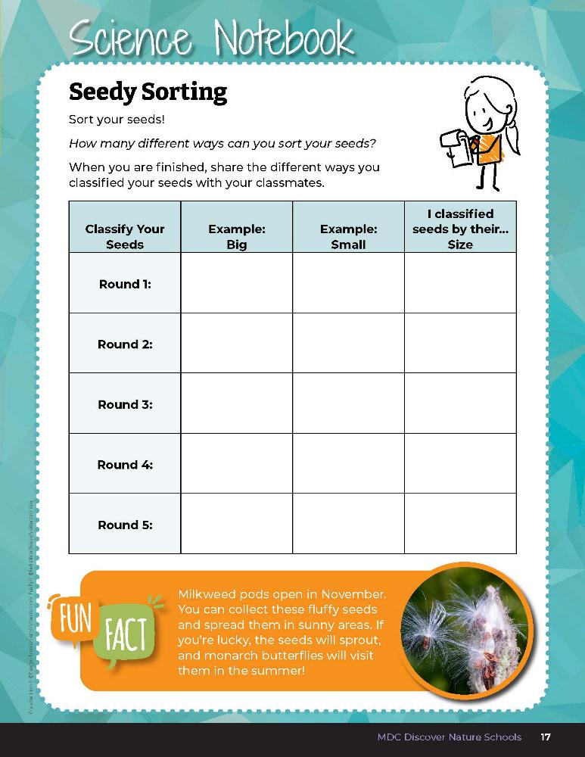
How many different ways can you sort your seeds?
1C
Life and Land in Missouri – 1C Seedy Sorting: Explore
13
Notes:
Have students keep a list of properties and characteristics for sorting seeds in their student guide, Science Notebook 1C Seedy Sorting on Page 17.
Teacher Note: Keep seeds for Lesson 1D.

Slide 14
How did you classify your seeds?
1C
Life and Land in Missouri – 1C Seedy Sorting: Explain
14
Notes:
Discuss physical properties and characteristics of the seeds such as shape, size, small, weight, texture, etc.

Slide 15
How do we identify the characteristics?
1C
Life and Land in Missouri – 1C Seedy Sorting: Explain
15
Notes:
(We use our senses.) Have students list their five senses (sight, hearing, touch, taste, and smell).

Slide 16
Which sense should you avoid using when observing these seeds?
1C
Life and Land in Missouri – 1C Seedy Sorting: Explain
16
Notes:
(Taste.)

Slide 17
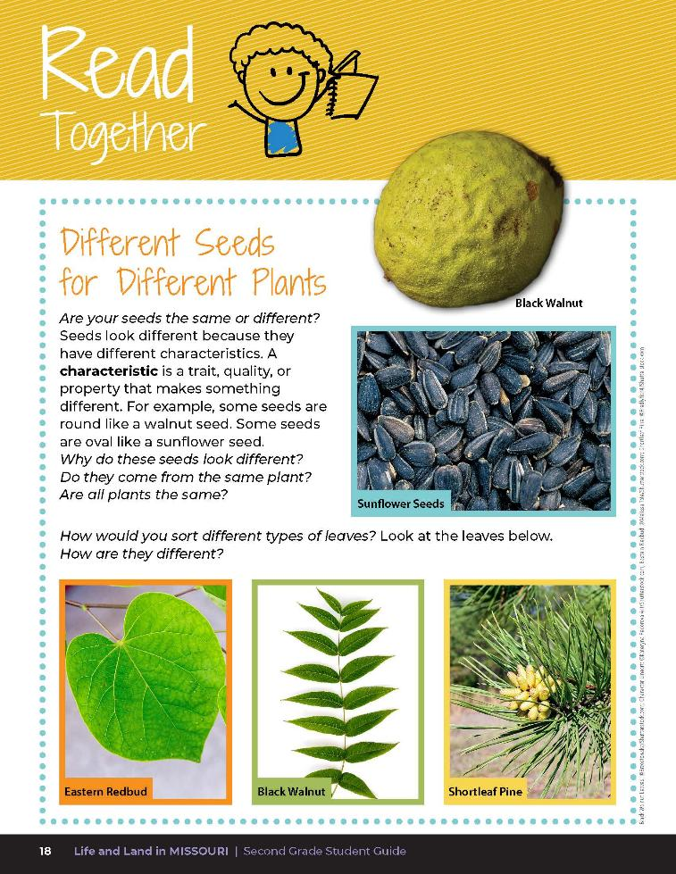
Different Seeds for Different Plants
Are your seeds the same or different? Seeds look different because they have different characteristics. A characteristic is a trait, quality, or property that makes something different. For example, some seeds are round like a walnut seed. Some seeds are oval like a sunflower seed.
1C
Life and Land in Missouri – 1C Seedy Sorting: Explain
17
Notes:
Read the Read Together 1C Different Seeds for Different Plants section on Page 18.

Slide 18
Different Seeds for Different Plants
Why do these seeds look different?
Do they all come from the same plant?
Are all plants the same?
How would you sort different types of leaves? Look at the leaves below.
How are they different?
1C
Life and Land in Missouri – 1C Seedy Sorting: Explain
18
Notes:
Read the Read Together 1C Different Seeds for Different Plants section on Page 18.

Slide 19
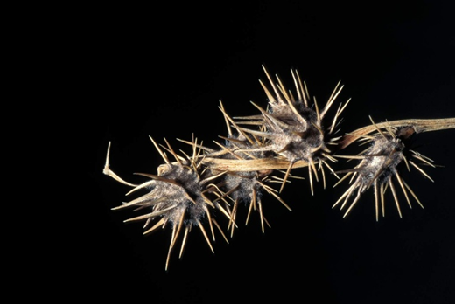
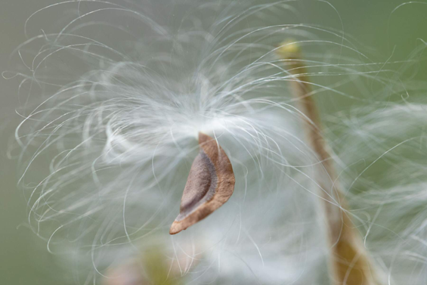
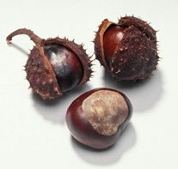
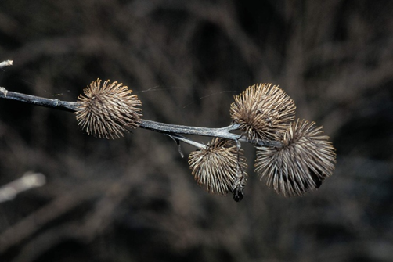
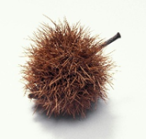
What is a characteristic?
1C
Life and Land in Missouri – 1C Seedy Sorting: Explain
19
Notes:
Discuss characteristics and list which sense(s) students used to sort their seeds. Have students brainstorm ways they could have used their other senses to sort and record these observations.
Plants in Pictures (top to bottom): Sandbur seed, Swamp milkweed seed, Ohio buckyeye fruit, Ozark chinquapin fruit, Burdock seed

Slide 20
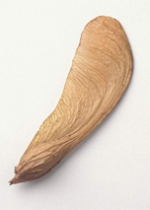
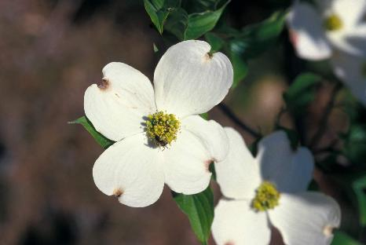
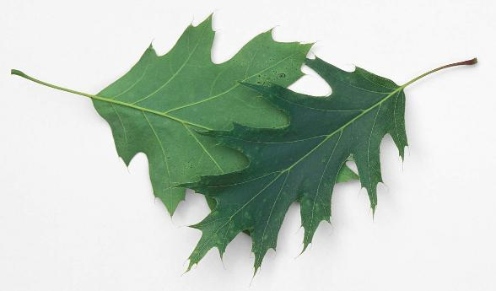
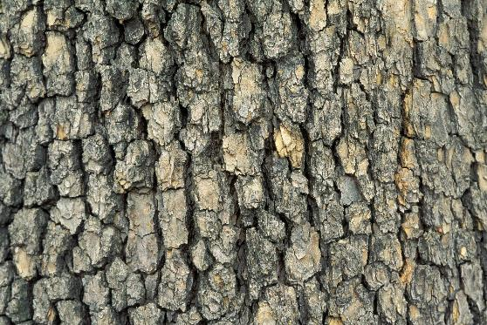
How else might your sort or identify trees?
1C
Life and Land in Missouri – 1C Seedy Sorting: Elaborate
20
Notes:
(Seeds, leaves, bark, smell, flowers.)
Plants in Pictures: Silver Maple tree seed, Dogwood tree flowers, Shumard Oak leaves, Sycamore bark

Slide 21
Go outside:
Collect different types of leaves.
Trace a leaf and name characteristics used to classify that leaf.
1C
Life and Land in Missouri – 1C Seedy Sorting: Elaborate
21
Notes:
Distribute the Show Me Trees: Lead ID Guide to each of your students. 1C Show Me Trees_Leaf ID Guide.pdf
Go outside with your class and have students collect different types of leaves. Using paper bags and magnifying glasses, collect and sort tree leaves and compare to the leaves in the booklets. If students can match the leaf to the tree listed in the Leaf ID Guide, have them trace the leaf and label words used to classify that leaf (short stem or long stem, large leaf to small leaves, by color, rough edges, or smooth edges around the leaf, etc.) Students can also use rulers to sort some of their leaves by size.
Display the MDC Field Guide from the MDC Teacher Portal on the classroom board to assist with tree identification. Field Guide | Missouri Department of Conservation

Slide 22

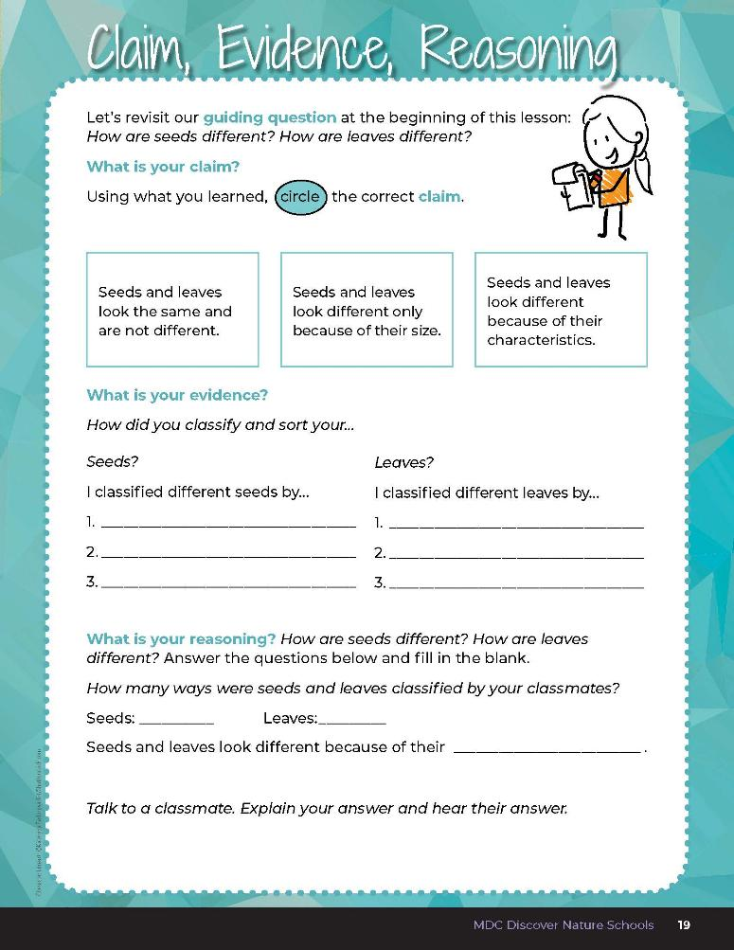
1C
Life and Land in Missouri – 1C Seedy Sorting: Evaluate
22
Notes:
Guiding Question: How are seeds different? How are leaves different?
After exploring the concept of classification and sorting seeds and leaves by different characteristics, have students open their student guides to the 1C Claim, Evidence, Reasoning section on Page 19. Guide students through the page by reviewing each section as a class and revisiting the scientific concepts learned to help answer each section.

Slide 23

Seeds
Leaves
1C
Life and Land in Missouri – 1C Seedy Sorting: Evaluate
23
Notes:
Write a T-Chart on the board with one side labeled “Seeds” and the other side labeled “Leaves.” Allow students time to write their answers on the T-Chart.

Slide 24

1C
Life and Land in Missouri – 1C Seedy Sorting: Evaluate
24
Notes:
Guiding Question: How are seeds different? How are leaves different?
After exploring the concept of classification and sorting seeds and leaves by different characteristics, have students open their student guides to the 1C Claim, Evidence, Reasoning section on Page 19. Guide students through the page by reviewing each section as a class and revisiting the scientific concepts learned to help answer each section.

Slide 25
Answers will vary
characteristics
1C
Life and Land in Missouri – 1C Seedy Sorting: Evaluate
25
Notes:
Rubric:
4 (Exceeds) — Student circles the correct claim and writes 3 ways seeds are classified and 3 ways leaves are
classified. Student provides the correct reasoning by filling in the blank correctly.
3 (Meets) — Student circles the correct claim and writes 2 ways seeds are classified and 2 ways leaves are
classified. Student provides the correct reasoning by filling in the blank correctly.
2 (Partially meets) — Student circles the correct claim and writes 1 way seeds are classified and 1 way leaves are
classified. Student does not provide the correct reasoning by filling in the blank correctly.
1 (Doesn’t meet) — Student does not provide the correct claim or evidence and does not write the correct
reasoning.

