Slide 1
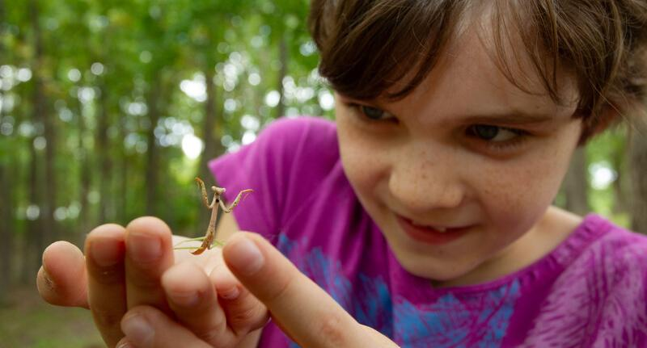

Exploring
MISSOURI
1B: If I Were a Lizard

Slide 2
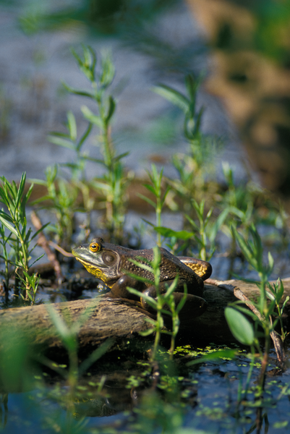
Guiding Question:
How do some animals use heat to stay warm?
1B
Exploring Missouri – 1B If I Were a Lizard: Engage
2
Notes:
Animal in Picture: Bullfrog

Slide 3
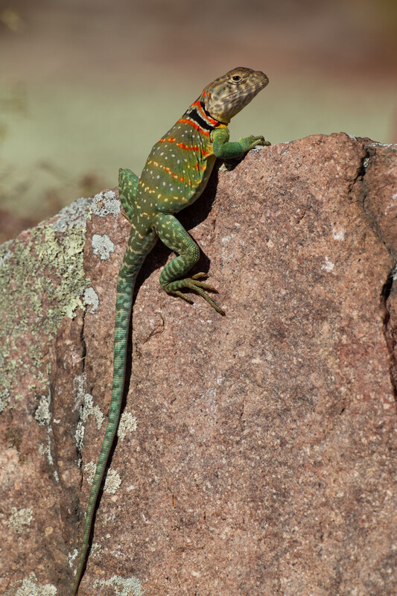
Go outside:
If you were a lizard living in the schoolyard, where would you go to stay warm on a cold day?
1B
Exploring Missouri – 1B If I Were a Lizard: Engage
3
Notes:
Go outside and have students find a warm location where they would want to be if they were a lizard.
Animal in Picture: Collared Lizard

Slide 4
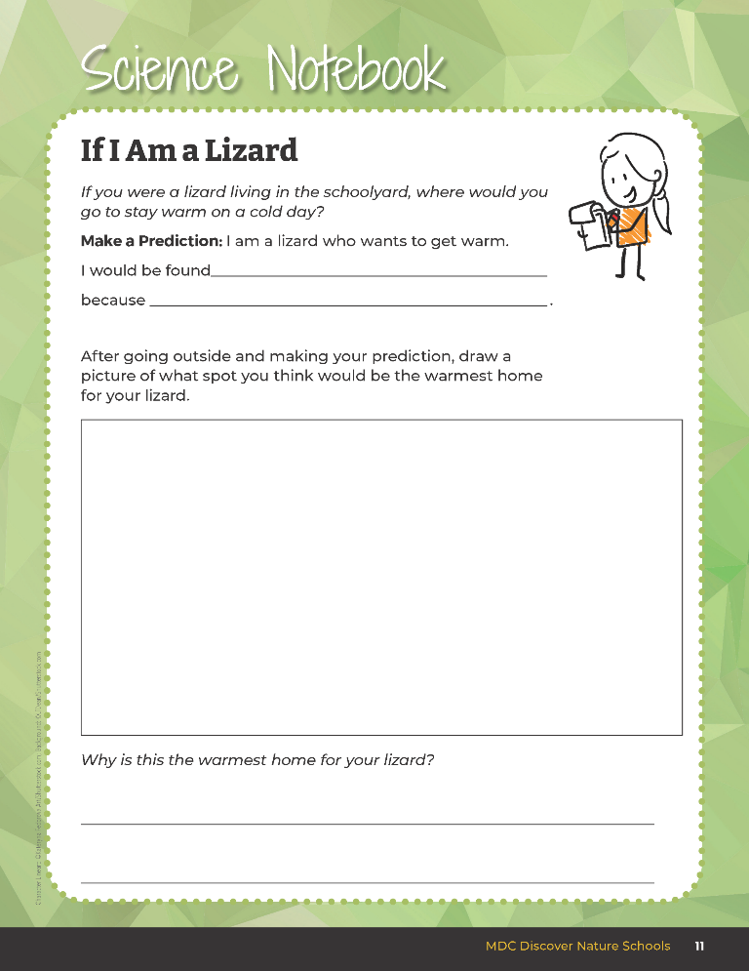

Make a prediction and draw a warm spot for your lizard home.
1B
Exploring Missouri – 1B If I Were a Lizard: Engage
4
Notes:
Students will complete a prediction using the following prompt in their student guide, Science Notebook 1B If I Am a Lizard on Page 11.
Have the students use the blank section from their student guide to draw a warm spot for their lizard home.

Slide 5
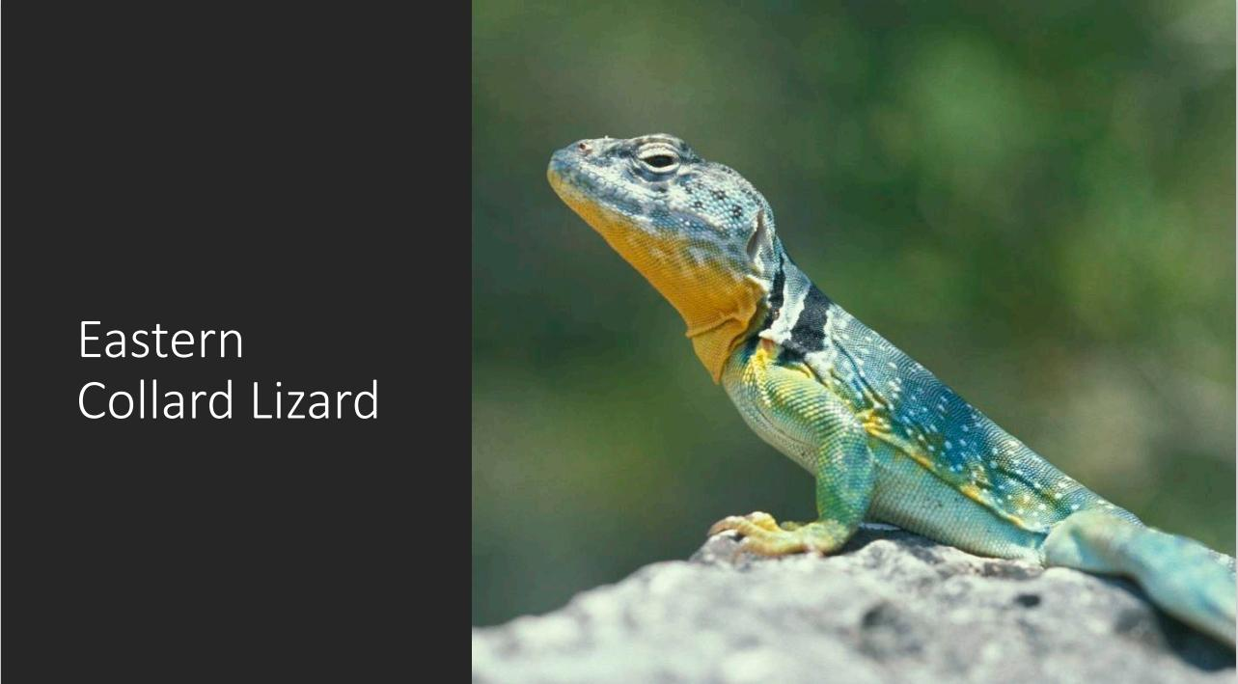
1B
Exploring Missouri – 1B If I Were a Lizard: Explore
5
Notes:
From the MDC Teacher Portal, display the Cold-Blooded vs. Warm-Blooded Presentation (Eastern Collard Lizard) with a picture of the first reptile. Place one container of sand at the front of the classroom. Pretend this sandbox is the lizard on the screen. Ask students to place their hand in the sand (about one inch deep).

Slide 6
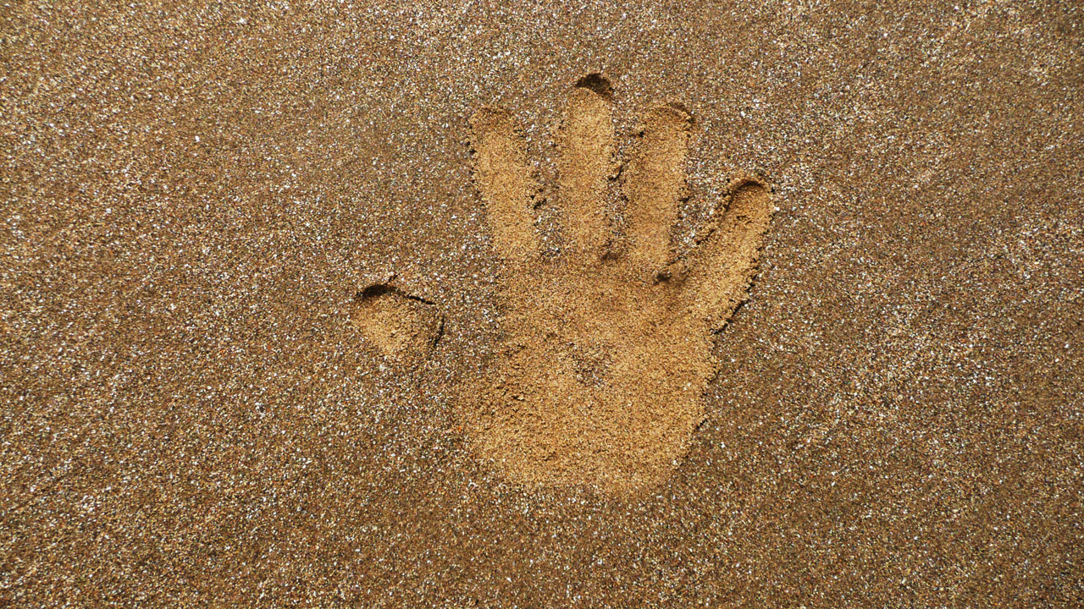
1B
Exploring Missouri – 1B If I Were a Lizard: Explore
6
Notes:
From the MDC Teacher Portal, display the Cold-Blooded vs. Warm-Blooded Presentation (Eastern Collard Lizard) with a picture of the first reptile. Place one container of sand at the front of the classroom. Pretend this sandbox is the lizard on the screen. Ask students to place their hand in the sand (about one inch deep).

Slide 7
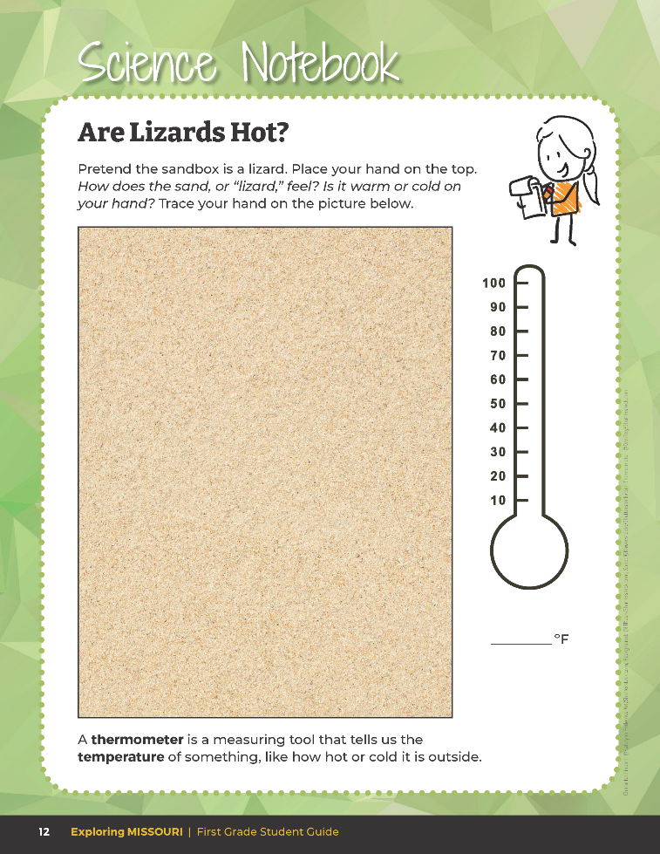
Trace your hand on the picture of sand.
1B
Exploring Missouri – 1B If I Were a Lizard: Explore
7
Notes:
Have students open their student guide to Science Notebook 1B Are Lizards Hot? On Page 12. Have students trace their hand into the first image of container of sand on that page.

Slide 8
How does the sand, or the “lizard,” feel?
1B
Exploring Missouri – 1B If I Were a Lizard: Explore
8
Notes:
Have students write descriptive words on the following lines.

Slide 9
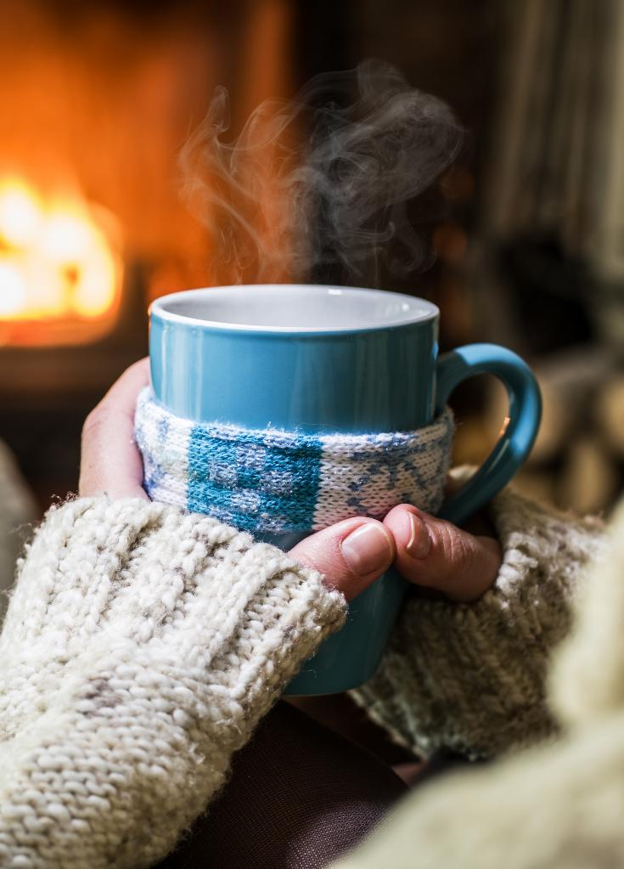
How do we know if something is hot?
1B
Exploring Missouri – 1B If I Were a Lizard: Explore
9
Notes:
When someone at home makes a meal, they need to set the oven to a temperature before cooking. When you feel sick, someone might take your temperature.

Slide 10
How do we measure the heat?
1B
Exploring Missouri – 1B If I Were a Lizard: Explore
10

Slide 11

How do scientists know how cold or hot something is?
How can we find out the actual temperature of our “lizard”?
1B
Exploring Missouri – 1B If I Were a Lizard: Explore
11
Notes:
Explain that we use a thermometer to measure exactly how hot or cold something is like the air, our oven, our bodies, or the ground.

Slide 12
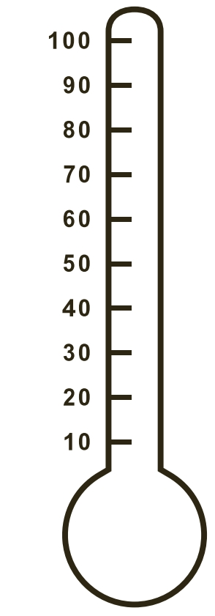
A thermometer is a measuring tool that tells us the temperature of something, like how hot or cold it is outside.
1B
Exploring Missouri – 1B If I Were a Lizard: Explore
12
Notes:
Display the large classroom thermometer at the front of the room. You can also display the Blank Thermometer Template from the MDC Teacher Portal.

Slide 13
Take the temperature of the sand.
What temperature does the thermometer say?
1B
Exploring Missouri – 1B If I Were a Lizard: Explore
13
Notes:
Let’s practice reading a thermometer and recording the temperature by taking the temperature of the sandbox (lizard). Show student where the sensor is located and how to use the thermometer. Take the temperature of the sand. What temperature does the thermometer say?

Slide 14
Draw the temperature into the blank thermometer.
1B
Exploring Missouri – 1B If I Were a Lizard: Explore
14
Notes:
Model this temperature on the large classroom thermometer and model how to draw the temperature into the blank thermometer in their student guides page 12 in the Science Notebook 1B Are Lizards Hot? section. Now have students draw the temperature into the first blank thermometer in their student guide as this is the temperature of the first sandbox, or “lizard.”

Slide 15

What is the temperature of the room?
1B
Exploring Missouri – 1B If I Were a Lizard: Explore
15
Notes:
Take the temperature of the room.

Slide 16
How does this compare with the temperature of the sandbox?
Why are they the same or different?
1B
Exploring Missouri – 1B If I Were a Lizard: Explore
16

Slide 17

What is the heat source in the room and where is the heat energy flowing to?
1B
Exploring Missouri – 1B If I Were a Lizard: Explore
17
Notes:
Answers will vary.

Slide 18
How does a thermometer work?
1B
Exploring Missouri – 1B If I Were a Lizard: Explore
18
Notes:
More heat energy causes the colored fluid in a thermometer to expand and rise, while less heat energy causes the colored fluids to contract and fall.

Slide 19

Take the temperature of your hand.
1B
Exploring Missouri – 1B If I Were a Lizard: Explore
18
Notes:
Distribute thermometers to students with one thermometer per three to four students. Let’s take the temperature of our own hands. Allow students to take turns taking the temperature of their hands. Write the temperatures on the board.

Slide 20
What is our most common number that we see?
1B
Exploring Missouri – 1B If I Were a Lizard: Explore
19
Notes:
What is our most common number that we see? (Answers will vary.) Write this common number on the board.

Slide 21
What was our common temperature that we took of our hands?
1B
Exploring Missouri – 1B If I Were a Lizard: Explain
21
Notes:
Refer to the common temperature of the class.

Slide 22

Why was our common temperature similar?
1B
Exploring Missouri – 1B If I Were a Lizard: Explain
22
Notes:
Have students discuss their ideas.

Slide 23

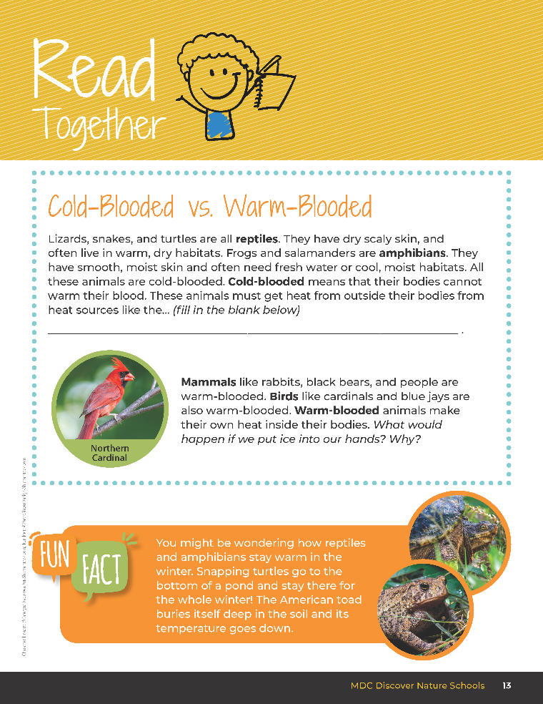
Cold-Blooded vs. Warm-Blooded
1B
Exploring Missouri – 1B If I Were a Lizard: Explain
23
Notes:
Have students open their student guide to Read Together 1B Cold-Blooded vs. Warm-Blooded section on Page 13.

Slide 24
Lizards, snakes, and turtles are all reptiles. They have dry scaly skin, and often live in warm, dry habitats.
Frogs and salamanders are amphibians. They have smooth, moist skin and often need fresh water or cool, moist habitats. All these animas are cold-blooded.
Cold-blooded means their bodies cannot warm their blood.
These animals must get heat from outside their bodies from heat sources like the...
1B
Exploring Missouri – 1B If I Were a Lizard: Explain
24
Notes:
Have students open their student guide to Read Together 1B Cold-Blooded vs. Warm-Blooded section on Page 13.
Read Together: Lizards, snakes, and turtles are all reptiles. They have dry scaly skin, and often live in warm, dry habitats. Frogs and salamanders are amphibians. They have smooth, moist skin and often need fresh water or cool, moist habitats. All these animas are cold-blooded. Cold-blooded means that their bodies cannot warm their blood. These animals must get heat from outside their bodies from heat sources like the...

Slide 25
Mammals like rabbits, black bears, and people are warm-blooded.
Birds like cardinals and blue jays are also warm-blooded.
Warm-blooded animals make tier own heat inside their bodies.
What would happen if we put ice into our hands? Why?
1B
Exploring Missouri – 1B If I Were a Lizard: Explain
25
Notes:
Have students open their student guide to Read Together 1B Cold-Blooded vs. Warm-Blooded section on Page 13.
Read Together: Mammals like rabbits, black bears, and people are warm-blooded. Birds like cardinals and blue jays are also warm-blooded. Warm-blooded animals make tier own heat inside their bodies. What would happen if we put ice into our hands? Why?

Slide 26
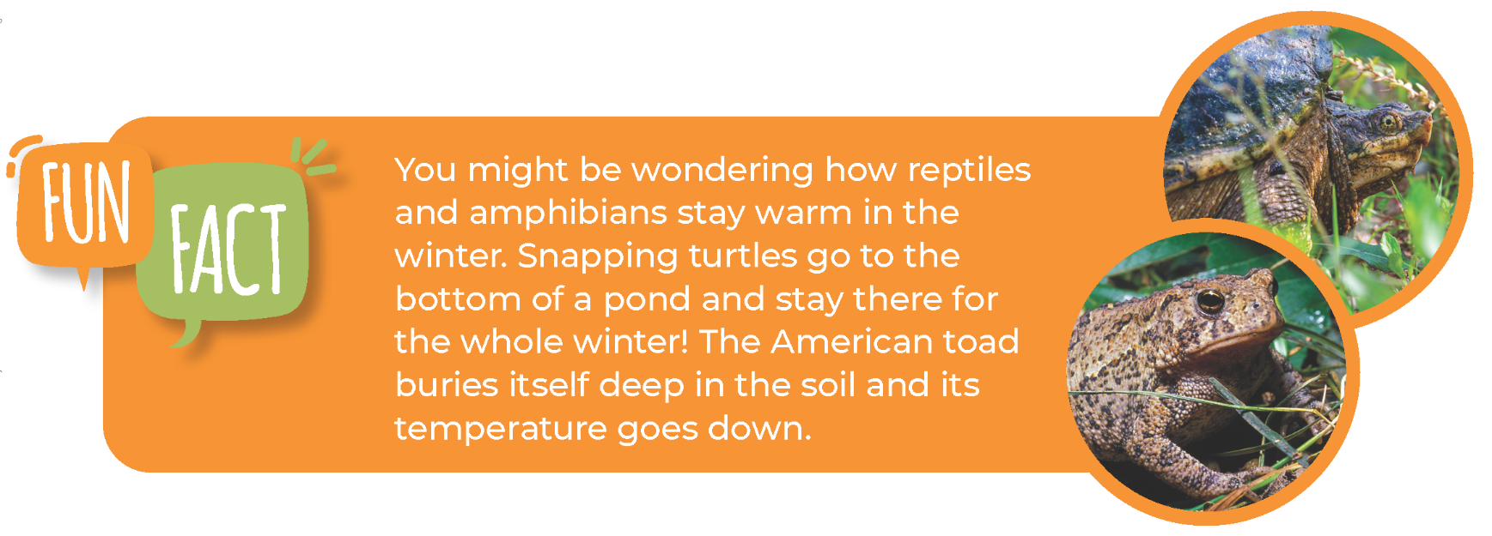
1B
Exploring Missouri – 1B If I Were a Lizard: Explain
26

Slide 27
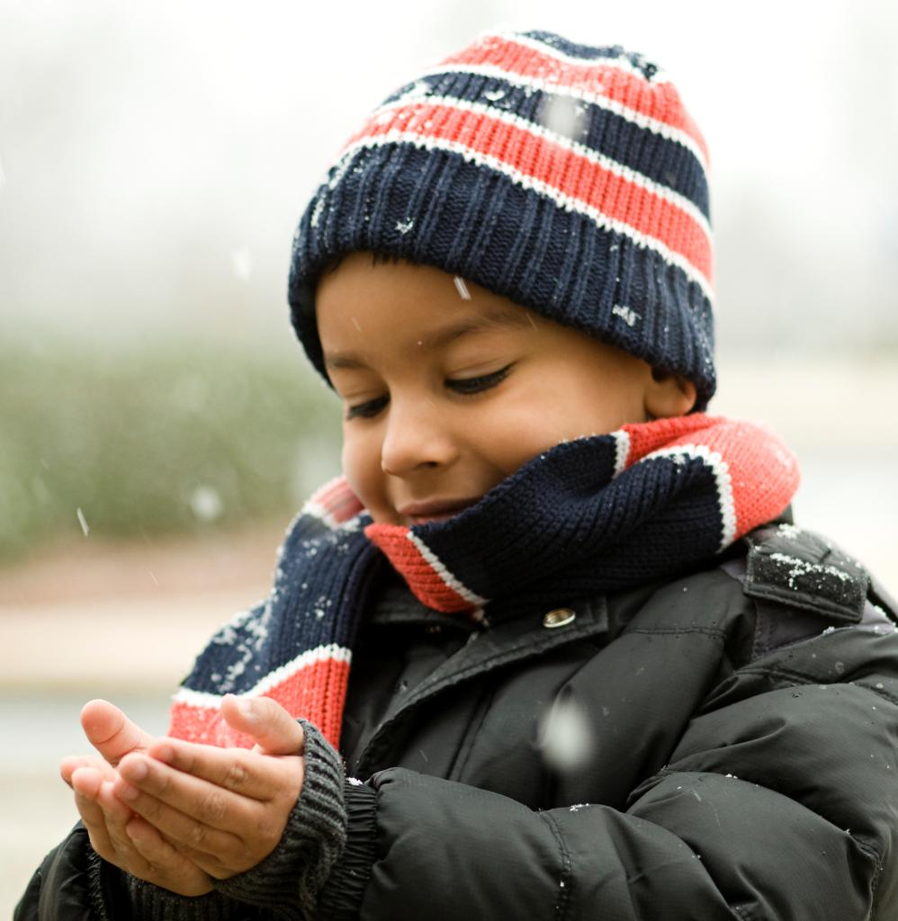
Why do we dress differently by wearing shorts in the summer and coats and hats in the winter?
1B
Exploring Missouri – 1B If I Were a Lizard: Explain
27
Notes:
We continue to make our own heat. You also do extra things to feel comfortable. Depending on the temperature outside, you will dress differently by wearing shorts in the summer and coats and hats in the winter. Why? (Our heat from our bodies would transfer to the cold outside and we would lose our heat. The heat from the sun causes us to warm so we dress to stay cool.)

Slide 28
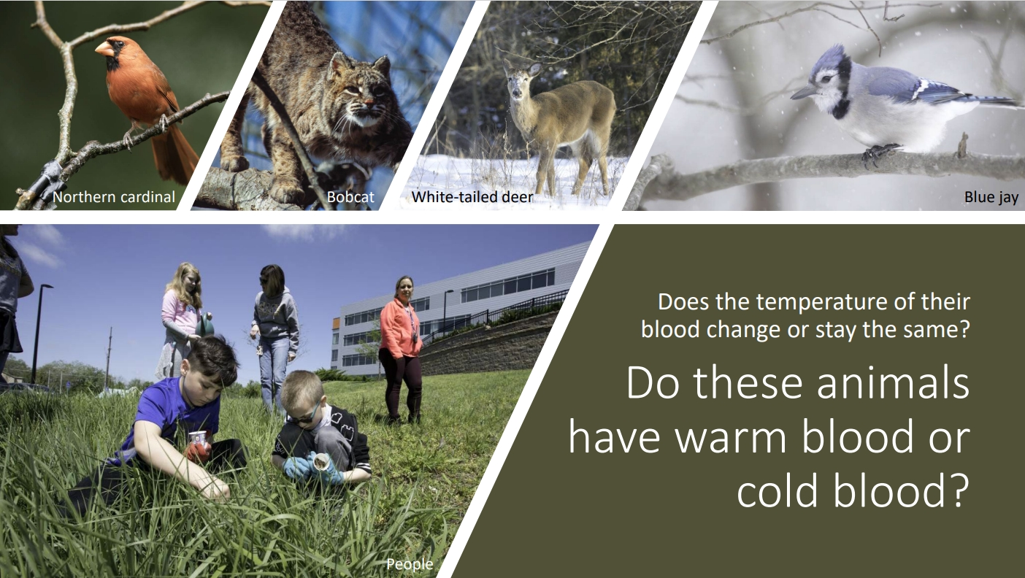
1B
Exploring Missouri – 1B If I Were a Lizard: Explain
28
Notes:
Using the Warm-Blooded vs. Cold-Blooded Presentation on the MDC Teacher Portal (Eastern Collard Lizard), display the different examples of mammals in Missouri, including photos of people. Mammals, birds, and people are warm-blooded, so our temperature stays the same.

Slide 29
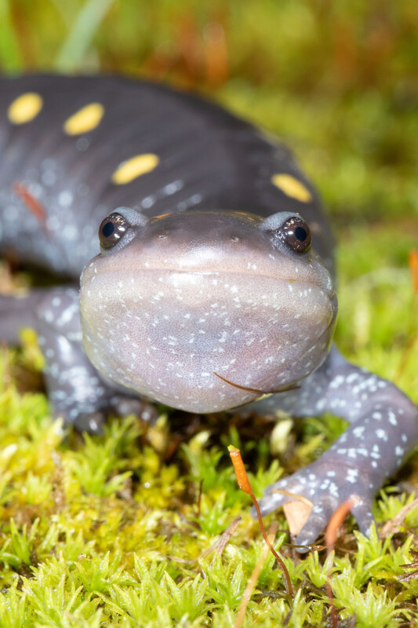
Other kinds of animals must get heat from outside their bodies from other heat sources.
Can you give an example of a heat source that these animals will use?
1B
Exploring Missouri – 1B If I Were a Lizard: Explain
29
Notes:
Other kinds of animals must get heat from outside their bodies from other heat sources. Can you give an example of a heat source that these animals will use? (Sun, heat lamp, heat pads, etc.)
Animal in Picture: Spotted Salamander

Slide 30
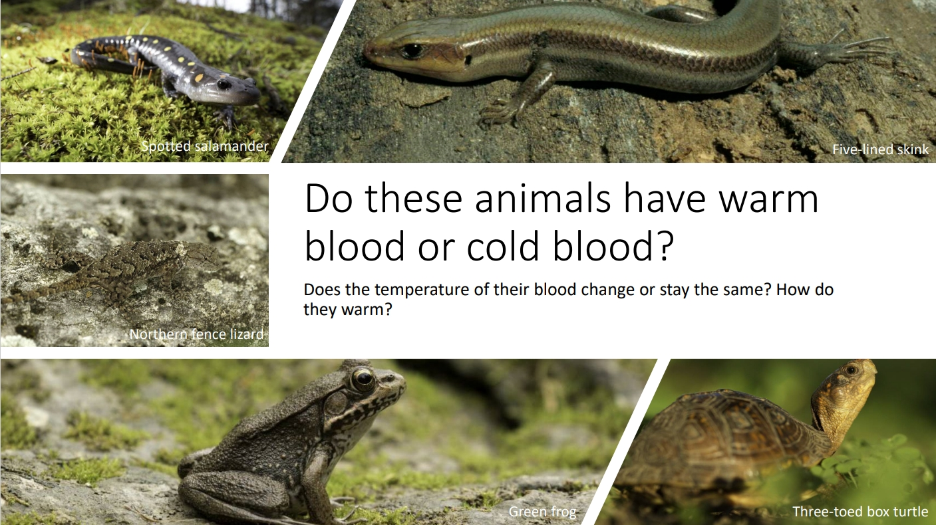
1B
Exploring Missouri – 1B If I Were a Lizard: Explain
30
Notes:
Using the Warm-Blooded vs. Cold-Blooded Presentation on the MDC Teacher Portal (Eastern Collard Lizard), display the different examples of reptiles and amphibians in Missouri. Cold-blooded means that the animals’ bodies cannot warm their blood. They take on the temperature of their surroundings. When it is cold outside, they are cold. When it is hot outside, they are hot.

Slide 31
Think back to where you thought the best spot for your lizard home would be located.
1B
Exploring Missouri – 1B If I Were a Lizard: Elaborate
31
Notes:
Step 1 – Have students revisit their drawing of their lizard home in their student guide on Science Notebook 1B If I Am a Lizard on page 11. Ask them to think back to where they thought the best spot for their lizard home would be located.

Slide 32
What was your prediction for the best location for your lizard to stay warm and survive?
1B
Exploring Missouri – 1B If I Were a Lizard: Elaborate
32
Notes:
At the front of the classroom on your board, create a class map with students’ input of the schoolyard. Make it from the perspective you would see from a treehouse. Using our predictions from Science Notebook 1B If I Am a Lizard, what was your prediction for the best location for your lizard to stay warm and survive?
Discuss the predicted locations students felt a lizard would live to stay warm and survive. Mark these locations on the schoolyard map. Based on the number of tubs with sand available, circle five to eight of the most common locations. You will visit these locations in the next step.
Teacher Note: Step 2 and 3 must be done on the same day.

Slide 33
Go outside:
Place containers of sand, or “lizards,” in the locations circled on the schoolyard map.
1B
Exploring Missouri – 1B If I Were a Lizard: Elaborate
33
Notes:
Step 2 – Go back outside. Based on the predictions made, have students place the containers of sand, or “lizards,” in the five to eight locations circled on the schoolyard map.

Slide 34
After a few hours return to the “lizards” and feel each container.
1B
Exploring Missouri – 1B If I Were a Lizard: Elaborate
34
Notes:
Step 3 – After a few hours, return to the “lizards” and have students feel each container.

Slide 35
What is the temperature of the sandbox you are standing next to?
1B
Exploring Missouri – 1B If I Were a Lizard: Elaborate
35
Notes:
Ask students to stand next to the sandbox, or lizard, closest to the lizard home that they drew. Distribute thermometers and advise the students to not touch the sensor of the thermometer with their hand. What is the temperature of the sandbox you are standing next to? Measure the temperature of each sandbox.

Slide 36
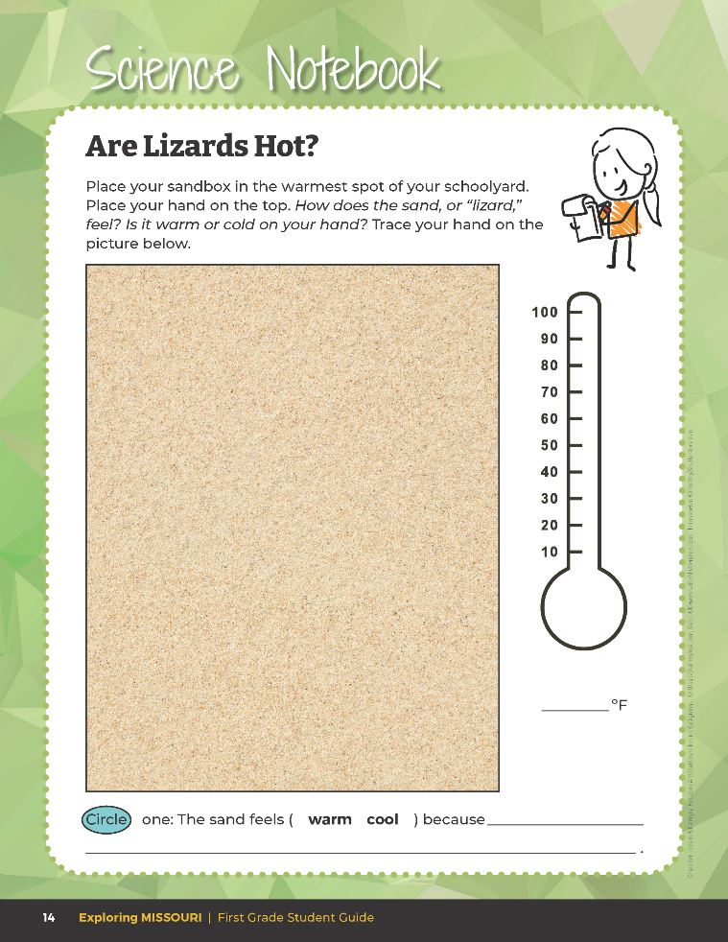
Record the temperature of the sandbox.
1B
Exploring Missouri – 1B If I Were a Lizard: Elaborate
36
Notes:
Have students open their student guide to the second black thermometer on the Science Notebook 1B Are Lizards Hot? section on Page 14 and record the temperature of the sandbox.

Slide 37
Record the temperature data on the school map.
1B
Exploring Missouri – 1B If I Were a Lizard: Elaborate
37
Notes:
Back in the classroom, have students record the temperature data on the school map at the front of the classroom of the five to eight different locations of the sandboxes.

Slide 38
What do you notice? Why?
1B
Exploring Missouri – 1B If I Were a Lizard: Elaborate
38
Notes:
Compare the data from what the sand felt like to what the thermometer shows. What do the students notice? Why? Ensure students notice patterns between the warmth of sand and corresponding temperature.

Slide 39
Which container of sand felt the warmest?
What was the thermometer reading of the warmest sand?
1B
Exploring Missouri – 1B If I Were a Lizard: Elaborate
39

Slide 40
Which container of sand felt the coolest?
What was the thermometer reading of the coolest sand?
1B
Exploring Missouri – 1B If I Were a Lizard: Elaborate
40

Slide 41
What do you notice between how the sand felt and the thermometer reading?
Do you notice any patterns?
1B
Exploring Missouri – 1B If I Were a Lizard: Elaborate
41
Notes:
Teacher Note: The schoolyard map will be referenced in Unit 1 Putting It All Together. It is recommended to leave this map on the board for students to reference during the assessment.

Slide 42
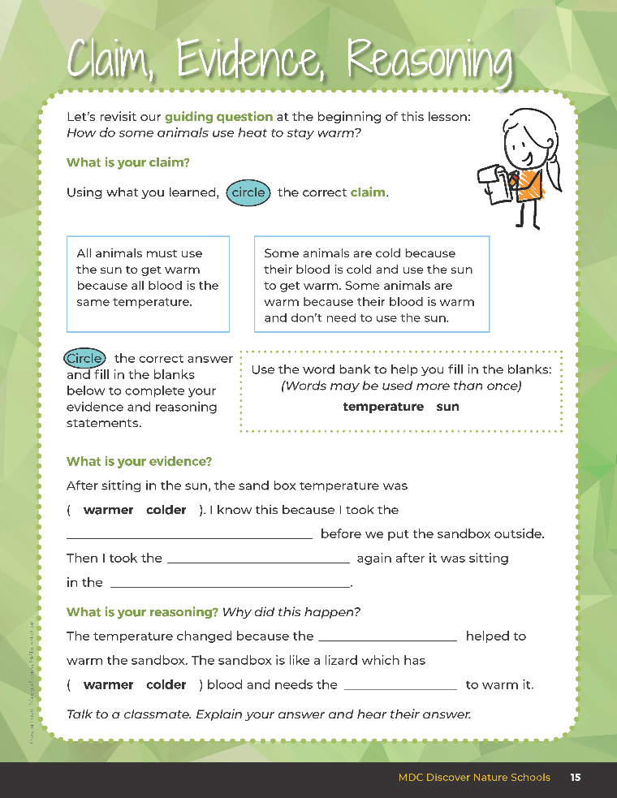
Guiding Question:
How do some animals use heat to stay warm?
1B
Exploring Missouri – 1B If I Were a Lizard: Evaluate
42
Notes:
After exploring the concept of warm-blooded versus cold-blooded animals and why some animals may have to use heat to stay alive, have students open their student guide to the Claim, Evidence, and Reasoning section on Page 15. Discuss the page with the students – read the guiding question and then explain what students need to do to answer the questions (circle the correct claim and fill in the blanks).

Slide 43

Answers
temperature
temperature
sun
sun
sun
1B
Exploring Missouri – 1B If I Were a Lizard: Evaluate
43
Notes:
Rubric:
3 (Meets) – Students can define and identify that a heat source creates heat energy. Students circle the correct claim, write the correct evidence statement, and identify the correct reason.
2 (Partially meets) – Students can define and identify that a heat source creates heat energy. Two of the three components of CER are correct.
1 (Doesn’t meet) – Students cannot answer the above questions. One of the three components of CER are correct.

Slide 44


Optional: Cross-Curricular Extension
Create a story to go along with the class map. You can either take the perspective of explorers looking for the cool area or the perspective of the lizard needing to find shelter.
1B
Exploring Missouri – 1B If I Were a Lizard: Cross-Curricular Extension
44
Notes:
English Language Arts
Research other native Missouri cold-blooded animals.
Have students create a story to go along with the class map. They can take the perspective of explorers looking for the cool area or the perspective of the lizard needing to find shelter.

