Slide 1
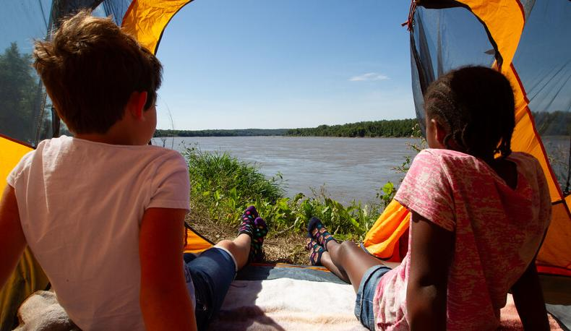

Life and Land in
MISSOURI
1B: Getting Buzzy

Slide 2
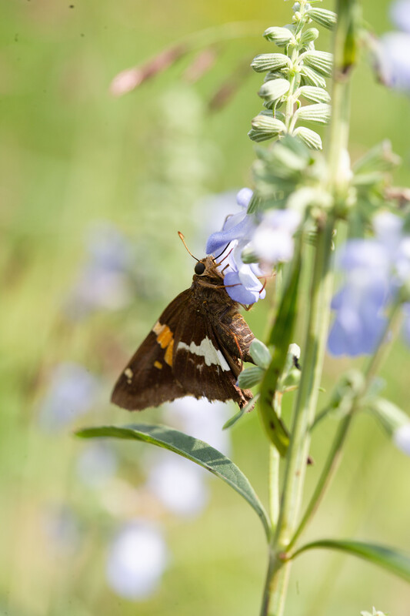
Guiding Question:
How do insects and birds help plants?
1B
Life and Land in Missouri – 1B Getting Buzzy: Engage
2
Notes:
Animal in Picture: Sliver-spotted Skipper

Slide 3
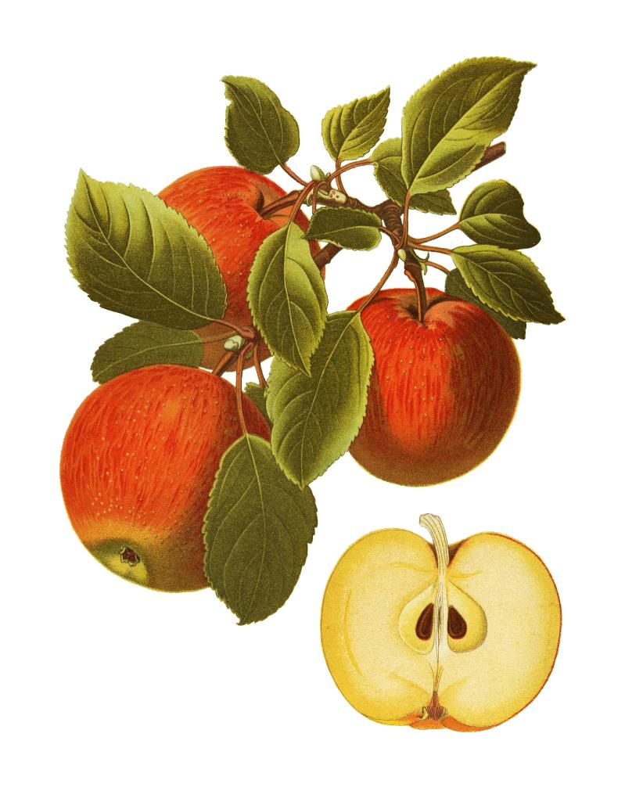
Where do apples (or other fruits and vegetables) come from?
1B
Life and Land in Missouri – 1B Getting Buzzy: Engage
3
Notes:
Show students the seeds in a sliced apple.
Where do apples (or other fruits and vegetables) come from? (Possible student responses are plants, trees, etc.)

Slide 4
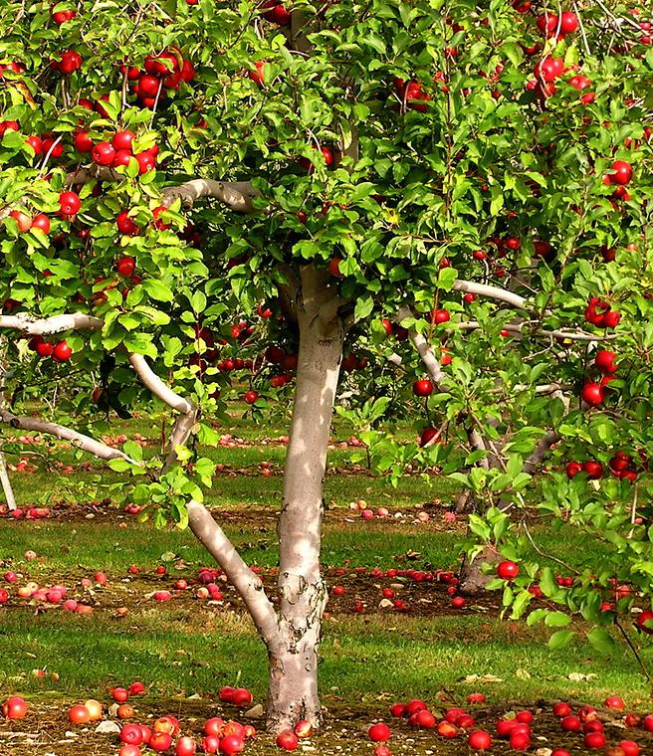
What does an apple tree need to produce an apple?
1B
Life and Land in Missouri – 1B Getting Buzzy: Engage
4
Notes:
Seeds. Also water, air, sunlight, and soil.
Tree in Picture: Apple tree

Slide 5
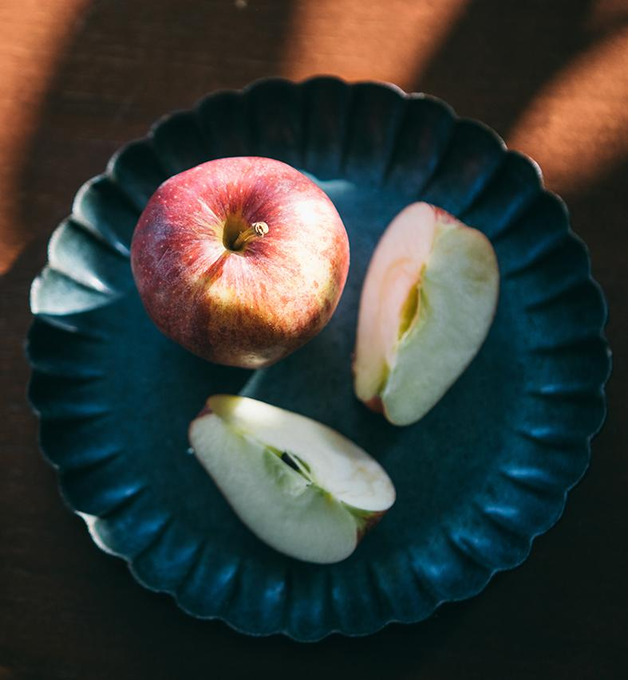
But how are seeds made?
1B
Life and Land in Missouri – 1B Getting Buzzy: Engage
5
Notes:
Today we are going to investigate pollination and pollinators. Then we are going to build a bee.

Slide 6
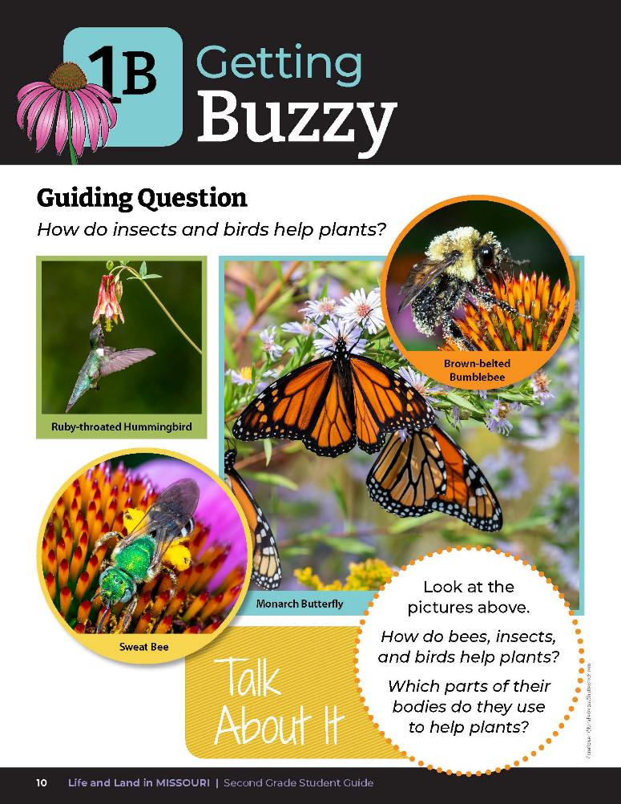
How do bees, insects, and birds help plants?
1B
Life and Land in Missouri – 1B Getting Buzzy: Explore
6
Notes:
Teacher Note: This activity can be split into two days. The first day the students will create the bees. The second day, the students will go outside and pollinate.
Refer to the pictures of the bee and other pollinators in the student guide Lesson 1B Getting Buzzy introduction on Page 10. Read the guiding question as a class and discuss initial ideas. How do insects and birds help plants? Discuss the Talk About It.

Slide 7
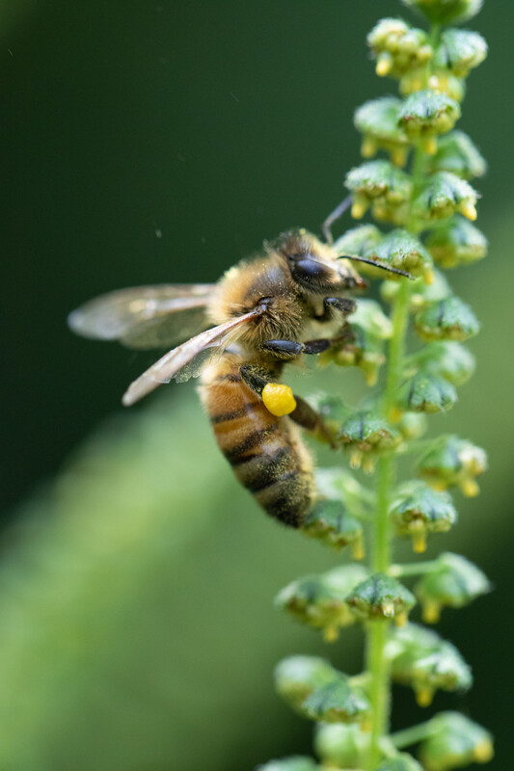
What parts of their bodies do the use to help plants?
1B
Life and Land in Missouri – 1B Getting Buzzy: Explore
7
Notes:
Look close at the body of the bee. What parts does it use to help plants? Bees have three body parts, which are the head, thorax, and abdomen. They also have six legs and two pairs of wings.
Animal in Picture: Honeybee

Slide 8
Today, we are going to create our own bees with two different types of legs.
Each bee needs to have the required number of body parts.
1B
Life and Land in Missouri – 1B Getting Buzzy: Explore
8
Notes:
Today, we are going to create our own bees with two different types of legs. Provide a variety of materials for students to create a bee. Each bee needs to have the required number of body parts and will have either paper or ribbon or chenille stick legs.
Students can either create a bee with chenille stick legs or a bee with paper strips or ribbon legs. Instructions for creating bees:
Cut paper towel roll in half and then into 3 equal pieces.
Glue, staple, or paper clip the 3 pieces together, so it looks like OOO from the side. This is the head, thorax, and abdomen.
Students can color their bee. Optionally, you can have the students glue yellow construction paper around the entire paper towel roll before it is cut in half.
Distribute 3 black chenille sticks or 3 black paper or ribbon strips to each student. These will be legs that will be attached to the thorax, or middle part, of the bee. Have students attach the chenille legs by inserting them through the thorax and folding them around the outside to create 3 legs on each side (total of 6 legs), all pointing in the same direction. For paper or ribbon legs, have students wrap and glue them around the thorax to create 3 legs on both sides.
Optional: Have students use the optional materials listed above to create different types of bees. These can be wrapped around the body of the bee to form fuzz or smooth parts along the body. Have students go outside with their bees, student guides, and pencils.

Slide 9
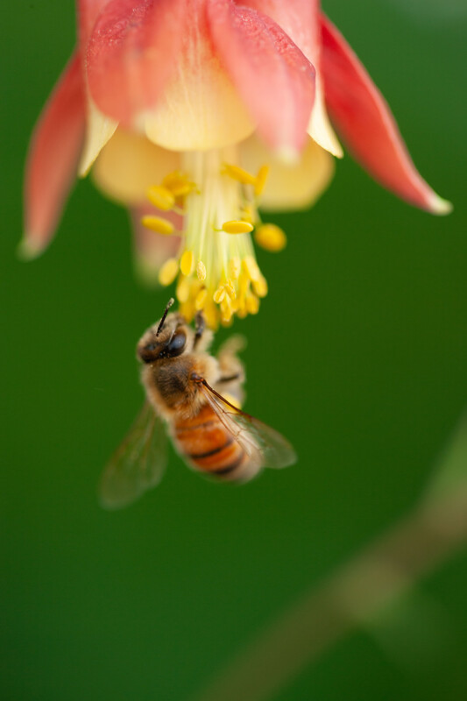
What do these bowls represent?
What does the cornmeal inside of the bowl represent?
1B
Life and Land in Missouri – 1B Getting Buzzy: Explore
9
Notes:
Bring the flower bowls of different colors of cornmeal made from Lesson 1A Flower Power. Show the students the different flower bowl that represent pollen.
The goal of the bee is to move pollen.
What do these bowls represent? What does the cornmeal inside of the bowl represent?
Animal in Picture: ; Plant in Picture: Columbine

Slide 10
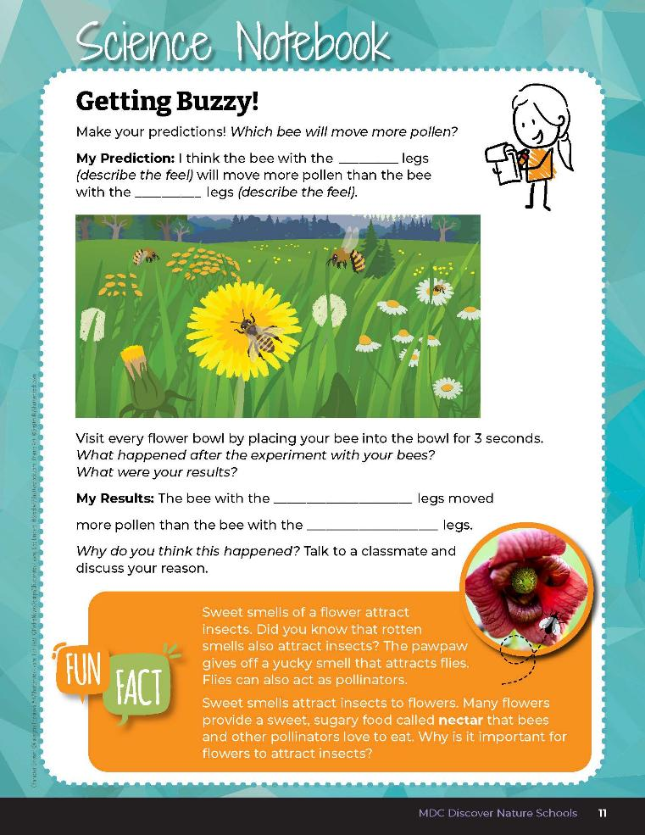

Make a prediction about which bee will be more effective in moving pollen.
1B
Life and Land in Missouri – 1B Getting Buzzy: Explore
10
Notes:
At the tope of student guide Science Notebook 1B Getting Buzzy! on Page 11, have students make their predictions about which bee will be more effective in moving pollen.

Slide 11
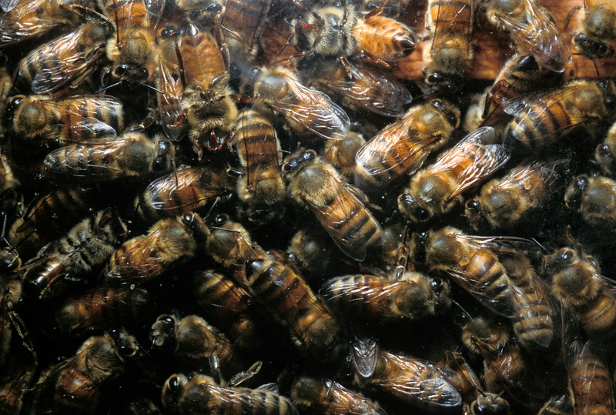
1B
Life and Land in Missouri – 1B Getting Buzzy: Explore
11
Notes:
The teacher will serve as the ‘beehive.” To gather as a large group, say, “I am the beehive, gather up to the beehive,” so all of your “bees,” or students, come to you.

Slide 12
Travel to each flower and land in the bowl with your bee legs.
Pretend to collect pollen by staying in the flower for 3 seconds.
Take turns with one bee in a flower at a time.
1B
Life and Land in Missouri – 1B Getting Buzzy: Explore
12
Notes:
Divide students evenly into five groups. Assign each student a flower color to start with.
Tell students to travel to each flower and land in the bowl with their bee legs. Students will pretend to collect pollen by staying in the flower for 3 seconds, then moving to the next flower. Student can count out loud “one, one thousand; two, one thousand; three, one thousand” to self-time their visit to the flower.
Remind students to take turns with one bee in a flower at a time. Put some distance between the flower bowls outside. Let students “fly” around to the bowls in any order they choose, lining up and taking turns at flowers to gather pollen.

Slide 13
1B
Life and Land in Missouri – 1B Getting Buzzy: Explore
13
Notes:
When the students have visited all flower bowls, say “gather up to the beehive.”

Slide 14

Make observations of your bees and the flowers and record your observations.
1B
Life and Land in Missouri – 1B Getting Buzzy: Explore
14
Notes:
Instruct students to make observations of their bees and the flowers and record their observations in their Science Notebook 1B Getting Buzzy! section on Page 11.

Slide 15
What did your classmates observe?
How does it compare to what you observed?
1B
Life and Land in Missouri – 1B Getting Buzzy: Explore
15
Notes:
Have students turn and talk to a partner and share their observations. What did your classmate observe? How does it compare to what you observed?

Slide 16
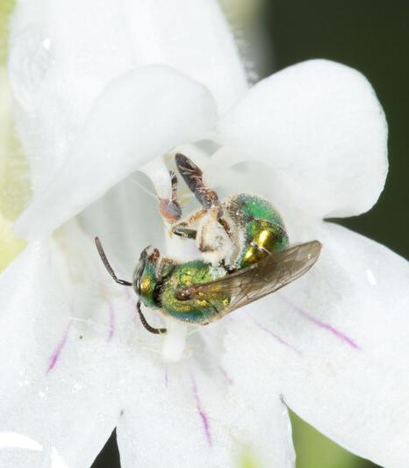
Did pollen (cornmeal) that remained in the bowls look the same or different than it did before the bees visited?
What is the same?
What is different?
1B
Life and Land in Missouri – 1B Getting Buzzy: Explain
16
Notes:
Discuss with the class whether their prediction was correct. Discuss findings and recordings. Have students explain their evidence using information gathered and recorded.
Animal in Picture: Metallic green sweat bee

Slide 17
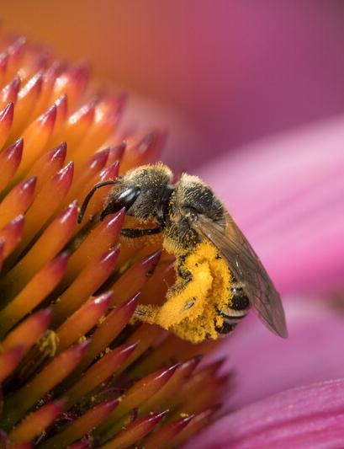
Did any of the cornmeal mix together? When?
Did both paper- and chenille-leg bees mix the cornmeal equally or did one mix them more? Why?
1B
Life and Land in Missouri – 1B Getting Buzzy: Explain
17
Notes:
Animal in Picture: Leafcutter Bee

Slide 18
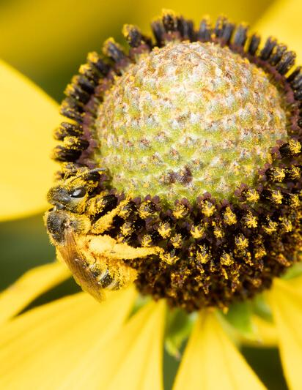
What does the mixing of cornmeal represent and why is it important to flowers?
1B
Life and Land in Missouri – 1B Getting Buzzy: Explain
18
Notes:
The process of pollination by different pollinators moves pollen from flower to flower, then the flower forms seed. The mixing of cornmeal colors represents pollen being moved by pollinators between flowers. Pollination is necessary for plants to make fruit, nuts, and seeds.
Animal in Picture: Sweat Bee

Slide 19
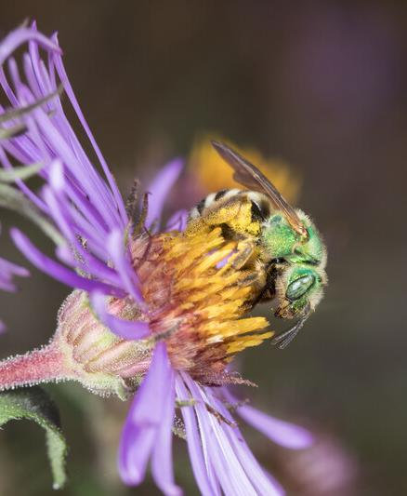
Which are more effective at moving pollen?
1B
Life and Land in Missouri – 1B Getting Buzzy: Explain
19
Notes:
Some bees have fuzzy legs and some bees have smooth legs.
Animal in Picture: Sweat bee

Slide 20

What do the bee’s legs look like in this photo?
1B
Life and Land in Missouri – 1B Getting Buzzy: Explain
20
Notes:
Refer students back to the introduction of Lesson 1B Getting Buzzy on student guide Page 10. Look at the photo of the bee again.

Slide 21
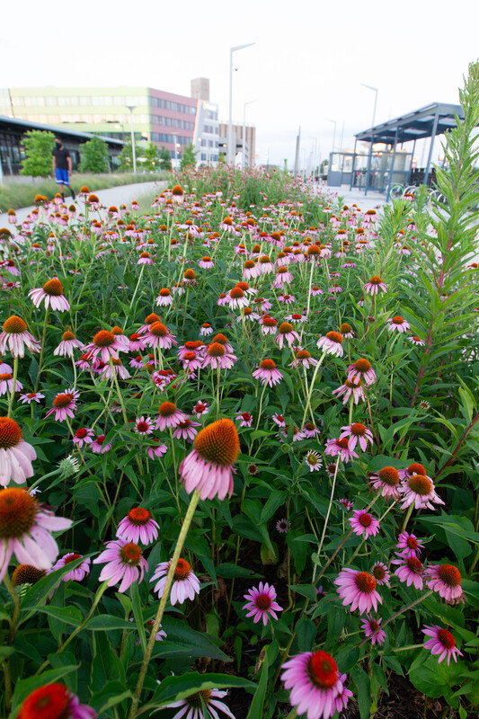
Can you think of other ways pollen moves from one flower to another?
1B
Life and Land in Missouri – 1B Getting Buzzy: Explain
21
Notes:
Plant: Purple Coneflower

Slide 22
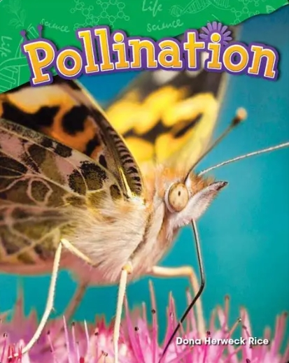
Read the book Pollination by Dona Herweck Rice.
Get Epic: Pollination Book by Dona Herweck Rice, Dona Rice | Epic
1B
Life and Land in Missouri – 1B Getting Buzzy: Explain
22
Notes:
Read the book Pollination by Dona Herweck Rice.

Slide 23
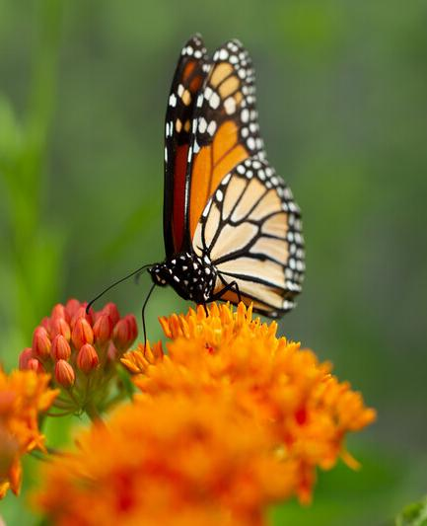
Can you think of other ways pollen moves from one flower to another?
1B
Life and Land in Missouri – 1B Getting Buzzy: Explain
23
Notes:
Ask again, can you think of other ways pollen moves from one flower to another? (Wind, other animals like butterflies, moths, flies, other insects, birds, fruit bats.) Consider a research project on other Missouri animals that act as pollinators.
Teacher Note: Missouri bats eat insects and do not pollinate flowers.
Animal in Picture: Monarch Butterfly; Plant in Picture: Butterfly Milkweed

Slide 24
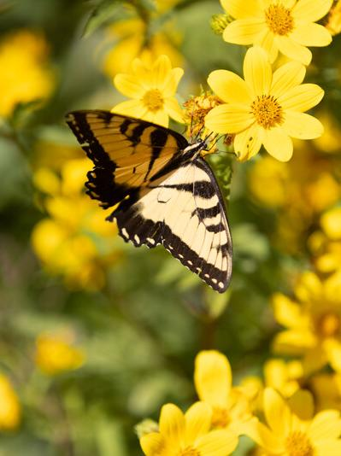
Why do you think flowers have brightly colored petals?
1B
Life and Land in Missouri – 1B Getting Buzzy: Explain
24
Notes:
(Brightly colored petals attract insects and other animals to the flower to get nectar.)
Animal in Picture: Eastern Tiger Swallowtail

Slide 25
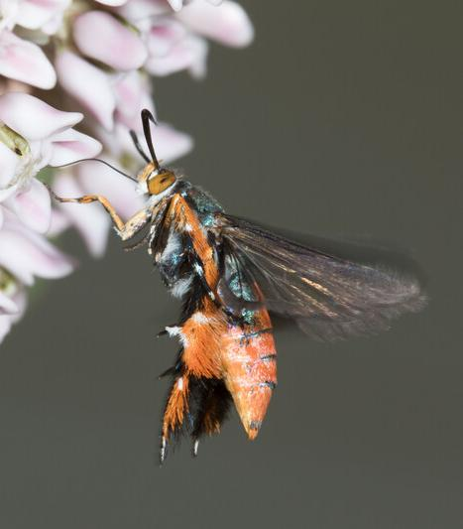
Why do you think many flowers have a good smell?
1B
Life and Land in Missouri – 1B Getting Buzzy: Explain
25
Notes:
(The good smell attracts insects and other animals to the flower.)
Animal in Picture: Squash Vine Borer; Plant in Picture: Common Milkweed

Slide 26
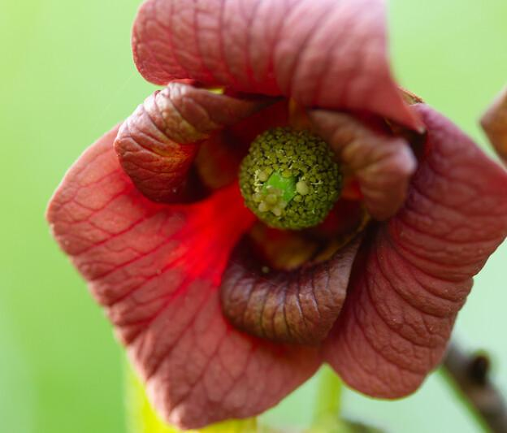
If a flower smells like something rotting, what insects might be attracted to the smell?
1B
Life and Land in Missouri – 1B Getting Buzzy: Explain
26
Notes:
(Flies can also be pollinators. Pawpaw flowers smell like rotting meat, which attracts pollinating flies.)
Plant in Picture: Pawpaw Tree flower

Slide 27
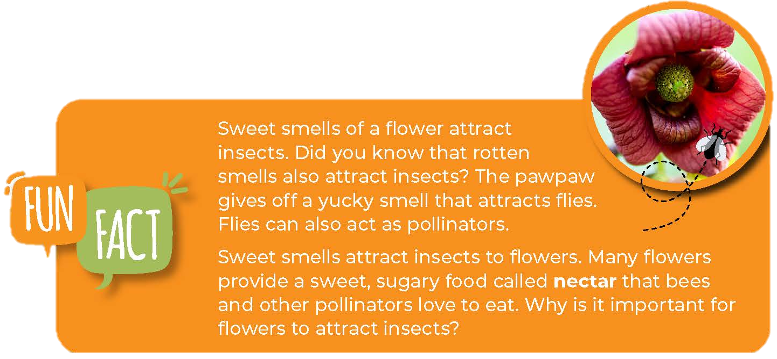
1B
Life and Land in Missouri – 1B Getting Buzzy: Explain
27
Notes:
Have students open guide to the Fun Fact on Page 11. Discuss the photo of the pawpaw and how the flowers give off a yucky smell that still draws in pollinators.

Slide 28
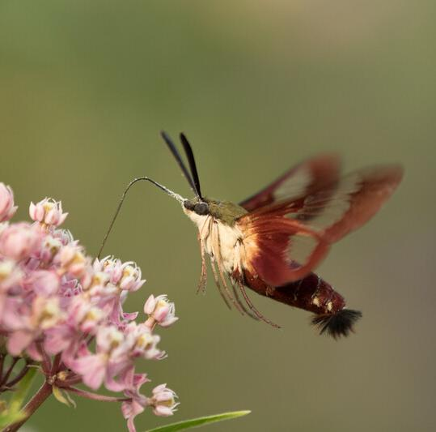
Why else might pollinators be attracted to flowers?
1B
Life and Land in Missouri – 1B Getting Buzzy: Explain
28
Notes:
Guiding Question: How do insects and birds help plants? (Many flowers provide pollinators with nectar. Nectar is a sugary liquid food produced by plants that some pollinators eat.)
Animal in Picture: Hummingbird Clearwing Moth; Plant in Picture: Common Milkweed

Slide 29
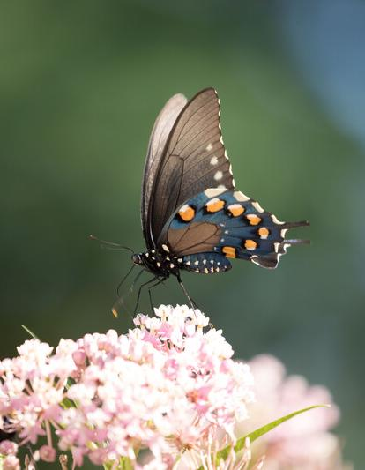
Why is it important for flowers to attract insects?
What is the reason for the flower again?
1B
Life and Land in Missouri – 1B Getting Buzzy: Explain
29
Notes:
(The plant needs to reproduce and the flower attracts the insect which then feeds off of its nectar and pollen. The pollinator then moves pollen from one flower to another flower and it helps to make seeds within that next flower.)
Animal in Picture: Eastern Tiger Swallowtail; Plant in Picture: Common Milkweed

Slide 30
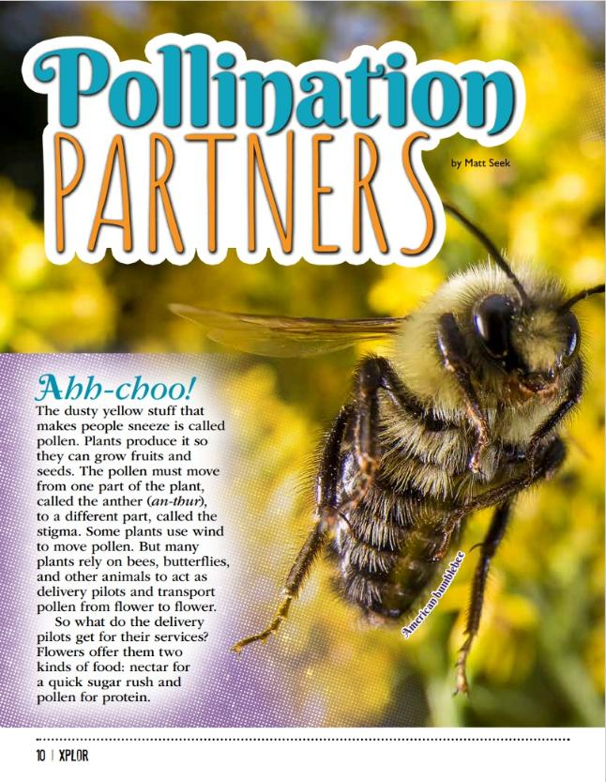
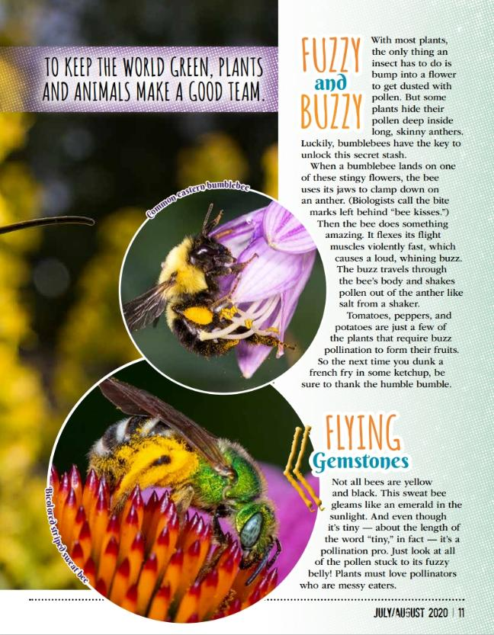
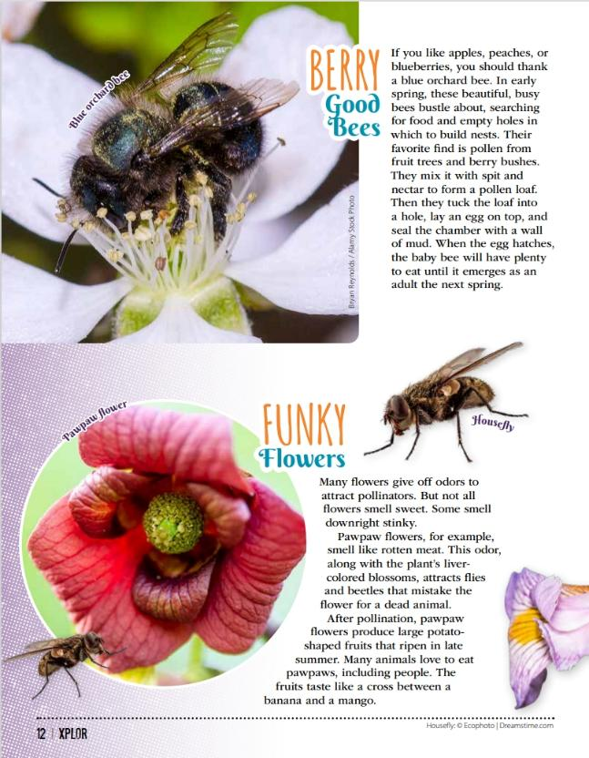
1B
Life and Land in Missouri – 1B Getting Buzzy: Elaborate
30
Notes:
Let’s review. From the MDC Teacher Portal, display or distribute copies of the Pollination Partners articles by Matt Seek from the July/August 2020 issue of Xplor again.

Slide 31
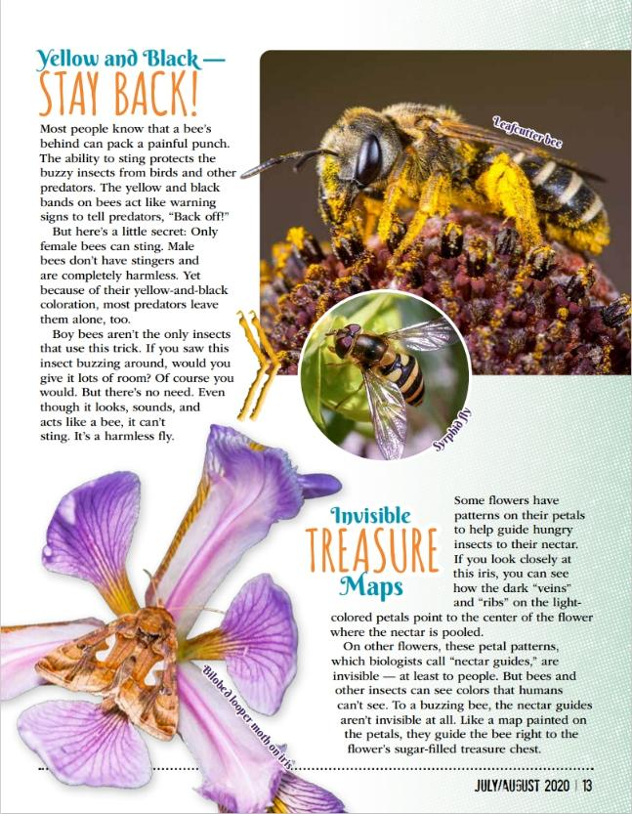
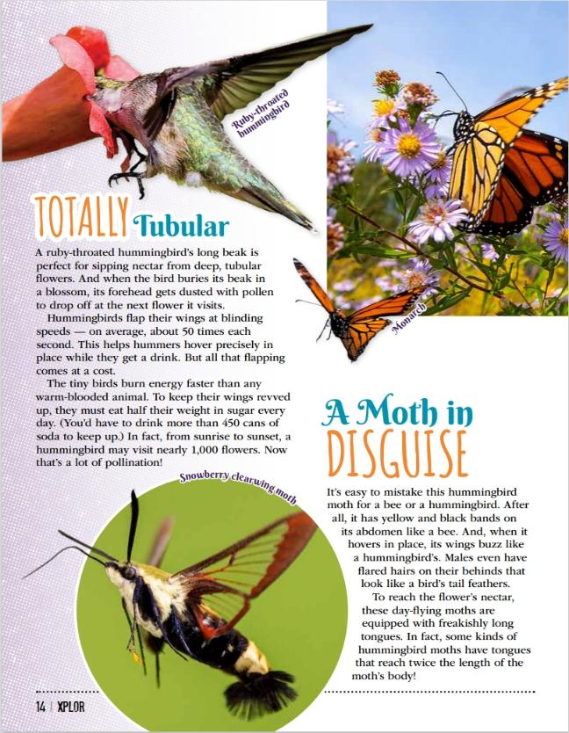
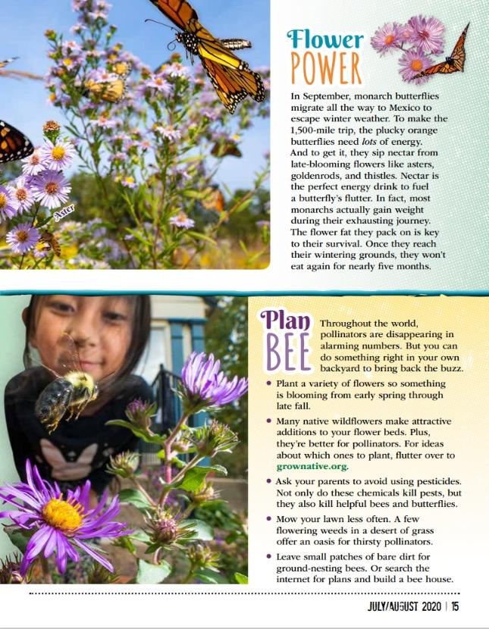
1B
Life and Land in Missouri – 1B Getting Buzzy: Elaborate
31

Slide 32
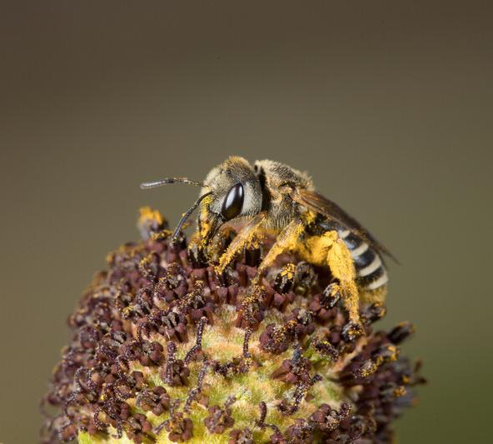
What is pollination?
Why is it important?
1B
Life and Land in Missouri – 1B Getting Buzzy: Elaborate
32
Notes:
Animal in Picture: Sweat Bee

Slide 33
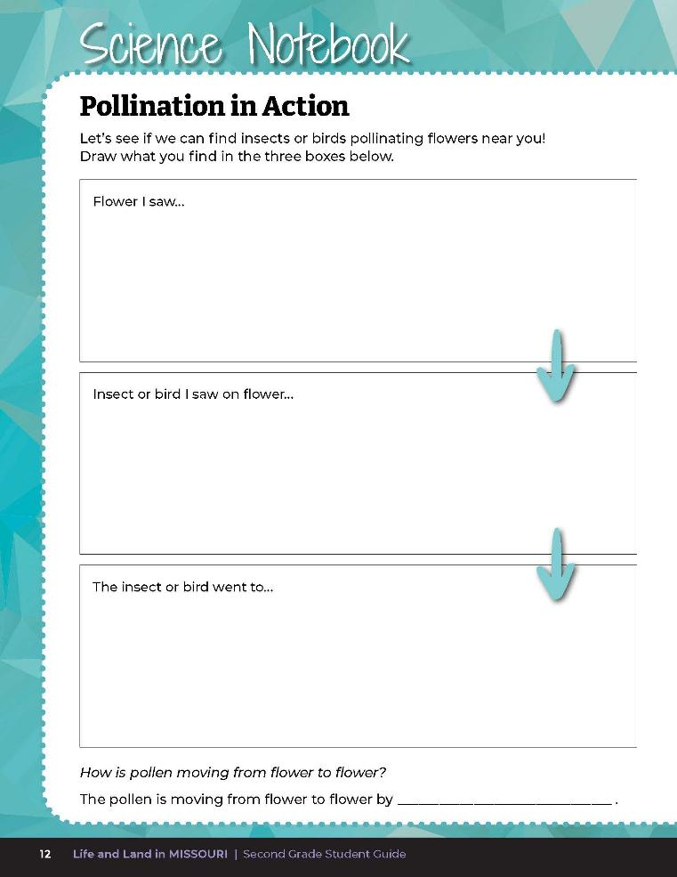
Let’s see if we can find insects or birds pollinating flowers near you!
Draw what you find!
1B
Life and Land in Missouri – 1B Getting Buzzy: Elaborate
33
Notes:
Introduce students to Science Notebook 1B Pollination in Action on Page 12. Take students to an outdoor classroom, park, or other area where there are blooming flowers or trees. This may even be an option in some parts of the schoolyard.

Slide 34
Observe flowers to look at pollen and watch for what may be spreading pollen between flowers.
Discuss the parts of a flower you see. Be sure to look for and include pollen.
1B
Life and Land in Missouri – 1B Getting Buzzy: Elaborate
34
Notes:
In small groups, have students closely observe flowers to look at pollen and watch for what may be spreading pollen between flowers. Have them observe and discuss the parts of a flower they see, being sure to look for and include pollen.

Slide 35
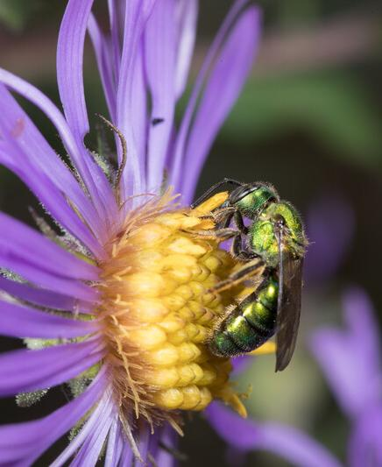
How is pollen moving from flower to flower?
What evidence do you see?
1B
Life and Land in Missouri – 1B Getting Buzzy: Elaborate
35
Notes:
If pollination is not seen in action, ask students to look for evidence that pollination has happened. (Pollen around petals, etc.)
Students should discuss and refine their ideas in small groups and report their claim, evidence, and reasoning for how pollen is moving between flowers.
Animal in Picture: Metallic Green Sweat Bee; Plant in Picture: New England Aster

Slide 36

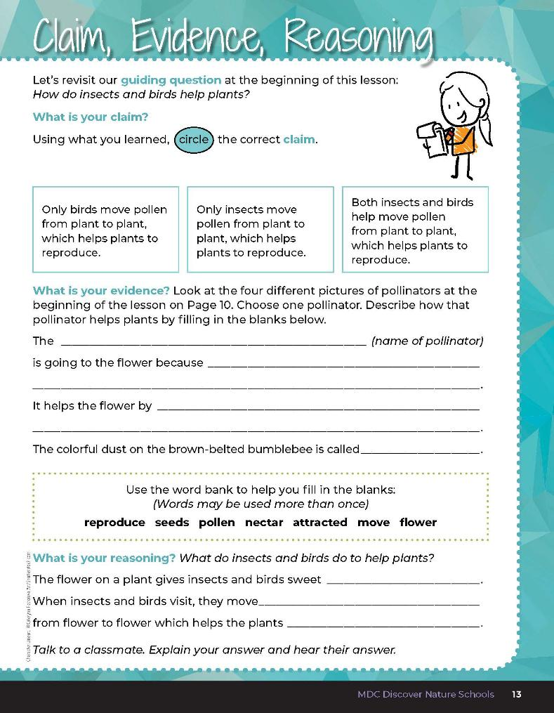
1B
Life and Land in Missouri – 1B Getting Buzzy: Evaluate
36
Notes:
Guiding Question: How do insects and birds help plants?
After further exploring the concept of pollination and different pollinators, have students open their student guides to the 1B Claim, Evidence, Reasoning section on Page 13. Guide students through the page by reviewing each section as a class and revisiting the scientific concepts learned to help answer each section. Students will reference the four pictures of pollinators from the Lesson 1B Getting Buzzy introduction page.

Slide 37
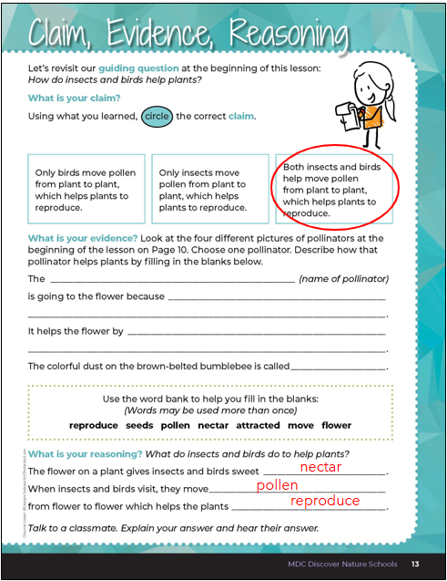
1B
Life and Land in Missouri – 1B Getting Buzzy: Evaluate
37
Notes:
Teacher Note: Assessment may be modified or differentiated by giving students sentences of what is happening in each photo in random order and having students match to the correct picture.
Rubric:
4 (Exceeds) – Student circles the correct claim and writes the correct evidence into the blanks and provides the correct reasoning by filling in all the blanks correctly.
3 (Meets) – Student circles either the correct claim or writes the correct evidence into the blanks and/or provides the correct reasoning by filling in all the blanks correctly.
2 (Partially meets) – Student circles either the correct claims or somewhat writes the correct evidence into the blanks and does not provide the correct reasoning.
1 (Doesn’t meet) – Student does not provide the correct claim or evidence and does not provide the correct reasoning.

