Slide 1
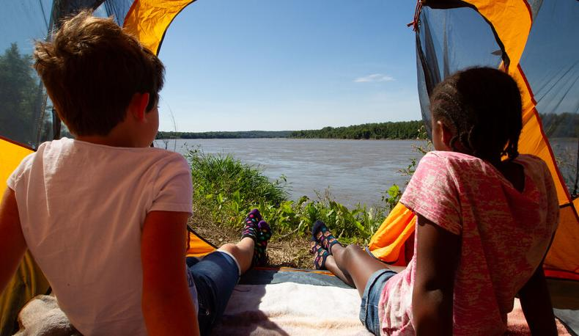

Life and Land in
MISSOURI
1A: Flower Power

Slide 2
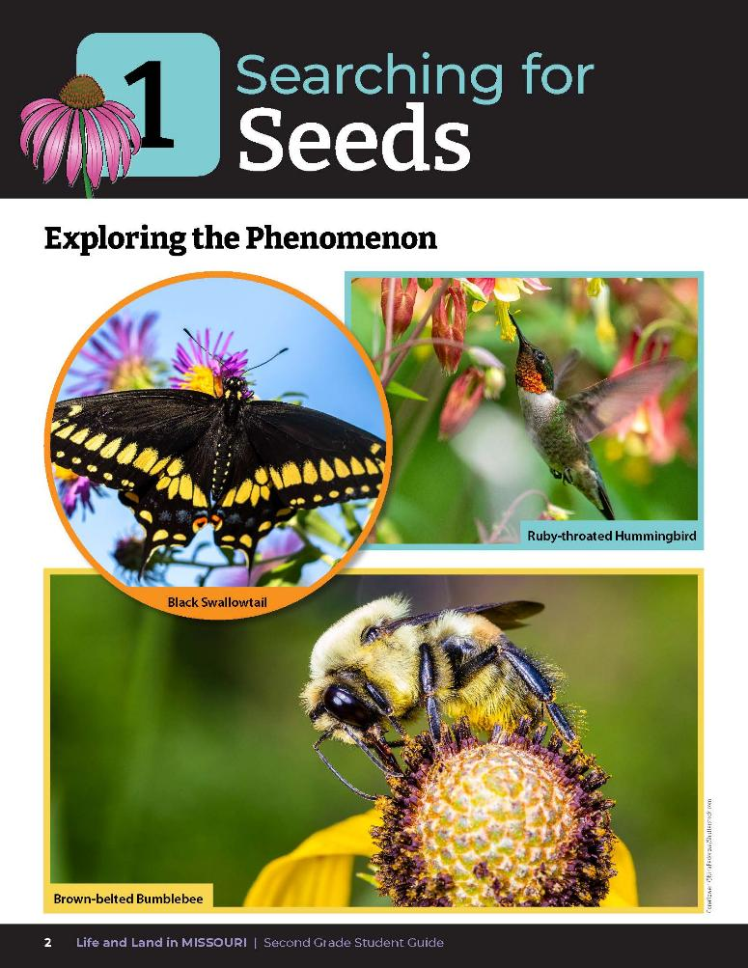
What do these photos have in common?
1A
Life and Land in Missouri – 1A Flower Power: Engage
2
Notes:
Have students look at the pictures of pollinators pollinating different Missouri flowers on the Unit 1 Exploring the Phenomenon section on Page 2.
What do these photos have in common? Allow students time to discuss and write ideas on the board. We will come back to this question at the end of the unit and see if we have more ideas after we have explored this topic further. It’ll be a chance for us to share all the things we have learned!

Slide 3
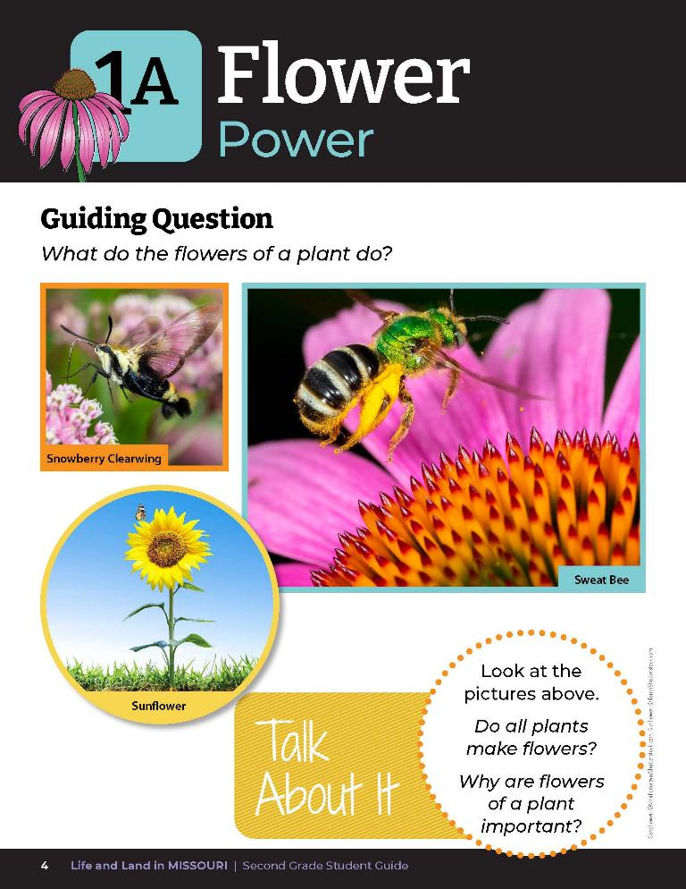
Guiding Question:
What do the flowers of a plant do?
Why do you think this?
1A
Life and Land in Missouri – 1A Flower Power: Engage
3
Notes:
Have students turn to the Lesson 1A Flower Power introduction on Page 4. Read the guiding question together. What do flowers of a plant do? Why do you think this? Write ideas on the board. This is called a guiding question and this question is what we are going to investigate today. We will see if we can answer this question at the end of this lesson. We will start by exploring different ideas, collect and record data, figure out what our data is telling us, research the topic more, and share our results and ideas with each other. Following these steps will help us answer the question, or make a claim, using the data we found as out evidence. We will keep practicing these steps for each lesson.

Slide 4
Do all plants make flowers?
Why are the flowers of a plant important?
1A
Life and Land in Missouri – 1A Flower Power: Engage
4
Notes:
Discuss the photos in the student guide and the Talk About It questions.

Slide 5
Go outside:
We are going to collect one plant with a blooming flower from the schoolyard!
1A
Life and Land in Missouri – 1A Flower Power: Explore
5
Notes:
Teacher Note: Before going outside, make sure that students know what poison ivy looks like and avoid touching it. Refer to poison ivy information on Page 9 of this teacher guide and sing the song together to the tune of Yankee Doodle.
Take class outside to collect one plant with a blooming flower from the schoolyard, or you can bring in a vase of wildflowers. Have students look carefully for blossoms of clover and other plants.
Teacher Note: If students collect from the schoolyard, be sure to set clear boundaries for where and which flowers students can collect. Explain that no more than 1 in 10 flowers can be collected to allow for regrowth. Students will need to carefully count and work together to ensure they do not collect more than the 1:10 ratio of flowers. Students may need to be divided into groups to follow the 1:10 rule. This will keep enough flowers available to support pollinators. If conducting this lesson during a field experience away from your schoolyard, it is recommended to not pick plants but to only observe and record them in student notebooks through drawings, descriptions, etc.

Slide 6

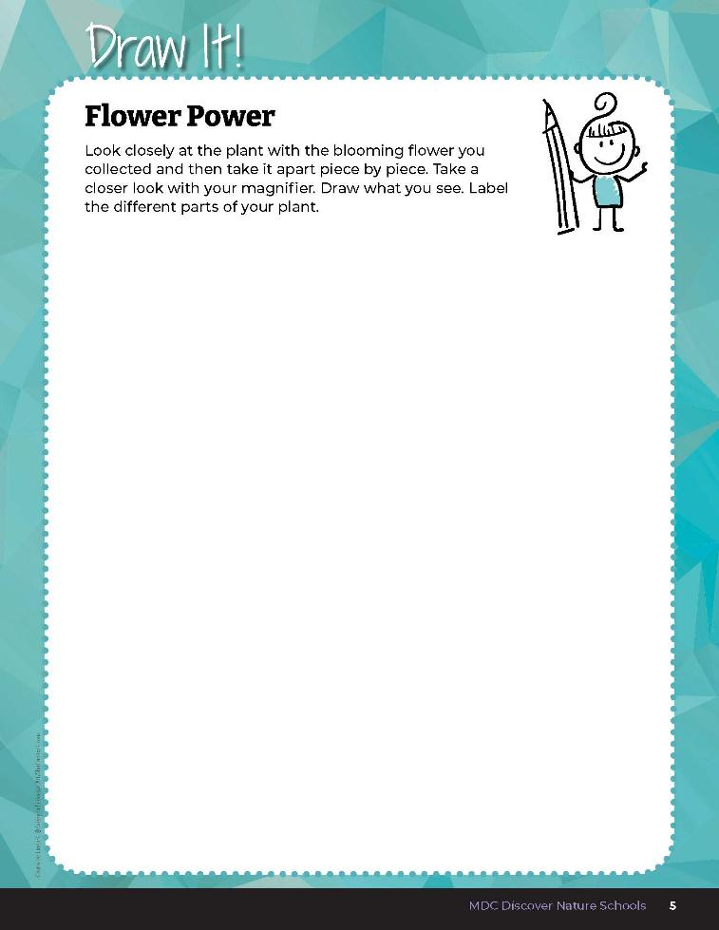
Look closely at the plant with the blooming flower you collected and then take it apart piece by piece. Take a closer look with your magnifier.
Draw what you see.
Label the different parts of your plant.
1A
Life and Land in Missouri – 1A Flower Power: Explore
6
Notes:
In their student guide Draw It! 1A Flower Power section on Page 5, students will draw and dissect (with their hands) their collected plant and flower and use a magnifier to observe it carefully. Have them practice labeling the basic parts of the plant they draw.
Teacher Note: If students collected one plant with a flower for a group, students may group around the flower to complete the page so that all can see the flower.
Students will share, observe, and discuss each group member’s flower and draw their findings in the student guide.

Slide 7
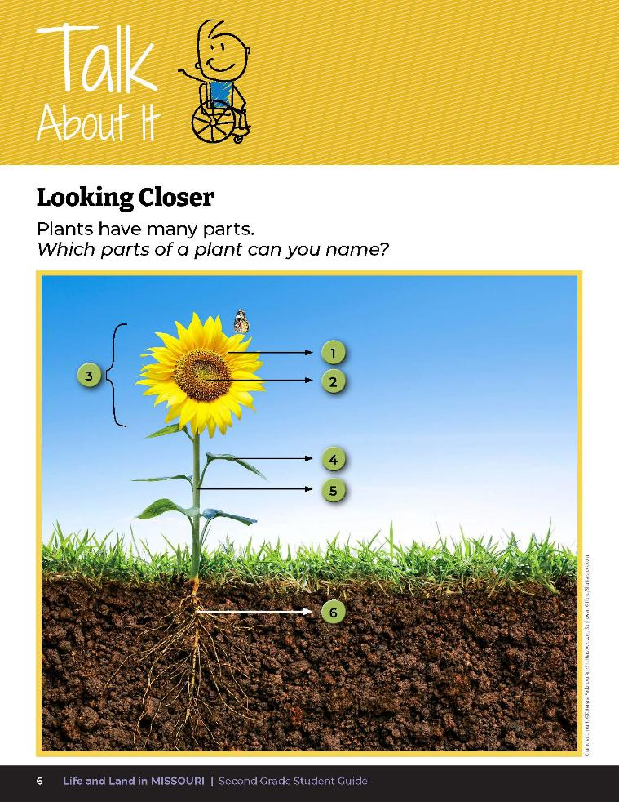

Which parts of a plant can you name?
1A
Life and Land in Missouri – 1A Flower Power: Explore
7

Slide 8
How did you know how to label the different parts of the plant?
1A
Life and Land in Missouri – 1A Flower Power: Explain
8
Notes:
After students have completed the Draw It! 1A Flower Power section, discuss what they drew.
How did you know how to label the different parts of the plant?
Allow students time to share their drawings and the labels they chose.

Slide 9
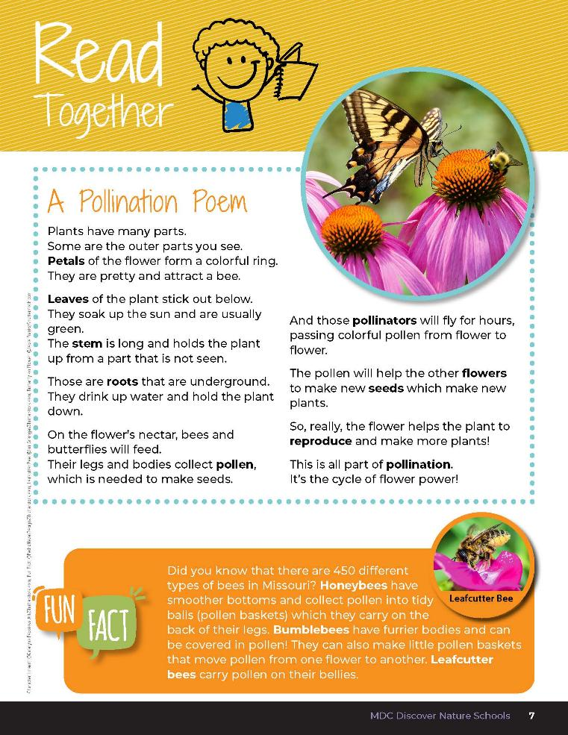

A Pollination Poem
Plants have many parts.
Some are outer parts you see.
Petals of the flower form a colorful ring.
They are pretty and attract a bee.
Leaves of the plant stick out below.
They soak up the sun and are usually green.
The stem is long and holds the plant up from a part that is not seen.
1A
Life and Land in Missouri – 1A Flower Power: Explain
9
Notes:
Have them open to Read Together 1A A Pollination Poem on Page 7. These pages will discuss the parts of a plant and its flower.

Slide 10
A Pollination Poem
Those are roots that are underground. They drink up water and hold the plant down.
On the flower’s nectar, bees and butterflies will feed.
Their legs and bodies collect pollen, which is needed to make seeds.
1A
Life and Land in Missouri – 1A Flower Power: Explain
10
Notes:
Have them open to Read Together 1A A Pollination Poem on Page 7. These pages will discuss the parts of a plant and its flower.

Slide 11
A Pollination Poem
And those pollinators will fly for hours, passing colorful pollen from flower to flower.
The pollen will help the other flowers to make new seeds which make new plants.
1A
Life and Land in Missouri – 1A Flower Power: Explain
11
Notes:
Have them open to Read Together 1A A Pollination Poem on Page 7. These pages will discuss the parts of a plant and its flower.

Slide 12
A Pollination Poem
So really, the flower helps the plant to reproduce and make more plants!
This is all part of pollination. It’s the cycle of flower power.
1A
Life and Land in Missouri – 1A Flower Power: Explain
12
Notes:
Have them open to Read Together 1A A Pollination Poem on Page 7. These pages will discuss the parts of a plant and its flower.

Slide 13
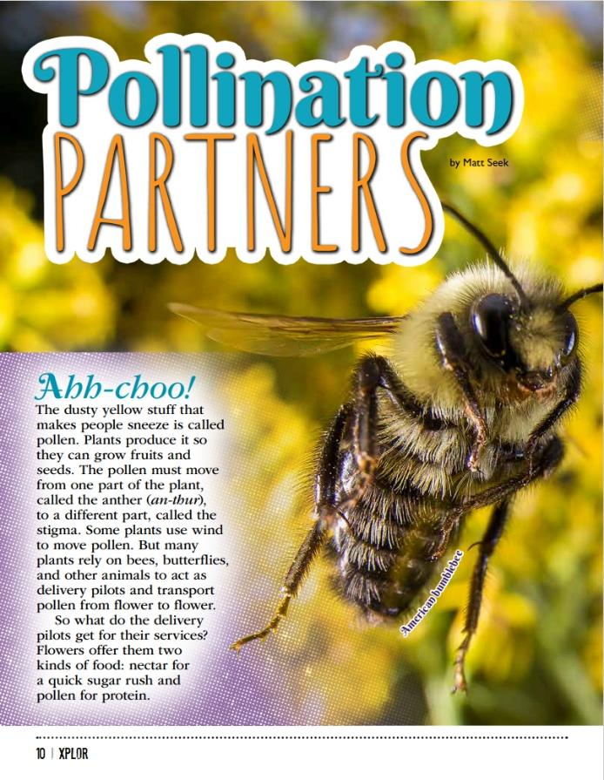
Read Together!
Link to Article:
1A Pollination Partners Xplor Article.pdf
1A
Life and Land in Missouri – 1A Flower Power: Explain
13
Notes:
From the MDC Teacher Portal, display or distribute copies of the Pollination Partners article by Matt Seek from the July/August 2020 issue of Xplor. Read Page 10 together and review the pictures in the rest of the article.

Slide 14
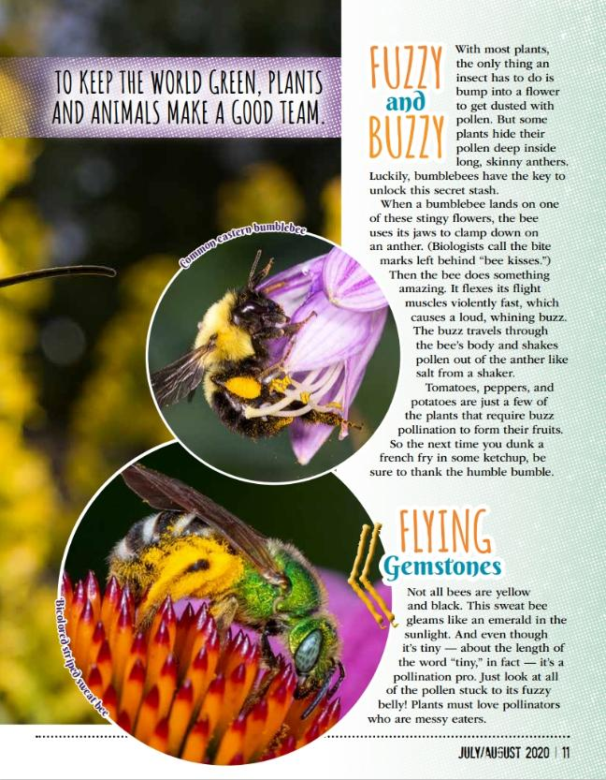
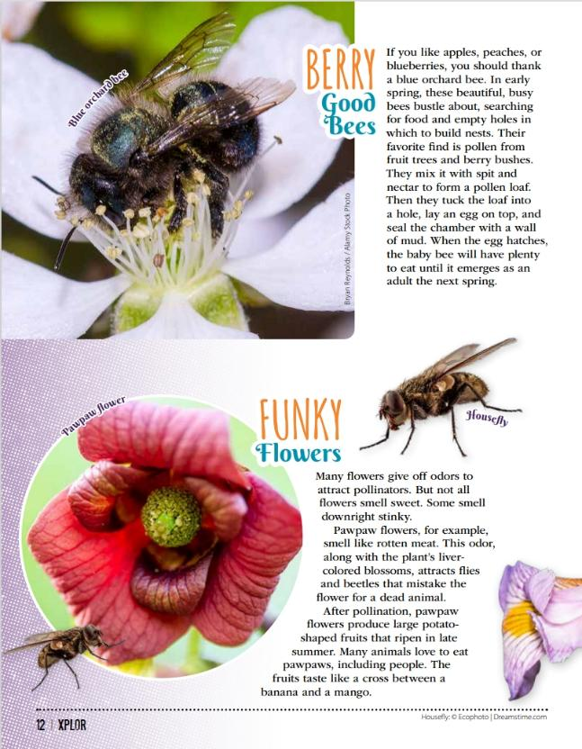
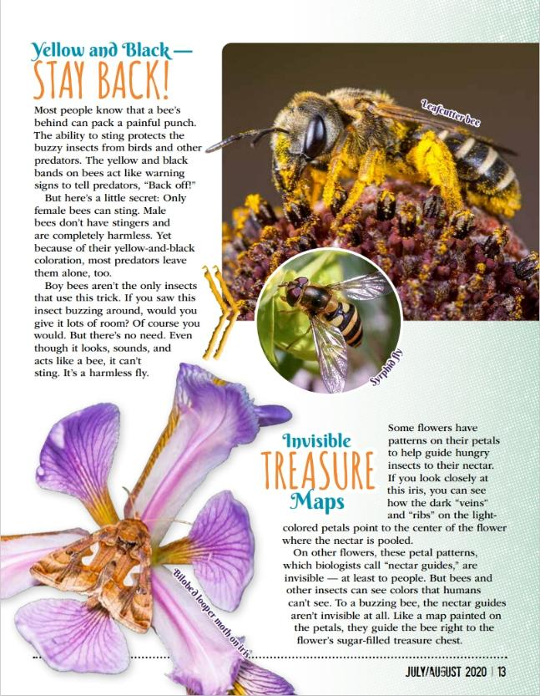
1A
Life and Land in Missouri – 1A Flower Power: Explain
14

Slide 15
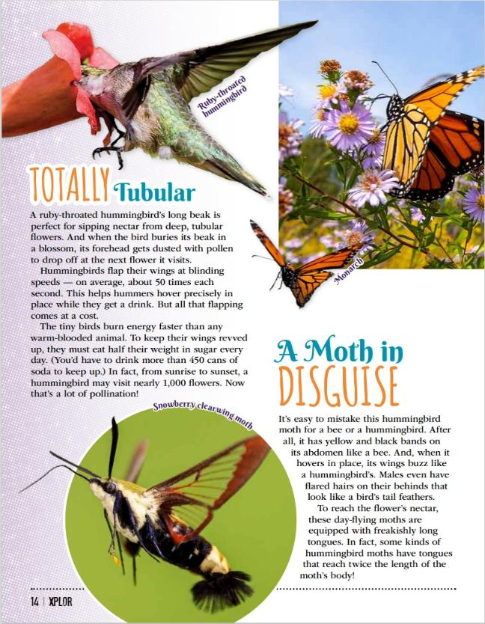
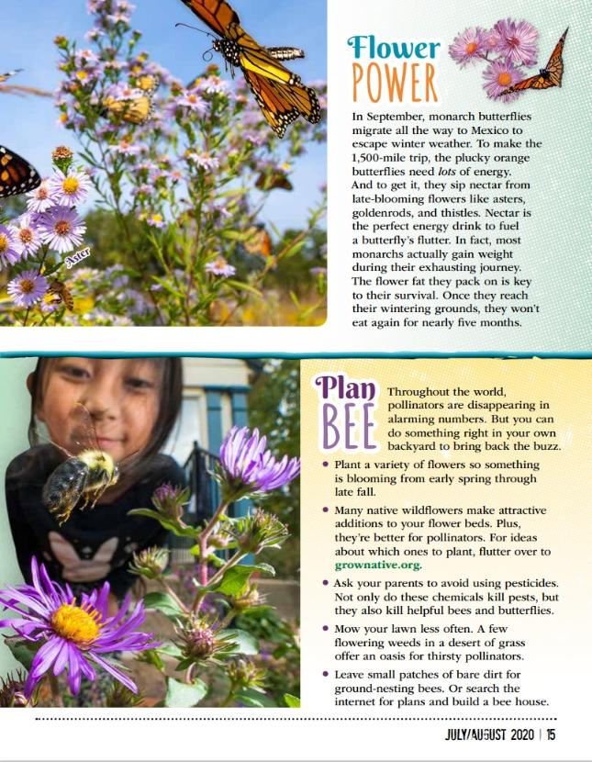
1A
Life and Land in Missouri – 1A Flower Power: Explain
15

Slide 16
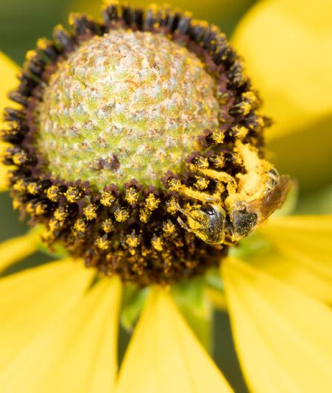
What is that yellow dust on the bee’s legs and why do the bees collect it?
1A
Life and Land in Missouri – 1A Flower Power: Explain
16
Notes:
Pollen. It feeds the bees and gives pollinators energy.
Animal in Picture: Sweat Bee

Slide 17
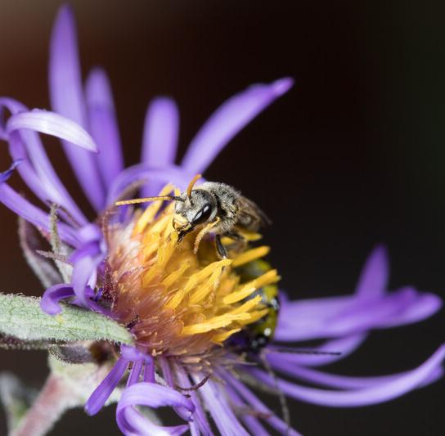
Where does the yellow dust come from?
1A
Life and Land in Missouri – 1A Flower Power: Explain
17
Notes:
The flower, or the anther of the flower.
Animal in Picture: Honey Bee

Slide 18
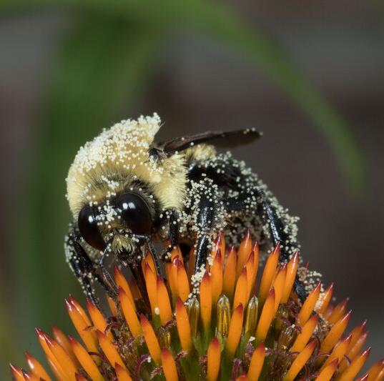
What attracts the bees to the flower?
1A
Life and Land in Missouri – 1A Flower Power: Explain
18
Notes:
The smell of the flower, the color, or how it is shaped.
Animal in Picture: Bumble Bee

Slide 19
Thinking about what we read from the magazine and from our poem, what are some parts of the plant and its flower that you collected?
1A
Life and Land in Missouri – 1A Flower Power: Explain
19
Notes:
Have students revisit their flower drawings on the Draw It! 1A Flower Power page of the student guide. Have them identify the parts of a plant using what they inferred from the poem.
Thinking about what we read from the magazine and from our poem, what are some parts of the plant and its flower that you collected? Allow students time to relabel any parts of the plant.

Slide 20
Can you point to the…Leaves? Roots? Petals? The dusty pollen?
1A
Life and Land in Missouri – 1A Flower Power: Explain
20
Notes:
Have students point either at their drawings or at the flower itself. Can you point to the…Leaves? Roots? Petals? The dusty pollen?

Slide 21
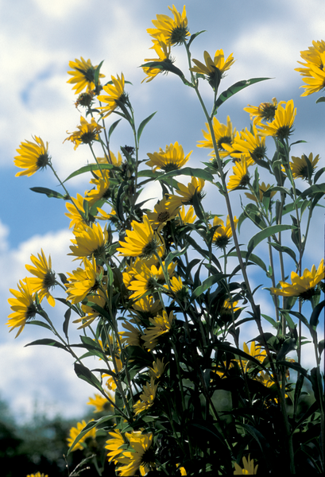
Why do all plants need all these parts and how do each of these parts or structures help the flower?
1A
Life and Land in Missouri – 1A Flower Power: Explain
21
Notes:
Continue to ask the following discussion questions, asking students to use their new vocabulary they have learned.
Flower in Picture: Sunflower

Slide 22
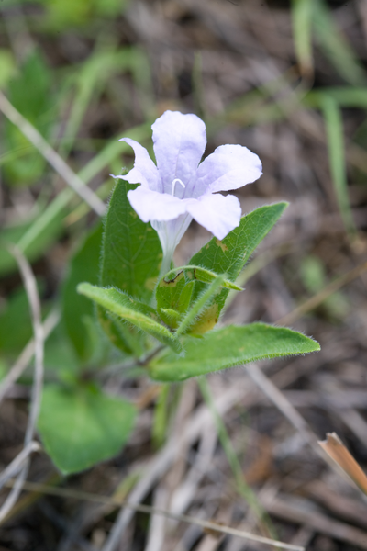
Are all flowers alike or are some flowers different?
1A
Life and Land in Missouri – 1A Flower Power: Explain
22
Notes:
Plant in Picture: Hairy Petunia

Slide 23
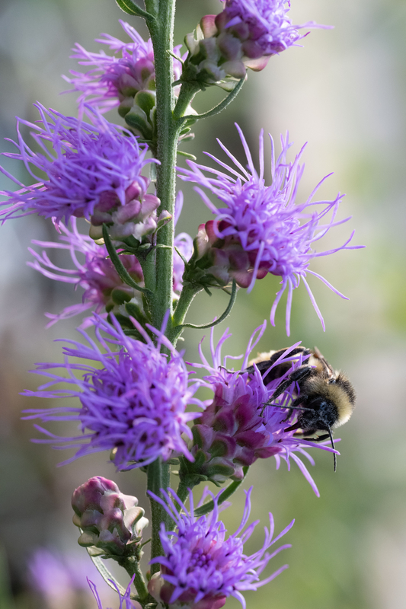
Why do flowers have different sizes, shapes, colors, smells?
1A
Life and Land in Missouri – 1A Flower Power: Explain
23
Notes:
Plant in Picture: Eastern Blazing Star

Slide 24
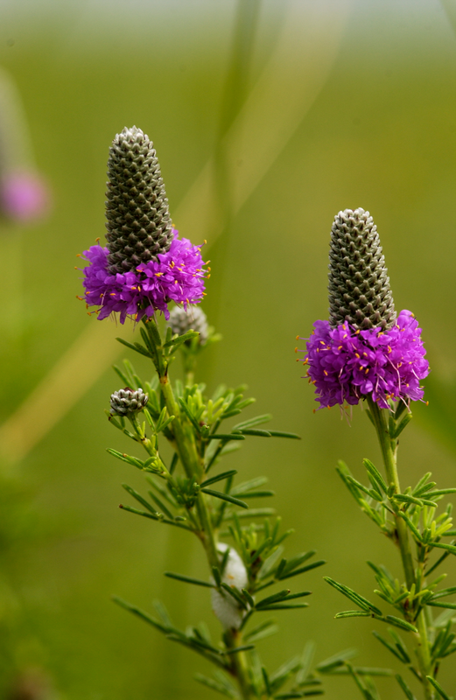
Why are flowers important?
1A
Life and Land in Missouri – 1A Flower Power: Explain
24
Notes:
Plant in Picture: Purple Prairie Clover

Slide 25
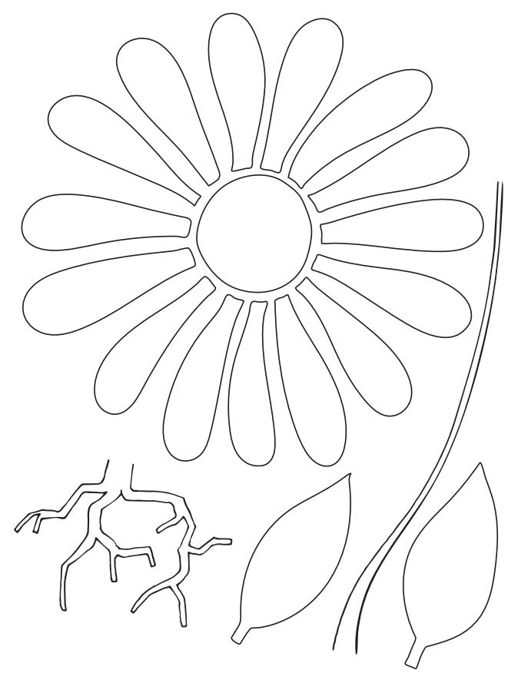
We are making 5 flowers from different colored bowls!
Each group will get one small bowl to hold pollen. You can color and put all the flower parts onto the bowl. Remember the flower needs to be attractive to bees and pollinators!
1A
Life and Land in Missouri – 1A Flower Power: Elaborate
25
Notes:
The class will need 5 flowers made with different colored bowls. Divide students into 5 groups. Give each group one small bowl to hold pollen (cornmeal). Using the 1A Parts of a Plant Cutouts on page 33 of the Teacher Guide, 1A Parts of a Plant Cutouts.pdf have students color and add all the flower parts to the bowl by gluing or taping the petals and leaves to the outside of the bowl, the stem along the side, and the roots at the bottom. Remember the flower needs to be attractive to bees and pollinators.
Students can mix the cornmeal with food coloring and add the mixture or “pollen” to their bowl. Each flower (or bowl) needs a different color of pollen.
Teacher Note: Students will build bees in the next lesson.

Slide 26
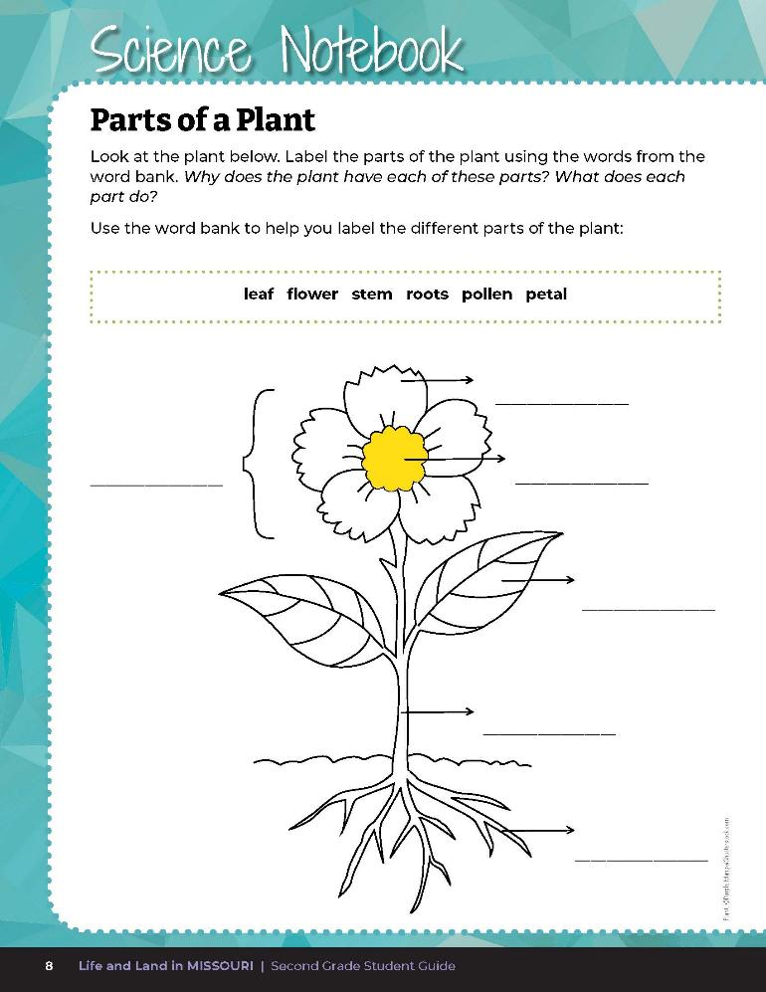
Label the parts of the plant.
1A
Life and Land in Missouri – 1A Flower Power: Elaborate
26
Notes:
Using student guide Science Notebook 1A Parts of a Plant on Page 8, have students label the parts of the flower on their drawing by choosing words from the word bank on the page. Check for accuracy.

Slide 27

1A
Life and Land in Missouri – 1A Flower Power: Elaborate
27
Notes:
Have students discuss the purpose of each part of the plant. If students have difficultly determining the function of a part, have them read A Pollination Poem again and infer the purpose of each part from the text.

Slide 28
Look up different native Missouri flowers on the Field Guide | Missouri Department of Conservation
For each flower or plant discuss:
The different parts
How it is pollinated
What the seeds look like
1A
Life and Land in Missouri – 1A Flower Power: Elaborate
28
Notes:
Look up different native Missouri flowers from the MDC Field Guide Field Guide | Missouri Department of Conservation. For each flower or plant, discuss the different parts, how it is pollinated, and what the seeds look like.

Slide 29
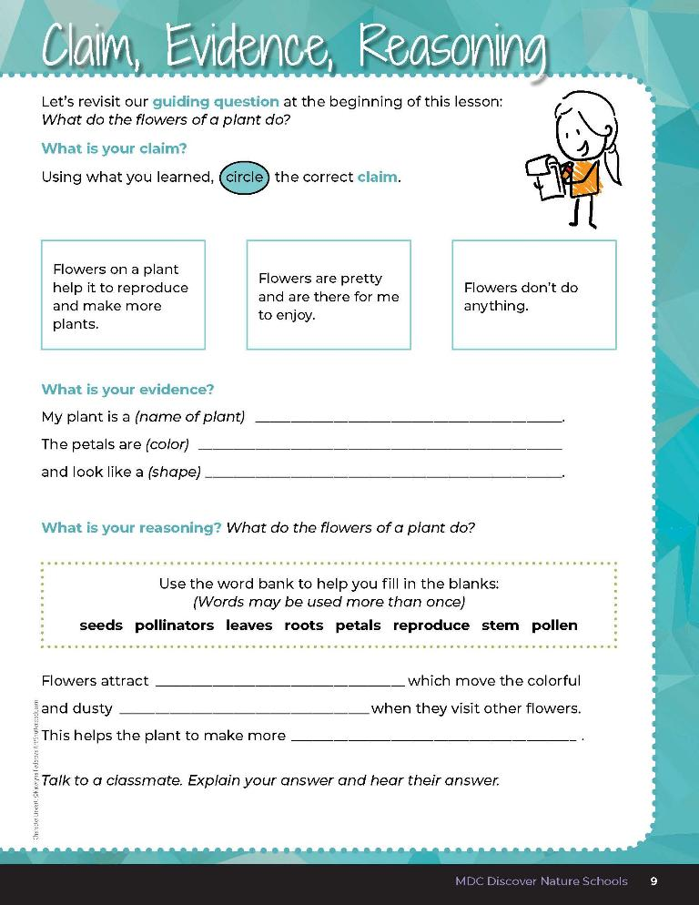

1A
Life and Land in Missouri – 1A Flower Power: Evaluate
29
Notes:
Guiding Question: What do the flowers of a plant do?
After exploring the concept of flower reproduction, pollination, and the purpose of flowers, have students open their student guides to the 1A Claim, Evidence, Reasoning section on Page 9. Guide students through the page by reviewing each section as a class and revisiting the scientific concepts learned to help answer each section.

Slide 30
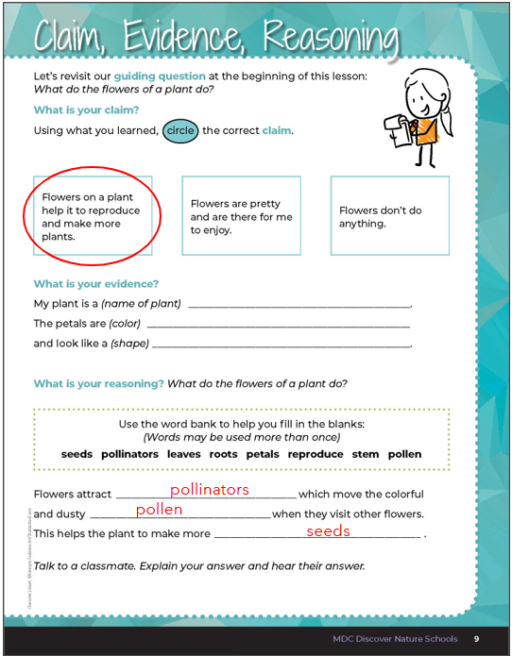
1A
Life and Land in Missouri – 1A Flower Power: Evaluate
30
Notes:
Rubric:
4 (Exceeds) – Student circles the correct claim and writes the correct evidence into the blanks and provides the correct reasoning by filling in all the blanks correctly.
3 (Meets) – Student circles either the correct claim or writes the correct evidence into the blanks and provides the correct reasoning by filling in most of the blanks correctly.
2 (Partially meets) – Student circles either the correct claim or somewhat writes the correct evidence into the blanks and may or may not provide the correct reasoning by filling in some of the blanks correctly.
1 (Doesn’t meet) – Student does not provide the correct claim or evidence and does not provide the correct reasoning.

