Slide 1
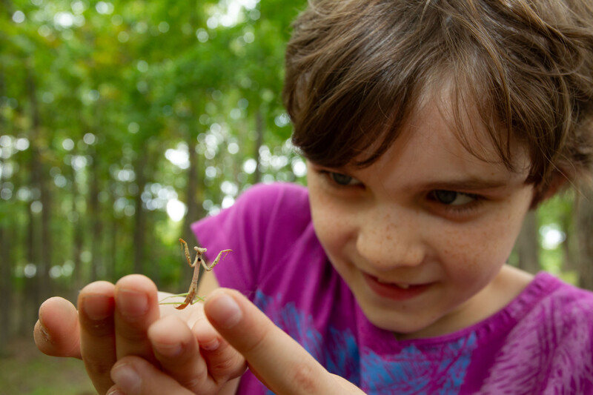

Exploring
MISSOURI
1A: Feeling the Warmth

Slide 2
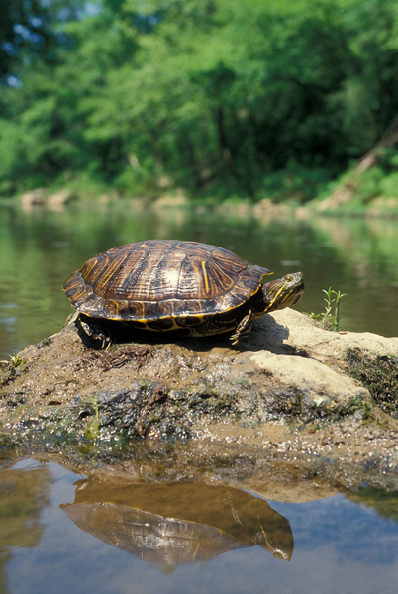
Guiding Question:
What causes something to get warmer?
1A
Exploring Missouri – 1A Feeling the Warmth: Engage
2
Notes:
Animal in picture: Red-eared Slider turtle

Slide 3
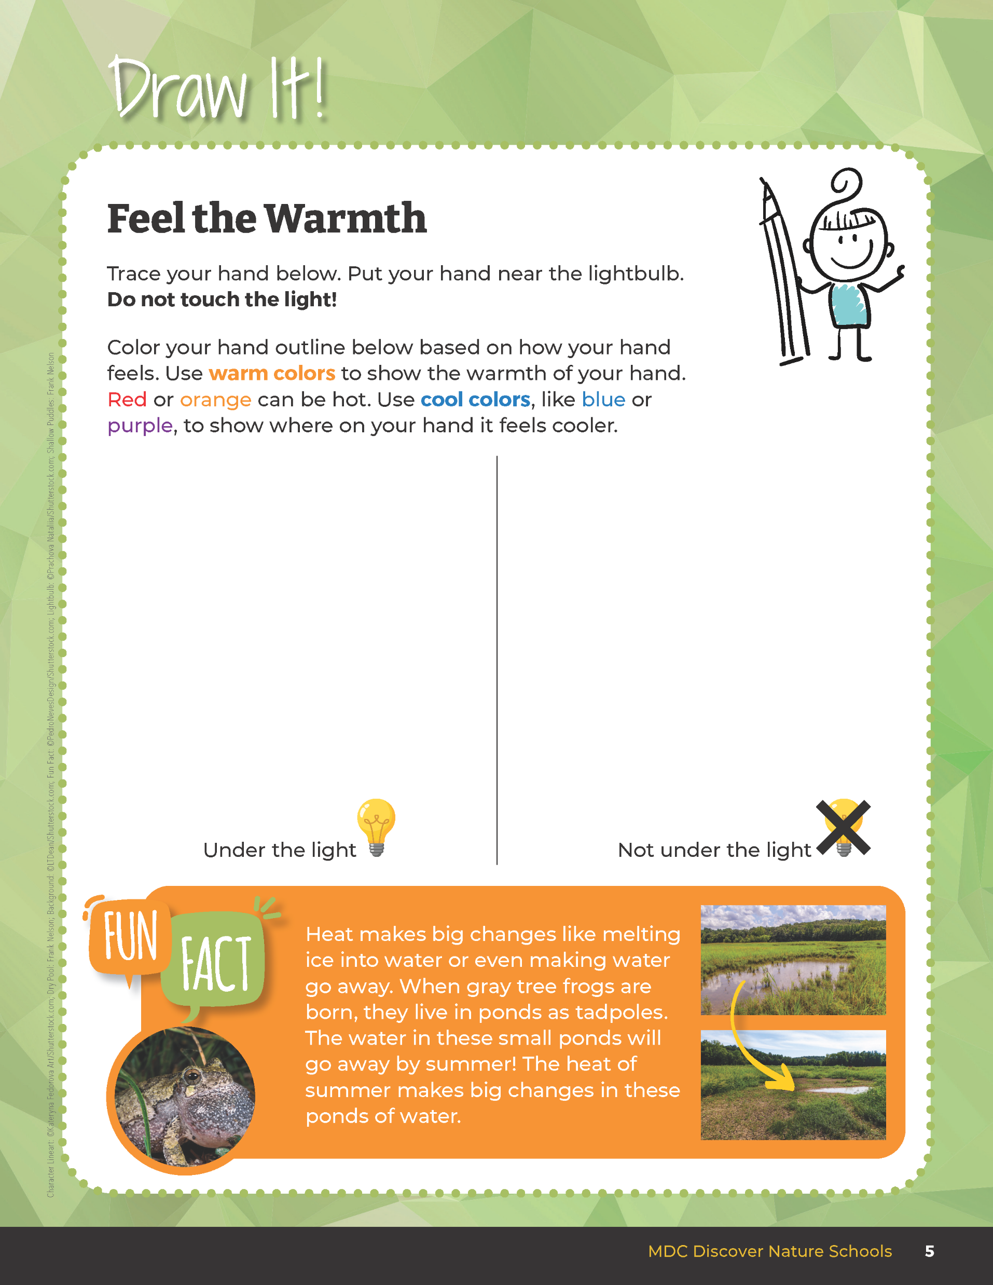

Trace your hand and use colors to show how it felt under the light and not under the light.
1A
Exploring Missouri – 1A Feeling the Warmth: Engage
3
Notes:
In this investigation, students will place their hands near 5-watt incandescent holiday lights. The bulbs will be warm, so encourage students to place their hand near, but not touching the actual light bulbs.
Step 1 – In the student guide, Draw It! 1A Feel the Warmth section on Page 5, have students trace their hand, then put their hand near the light bulb. Use colors to indicate how their hand felt – orange and red indicates warm to hot while blue and white indicated cool to cold. As able, students should write or share a description of how their hand felt under the light.
Step 2 – Have students again trace their hand, then put their hand on their desk. Have students use colors to indicate how their hand felt. As able, students should write or share a description of how their hand felt when it wasn’t under the light.

Slide 4
1A
Exploring Missouri – 1A Feeling the Warmth: Engage
4

Slide 5


Why did your hand feel warm under the light?
1A
Exploring Missouri – 1A Feeling the Warmth: Engage
5
Notes:
Step 3 – Ask them to try and explain why their hand felt warm under the light.
Teacher Note: At this point in the lesson, do not clarify right or incorrect observations.
Explanation and clarification of phenomenon will occur in the Explain portion. Allowing for incorrect assumptions will engage students to make claims and seek evidence for reasoning explained later.

Slide 6
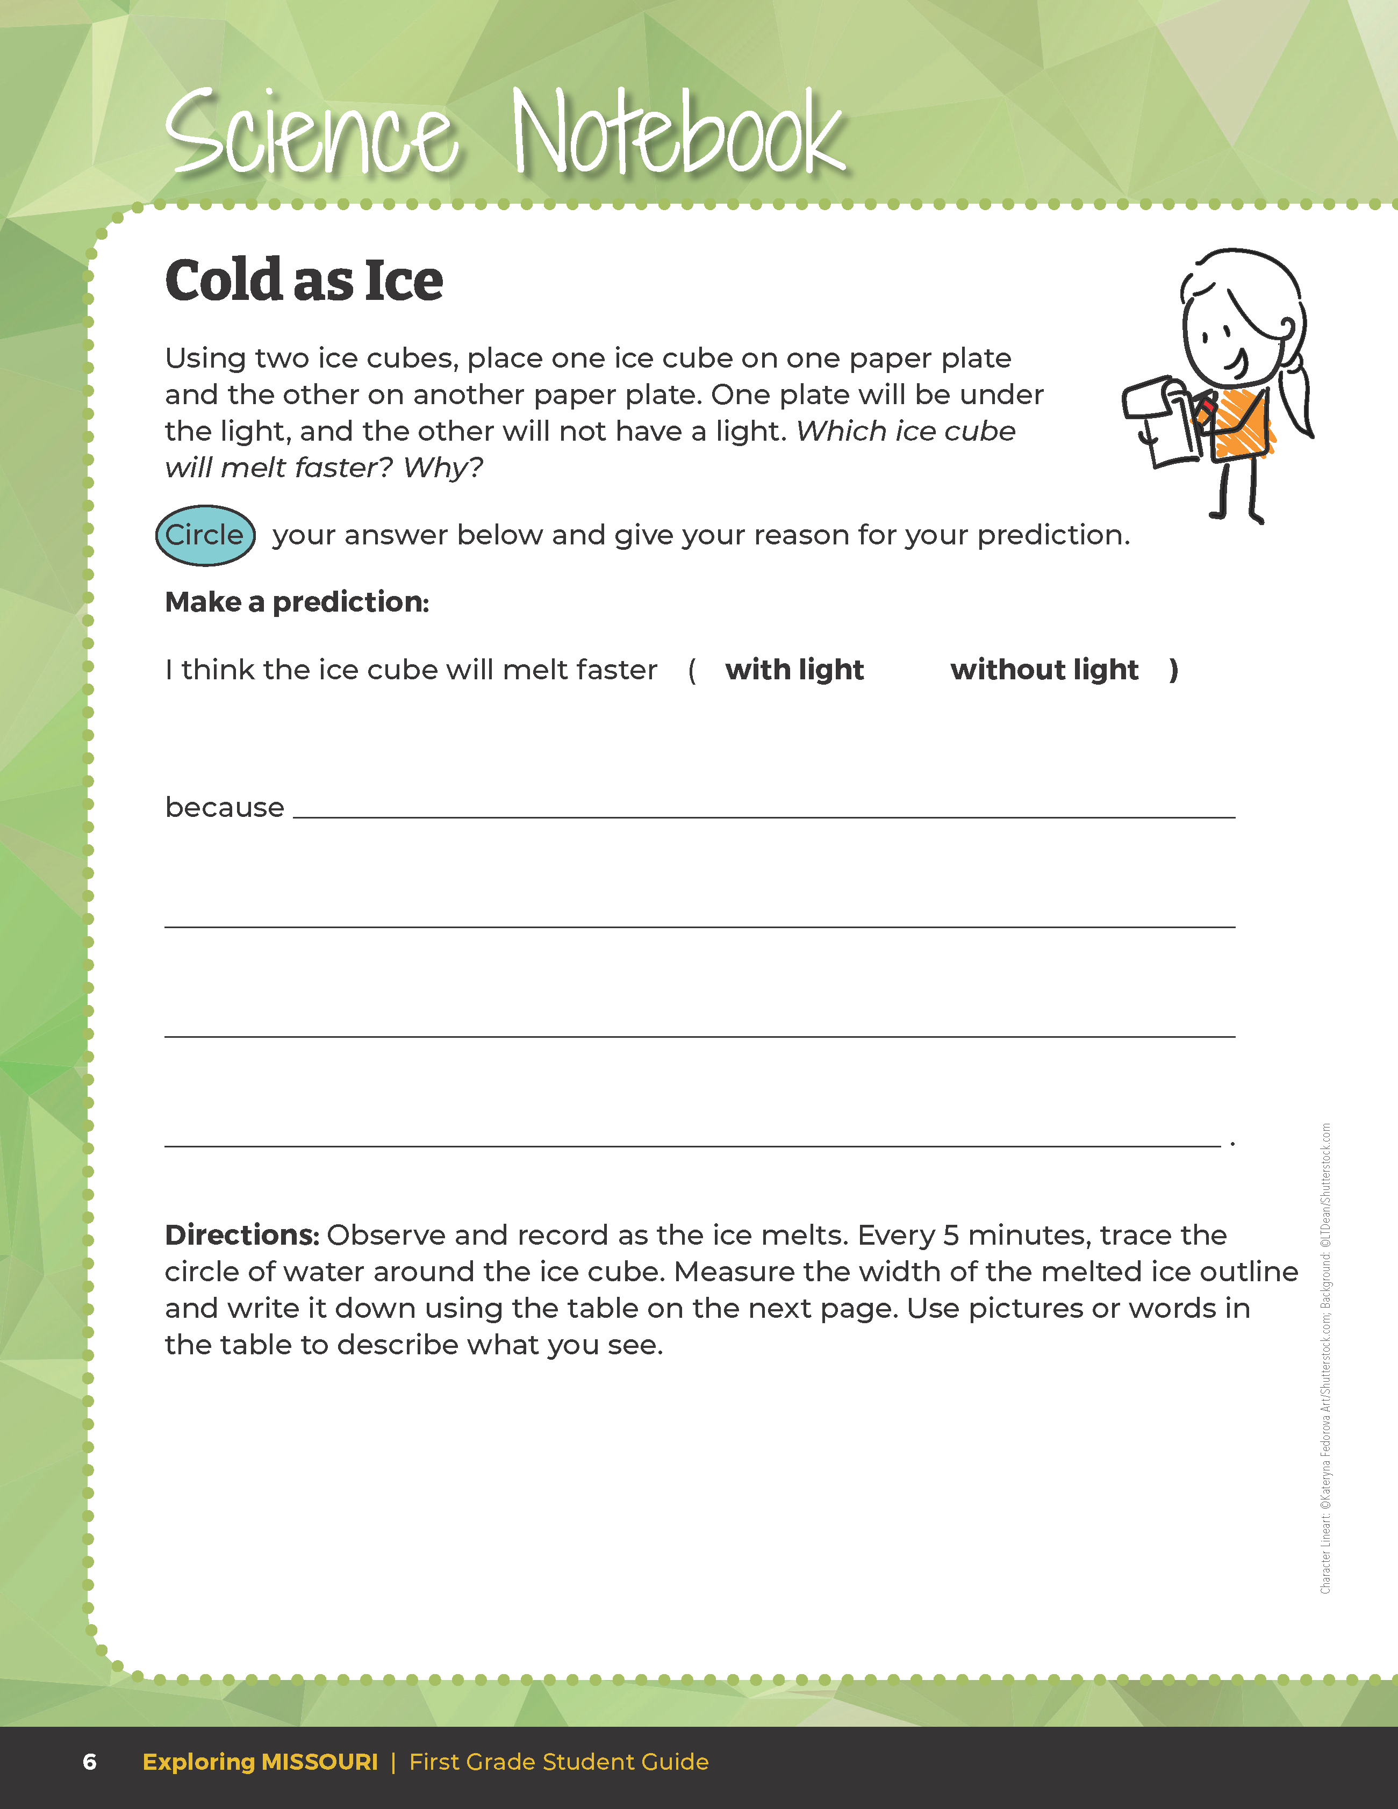

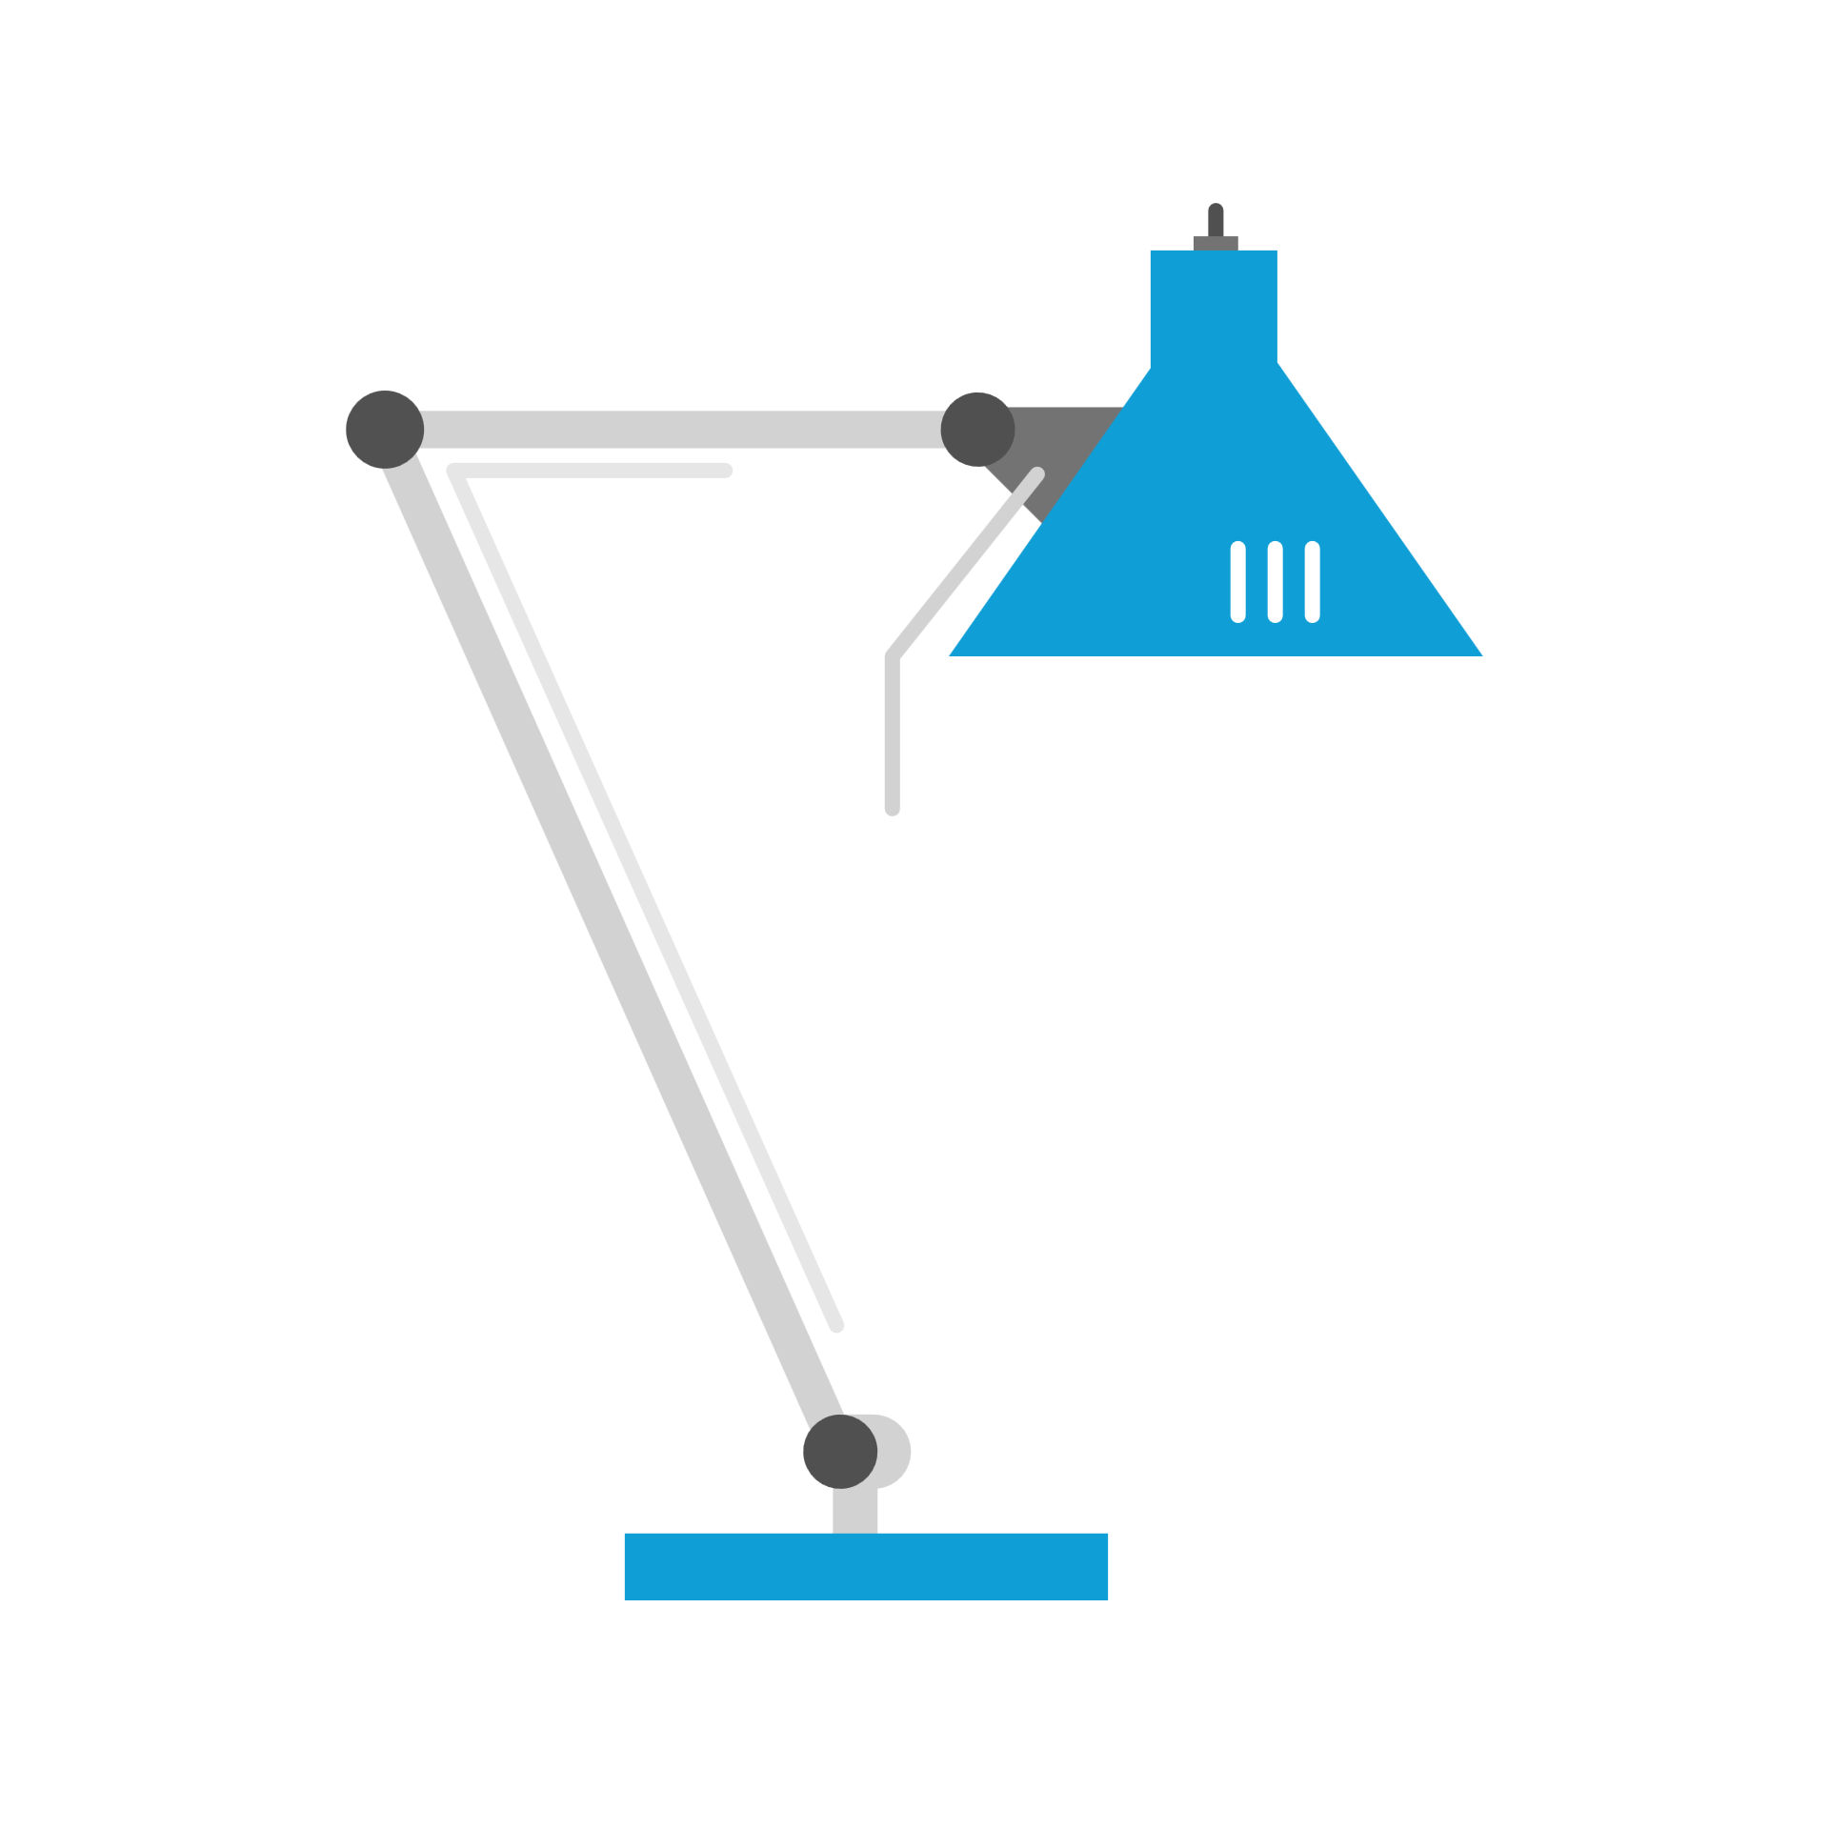


Predict: Which ice cube will melt faster? Why?
1A
Exploring Missouri – 1A Feeling the Warmth: Explore
6
Notes:
Place one ice cube on a small plate on a table. Place a second ice cube on a small plate on a table with a lamp shining on it. Teacher Note: using a 40-watt blub, 9 inches above the ice cubs, it will take about 45 minutes for the heated ice cube to completely melt.
In the student guide, Science Notebook 1A Cold as Ice section on Page 6, student will complete a prediction using the following prompt: “I think _____________ will happen because ____________.”

Slide 7
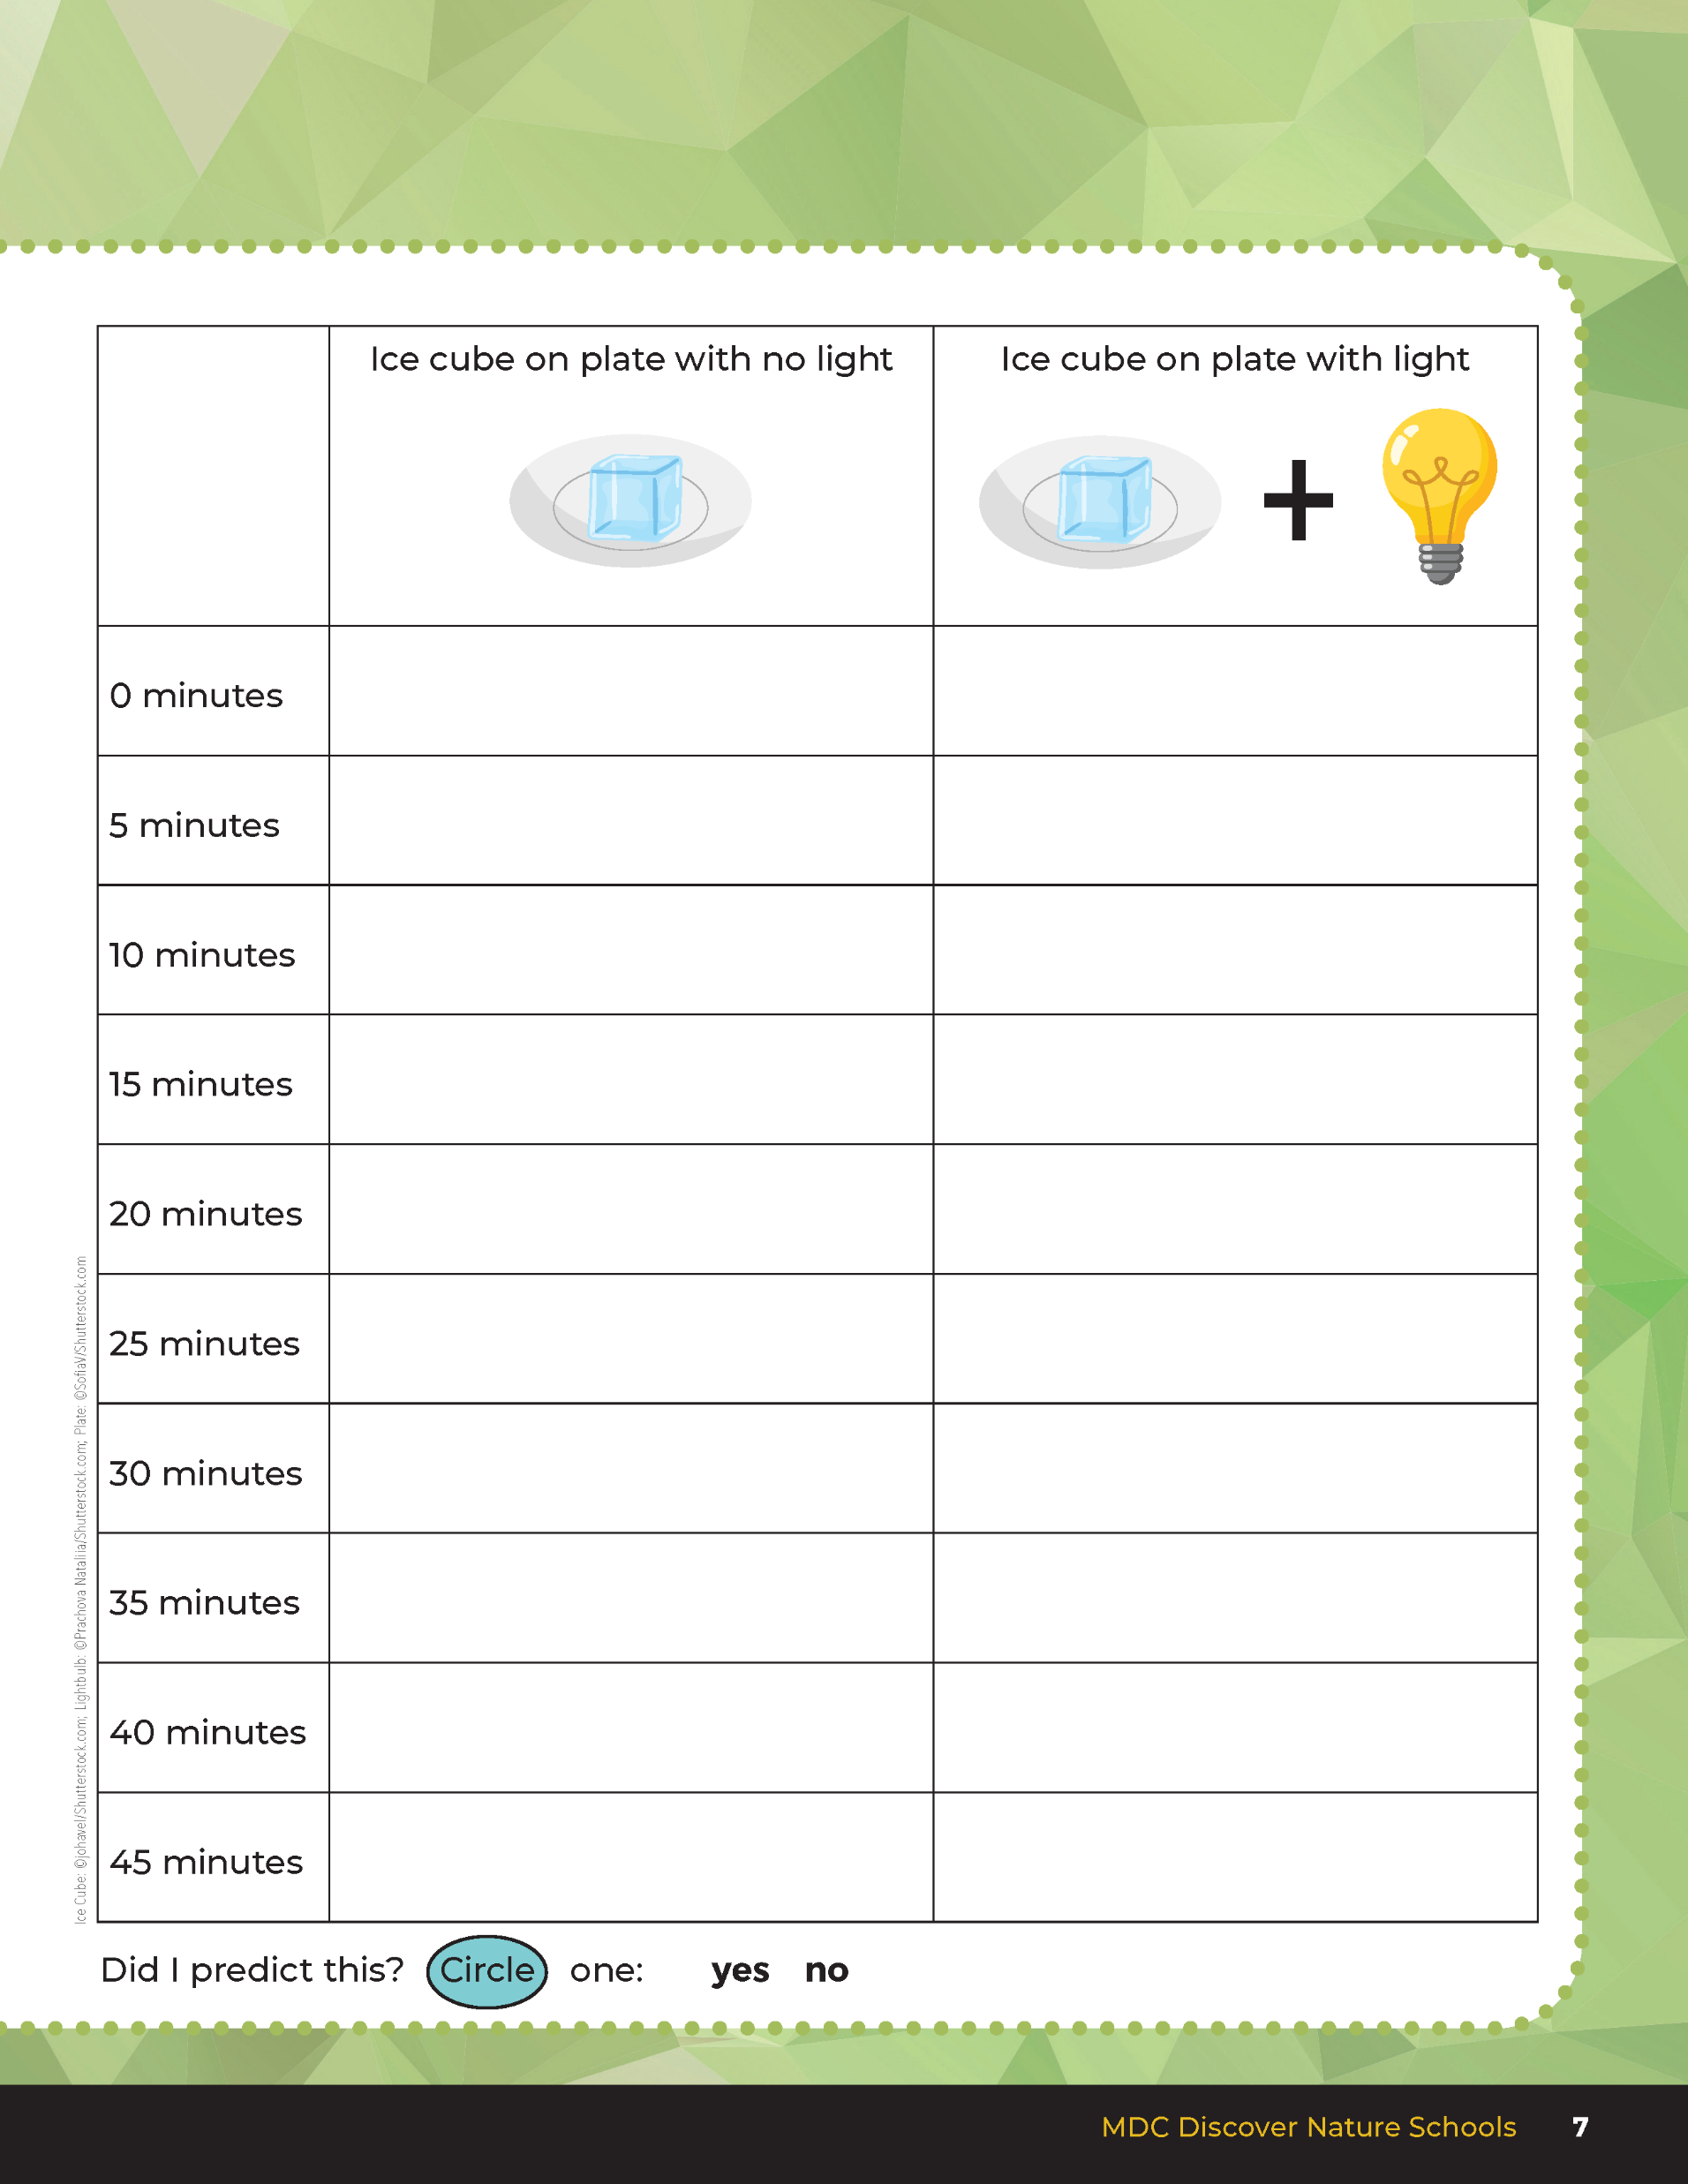

Every 5 minutes record your observations using drawings and words.
Trace the outline of the water line using permanent marker to see how the liquid puddle changes in size. Using a ruler measure the diameter of the melted water and record this in the student guide.
1A
Exploring Missouri – 1A Feeling the Warmth: Explore
7
Notes:
Using the data table in the student guide, Science Notebook 1A Cold as Ice section on Page 7, students will record the rate of the ice cubes melting – one under a light and the other not under a light. Set a timer and every 5 minutes have students record their observation using drawings and words. At the same time, have students trace the outline of the water line using permanent marker to see how the liquid puddle changes in size. Using a ruler measure the diameter of the melted water and record this in the student guide Science Notebook 1A Cold as Ice section under the prediction. Sciences can use words and drawings to document the experiment.
Throughout this activity, encourage students to discuss and compare their observations and predictions with their classmates.

Slide 8
Did I predict this?
1A
Exploring Missouri – 1A Feeling the Warmth: Explore
8
Notes:
After the experiment, have students answer the final question in their student guide by circling the answer: Did I predict this? (yes or no)

Slide 9
Was it melting faster or slower with the light? Why is this?
.
1A
Exploring Missouri – 1A Feeling the Warmth: Explain
9
Notes:
Think about what happened when the ice cube was melting.
Was it melting faster or slower with the light? Why is this? The heat energy was passing from the lamp to the ice cube which was cooler and caused the ice to melt faster. The heat energy from the room was not as hot, so the ice did not melt as fast because the temperature of the room and the temperature of the ice cube were closer together.)

Slide 10
What about when we placed our hands under the light? Where was that heat energy coming from?
.
1A
Exploring Missouri – 1A Feeling the Warmth: Explain
10
Notes:
The heat energy from the light was hotter and we could feel that energy transferring to our hands when they were the closest to the light.

Slide 11
Heat Energy
.
1A
Exploring Missouri – 1A Feeling the Warmth: Explain
11
Notes:
Prepare for a whole group conversation.

Slide 12
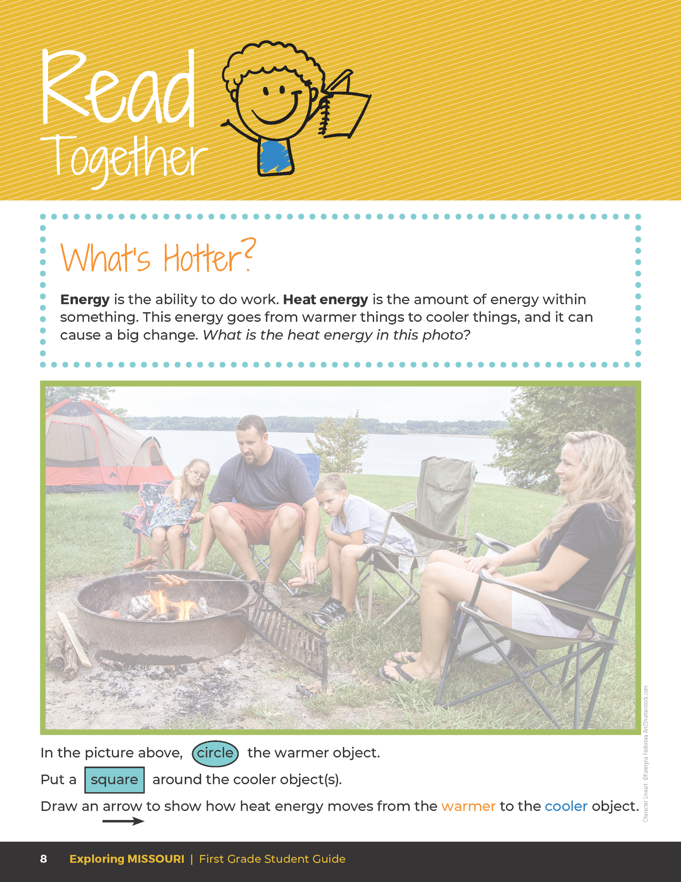

What’s Hotter?
Energy is the ability to do work. Heat energy is the amount of energy within something. This energy goes from warmer things to cooler things, and it can cause a big change.
.
1A
Exploring Missouri – 1A Feeling the Warmth: Explain
12
Notes:
Have students turn to the Read Together 1A What’s Hotter? section on Page 8 for the example of heat energy which is the fire and how the fire flows from the warmer object (the flames) to the cooler objects (people and food).

Slide 13
What’s Hotter?
What is the heat energy in this photo?
Circle the warmer object.
Put a square around the cooler object(s).
Draw an arrow to show how heat energy moves from the warmer to the cooler object.
.
1A
Exploring Missouri – 1A Feeling the Warmth: Explain
13
Notes:
Have students turn to the Read Together 1A What’s Hotter? section on Page 8 for the example of heat energy which is the fire and how the fire flows from the warmer object (the flames) to the cooler objects (people and food).

Slide 14

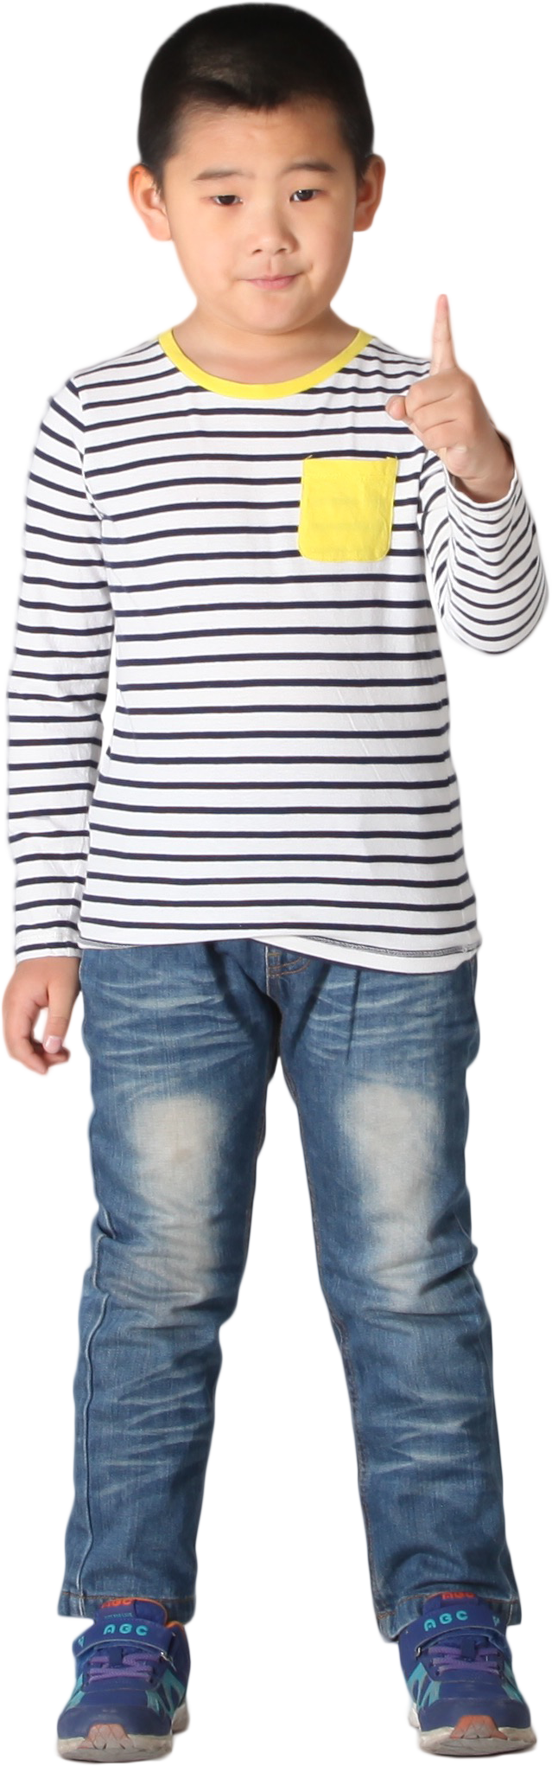
Go Outside:
Stand directly in the sunlight.
How does your body feel?
What is giving you warmth?
How is this source of heat different from the heat felt earlier?
.
1A
Exploring Missouri – 1A Feeling the Warmth: Elaborate
14
Notes:
Take a walk outside. Identify places that are in full sunlight and places that are in the shade.
Have students stand directly in the sunlight, then ask them how their bodies feel. What is giving them their warmth? How is this source of heat different from the heat felt earlier? (Students can feel this heat all over as opposed to just one part of their body.)

Slide 15
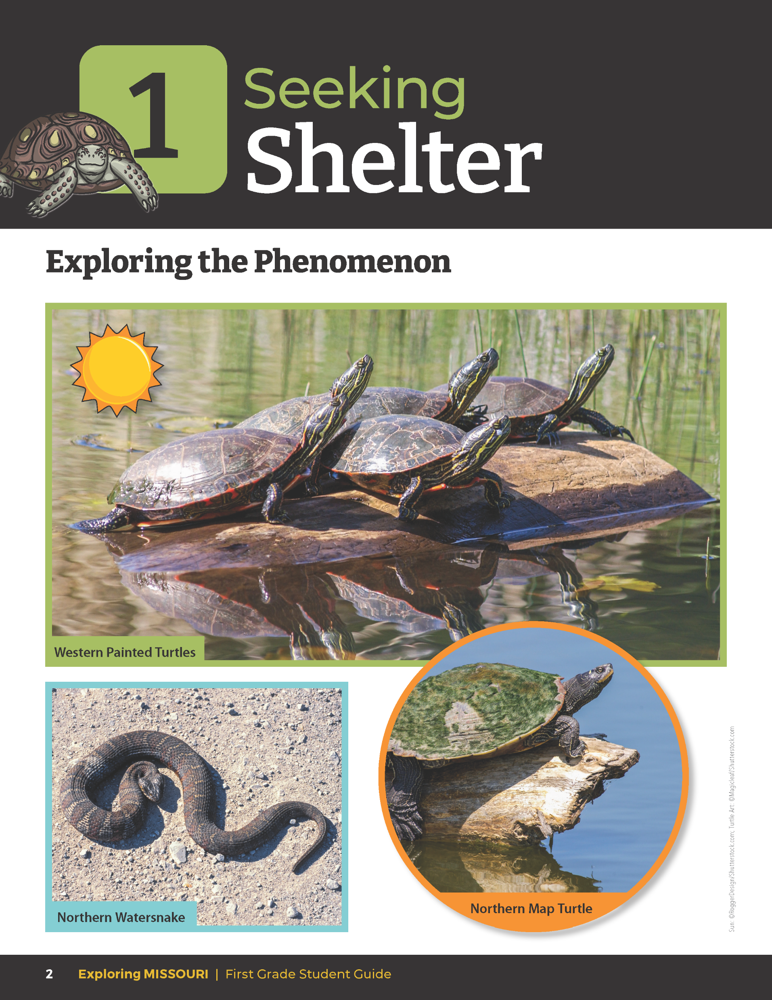
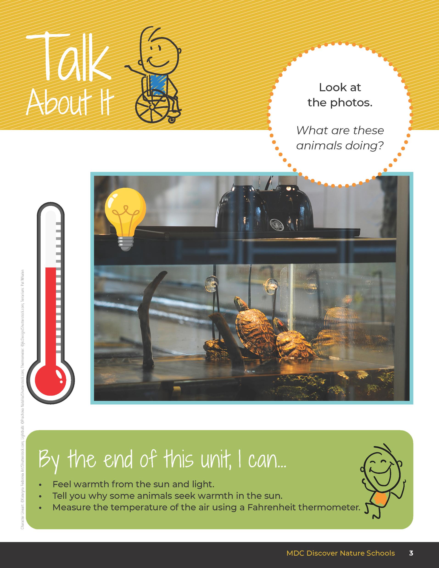
What is the source of heat energy for both animals?
What is the hotter object and how is it flowing to the colder object?
.
1A
Exploring Missouri – 1A Feeling the Warmth: Elaborate
15
Notes:
Refer to the student guide Unit 1 Exploring the Phenomenon Talk About It pages. What is the source of the heat energy for both reptiles? (The heat source in the picture on the student guide Page 2 is the sun. The heat source in the picture on the student guide Page 3 is the lamp.) What is the hotter object and how is it flowing to the colder object? (The sun is the hotter object and the heat flows into the reptile which is cooler. The lamp is the hotter object and flows into the reptile which is cooler.)

Slide 16
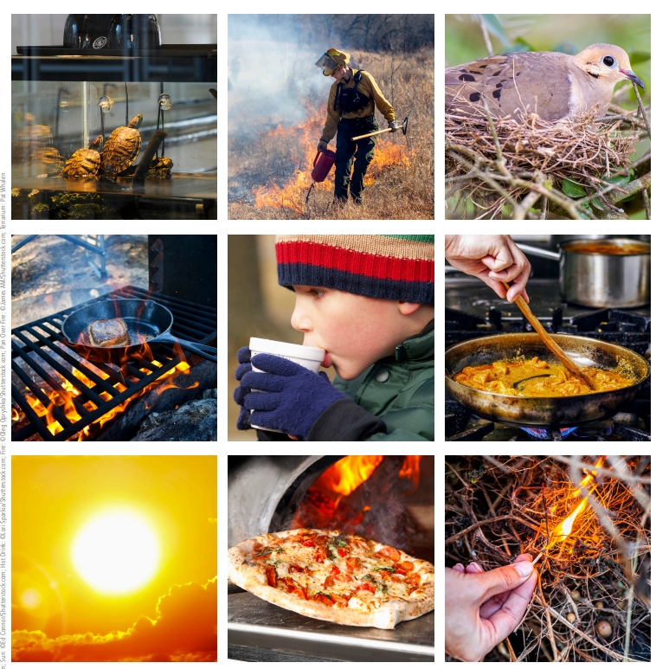
Objects that Give Off Heat
.
1A
Exploring Missouri – 1A Feeling the Warmth: Elaborate
16
Notes:
Introduce objects that give off heat to the students. Have students come up with a list of sample objects (e.g., sun, flame, stove, match, animal, etc.). Use the 1A Heat Source Resource Cards 1A Heat Source Resource Cards.pdf on Page 27 of the Teacher Guide to give a visual.

Slide 17
What happens to the heat when it comes from these objects or animals?
.
1A
Exploring Missouri – 1A Feeling the Warmth: Elaborate
17
Notes:
Answers will vary based on the heat source discussed. 1A Heat Source Resource Cards.pdf

Slide 18
Does it just disappear, or does it move into another object and cause it to warm up? Why?
.
1A
Exploring Missouri – 1A Feeling the Warmth: Elaborate
18
Notes:
Answers will vary based on the heat source discussed. 1A Heat Source Resource Cards.pdf

Slide 19
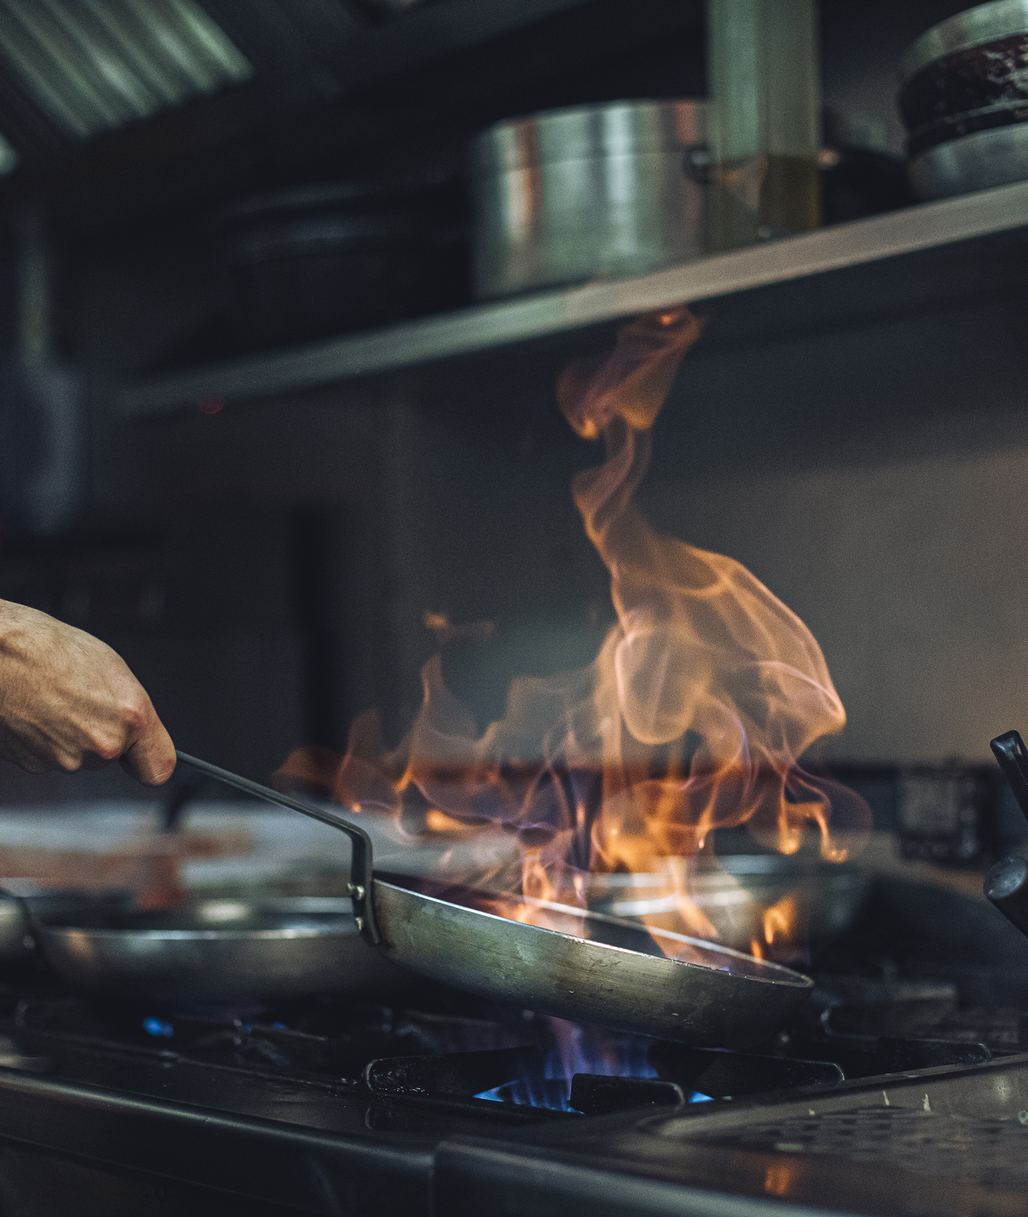
Give a complete example of what happens to the heat.
Share your example with another student.
.
1A
Exploring Missouri – 1A Feeling the Warmth: Elaborate
19
Notes:
Have students give a complete example of what happens to the heat. For example, the heat from the fire moves into the pan and from the pan into food to cook it. Have each student share their example with another student.

Slide 20
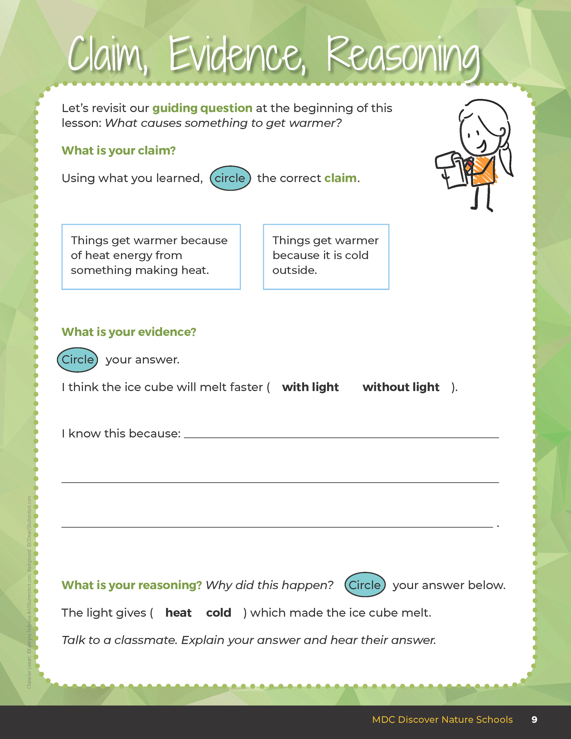
Guiding Question:
What causes something to get warmer?
.
1A
Exploring Missouri – 1A Feeling the Warmth: Evaluate
20
Notes:
After exploring the concept of heat energy, have students open their student guides to the Claim, Evidence, Reasoning section on Page 9. Discuss the page with the students – read the guiding question and then explain what the students need to do to answer the questions (circle the correct claim and fill in the blanks).

Slide 21
Answers
I saw it. I wrote about it. I observed it. Etc.
1A
Exploring Missouri – 1A Feeling the Warmth: Evaluate
21
Notes:
Rubric:
3 (Meets) – Students can define and identify that a heat source creates heat energy. Students circle the correct claim, write the correct evidence statement, and identify the correct reason.
2 (Partially meets) – Students can define and identify that a heat source creates heat energy. Two of the three components of CER are correct.
1 (Doesn’t meet) – Students cannot answer the above questions. One of the three components of CER are correct.

