Slide 1
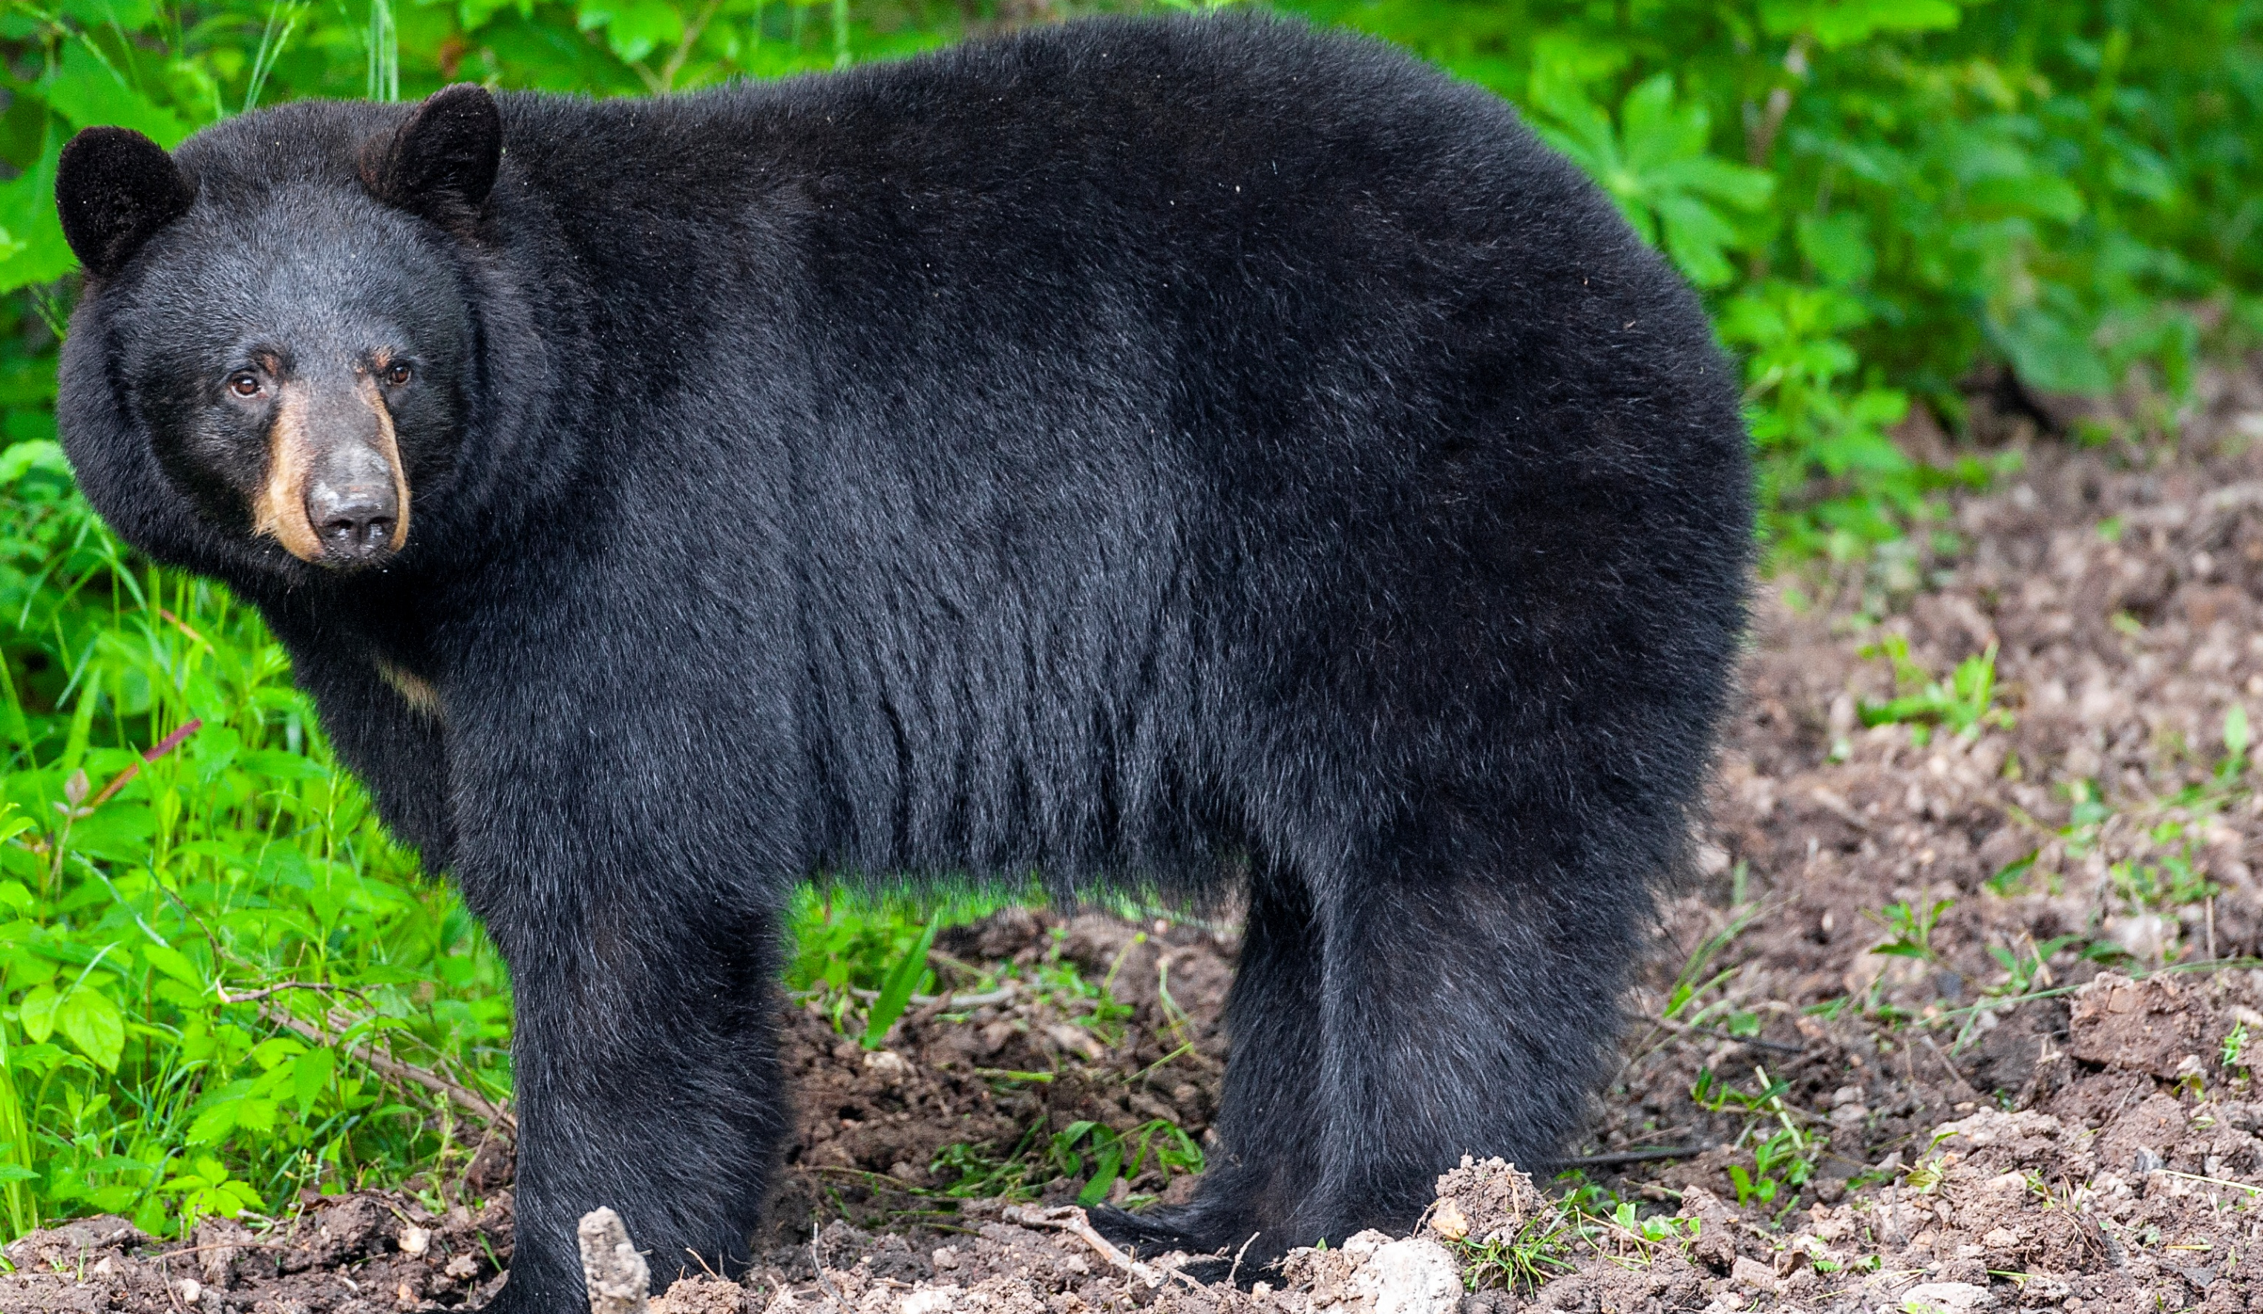

BEARS
Through the Seasons
Lesson 4E: Hungry Again!

Slide 2
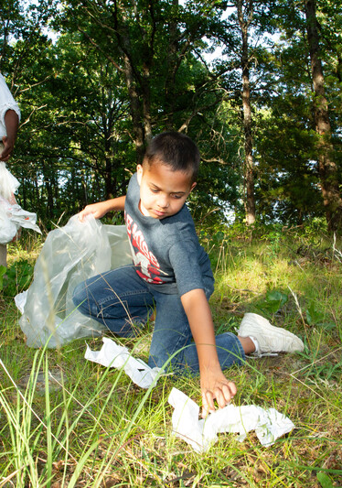

Guiding Question:
How can we be more bear aware?
Bears through the Seasons – 4E Hungry Again: Engage
2

Slide 3

Bears through the Seasons – 4E Hungry Again: Engage
3
Notes:
Prepare and display your Noticings and Wonderings Chart for this lesson. Add student observations and/or questions to the chart as the lesson proceeds in reference to the phenomenon studied.

Slide 4
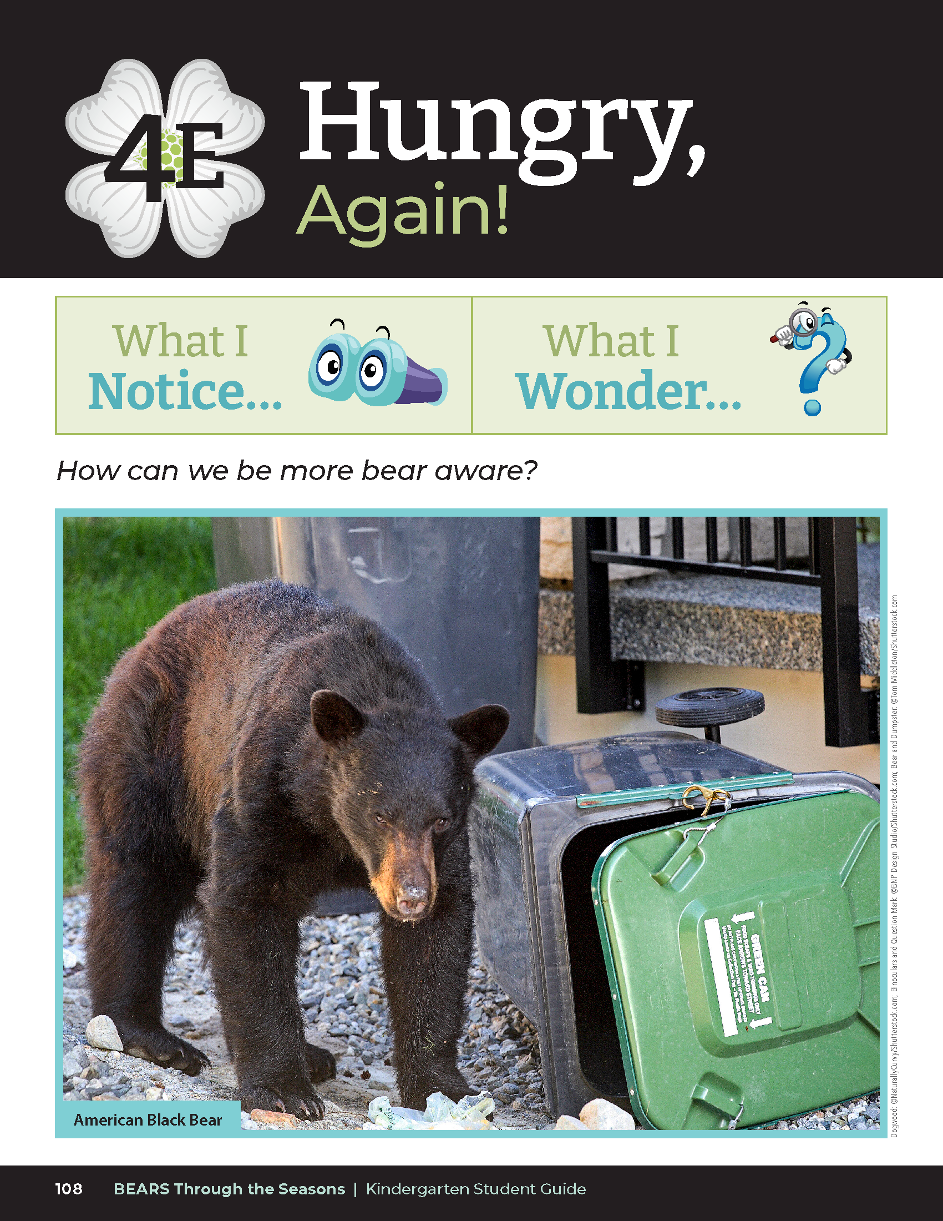
Why is the bear getting into the trash?
Bears through the Seasons – 4E Hungry Again: Engage
4

Slide 5

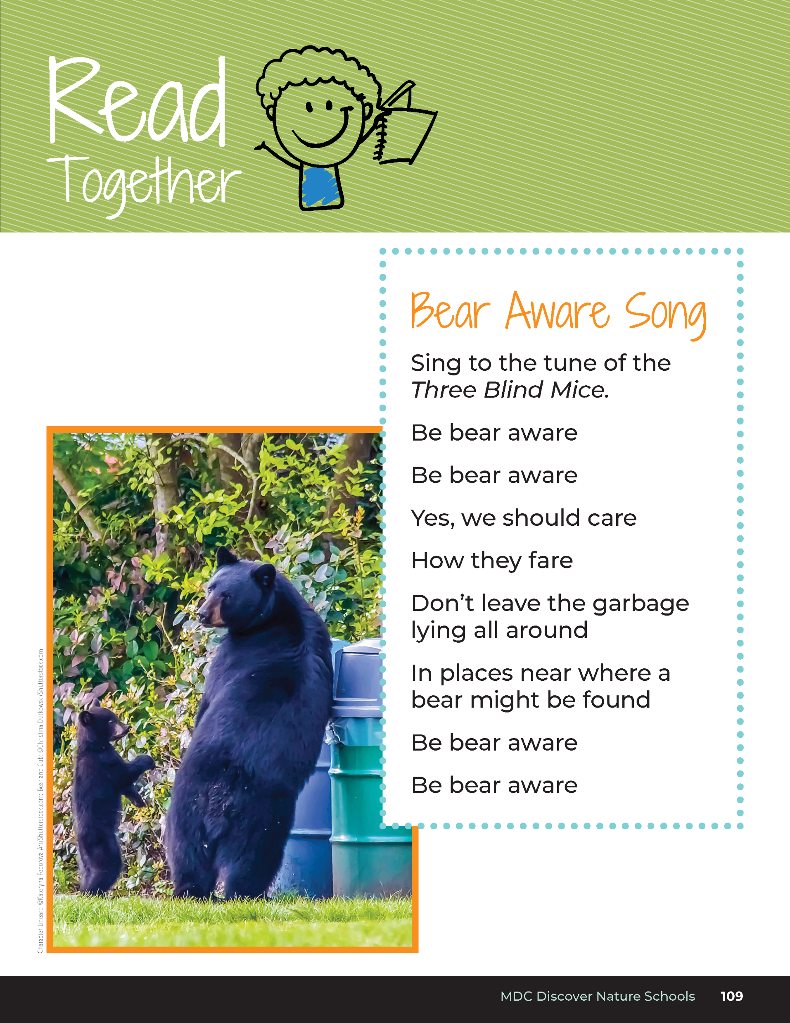
Bear Aware Song
Sing to the tune of the Three Blind Mice.
Be bear aware
Be bear aware
Yes, we should care
How they fare
Don’t leave the garbage lying all around
In places near where a bear might be found
Be bear aware
Be bear aware
Bears through the Seasons – 4E Hungry Again: Engage
5
Notes:
Read aloud the Read Together Bear Aware Song on page 109.

Slide 6
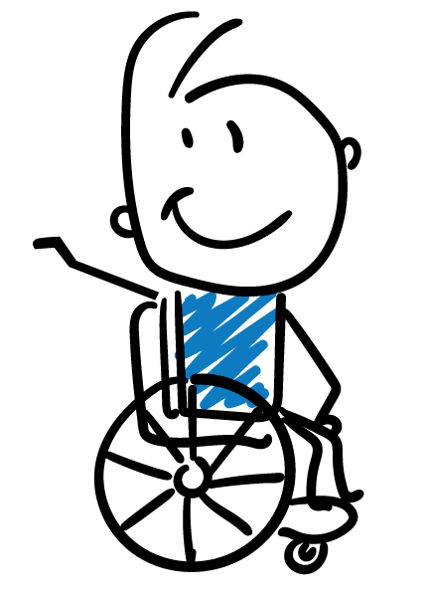
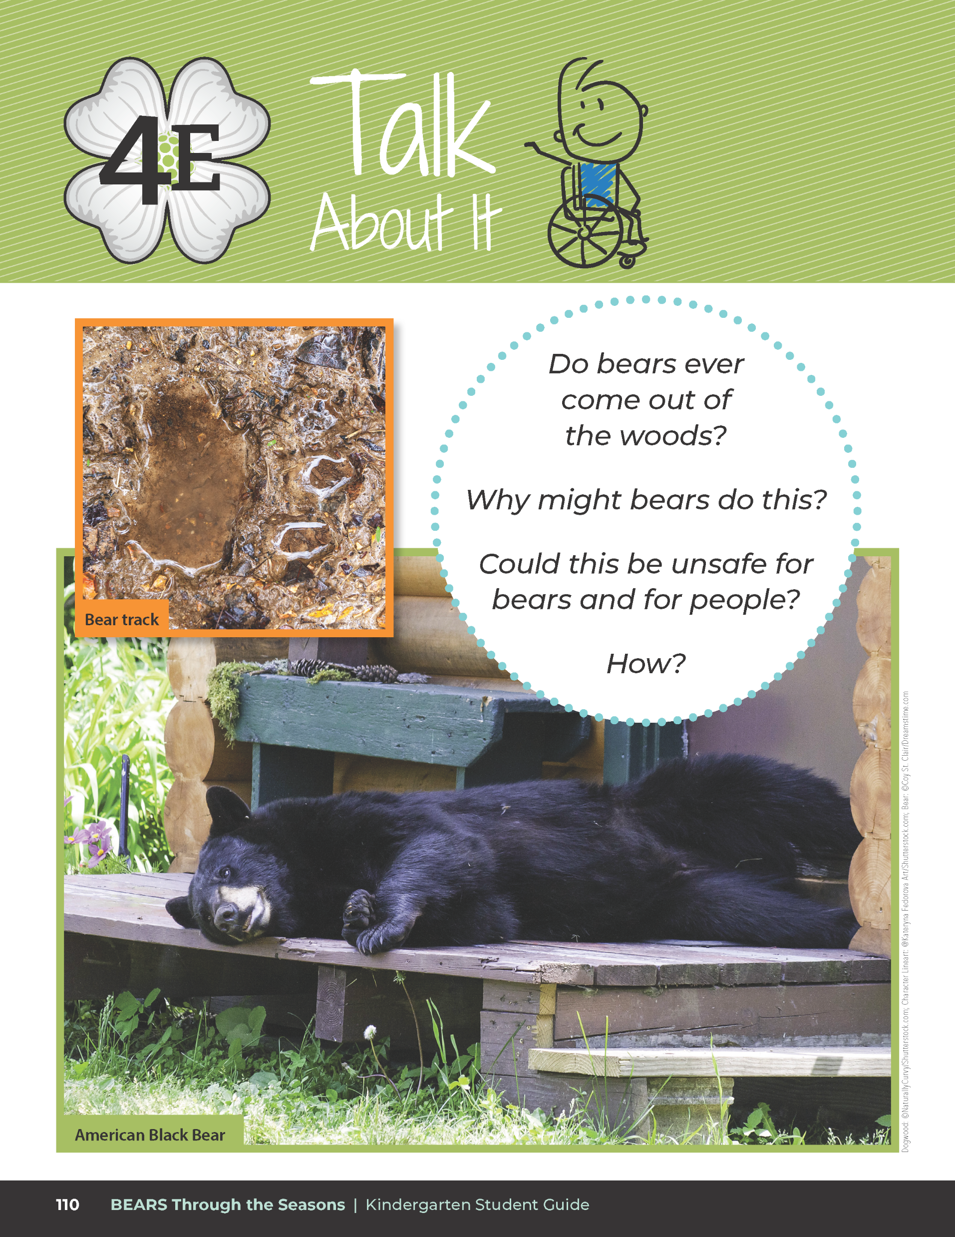
Do bears ever come out of the woods?
Why might bears do this?
Could this be unsafe for bears and for people?
How?
Bears through the Seasons – 4E Hungry Again: Engage
6

Slide 7
Bears through the Seasons – 4E Hungry Again: Engage
15
Notes:
Add student observations and/or questions to the Noticings and Wonderings Chart as the lesson concludes in reference to the phenomenon studied.

Slide 8

Link: Diary of a Black Bear
Bears through the Seasons – 4E Hungry Again: Explore
8
Notes:
Read aloud the September 19 section of Diary of a Black Bear in Xplor magazine August/September 2010 issue, page 13. (Access link on MDC Teacher Portal Kindergarten Unit 4E.) Diary of a Black Bear

Slide 9
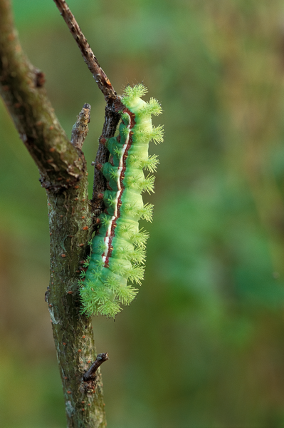
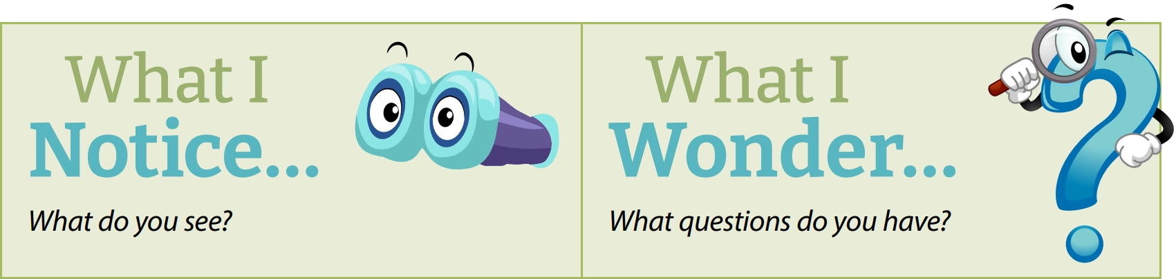
What does the bear eat in springtime?
Bears through the Seasons – 4E Hungry Again: Explore
9
Notes:
Bears eat plants, acorns, and insect larvae.

Slide 10
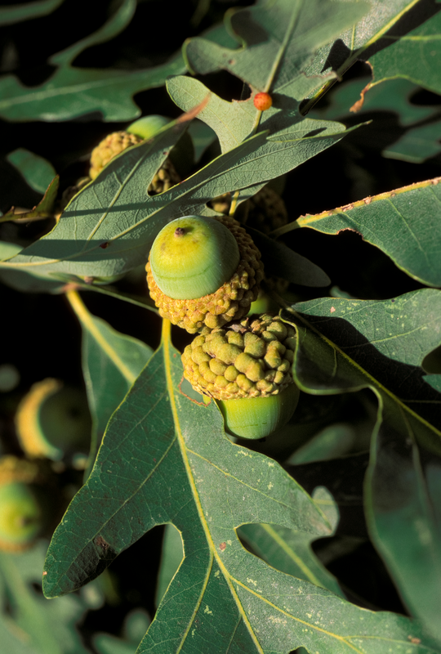
Why do the bears eat the foods they eat in springtime?
Bears through the Seasons – 4E Hungry Again: Explore
10

Slide 11
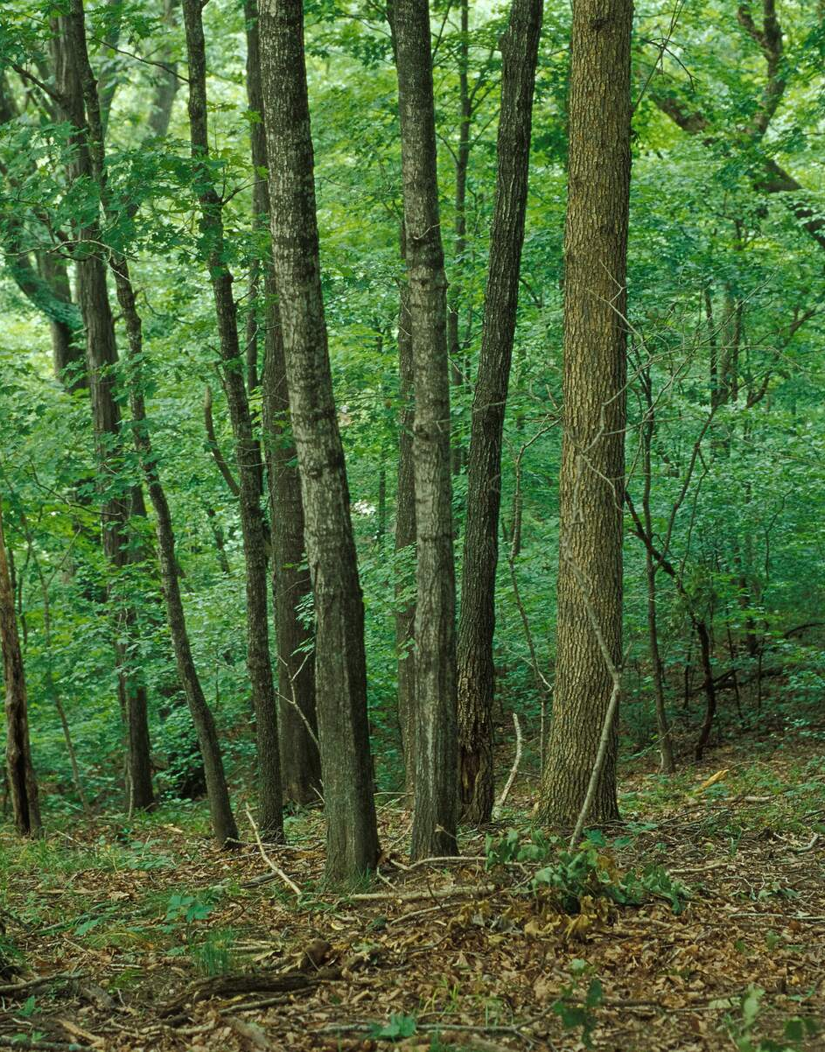
Where can a bear find food?
Bears through the Seasons – 4E Hungry Again: Explore
11

Slide 12
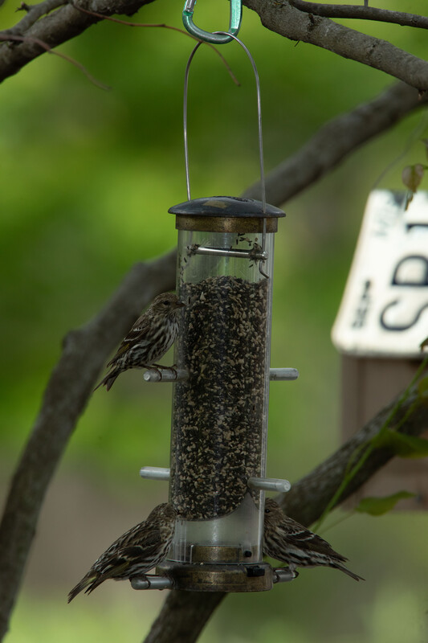
How else do humans provide food unintentionally for bears?
Bears through the Seasons – 4E Hungry Again: Explore
12
Notes:
Draw their attention to the dog food on the porch in the entry. The bear was hungry and looking for food.
Ask students: How else do humans provide food unintentionally for bears? Have students brainstorm their thoughts and add them to the Noticings and Wonderings Chart.

Slide 13
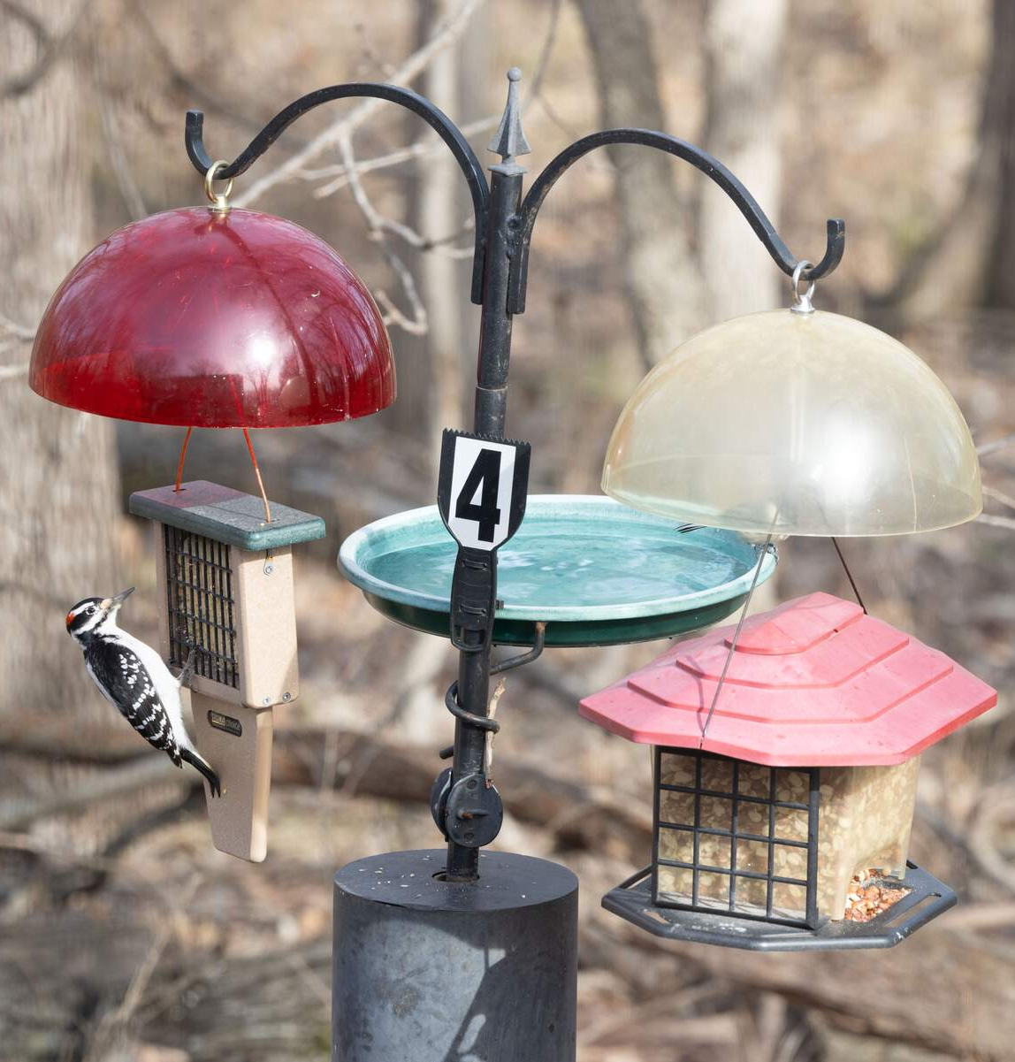
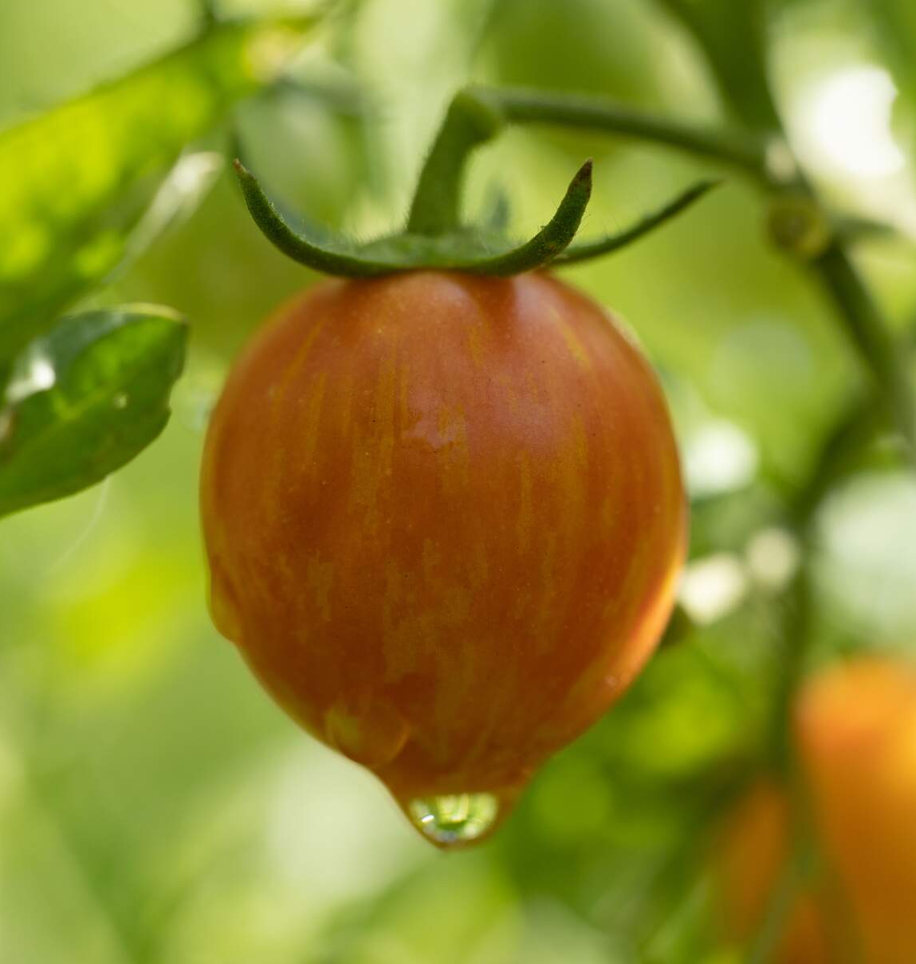
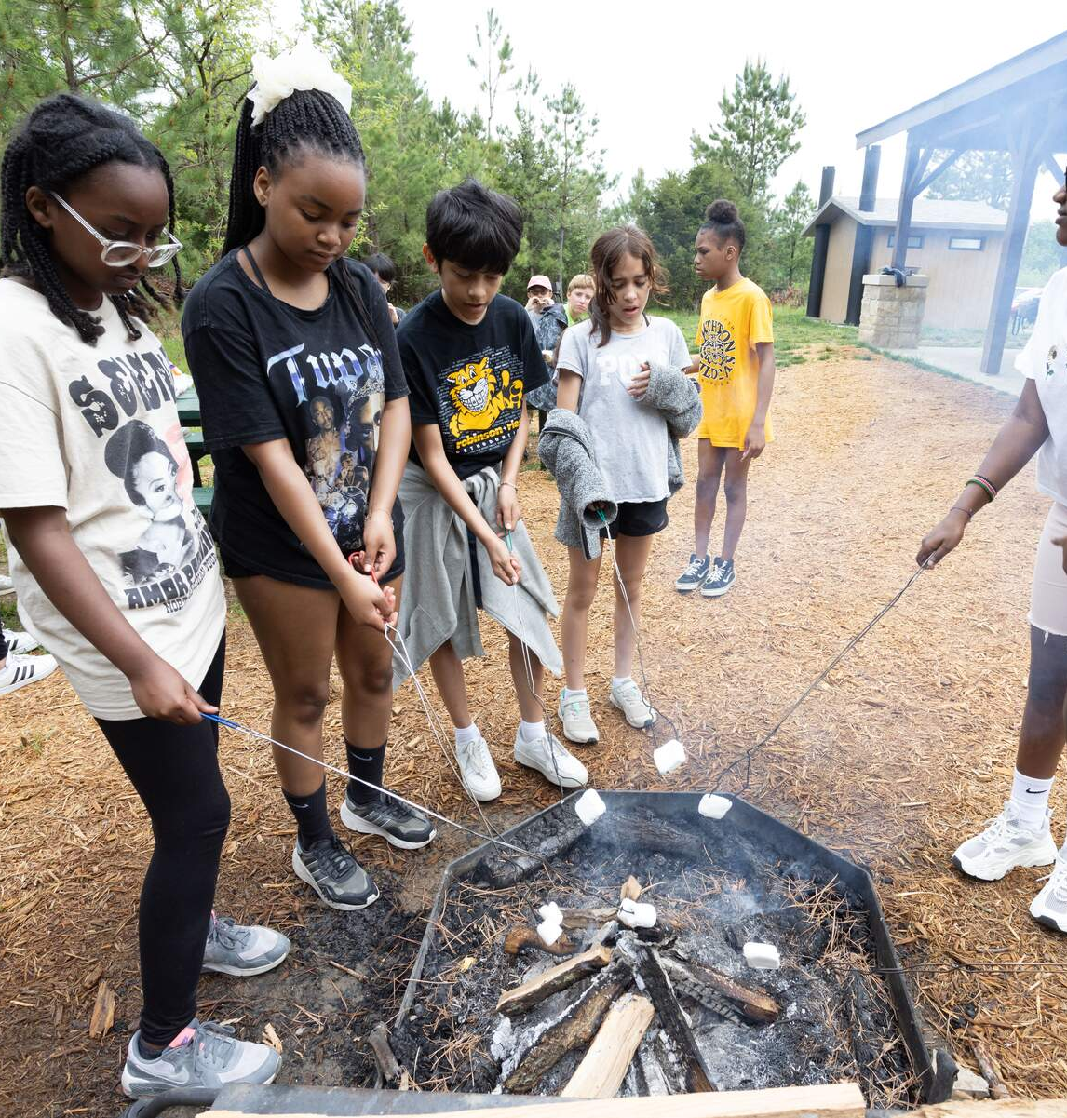
Link: Be Bear Aware - HomeOwners
Bears through the Seasons – 4E Hungry Again: Explain
13
Notes:
Discuss how people can change a bear’s habitat. When humans live near bears, they may not realize they are providing food that a bear may find. Bears will use their strong sense of smell and find food around homes. Bird feeders, pet food, compost, fruiting plants, or garbage all have strong smells that can attract a bear. MDC encourages people to remove all food sources that may be attracting black bears. Watch the MDC Be Bear Aware video available on the MDC Teacher Portal, Kindergarten Unit Lesson 4E.

Slide 14
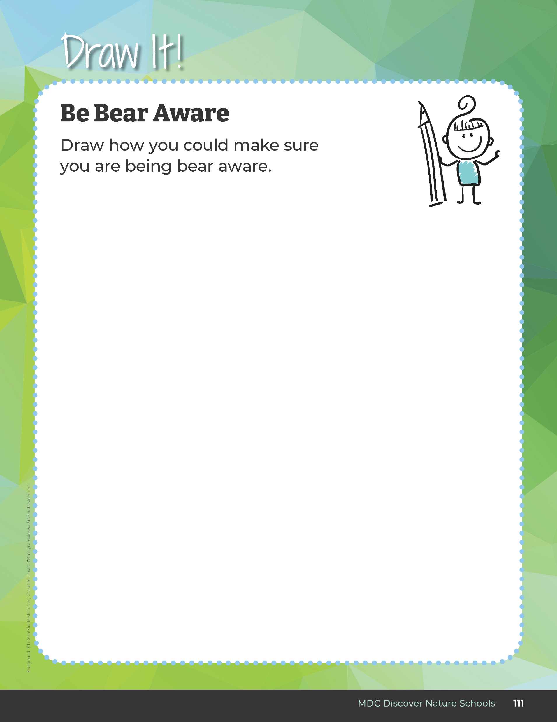
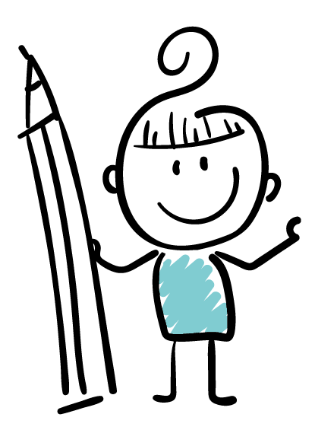
Draw how you could make sure you are being bear aware.
Bears through the Seasons – 4E Hungry Again: Elaborate
14
Notes:
In their student guide on the Draw It! Be Bear Aware page, students will draw themselves being bear aware. Share and discuss the drawings with the class.

Slide 15
Create a poster about solutions to human impact on their environment
Bears through the Seasons – 4E Hungry Again: Elaborate
15
Notes:
Then, in partners or as a group, have students create a poster about solutions to human impact on their environment making them more “bear aware.” Teacher may assign one situation to each group or have each group decide which situation to use to inform people.
Potential Situations:
Ber comes onto porch at night smelling food from outdoor grill
Bear takes bird feeders from pollinator garden area
Bear visits beehives that a local homeowner is keeping
Bear visits campsites in a state park when food is not put away
Bear digs into garbage cans around a neighborhood
Bear finds dog food that was left outside

Slide 16
Bears through the Seasons – 4E Hungry Again: Elaborate
16
Notes:
Add student observations and/or questions to the Noticings and Wonderings Chart as the lesson concludes in reference to the phenomenon studied.

Slide 17
Present Poster
Bears through the Seasons – 4E Hungry Again: Evaluate
17
Notes:
Students present their poster to the class or to another group. They need to include in their presentation how humans changed the environment.

Slide 18
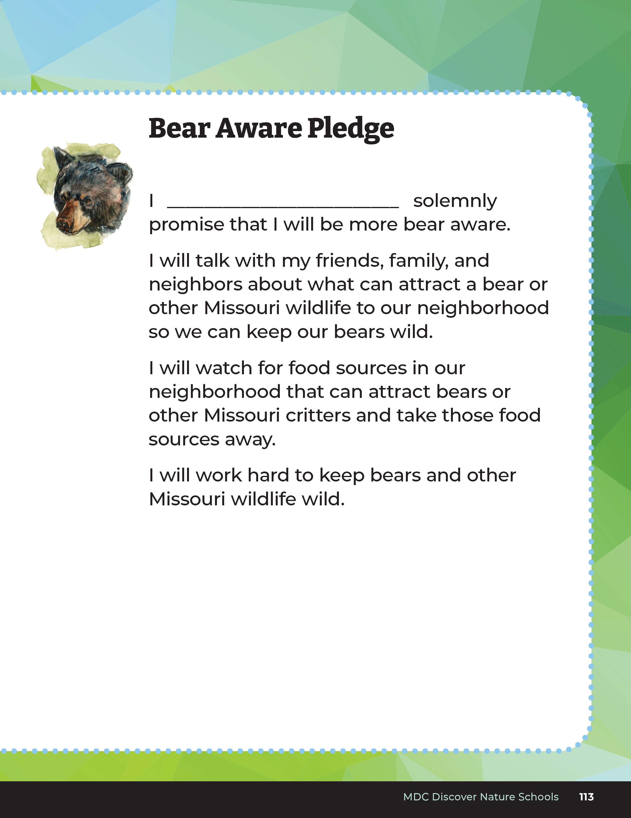
Bear Aware Pledge
Bears through the Seasons – 4E Hungry Again: Evaluate
18
Notes:
At the conclusion of the presentations, each student receives a Be Bear Aware sticker and recites the following Bear Aware Pledge:
I ________________________ (name stated) solemnly promise that I will be more bear aware.
I will talk with my friends, family, and neighbors about what can attract a bear or other Missouri wildlife to our neighborhood so we can keep our bears wild.
I will watch for food sources in our neighborhood that can attract bears or other Missouri critters and take those food sources away.
Optional: Be Bear Aware or Be BearWise stickers may be available at your local Missouri Department of Conservation office. Contact your local MDC conservation educator first for sticker availability. Access the MDC Teacher Portal for more Bear Aware or BearWise resources on the Kindergarten 4E Teacher Page and for your MDC conservation educator contact information.

Slide 19

Optional: Cross-Curricular Extension
How would you talk to a friend or neighbor about what it means to be more bear aware?
Bears through the Seasons – 4E Hungry Again: Cross-Curricular Extension
19
Notes:
After taking the Bear Aware Pledge, have students talk about how they would talk to a friend or neighbor about what it means to be more bear aware. Discuss that some people may not agree with them. How do we talk out our disagreements? The teacher can role-play someone who disagrees with their group poster and the situation regarding black bear practices (for example, “I like my bird feeders up because I enjoy my birds,” or, “I like to grill out almost every night in the summer.”)

