Slide 1
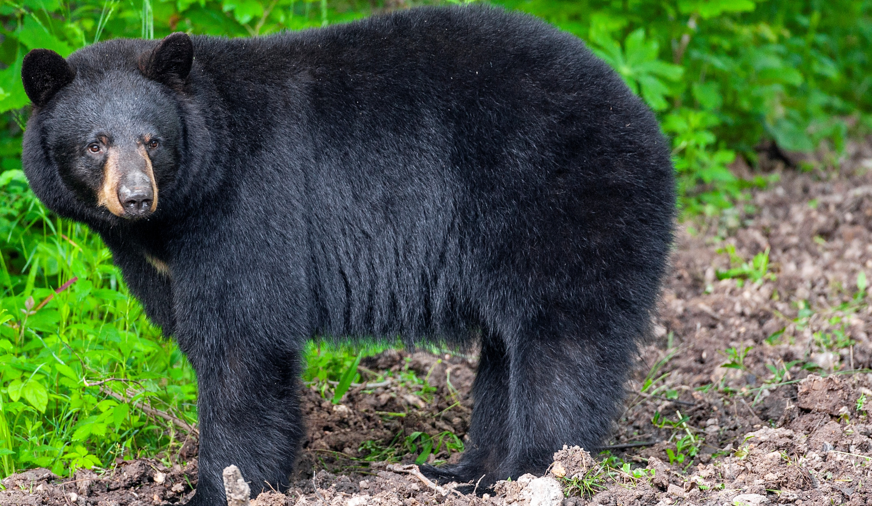

BEARS
Through the Seasons
Black Bear Graduation

Slide 2
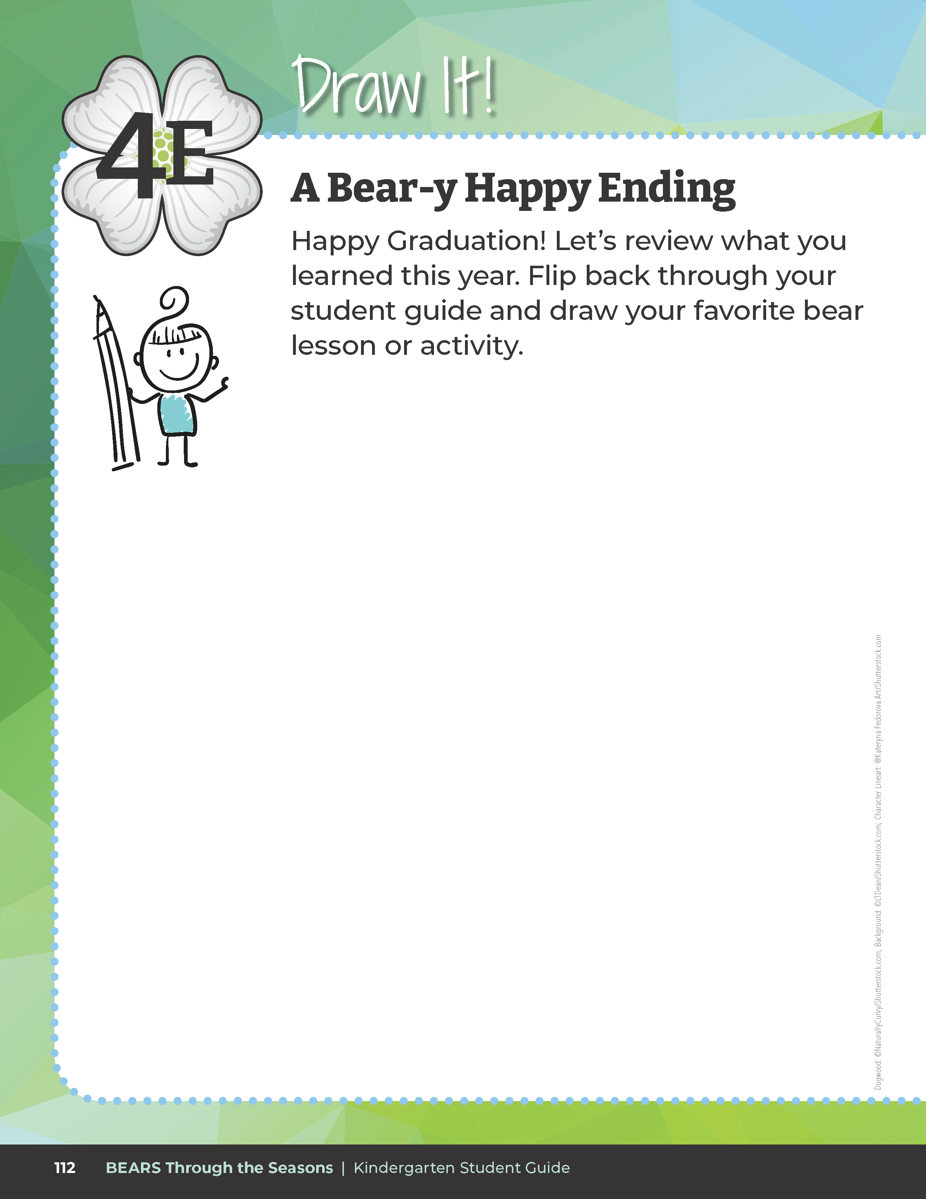
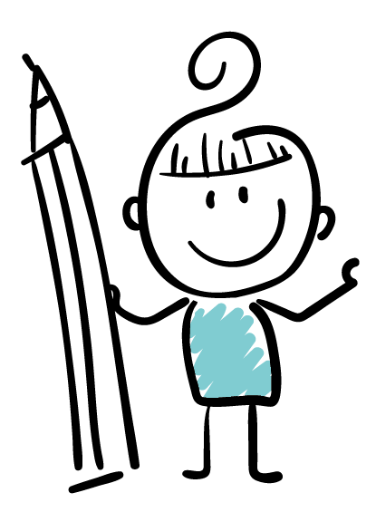

Draw your favorite bear lesson or activity.
Bears through the Seasons – Black Bear Graduation
2
Notes:
The last student guide entry is Lesson 4E Draw It! A Bear-y Happy Ending on Page 112.
After reviewing work in their student guide, students can draw their favorite lesson, activity, or learning nugget on this page.
Explain to students that they will be graduating from Black Bear Cubs to Black bear Yearlings!

Slide 3
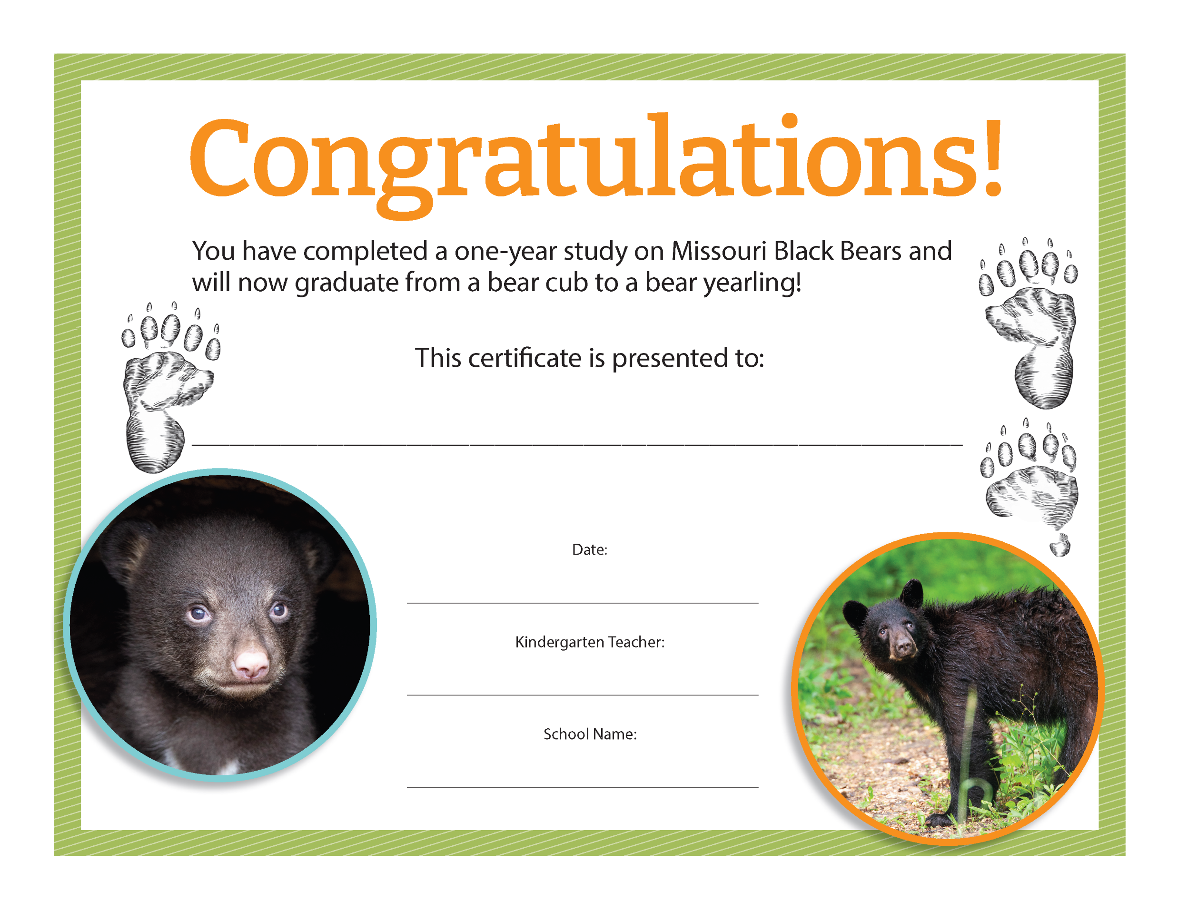
Bears through the Seasons – Black Bear Graduation
3
Notes:
At the conclusion of this entire Black Bear Science Unit, have a Bear party! The students should wear their bear paws (black crew socks), and bear headbands. Play graduation music and distribute the Black Bears of Missouri Certificate. Copy and sign the certificate template. You can also visit the MDC Teacher Portal Kindergarten Unit Graduation for the Black Bears of Missouri Certification.
Present each Black Bear Cub with their certificate and tell them they are now yearlings and can survive on their own with the knowledge they learned through the year.

