Slide 1
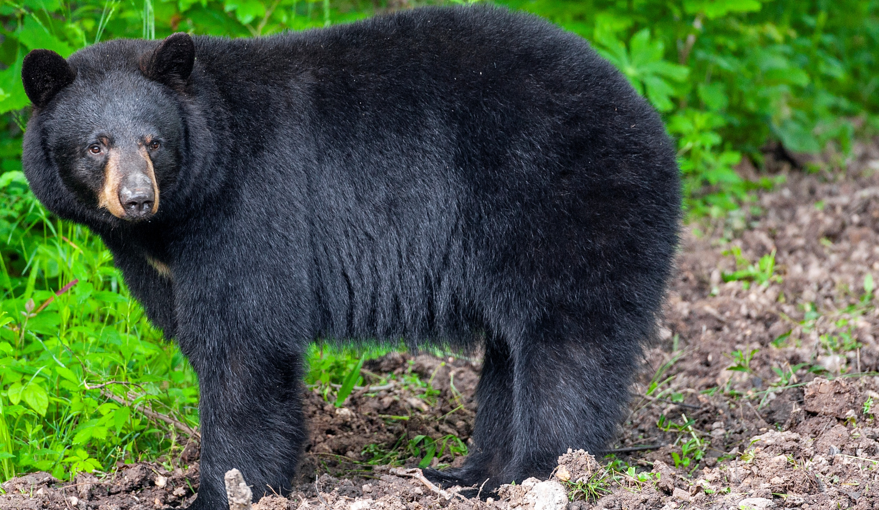

BEARS
Through the Seasons
Lesson 4D: Sunshine Days

Slide 2
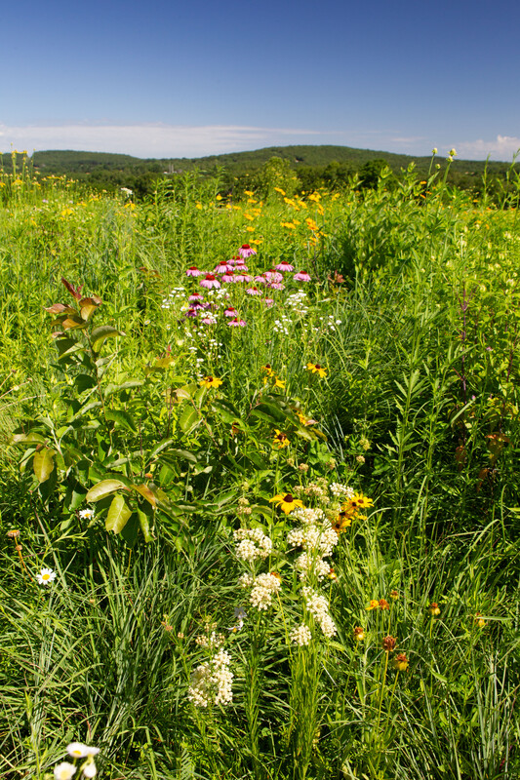

Guiding Question:
When do we have the most sun during the year?
Bears through the Seasons – 4D Sunshine Days: Engage
2

Slide 3

Bears through the Seasons – 4D Sunshine Days: Engage
3
Notes:
Prepare and display your Noticings and Wonderings Chart for this lesson. Add student observations and/or questions to the chart as the lesson proceeds in reference to the phenomenon studied.

Slide 4
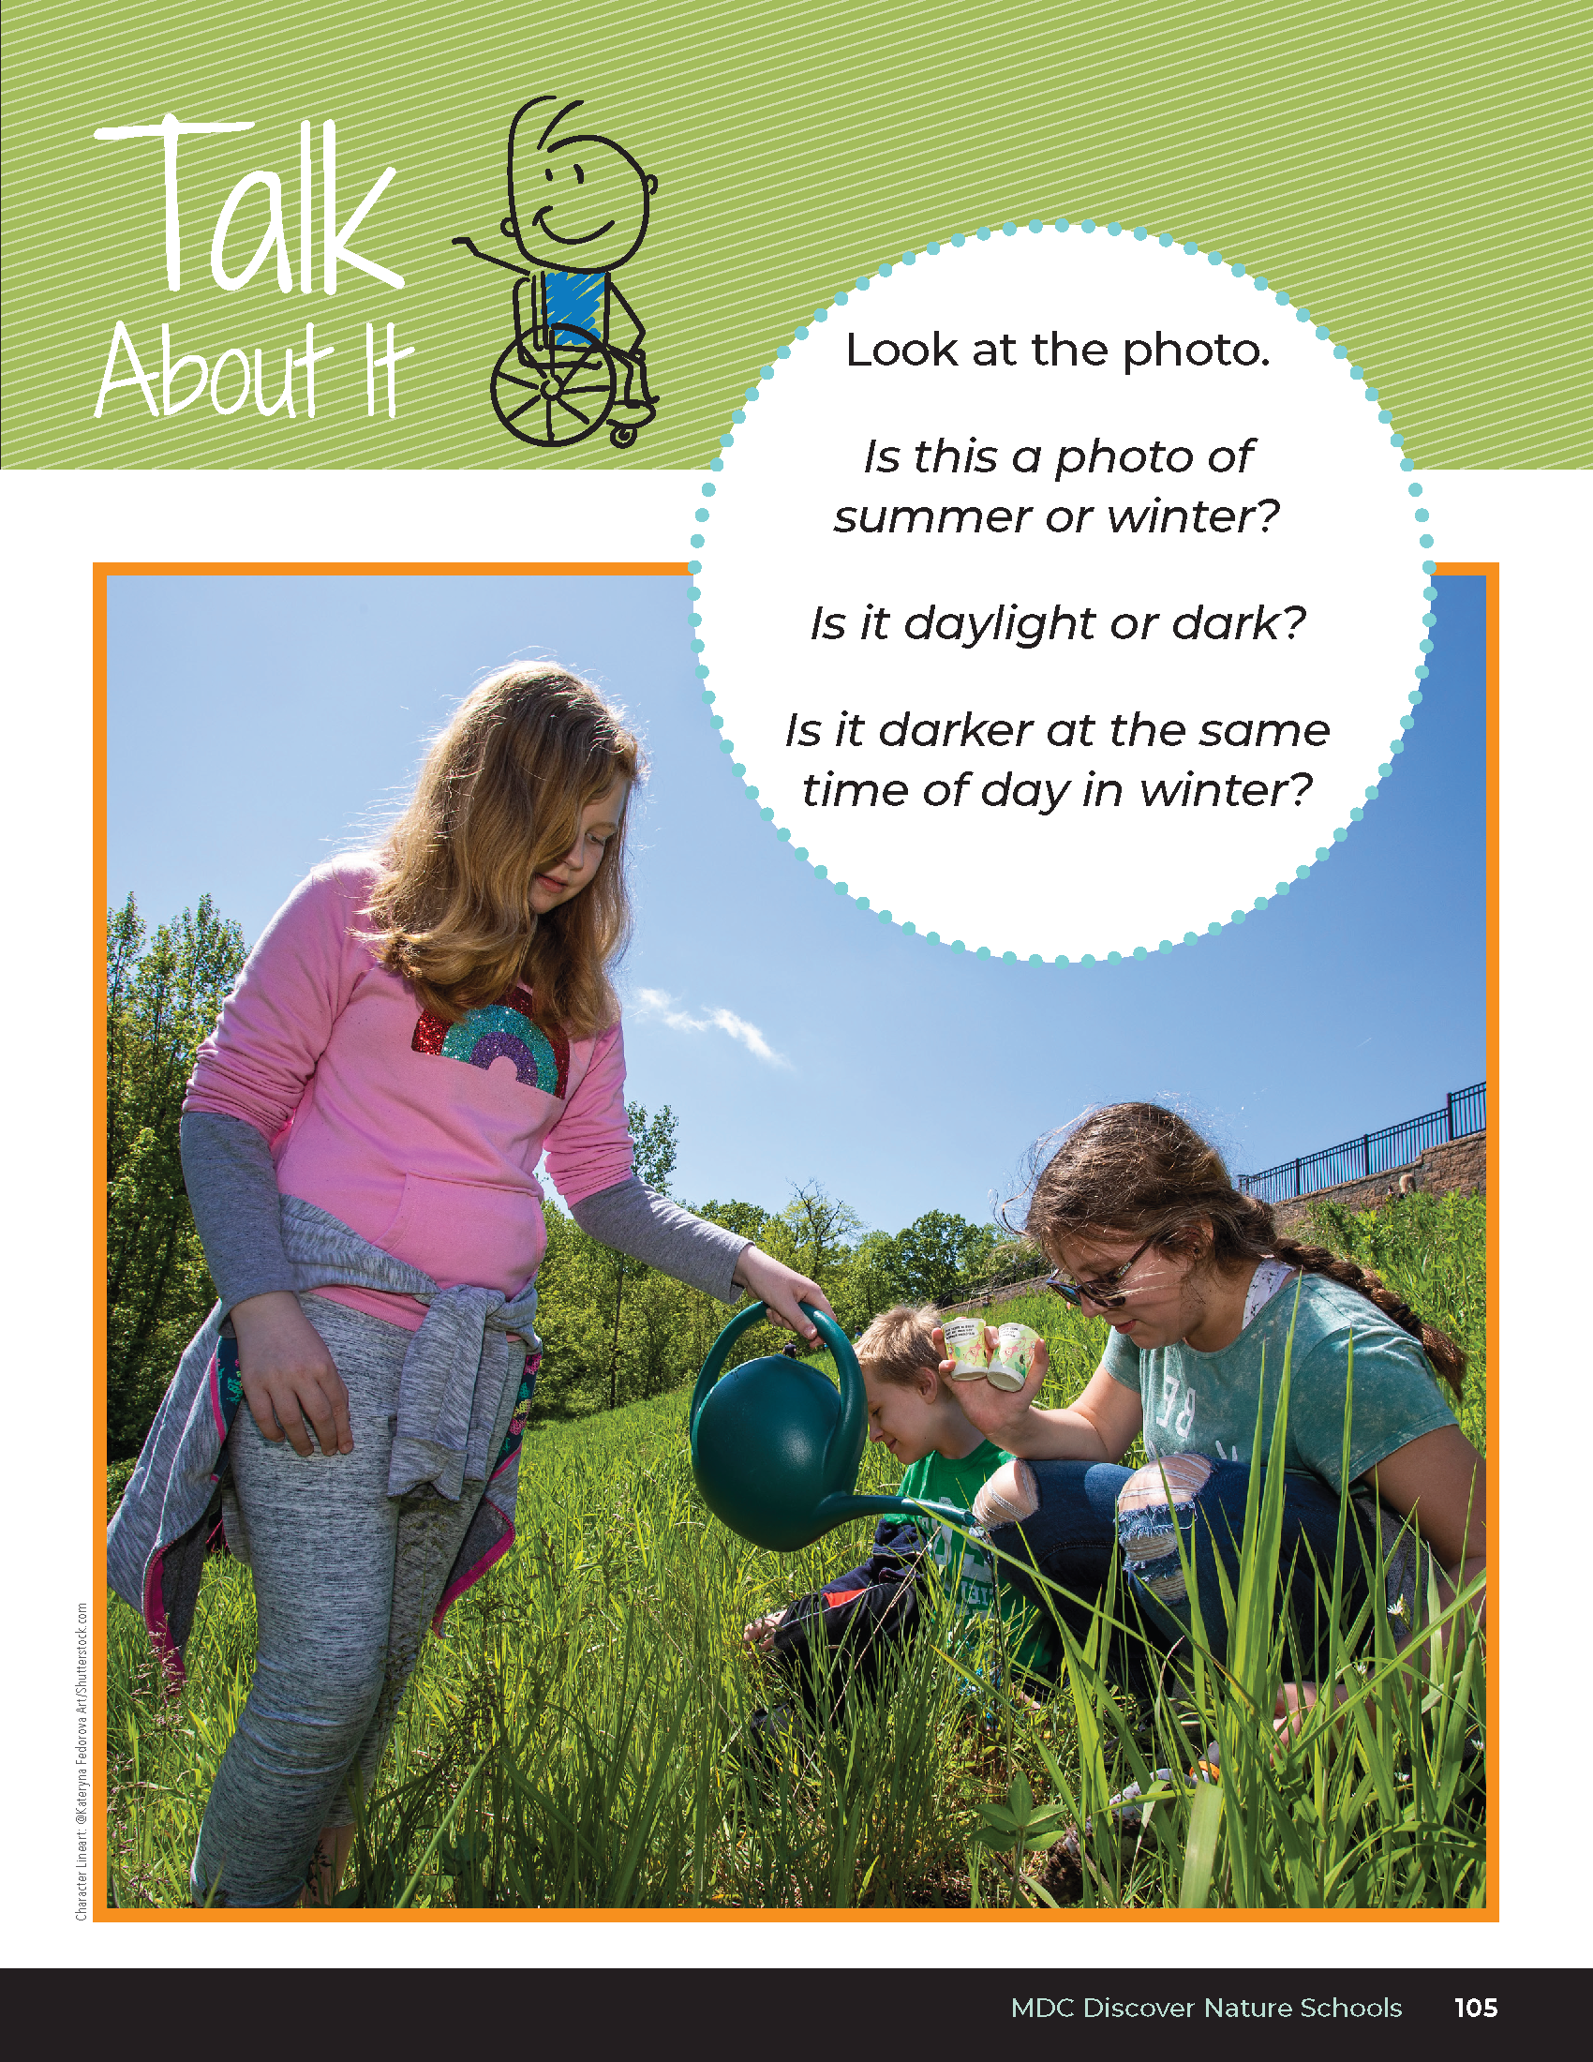

Is this a photo of summer or winter?
Is it daylight or dark?
Is it darker at the same time of day in winter?
Bears through the Seasons – 4D Sunshine Days: Engage
4

Slide 5
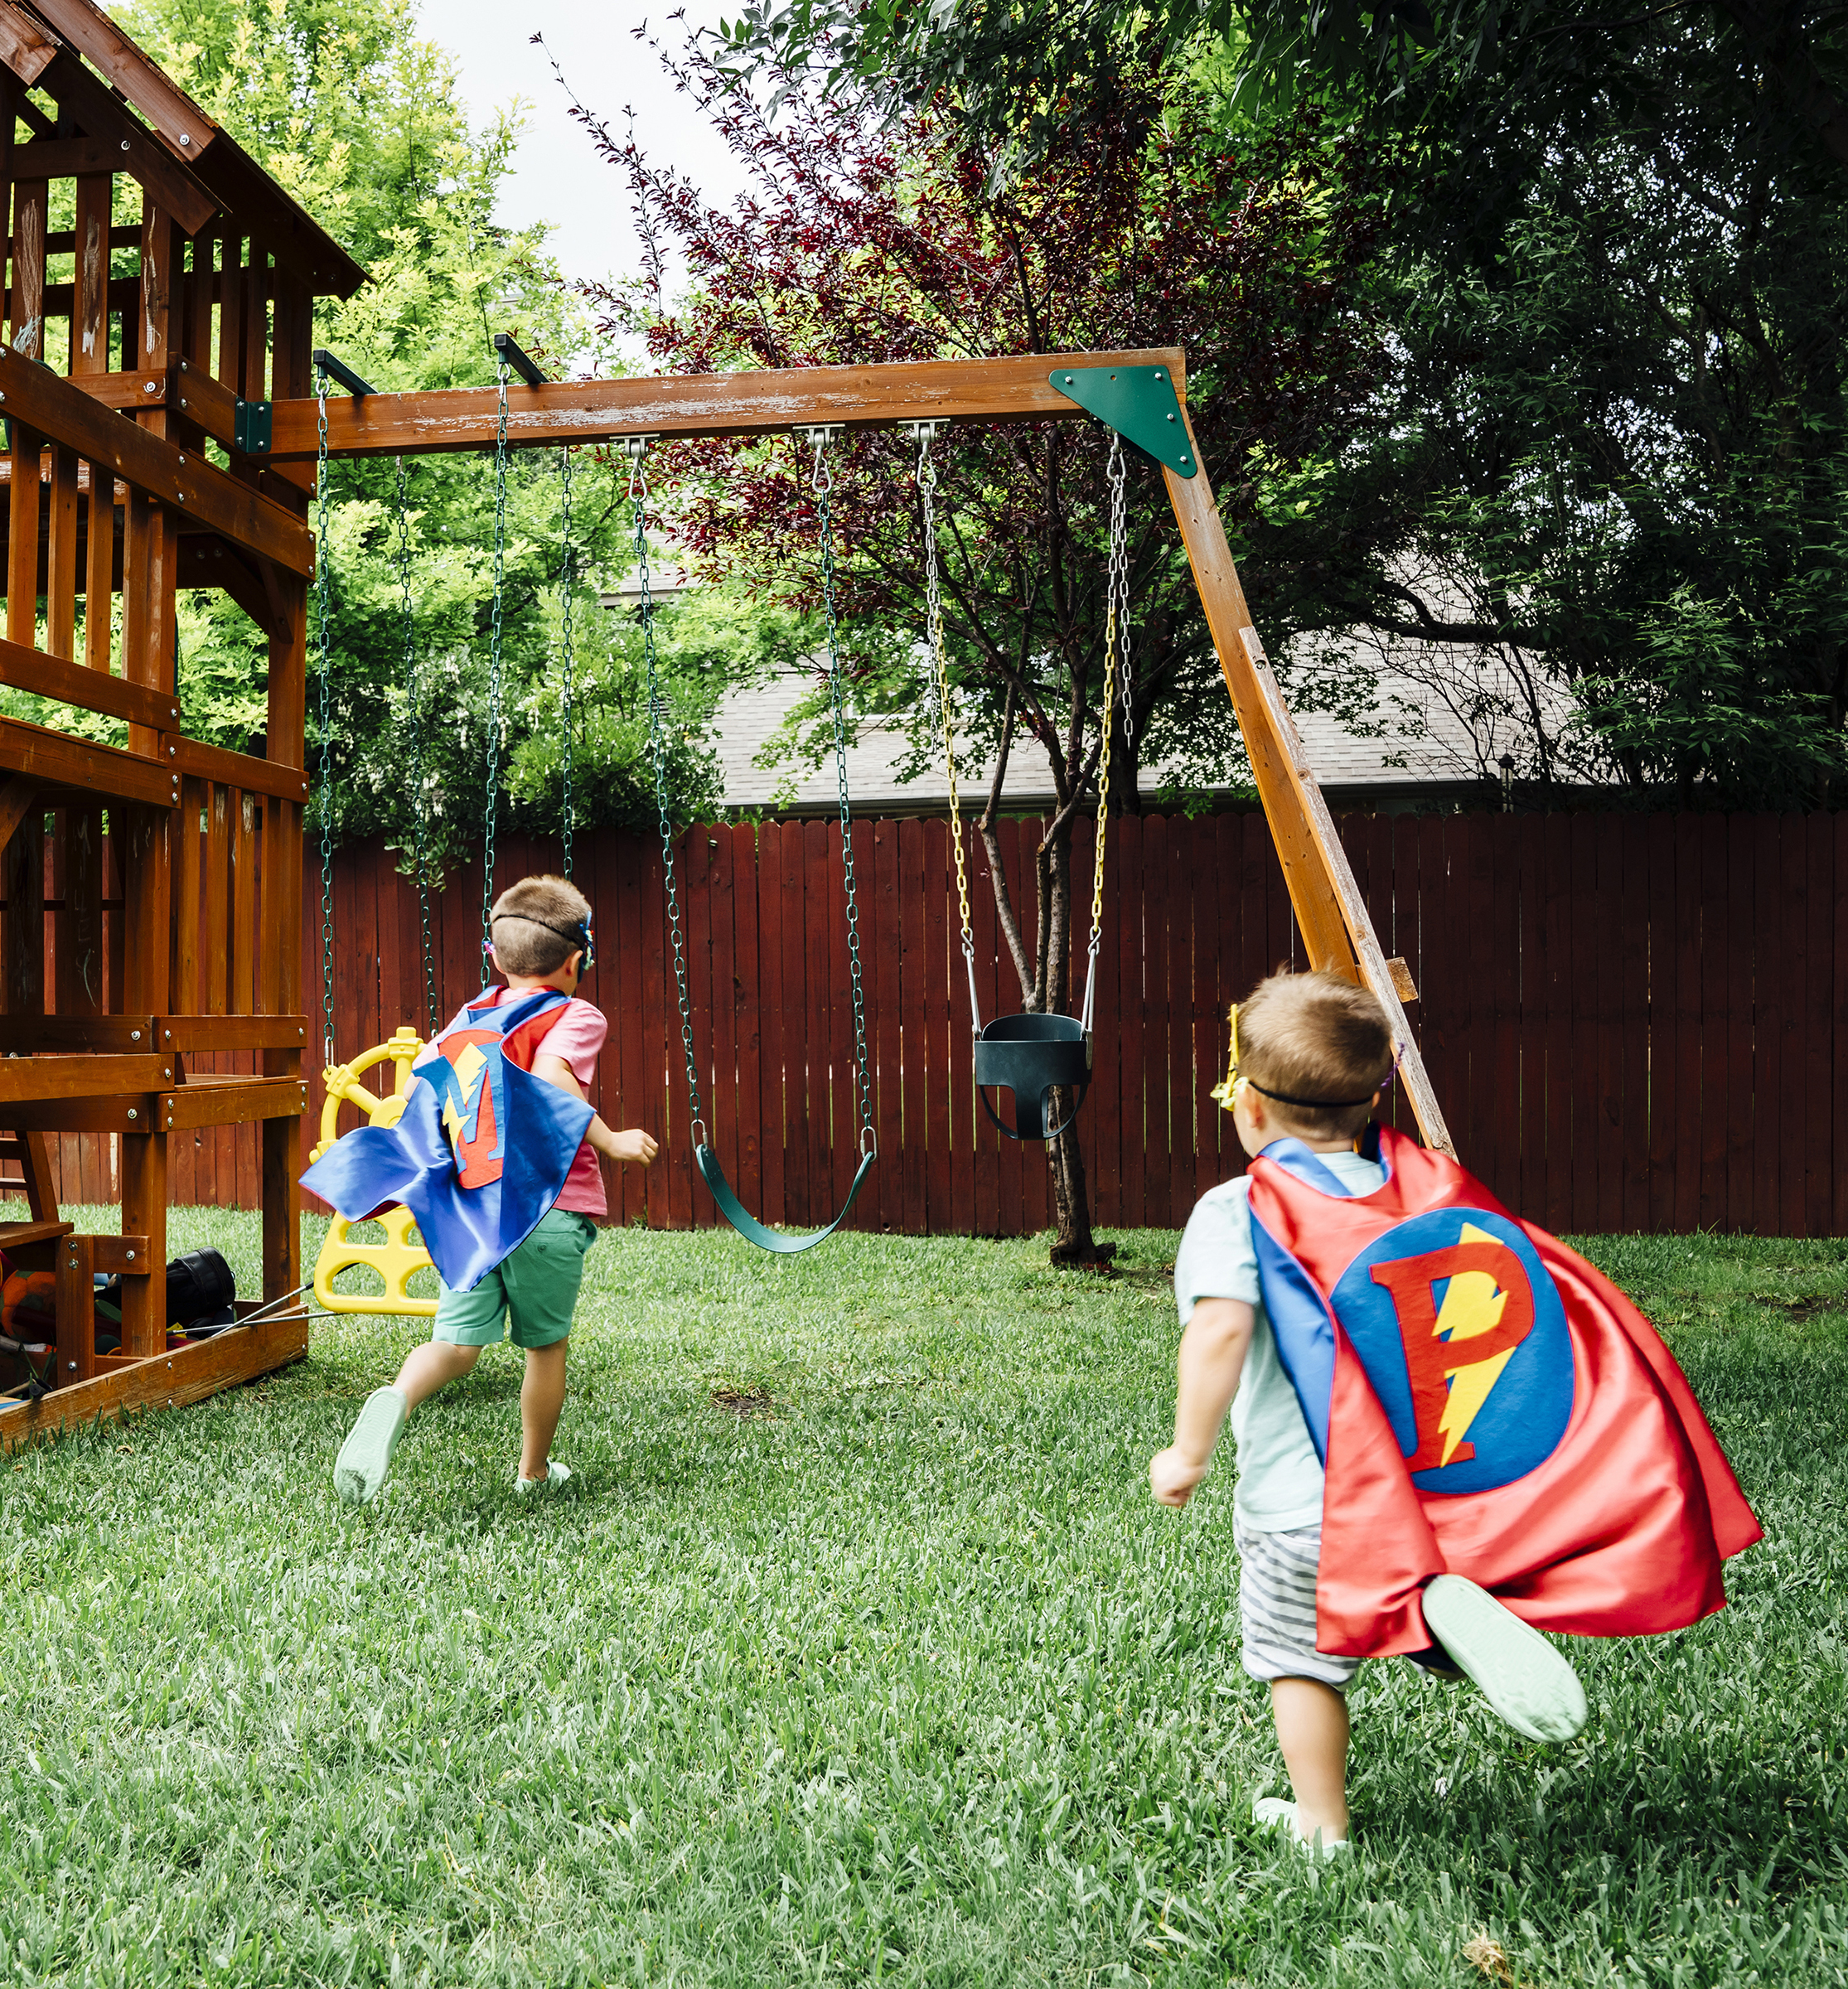
Can you play outside after dinner in the winter? Why not?
Bears through the Seasons – 4D Sunshine Days: Engage
5
Notes:
Discuss image of kids playing outside in summer.

Slide 6
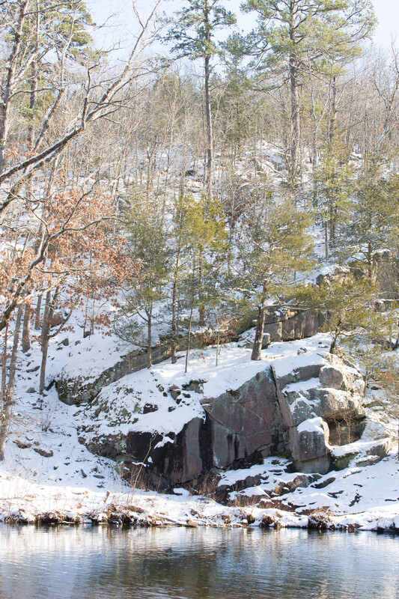

Does it get darker sooner or later in winter?
Bears through the Seasons – 4D Sunshine Days: Engage
6

Slide 7
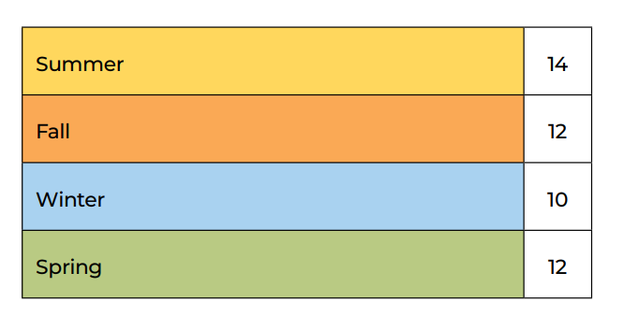
Bears through the Seasons – 4D Sunshine Days: Explore
7
Notes:
Use 4D Average Daylight Length (Hours) by Season Data Table (the average number of daylight hours for each season.) Partner students and give each partner set a color of sticky notes that corresponds to the season of the month they are graphing (example: summer=yellow, fall=orange, winter=blue, spring=green).

Slide 8
Count out the number of sticky notes for the number of daylight hours for your assigned season.
Bears through the Seasons – 4D Sunshine Days: Explore
8
Notes:
Tell students that they are to count out the number of sticky notes for the number of daylight hours for their assigned season. You can give them a sticky note with the season name on it and the number of average daylight hours to place label for the x-axis. Each group will stack the sticky notes as a bar graph for their season over the season label. When complete, there will be a class graph of the average number of hours of daylight in each season. Reference 4D Average Daylight Hours per Season Answer Key.
Summer = 14
Fall = 12
Winter = 10
Spring = 12

Slide 9
What do you notice about the length of days throughout the year from season to season?
Bears through the Seasons – 4D Sunshine Days: Explain
9
Notes:
If the graphs for each season are on different chart paper, put them together to make a graph showing the year. Discuss the patterns for the season.
Discuss with students that these patterns repeat each year.

Slide 10
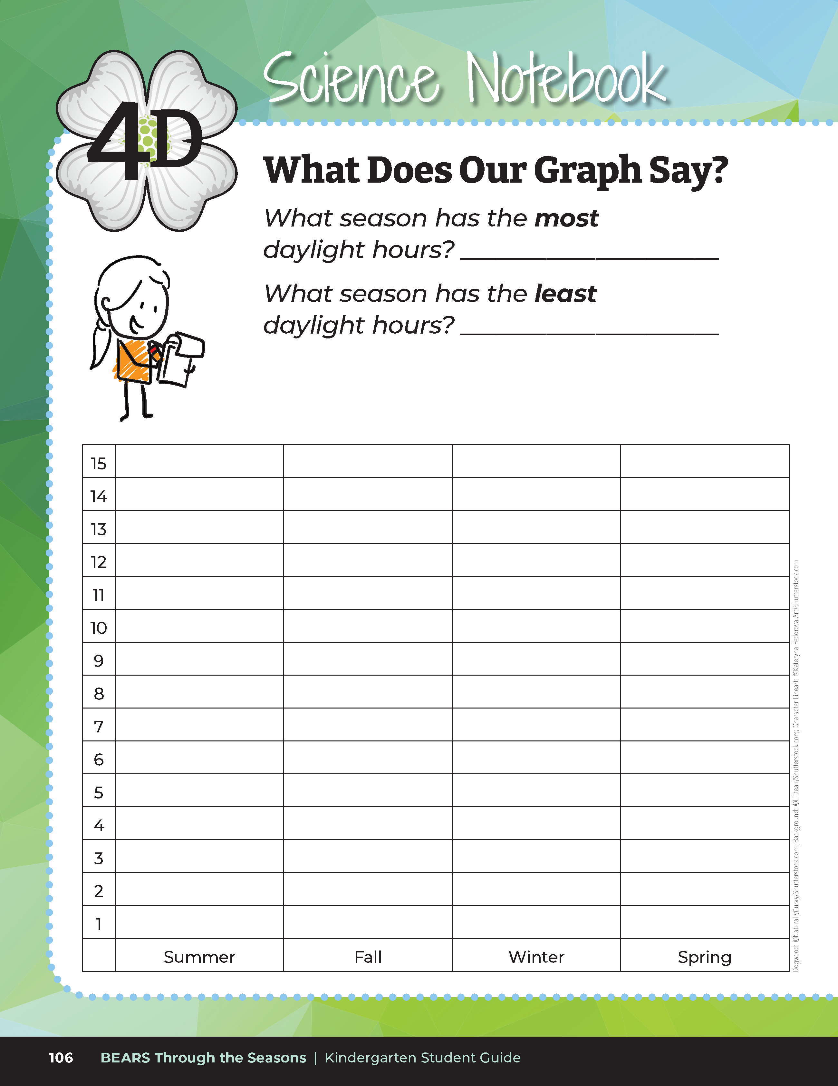

What do you notice about the average length of days in each of the seasons?
Bears through the Seasons – 4D Sunshine Days: Elaborate
10
Notes:
Students will graph the data for the seasons into their student guide on Science Notebook What Does Our Graph Say? on Page 106

Slide 11
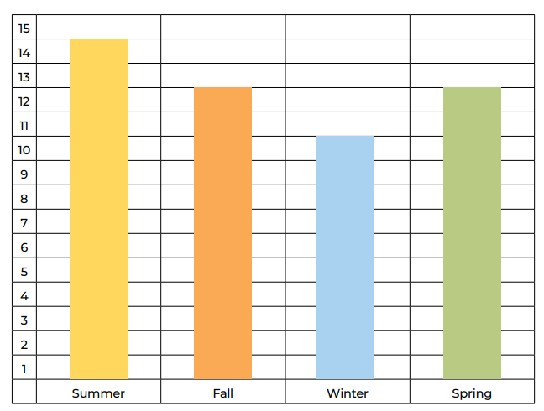
4D Average Daylight Hours per Season Answer Key
Bears through the Seasons – 4D Sunshine Days: Explore
11

Slide 12
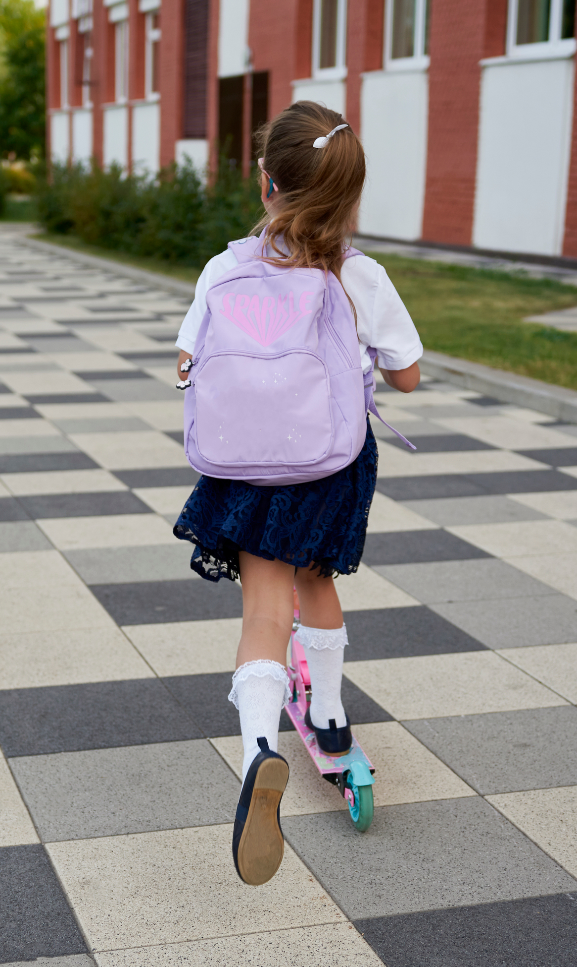
How does this affect what we do after school in the different seasons?
Bears through the Seasons – 4D Sunshine Days: Elaborate
12

Slide 13
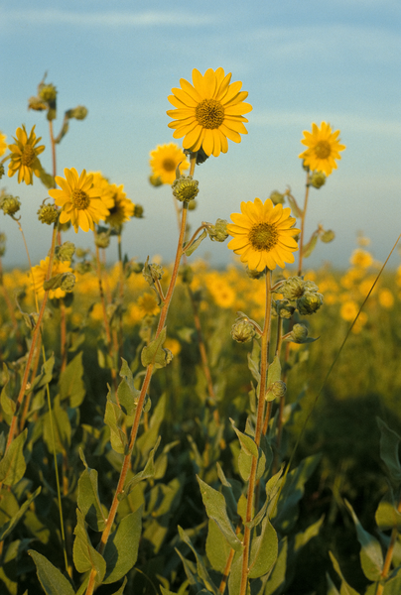
How does this pattern of changing daylight and changing weather affect plant growth during the year?
Bears through the Seasons – 4D Sunshine Days: Elaborate
13

Slide 14
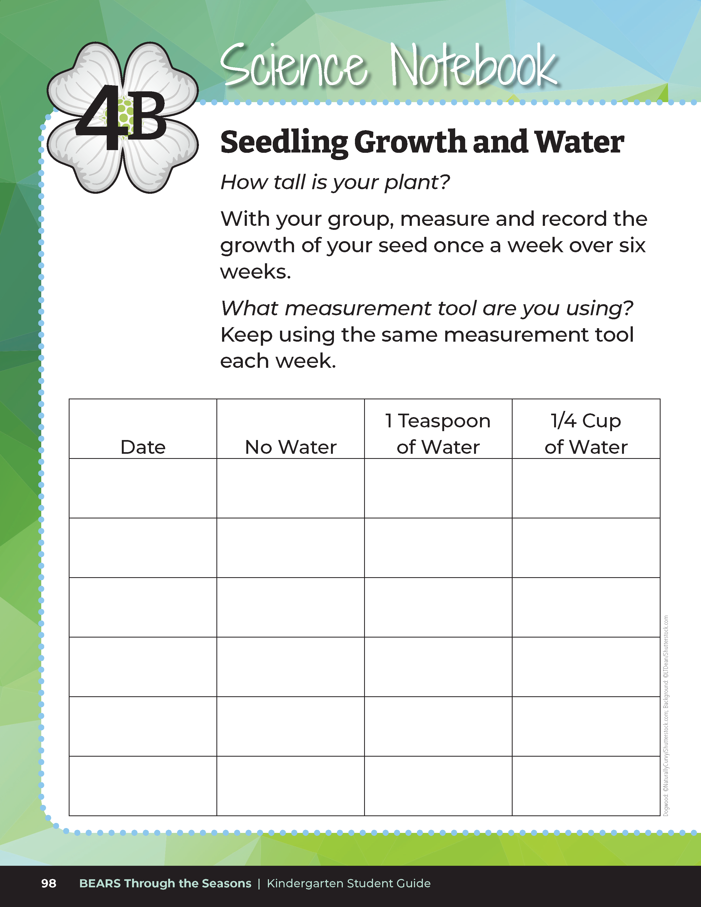
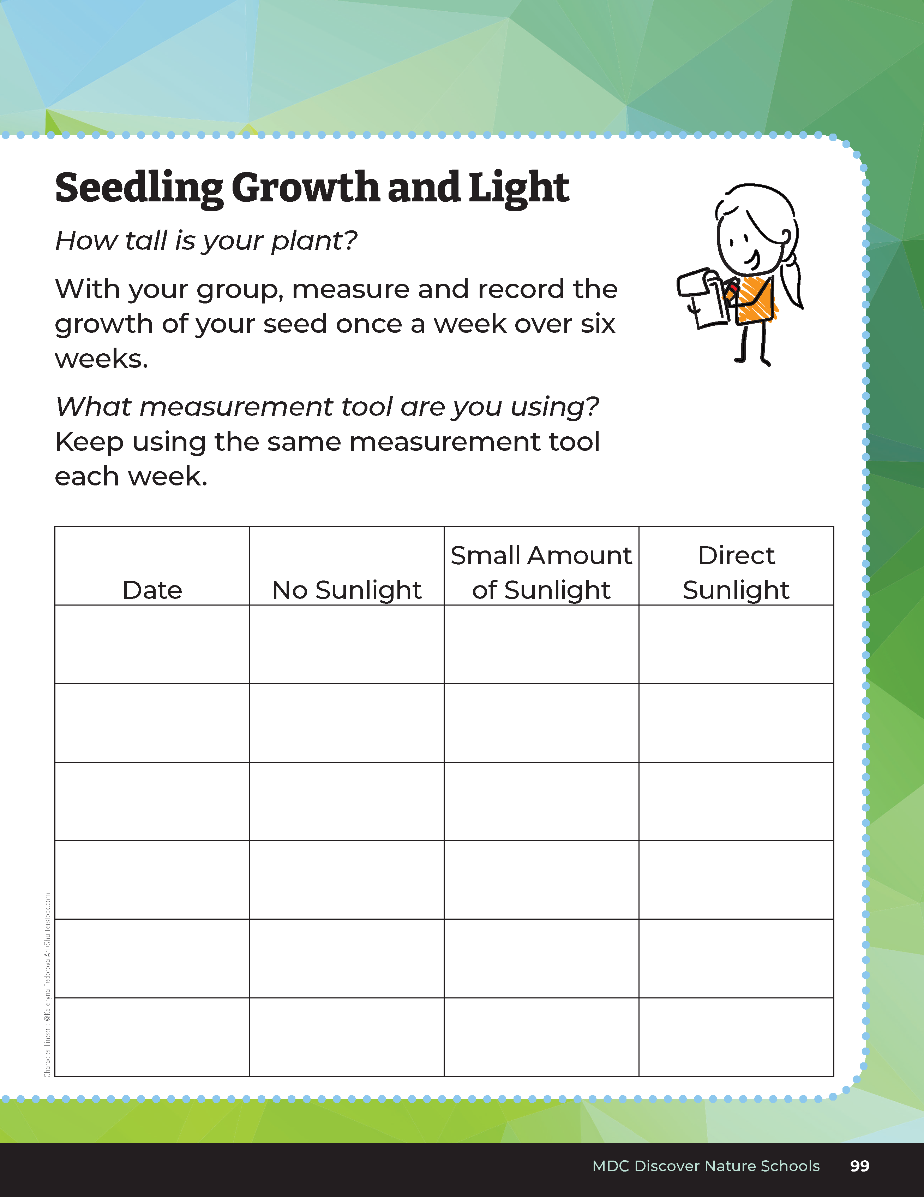
What was the effect of little to no sunlight on the seedling?
What happened to the seedling?
What was the effect of more sunlight?
Bears through the Seasons – 4D Sunshine Days: Elaborate
14
Notes:
Turn to student guides to Lesson 4B Sprouting Seedlings.

Slide 15
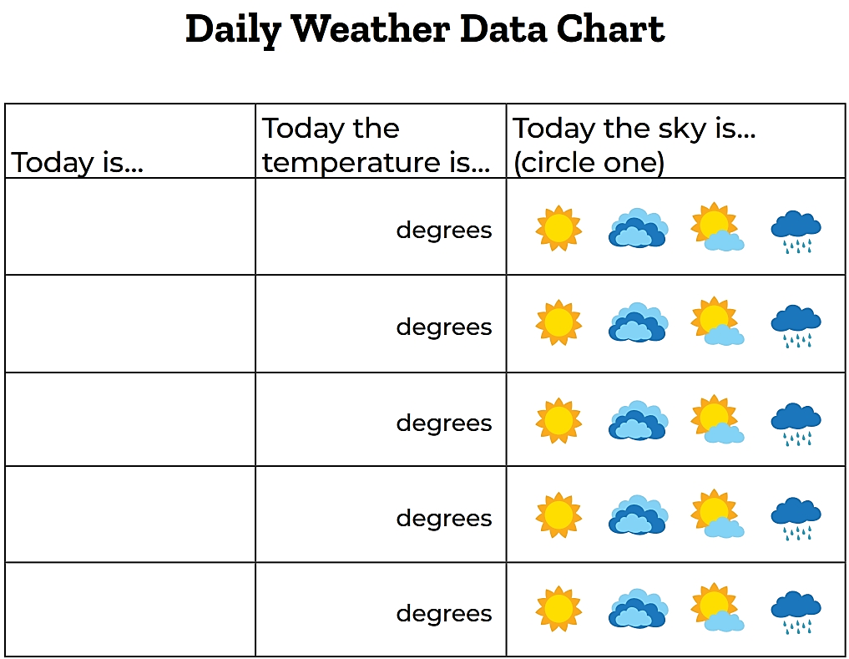
How does the weather you saw affect plant growth?
How did the temperature change each season?
How did the weather change?
Bears through the Seasons – 4D Sunshine Days: Elaborate
15
Notes:
Look back at the Temperature Data Sheets collected throughout each season in lesson 1B, 2A, 3A, and 4A. Compare the dates that you collected your data to the amount of sunshine for that season.

Slide 16
Bears through the Seasons – 4D Sunshine Days: Elaborate
16
Notes:
Add student observations and/or questions to the Noticings and Wonderings Chart as the lesson concludes in reference to the phenomenon studied.

Slide 17
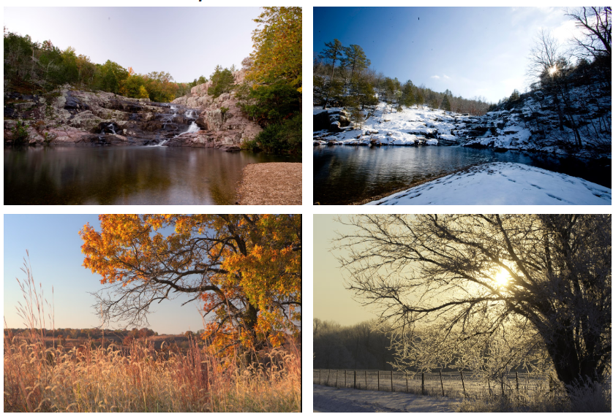
Bears through the Seasons – 4D Sunshine Days: Evaluate
17
Notes:
Display 4D Different Seasons, Same Times photos. These pictures were taken at the same time in the same location, but in different seasons.

Slide 18
Think-Pair-Share
Identify which of the images is in the winter season and which is in the spring
Bears through the Seasons – 4D Sunshine Days: Evaluate
18
Notes:
Students will Think-Pair-Share and identify which of the images is in the winter season and which is in the spring Share reasons with the class.

Slide 19

Optional: Cross-Curricular Extension
Make an acrostic poem using the letters S, U, N
Bears through the Seasons – 4D Sunshine Days: Evaluate
19
Notes:
Make an acrostic poem using the letters S, U, N and relate the descriptive words to describe the longer daylight hours in the spring.

