Slide 1
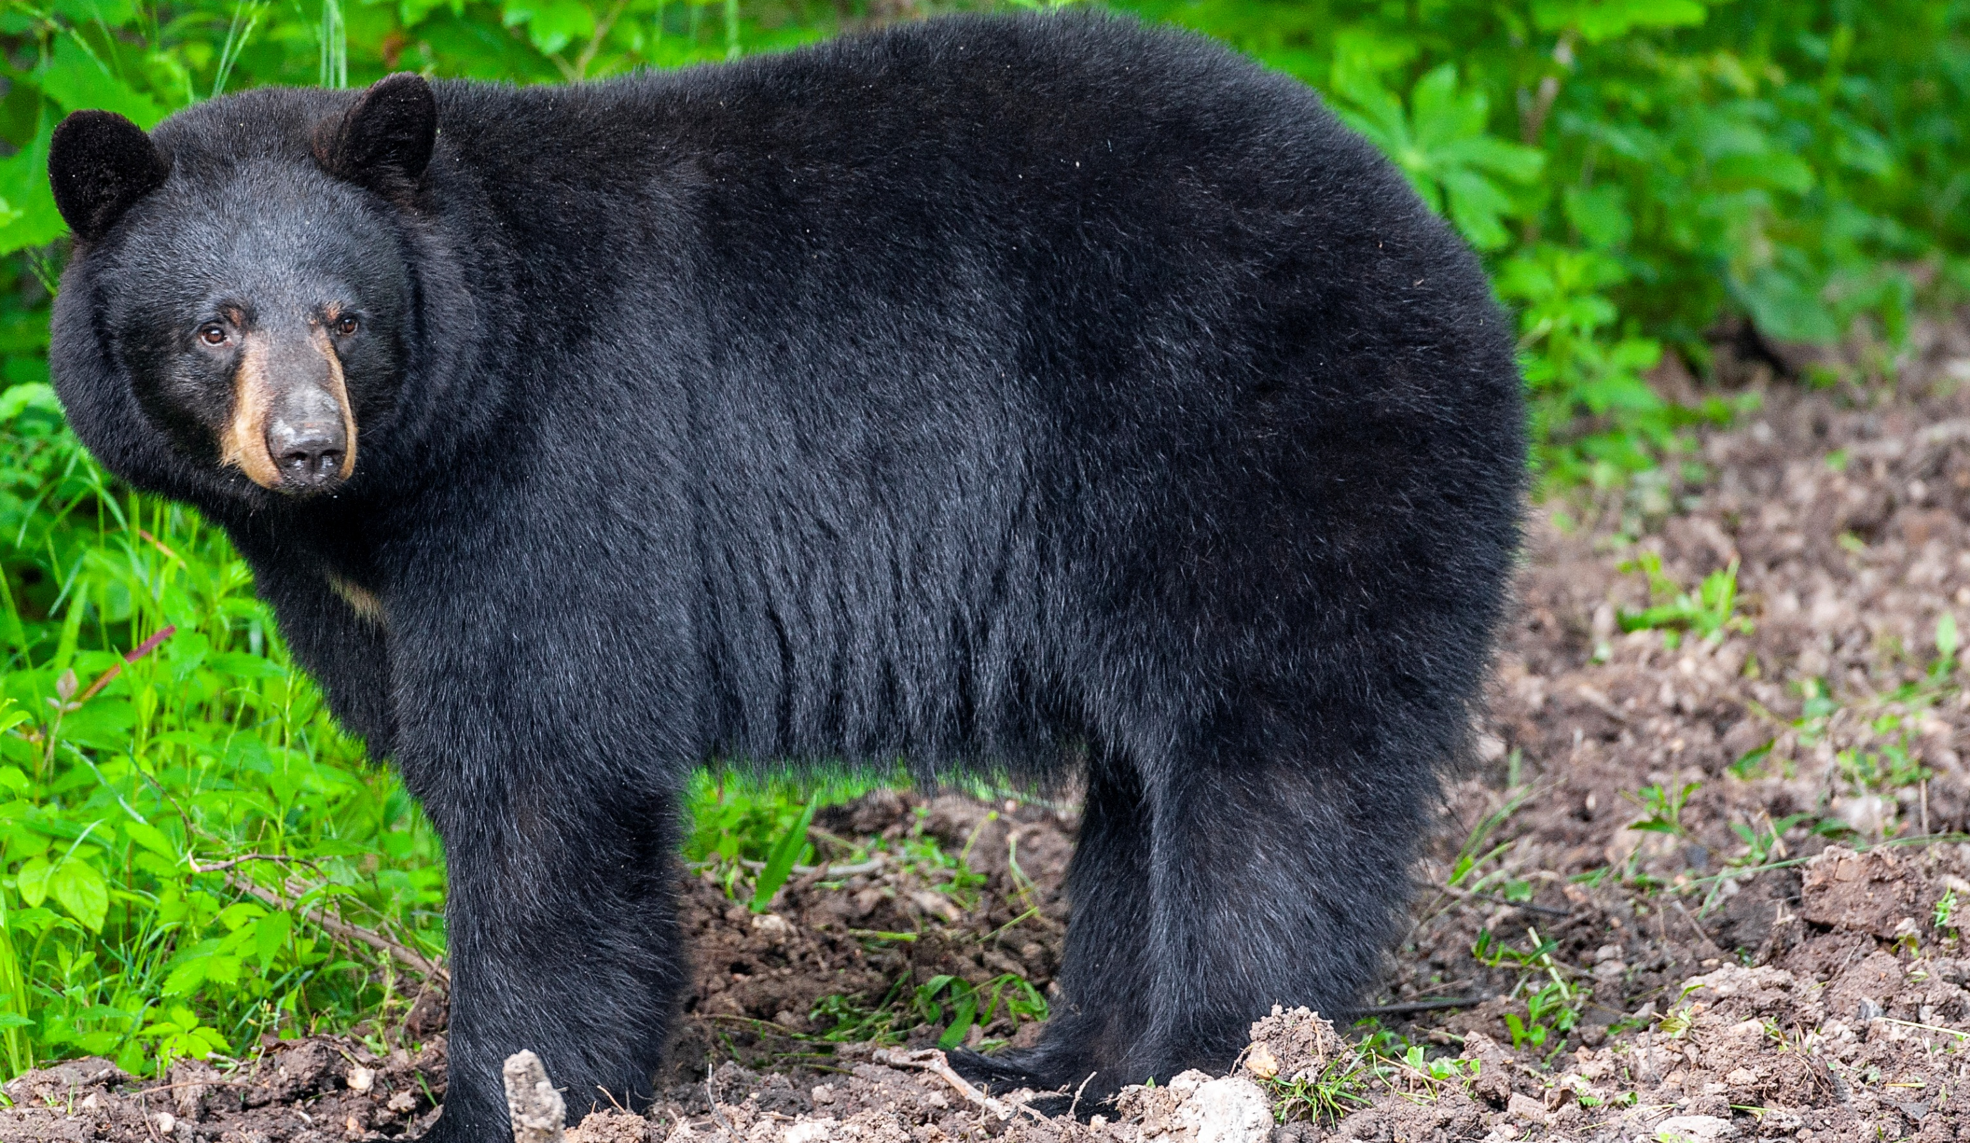

BEARS
Through the Seasons
Lesson 4C: Tree Takeover

Slide 2


Guiding Question:
Why do plants grow in different places?
Bears through the Seasons – 4C Tree Takeover: Engage
2

Slide 3

Bears through the Seasons – 4C Tree Takeover: Engage
3
Notes:
Prepare and display your Noticings and Wonderings Chart for this lesson. Add student observations and/or questions to the chart as the lesson proceeds in reference to the phenomenon studied.

Slide 4

Read the book Over and Under the Pond by Kate Messner
Link to Read-Aloud: Over and Under the Pond | Read Aloud
Bears through the Seasons – 4C Tree Takeover: Engage
4

Slide 5

What did you notice in the book?
Bears through the Seasons – 4C Tree Takeover: Engage
5

Slide 6
Focus on the plants!
Listen to the book Over and Under the Pond by Kate Messner
Link to Read-Aloud: Over and Under the Pond | Read Aloud
Bears through the Seasons – 4C Tree Takeover: Explore
6
Notes:
Read through the Over and under the Pond book again asking students to focus on the plants.

Slide 7
What plants does the author highlight or talk about in the book?
Bears through the Seasons – 4C Tree Takeover: Explore
7

Slide 8
Are the plants growing in different places or are they all growing in the same place?
Bears through the Seasons – 4C Tree Takeover: Explore
8

Slide 9
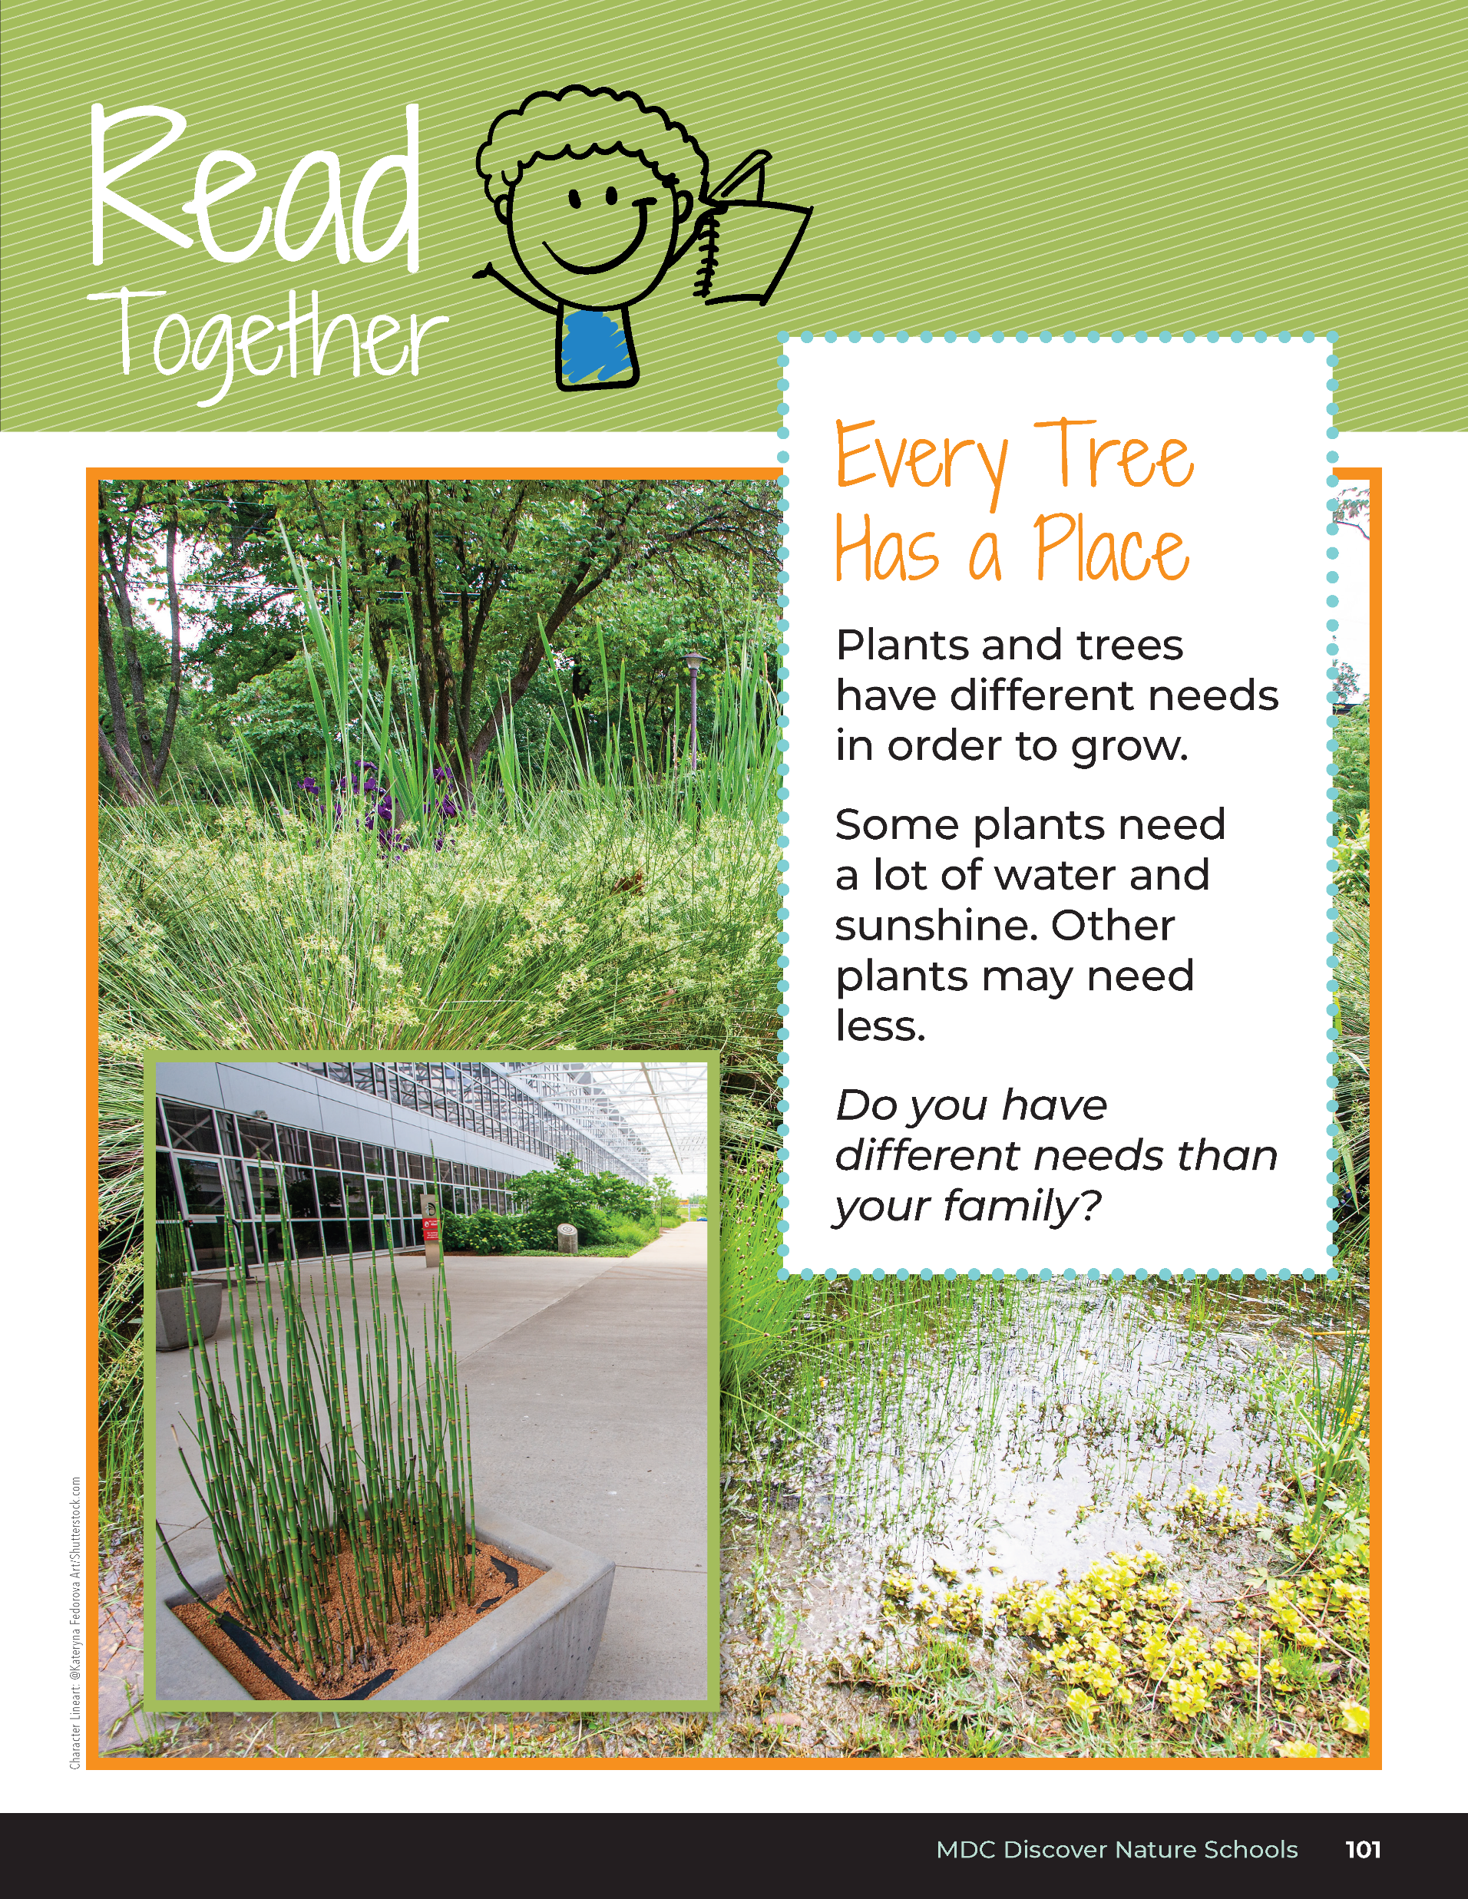

Every Tree Has a Place
Plants and trees have different needs in order to grow.
Some plants need a lot of water and sunshine. Other plants may need less.
Do you have different needs than your family?
Bears through the Seasons – 4C Tree Takeover: Explain
9
Notes:
Read aloud from the student guide Read Together Every Tree Has a Place on Page 101.

Slide 10
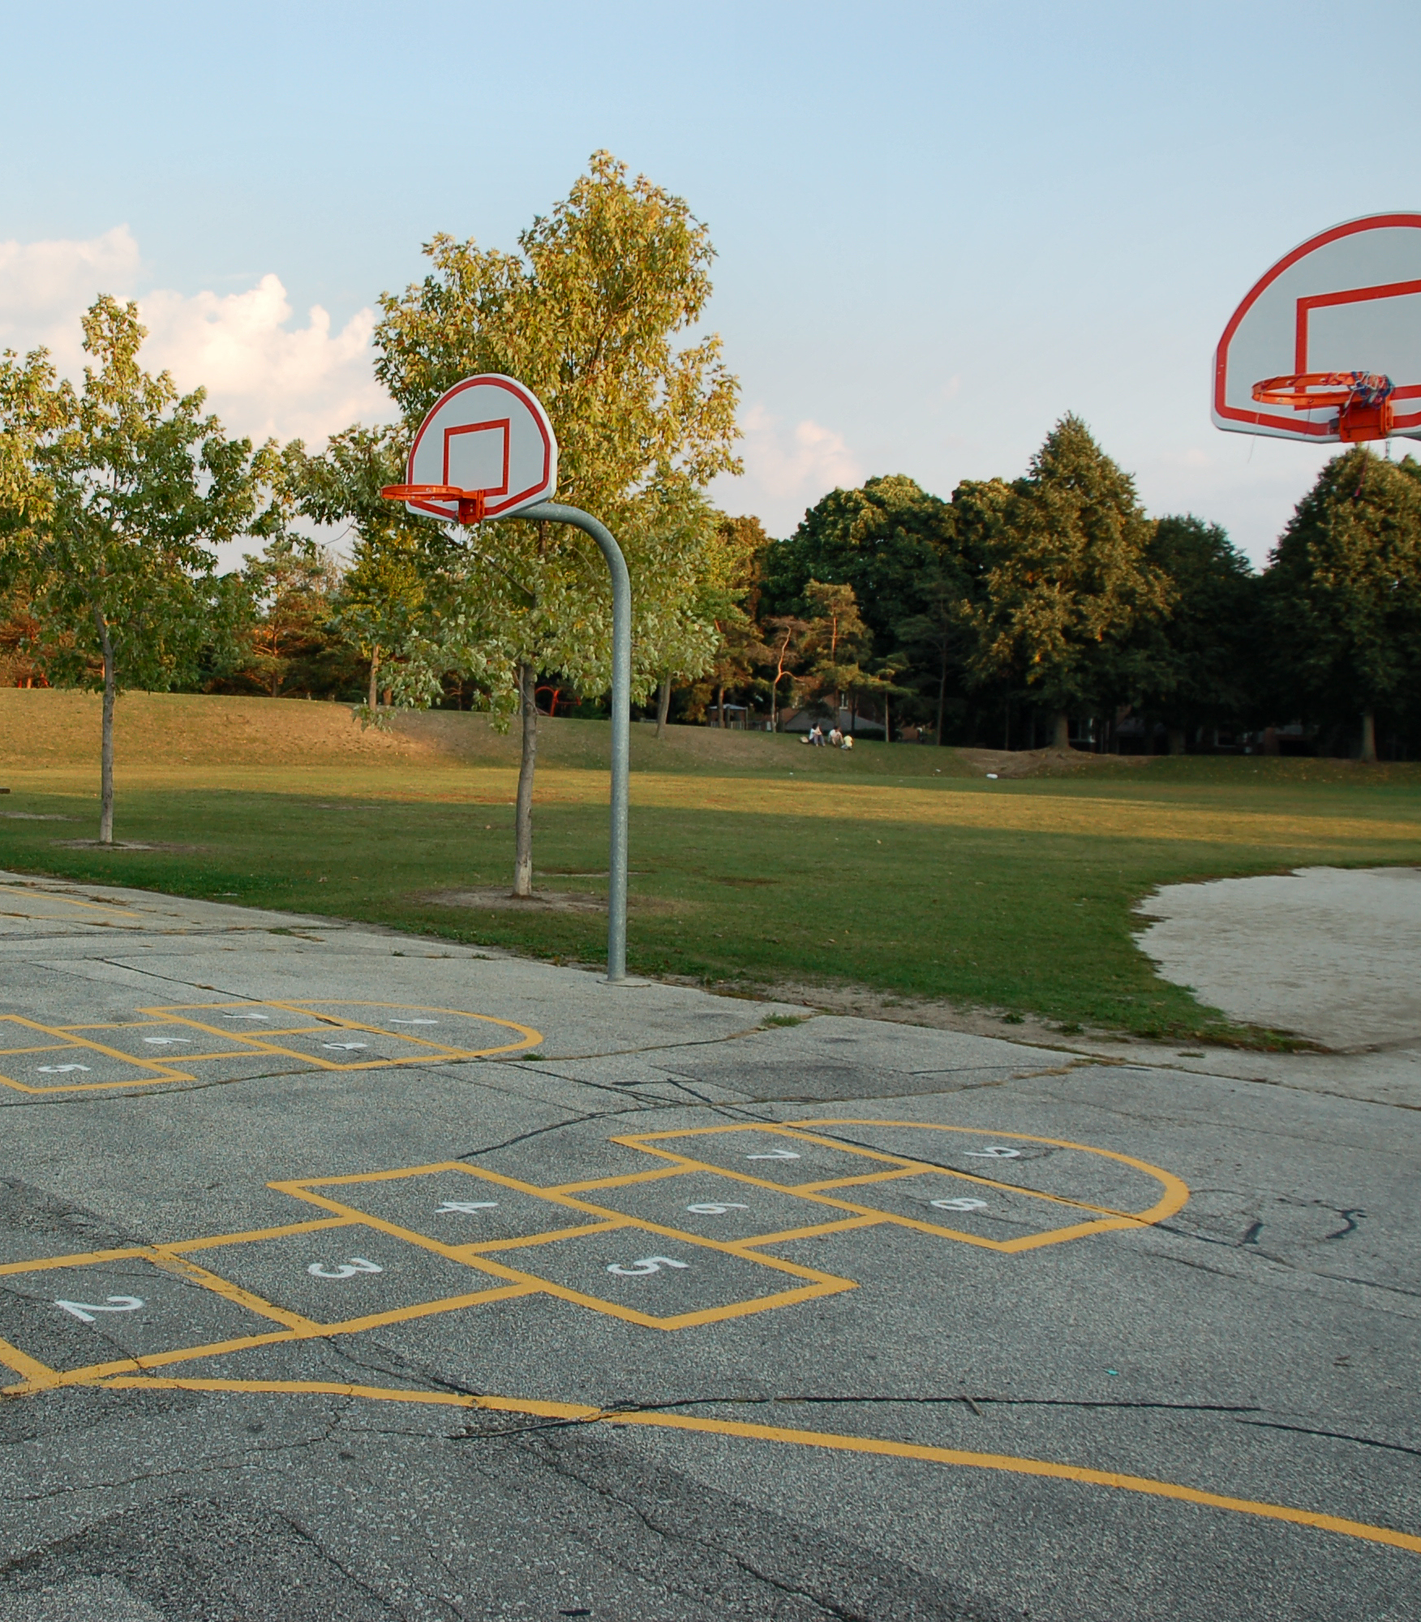
Think about your yard at home or the schoolyard.
Bears through the Seasons – 4C Tree Takeover: Explain
10

Slide 11
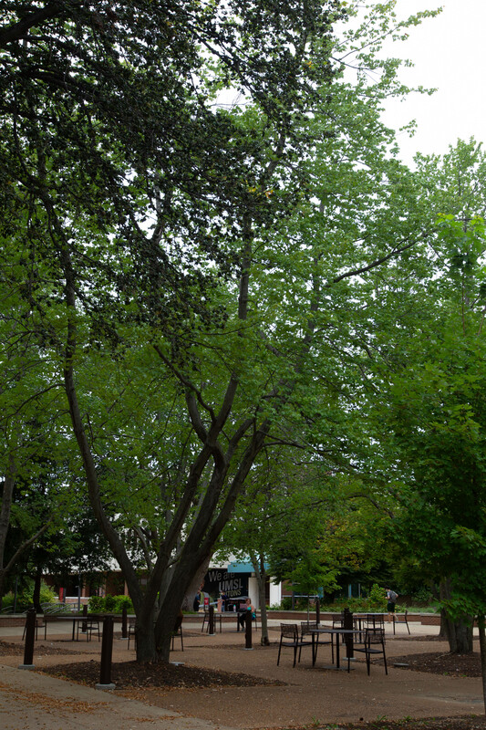
Do you notice any of the same plants from the story book we read earlier?
Bears through the Seasons – 4C Tree Takeover: Explain
11

Slide 12
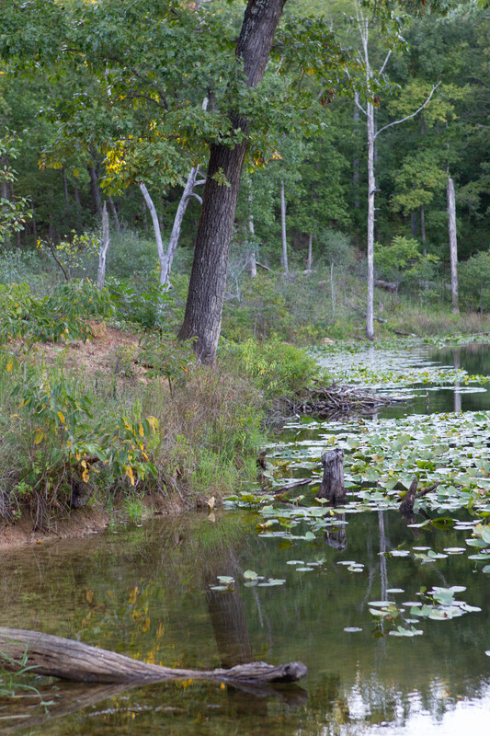
Why are the plants in those locations in the story and not in our schoolyard?
Bears through the Seasons – 4C Tree Takeover: Explain
12

Slide 13
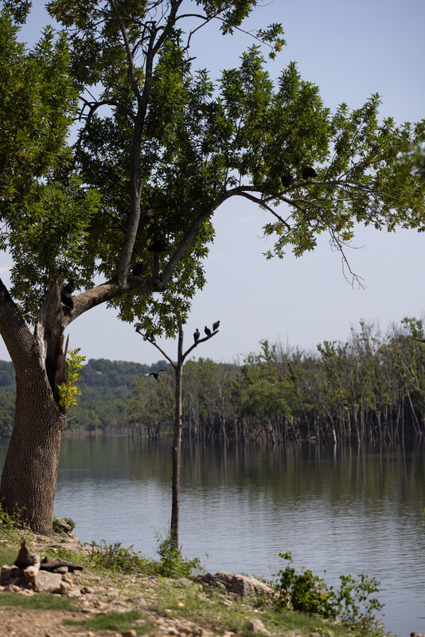
How do the locations match their needs?
Bears through the Seasons – 4C Tree Takeover: Explain
13

Slide 14
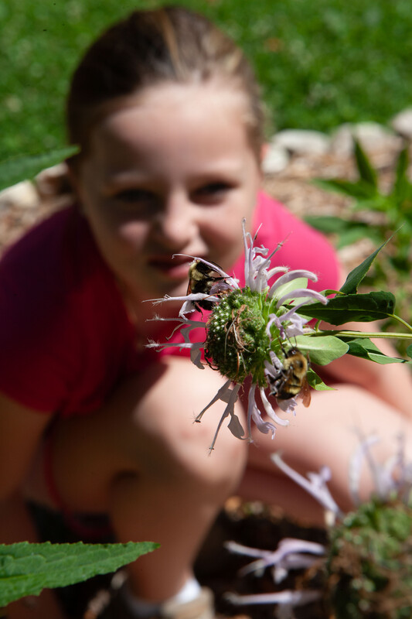
What do you notice about how the plants in the schoolyard meet their needs and change the environment?
Bears through the Seasons – 4C Tree Takeover: Elaborate
14
Notes:
Take students out to the schoolyard. Ask a group, make observations about where plants are located.

Slide 15
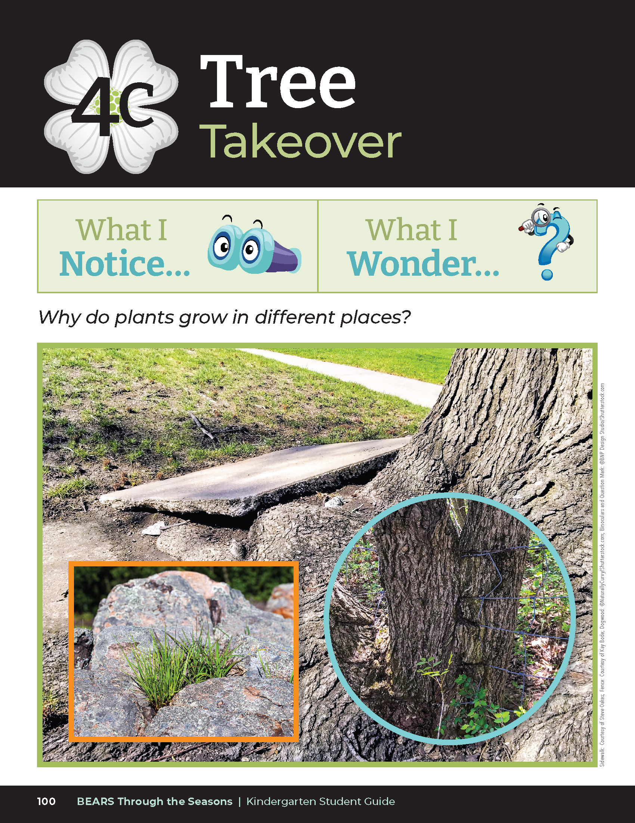
Are they able to get light and water?
Bears through the Seasons – 4C Tree Takeover: Elaborate
15
Notes:
Look at specific plants that are in your schoolyard with students.
Are they able to get light and water?
A tree’s roots may be breaking up rock or a sidewalk. Its roots are seeking water to meet its needs. Other plants may be growing through cracks in a sidewalk or in rocks.
Note: If you cannot find a place where plants have changed the environment, use the photos in the student guide 4C Tree Takeover on Page 100.

Slide 16
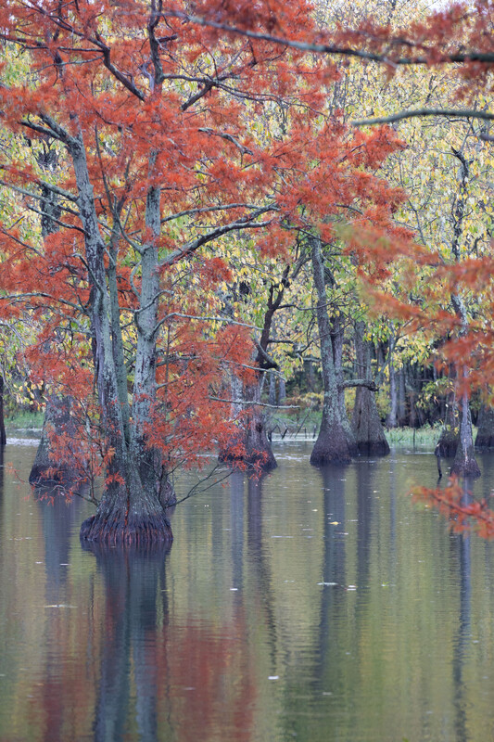
Look at the following pictures. What changes are being made in the environment by the tree or plant?
Bears through the Seasons – 4C Tree Takeover: Evaluate
16

Slide 17
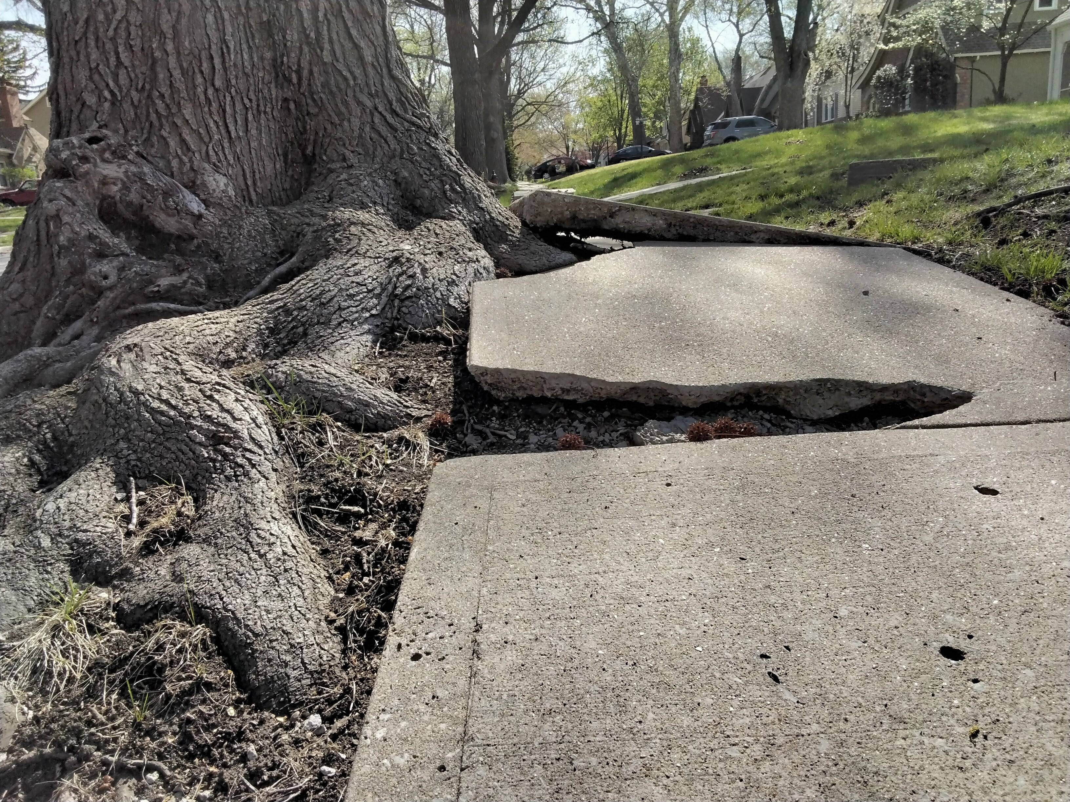
Bears through the Seasons – 4C Tree Takeover: Evaluate
17

Slide 18
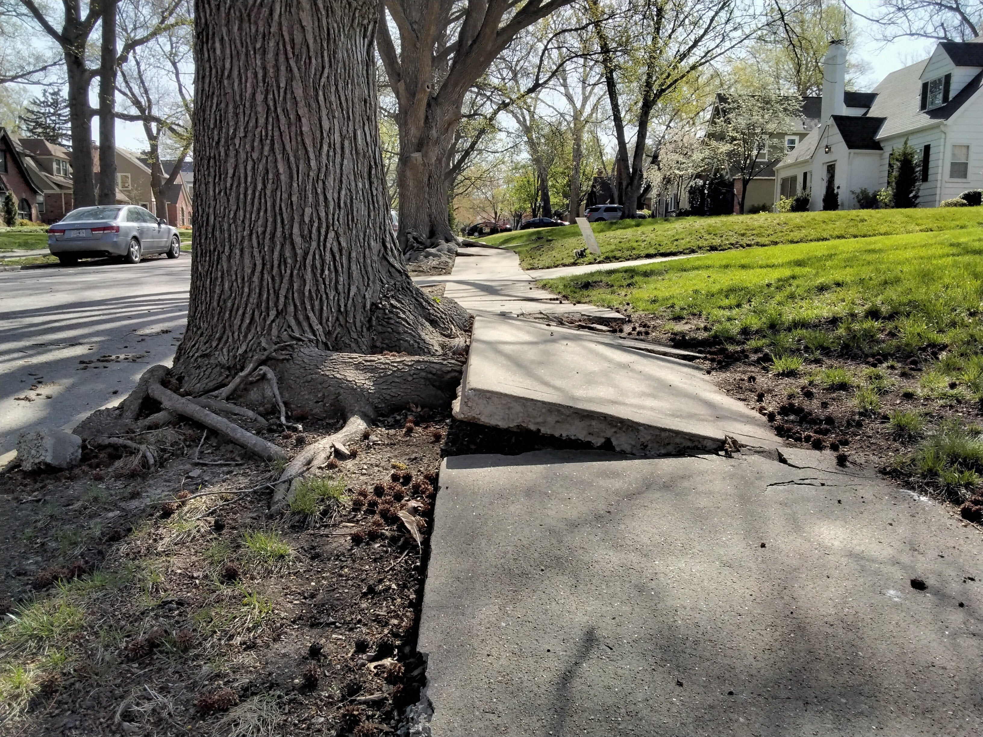
Bears through the Seasons – 4C Tree Takeover: Evaluate
18

Slide 19
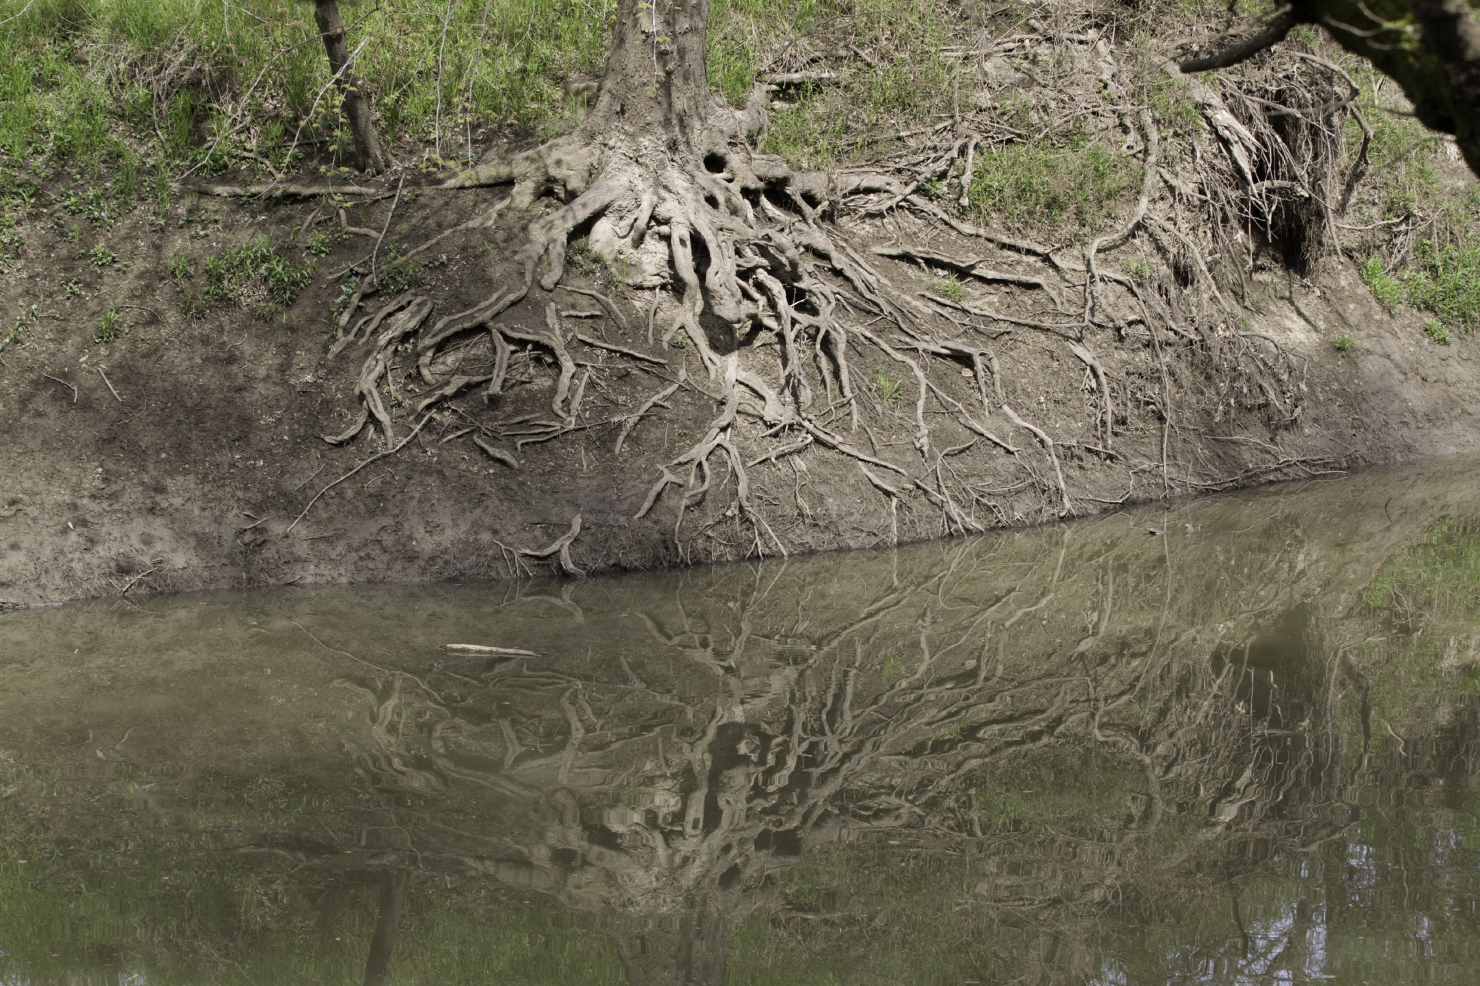
Bears through the Seasons – 4C Tree Takeover: Evaluate
19

Slide 20
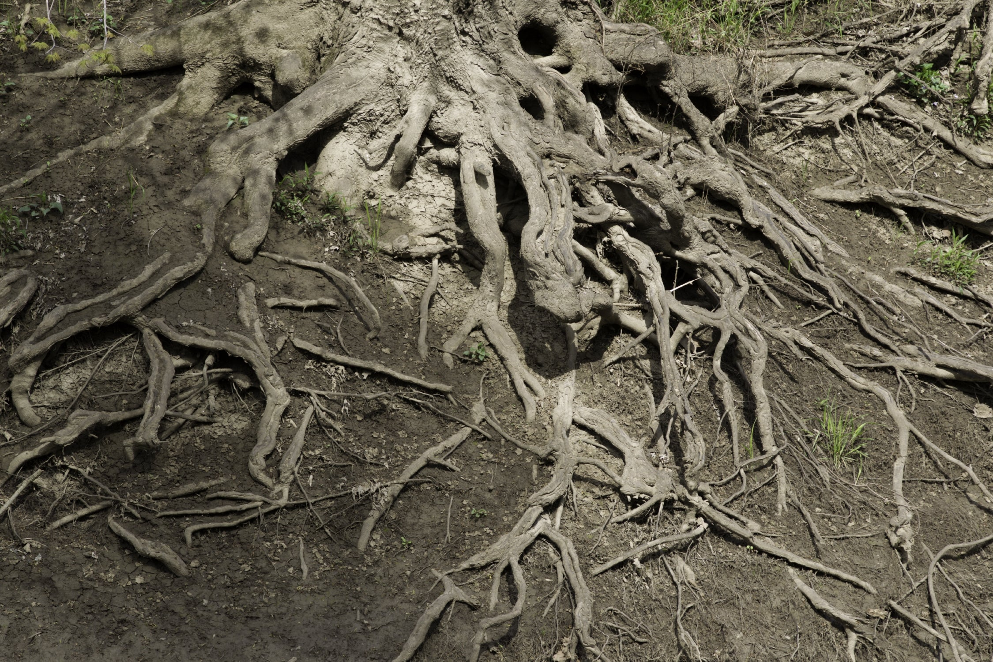
Bears through the Seasons – 4C Tree Takeover: Evaluate
20

Slide 21
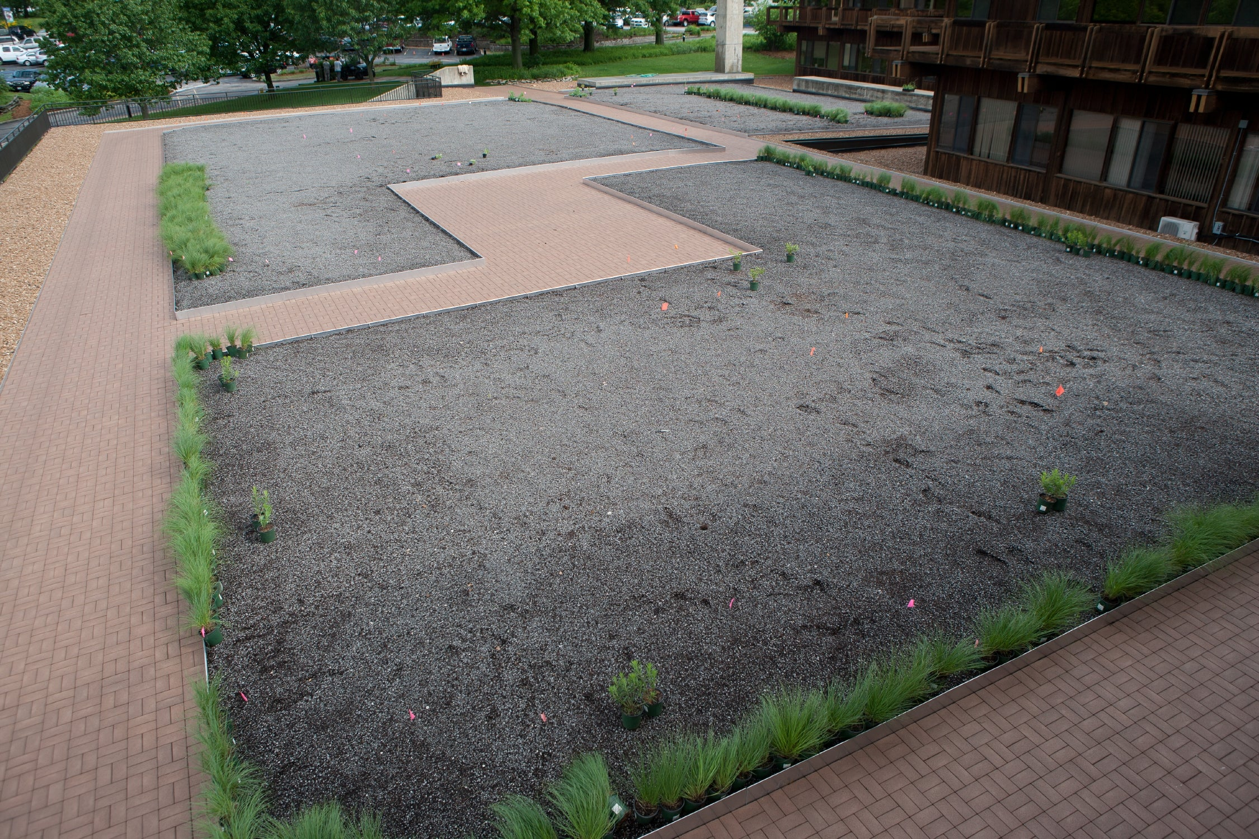
Bears through the Seasons – 4C Tree Takeover: Evaluate
21

Slide 22
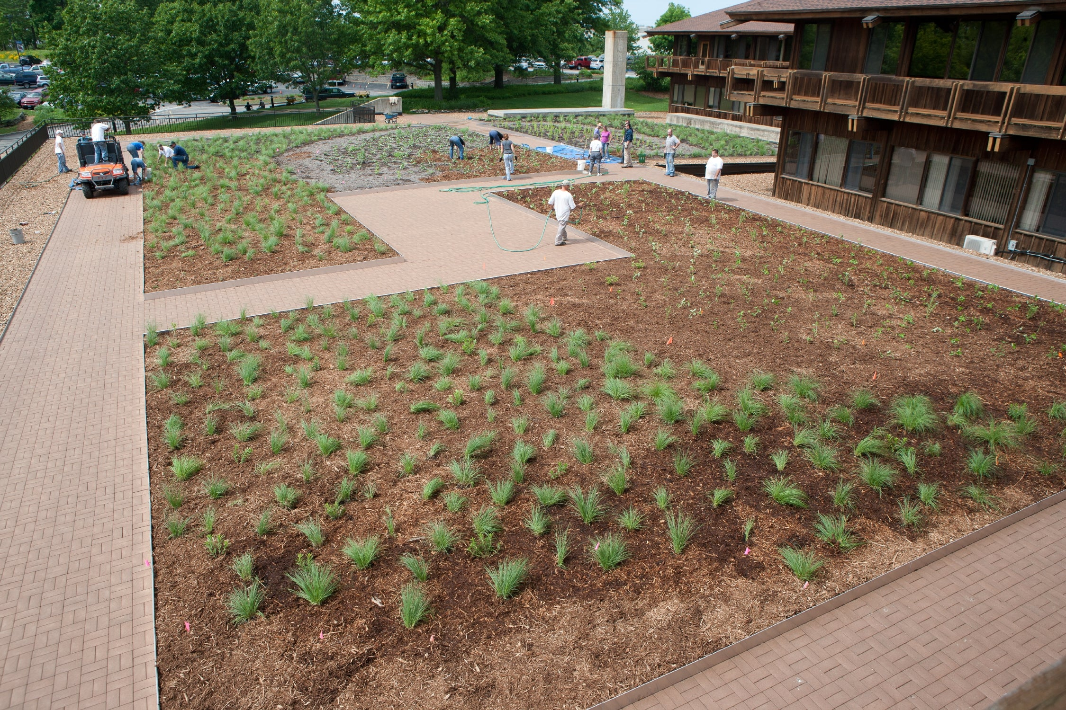
Bears through the Seasons – 4C Tree Takeover: Evaluate
22

Slide 23
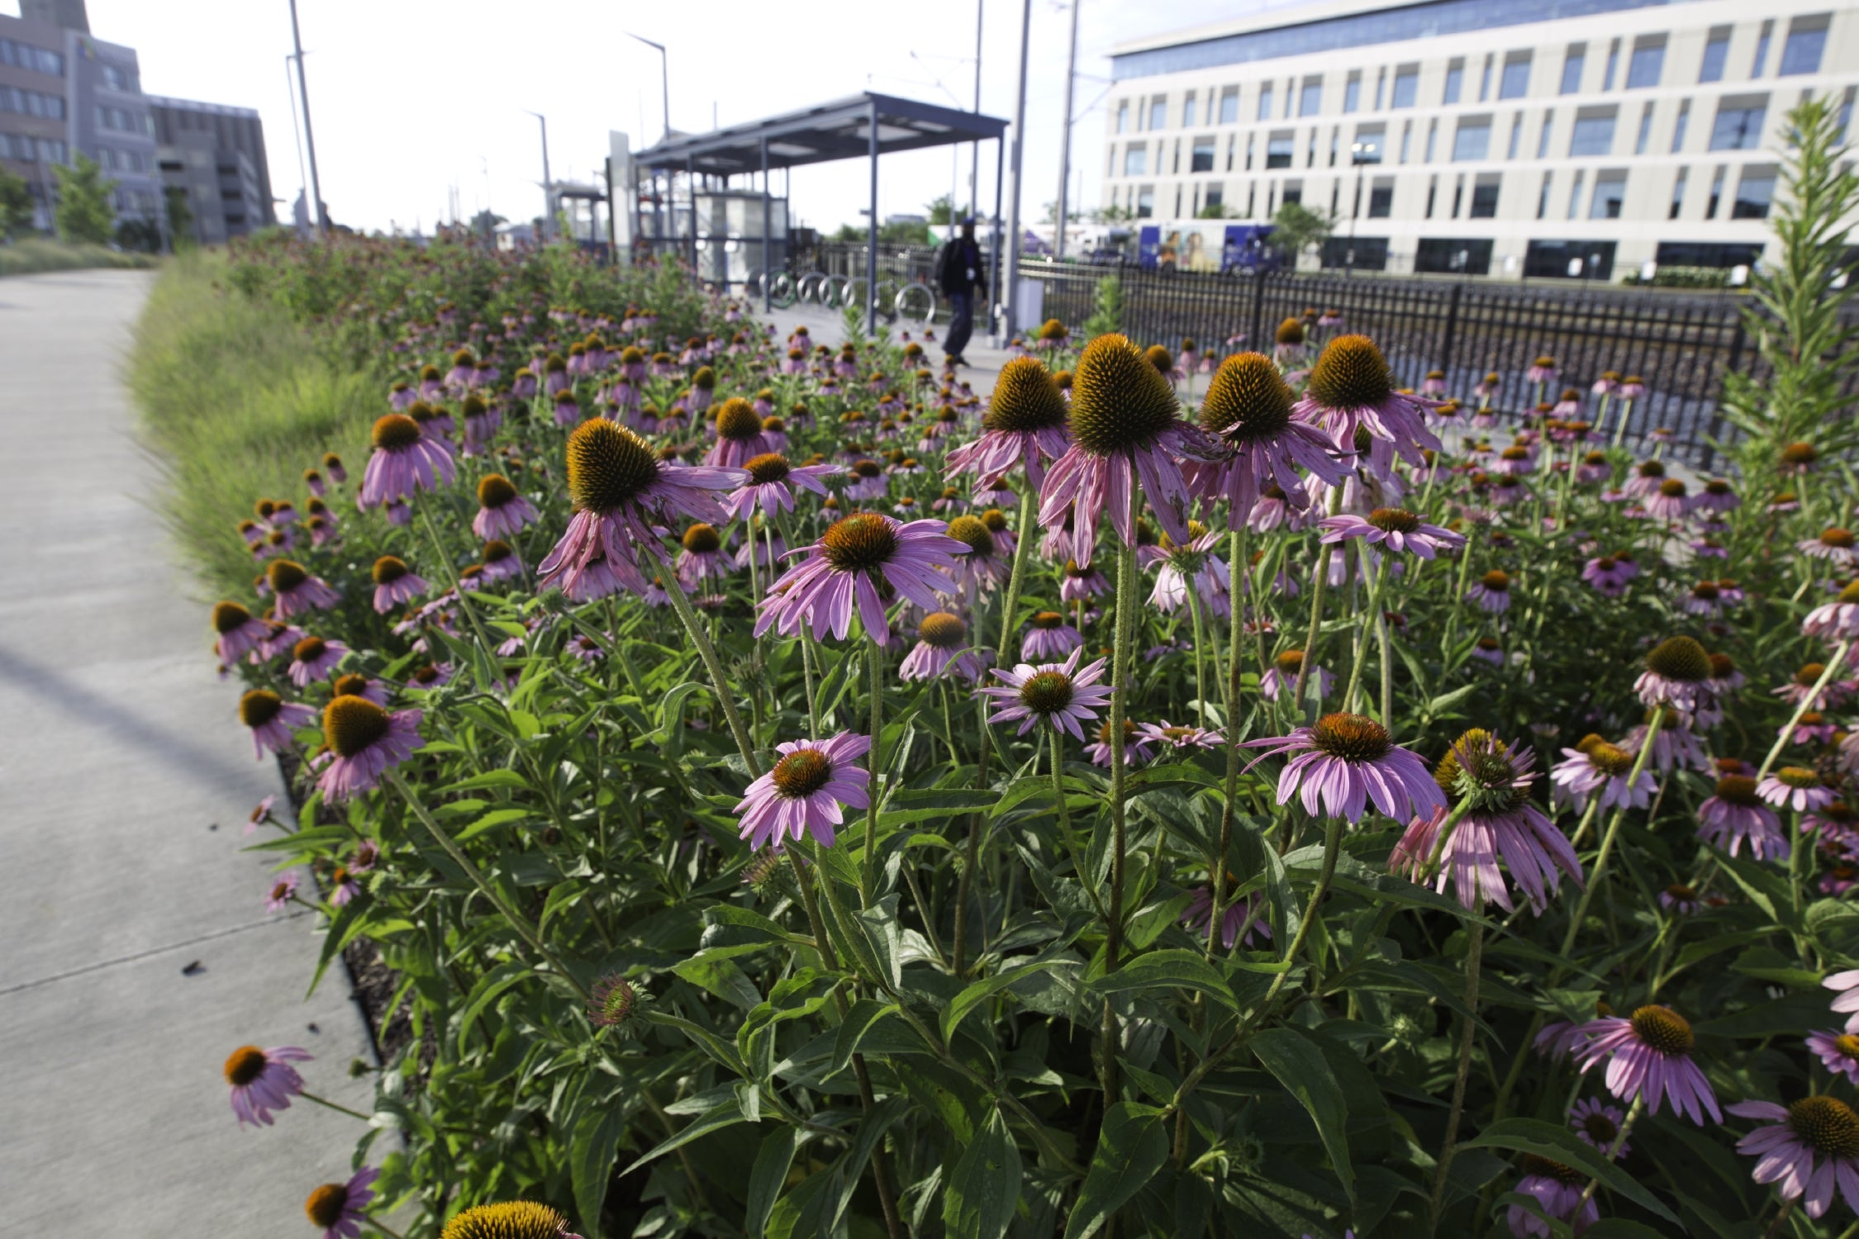
Bears through the Seasons – 4C Tree Takeover: Evaluate
23

Slide 24
Bears through the Seasons – 4C Tree Takeover: Elaborate
24
Notes:
Add student observations and/or questions to the Noticings and Wonderings Chart as the lesson concludes in reference to the phenomenon studied.

Slide 25


Draw how the growing plant or tree changes its surroundings.
Bears through the Seasons – 4C Tree Takeover: Evaluate
25
Notes:
Have students to draw one of these images in the student guide Science Notebook Changes on Page 102.
In their drawings, have students include any changes made to the surroundings by the plant or tree.
Discuss student drawings, giving each child time to explain the changes made.

Slide 26

Optional: Cross-Curricular Extension
Interview a family member about what their life was like when they were young.
Bears through the Seasons – 4C Tree Takeover: Cross-Curricular Extension
26
Notes:
Think about the trees shown in your student guide and when they first sprouted as seedlings 20, 50, or 100 years ago. Interview a family member who is at least 20 years older than you and ask what life was like for them when they were young. How does it compare to today. Share your story with your teacher and classmates.

