Slide 1
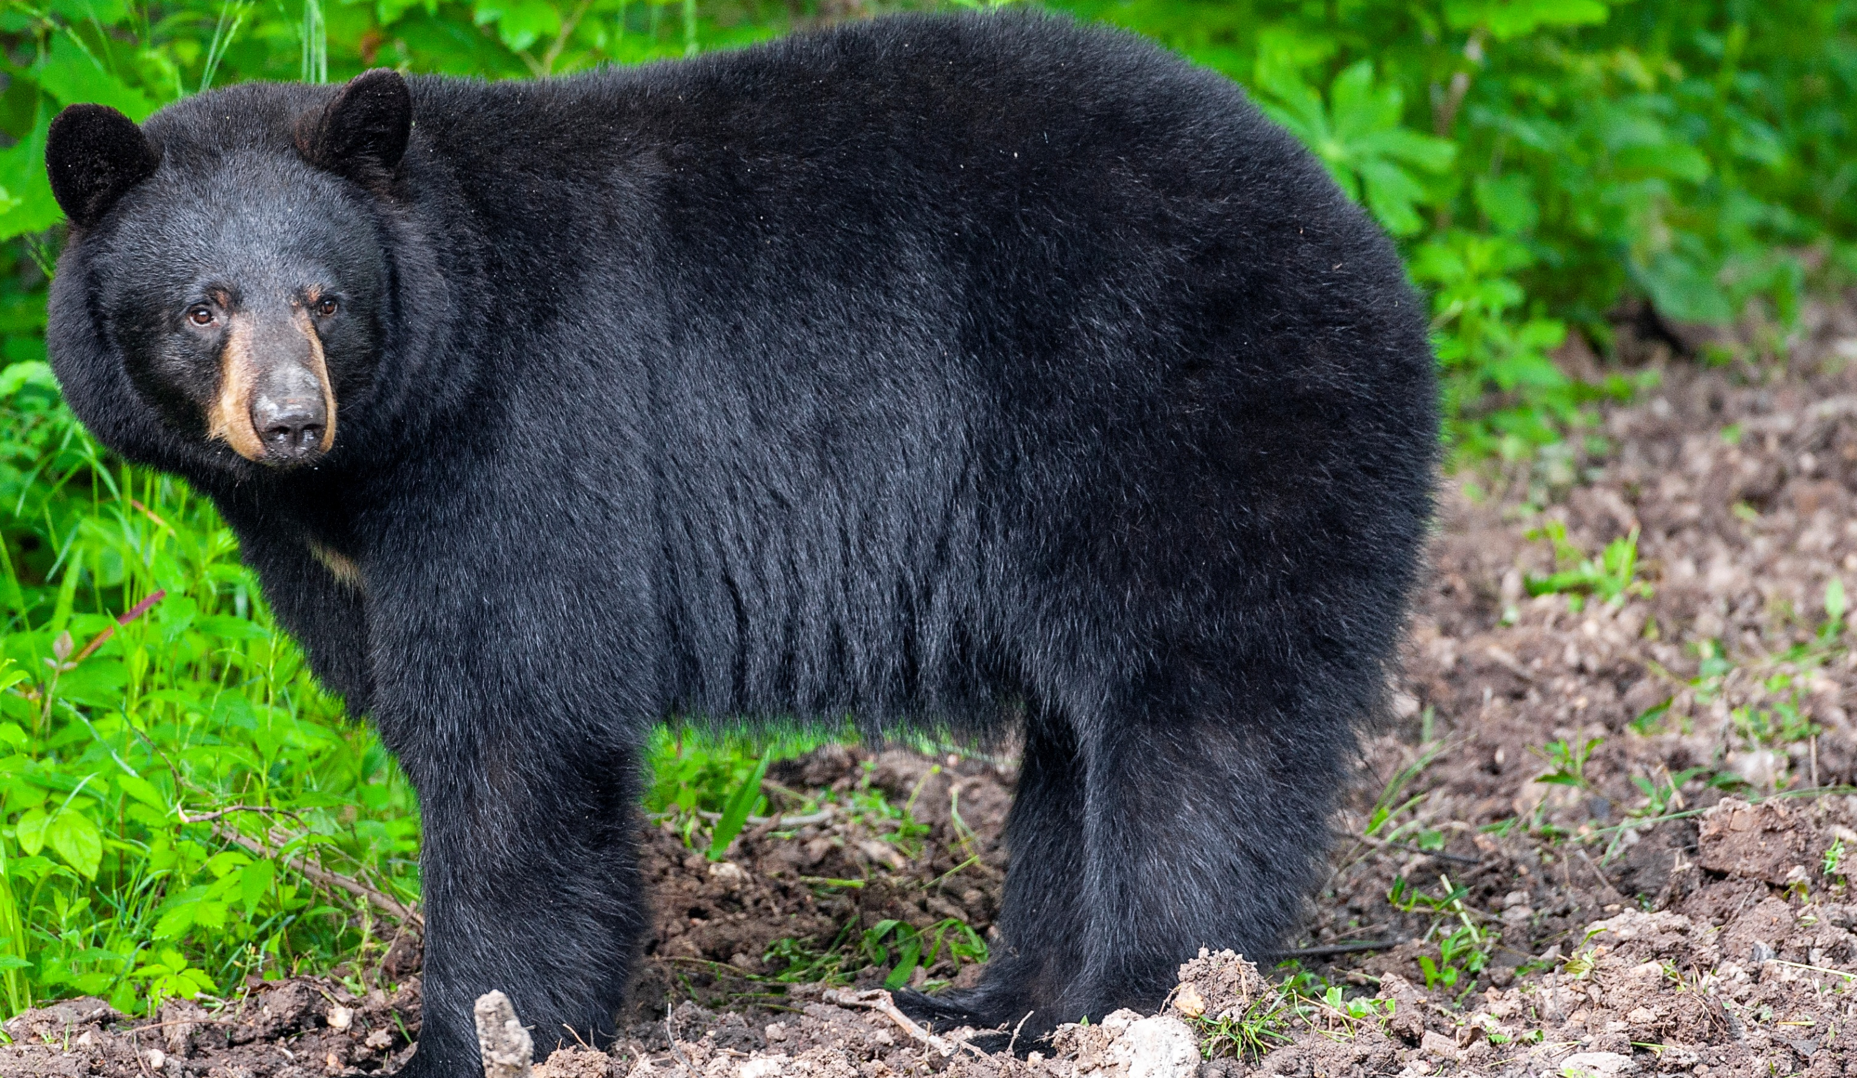

BEARS
Through the Seasons
Lesson 4B: Sprouting Seedlings
Notes:
Teacher Note: Teachers should work with their local MDC conservation educator to obtain seeds from native plants for their classroom. Go to the MDC Teacher Portal Kindergarten Unit 4B for ordering, planting, and care information. You will also need soil, pots, and classroom locations to place the trees or plants.

Slide 2
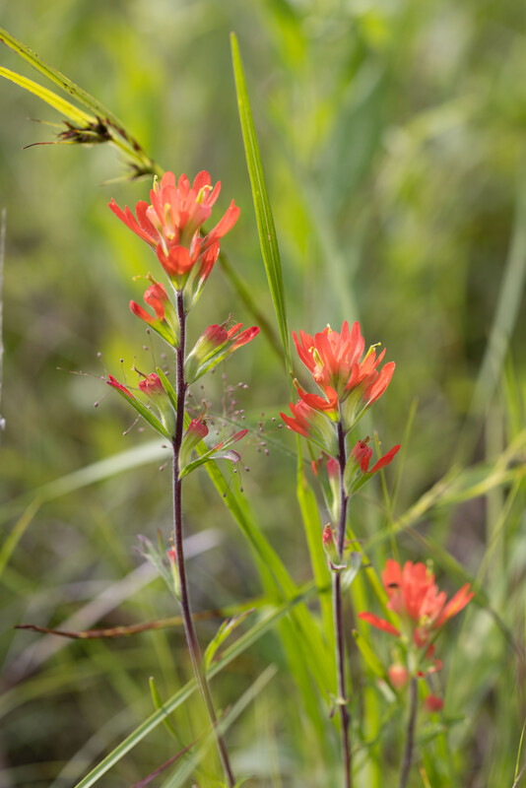

Guiding Question:
What do plants need to grow?
Bears through the Seasons – 4B Sprouting Seedlings: Engage
2

Slide 3

Bears through the Seasons – 4B Sprouting Seedlings: Engage
3
Notes:
Prepare and display your Noticings and Wonderings Chart for this lesson. Add student observations and/or questions to the chart as the lesson proceeds in reference to the phenomenon studied.

Slide 4
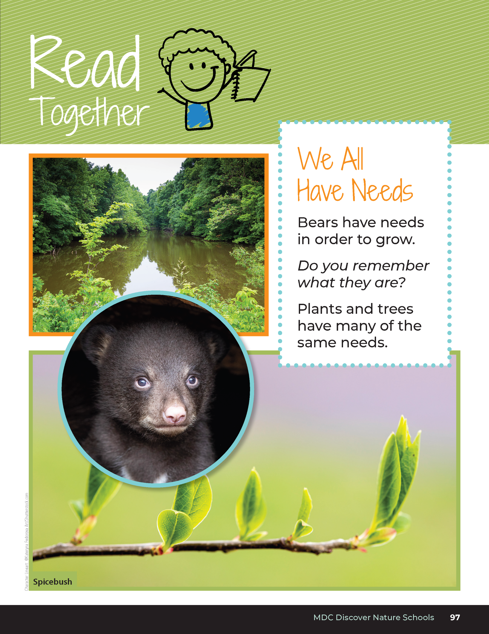

We All Have Needs
Bears have needs in order to grow.
Do you remember what they are?
Plants and trees have many of the same needs.
Bears through the Seasons – 4B Sprouting Seedlings: Engage
4
Notes:
Read aloud together from the student guide Read Together We All Have Needs on Page 97.

Slide 5

Read the book Plants Can’t Sit Still by Rebecca E. Hirsch
Link to book on Epic!: Plants Can't Sit Still by Rebecaa E. Hirsh
Available for free to classroom teachers on Epic! (login required)
Link to Read-Aloud: https://youtu.be/HZat4xi2R7w?si=tpoK1BspVF13eXkU
Bears through the Seasons – 4B Sprouting Seedlings: Engage
5

Slide 6
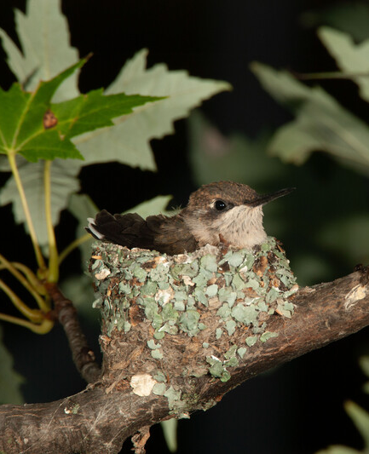

What do animals need in order to live and grow?
Bears through the Seasons – 4B Sprouting Seedlings: Engage
6
Notes:
At the beginning of the year, we learned about what animals like bears need to survive. Ask students:
What do animals need in order to live and grow?
Discuss how animals need food, water, air, and shelter or space.

Slide 7
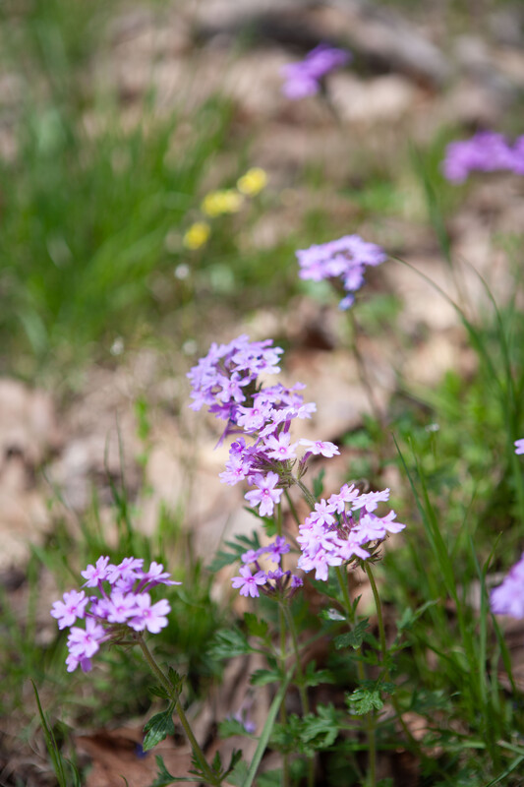
Do plants need the same thing as animals to grow and survive?
Bears through the Seasons – 4B Sprouting Seedlings: Engage
7
Notes:
Divide students into six groups. Give each group a seed from a native plant. Ask students:
Do plants need the same thing as animals to grow and survive?

Slide 8
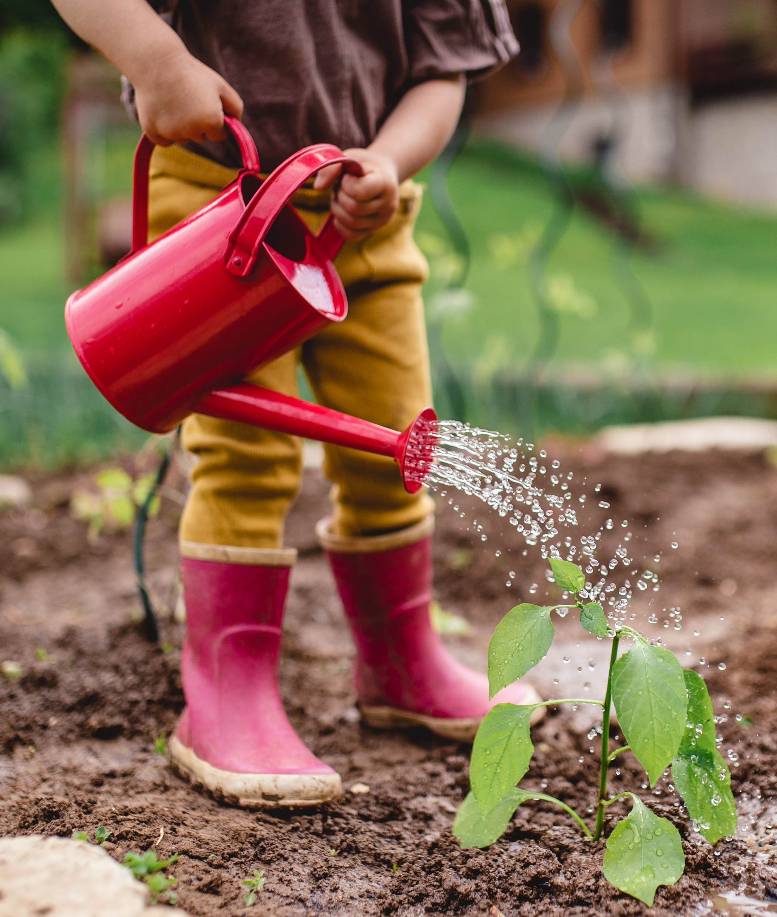
How can we help this seedling to grow?
Bears through the Seasons – 4B Sprouting Seedlings: Engage
8

Slide 9
How can we test our ideas about how to help our seedling grow?
Bears through the Seasons – 4B Sprouting Seedlings: Explore
9

Slide 10
Discuss and draw your ideas to test what plants need to grow.
Bears through the Seasons – 4B Sprouting Seedlings: Explore
10
Notes:
Groups discuss and draw their ideas to test what plants need to grow. Have them record their ideas on a separate sheet of paper to share with the class.

Slide 11
Share Ideas
Bears through the Seasons – 4B Sprouting Seedlings: Explain
11
Notes:
Groups will report out their ideas. They should include water and light. Lead students to designing investigations. You can do this in two groups. Each group will have a variable (either light of water) and a condition that they are responsible for monitoring.

Slide 12
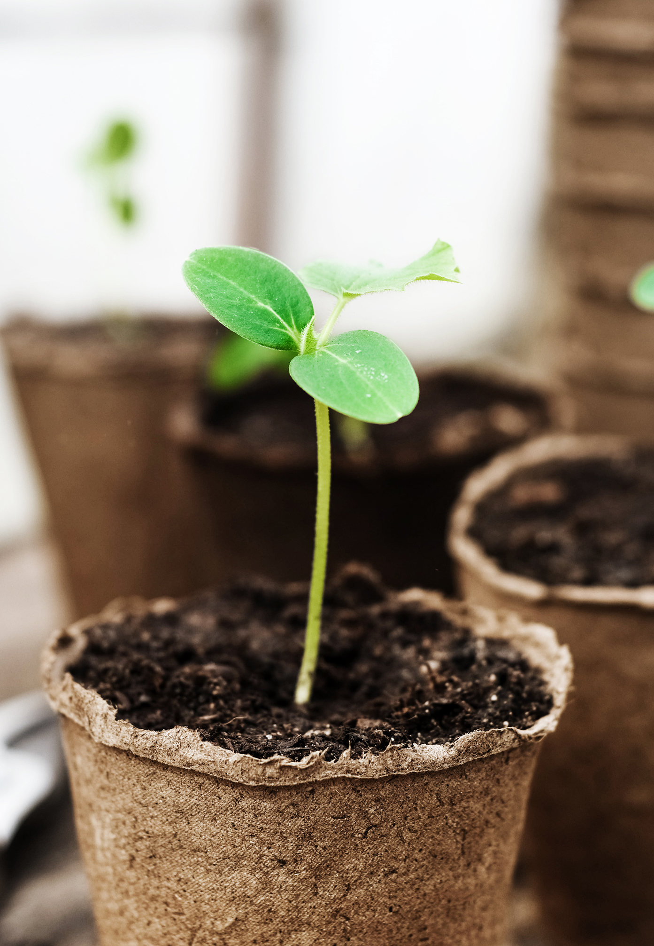
How will we determine how much water or light to give the plant?
Bears through the Seasons – 4B Sprouting Seedlings: Explain
12
Notes:
Teacher Note: Create six groups. Three groups can investigate water and three groups can investigate light. For testing water, your conditions can be no water, 1 teaspoon of water, and ¼ cup of water daily (keeping the soil moist). For testing light, the conditions can be no light, a small amount of sunlight (like under a table or in a corner with little light), and most amount of sunlight (like directly in front of a window).

Slide 13

How will we measure changes?
How often will we make observations and changes?
How will we record our observations and changes?
Bears through the Seasons – 4B Sprouting Seedlings: Explain
13

Slide 14


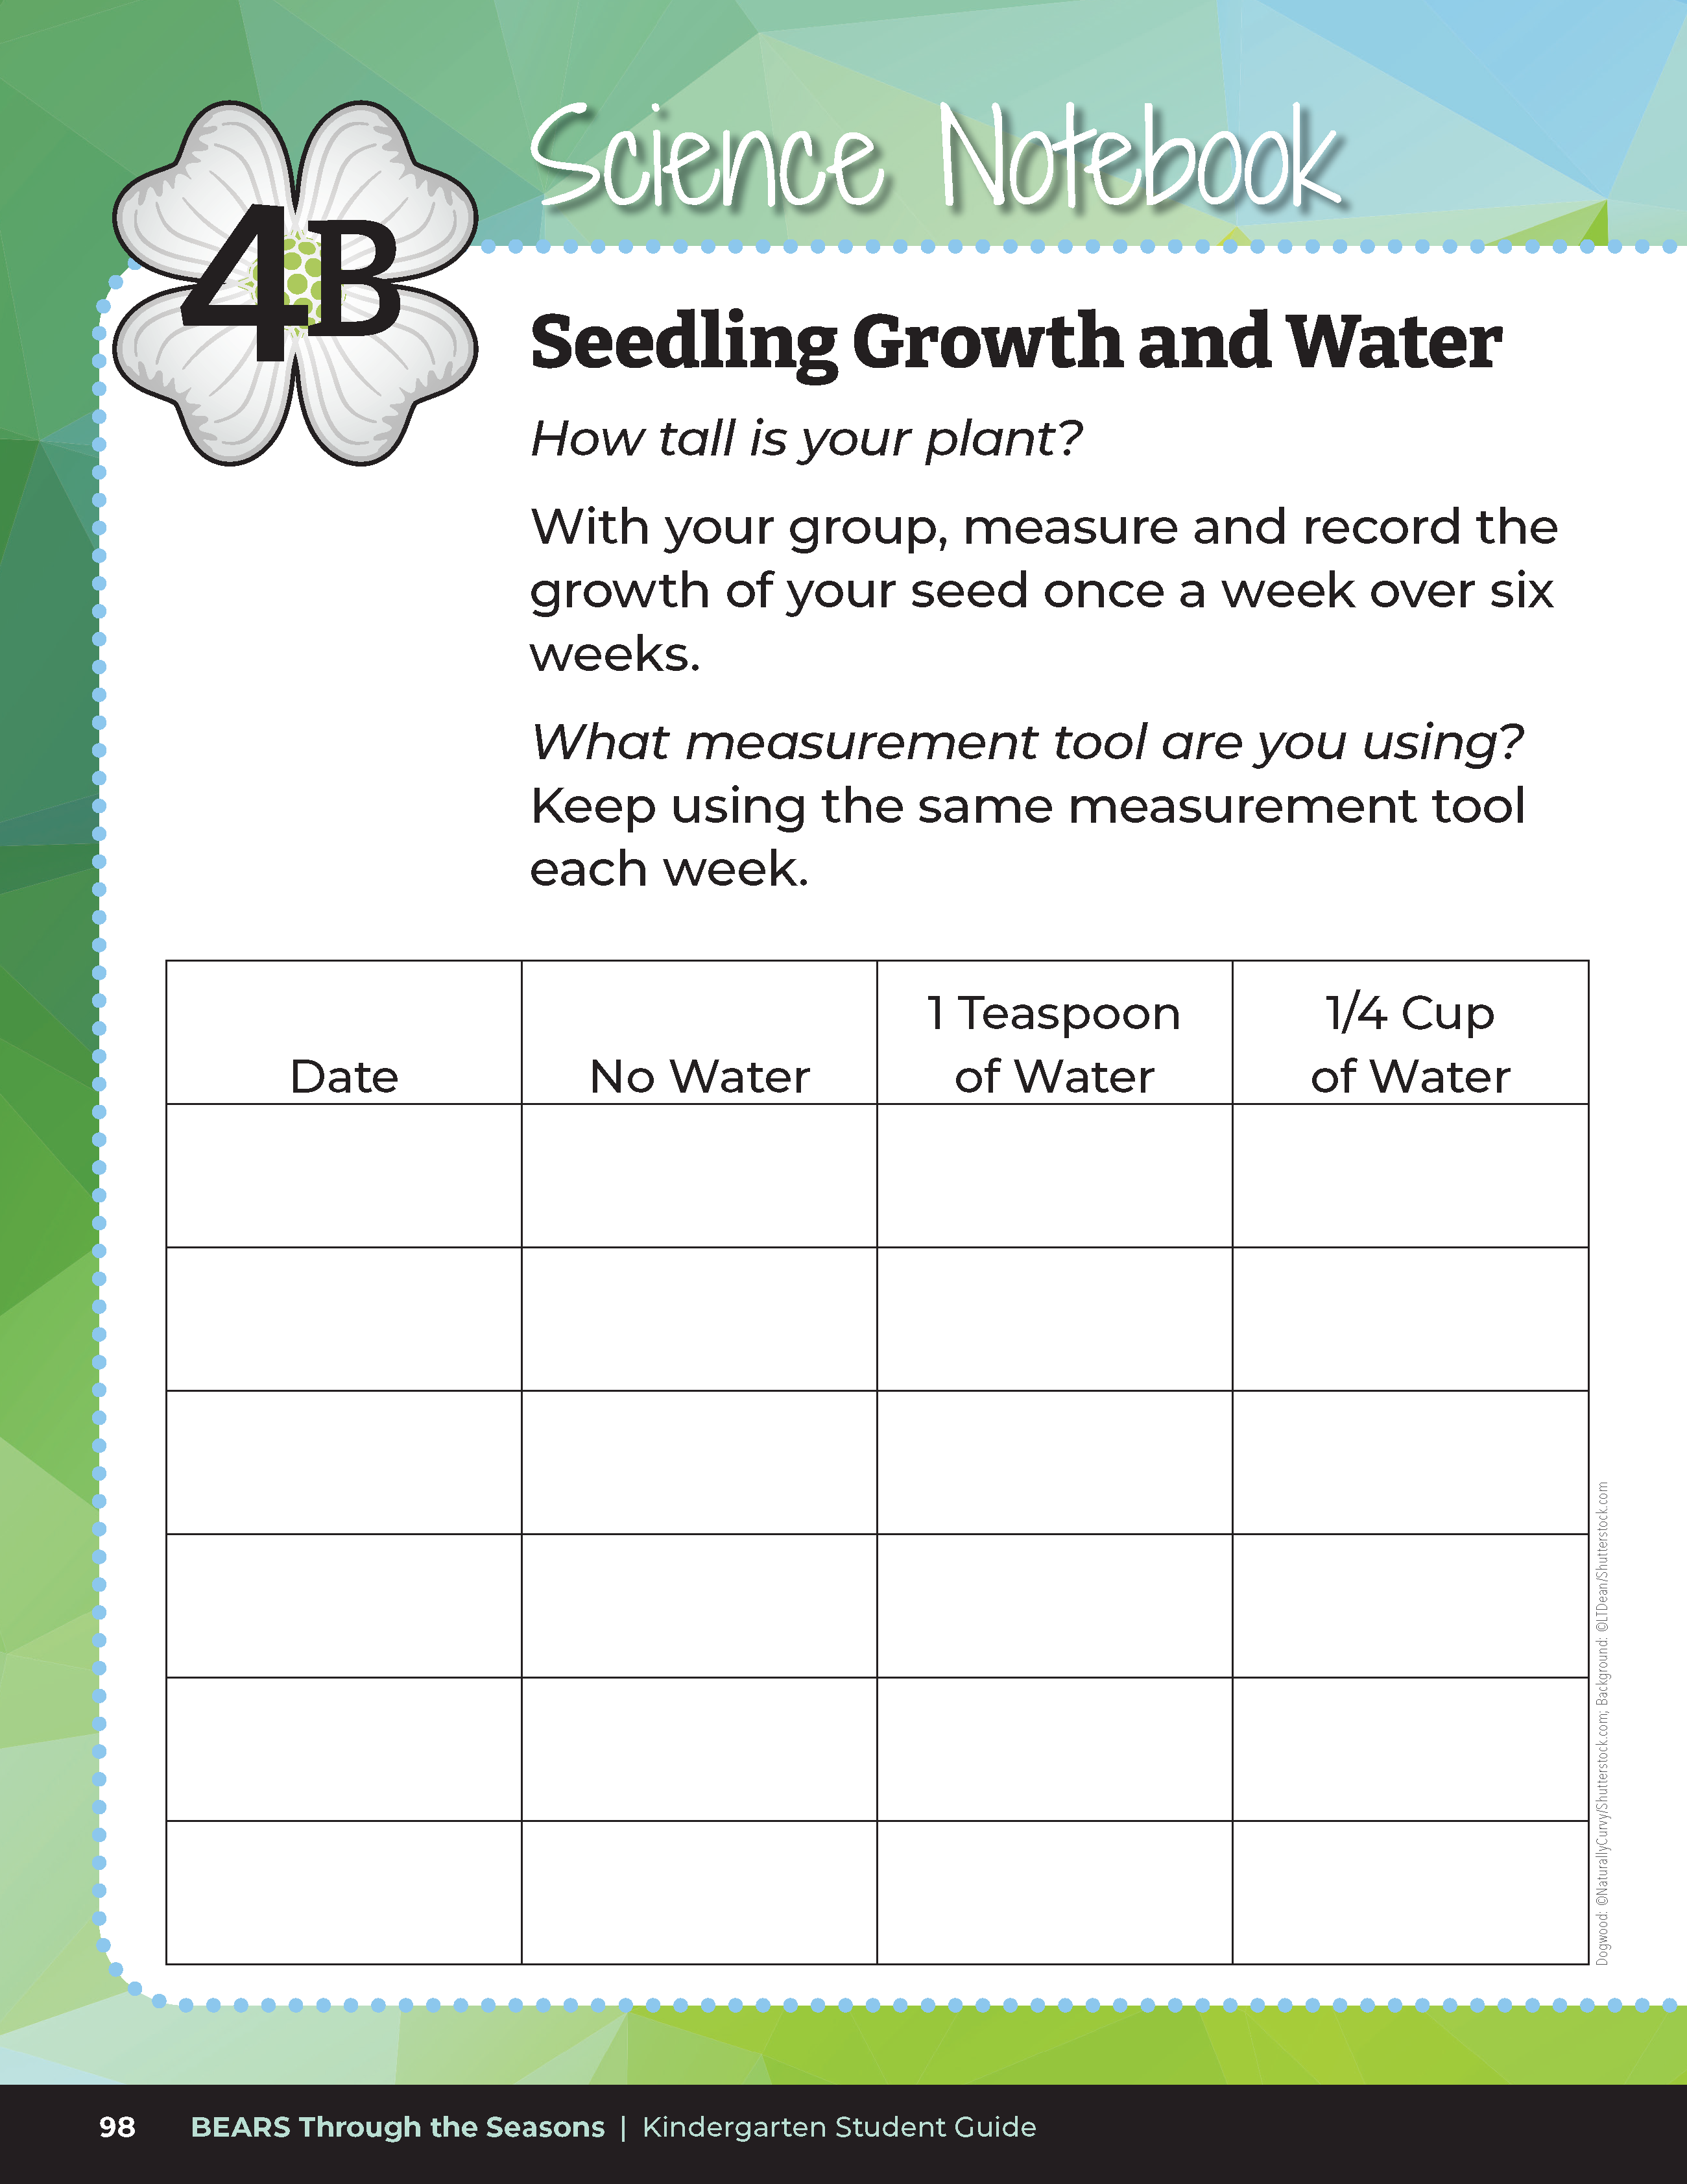
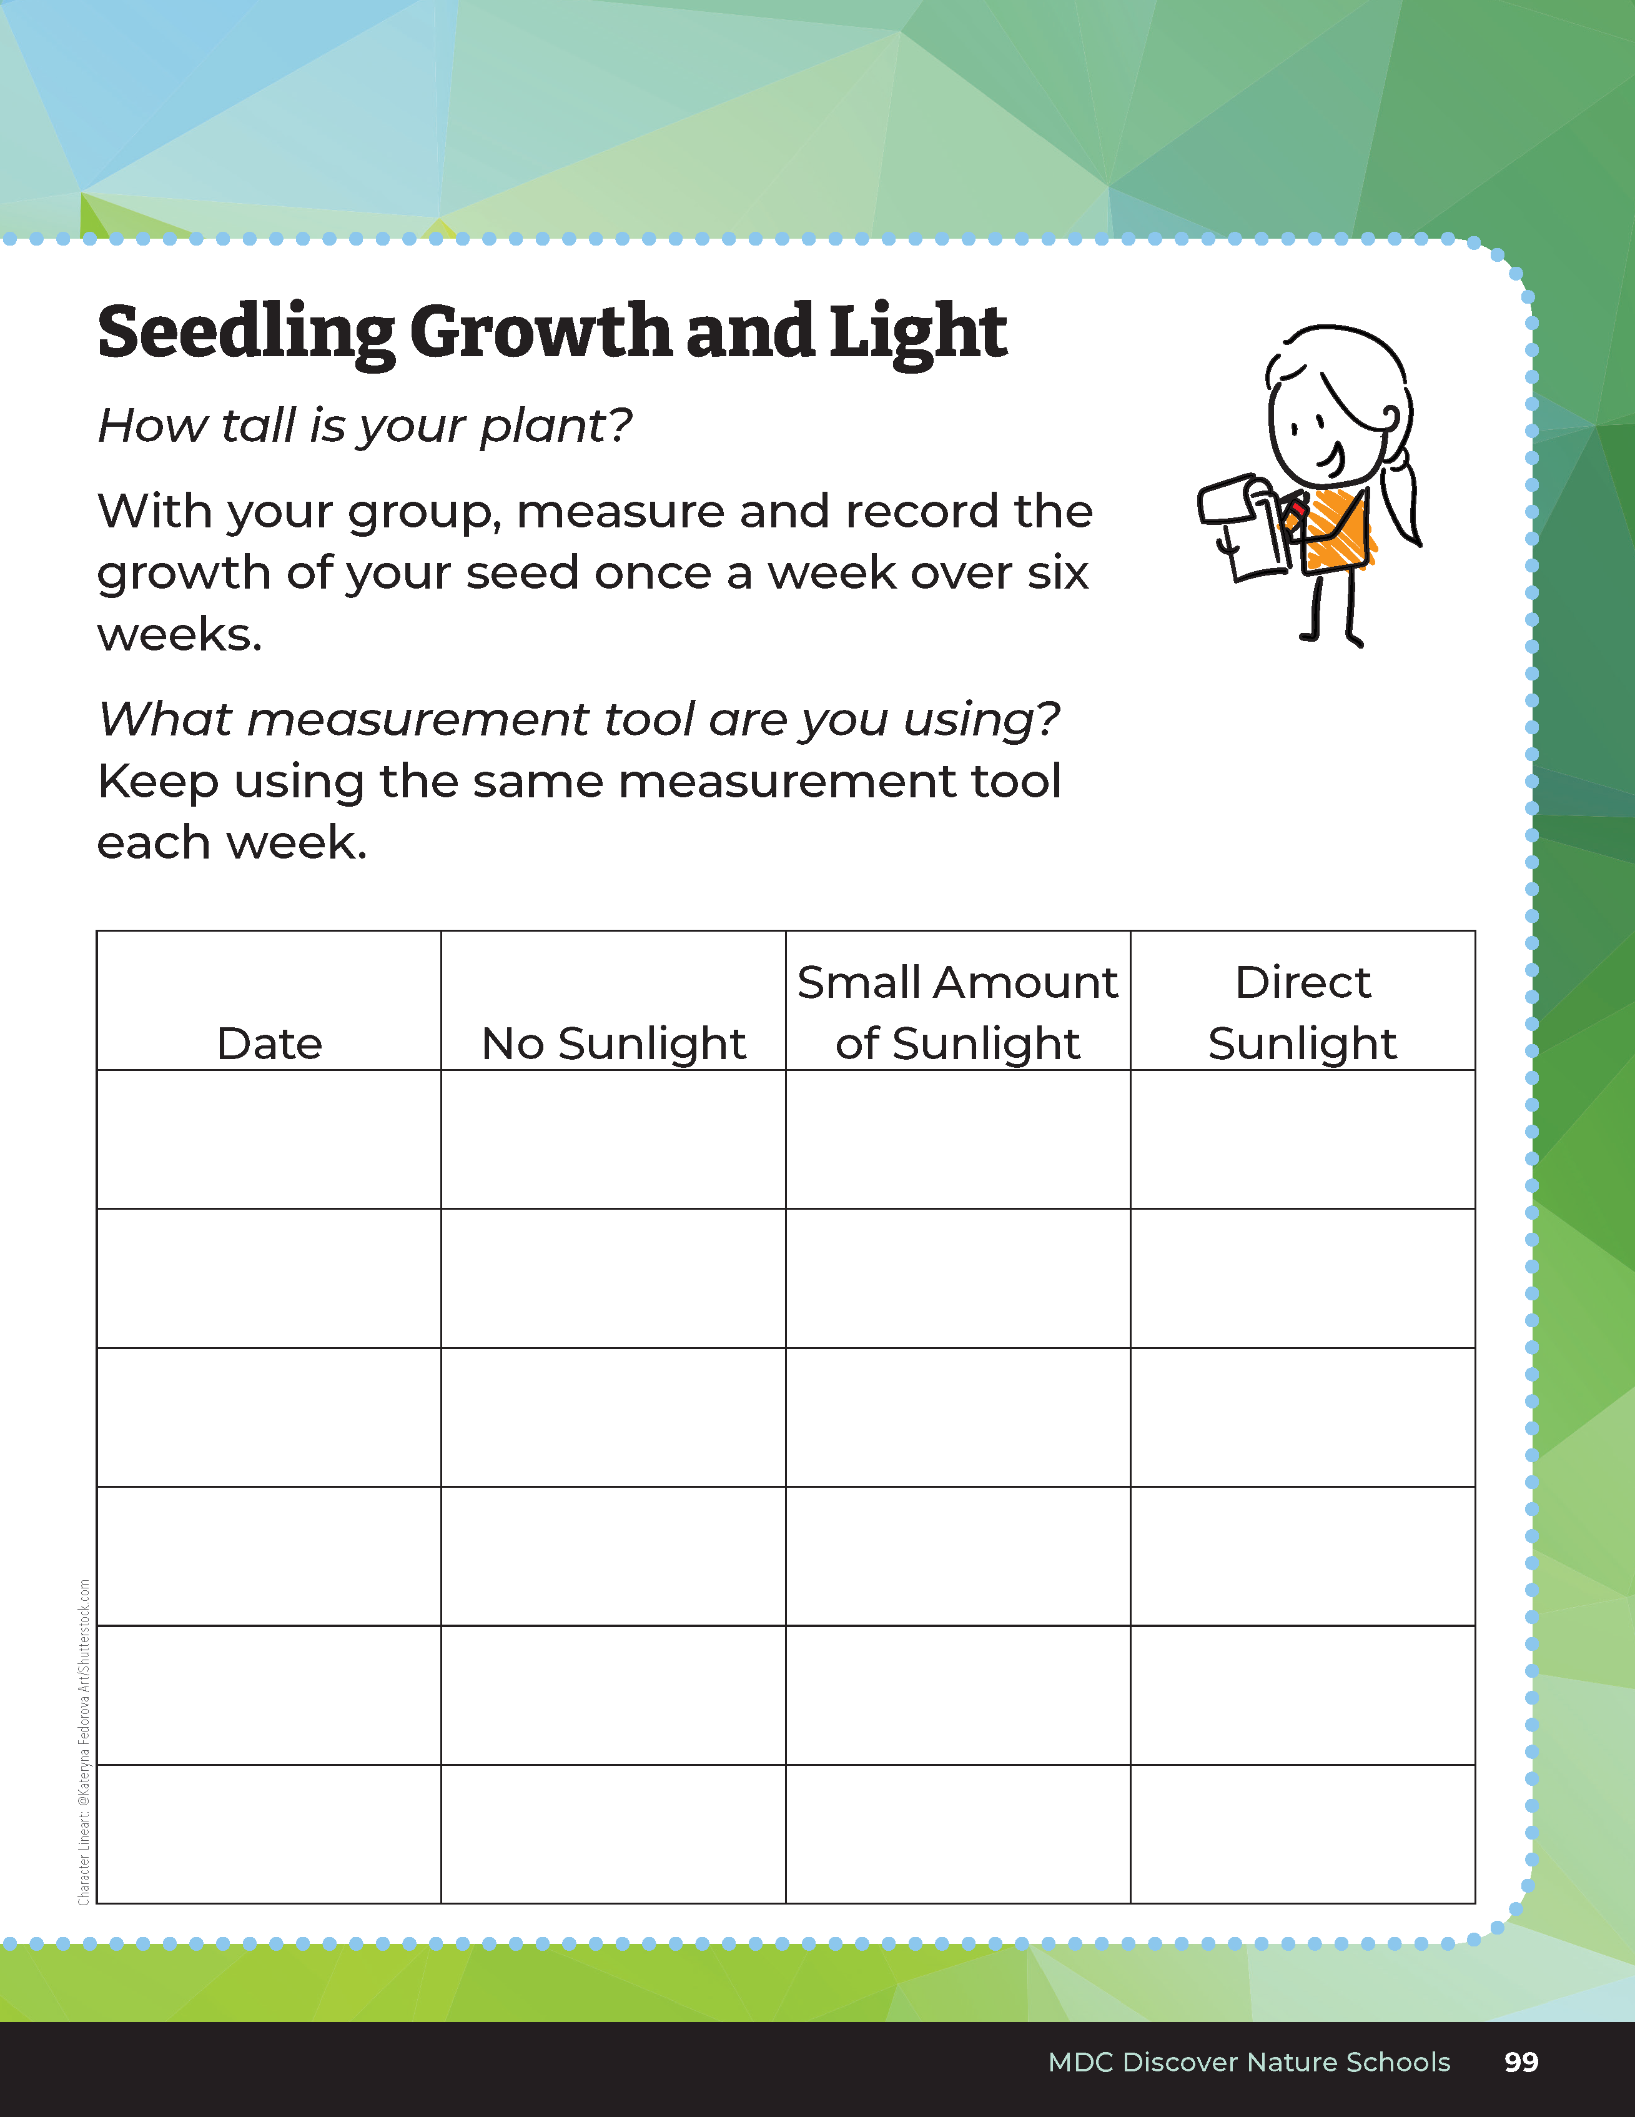
10
6
X
MINUTES
DAYS
Bears through the Seasons – 4B Sprouting Seedlings: Elaborate
14
Notes:
Set up and implement the investigations.
Students will collect data over the period of time teacher sets for this investigation. Students record results in the student guide, Science Notebook – Seedling Growth and Water and Seedling Growth and Light on pages 98-99.
Students will report and share their findings; all students will record data from each group’s water and light investigation.

Slide 15
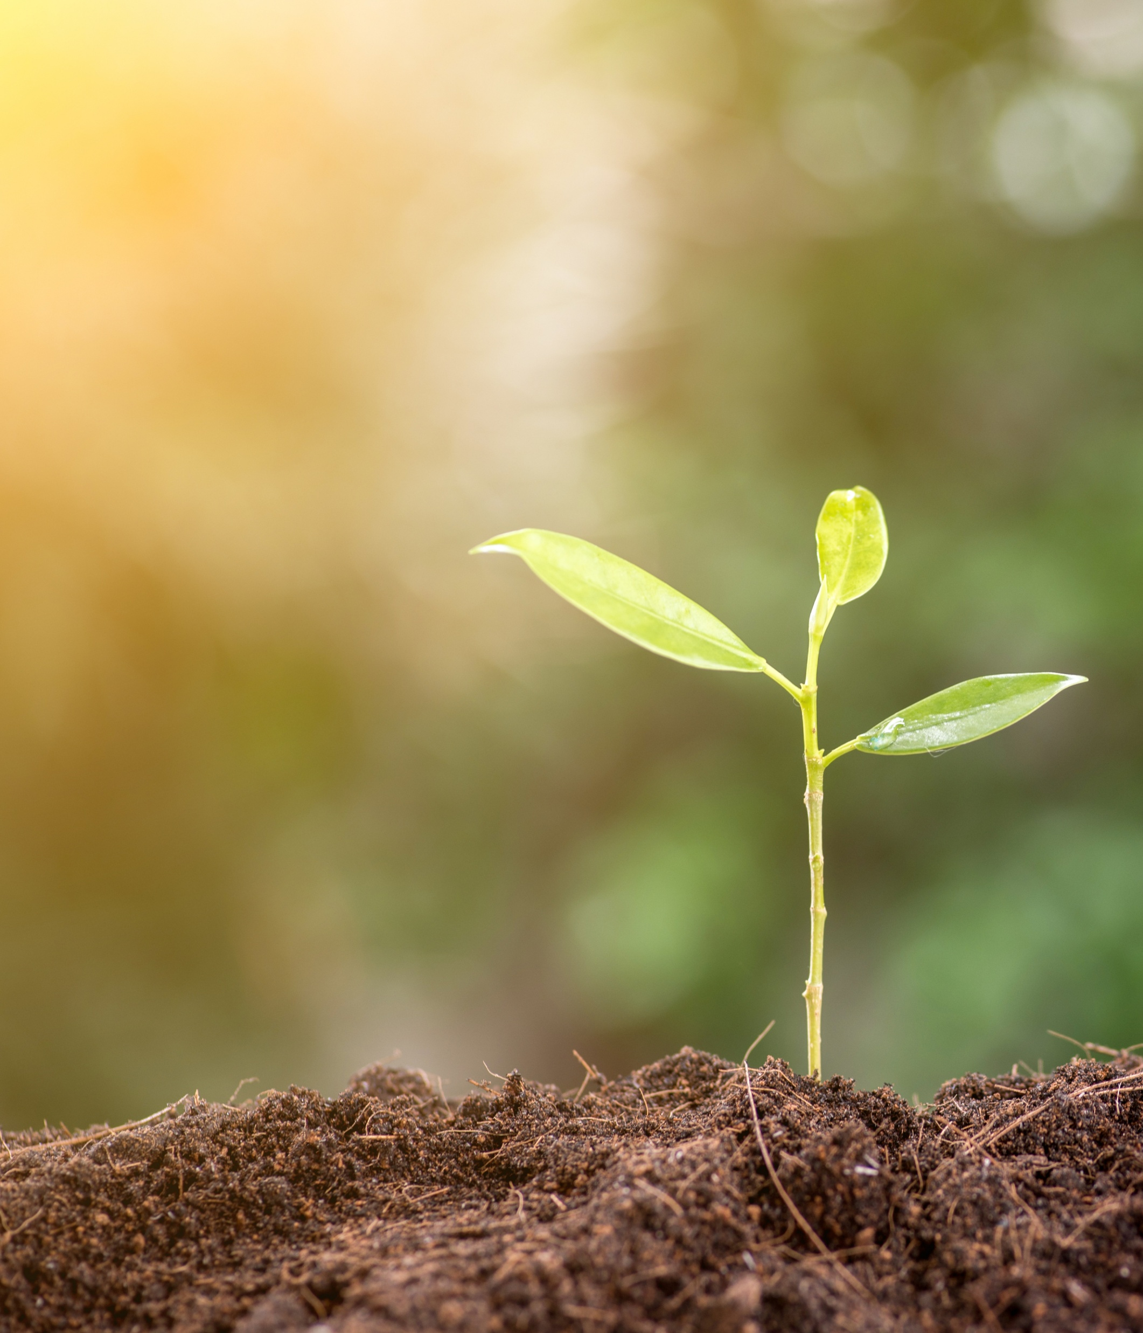
Based on what we found in our data sheets, what do plants need to grow and survive?
Bears through the Seasons – 4B Sprouting Seedlings: Elaborate
15

Slide 16
Bears through the Seasons – 4B Sprouting Seedlings: Elaborate
16
Notes:
Add student observations and/or questions to the Noticings and Wonderings Chart as the lesson concludes in reference to the phenomenon studied.

Slide 17
Create a T-chart comparing plant and animal needs.
Bears through the Seasons – 4B Sprouting Seedlings: Evaluate
17
Notes:
In previous units, animal needs have been taught. Have students reflect on this learning to scaffold learning about plants. Create a T-chart comparing plant and animal needs.

Slide 18
How does the availability of needs (light, food, water) affect organisms’ ability to survive?
Bears through the Seasons – 4B Sprouting Seedlings: Evaluate
18
Notes:
Student responses should serve as a basis of evaluation.

Slide 19


Optional: Cross-Curricular Extension
Write and illustrate a story about your growing plant seedling and how it lives day to day.
Bears through the Seasons – 4B Sprouting Seedlings: Cross-Curricular Extension
19
Notes:
Write and illustrate a story about your growing plant seedling and how it lives day to day. Does it receive what it needs to survive? If so, what will it look like at the end? Is it missing something that it needs? If so, what is it missing and what will it look like at the end of the story?

