Slide 1
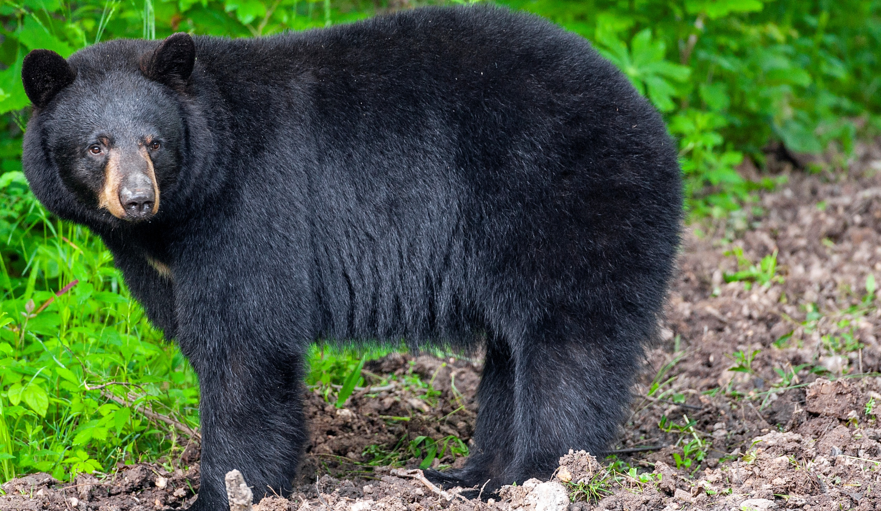

BEARS
Through the Seasons
Lesson 3D: Wake Up, Hungry Bears!

Slide 2
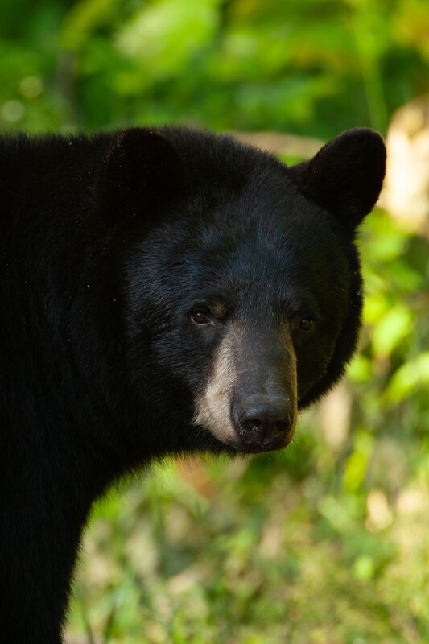

Guiding Question:
How do bears find food when they wake up?
Bears through the Seasons – 3D Wake Up, Hungry Bears: Engage
2

Slide 3

Bears through the Seasons – 3D Wake Up, Hungry Bears: Engage
3
Notes:
Prepare and display your Noticings and Wonderings Chart for this lesson. Add student observations and/or questions to the chart as the lesson proceeds in reference to the phenomenon studied.

Slide 4

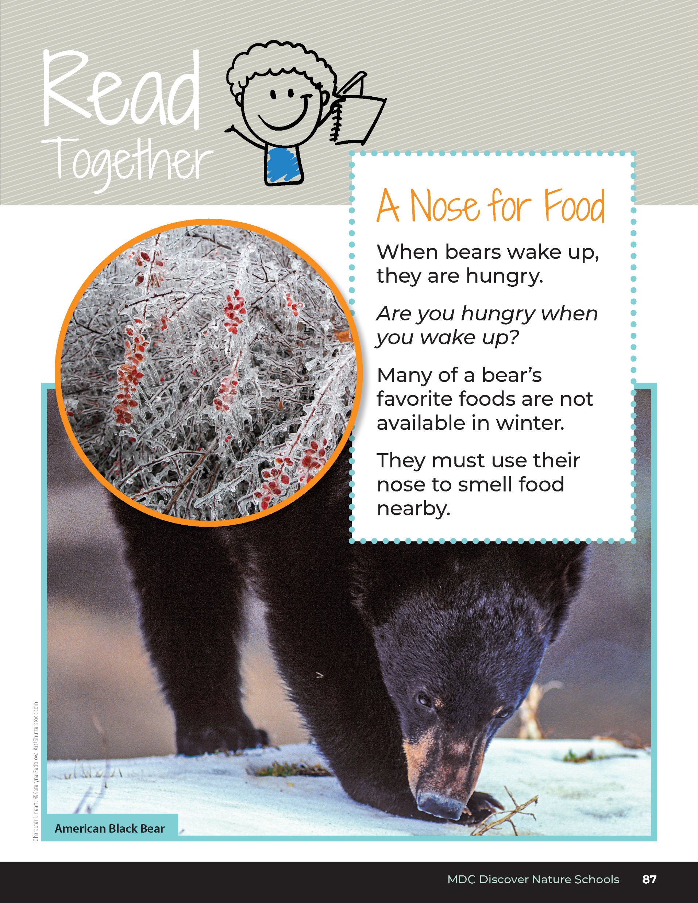
A Nose for Food
When bears wake up, they are hungry.
Are you hungry when you wake up?
Many of a bear’s favorite foods are not available in winter.
They must use their nose to smell food nearby.
Bears through the Seasons – 3D Wake Up, Hungry Bears: Engage
4
Notes:
Tell students that winter is almost over and spring is near. Read aloud from the student guide, Read Together A Nose for Food on Page 87.

Slide 5
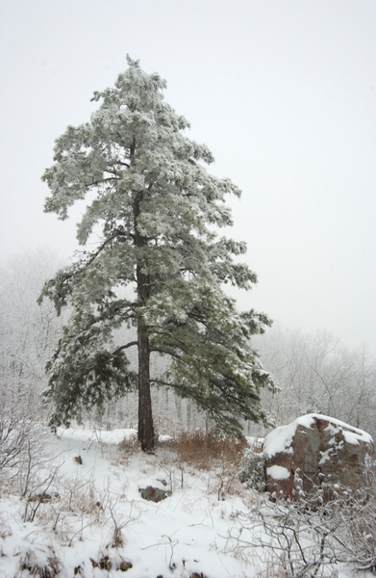
How do you think bears can find food in the winter if they happen to go out?
Bears through the Seasons – 3D Wake Up, Hungry Bears: Engage
5
Notes:
Discuss with students how winter affects a bear.
Wintertime for students may seem to drag on, as they may not go outside as often to play. Bears feel the same way sometimes. If there is an unusually warm day in winter, they may leave their dens in search of a snack. However, dead leaves and snow cover the ground. Bears have poor eyesight, but they have a strong sense of smell. They use this smell to find acorns and other foods.

Slide 6

Which sense do you think is the best for a bear?
Bears through the Seasons – 3D Wake Up, Hungry Bears: Engage
6
Notes:
Let’s see if you can name each of your senses.

Slide 7

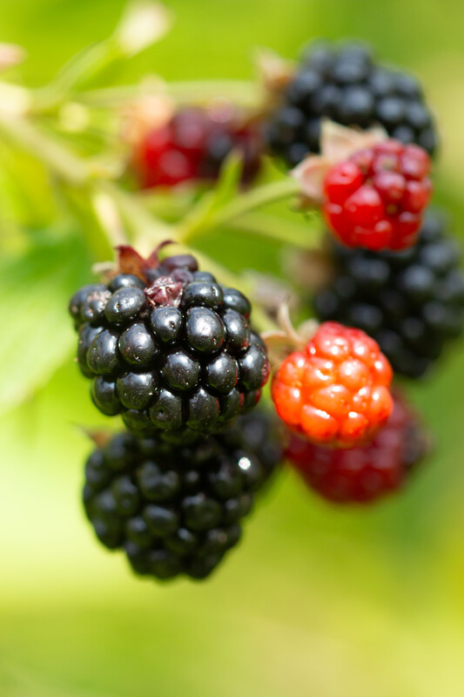
We are going to answer two questions:
What kinds of foods do bears look for to eat?
Bears through the Seasons – 3D Wake Up, Hungry Bears: Explore
7
Notes:
You will need five small boxes or jars. Copy and cut 3D Token Cutouts page from the handout following this lesson. Three of the boxes or jars will have pleasant scents of food in them that a bear might eat (raspberry extract, strawberry extract, almond extract, etc.), and two will have unpleasant scents (white vinegar, apple cider vinegar, etc.). Put several drops of extract onto a cotton ball so it has a heavy scent. Put the cotton balls in a small envelope that will sit on top of the box so students will be able to smell the scents. Put 12 tokens in the box or jar representing the nuts (almonds), 2 tokens into the box or jar representing raspberries, and 0 tokens into the box or jars that do not have a pleasant smell. Hide the boxes or jars with the correct envelopes on top inside or outside the classroom. Note: This activity can be done outside or in the classroom. Before students come into your classroom or go outside, you will need to hide the five boxes or jar of scents. Hide them under things like leaves if outside or a piece of cloth or paper if in classroom. Make sure you tell students the boundaries of where they may and may not go.
Tell students that they are going to be bears looking for food. They are going to answer two questions:
What kinds of foods do bears look for to eat?

Slide 8
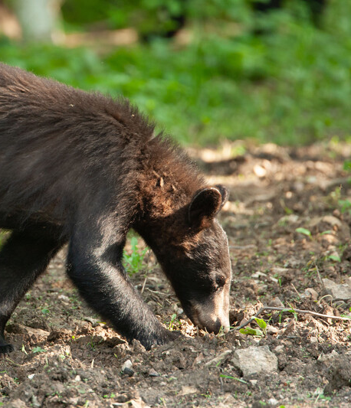
2. How will a bear find those foods?
Bears through the Seasons – 3D Wake Up, Hungry Bears: Explore
8
Notes:
Answer: Smell, sight, use their paws to dig.

Slide 9


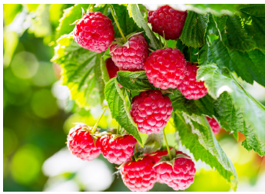
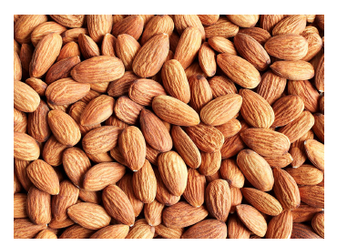

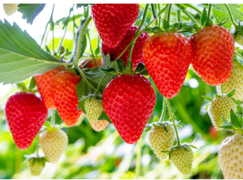
Identify the smell. Which smell is which?
Bears through the Seasons – 3D Wake Up, Hungry Bears: Explore
9
Notes:
Have a second set of the cotton balls (for all five boxes/jars) for the students to smell before they go find the boxes/jars with the scented cotton balls and tokens in them. Put those cotton balls in their own envelopes so they are easy to pass around.
Tell students that they will have to use the same methods a bear would use. Let them smell each of the smells and show their picture.

Slide 10

Let's make a prediction!
Of each food, what do you think you will find the most of?
Bears through the Seasons – 3D Wake Up, Hungry Bears: Explore
10
Notes:
Tell students that when they look for food, they are going to find a token in the box. The tokens are a model representing the amount of food there is for each type. The more tokens, the more of that food.
Of each food, what do you think you find the most of?

Slide 11

Create a predictions graph!
Bears through the Seasons – 3D Wake Up, Hungry Bears: Explore
11
Notes:
Make a chart of their predictions.

Slide 12
We are going to become bears! Around the classroom (or outside), you will search for 5 small boxes or jars with envelopes on them with a smell inside the envelope.
Bears through the Seasons – 3D Wake Up, Hungry Bears: Explore
12
Notes:
You will need five small boxes or jars. Copy and cut 3D Token Cutouts page from the handout following this lesson. Three of the boxes or jars will have pleasant scents of food in them that a bear might eat (raspberry extract, strawberry extract, almond extract, etc.), and two will have unpleasant scents (white vinegar, apple cider vinegar, etc.). Put several drops of extract onto a cotton ball so it has a heavy scent. Put the cotton balls in a small envelope that will sit on top of the box so students will be able to smell the scents. Put 12 tokens in the box or jar representing the nuts (almonds), 2 tokens into the box or jar representing raspberries, and 0 tokens into the box or jars that do not have a pleasant smell. Hide the boxes or jars with the correct envelopes on top inside or outside the classroom.

Slide 13
You have 2-3 minutes to search for different scents. If you find it, pull one token out of the box. Only the first to find food will get a token!
Bears through the Seasons – 3D Wake Up, Hungry Bears: Explore
13
Notes:
Note: This activity can be done outside or in the classroom. Before students come into your classroom or go outside, you will need to hide the five boxes or jar of scents. Hide them under things like leaves if outside or a piece of cloth or paper if in classroom. Make sure you tell students the boundaries of where they may and may not go.
Give students 2-3 minutes to search for the different scents. If they find it, they will pull one token out of the box. Tell them that there are only so many tokens, so only the first to find the food will get a token.
Review at the end: If they open a box or jar and sell the unpleasant smell, they will have no tokens to collect. Why? Because a bear may not be interested in that food. What was their favorite scent? Have students bring their tokes to you when they find one.

Slide 14
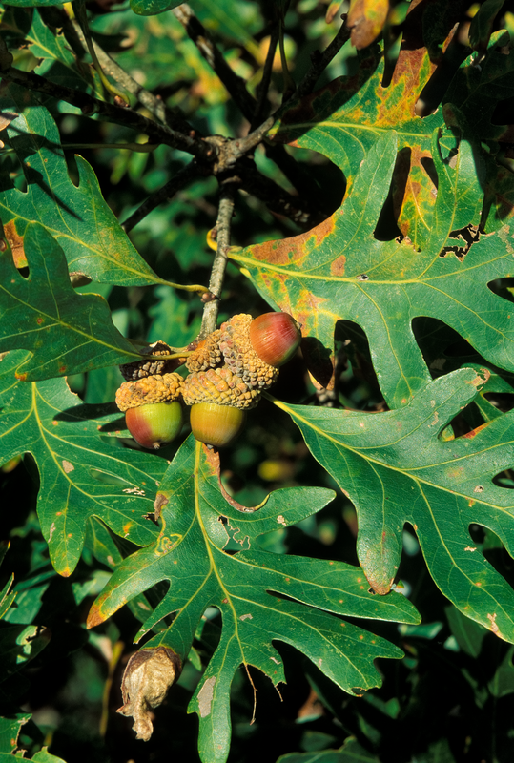
Remember, we are asking two questions:
What kinds of foods do bears look for to eat?
How will a bear find that food?
Bears through the Seasons – 3D Wake Up, Hungry Bears: Explore
14

Slide 15
If you find a token in the box, bring it to me.
What happens if you don't find any tokens?
Bears through the Seasons – 3D Wake Up, Hungry Bears: Explore
15
Notes:
Review at the end: If they open a box or jar and sell the unpleasant smell, they will have no tokens to collect. Why? Because a bear may not be interested in that food. What was their favorite scent? Have students bring their tokes to you when they find one.

Slide 16
Look at the types of tokens you found.
Bears through the Seasons – 3D Wake Up, Hungry Bears: Explain
16
Notes:
Berries are available during warmer times of the year. However, there may be some leftover acorns or roots that bears will eat in late winter or early spring.
Animals with wet noses have a better sense of smell. Bears have wet noses, so they have a good sense of smell. They use that sense of smell year-round to find food. However, bears have fairly small eyes and only see well up close. Sometimes they will stand on their back legs to look around, but they use their sense of smell the most to find food. Ask students to look at the types of tokens they found.

Slide 17
What were the tokens a model for?
Bears through the Seasons – 3D Wake Up, Hungry Bears: Explain
17
Notes:
Answer: Food a bear would eat.

Slide 18
Why were there only a few tokens in each box?
Bears through the Seasons – 3D Wake Up, Hungry Bears: Explain
18
Notes:
Answer: Only so much food out there.

Slide 19
How many of each of the tokens did the class find?
Bears through the Seasons – 3D Wake Up, Hungry Bears: Explain
19

Slide 20
Were there any tokens of the bad smelling foods?
Why weren’t there any tokens of those foods?
Bears through the Seasons – 3D Wake Up, Hungry Bears: Explain
20

Slide 21
Create a graph!
Bears through the Seasons – 3D Wake Up, Hungry Bears: Explain
21
Notes:
Work with the students to create a graph using the tokens that they found.
Use chart paper or whiteboard to construct the graph. Have students tape the tokens to the graph.

Slide 22
What patterns do you notice in the graph?
Bears through the Seasons – 3D Wake Up, Hungry Bears: Elaborate
22
Notes:
Discuss which type of food was eaten the most and the least.

Slide 23
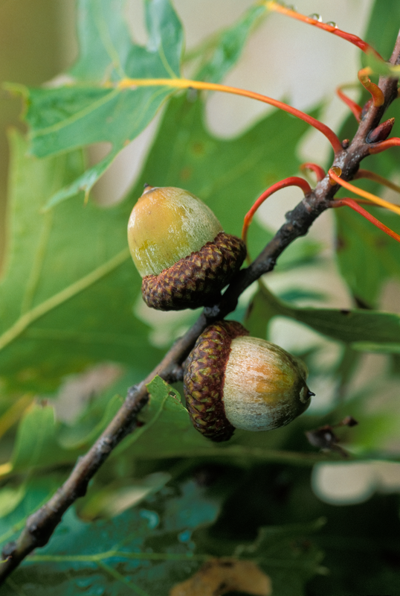
Why do bears eat more nuts than berries?
Bears through the Seasons – 3D Wake Up, Hungry Bears: Elaborate
23
Notes:
Answer: There are more nuts available to eat than berries, they may be easier to find, and they may be easier to get to.

Slide 24
What do the number of tokens tell us? What does it mean when there are no tokens?
Let's compare our graph of predictions to the graph of what we found.
Bears through the Seasons – 3D Wake Up, Hungry Bears: Elaborate
24
Notes:
Discuss if the types of food would change by season. Have students compare that graph with their original predictions. Discuss why it isn’t the same.

Slide 25
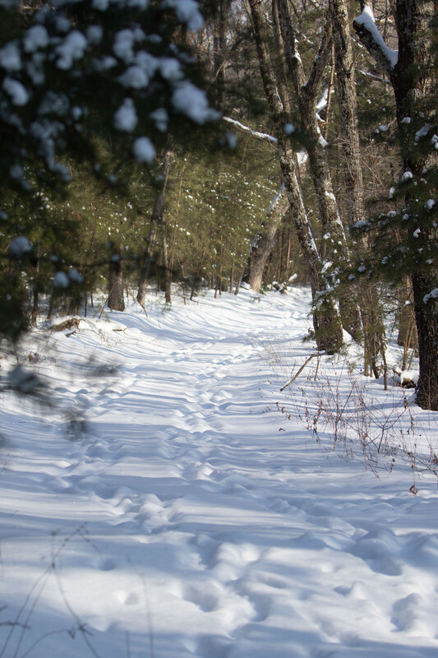
Do these foods really represent what a bear would eat in the winter? Why?
Bears through the Seasons – 3D Wake Up, Hungry Bears: Elaborate
25
Notes:
Answer: No – they are foods bears would eat in fall or summer.
Discuss that they may or may not go out to find food, but if they do it is not very often. Discuss how a bear’s sense of smell helps it to survive by helping it find food

Slide 26
Bears through the Seasons – 3D Wake Up, Hungry Bears: Elaborate
26
Notes:
Add student observations and/or questions to the Noticings and Wonderings Chart as the lesson concludes in reference to the phenomenon studied.

Slide 27
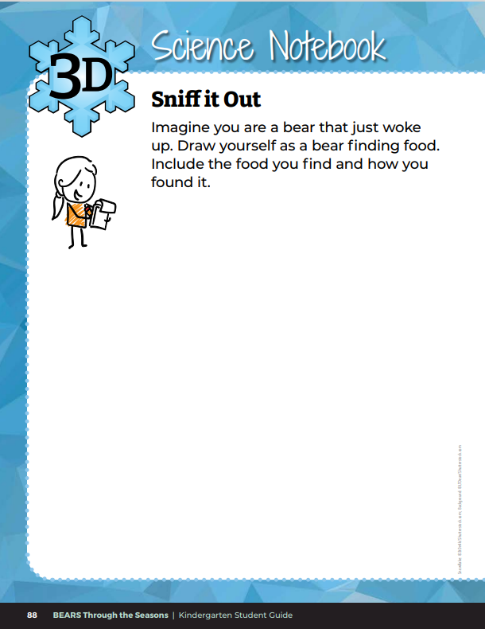
Draw yourself as a bear finding food.
Bears through the Seasons – 3D Wake Up, Hungry Bears: Evaluate
27
Notes:
Have students create a drawing in their student guide in Science Notebook Sniff it Out on Page 88. Students will imagine they are a bear and just woke up. They will draw themselves as a bear finding food and include the food they found and how they found it.

Slide 28

Read the book Under the Snow by Melissa Stewart
Link to book on Epic!: Under the Snow by Melissa Stewart
Available for free to classroom teachers on Epic! (login required)
Link to Read-Aloud: https://youtu.be/BgIEXhaS1Xc?si=49q5i74TQJq8uzFs
Bears through the Seasons – 3D Wake Up, Hungry Bears: Extend
28
Notes:
Read the book Under the Snow by Melissa Stewart.

Slide 29
How do other Missouri animals survive the winter?
How do they compare to a bear?
Bears through the Seasons – 3D Wake Up, Hungry Bears: Extend
28
Notes:
Discuss how other Missouri animals look for food. Have students compare differences and similarities that those animals have to bears.

Slide 30


Optional: Cross-Curricular Extension
What did you have for breakfast or lunch? What types of food do we need?
Let's graph it!
Bears through the Seasons – 3D Wake Up, Hungry Bears: Extend
30
Notes:
Discuss what students had for breakfast or lunch. As a class, create a shopping list for getting all these items from the grocery store. Count how many items are on your list. Split your list out by fruits and vegetables, meat, grains, dairy, sweets, drinks, etc. Graph the number of different foods by category.

