Slide 1
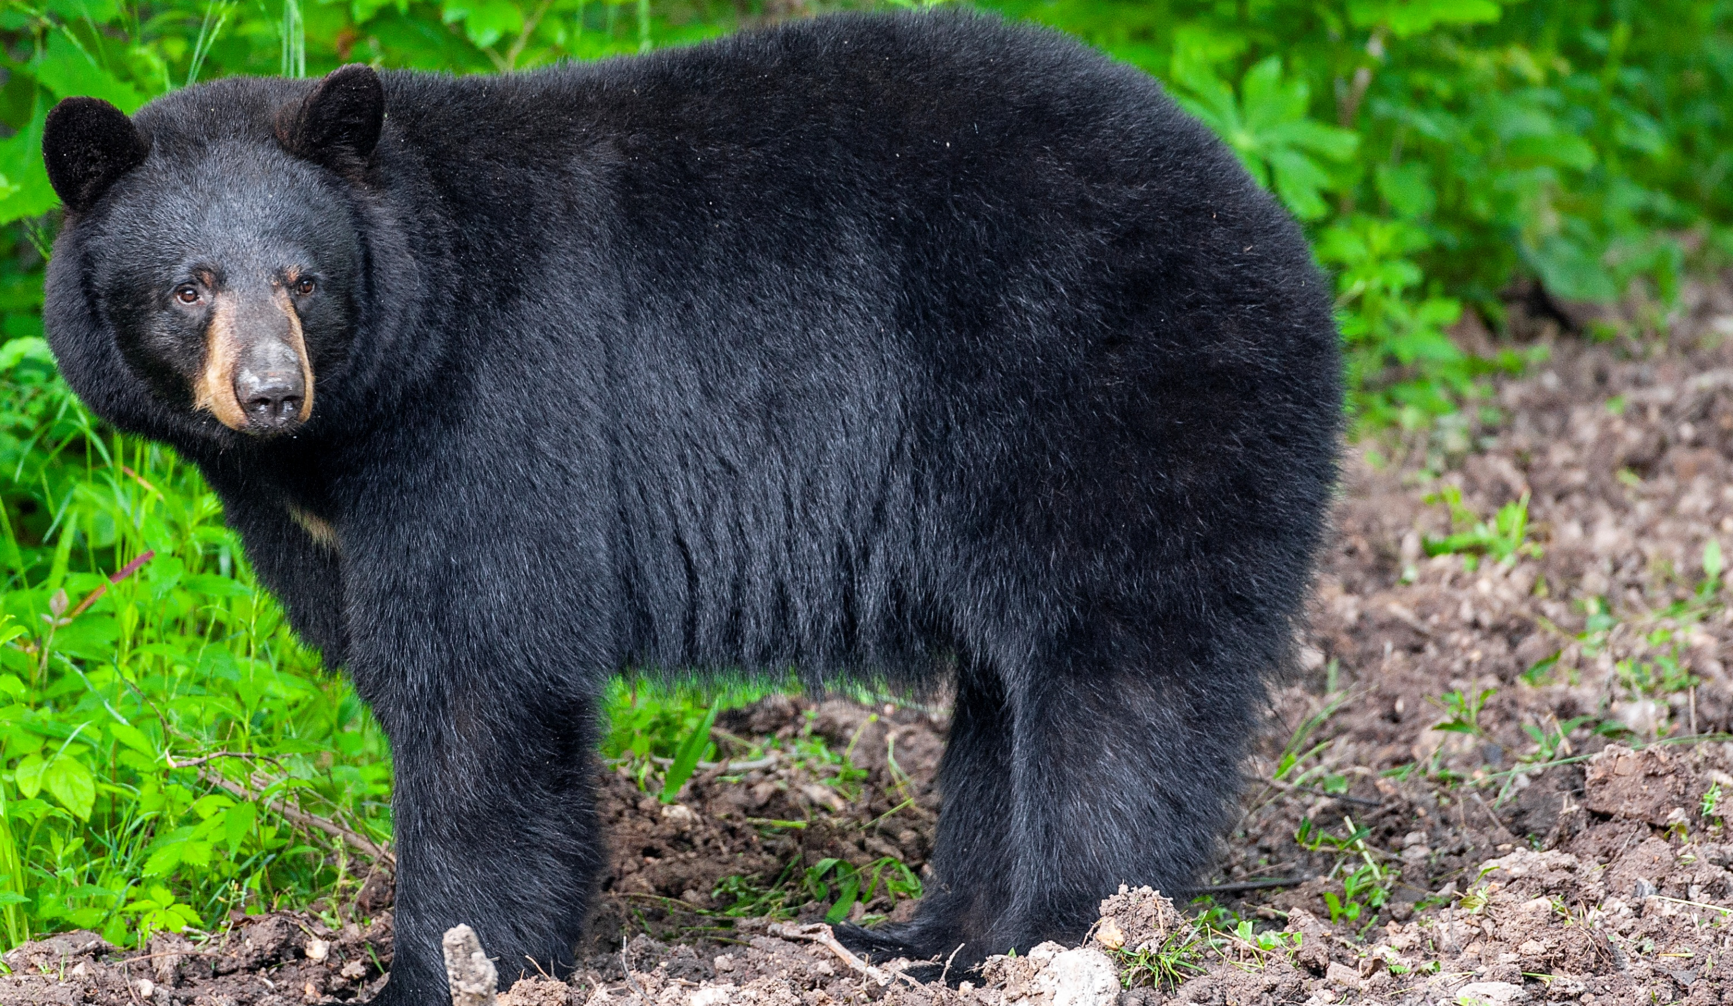
BEARS
Through the Seasons
Lesson 3C: Surviving a Storm

Slide 2
Guiding Question:
How do our homes keep us safe during bad weather?
Bears through the Seasons – 3C Surviving a Storm: Engage
2

Slide 3
Bears through the Seasons – 3C Surviving a Storm: Engage
3
Notes:
Prepare and display your Noticings and Wonderings Chart for this lesson. Add student observations and/or questions to the chart as the lesson proceeds in reference to the phenomenon studied.

Slide 4
Read the book What is Severe Weather? by Jennifer Boothroyd
Link to book on Epic!: What is Severe Weather? By Jennifer Boothroyd
Available for free to classroom teachers on Epic! (login required)
Link to Read-Aloud: https://youtu.be/mqG-prBYH7A?si=QgrYm7DjNQF7k1vX
Bears through the Seasons – 3C Surviving a Storm: Engage
4
Notes:
Prepare and display your Noticings and Wonderings Chart for this lesson. Add student observations and/or questions to the chart as the lesson proceeds in reference to the phenomenon studied.

Slide 5
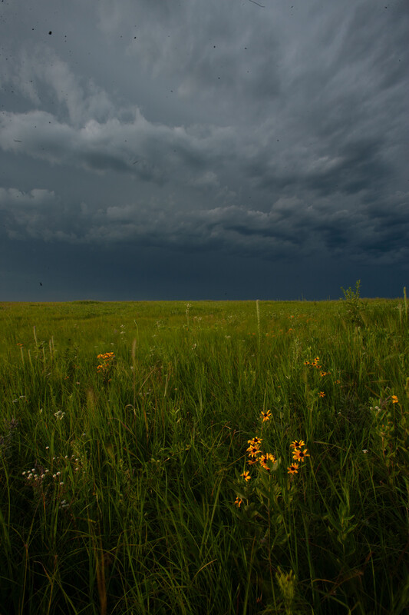
How do we know unsafe weather is coming?
Bears through the Seasons – 3C Surviving a Storm: Engage
5

Slide 6
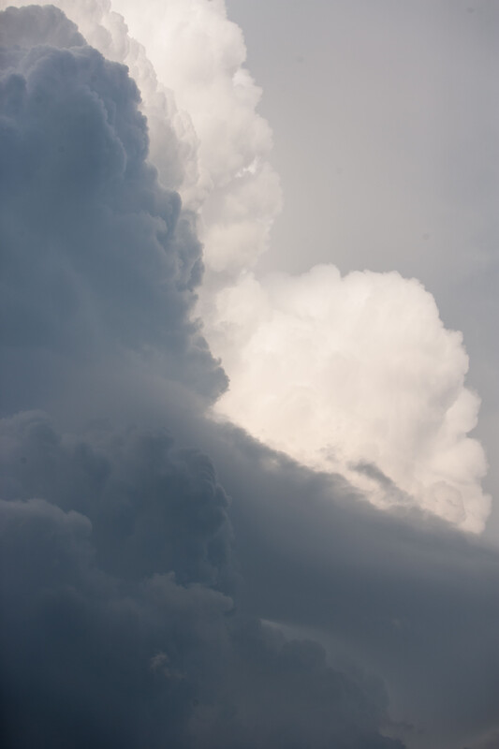
Can we tell by how the sky changes?
What does it look like?
Bears through the Seasons – 3C Surviving a Storm: Engage
6

Slide 7
Is there anything that can warn us in advance that a storm is coming?
Bears through the Seasons – 3C Surviving a Storm: Engage
7

Slide 8
Be Prepared
The wind blows fast
We look and see,
The sky turns dark
For bears and me.
The air is cold
Safe home we run.
Bears are safe,
In their den when the storm is done.
Bears through the Seasons – 3C Surviving a Storm: Engage
8
Notes:
Read aloud together from the student guide Read Together Be Prepared on Page 83.

Slide 9
Be Prepared
What kind of weather is in this photo?
How can we tell that unsafe weather is coming?
Bears through the Seasons – 3C Surviving a Storm: Engage
9
Notes:
Read aloud together from the student guide Read Together Be Prepared on Page 83.

Slide 10
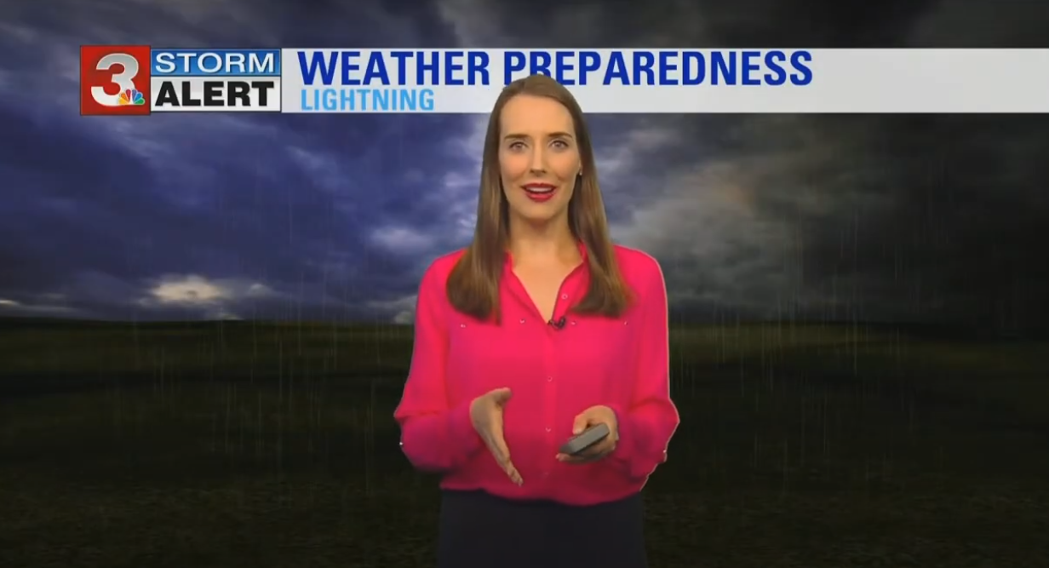
Link: Weather Wise: Kids - Howto stay safe in severe weather
Bears through the Seasons – 3C Surviving a Storm: Engage
10
Notes:
Show students a short clip of a weather forecast that is predicting severe weather (play an online recording from the MDC Teacher Portal Kindergarten Lesson 3C link)

Slide 11
What are the three questions we should ask when severe weather is coming?
Bears through the Seasons – 3C Surviving a Storm: Engage
11
Notes:
Answer: Where (where is the storm happening), When (are the storms happening), and Action (what should we do?)

Slide 12
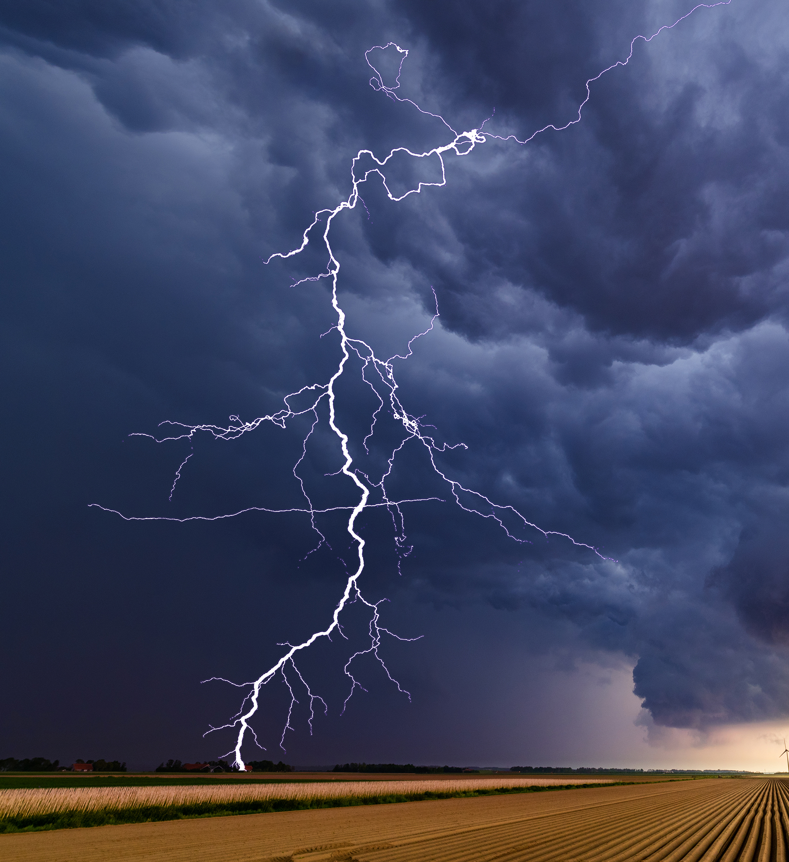
What should we do during a thunderstorm?
Bears through the Seasons – 3C Surviving a Storm: Engage
12
Notes:
Answer: Go inside, stay away from trees, etc.

Slide 13
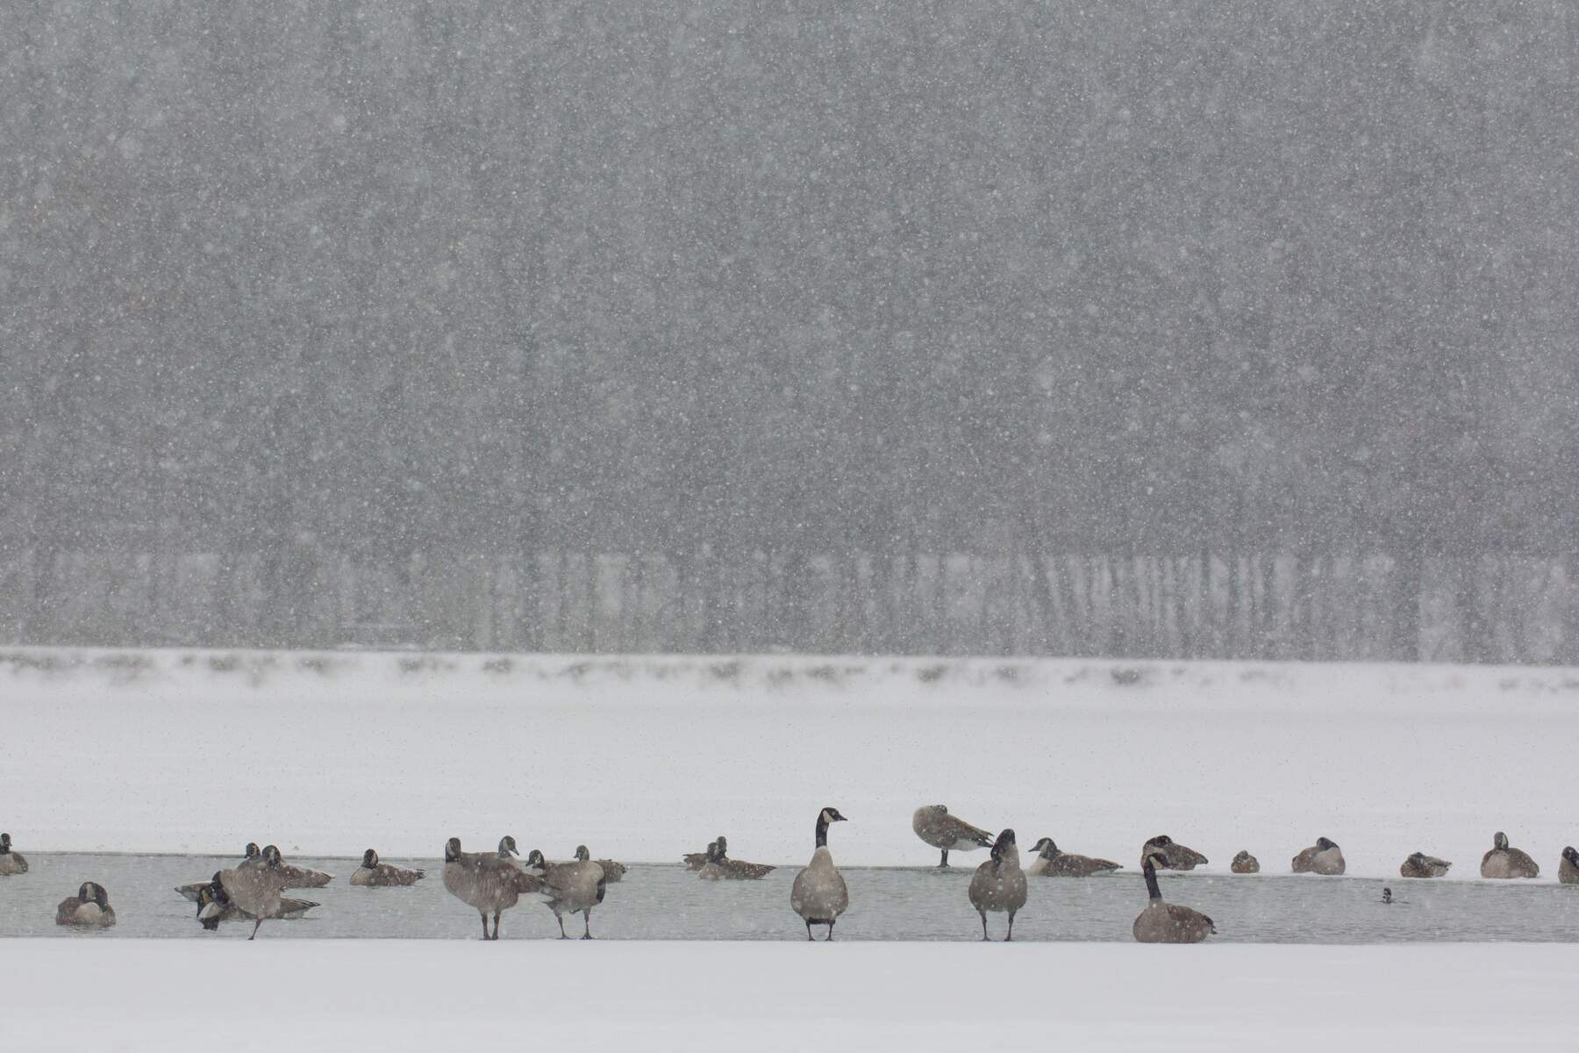
A blizzard?
Bears through the Seasons – 3C Surviving a Storm: Engage
13
Notes:
Answer: Go inside, get blankets in case electricity is lost, etc.

Slide 14
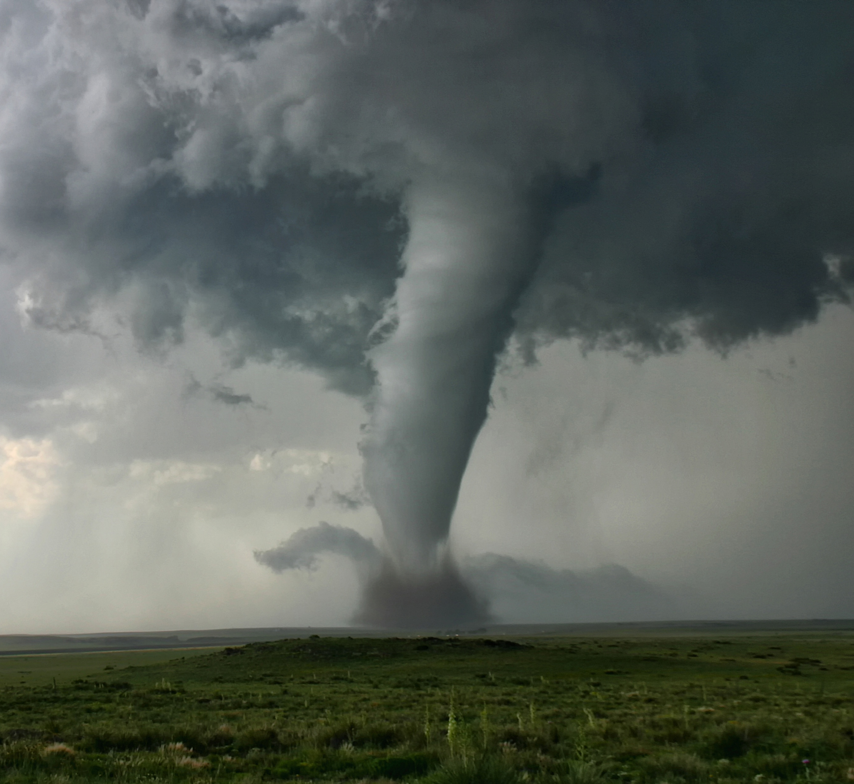
A tornado?
Bears through the Seasons – 3C Surviving a Storm: Engage
14
Notes:
Answer: Go to a basement or center/small room of a house like a bathroom, etc.

Slide 15
For people to stay safe from severe weather, they need to build structures that will keep them safe.
Bears through the Seasons – 3C Surviving a Storm: Explore
15

Slide 16
You are going to build a model of a house that will keep the people inside dry and safe from severe weather.
Bears through the Seasons – 3C Surviving a Storm: Explore
16

Slide 17
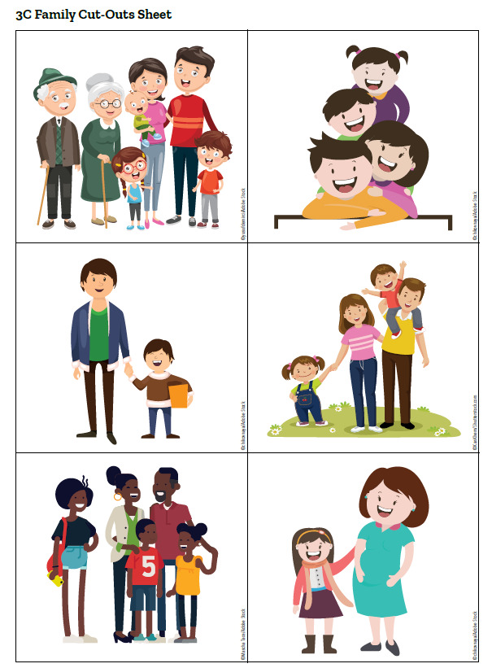
As a group, remember:
The shelter should just be big enough to keep the family given to you safe and dry.
Bears through the Seasons – 3C Surviving a Storm: Explore
17
Notes:
Divide students into groups of 2-3 to build a structure together. Give each group paper cutouts from 3C Family Cutouts Sheet.
Tell them that the shelter should just be big enough to keep the family dry and safe. Have a wide variety of materials available for the students to create a small shelter. Tell them that they need to make sure no water or snow can get into their buildings. Also, water and snow shouldn’t be allowed to accumulate on the roof of their structure because it could get heavy and collapse. This is especially true with snow. Give the students time to build their structure. Put the structures in a plastic show box or in a sink to help with clean up.

Slide 18
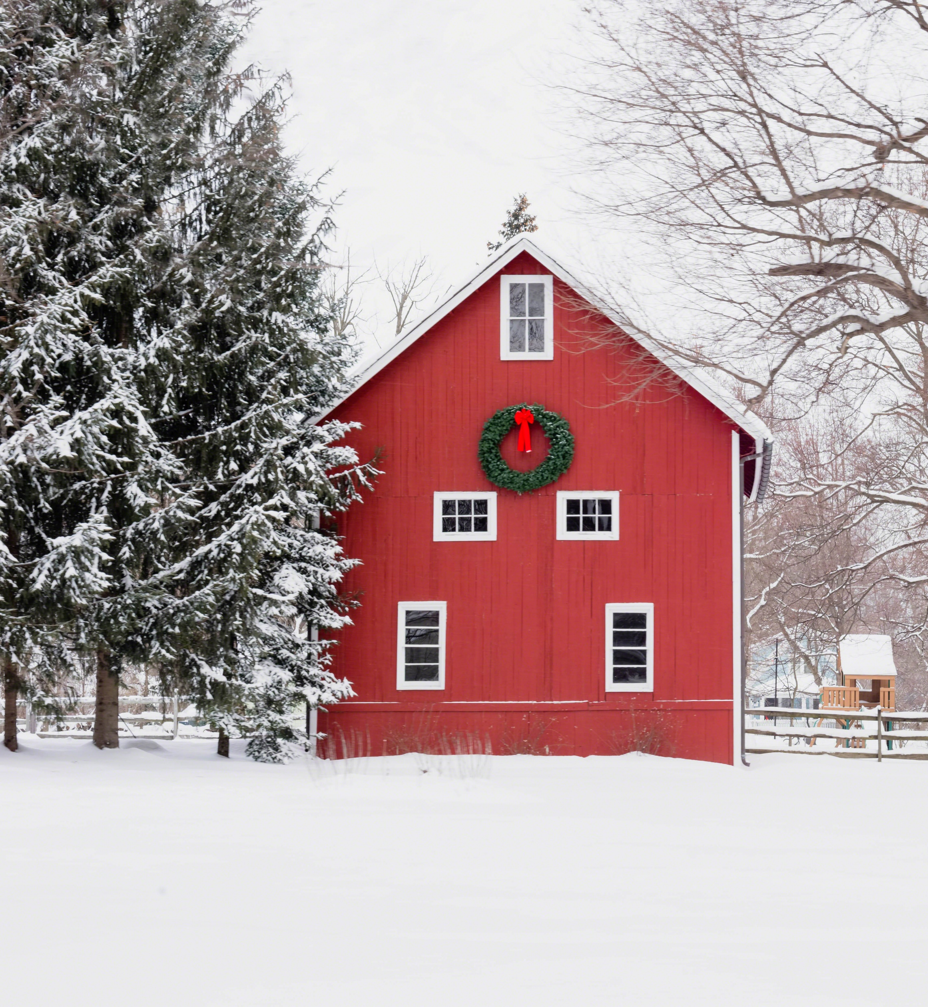
As a group, remember:
The shelter should protect the family from rain and snow.
How will we test this?
Bears through the Seasons – 3C Surviving a Storm: Explore
18
Notes:
Divide students into groups of 2-3 to build a structure together. Give each group paper cutouts from 3C Family Cutouts Sheet.
Tell them that the shelter should just be big enough to keep the family dry and safe. Have a wide variety of materials available for the students to create a small shelter. Tell them that they need to make sure no water or snow can get into their buildings. Also, water and snow shouldn’t be allowed to accumulate on the roof of their structure because it could get heavy and collapse. This is especially true with snow. Give the students time to build their structure. Put the structures in a plastic show box or in a sink to help with clean up.

Slide 19
As a group, remember:
The water and snow should not gather on the roof because it may fall.
How will we test this?
Bears through the Seasons – 3C Surviving a Storm: Explore
19
Notes:
Divide students into groups of 2-3 to build a structure together. Give each group paper cutouts from 3C Family Cutouts Sheet.
Tell them that the shelter should just be big enough to keep the family dry and safe. Have a wide variety of materials available for the students to create a small shelter. Tell them that they need to make sure no water or snow can get into their buildings. Also, water and snow shouldn’t be allowed to accumulate on the roof of their structure because it could get heavy and collapse. This is especially true with snow. Give the students time to build their structure. Put the structures in a plastic show box or in a sink to help with clean up.

Slide 20
As a group:
Use the materials available to build your shelter. We will test using the same methods before – a spray bottle and flour.
Bears through the Seasons – 3C Surviving a Storm: Explore
20
Notes:
Divide students into groups of 2-3 to build a structure together. Give each group paper cutouts from 3C Family Cutouts Sheet.
Tell them that the shelter should just be big enough to keep the family dry and safe. Have a wide variety of materials available for the students to create a small shelter. Tell them that they need to make sure no water or snow can get into their buildings. Also, water and snow shouldn’t be allowed to accumulate on the roof of their structure because it could get heavy and collapse. This is especially true with snow. Give the students time to build their structure. Put the structures in a plastic show box or in a sink to help with clean up.

Slide 21
Testing Directions:
Sprinkle ¼ cup of flour over the structure first to make sure snow can’t get in or accumulate on the roof.
Then, pour a cup of water over the shelter to make sure the family stays dry.
Have students check their family to make sure they didn’t get wet or have snow on them.
Have students discuss the shelter designs and why they think some worked better than others.
Bears through the Seasons – 3C Surviving a Storm: Explore
21

Slide 22
Discuss shelter designs and why some worked better than others.
Bears through the Seasons – 3C Surviving a Storm: Explore
22

Slide 23
How did the materials and the shape of the roof help in keeping your family safe and dry during the storm?
Bears through the Seasons – 3C Surviving a Storm: Explain
23
Notes:
Discuss: Both animals and people have learned to use their environment to protect themselves from unsafe weather. We build houses made of brick, stone, and siding that are strong and sturdy. Most roofs have a tilt to them so snow and rain can run off.

Slide 24
What worked best? Why?
Bears through the Seasons – 3C Surviving a Storm: Explain
24

Slide 25
What didn’t work as well? Why?
Bears through the Seasons – 3C Surviving a Storm: Explain
25

Slide 26
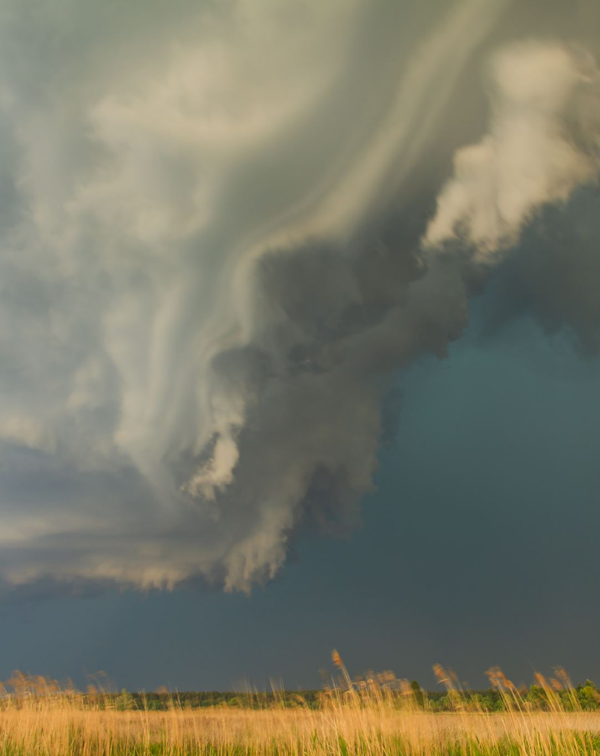
Do storms develop quickly or slowly?
Bears through the Seasons – 3C Surviving a Storm: Explain
26

Slide 27
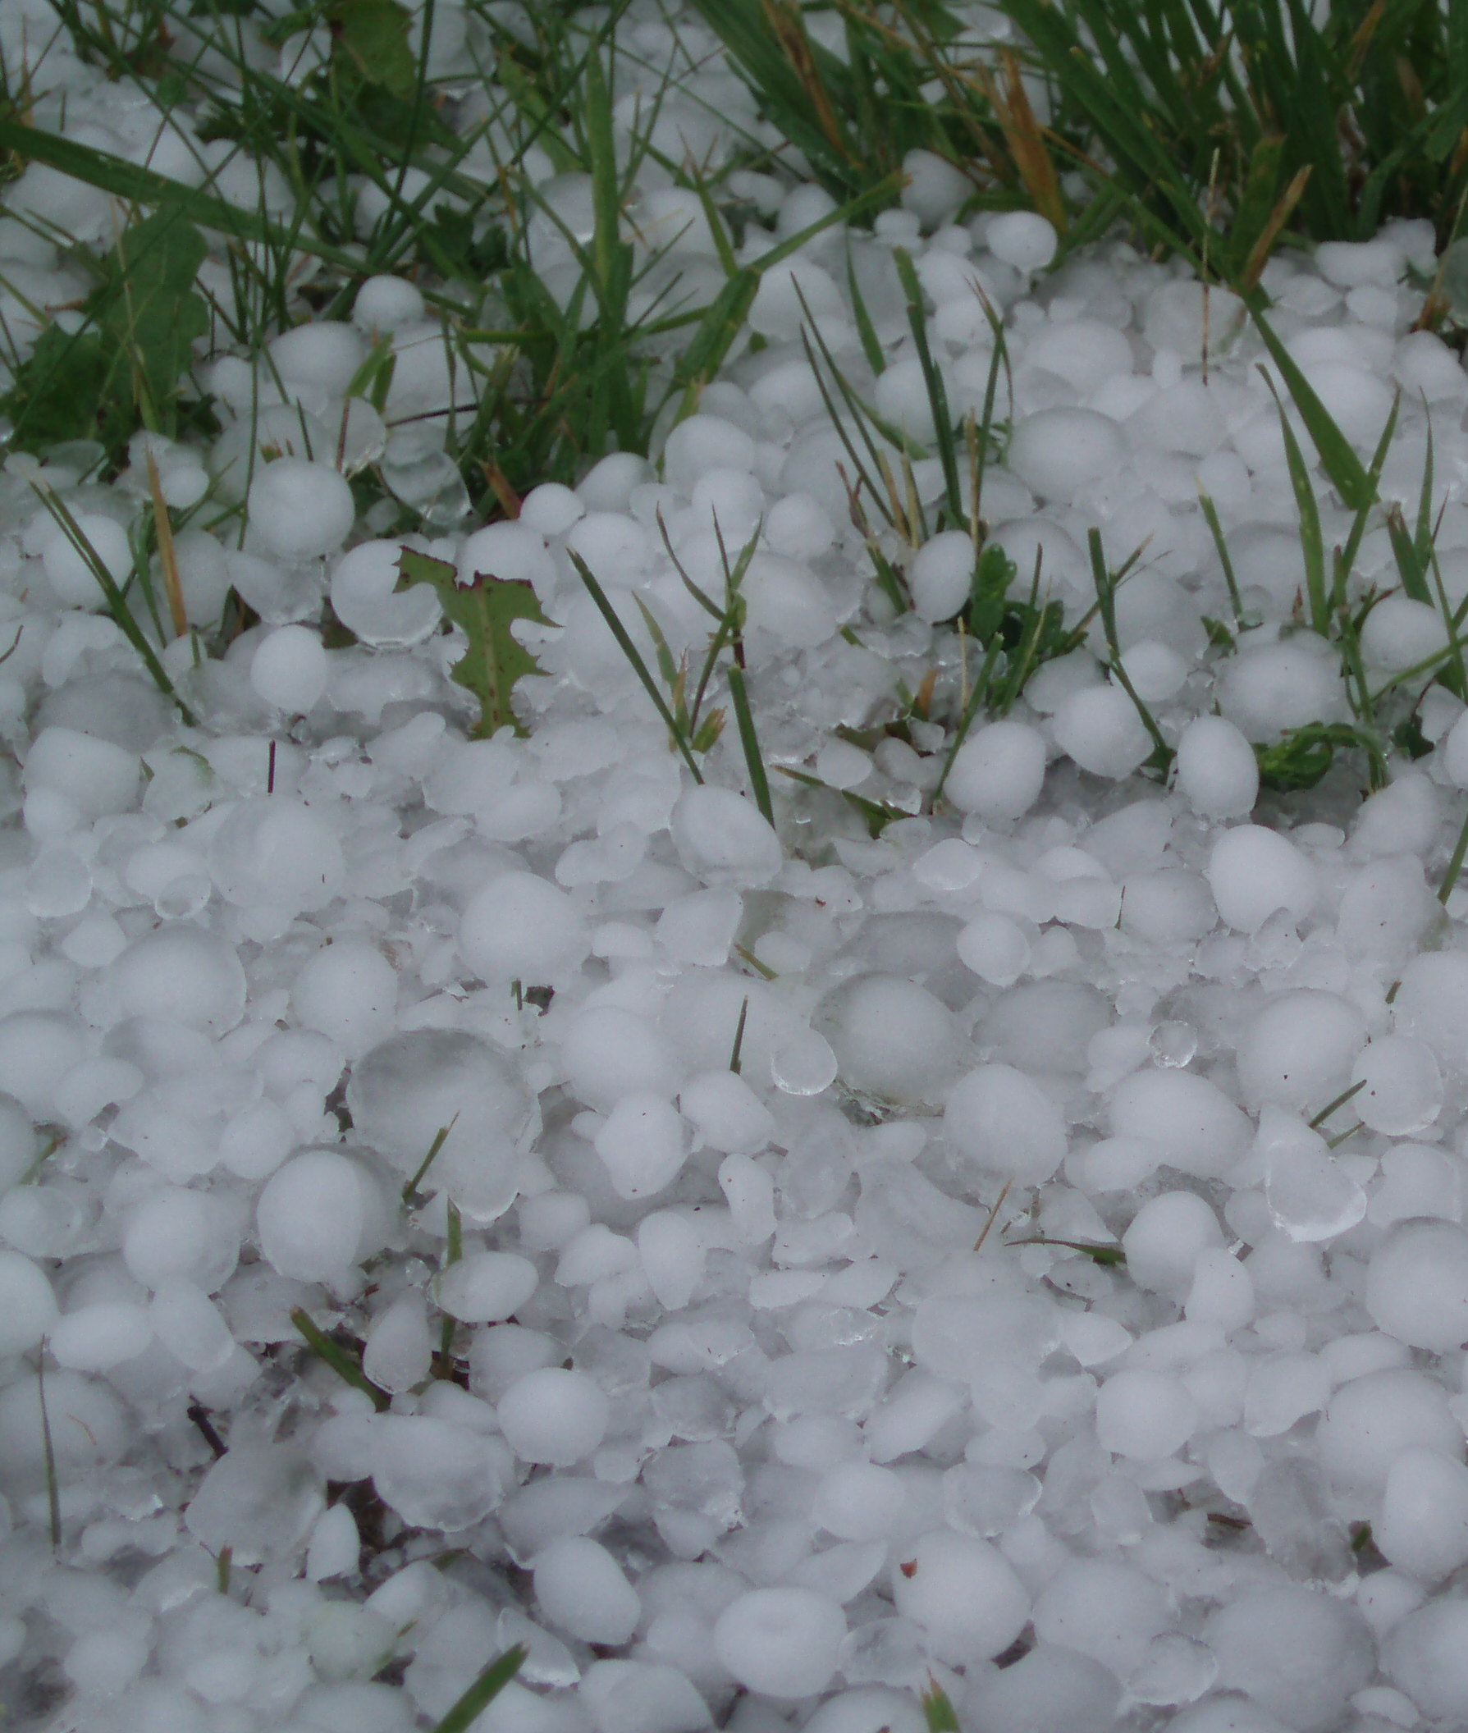
What about a tornado or hail that forms during a storm? Does it develop quickly or slowly?
Bears through the Seasons – 3C Surviving a Storm: Explain
27
Notes:
Answer: The weather can be stable for a while (same every day, but severe weather can change quickly.

Slide 28
How do weather forecasts help us prepare?
Bears through the Seasons – 3C Surviving a Storm: Explain
28
Notes:
Answer: They give us time to take shelter. If we didn’t have weather forecasts, then we wouldn’t have as much time to prepare.

Slide 29
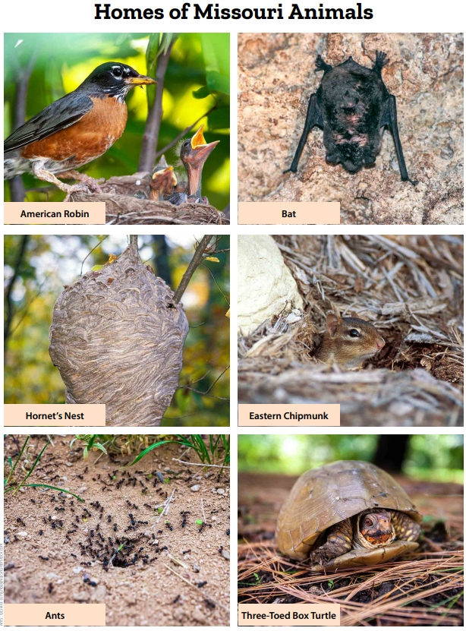
How are the structures we build as humans like these animal structures? How are they different?
Bears through the Seasons – 3C Surviving a Storm: Elaborate
29
Notes:
Refer to the 3C Homes of Missouri Animals page at the end of this lesson in the teacher guide. Compare the materials and designs of various animal shelters (Missouri animals) to that of shelters that humans build:
How are the structures we build as humans like these animal structures? How are they different?
Discuss with the students how each shelter can protect the living things inside of it.

Slide 30
How do these shelters compare to a bear den?
Bears through the Seasons – 3C Surviving a Storm: Elaborate
30
Notes:
Discuss how each will handle rain or snow (a robin’s nest will let the rain go through and the tree’s leaves/branches protect it; the bat is in a cave with safe sturdy walls; ants and chipmunks go below ground where they are safe; turtles use their curved shells as a home; hornets create nests that let rain and snow slide off much like it would on a house’s roof).

Slide 31
Bears through the Seasons – 3B Surviving a Storm: Elaborate
31
Notes:
Add student observations and/or questions to the Noticings and Wonderings Chart as the lesson concludes in reference to the phenomenon studied.

Slide 32
Draw a shelter that will keep a family safe and dry from severe weather.
Bears through the Seasons – 3C Surviving a Storm: Evaluate
32
Notes:
In the student guide Science Notebook A Safe and Snug Shelter, using what they’ve learned, have students draw a shelter that keep a family safe.

Slide 33
Why do you think this is the best shelter?
Bears through the Seasons – 3C Surviving a Storm: Evaluate
33
Notes:
Divide students into small groups to share their design and have them explain why this shelter will jeep their family safe.

Slide 34
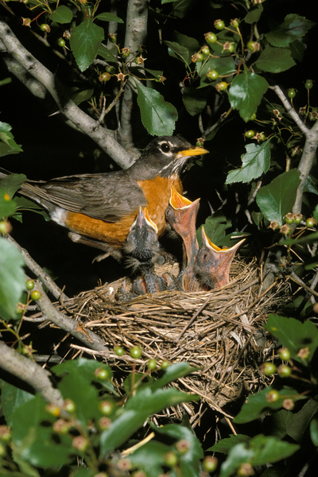
How do humans and animals move materials to build their shelter?
Bears through the Seasons – 3C Surviving a Storm: Extend
34
Notes:
Tell students that when animals and people build shelters, they change the environment. They do so by moving things around, taking materials from one place to another.
How do humans and animals move materials to build their shelter? (Answer: People use wood from trees to build houses, animals use twigs and leaves to build a nest.)
Tell students that animals can change their environment for other reasons besides just building a shelter. Tell them that plants can too!

Slide 35
Link: https://youtu.be/EztOwUzjz_4
Bears through the Seasons – 3C Surviving a Storm: Extend
35
Notes:
On the MDC Teacher Portal go to Kindergarten Lesson 3C to watch the How Plants and Animals Change Their Environment video.

Slide 36
Optional: Cross-Curricular Extension
Include type of weather
Include how to prepare
Weather Report-Role Play
Bears through the Seasons – 3C Surviving a Storm: Cross-Curricular Extension
36
Notes:
Weather Report-Role Play: Tell students they will each get a turn to be a television weather reporter. Small props such as a toy microphone, chalkboard, or whiteboard can be used.
Give each student a specific type of weather forecast and let their imaginative play begin. Let them role play, discussing how they will inform or warn the audience of severe weather, perhaps including what clothing attire to dress in for the upcoming weather.

