Slide 1
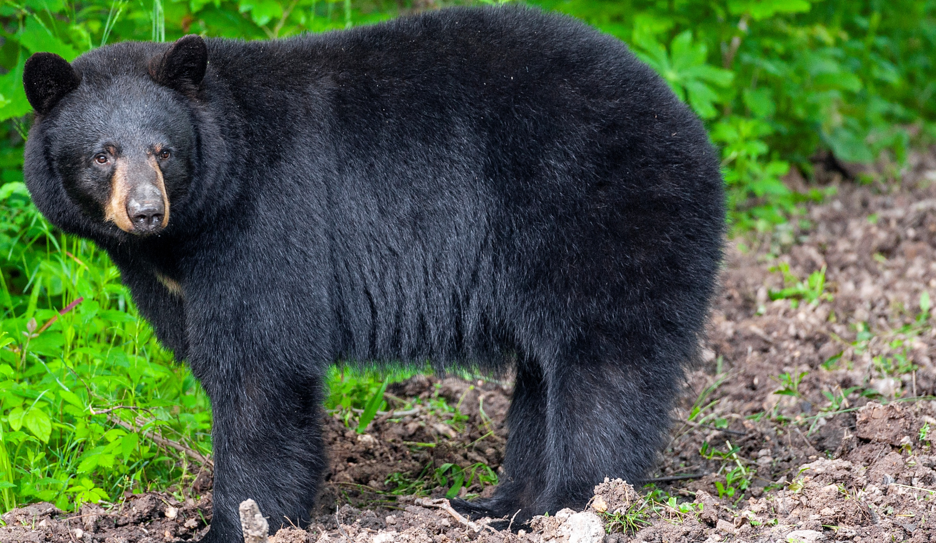

BEARS
Through the Seasons
Lesson 3B: New Cubs!

Slide 2
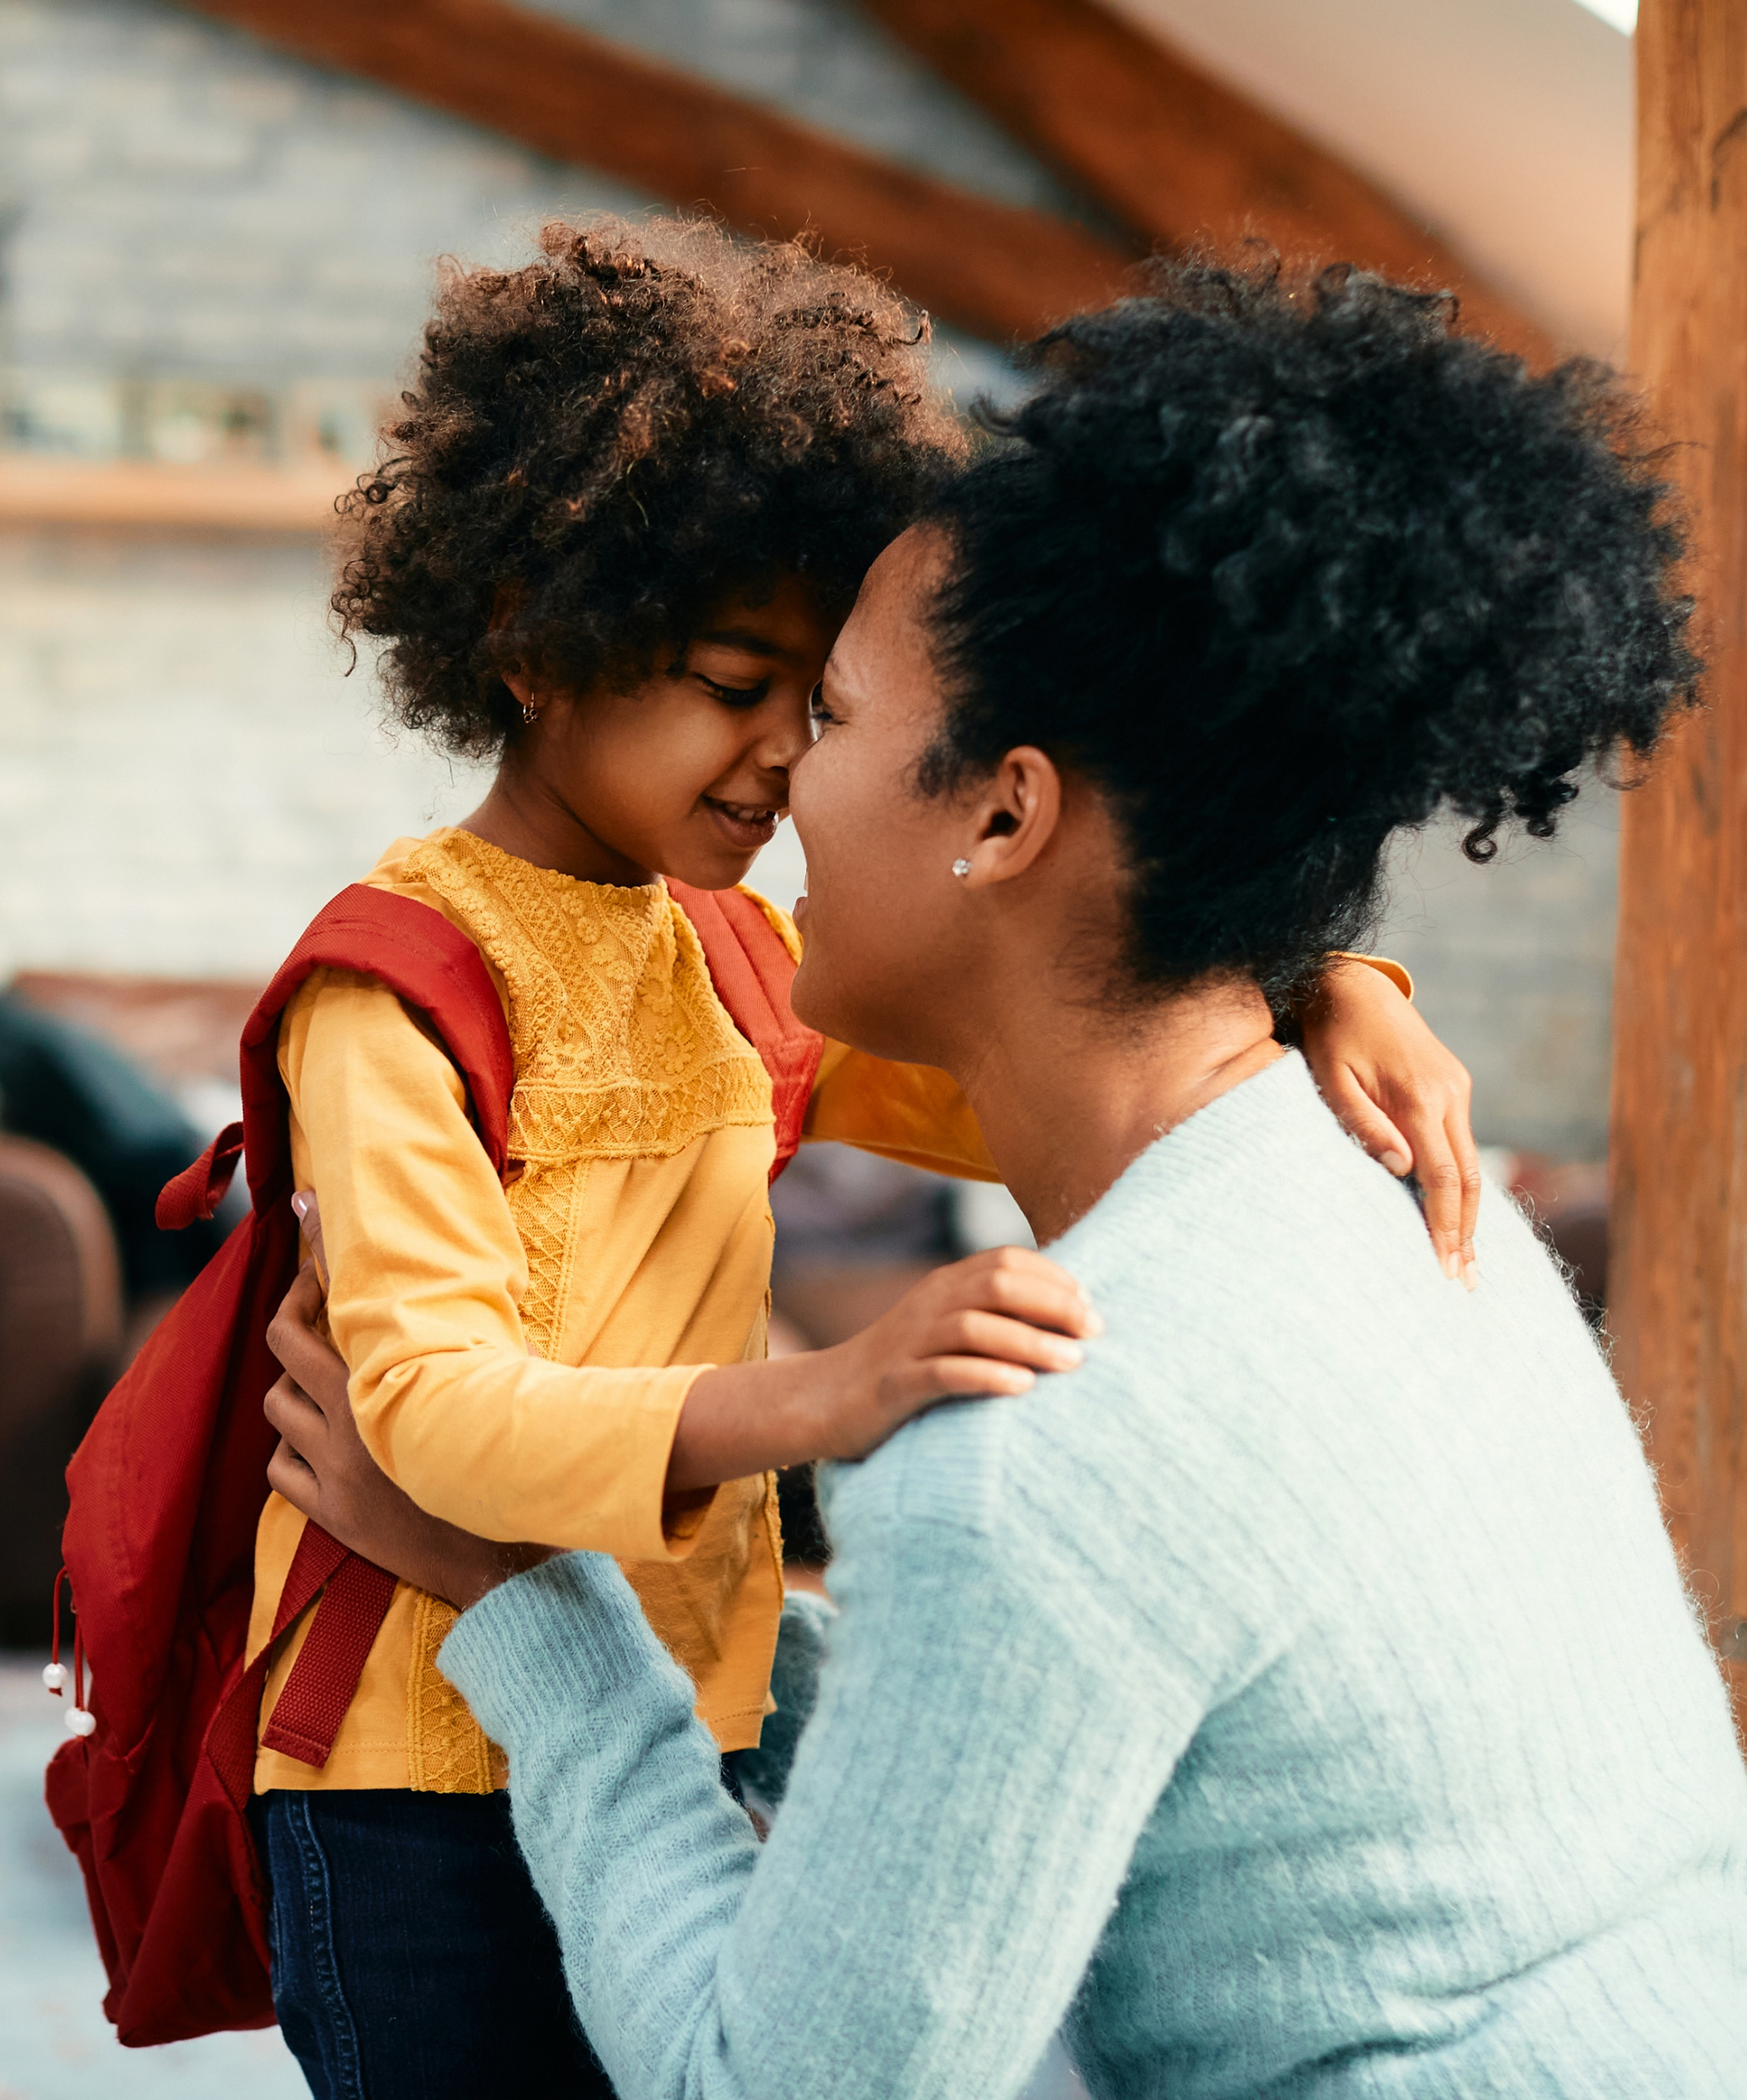

Guiding Question:
How does mama bear keep her cubs safe?
How do our own mothers keep us safe?
Bears through the Seasons – 3B New Cubs: Engage
2

Slide 3

Bears through the Seasons – 3B New Cubs: Engage
3
Notes:
Prepare and display your Noticings and Wonderings Chart for this lesson. Add student observations and/or questions to the chart as the lesson proceeds in reference to the phenomenon studied.

Slide 4
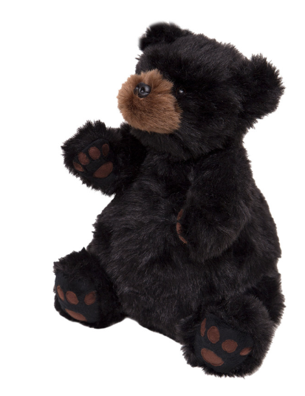
How does this stuffed animal feel in your hands? Is it heavy? Light?
Bears through the Seasons – 3B New Cubs: Engage
4
Notes:
Pass around a stuffed animal bear (or small item weighing about 8 ounces) and tell students that is represents a newborn cub.

Slide 5
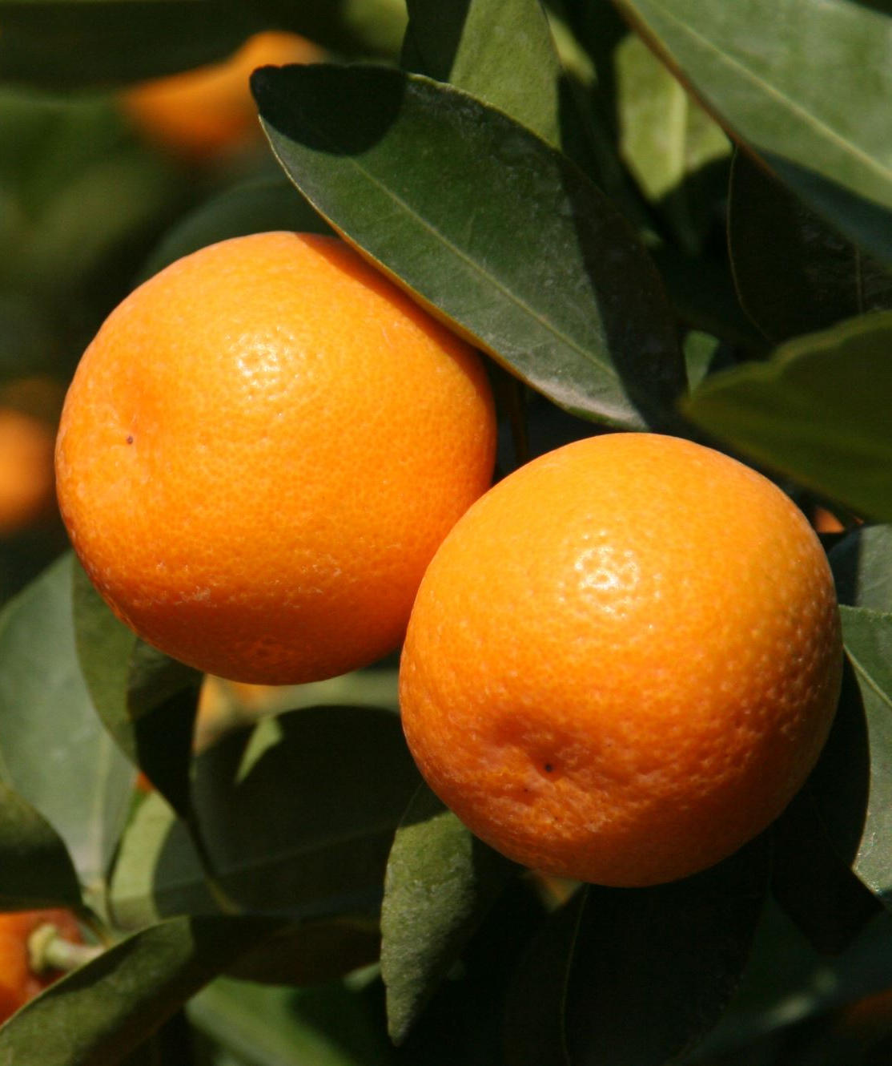
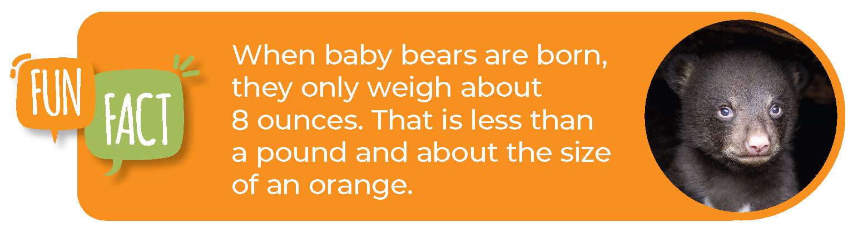
Bears through the Seasons – 3B New Cubs: Engage
5

Slide 6
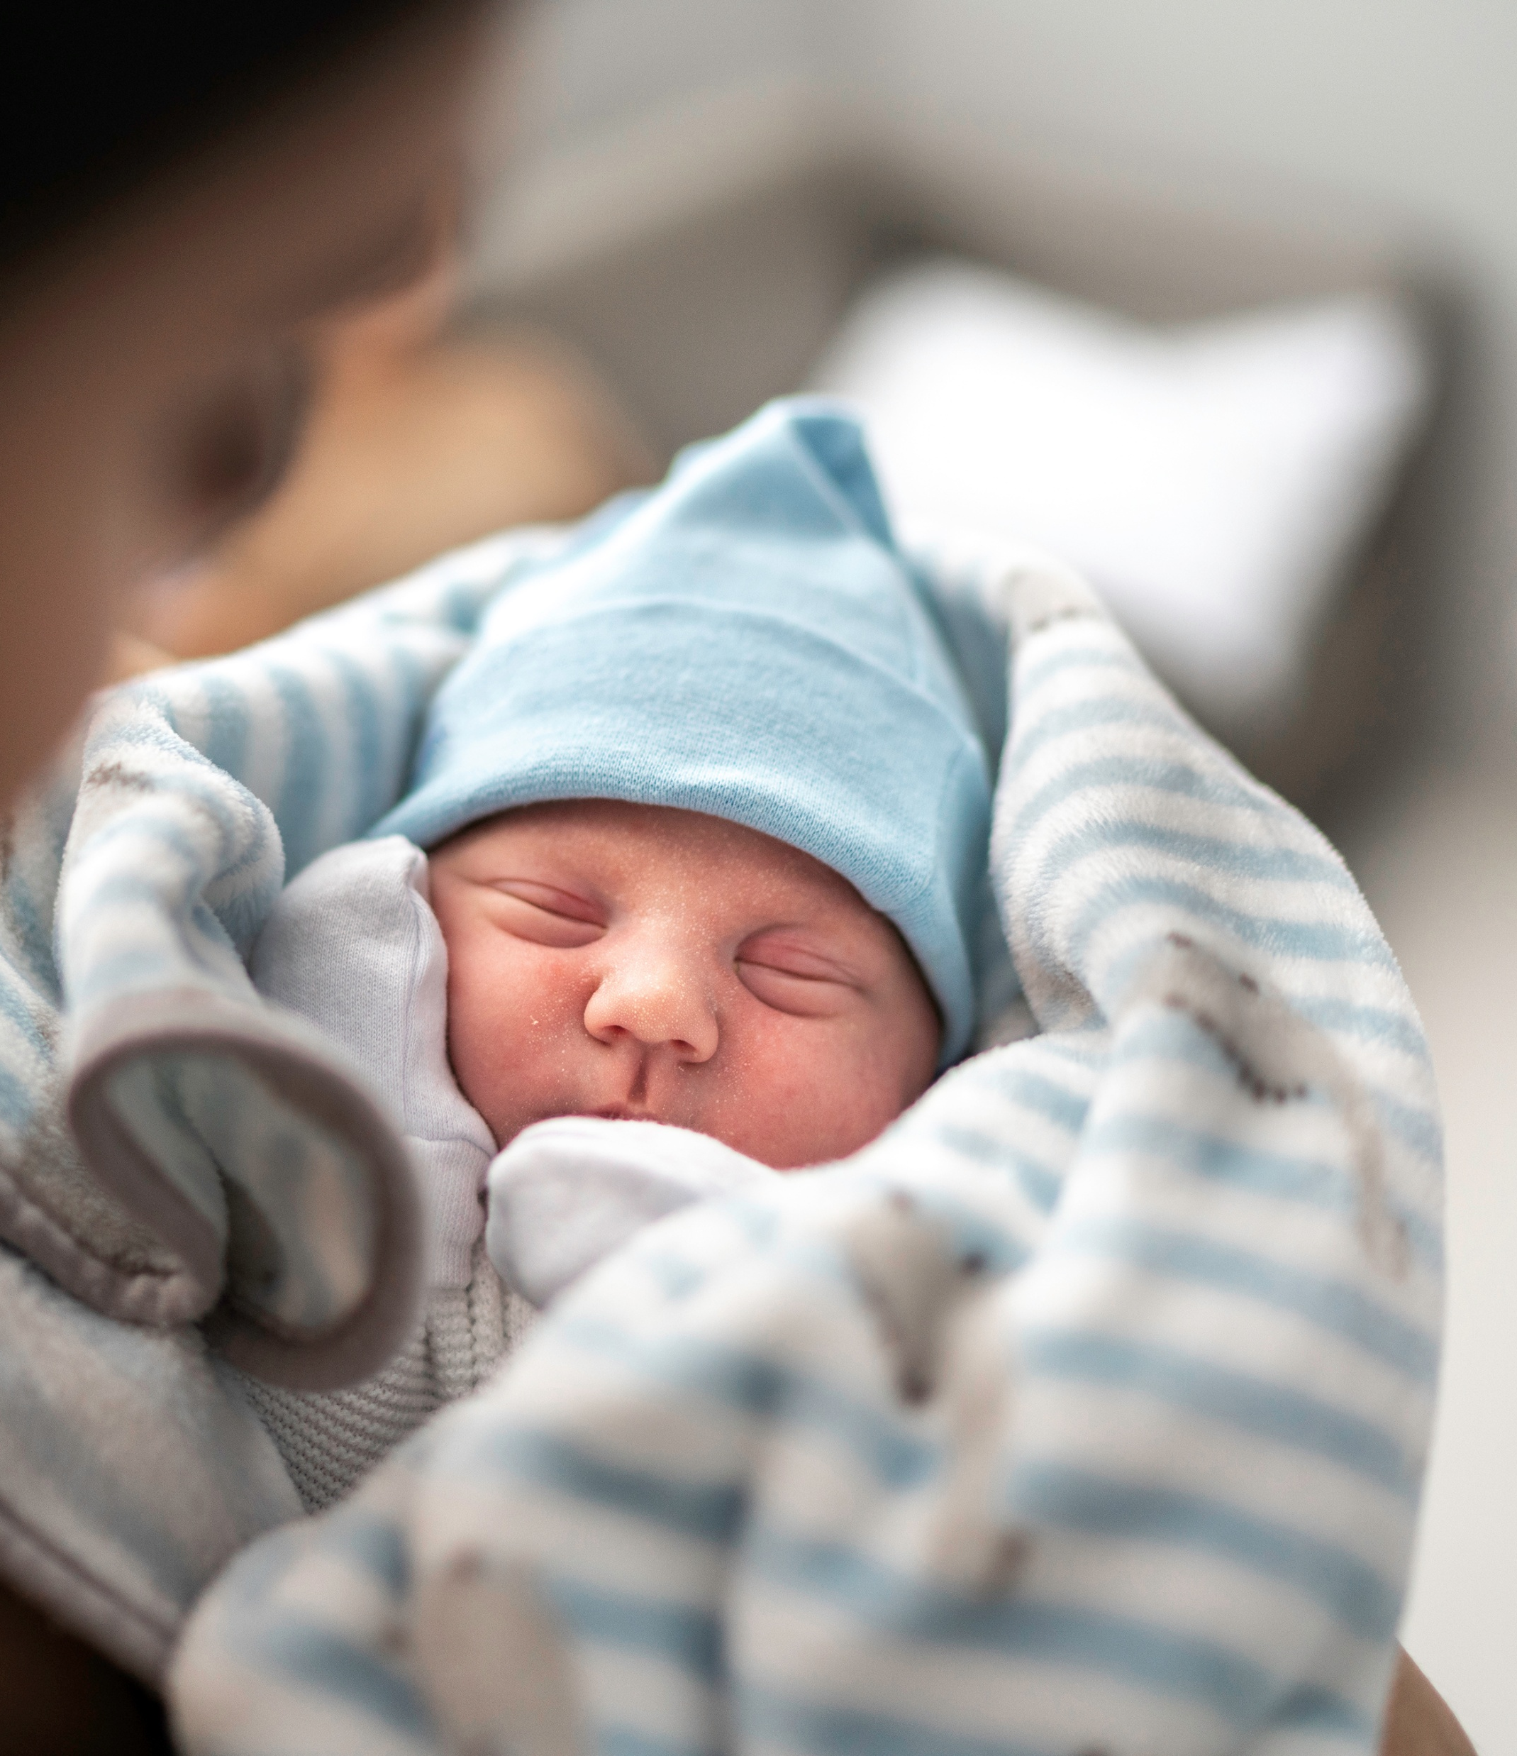
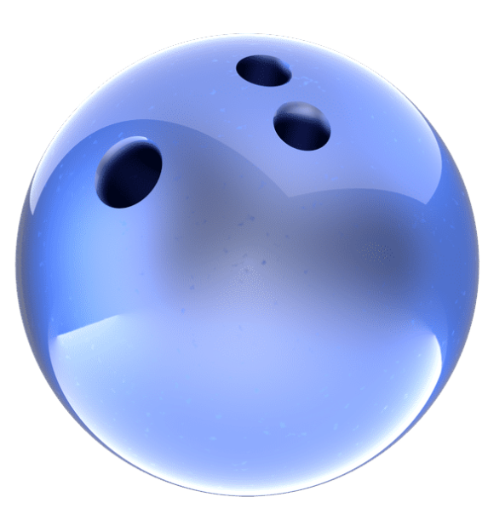
How big were you when you were first born?
Most babies weigh 6-8 pounds (which is about the size of a bowling ball!)
Bears through the Seasons – 3B New Cubs: Engage
6
Notes:
Most baby humans weigh 6-8 pounds. Pass around something that is 6-8 pounds. By the time spring comes, the cubs are about 6 pounds. Tell the students that since their mothers are hibernating, they will wake up in the winter (January) to give birth to their cubs. Cubs are born helpless, just like humans, so it is important that they start growing fast to survive. The mother bear produces milk that is high in fat. This helps cubs to grow quickly. When they get a little bigger, they are able to leave the safety of the den and just like them babies learn to walk, they can travel to other places. Since cubs are little, there are many things that they need to learn in order to survive, just like humans.

Slide 7
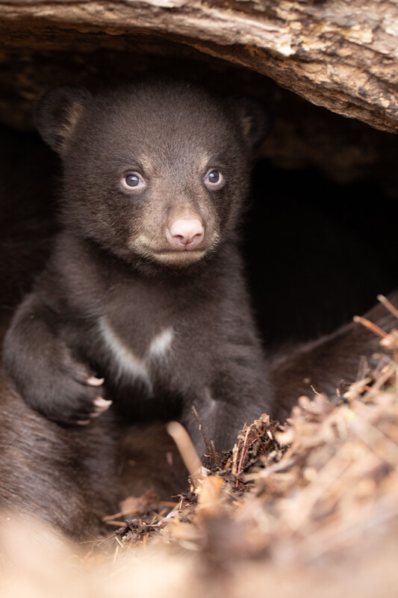
How much do you think cubs will weigh by spring?
Bears through the Seasons – 3B New Cubs: Engage
7
Notes:
Answer: 6 pounds! Tell the students that since their mothers are hibernating, they will wake up in the winter (January) to give birth to their cubs. Cubs are born helpless, just like humans, so it is important that they start growing fast to survive. The mother bear produces milk that is high in fat. This helps cubs to grow quickly. When they get a little bigger, they are able to leave the safety of the den and just like them babies learn to walk, they can travel to other places. Since cubs are little, there are many things that they need to learn in order to survive, just like humans.

Slide 8

What kinds of things did you learn when you were little that kept you safe?
Bears through the Seasons – 3B New Cubs: Engage
8

Slide 9
What kinds of things do you think cubs need to learn?
Bears through the Seasons – 3B New Cubs: Engage
9
Notes:
Answer: When to know there is danger, how to find food, find a shelter, etc.

Slide 10

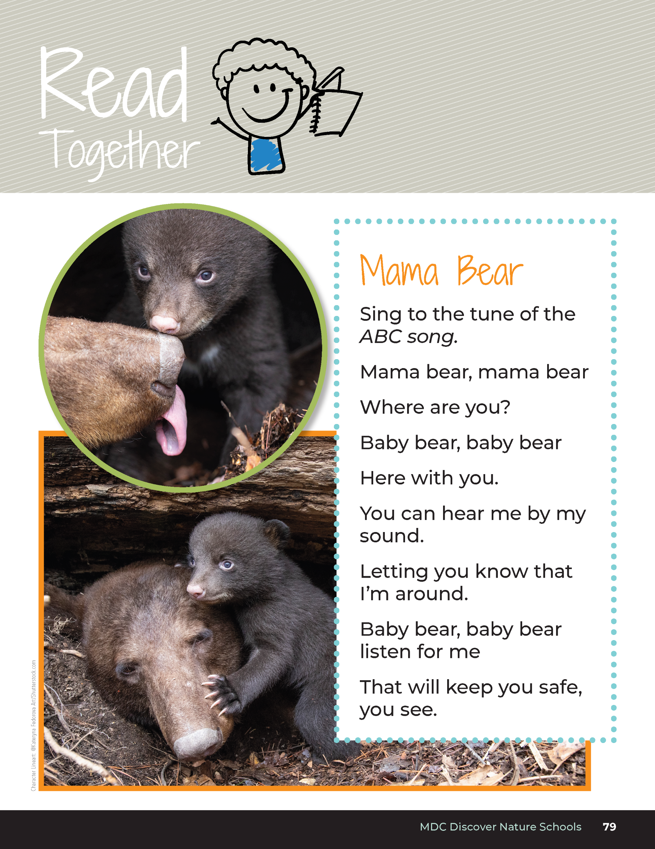
Mama Bear
Sing to the tune of the ABC song.
Mama bear, mama bear
Where are you?
Baby bear, baby bear
Here with you.
You can hear me by my sound.
Letting you know that I’m around.
Baby bear, baby bear, listen for me
That will keep you sage, you see.
Bears through the Seasons – 3B New Cubs: Engage
10

Slide 11
Bears through the Seasons – 3B New Cubs: Engage
11
Notes:
Prepare and display your Noticings and Wonderings Chart for this lesson. Add student observations and/or questions to the chart as the lesson proceeds in reference to the phenomenon studied.

Slide 12
Listen to each sound of a mama bear that teaches cubs an action.
What things do you think the mama bear is teaching them?
What would the baby bear do?
Bears through the Seasons – 3B New Cubs: Explore
12
Notes:
Tell students that they are going to hear three different vocalizations (noises) that mother bear can make to help teach her cubs to be safe and survive. Take your students outside for this activity if possible. Set clear boundaries where students can and cannot go. Tell the students that they are going to be bear cubs and you are going to be the mother bear.
Play recordings of bear noises (stamping feet or jaw popping, snorting, grunting). Before you start the activity, play each sound one at a time and tell the students (cubs) what to do if they hear that sound.

Slide 13

Mama Bear Popping her Jaw and Clicking her Tongue?
What do you think the mother bear is trying to say to the baby bear? What should the baby bear do?
Bear Popping her Jaw and Clicking her Tongue
Bears through the Seasons – 3B New Cubs: Explore
13
Notes:
Play the bear popping its jaw.
Tell students it means that there is danger nearby. Tell them that natural predators like coyotes and bobcats as well as dogs, people, and cars can be a danger to small cubs.
These vocalizations serve as a warning to the danger. Explain that mother bear will teach the cubs to climb a tree with rough bark because it is easy to climb. If there is a tree nearby like that, tell students to touch a tree if they hear that noise. If a tree is not available, come up with an area that represents the tree. Mother bear will grunt at the cubs when it is safe to come down.

Slide 14
Mama Bear Snorting and Chomping
What do you think the mother bear is trying to say to the baby bear? What should the baby bear do?
Bear Snorting and Chomping
Bears through the Seasons – 3B New Cubs: Explore
14
Notes:
Play the next noise, snorting and chomping.
Tell the that the mother bear is trying to teach them something important that they need to pay attention to like how to find food, climb trees, to follow her. Baby bears should be still and quiet so they can follow directions.

Slide 15
Mama Bear Grunting
What do you think the mother bear is trying to say to the baby bear? What should the baby bear do?
Bear Grunting
Bears through the Seasons – 3B New Cubs: Explore
15
Notes:
Play the last sound, grunting.
Tell them it means that things are peaceful. Cubs will play with each other or snuggle with their mother. Tell them to gather together as if they were going to play.

Slide 16
Practice Making Each Sound
Bears through the Seasons – 3B New Cubs: Explore
16
Notes:
Have the students practice making each sound.

Slide 17
Turn around (no peeking!). You are my cubs. I will play each sound. Act out what the cub would do in response to each sound.
Mystery Sound #1
Mystery Sound #2
Mystery Sound #3
Bears through the Seasons – 3B New Cubs: Explore
17
Notes:
Now, play each noise several times in a random order. The students should pretend they are cubs and do the activity that matches the sound of the mother bear
grunting – gather with the other cubs to play
jaw popping – go to tree or to a safe spot in the classroom
snort – stop and stay quiet

Slide 18

What patterns do you notice for the sounds the mother bear makes?
Bears through the Seasons – 3B New Cubs: Explore
18
Notes:
Answer: Louder and more urgent to quieter and calmer to match the situation.

Slide 19
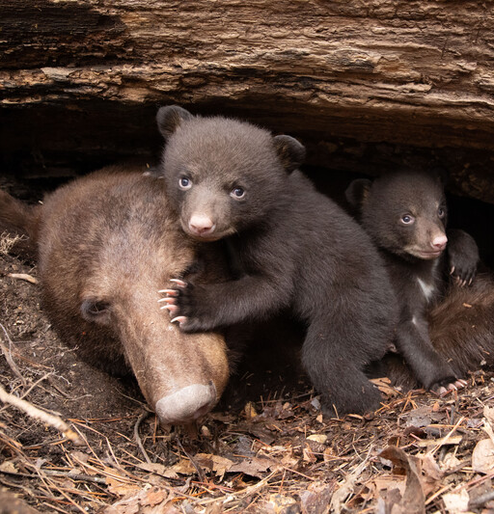
Sound is an important tool that mother bears use to keep their cubs safe.
Bears through the Seasons – 3B New Cubs: Explain
19
Notes:
Tell students that sound is an important tool that mother bears use to keep their cubs safe. You may note to your students that bears will also teach their cubs by showing and may not vocalize as much as many other animals.

Slide 20

How do your parents/guardians and other adults let you know when danger is present?
Bears through the Seasons – 3B New Cubs: Explain
20

Slide 21
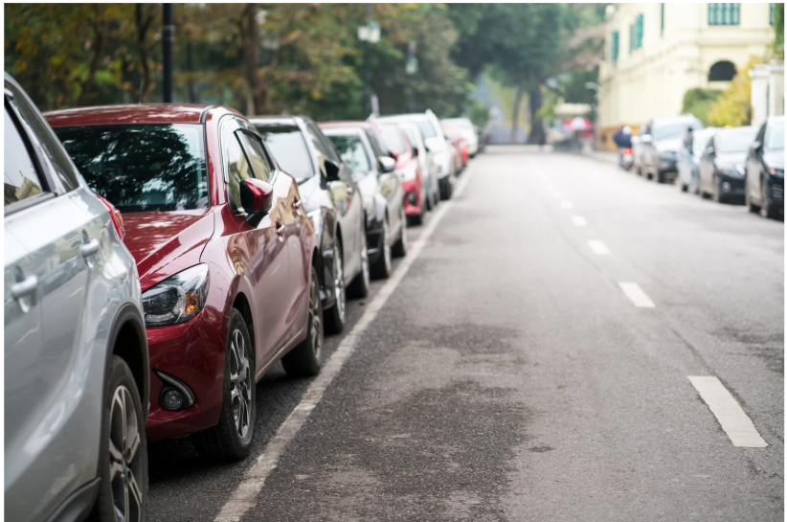
What should you do if there is danger present like a busy street or a stranger?
Bears through the Seasons – 3B New Cubs: Explain
21

Slide 22

How do you know that your family and/or teachers are trying to teach you something?
Bears through the Seasons – 3B New Cubs: Explain
22

Slide 23
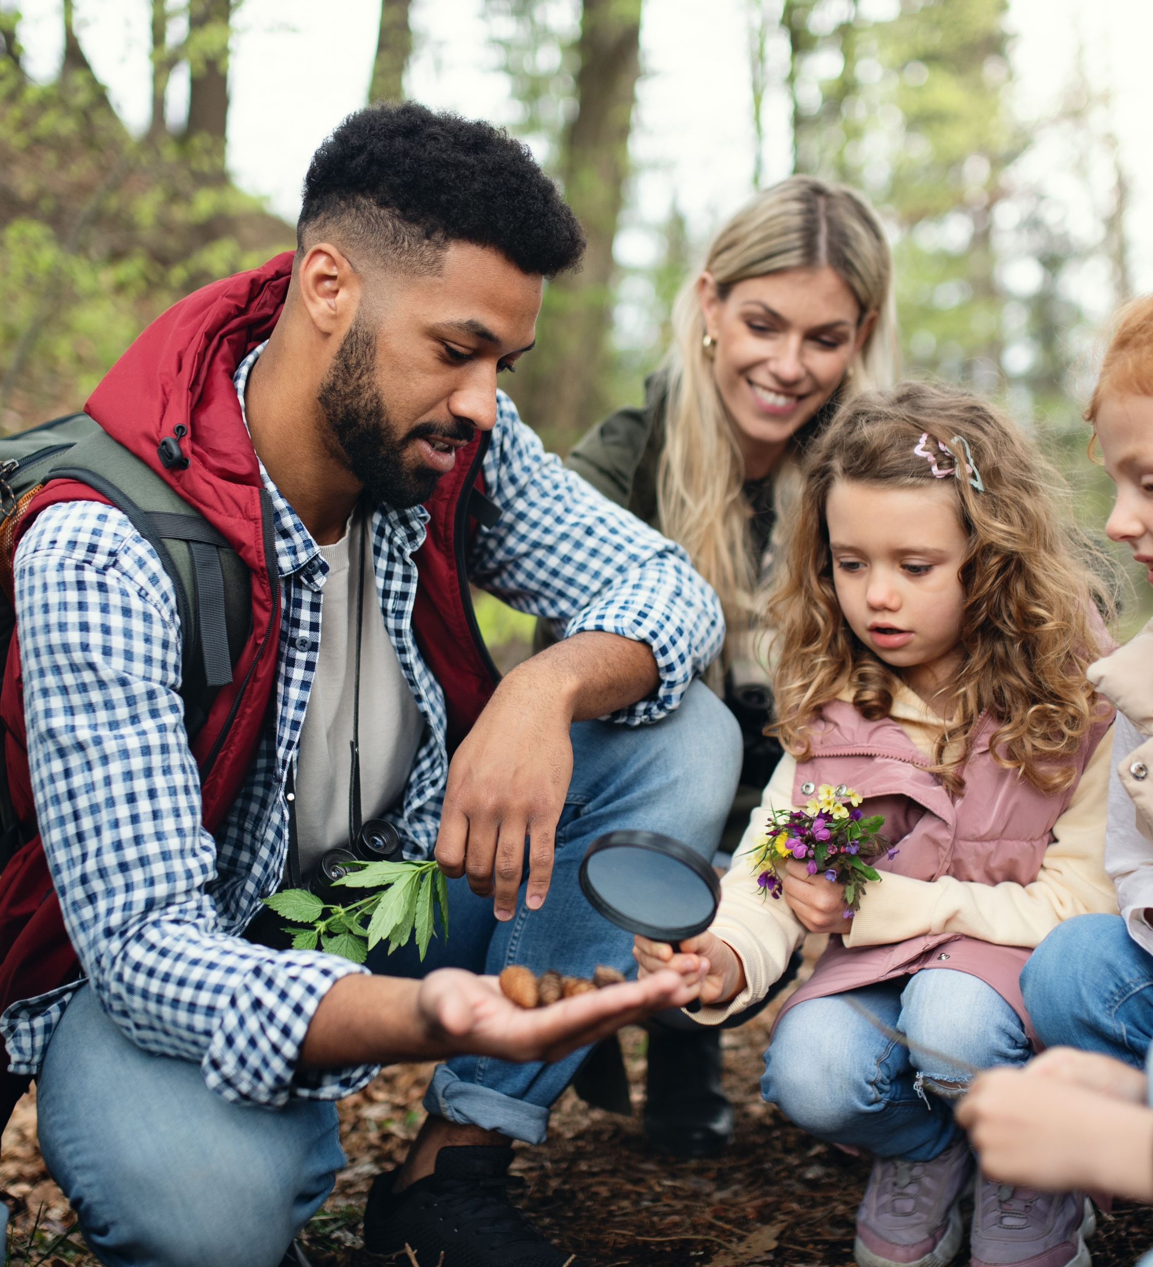
How do you know when it is time to learn?
Bears through the Seasons – 3B New Cubs: Explain
23

Slide 24

What should you be doing when it is time to learn?
Bears through the Seasons – 3B New Cubs: Explain
24

Slide 25

How do you know it is safe to play?
Bears through the Seasons – 3B New Cubs: Explain
25

Slide 26
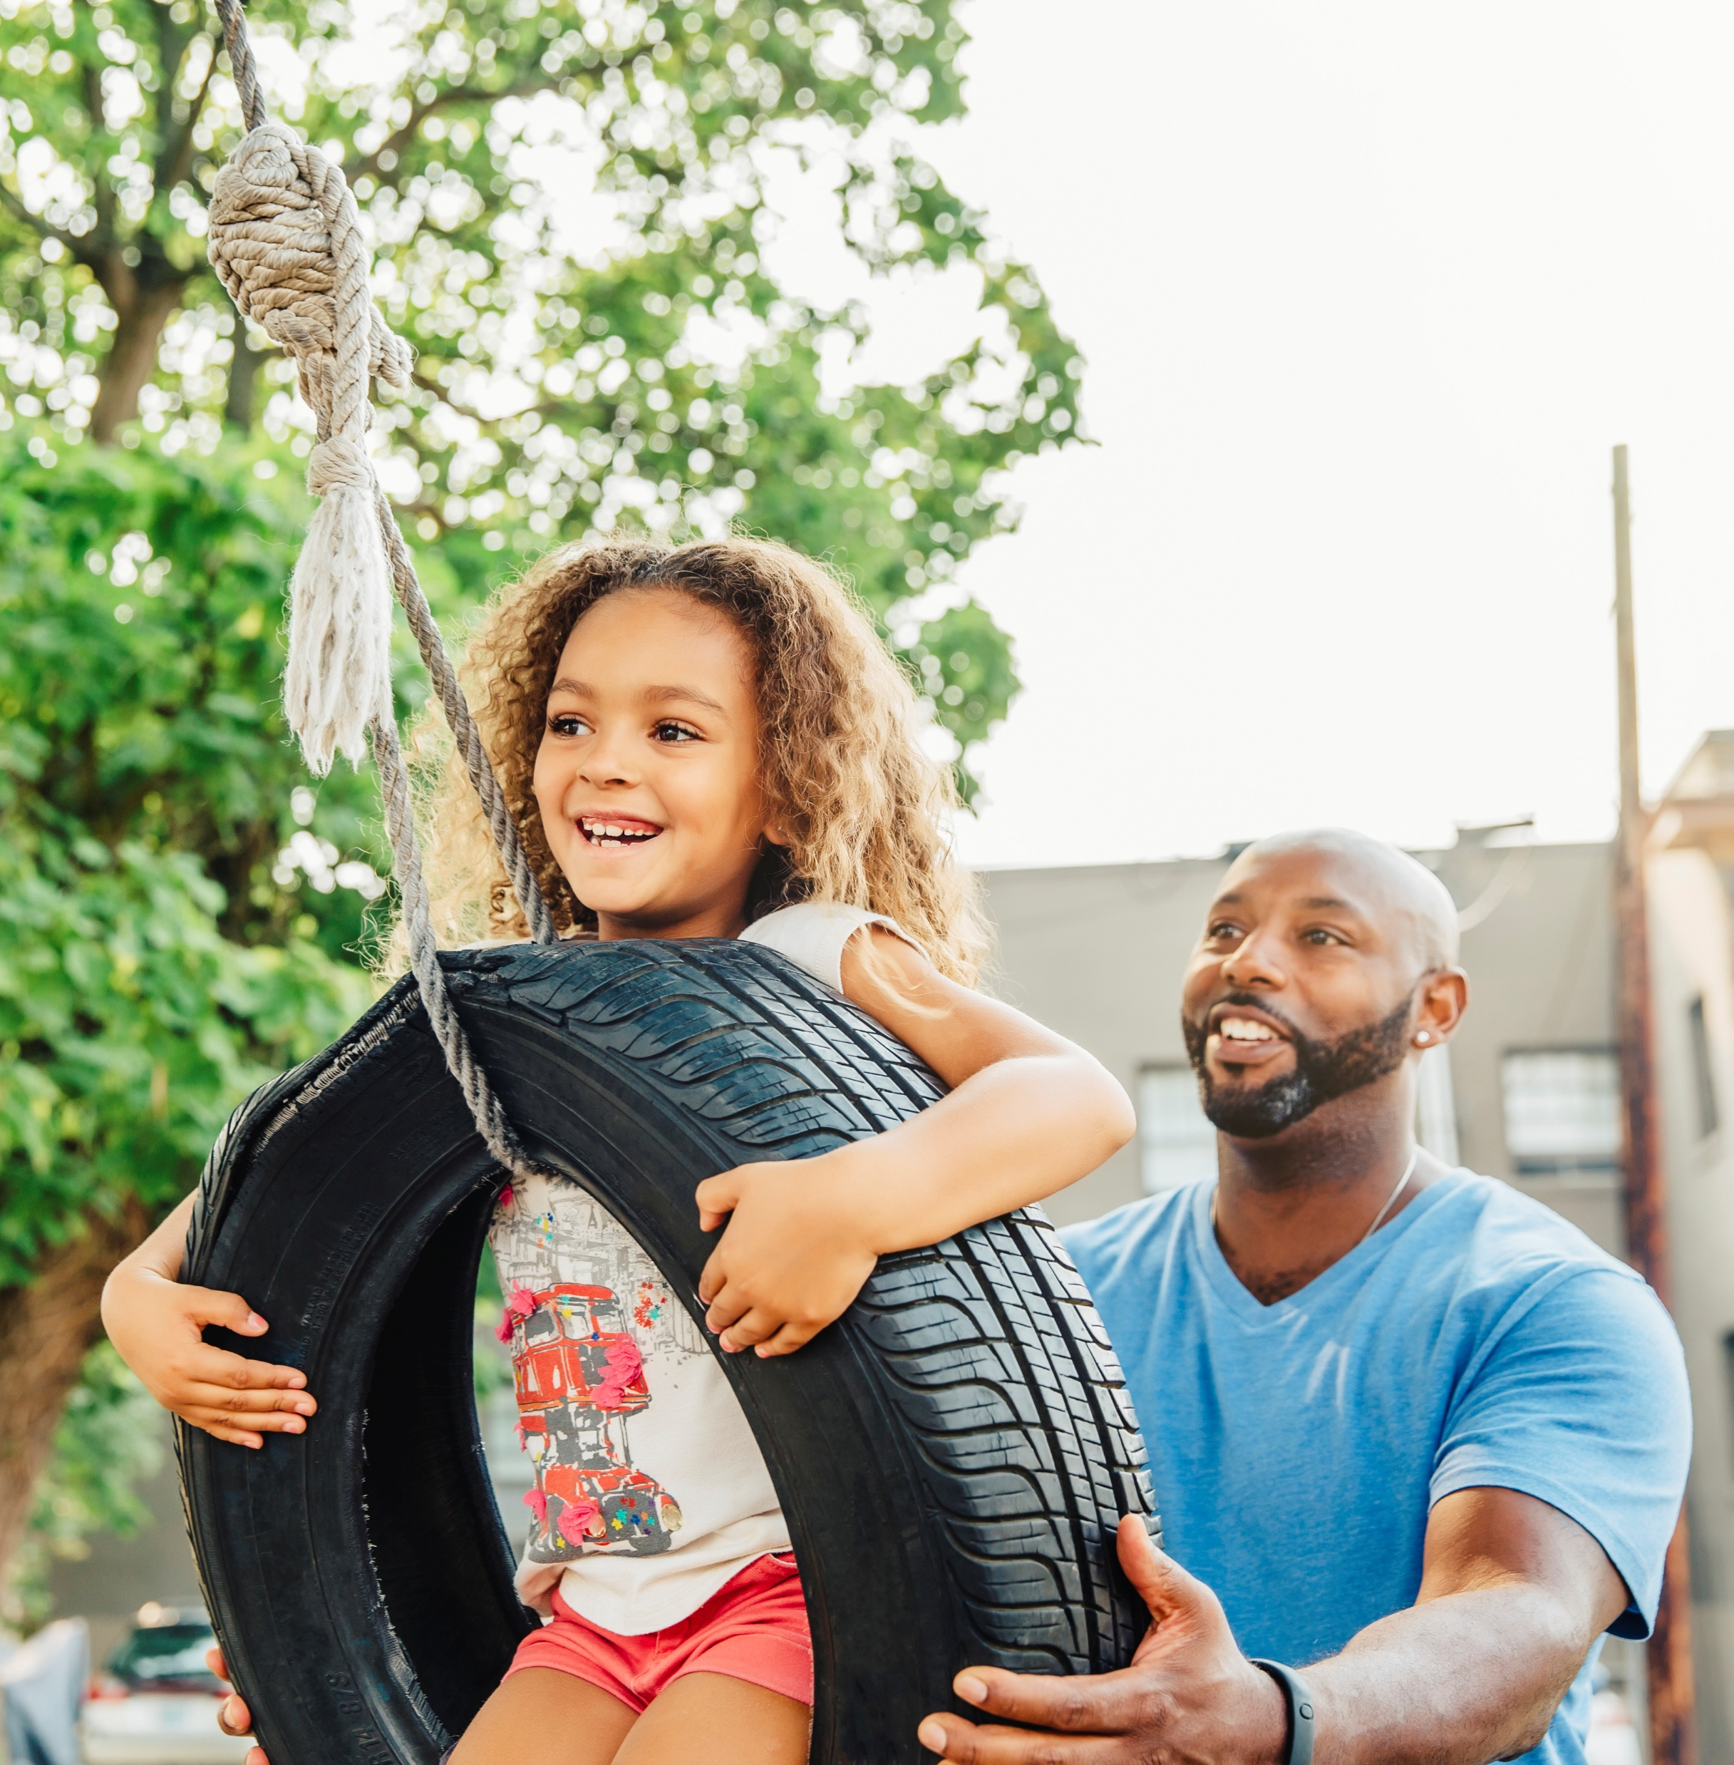
What are your family and/or teachers doing during the time it is safe to play?
Bears through the Seasons – 3B New Cubs: Explain
26

Slide 27
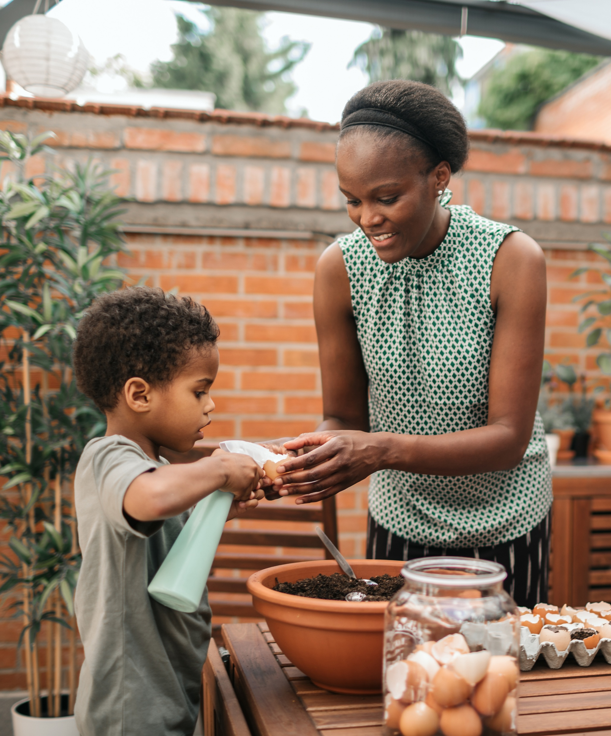
Do you notice any patterns in the volume and urgency of your families’ voices?
Bears through the Seasons – 3B New Cubs: Explain
27

Slide 28
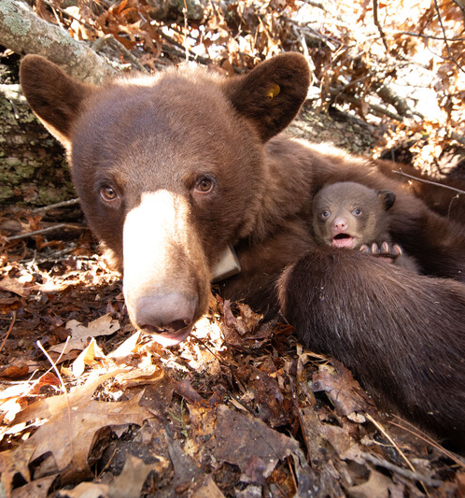
How does it compare to mother bear’s voice?
Bears through the Seasons – 3B New Cubs: Explain
28

Slide 29

How does the way you learn compare with how cubs learn?
Bears through the Seasons – 3B New Cubs: Explain
29

Slide 30
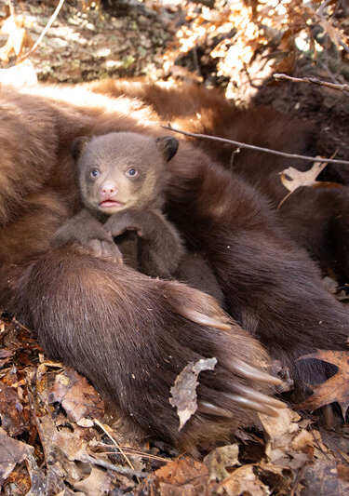
What is the effect on the bear cubs when the mother pops her jaw? Grunts? Snorts?
Bears through the Seasons – 3B New Cubs: Explain
30

Slide 31
How do the cubs react?
Bears through the Seasons – 3B New Cubs: Explain
31
Notes:
Discuss the cause-and-effect relationship on the students’ behavior when their parents/guardians use a certain tone or volume of voice.

Slide 32
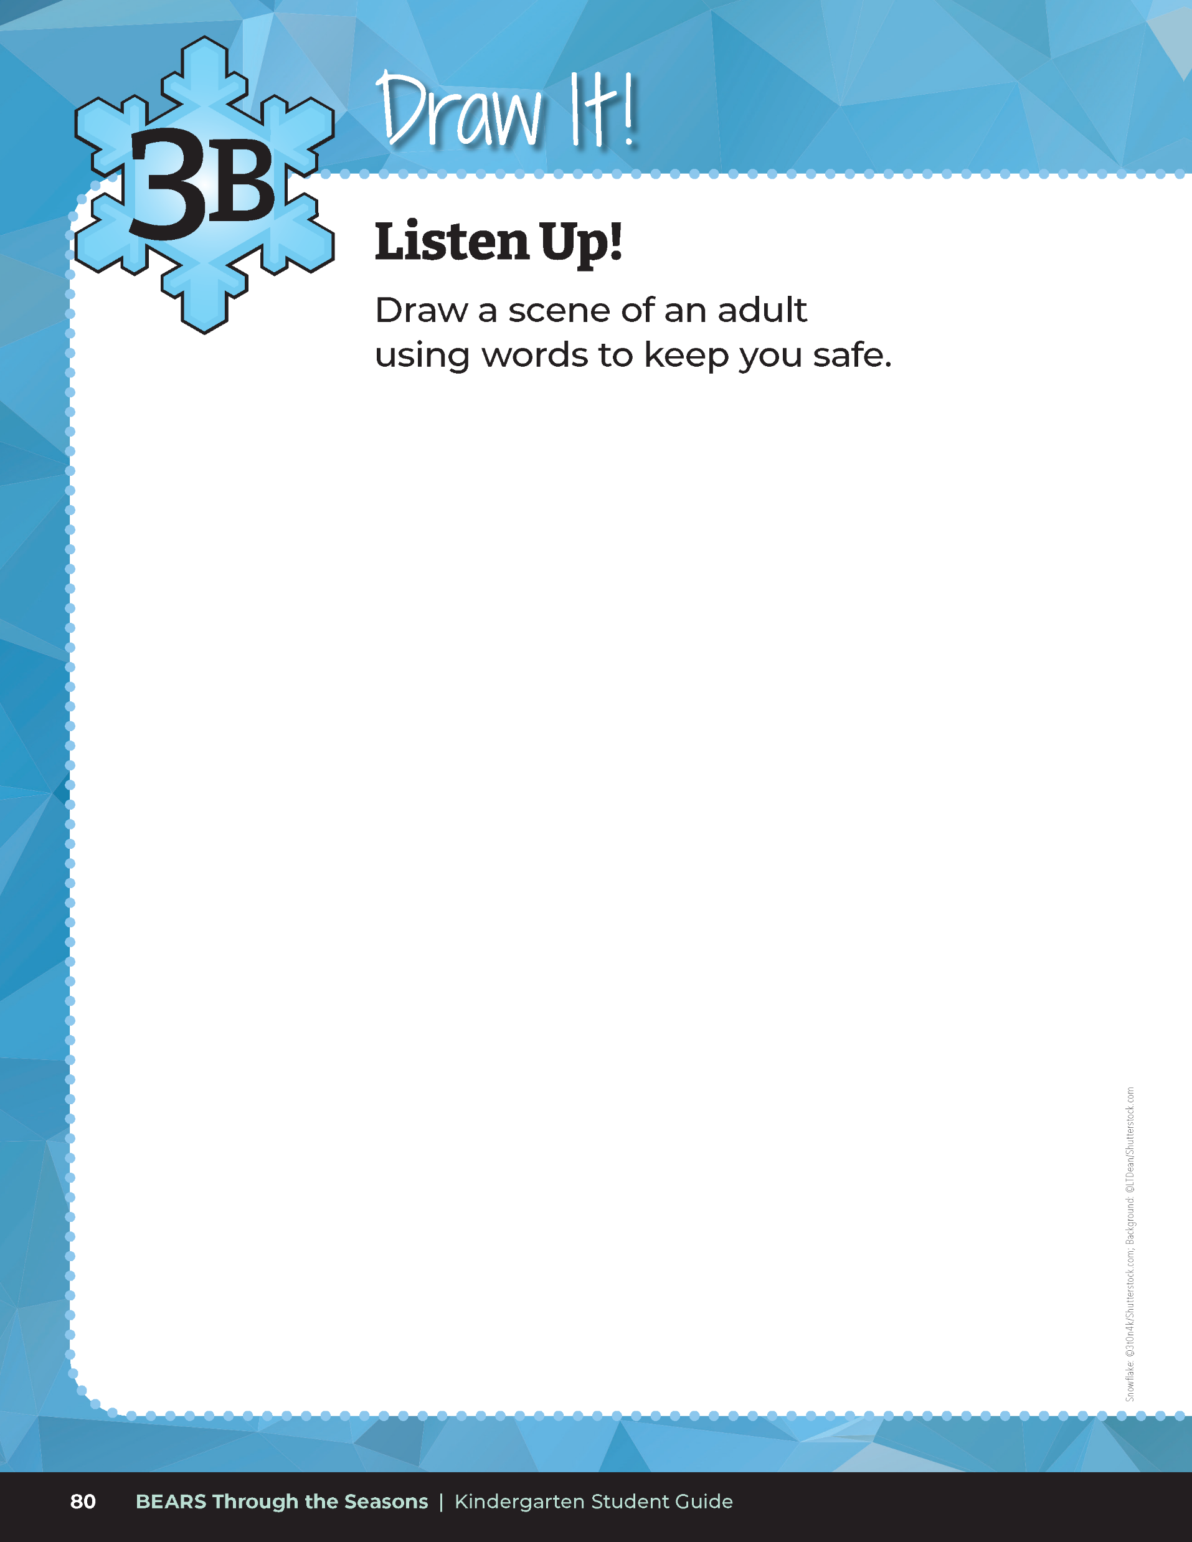
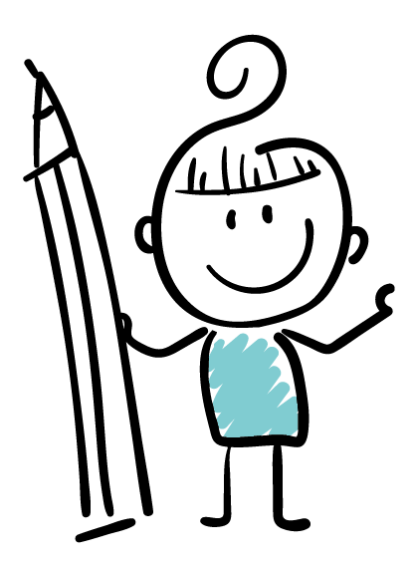
Draw a scene of an adult using words to keep you safe.
Bears through the Seasons – 3B New Cubs: Explain
32

Slide 33
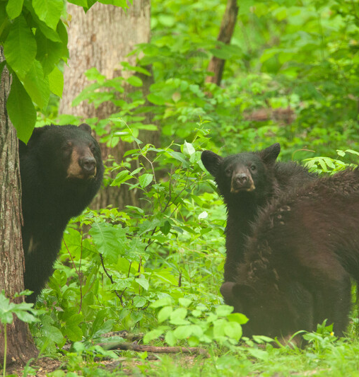
How do mother bears use sounds with their cubs?
Bears through the Seasons – 3B New Cubs: Elaborate
33
Notes:
Answer: Keep their cubs safe, teach them how to survive, and let them know it’s safe to play.

Slide 34
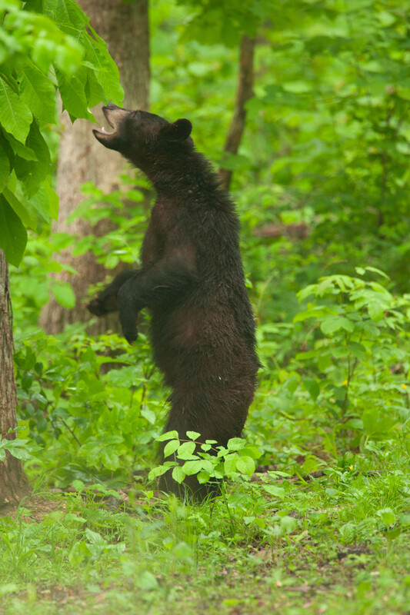
What else does a mama bear do to teach her cubs to survive?
Bears through the Seasons – 3B New Cubs: Elaborate
34
Notes:
Answer: As a mother bear finds food, the cubs see what she eats and where to find it.

Slide 35
Develop a set of code sounds for the following commands:
“Come here, baby cub”
“All is well, lie down and rest”
“Danger, stop”
Bears through the Seasons – 3B New Cubs: Elaborate
35
Notes:
Divide students into pairs. Assign each student in the pair to be either a mother or a cub. Mother bear will be asked to communicate and teach their cub to learn what the following sounds mean. Tell students that they are to develop a set of code sounds, (for example, grunts, long grunts, growls, and snarls) for the following commands:
“Come here, baby cub.” (example: harsh, sharp, or loud growl)
“All is well, lie down and rest.” (example: grunt sound or low rumble)
“Danger, stop!” (example: stomp feet or pop jaw)

Slide 36
Bears through the Seasons – 3B New Cubs: Elaborate
36
Notes:
Add student observations and/or questions to the Noticings and Wonderings Chart as the lesson concludes in reference to the phenomenon studied.

Slide 37
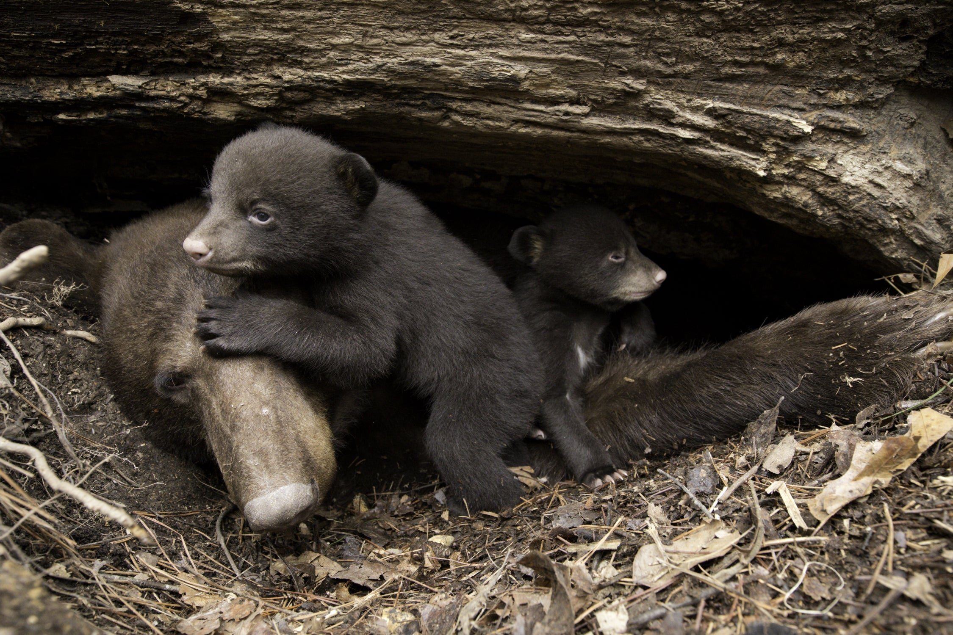
Bears through the Seasons – 3B New Cubs: Evaluate
37
Notes:
Have students pretend they are the mother bear. What sounds would the mother bear make during each scene? Students should make the correct sound.

Slide 38
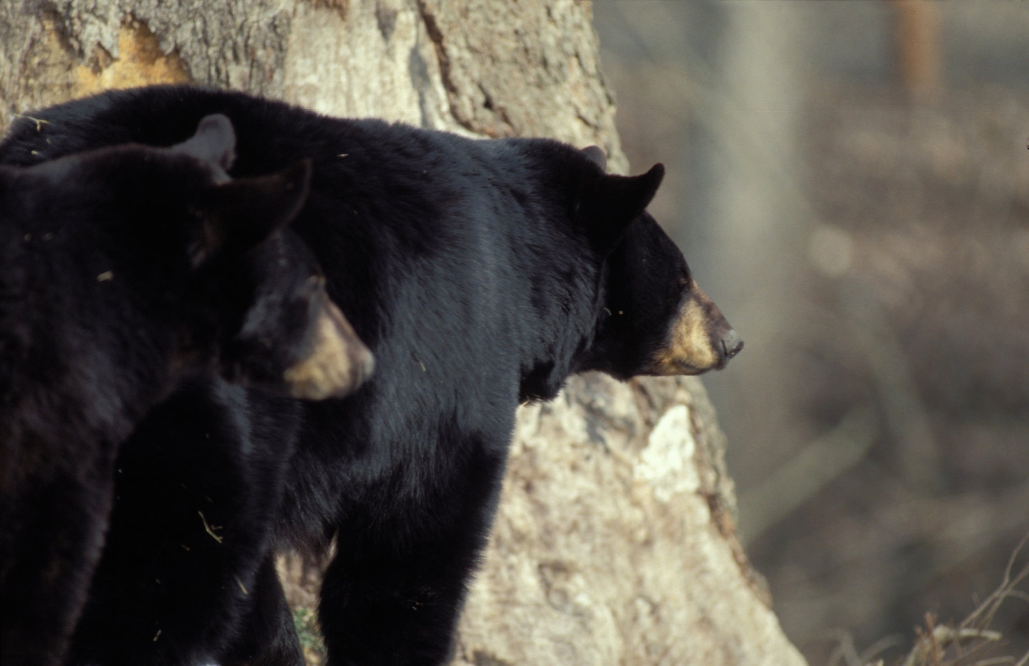
Bears through the Seasons – 3B New Cubs: Evaluate
38
Notes:
What sounds would the mother bear make during each scene?

Slide 39
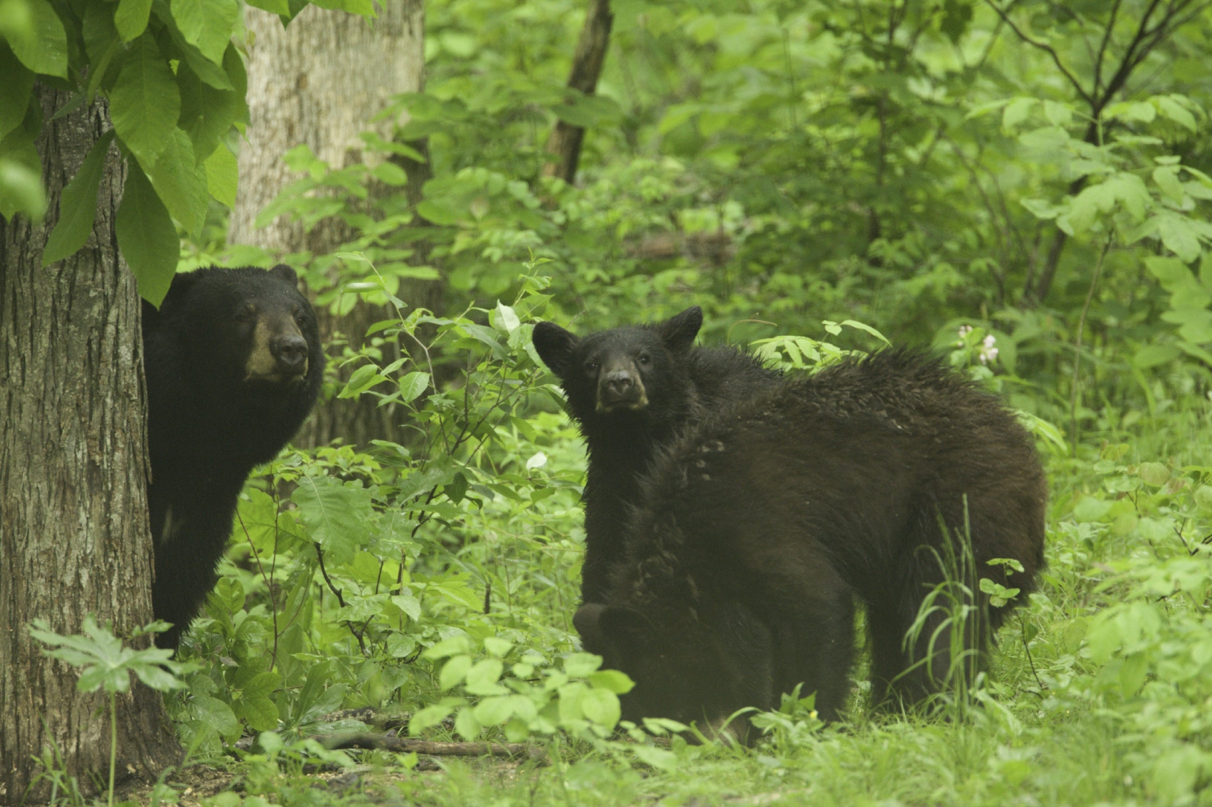
Bears through the Seasons – 3B New Cubs: Evaluate
39
Notes:
What sounds would the mother bear make during each scene?

Slide 40


Optional: Cross-Curricular Extension
Invite a school nurse or community safety person to share how their work help ensure people in the school or community stay safe
Bears through the Seasons – 3B New Cubs: Evaluate
40
Notes:
Invite the school nurse or community safety person (emergency response or health care worker) to your classroom to share how their work helps ensure people in the school or community stay safe. Have them discuss how they communicate safety needs when working with others.
Invite someone who cares for animals (veterinarian, zoo, animal shelter, or conservation staff) to share how their job helps ensure animals stay safe.

