Slide 1
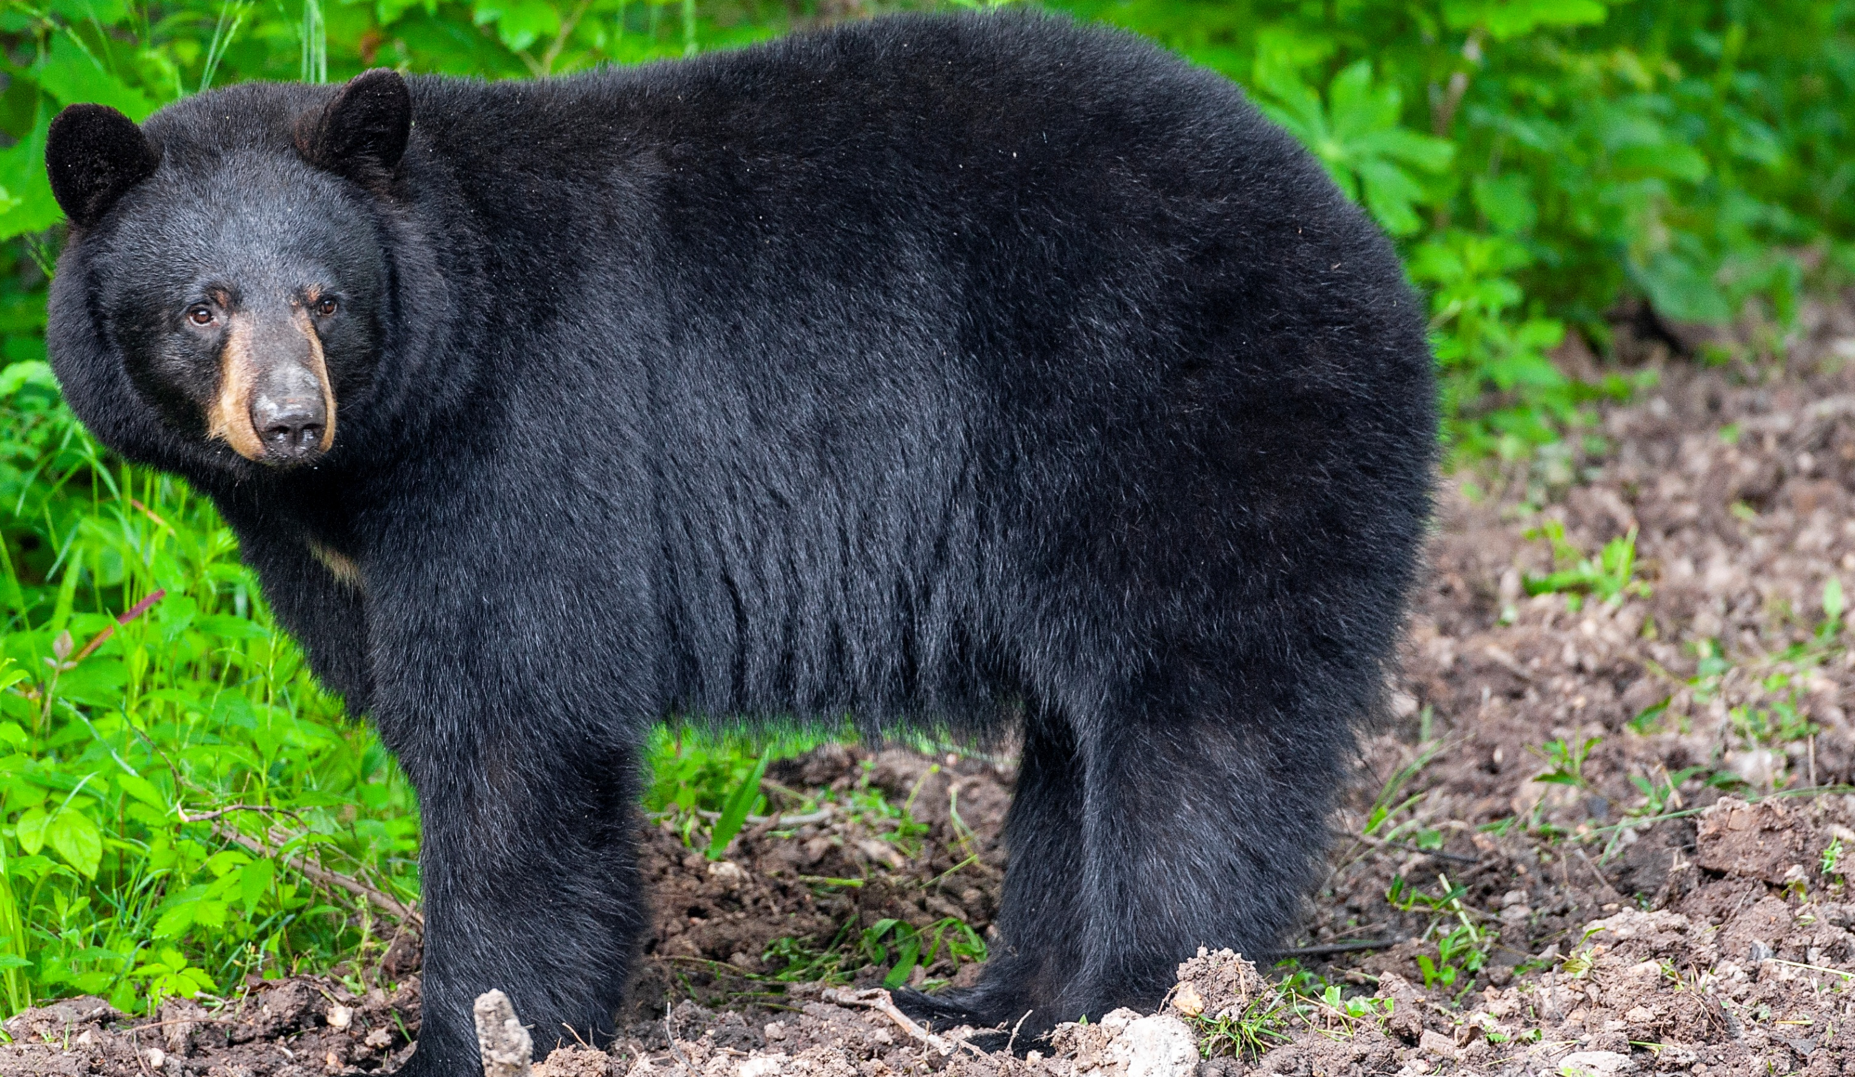

BEARS
Through the Seasons
Lesson 3A: Surviving the Cold

Slide 2
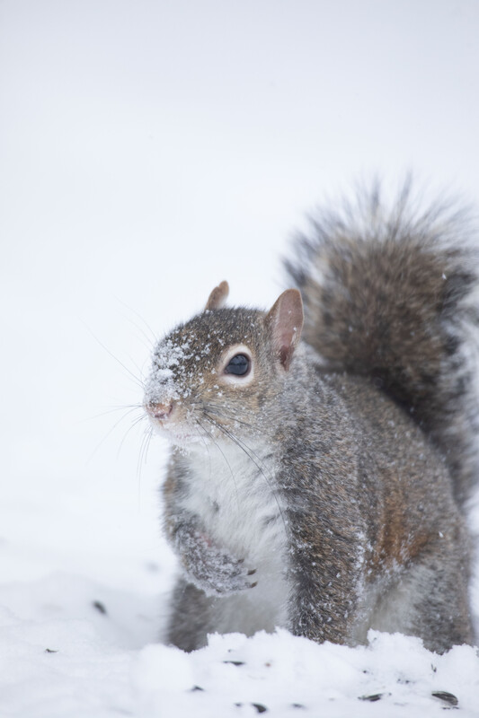

Guiding Question:
How do animals survive in the winter?
Bears through the Seasons – 3A Surviving the Cold: Engage
2

Slide 3

Bears through the Seasons – 3A Surviving the Cold: Engage
3
Notes:
Prepare and display your Noticings and Wonderings Chart for this lesson. Add student observations and/or questions to the chart as the lesson proceeds in reference to the phenomenon studied.

Slide 4
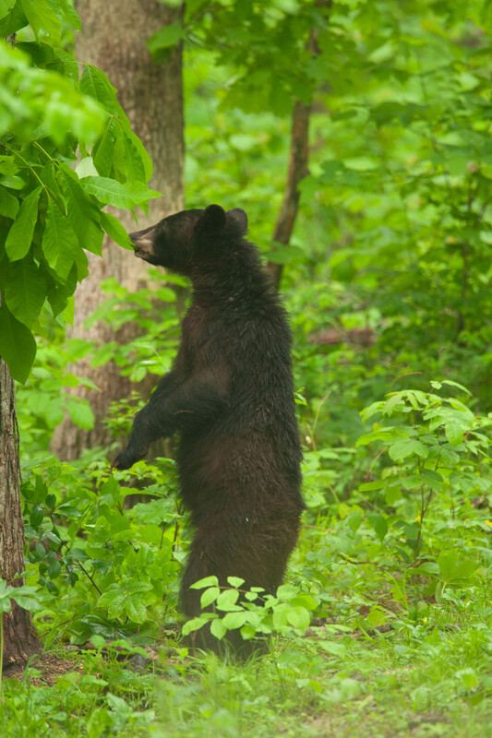

What do bears do in the fall to prepare for winter?
Bears through the Seasons – 3A Surviving the Cold: Engage
4
Notes:
Answer: Find dens, eat a lot

Slide 5
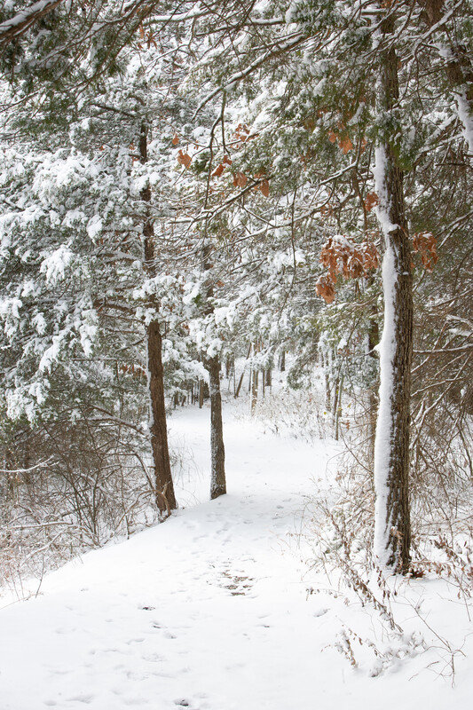
Why do bears need to prepare for winter?
Bears through the Seasons – 3A Surviving the Cold: Engage
5
Notes:
Answer: Less food, very cold

Slide 6
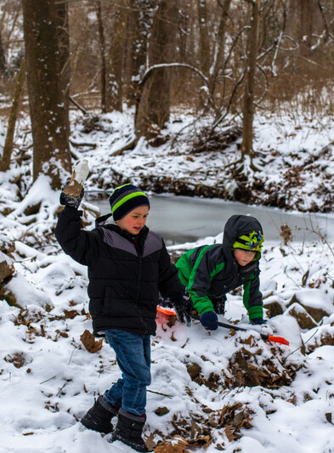
What do people do to survive in the winter?
Bears through the Seasons – 3A Surviving the Cold: Engage
6
Notes:
Answer: Stay in a warm house/school, wear warm clothes

Slide 7

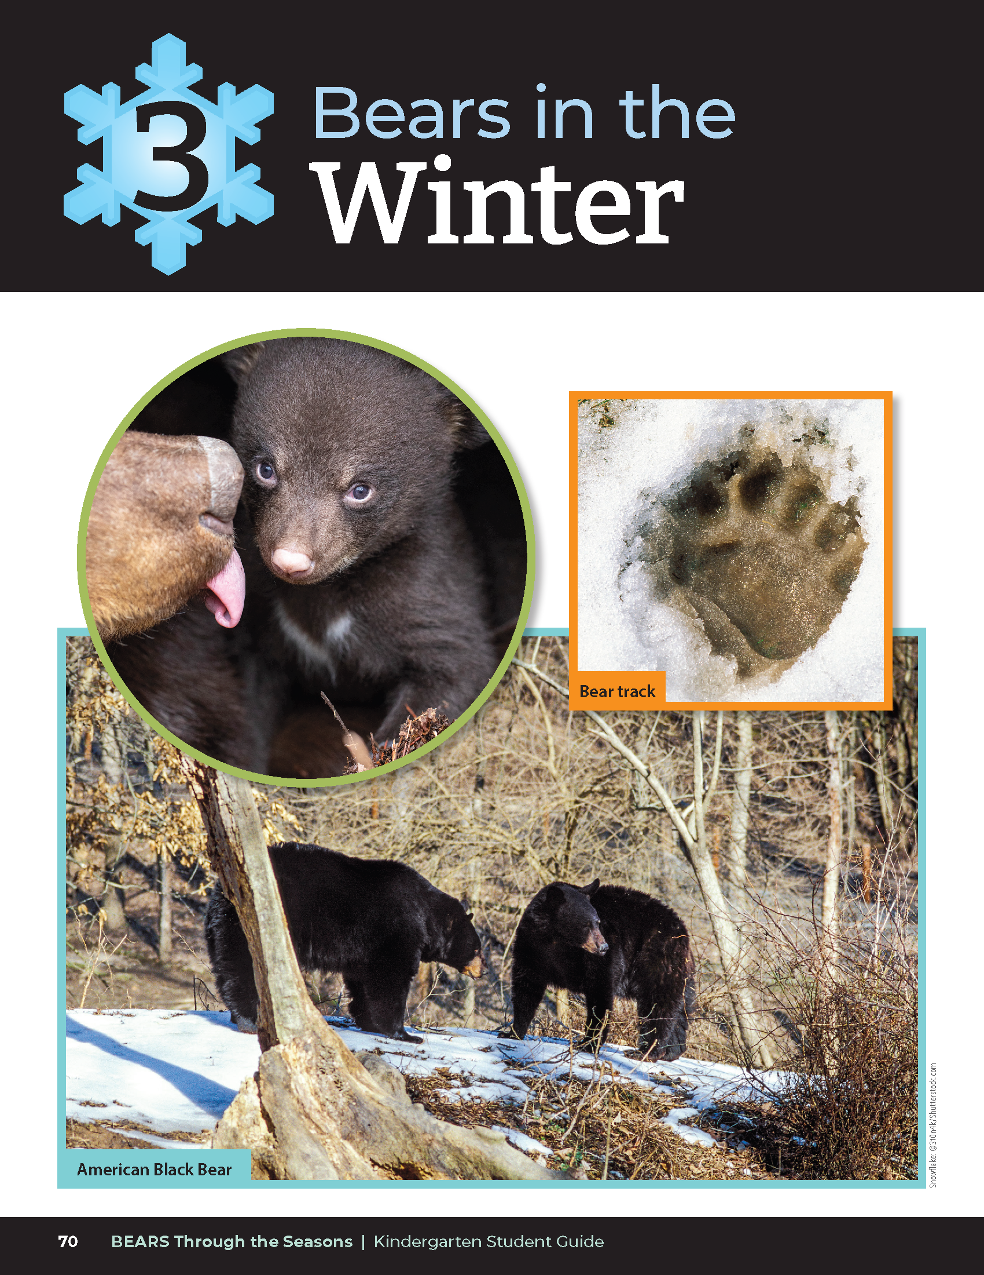
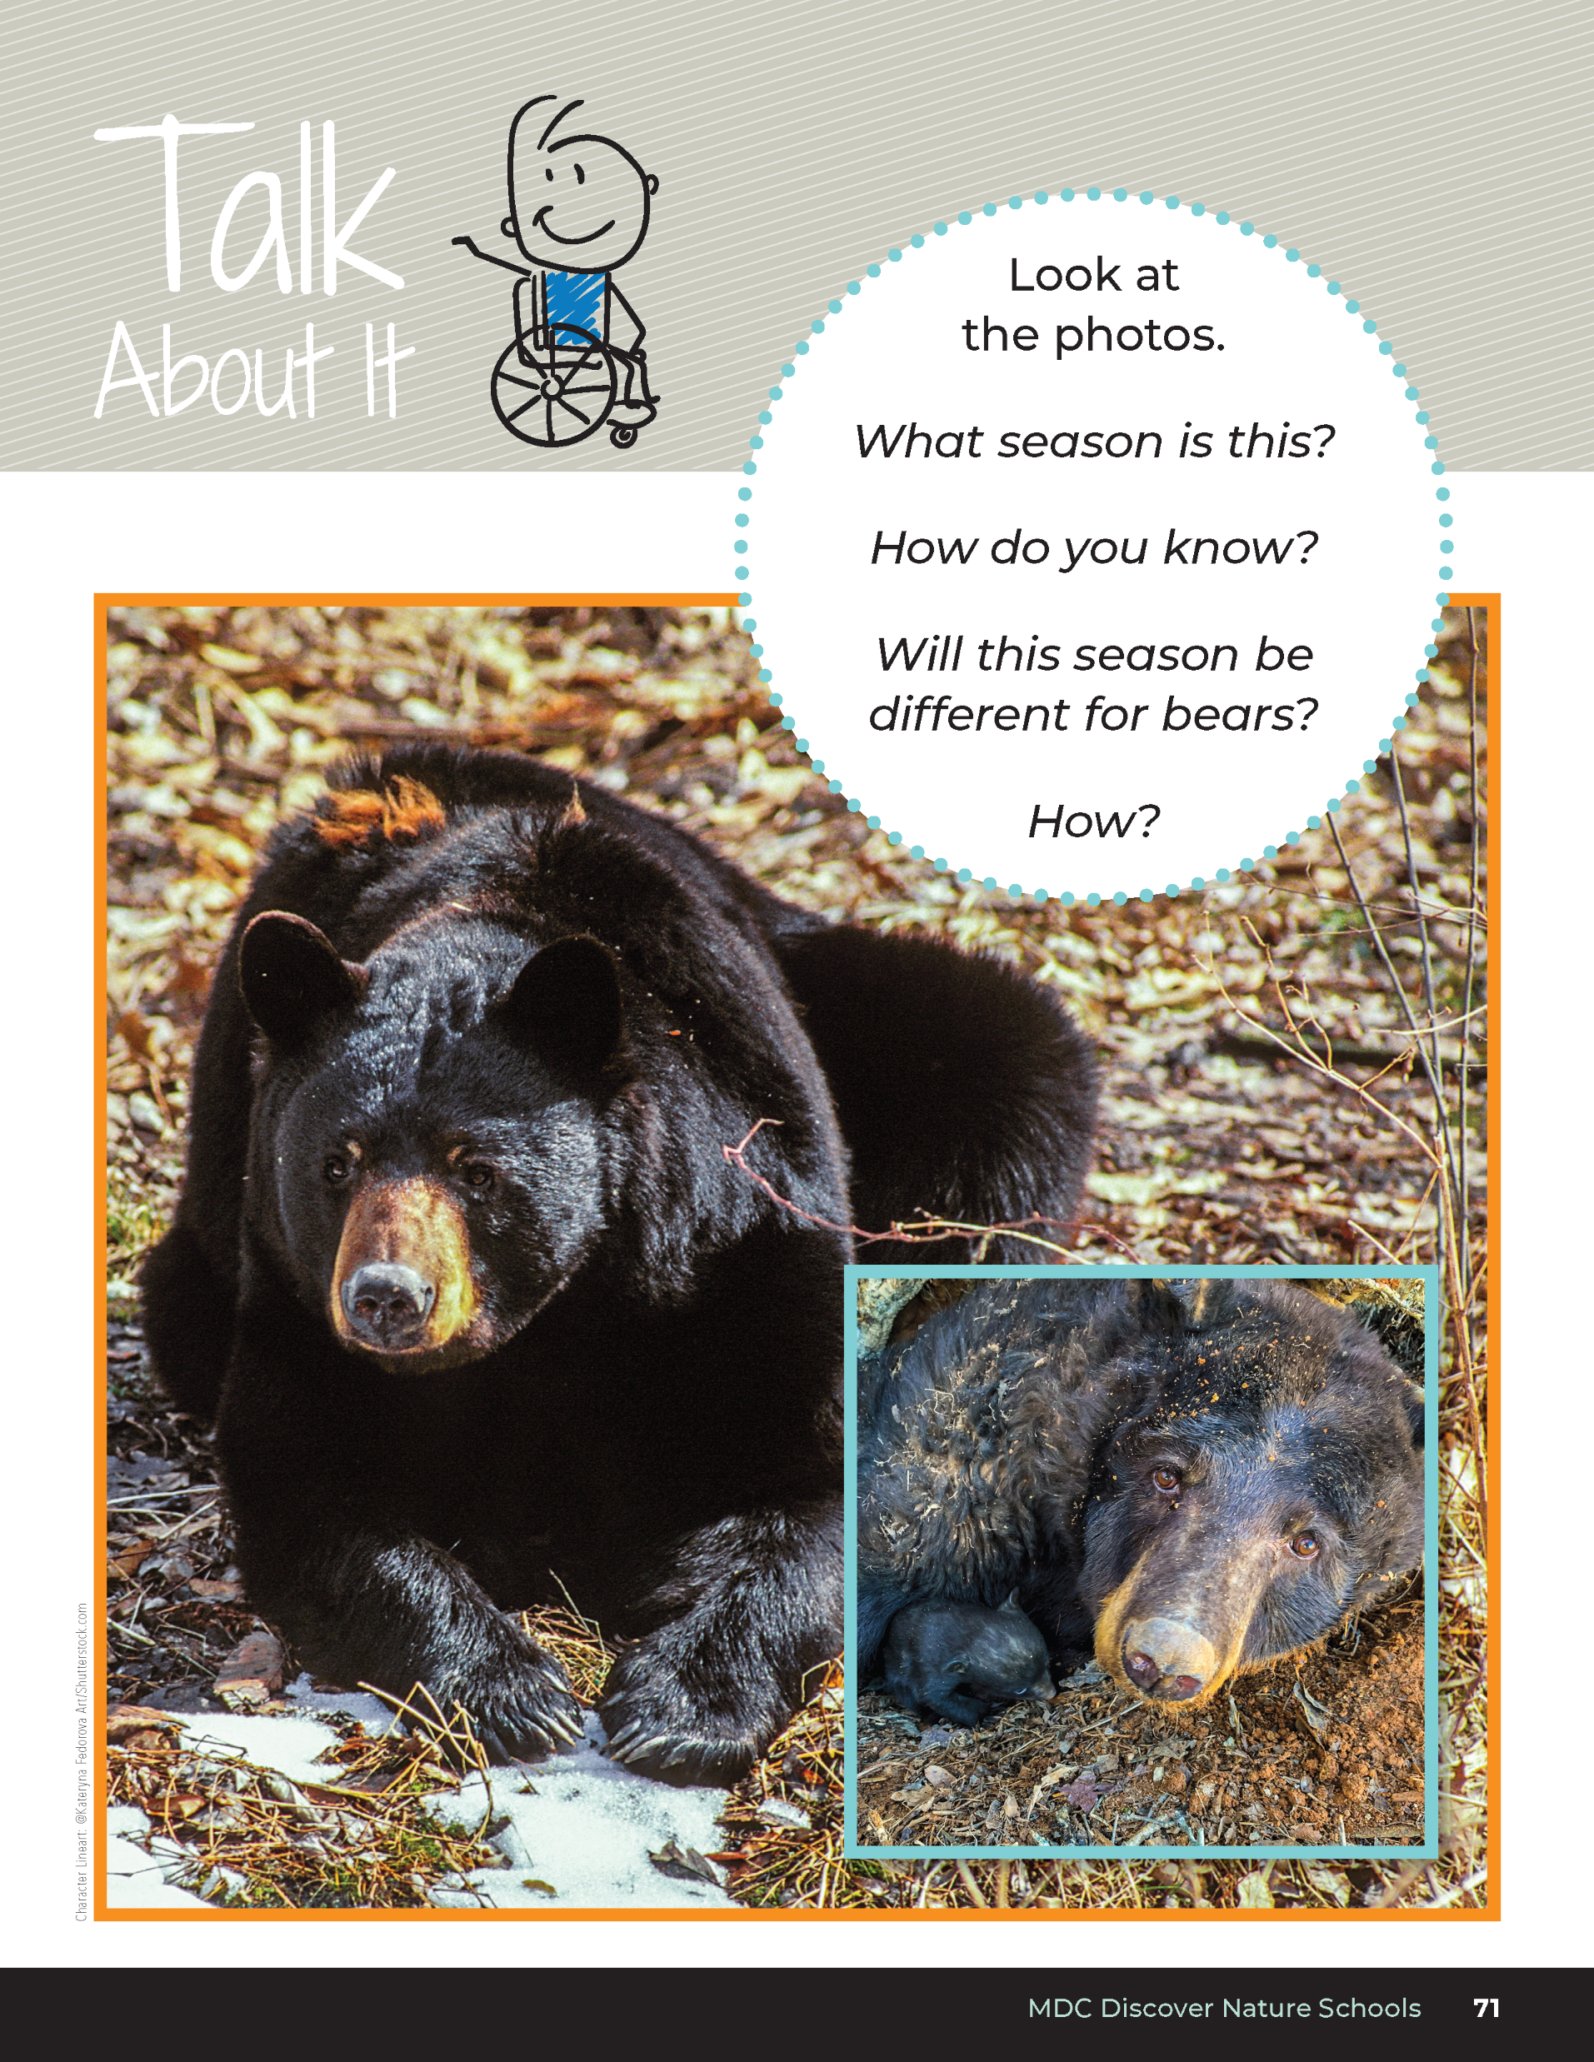
What season is this?
How do you know?
Will this season be different for bears?
Bears through the Seasons – 3A Surviving the Cold: Engage
7
Notes:
In the student guide, have students look at the pictures in the Unit 3 Introductions on page 70 and the Talk About It on page 71.

Slide 8
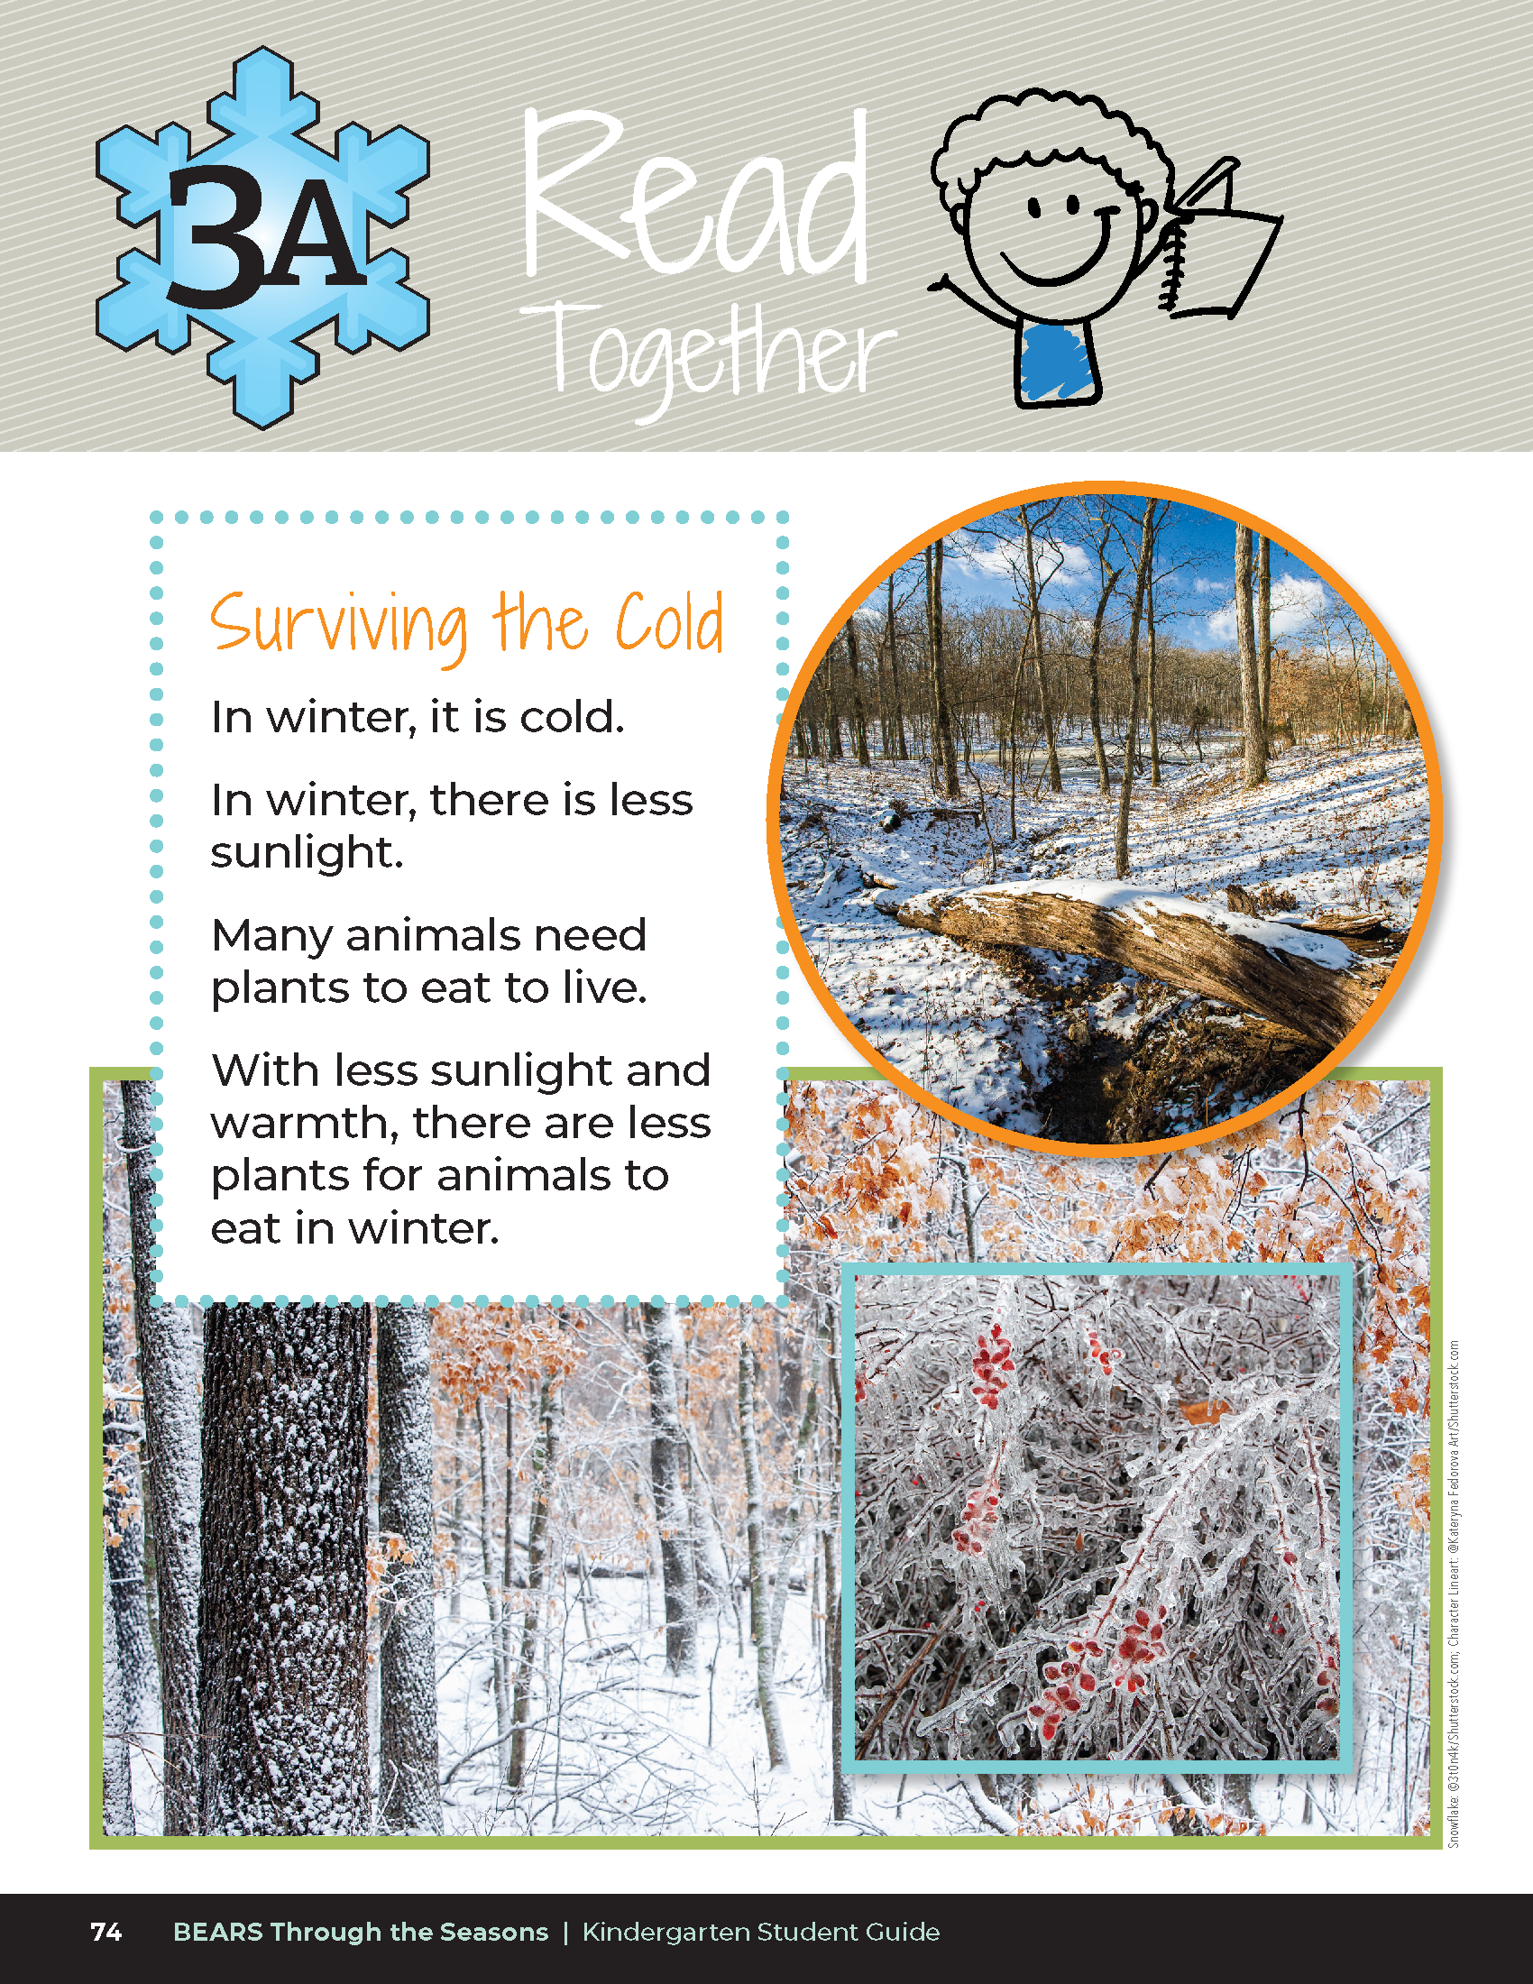

Surviving the Cold
In the winter, it is cold.
In winter, there is less sunlight.
Many animals need plants to eat to live.
With less sunlight and warmth, there are less plants for animals to eat in winter.
Bears through the Seasons – 3A Surviving the Cold: Engage
8
Notes:
Read aloud from the student guide Read Together Surviving the Cold on Page 74.

Slide 9

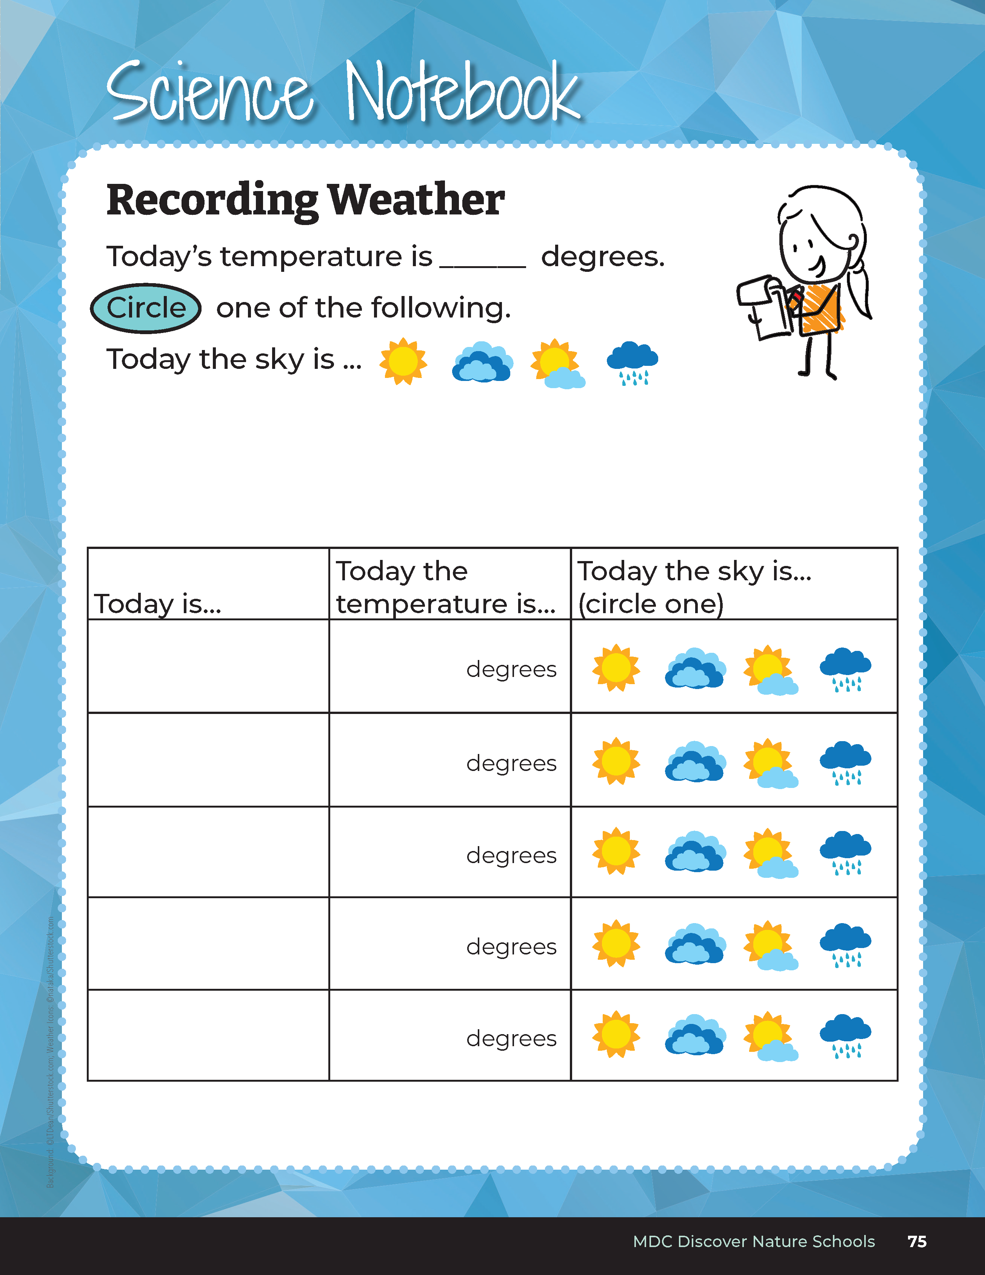

10
20
X
MINUTES
DAYS
Directions:
Collect weather data each day for 3-4 weeks.
Put a thermometer outside the window.
Look at the sky.
Record what you see.
Bears through the Seasons – 3A Surviving the Cold: Engage
9
Notes:
It’s time to collect our seasonal weather data. As a class, go outside with the student guides to record the temperature and collect weather data. Record findings in the student guide Science Notebook Recording Weather on Page 75.

Slide 10
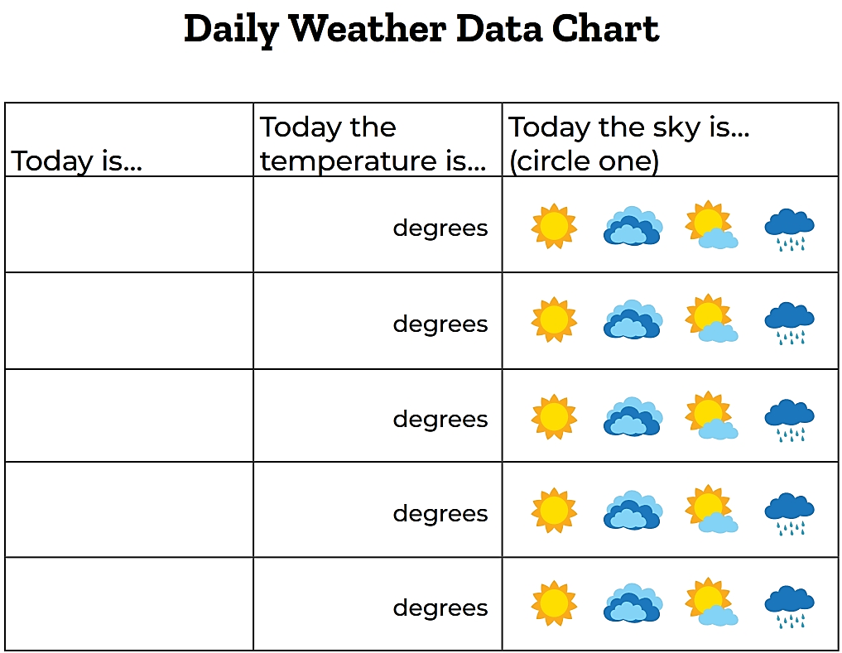
Bears through the Seasons – 3A Surviving the Cold: Engage
10
Notes:
Refer to the 3A Daily Weather Data Chart at the end of this lesson. Each day, week, or designated time data is collected as a class, have students record findings on the Daily Weather Data Chart. You may post a larger version of this chart to the front of the class. If additional copies are needed throughout the year, photocopies can be made and distributed to students.

Slide 11
10
20
X
MINUTES
DAYS
How will days that have some rain or some sun be reported?
Bears through the Seasons – 3A Surviving the Cold: Engage
11
Notes:
Collect additional data and determine when it will be filled out each day.

Slide 12
10
20
X
MINUTES
DAYS
How has the weather changed this week?
Was it a fast change or a slow change?
How does it compare to fall?
Bears through the Seasons – 3A Surviving the Cold: Engage
12
Notes:
Optional: Collect data for 4 weeks. If this option is chosen, continue to use the Daily Weather Data Chart, a 4-week data collection tool. Students can draw the weather and record the temperature in the boxes – decide what symbols to use for recording. Ask students why they should all use the same symbols to record. After a week of data collection, discuss how the weather has changed over the course of the week. Has there been a lot of change or a little change? Has is occurred fast or slow? There may be rapid change in weather when storm systems come in. Seasonal changes occur more slowly.

Slide 13
Sit very still without talking
Bears through the Seasons – 3A Surviving the Cold: Explore
13

Slide 14
You are going to count your breath for 20 seconds after doing three activities for 1 minute
Bears through the Seasons – 3A Surviving the Cold: Explore
14
Notes:
Step 1. Tell them that they are going to count their breaths for 20 seconds after doing three different activities for 1 minute. Tell them that the first time they do it they will be sitting very still, the second time, they will be walking in place, and the third time they will be running in place.

Slide 15
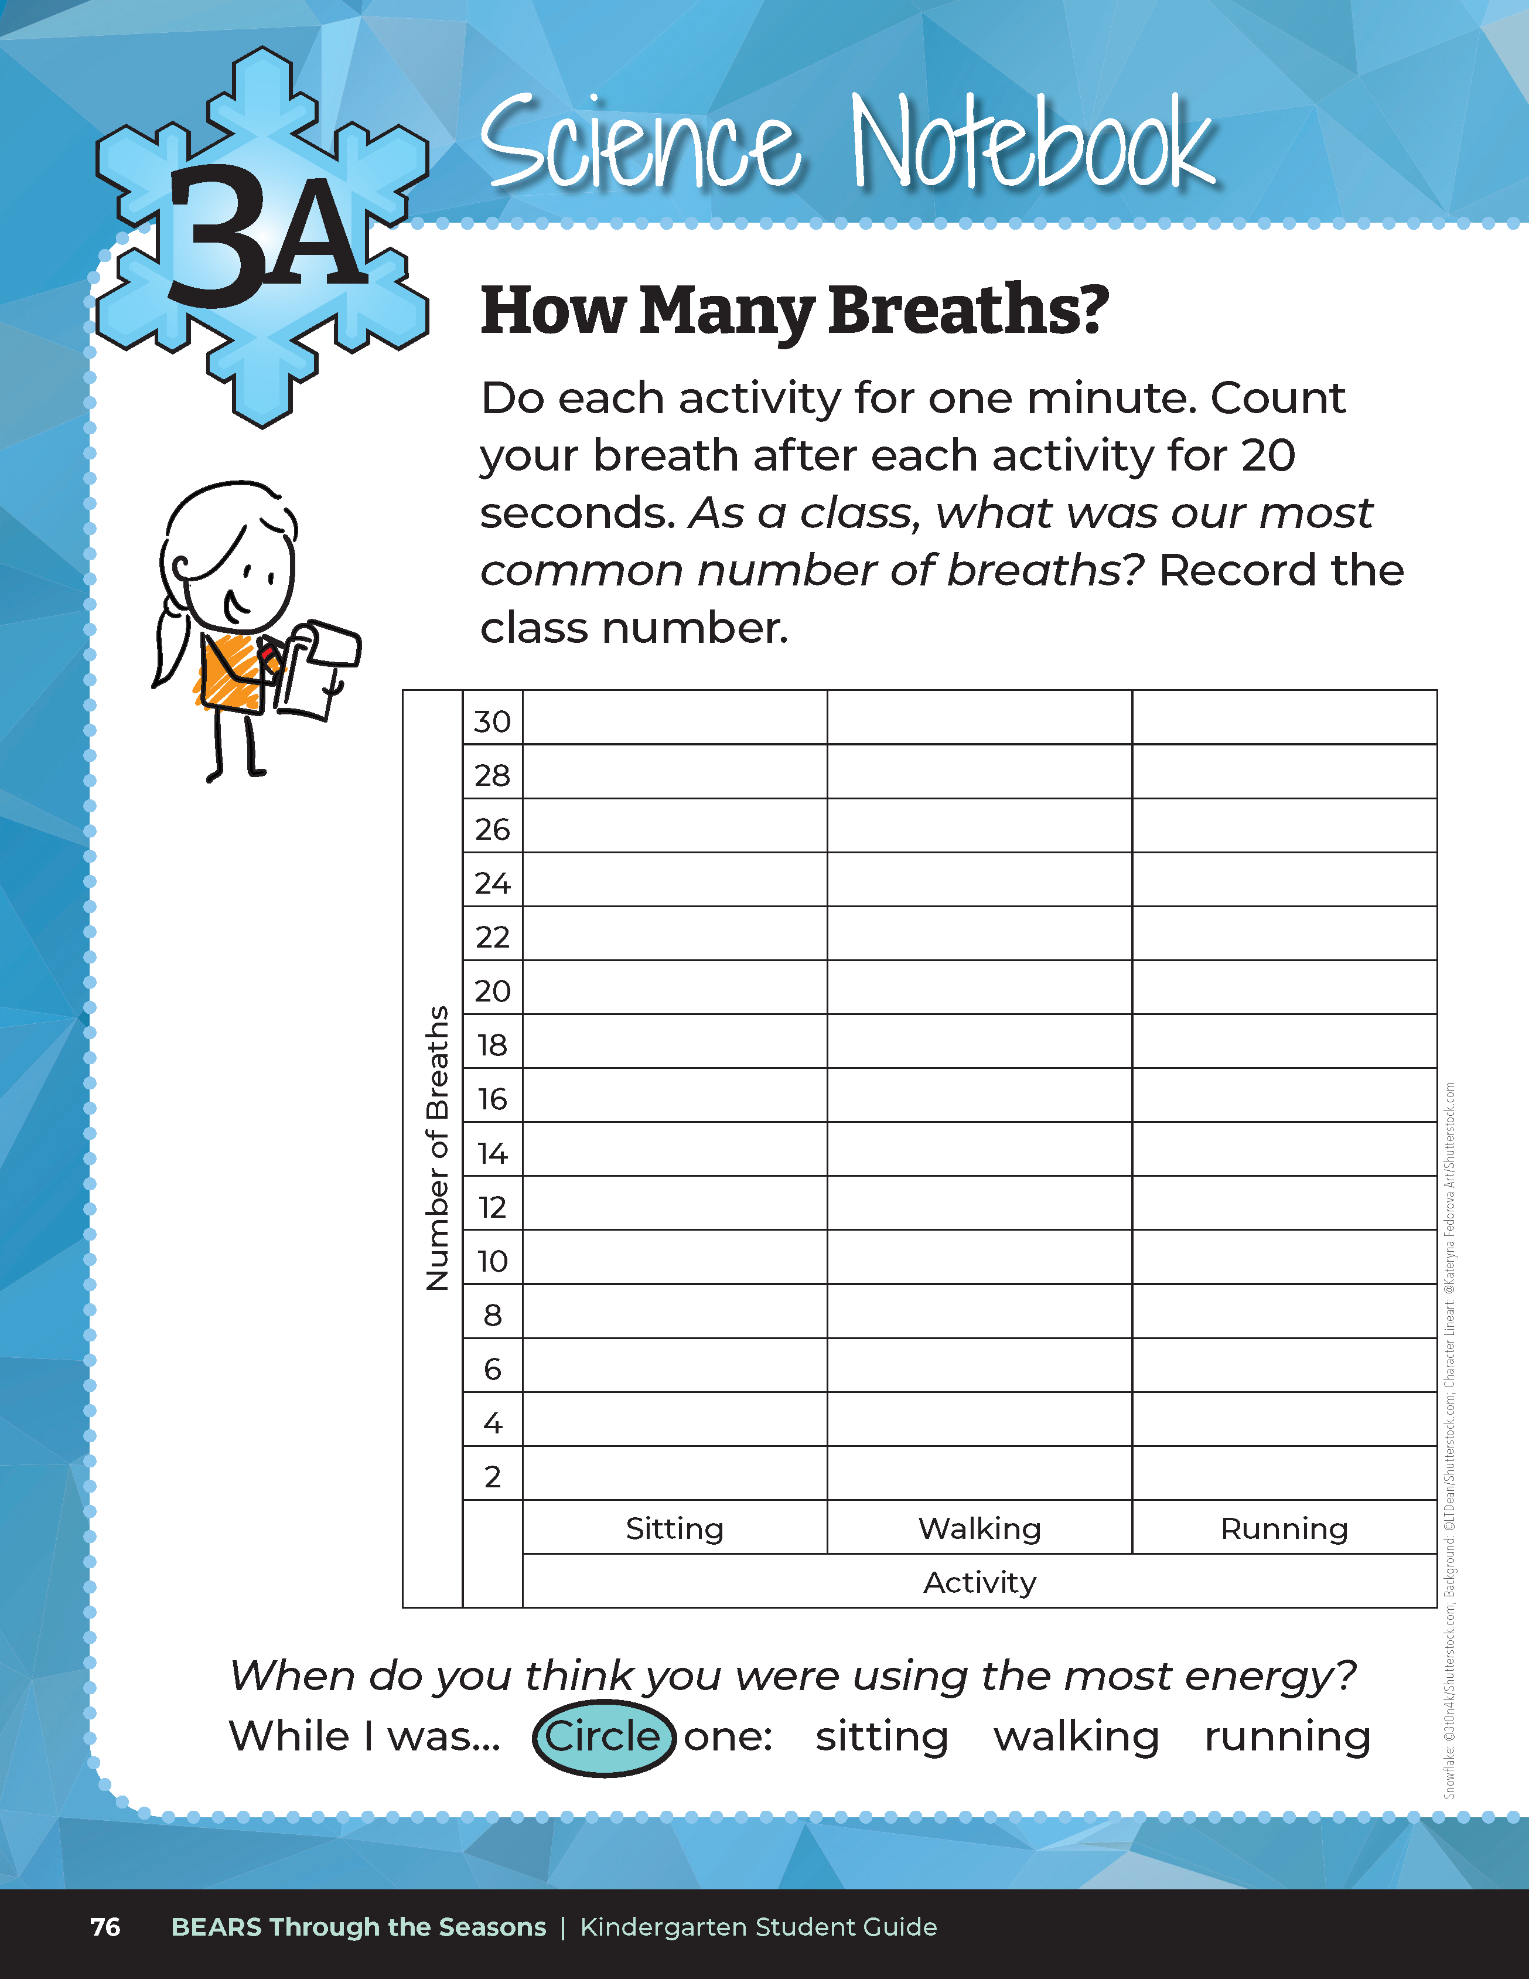
Let's make a prediction!
How many breaths do you think you will take while you are...
Sitting?
Walking in place?
Running in place?
Bears through the Seasons – 3A Surviving the Cold: Explore
15
Notes:
Step 2. Using the Science Notebook How Many Breaths? Chart template, draw the chart onto the whiteboard or chart paper for the class to view. Ask students to predict how many breaths they will take each time. Do you think the number will be the same or different for each activity? Have students record their predictions on the whiteboard or on their chart paper

Slide 16
Now we will do each activity for 1 minute and then count and record the number of breaths for 20 seconds after each activity.
Activity 1 – Sitting very still
Activity 2 – Walking in place
Activity 3 – Running in place
Bears through the Seasons – 3A Surviving the Cold: Explore
16
Notes:
Step 3. Next, have students do each activity for 1 minute, stopping to count how many breaths they take in 20 seconds after each activity. Time the students and tell them to remember how many breaths they took. After the 20 seconds, have them feel their chest to see how fast their heart is beating.

Slide 17
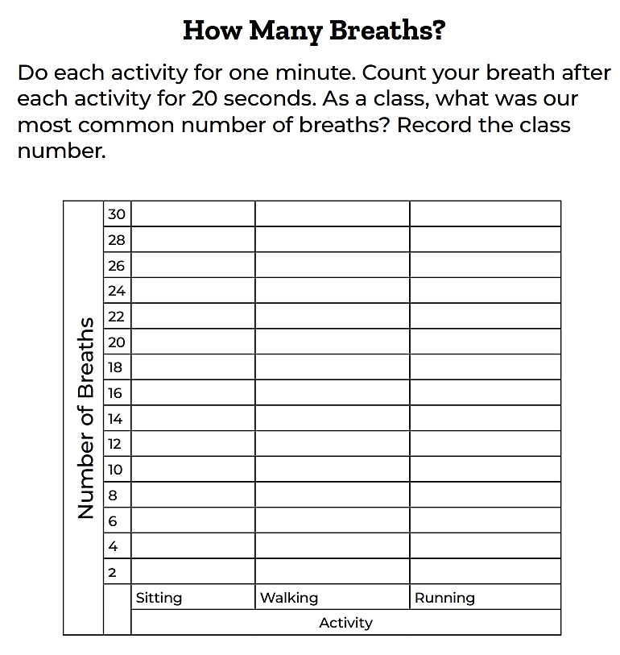
Let's record our results!
Let's take the most common number of breaths we hear for each activity and use this number in our class chart.
Bears through the Seasons – 3A Surviving the Cold: Explore
17
Notes:
On the whiteboard record how many breaths each student took. Using the How Many Breaths? Chart, take the most common number of breaths taken by each student and graph that number onto the classroom chart. Have the students compare the quantities in each column and record the class data into their student guide Science Notebook How many Breaths? chart on Page 76.

Slide 18
Record our class data into your book!
Bears through the Seasons – 3A Surviving the Cold: Explore
18
Notes:
Have the students compare the quantities in each column and record the class data into their student guide Science Notebook How many Breaths? chart on Page 76.

Slide 19
What patterns do you notice in our breathing?
Bears through the Seasons – 3A Surviving the Cold: Explore
19

Slide 20
What do the numbers tell you?
Bears through the Seasons – 3A Surviving the Cold: Explore
20

Slide 21
When do you think you were using the most energy?
Bears through the Seasons – 3A Surviving the Cold: Explore
21

Slide 22
Circle when you think you were using the most energy?
Bears through the Seasons – 3A Surviving the Cold: Explore
22
Notes:
Students circle the activity in their student guide.

Slide 23

What are the effects of using more energy when we ran?
Bears through the Seasons – 3A Surviving the Cold: Explore
23

Slide 24

When we run, we burn more energy.
Bears through the Seasons – 3A Surviving the Cold: Explore
24

Slide 25

What activity would burn the least energy, but you could do it for longer periods of time?
Bears through the Seasons – 3A Surviving the Cold: Explore
25
Notes:
Answer: Sitting

Slide 26

Is sleeping an activity? Why or why not?
Bears through the Seasons – 3A Surviving the Cold: Explore
26

Slide 27

Do we use energy when we sleep?
Bears through the Seasons – 3A Surviving the Cold: Explore
27

Slide 28

Do you wake up hungry sometimes? Why?
Bears through the Seasons – 3A Surviving the Cold: Explore
28

Slide 29
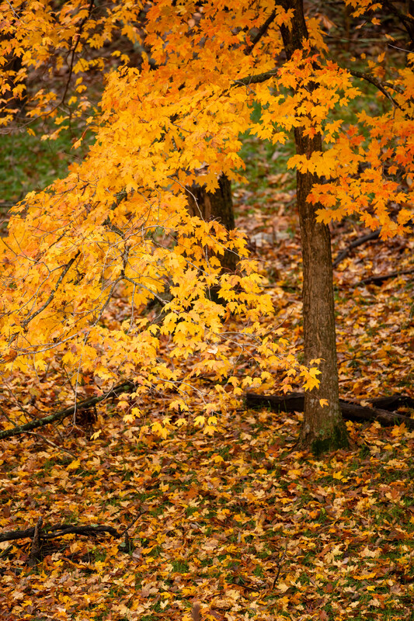
Which season showed bears eating the most food?
Bears through the Seasons – 3A Surviving the Cold: Explore
29
Notes:
Think back to when we weighed the bags of beans or rice in Lesson 2C Wow! Bears Eat A Lot!
Answer: Fall

Slide 30
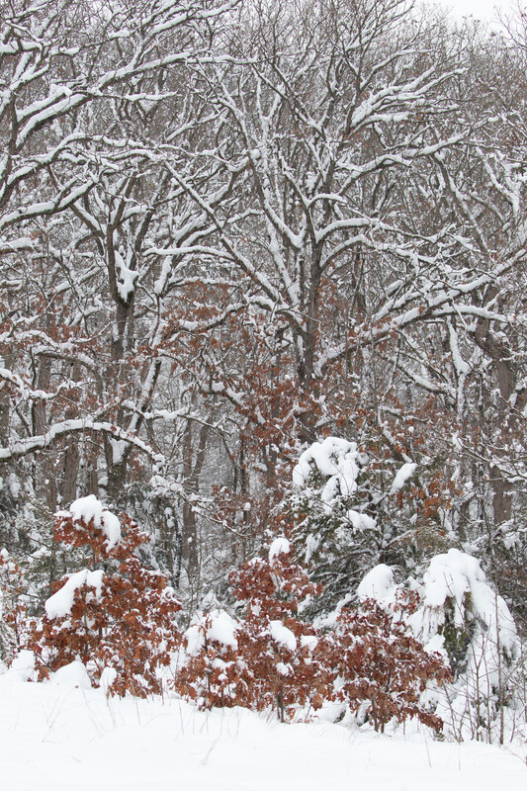
Which season showed bears eating little to no food?
Bears through the Seasons – 3A Surviving the Cold: Explore
30
Notes:
Think back to when we weighed the bags of beans or rice in Lesson 2C Wow! Bears Eat A Lot!
Answer: Winter

Slide 31
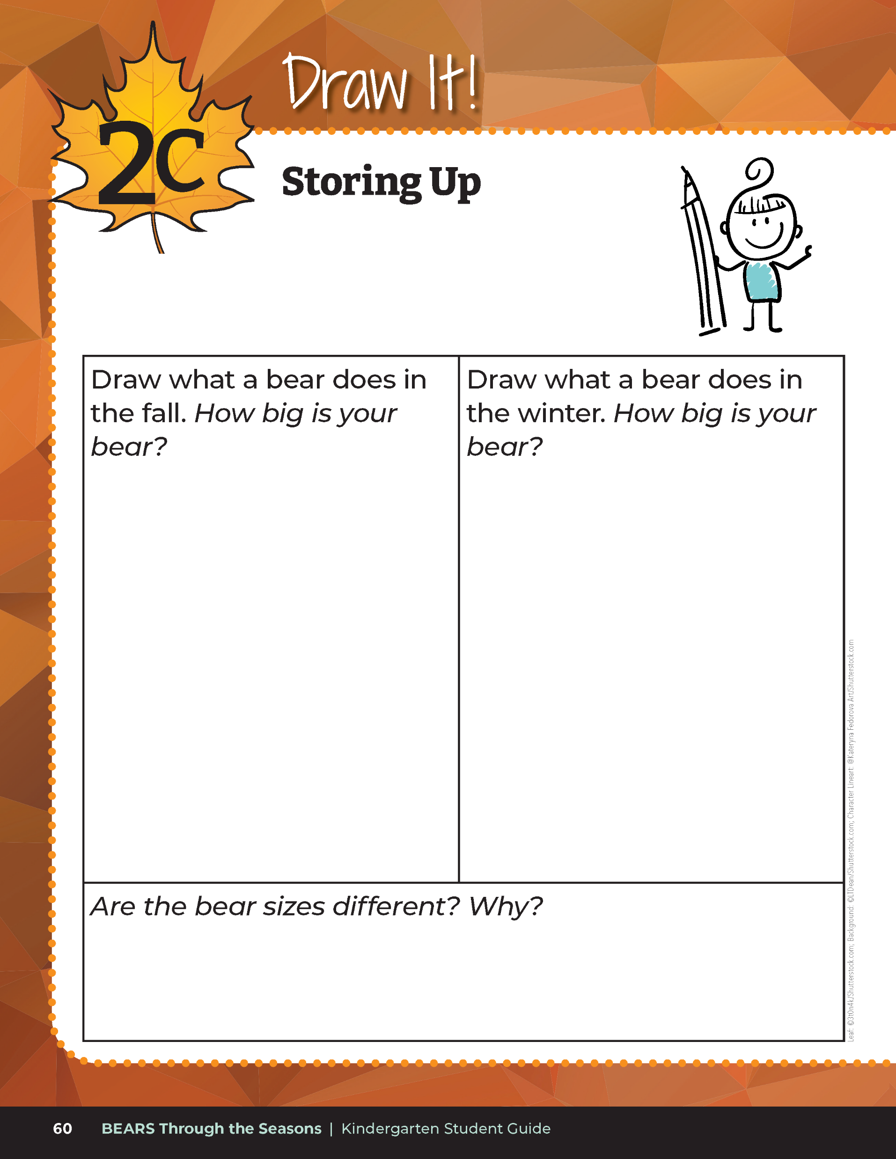
Why do bears eat a lot of acorns and other food in the fall?
Bears through the Seasons – 3A Surviving the Cold: Explore
31
Notes:
Have students open their student guide and turn back to Lesson 2C Draw It! Storing Up on Page 60.
Answer: Store fat for the winter to use as energy to survive while they sleep for months

Slide 32

Read the book Hush Up and Hibernate by Sandra Markle
Link to book on Epic!: Hush Up and Hibernate by Sandra Markle
Available for free to classroom teachers on Epic! (login required)
Link to Read-Aloud: https://youtu.be/nPRP8QTEA3M?si=F86mSpKIl41UOMHz
Bears through the Seasons – 3A Surviving the Cold: Explain
32

Slide 33
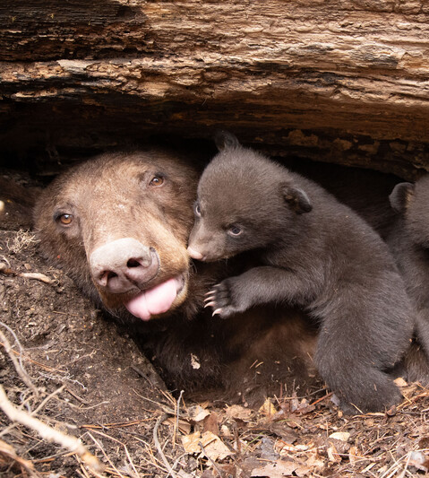
What do bears do in the wintertime to conserve energy?
Bears through the Seasons – 3A Surviving the Cold: Explain
33
Notes:
Answer: Hibernate

Slide 34
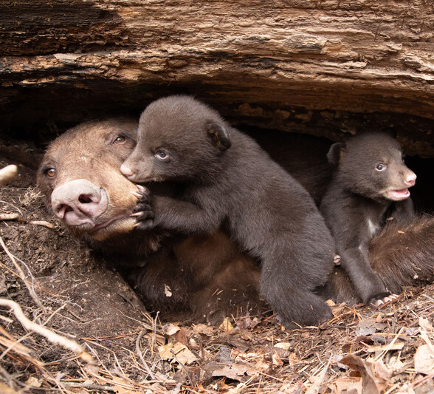
What were some of the reasons Mama Bear said why bears needed to hibernate?
Bears through the Seasons – 3A Surviving the Cold: Explain
34
Notes:
Answer: Food availability and to avoid predators

Slide 35
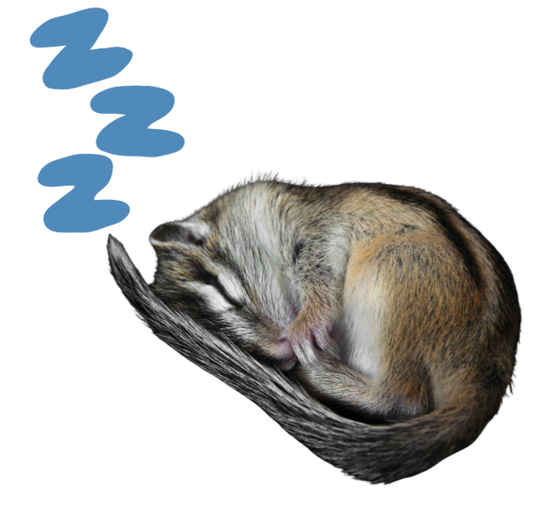
Hibernation
Animals that hibernate go into a deep sleep all winter and don't wake up for days, weeks or months
Chipmunks are true hibernators
Bears through the Seasons – 3A Surviving the Cold: Explain
35
Notes:
Some animals go into deep sleep and do not wake up for days, weeks, or months. This is called hibernation.
Teacher Note: You may either teach the concept of hibernation or the concept of torpor to your students, depending on their level of understanding. This lesson uses the term hibernation as this is the term most understood by this grade level.
Hibernation versus torpor: Both are similar in that animals use a lot less energy, their heart rate decreases, and they breathe less. However, there are some differences between the two. Animals that hibernate go into a long deep sleep all winter and don’t wake up. Smaller animals are the only true hibernators. Bears don’t truly hibernate; they go into a state of torpor. Animals that go into torpor are asleep, but it is not as deep of sleep or as long. They can still quickly wake up if danger is around or, in the case of bears, to give birth. Animals in a state of torpor will wake up if they sense food or if the weather warms up for a day or two.

Slide 36
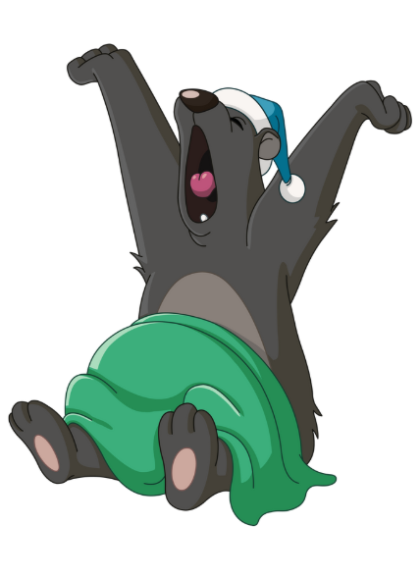
Torpor
Animals go into torpor will sleep deeply but will wake up if needed.
Bears do not hibernate because they will wake up if they sense food or to give birth!
Bears through the Seasons – 3A Surviving the Cold: Explain
36
Notes:
Other animals will sleep deeply but will wake up if needed. This is called torpor.

Slide 37
When did you use less energy?
While you were sitting, walking, or running?
Bears through the Seasons – 3A Surviving the Cold: Explain
37
Notes:
Discuss the results of their breathing/heart rate activity again from student guide Science Notebook How Many Breaths? On Page 76.

Slide 38
When Mama Bear and cub finally went into their den, how did they act?
Bears through the Seasons – 3A Surviving the Cold: Explain
38
Notes:
Think back to the book Hush Up and Hibernate.

Slide 39
What causes bears to hibernate?
Bears through the Seasons – 3A Surviving the Cold: Explain
39
Notes:
Answer: Not much food available so they need to conserve energy.

Slide 40
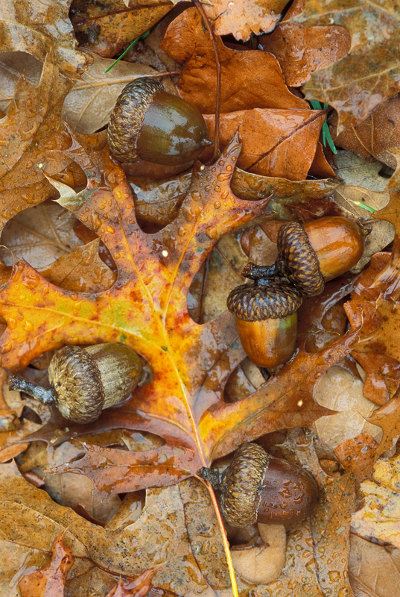
Why are they able to stay alive while they hibernate?
Bears through the Seasons – 3A Surviving the Cold: Explain
40
Notes:
Answer: Bears eat a lot in the fall to build up fat to survive in the winter since they are sleeping.

Slide 41
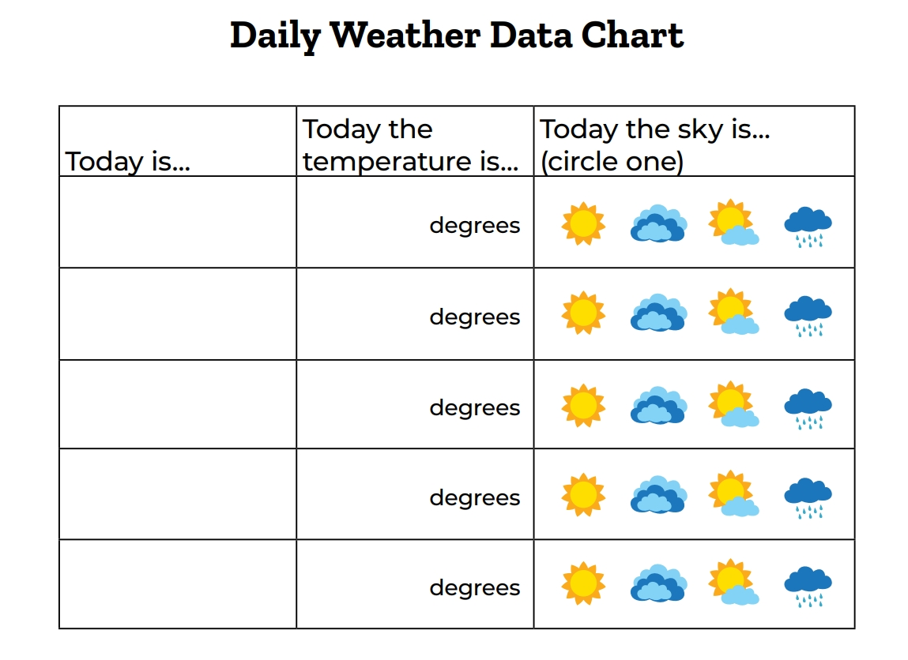
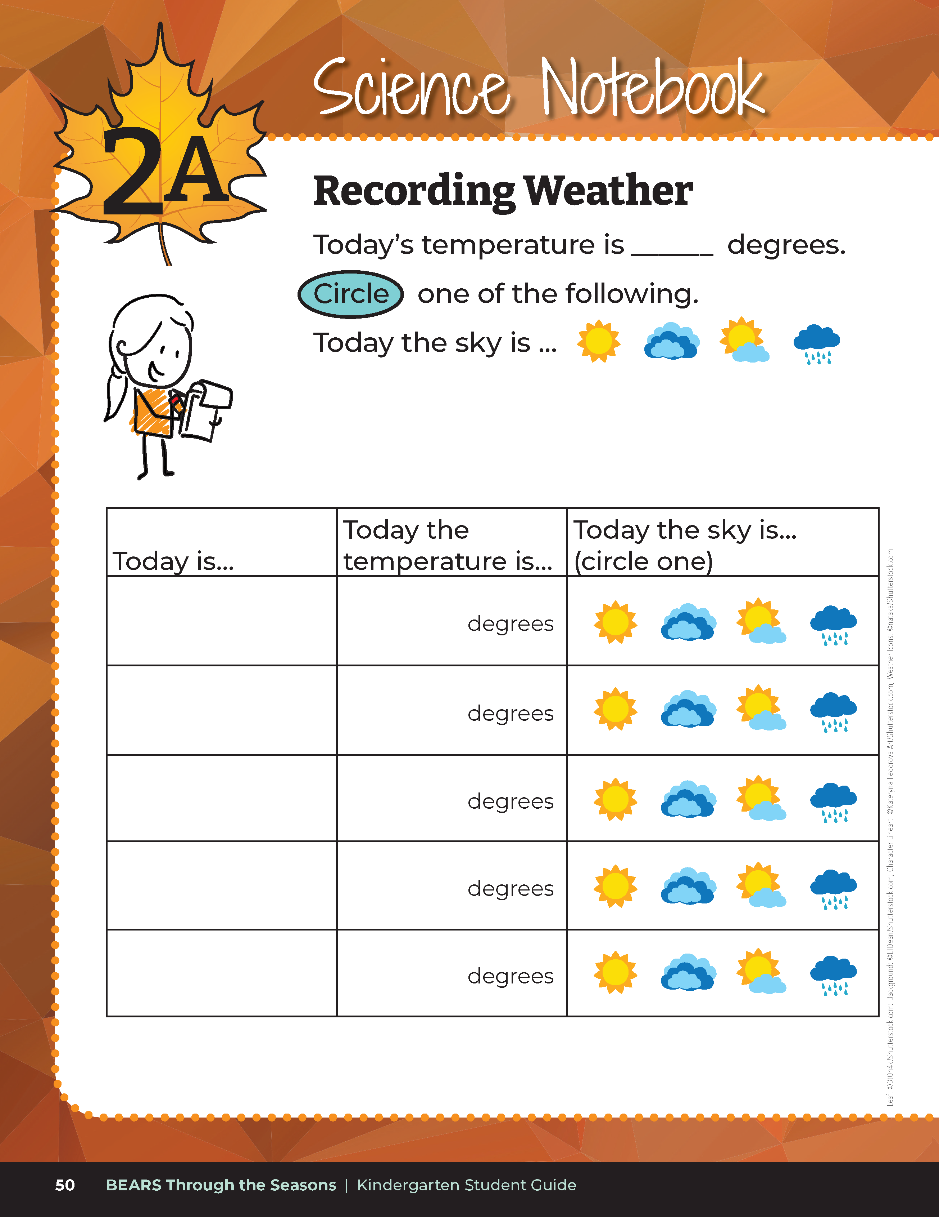
What was the weather like...
in the summer?
in the fall?
in the winter?
Bears through the Seasons – 3A Surviving the Cold: Explain
41
Notes:
Discuss the cause the effect if the weather and decreasing amount of daylight on the amount of food present for animals. Refer to student guide 1B Science Notebook Weather Data page and 2A Science Notebook Weather Data page.

Slide 42

How does weather in the changing seasons effect plants?
How does having less food affect some animals?
Bears through the Seasons – 3A Surviving the Cold: Explain
42

Slide 43
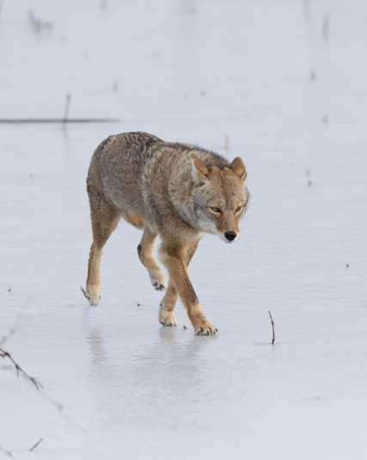
Do all animals hibernate?
Bears through the Seasons – 3A Surviving the Cold: Elaborate
43

Slide 44

Read the book What Happens in Winter? Animals in Winter by Jennifer Fretland VanVoorst
Link to book on Epic!: Animals in Winter by Jennifer Fretland VanVoorst
Available for free to classroom teachers on Epic! (login required)
Link to Read-Aloud: https://youtu.be/JdOIsEzImGU?si=L1xU8v75AbwtFcNK
Bears through the Seasons – 3A Surviving the Cold: Elaborate
44

Slide 45
What techniques have we learned that animals use to survive winter?
Bears through the Seasons – 3A Surviving the Cold: Elaborate
45

Slide 46
What do frogs do to survive the winter?
Bears through the Seasons – 3A Surviving the Cold: Elaborate
46
Notes:
Answer: They survive underwater.

Slide 47
What do foxes do?
Bears through the Seasons – 3A Surviving the Cold: Elaborate
47
Notes:
Answer: They hunt.

Slide 48
Thinking back to Hush Up and Hibernate, what do wolves and mountain lions do?
Bears through the Seasons – 3A Surviving the Cold: Elaborate
48
Notes:
Answer: They hunt.

Slide 49
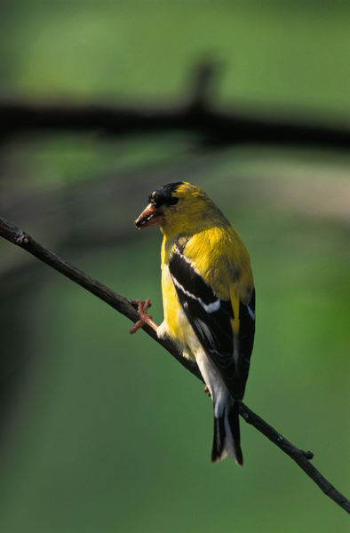
Do all animals that we’ve discussed spend the winter here in Missouri?
Bears through the Seasons – 3A Surviving the Cold: Elaborate
49
Notes:
Animal in picture: American goldfinch

Slide 50
What were the geese doing in the beginning of the book? Why?
Bears through the Seasons – 3A Surviving the Cold: Elaborate
50
Notes:
Answer: They were flying south to avoid the colder temperatures.

Slide 51
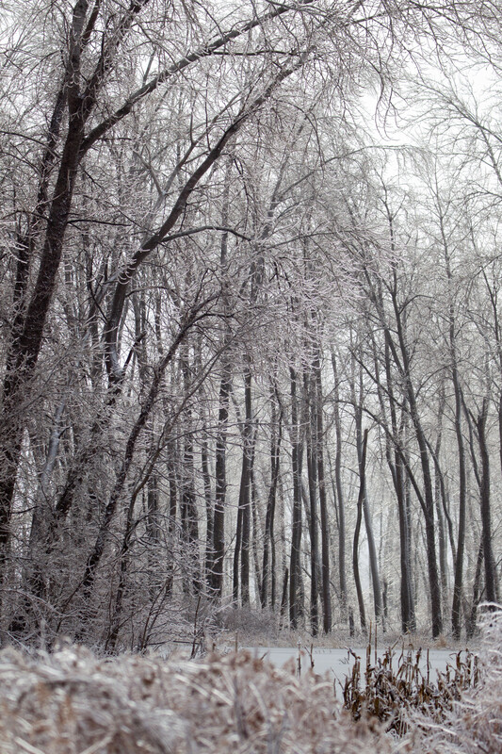
What is happening around them that makes them change their behavior?
Bears through the Seasons – 3A Surviving the Cold: Elaborate
51

Slide 52
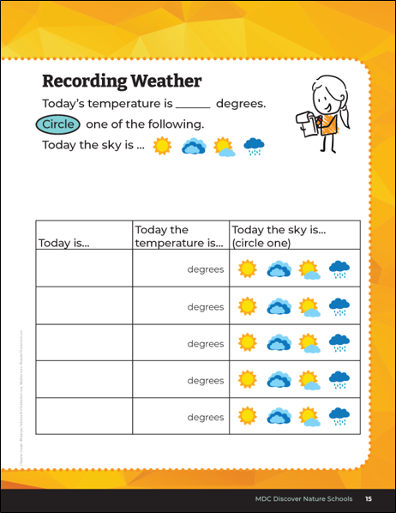
Think about our weather data we’ve taken earlier this lesson. How is this different from our weather data in the fall and summer?
Bears through the Seasons – 3A Surviving the Cold: Elaborate
52
Notes:
Answer: Less available food and colder temperatures.

Slide 53
Bears through the Seasons – 3A Surviving the Cold: Elaborate
53
Notes:
Add student observations and/or questions to the Noticings and Wonderings Chart as the lesson concludes.

Slide 54

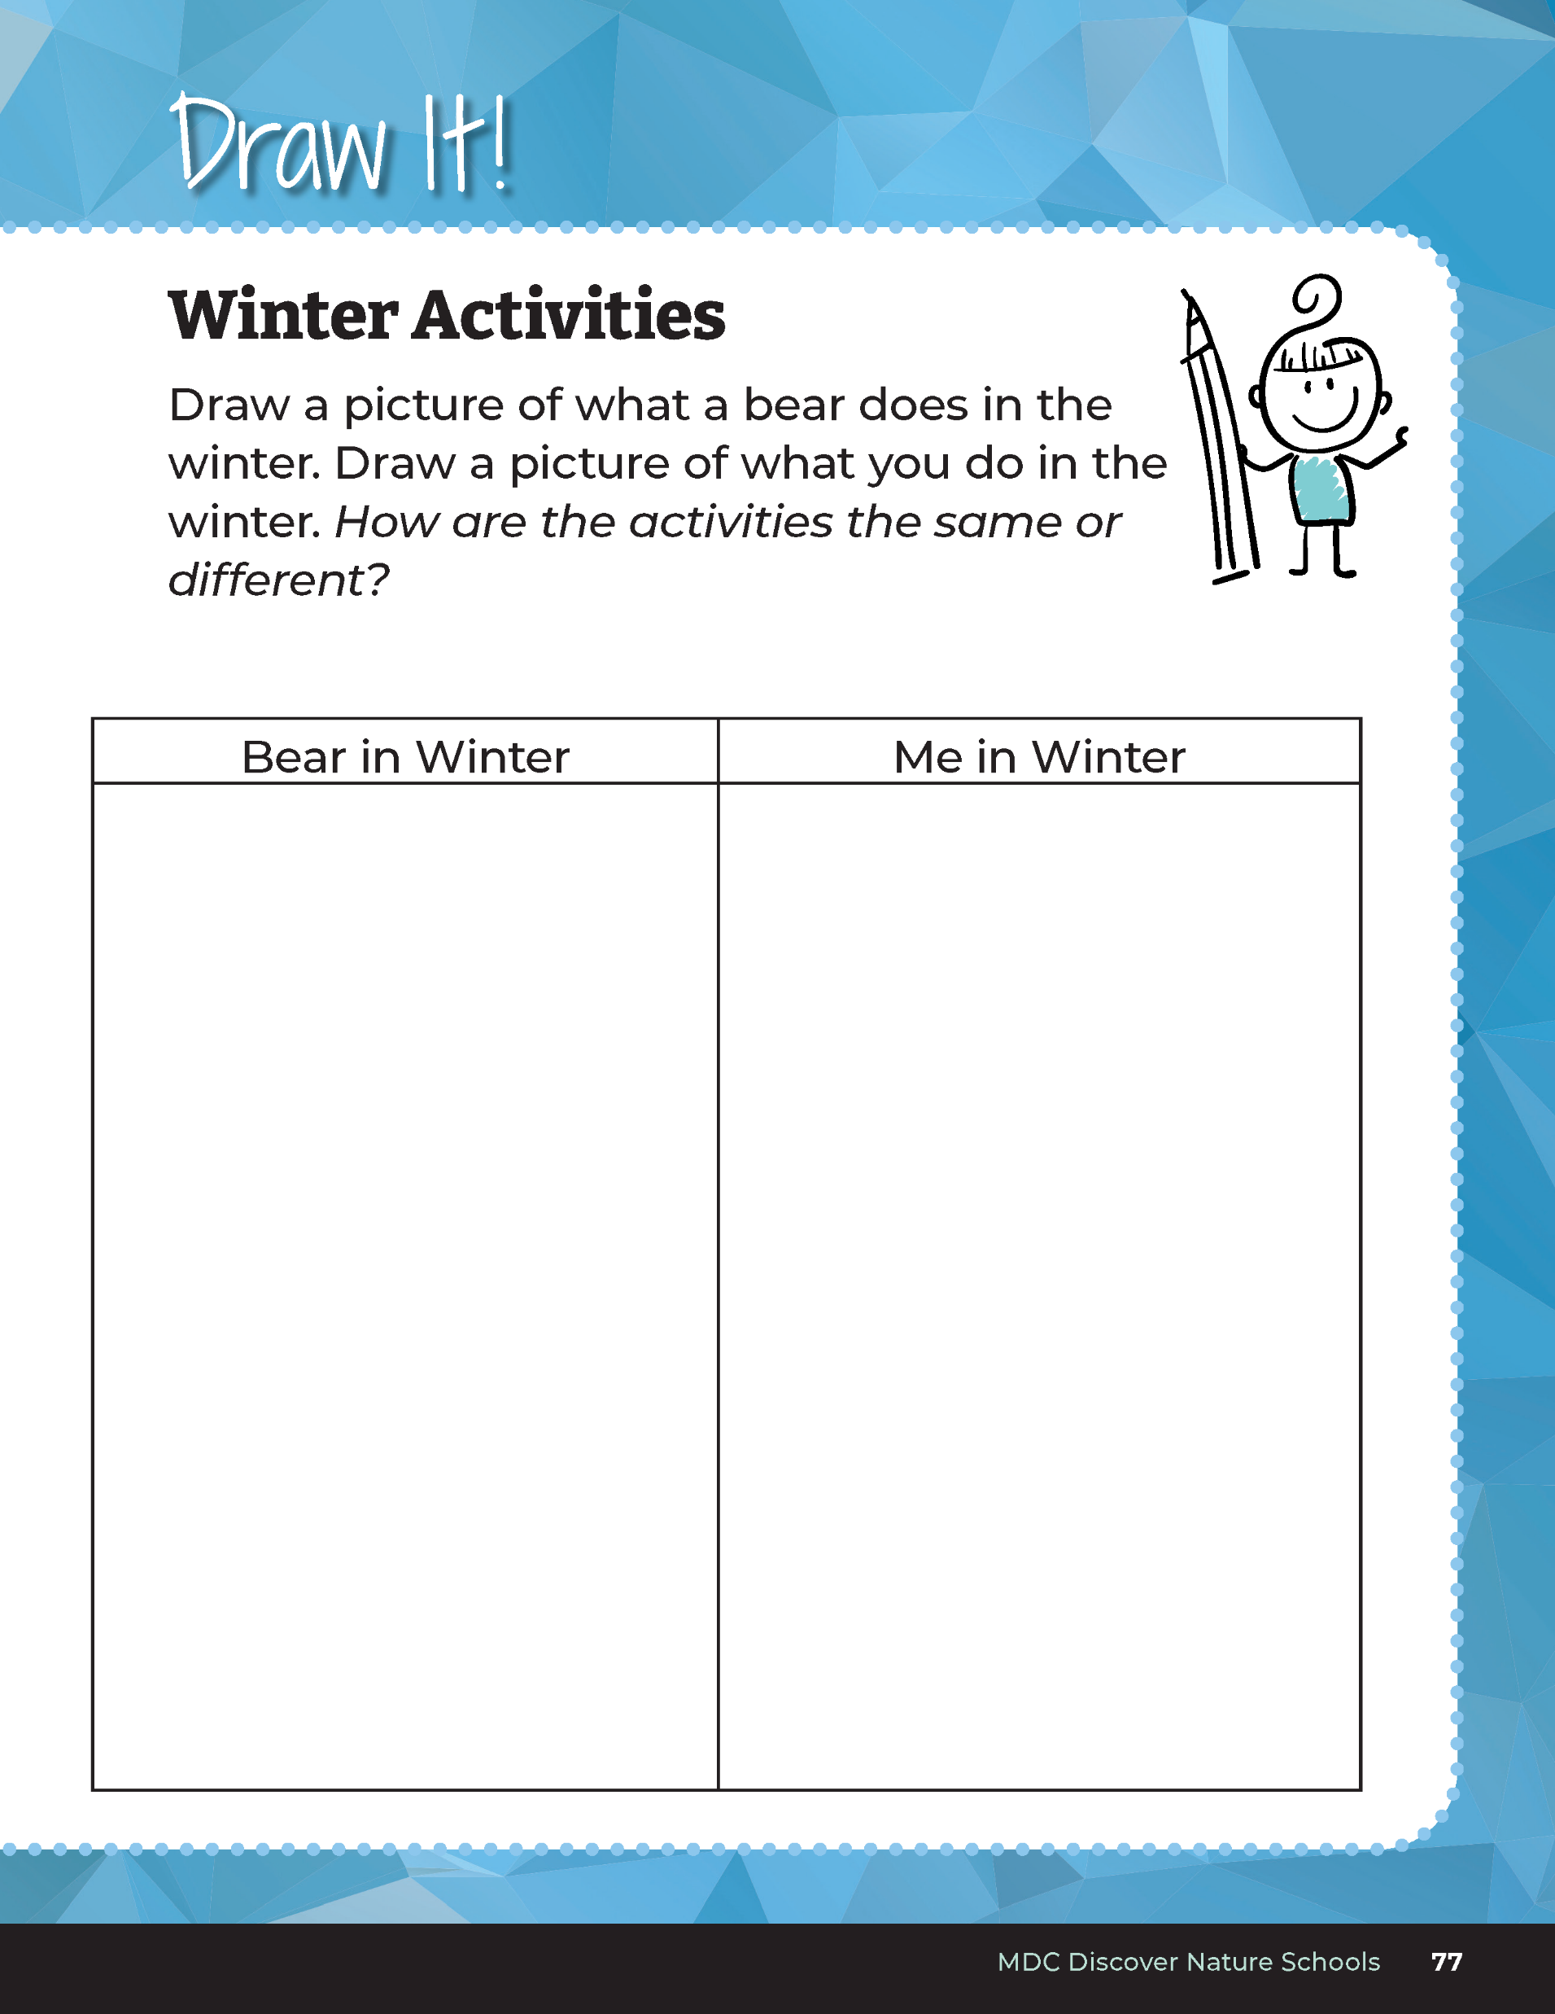
Draw a picture of what a bear does in the winter.
Draw a picture of what you do in the winter.
Bears through the Seasons – 3A Surviving the Cold: Evaluate
54
Notes:
Have students complete student guide Draw It! Winter Activities on Page 77. Students will draw what bear does in the winter and what they do in the winter.

Slide 55
How are our activities the same?
How are they different?
Bears through the Seasons – 3A Surviving the Cold: Evaluate
55
Notes:
Discuss how the activities are the same or different.

Slide 56
Why are we different from what a bear does?
Bears through the Seasons – 3A Surviving the Cold: Evaluate
56
Notes:
Review why a bear hibernates and the activities of a human in the winter. (Answer: We spend more time indoors because of the weather and shorter days, but we don’t need to conserve energy the way a bear does because our food supply remains available.)

Slide 57


Optional: Cross-Curricular Extension
Act It Out! Grab your bear headbands and perform the actions from Hush Up and Hibernate by Sandra Markle.
Bears through the Seasons – 3A Surviving the Cold: Cross-Curricular Extension
57

