Slide 1
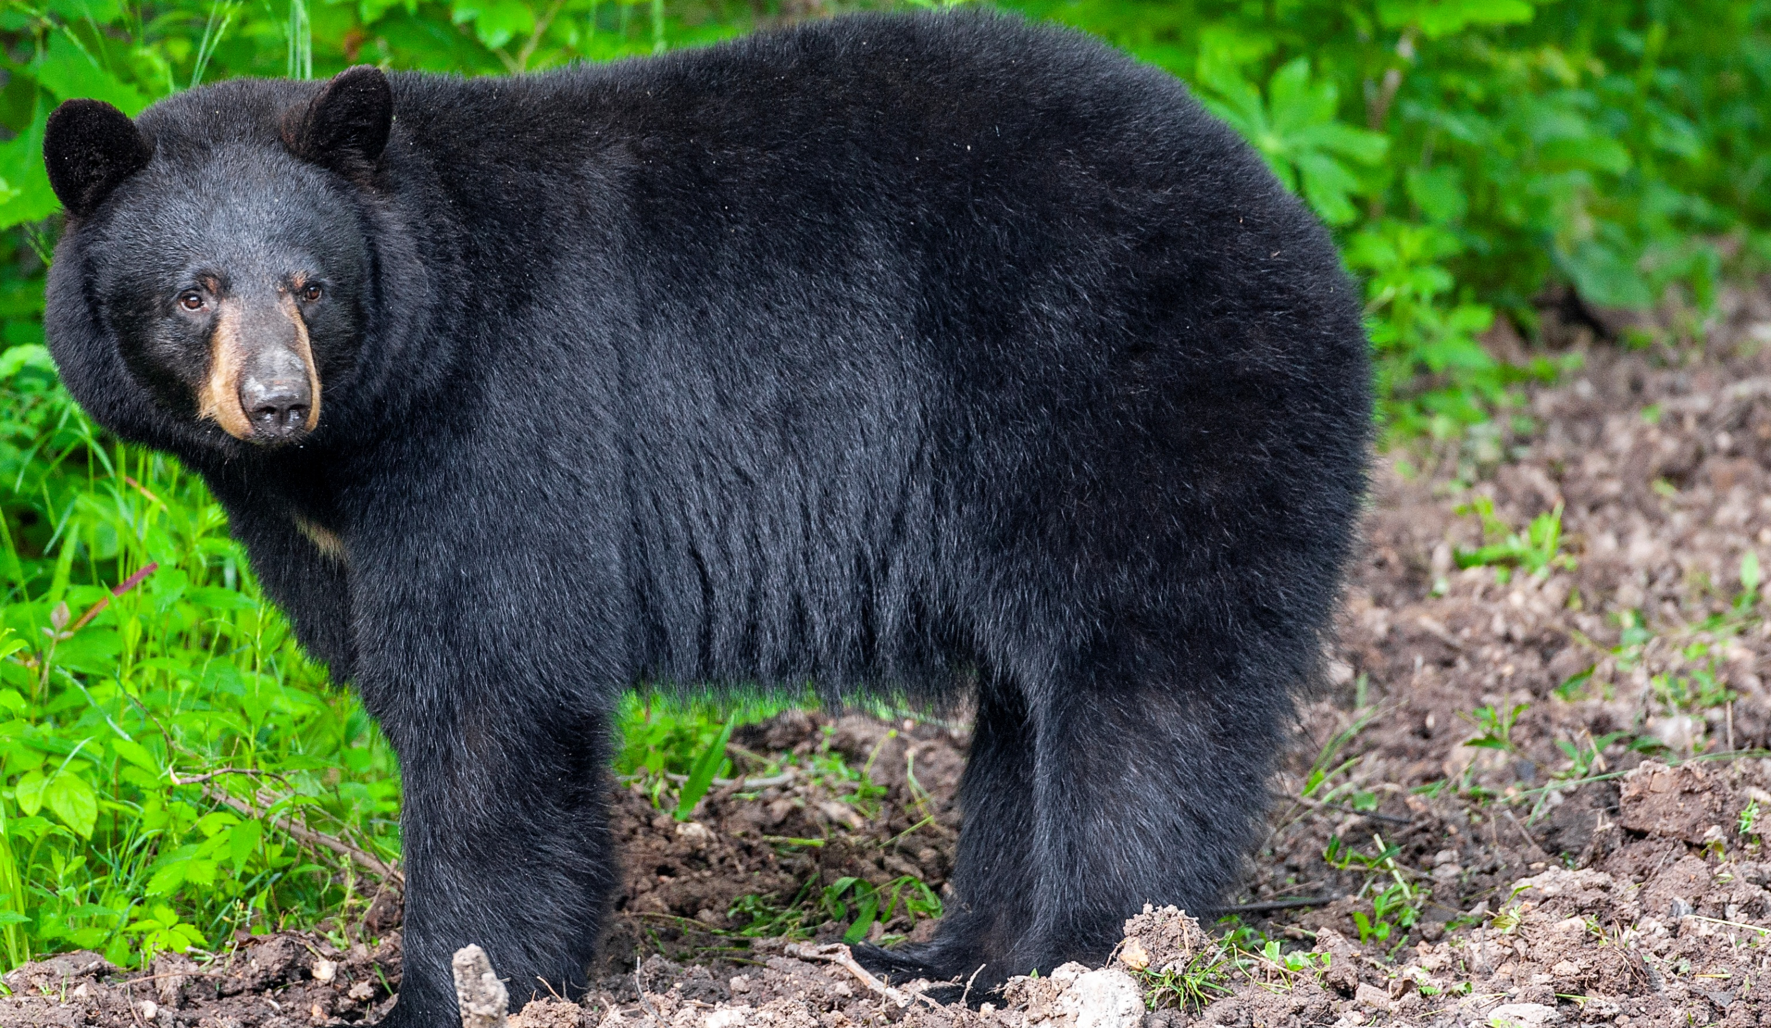

BEARS
Through the Seasons
Lesson 2E: Finding a Den

Slide 2
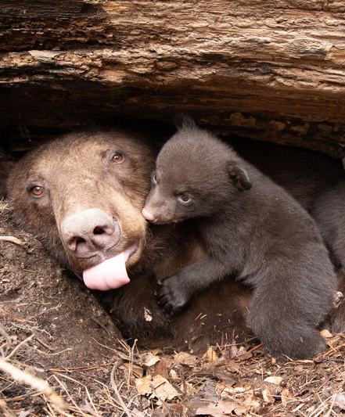

Guiding Question:
How do bears use their den to survive?
Bears through the Seasons – 2E Finding a Den: Engage
2

Slide 3

Bears through the Seasons – 2E Finding a Den: Engage
3
Notes:
Prepare and display your Noticings and Wonderings Chart for this lesson. Add student observations and/or questions to the chart as the lesson proceeds in reference to the phenomenon studied.

Slide 4

How do you like to sleep in the wintertime?
Bears through the Seasons – 2E Finding a Den: Engage
4

Slide 5
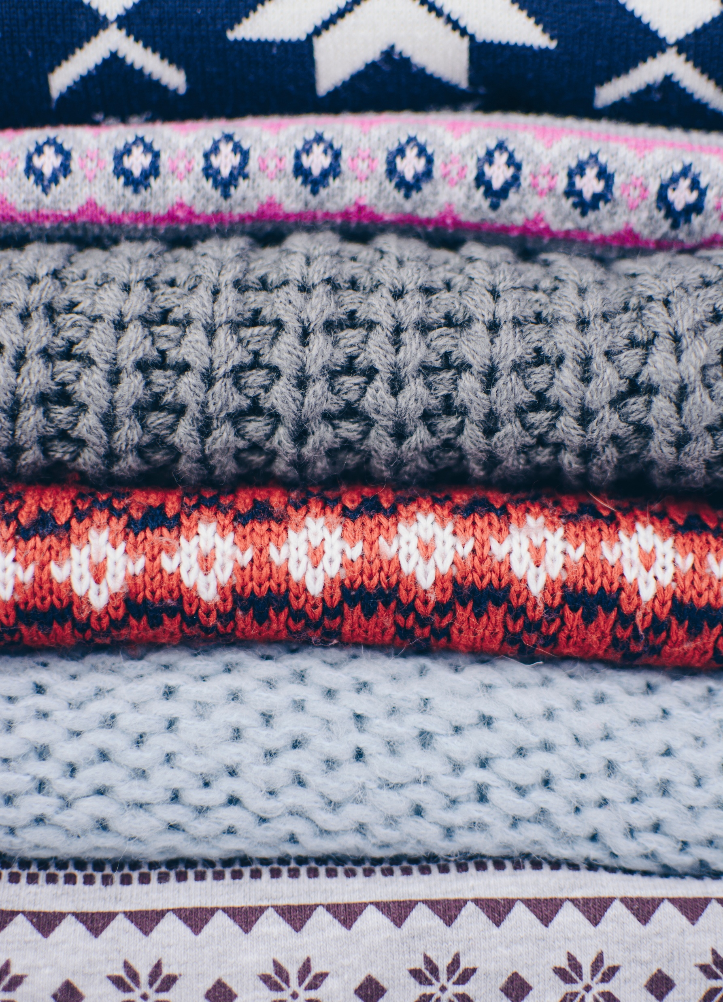
Do you use a lot of blankets? Does your family turn the heat up, etc.?
Bears through the Seasons – 2E Finding a Den: Engage
5

Slide 6
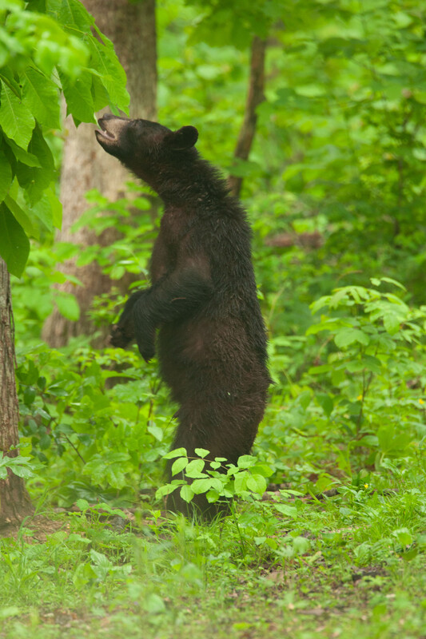

What do bears do to prepare for the cold of winter?
Bears through the Seasons – 2E Finding a Den: Engage
6

Slide 7
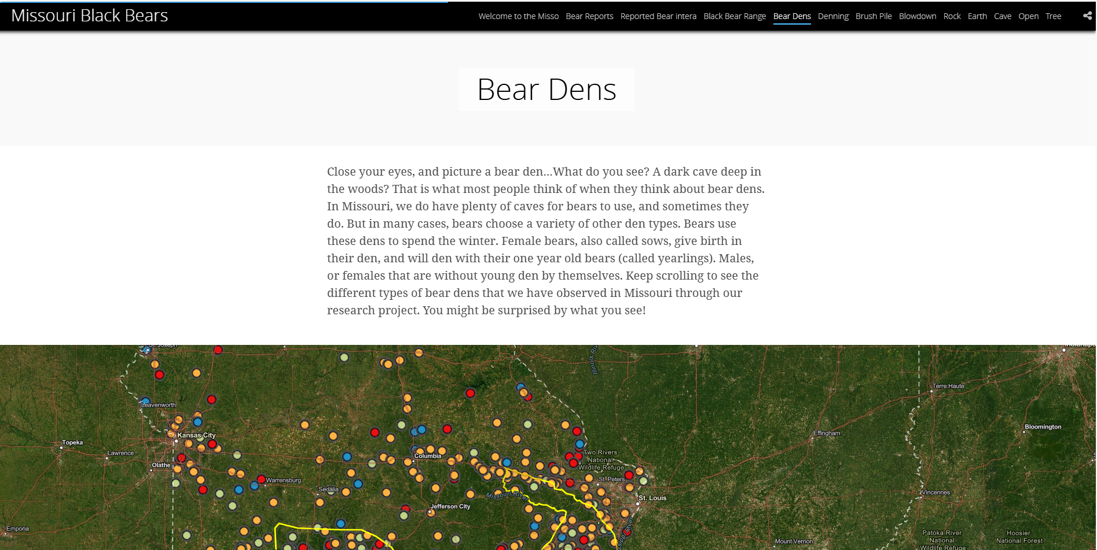
Black Bear Interactive Story Map
Link:
https://mdcgis.maps.arcgis.com/apps/Cascade/index.html?appid=712cc83bff5145808936d38a3822ebb7
Display the den types
Bears through the Seasons – 2E Finding a Den: Explore
7
Notes:
Refer to the interactive Black Bear Story Map and display the den types

Slide 8

You will be building a den that a bear would find and use to survive.
Bears through the Seasons – 2E Finding a Den: Explore
8
Notes:
Distribute cotton balls or rolled up socks. Tell students that they will be building a den that a bear would find and use to survive. The cotton balls or socks represent the bear.

Slide 9
What kinds of natural things can we find outside that bears would find useful when seeking a good den to sleep in through the winter?
Bears through the Seasons – 2E Finding a Den: Explore
9
Notes:
Tell students that they will go outside to look around at what locations a bear might look for as they seek a den. Bears search for dens under fallen trees, in caves, inside hollow trees, or may dig out a bigger hole in the ground. Often bears add leaves or grass to the bottom of the den. Let students collect leaves and twigs or other items outside that are safe for them to use to build a space that a bear may use as a den.

Slide 10
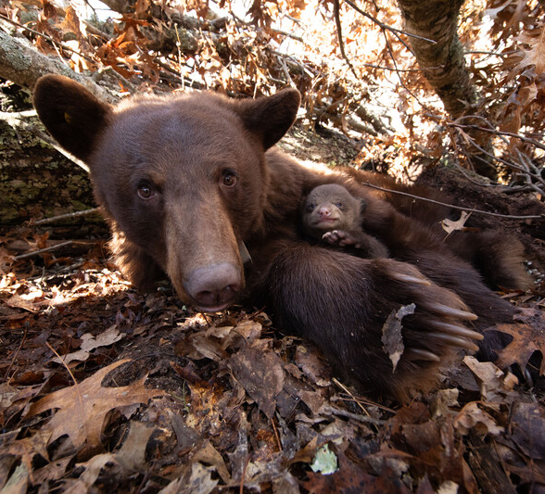
How would building a model bear den help you learn more about how bears survive in the winter?
Bears through the Seasons – 2E Finding a Den: Explore
10
Notes:
Tell students that they are going to create a model of a bear den that a bear would find and use for its winter hibernation.
How would building a model bear den help them learn more about how bears survive in the winter?
Bears find dens to stay safely hidden from other animals/humans, and dens protect bears from bad weather. Bear cubs are born in the den.

Slide 11
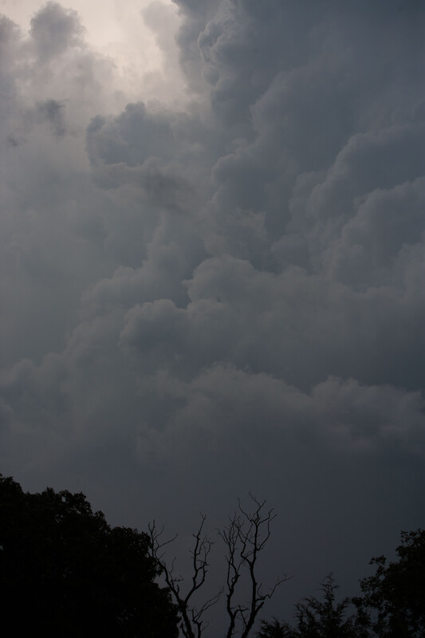
What makes a good den?
Bears through the Seasons – 2E Finding a Den: Explore
11
Notes:
List student suggestions on the board and begin creating a evaluation tool using those suggestions (stays together, keeps the bear hidden, keeps out bad weather, etc.) Students should also use their observation skills to see which dens hid the bear the best and which den was the strongest (most sturdy).

Slide 12
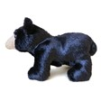
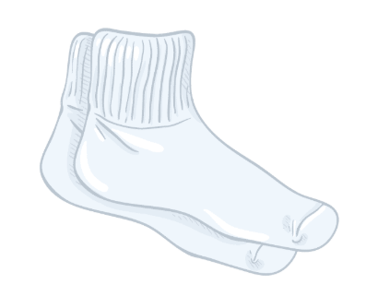

Create a den model for your bear puppet (cotton balls or rolled up socks).
Bears through the Seasons – 2E Finding a Den: Explore
12
Notes:
Students should work in small groups to create a den model for their bear puppets.

Slide 13

Grab your headbands, it’s time to become a black bear!
Bears through the Seasons – 2E Finding a Den: Explore
13
Notes:
Go outside for students to make their first bear den. When they are done with their first prototype, have students do a gallery walk to look at other students’ dens. The gallery walk consists of one or two students staying with the group’s den to explain their reason for building and shaping their bear den model and to answer questions. The other group member(s) will go to one or two other dens to ask questions and learn about the other dens.

Slide 14
How do we test what we listed? What things can affect a den?
Bears through the Seasons – 2E Finding a Den: Explore
14

Slide 15

Take a paper plate and wave it. What does this make?
How does your den hold up?
Bears through the Seasons – 2E Finding a Den: Explore
15
Notes:
Let’s test our criteria. Take a paper plate and wave it to make wind.

Slide 16

Spray water over your den.
How does the den hold off precipitation? Is your bear puppet dry?
Bears through the Seasons – 2E Finding a Den: Explore
16
Notes:
Use a mister or spray bottle. Spray water over the den. To represent snow, use shredded paper or leaves or flour, and sprinkle over the bear den.

Slide 17


Sprinkle flour or crunched up leaves over your den.
How does the den hold off precipitation? Is your bear puppet dry?
Bears through the Seasons – 2E Finding a Den: Explore
17
Notes:
Using flour or potato flakes, sprinkle some flour or flakes over the den. To represent snow, use shredded paper or leaves or flour, and sprinkle over the bear den.

Slide 18

What is one strength of your design?
Bears through the Seasons – 2E Finding a Den: Explore
18
Notes:
After the first test is done, ask students: What was one strength of your design? What is one weakness?
Allow students time to modify their bear den again for a second test. Ask the same questions again.

Slide 19

What is one weakness?
Bears through the Seasons – 2E Finding a Den: Explore
19
Notes:
After the first test is done, ask students: What was one strength of your design? What is one weakness?
Allow students time to modify their bear den again for a second test. Ask the same questions again.

Slide 20

We can always make things better after our first try!
How can you make your den better? Rebuild it again and retest!
Bears through the Seasons – 2E Finding a Den: Explore
20
Notes:
Allow students time to modify their bear den again for a second test. Ask the same questions again.

Slide 21
Take a paper plate and wave it. What does this make?
How does your den hold up?
Bears through the Seasons – 2E Finding a Den: Explore
21
Notes:
Let’s test our criteria. Take a paper plate and wave it to make wind.

Slide 22
Spray water over your den.
How does the den hold off precipitation? Is your bear puppet dry?
Bears through the Seasons – 2E Finding a Den: Explore
22
Notes:
Use a mister or spray bottle. Spray water over the den. To represent snow, use shredded paper or leaves or flour, and sprinkle over the bear den.

Slide 23
Sprinkle flour or crunched up leaves over your den.
How does the den hold off precipitation? Is your bear puppet dry?
Bears through the Seasons – 2E Finding a Den: Explore
23
Notes:
Using flour or potato flakes, sprinkle some flour or flakes over the den. To represent snow, use shredded paper or leaves or flour, and sprinkle over the bear den.

Slide 24
What is one strength of your second design?
Bears through the Seasons – 2E Finding a Den: Explore
24

Slide 25
What is one weakness?
Bears through the Seasons – 2E Finding a Den: Explore
25

Slide 26
What evidence do we have to prove one den was better than another? What was learned from using their den models?
Bears through the Seasons – 2E Finding a Den: Explore
26
Notes:
Discuss with the class why some dens worked better than others.

Slide 27
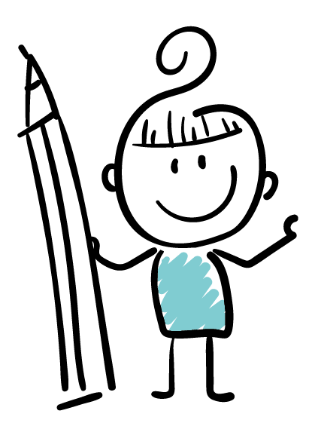
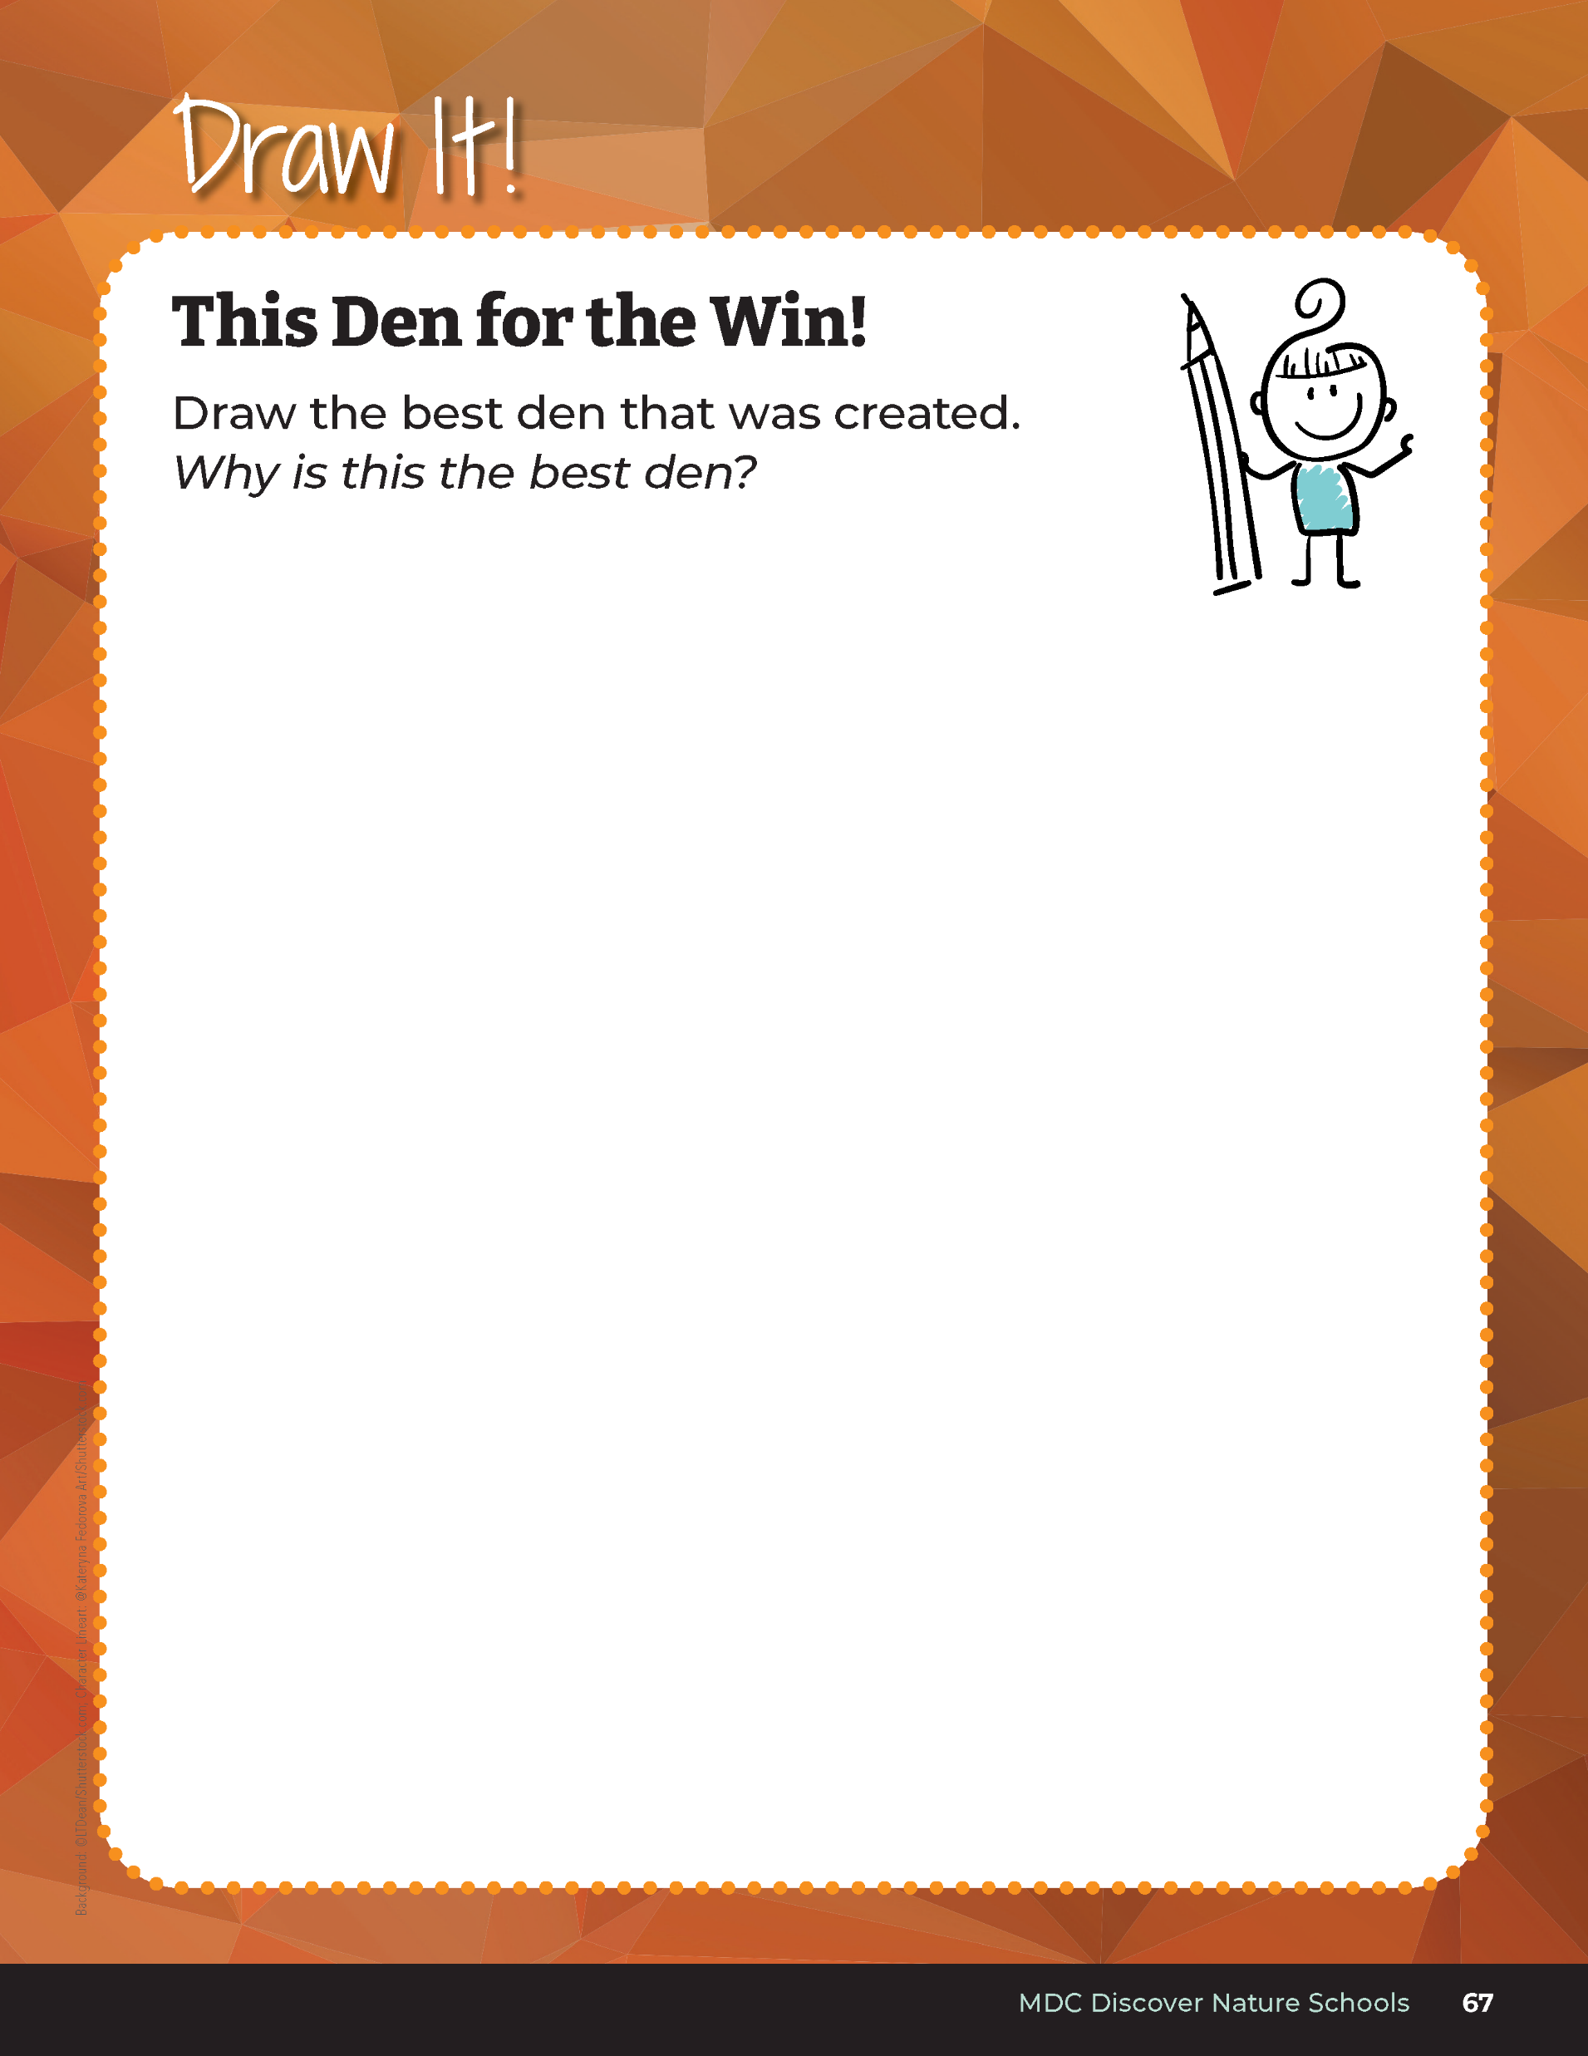
Draw the best den that was created.
Bears through the Seasons – 2E Finding a Den: Explore
27
Notes:
Have students open their student guide Draw It! This Den for the Win! on Page 67.
On the science notebook page, have students draw the den that was best designed to withstand the weather. Discuss class drawings and have students share which den was a win.

Slide 28
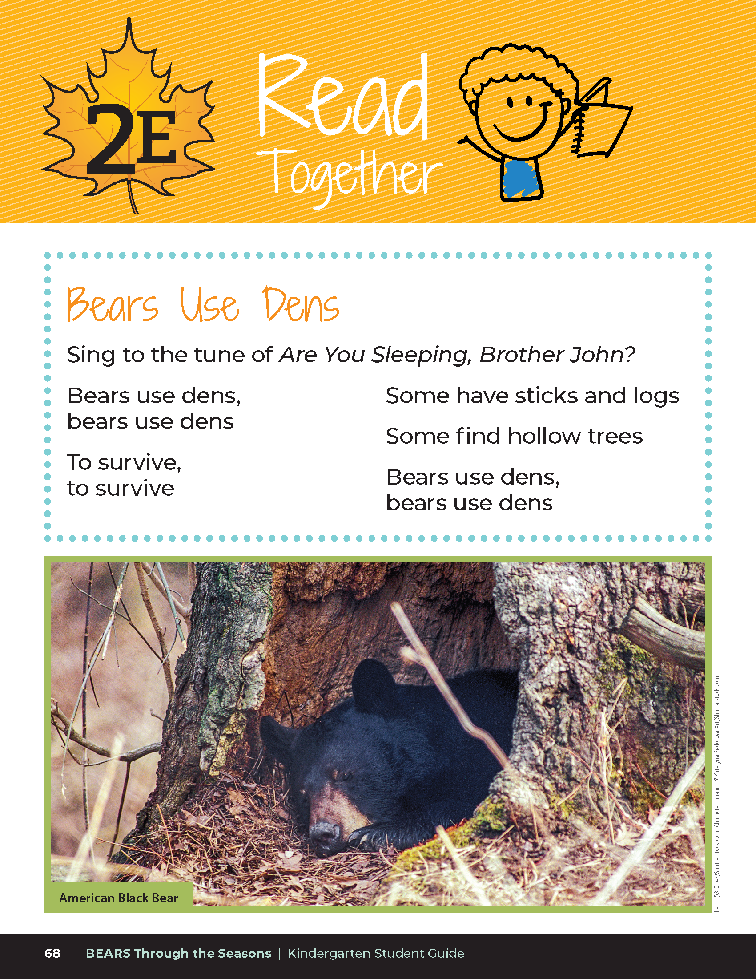

Bears Use Dens
Sing to the tune of Are You Sleeping Brother John?
Bears use dens,
Bears use dens
To survive,
To survive
Some have sticks and logs
Some find hollow trees
Bears use dens,
Bears use dens
Bears through the Seasons – 2E Finding a Den: Explain
28
Notes:
Read the Read Together Bears Use Dens on Page 68. Have students sign this to the tune of Frere Jacques (Are you Sleeping, Brother John?)

Slide 29
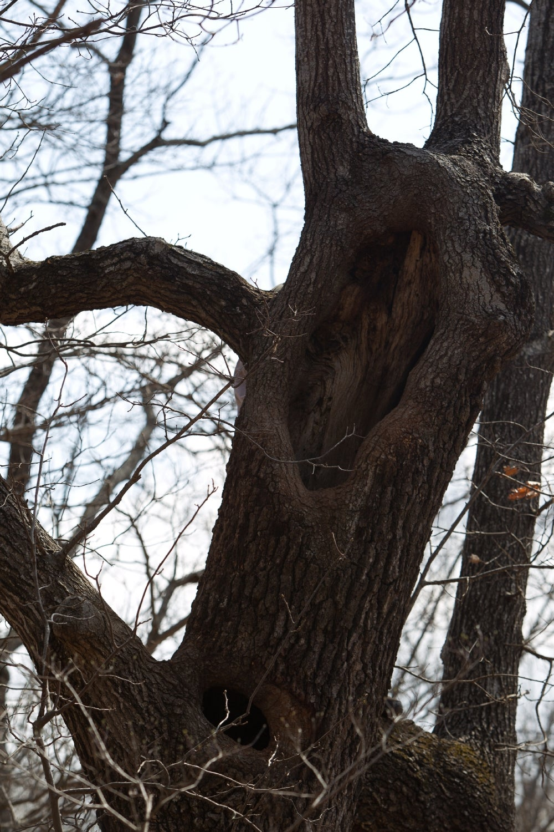
What types of dens are these?
What natural materials are the bears using?
Bears through the Seasons – 2E Finding a Den: Explain
29
Notes:
Show 2E Bear Dens Photo to the students
What types of dens are bears sleeping in? What types of materials from these photos are bears using?

Slide 30
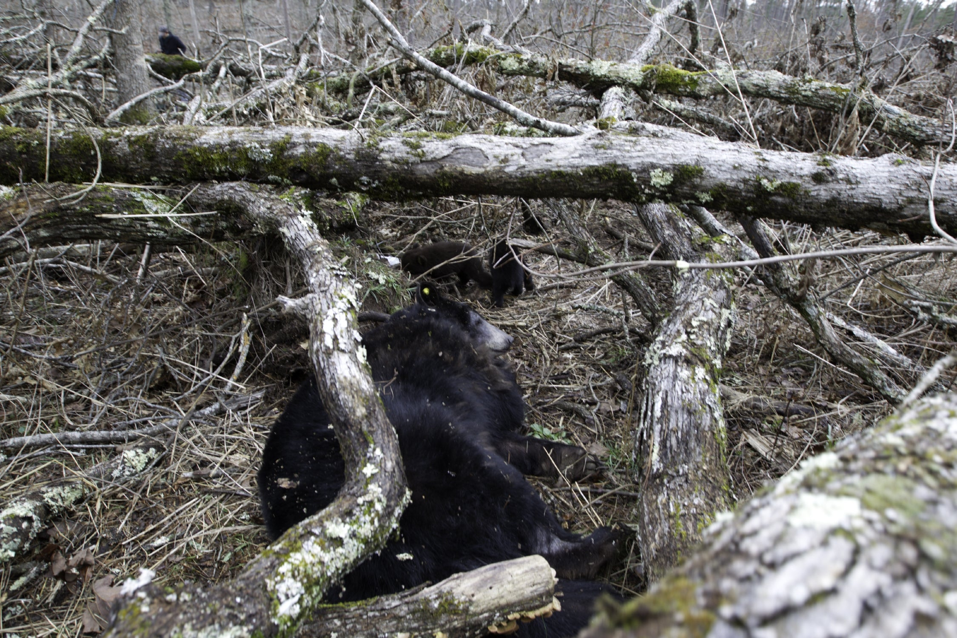
Bears through the Seasons – 2E Finding a Den: Explain
30
Notes:
What types of dens are bears sleeping in? What types of materials from these photos are bears using?

Slide 31
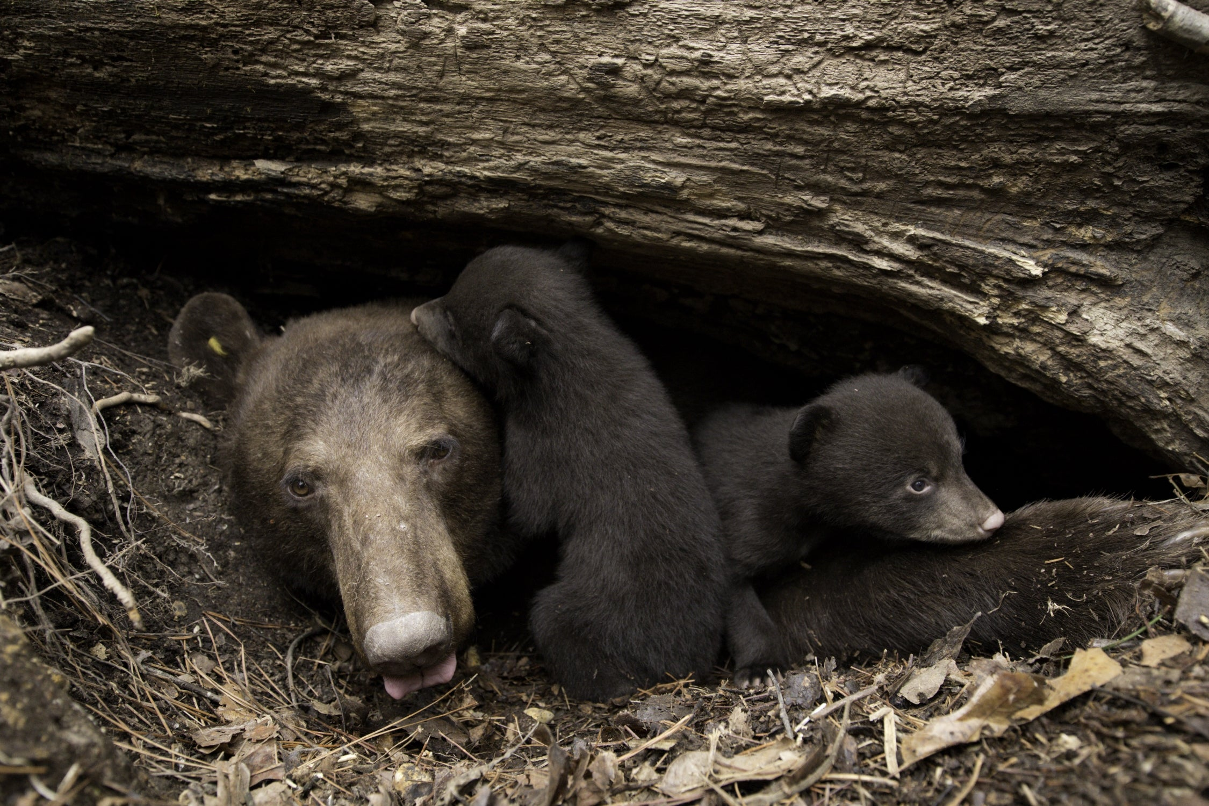
Bears through the Seasons – 2E Finding a Den: Explain
31
Notes:
What types of dens are bears sleeping in? What types of materials from these photos are bears using?

Slide 32
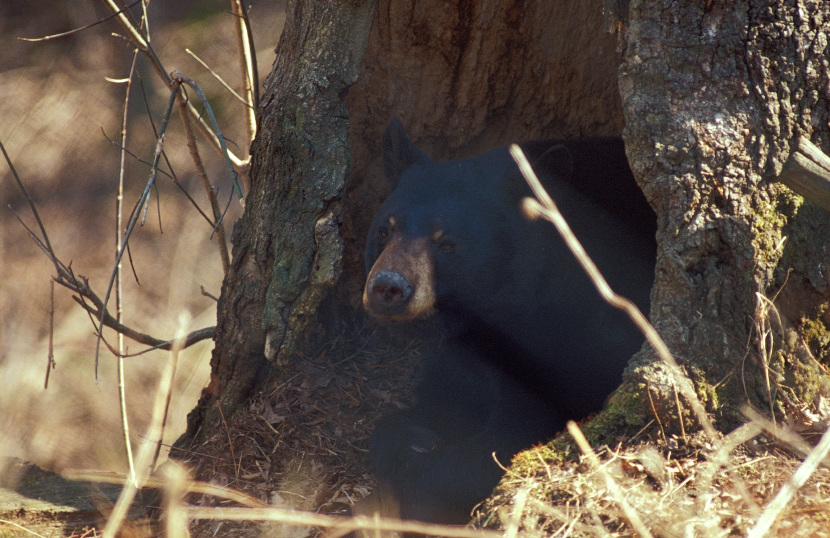
Bears through the Seasons – 2E Finding a Den: Explain
32
Notes:
What types of dens are bears sleeping in? What types of materials from these photos are bears using?

Slide 33
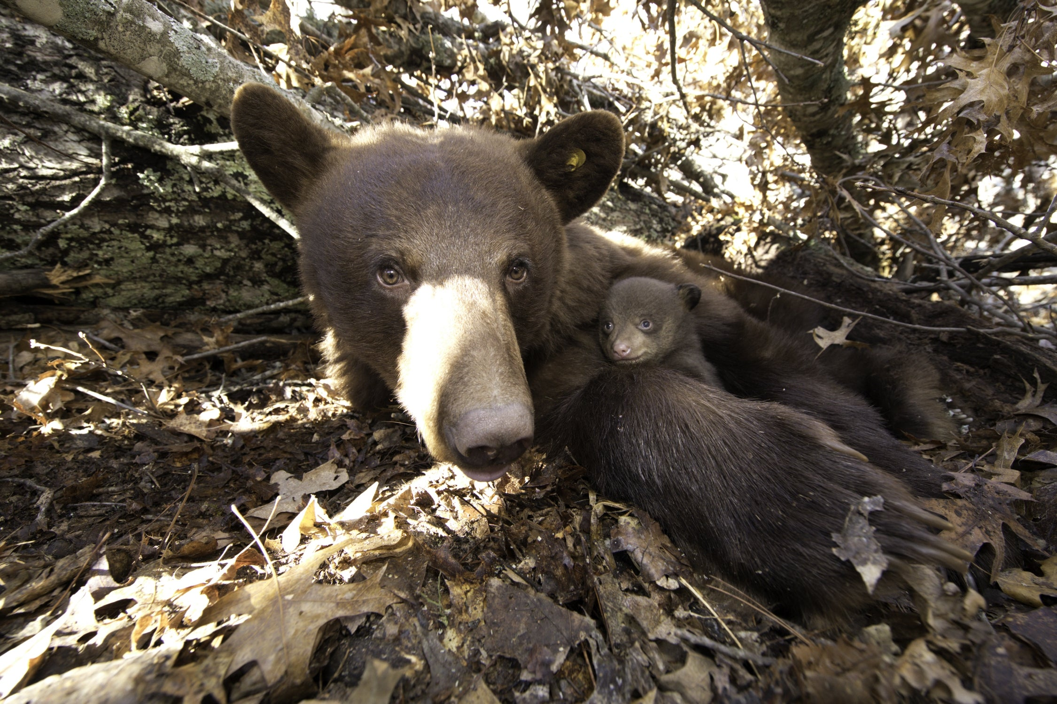
Bears through the Seasons – 2E Finding a Den: Explain
33
Notes:
What types of dens are bears sleeping in? What types of materials from these photos are bears using?

Slide 34
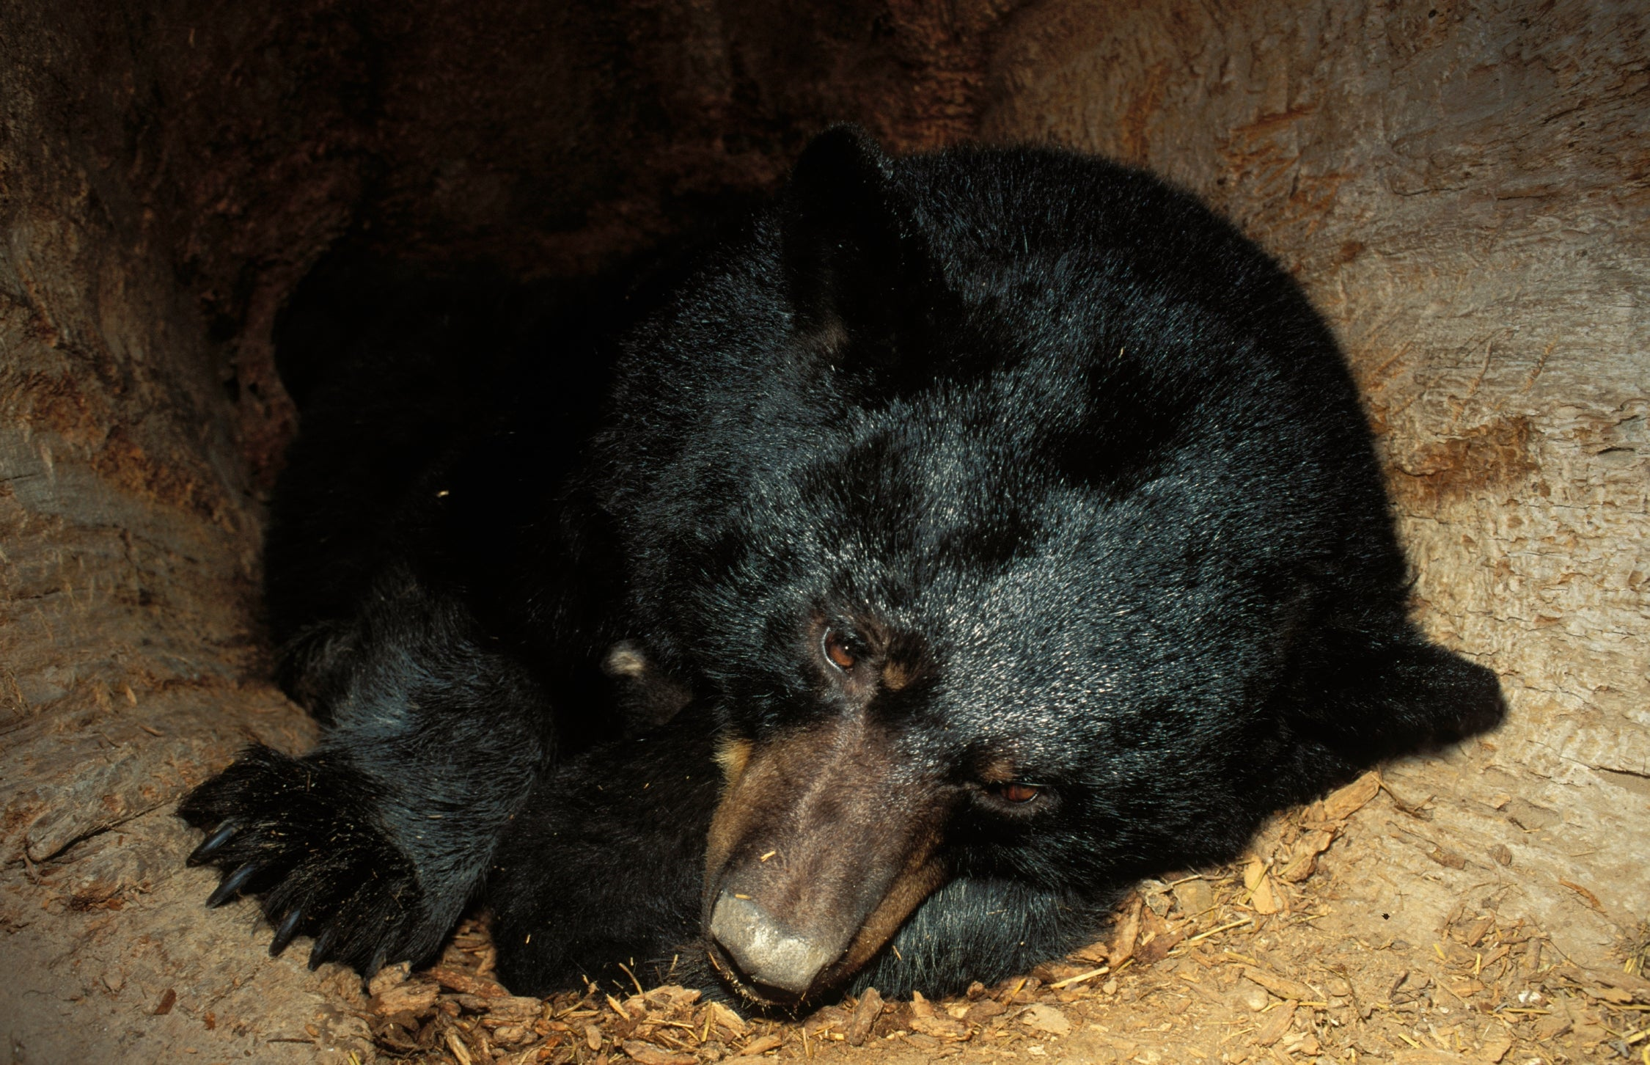
Bears through the Seasons – 2E Finding a Den: Explain
34
Notes:
What types of dens are bears sleeping in? What types of materials from these photos are bears using?

Slide 35
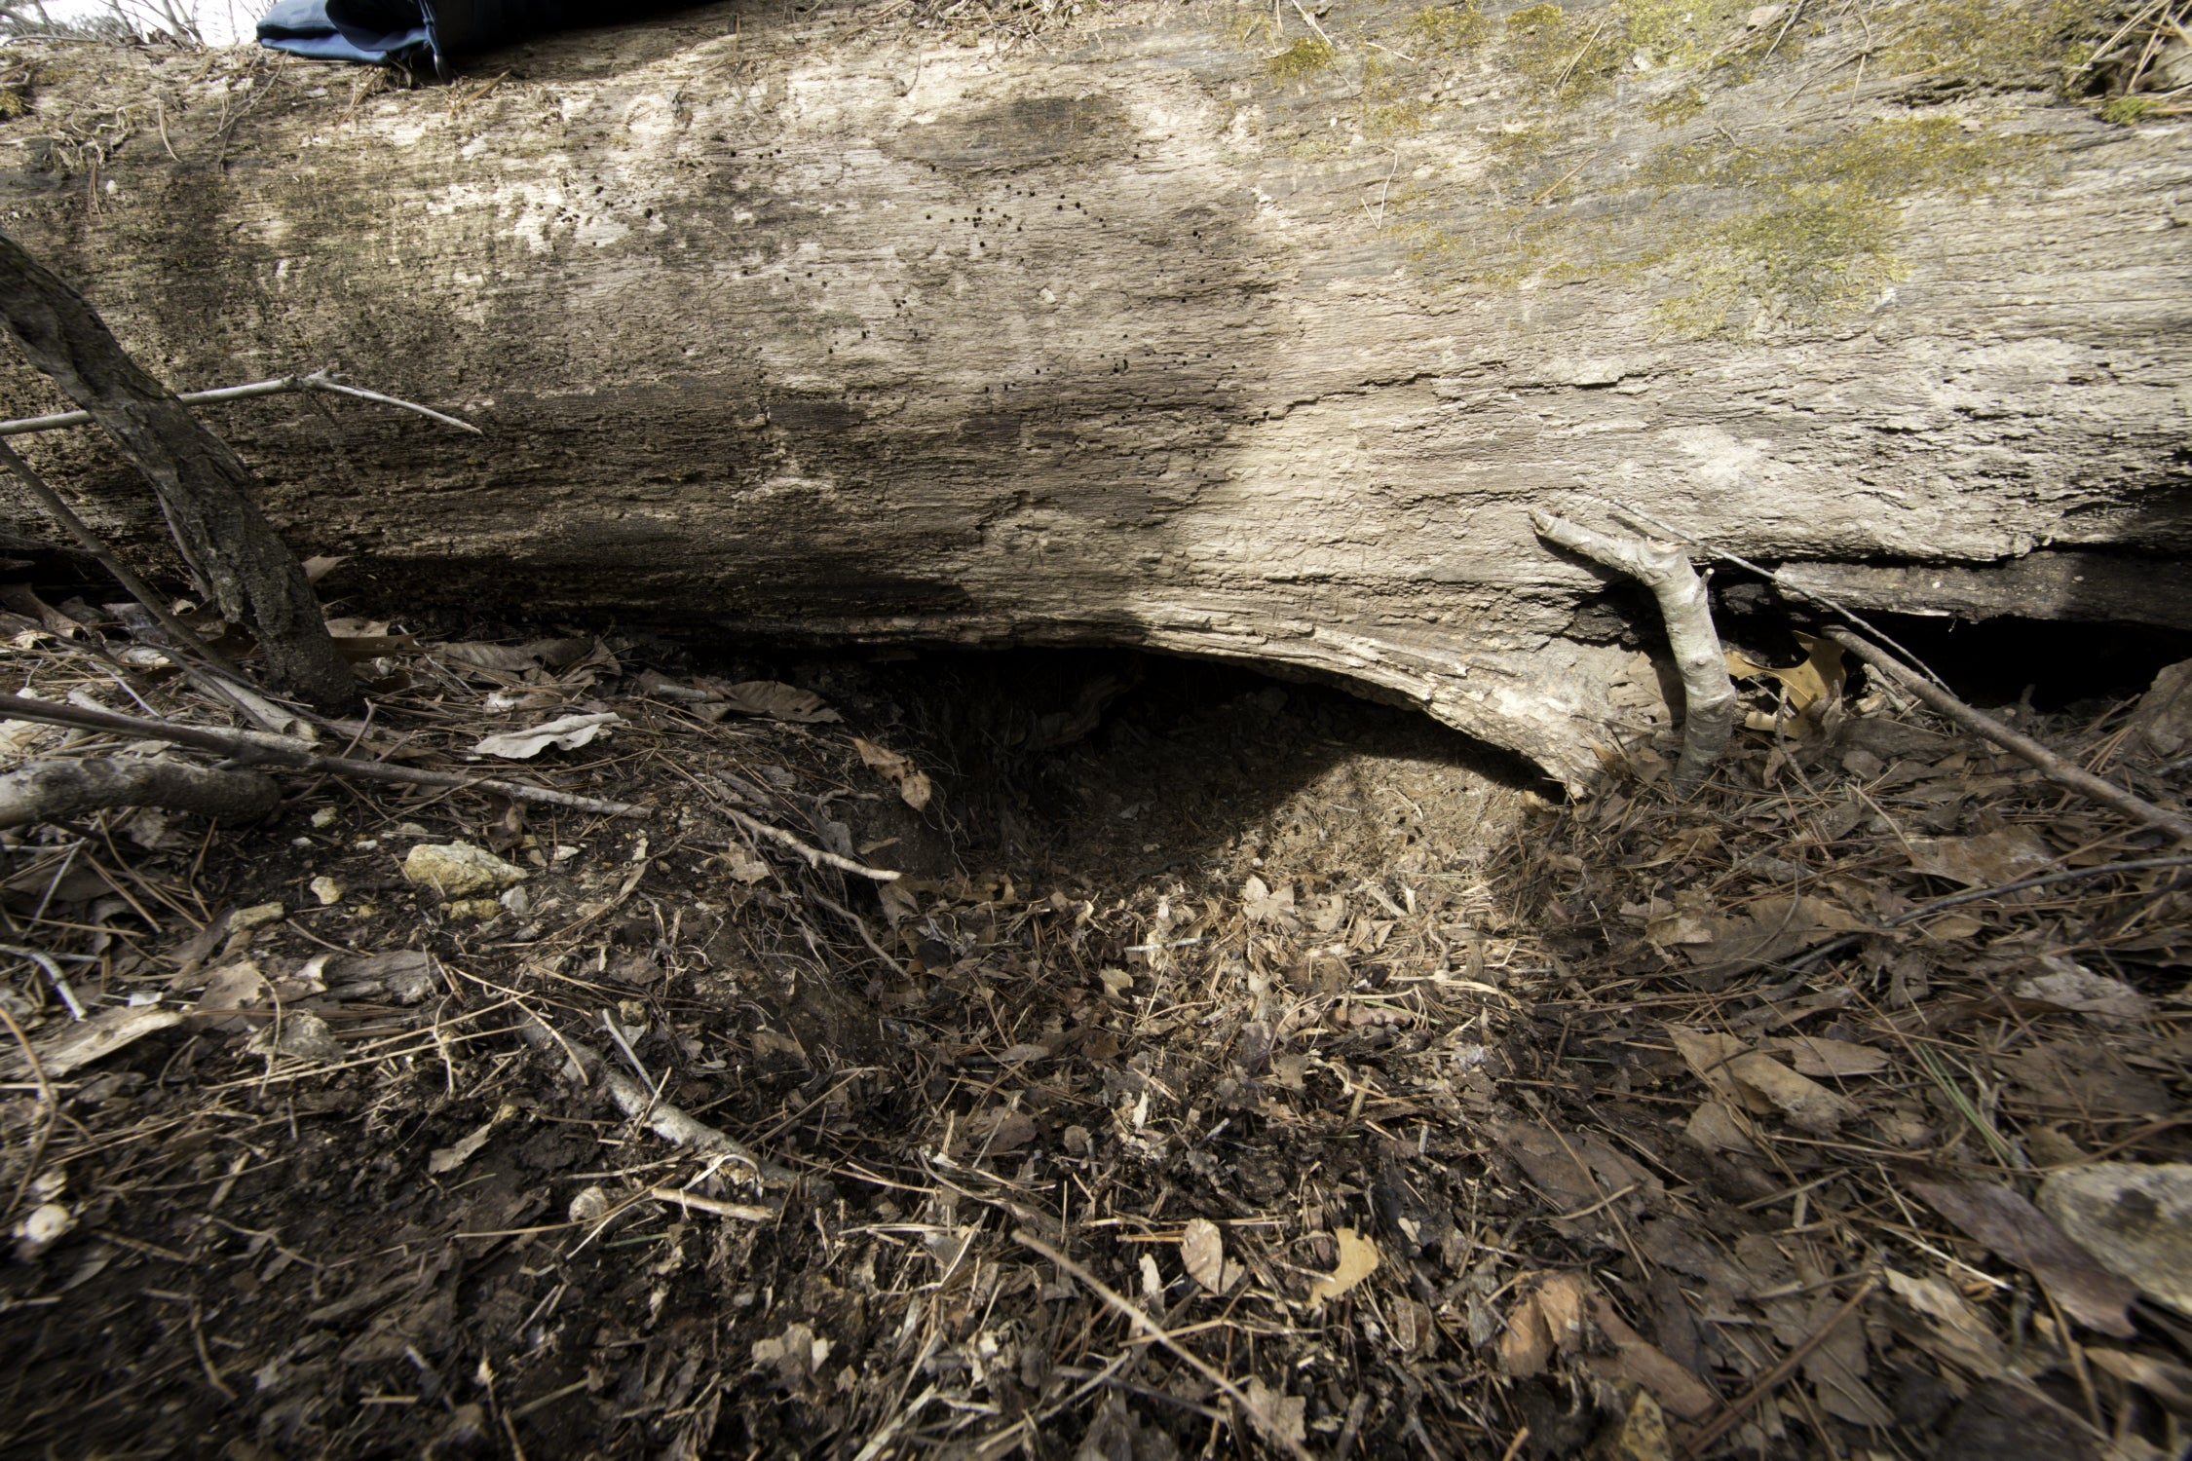
Bears through the Seasons – 2E Finding a Den: Explain
35
Notes:
What types of dens are bears sleeping in? What types of materials from these photos are bears using?

Slide 36
What type of dens are bears sleeping in?
Bears through the Seasons – 2E Finding a Den: Explain
36

Slide 37
What types of materials from these photos are the bears using?
Bears through the Seasons – 2E Finding a Den: Explain
37
Notes:
Explain that bears like to use what is available, like a cave or hollowed-out tree, or even thick brush. It is a misconception that all bears sleep in caves. Some bears may den in a hollowed-out tree, earth den, blowdown tree, or even right on the ground. However, they often must change their environment to make it more suitable.

Slide 38
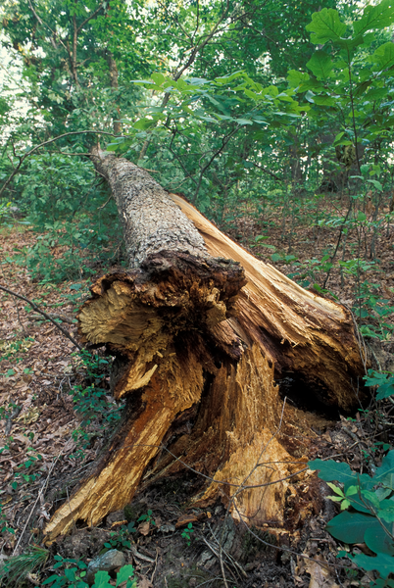
How could you change a hollowed-out or blowdown tree to make it a better place to spend the winter?
Bears through the Seasons – 2E Finding a Den: Explain
38

Slide 39
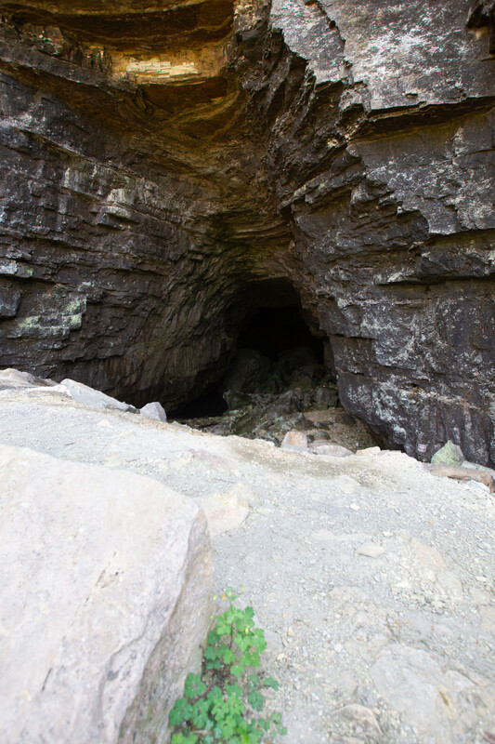
How does changing something help with the way it may work?
Bears through the Seasons – 2E Finding a Den: Explain
39
Notes:
Have students explain how the structure and function of dens that bears use help them stay alive through the winter. Talk about how the hollowed-out tree, earth den, or cave gives the den stability (structure) so it stays intact all winter (function).

Slide 40
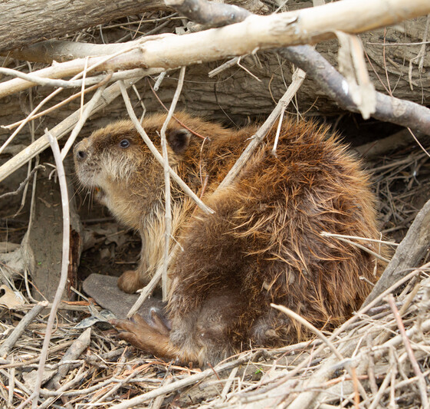
Bears may chew sticks, dig out rocks or excess dirt to make more space, or pull in leaves and grass. Bears do not actively build a structure like a beaver would.
Bears through the Seasons – 2E Finding a Den: Elaborate
40

Slide 41
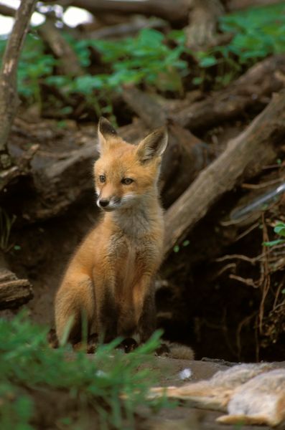
What other animals in Missouri use dens for the winter?
Bears through the Seasons – 2E Finding a Den: Elaborate
41
Notes:
Red fox

Slide 42
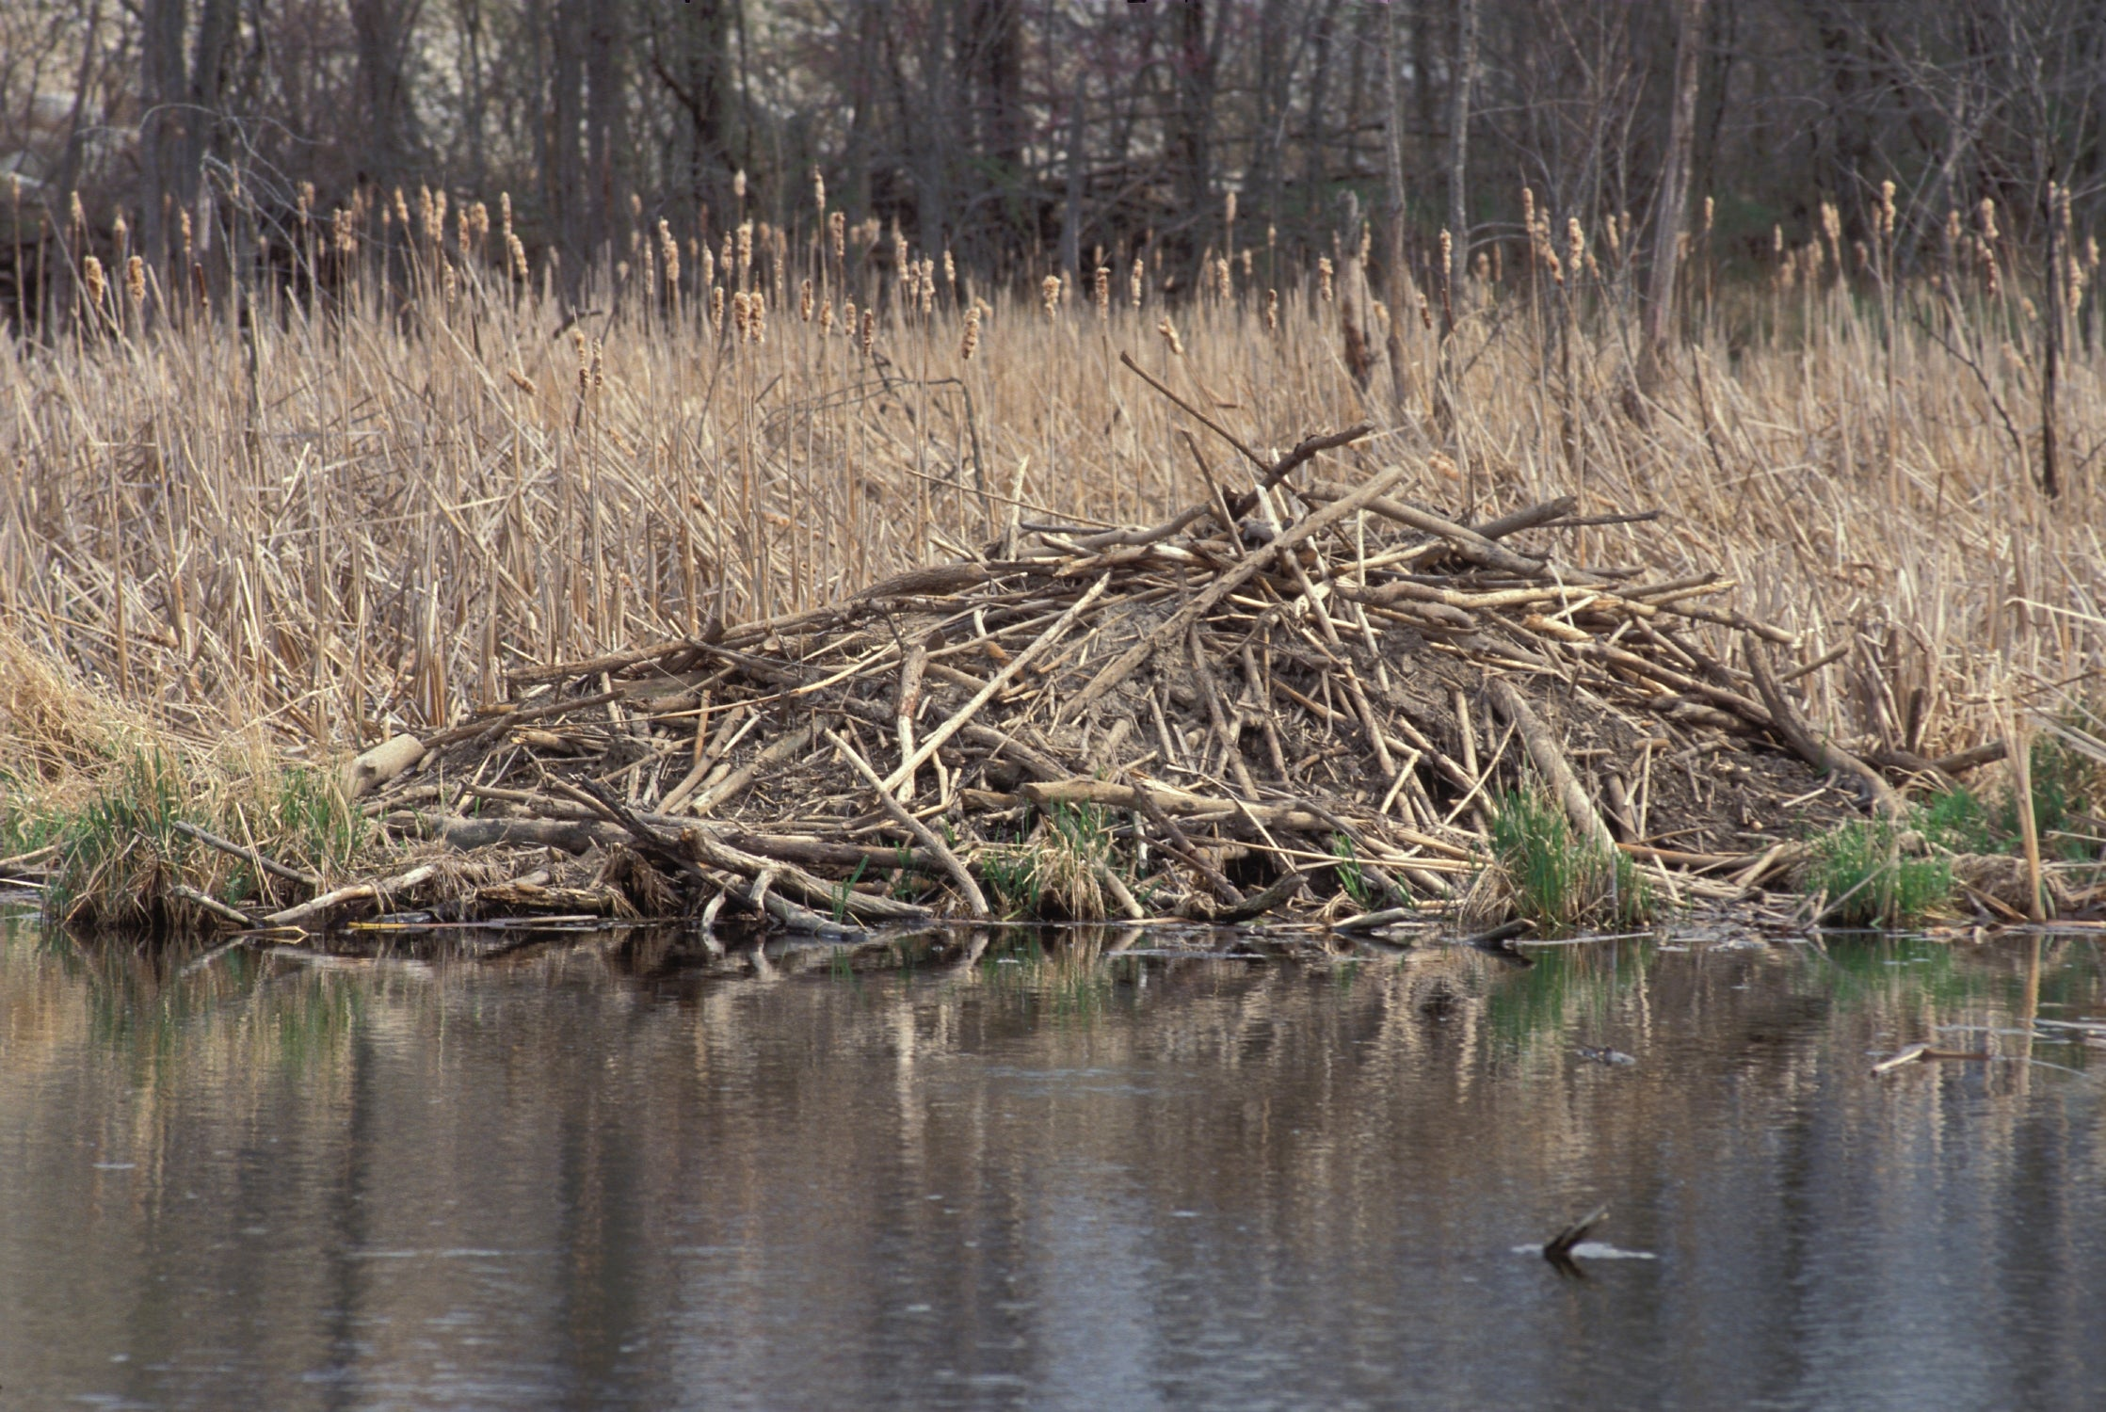
Bears through the Seasons – 2E Finding a Den: Elaborate
42
Notes:
Beaver

Slide 43
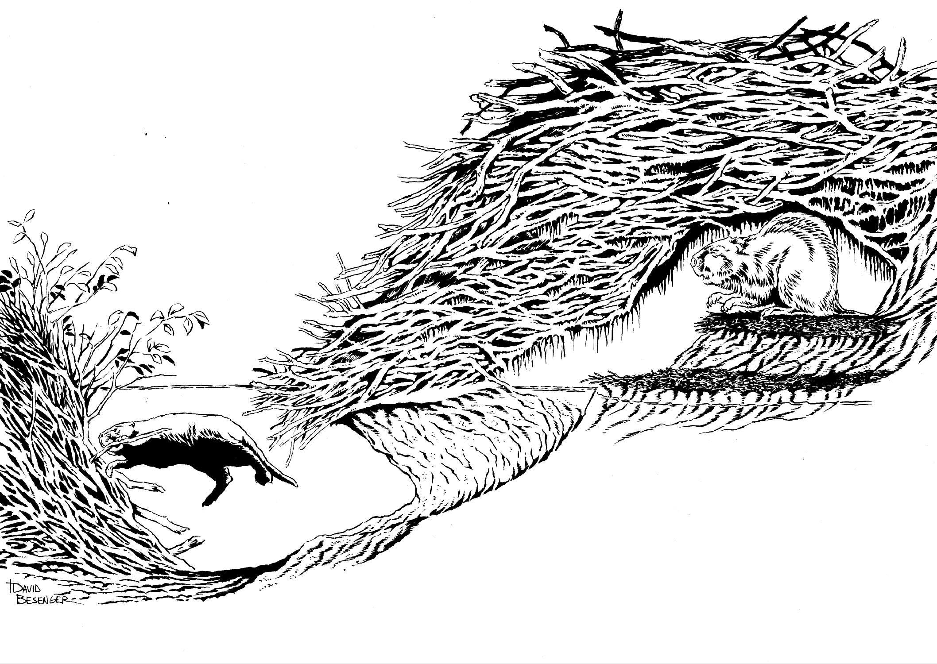
Bears through the Seasons – 2E Finding a Den: Elaborate
43
Notes:
Display Missouri Animals and Their Dens.
Teacher Note: Beavers and muskrats build their lodges and huts. These are similar to bear dens in that the animals spend the winters there, but beavers and muskrats stay active all winter and their homes are called different things. Also, lodges and huts are used year-round whereas dens are only used by bears only in the winter.

Slide 44
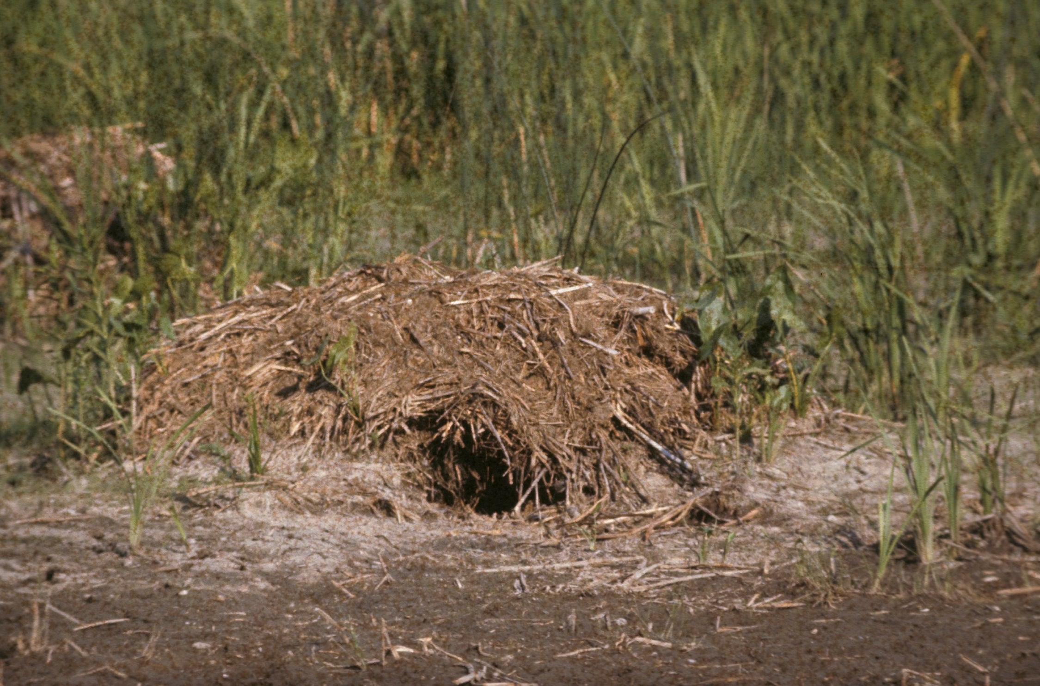
Bears through the Seasons – 2E Finding a Den: Elaborate
44
Notes:
Muskrat mound

Slide 45
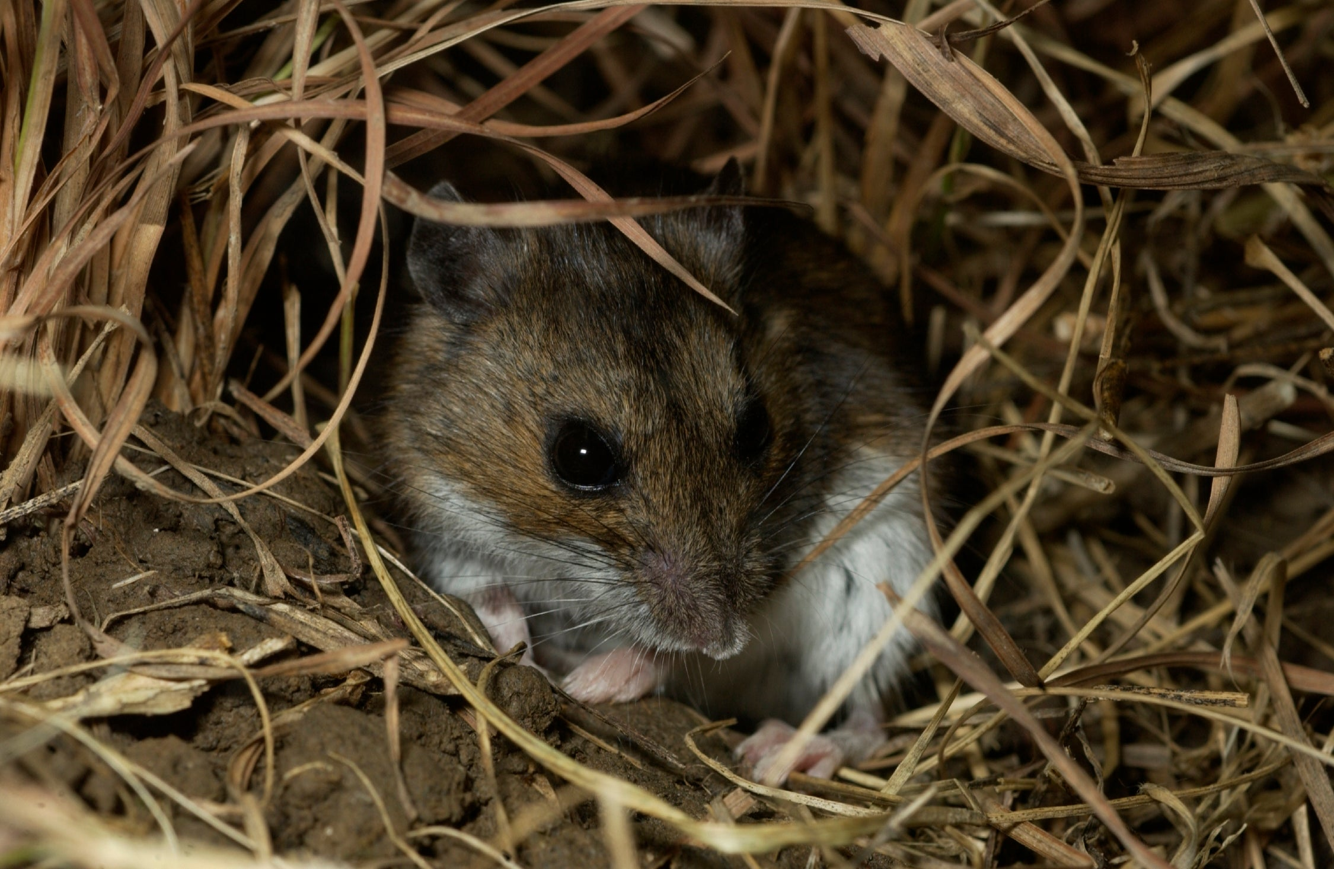
Bears through the Seasons – 2E Finding a Den: Elaborate
45
Notes:
Deer Mouse

Slide 46
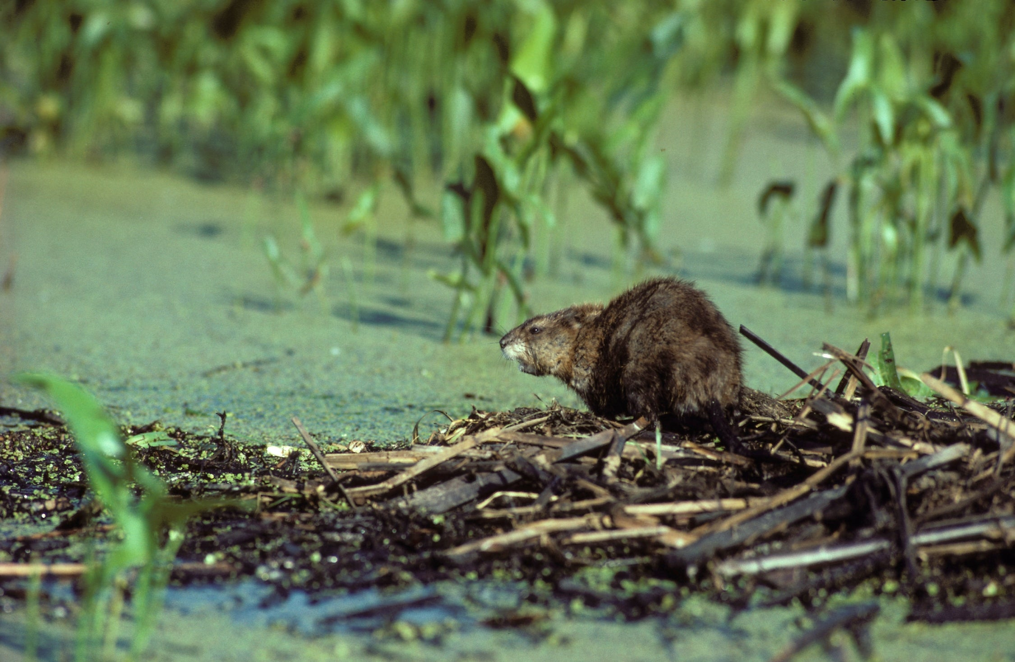
Bears through the Seasons – 2E Finding a Den: Elaborate
46
Notes:
Beaver

Slide 47
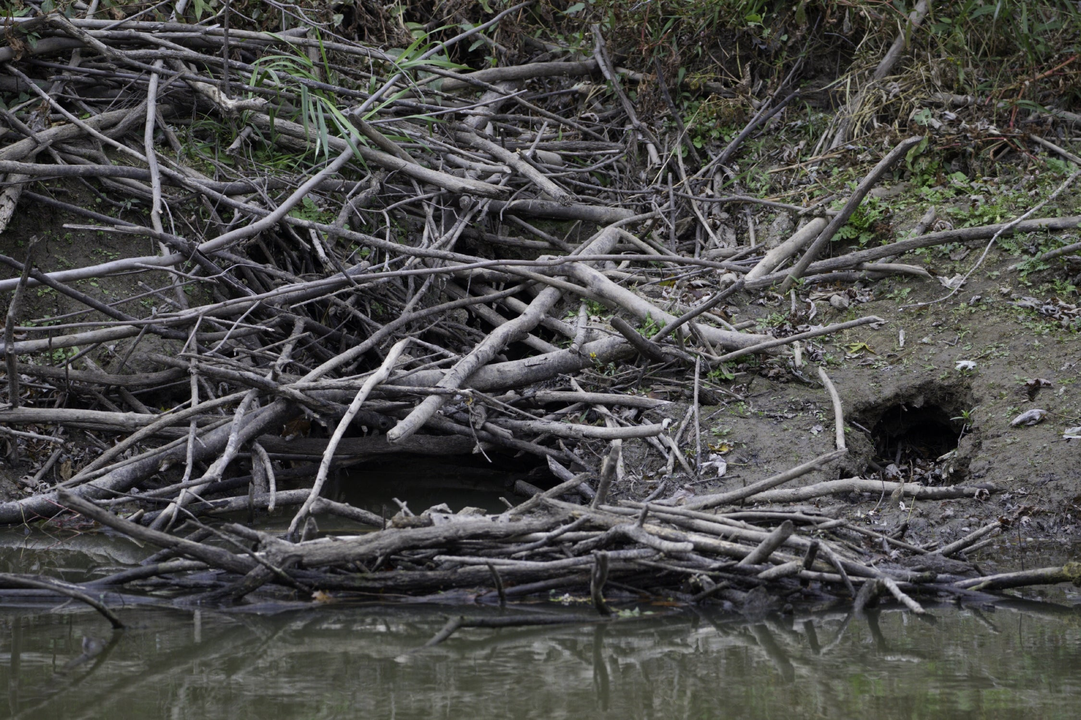
Bears through the Seasons – 2E Finding a Den: Elaborate
47
Notes:
Beaver lodge

Slide 48
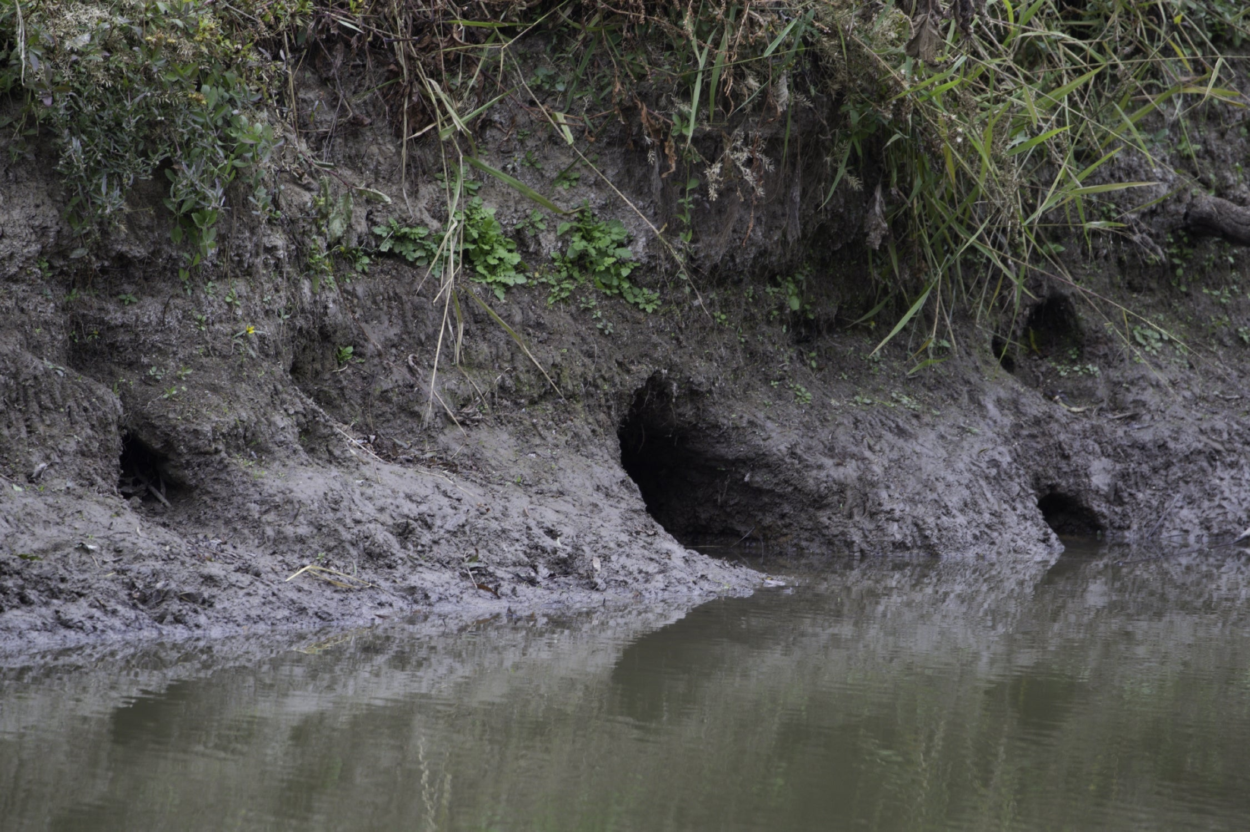
Bears through the Seasons – 2E Finding a Den: Elaborate
48
Notes:
Made by Otter or Beaver – could be used by muskrats and turtles

Slide 49
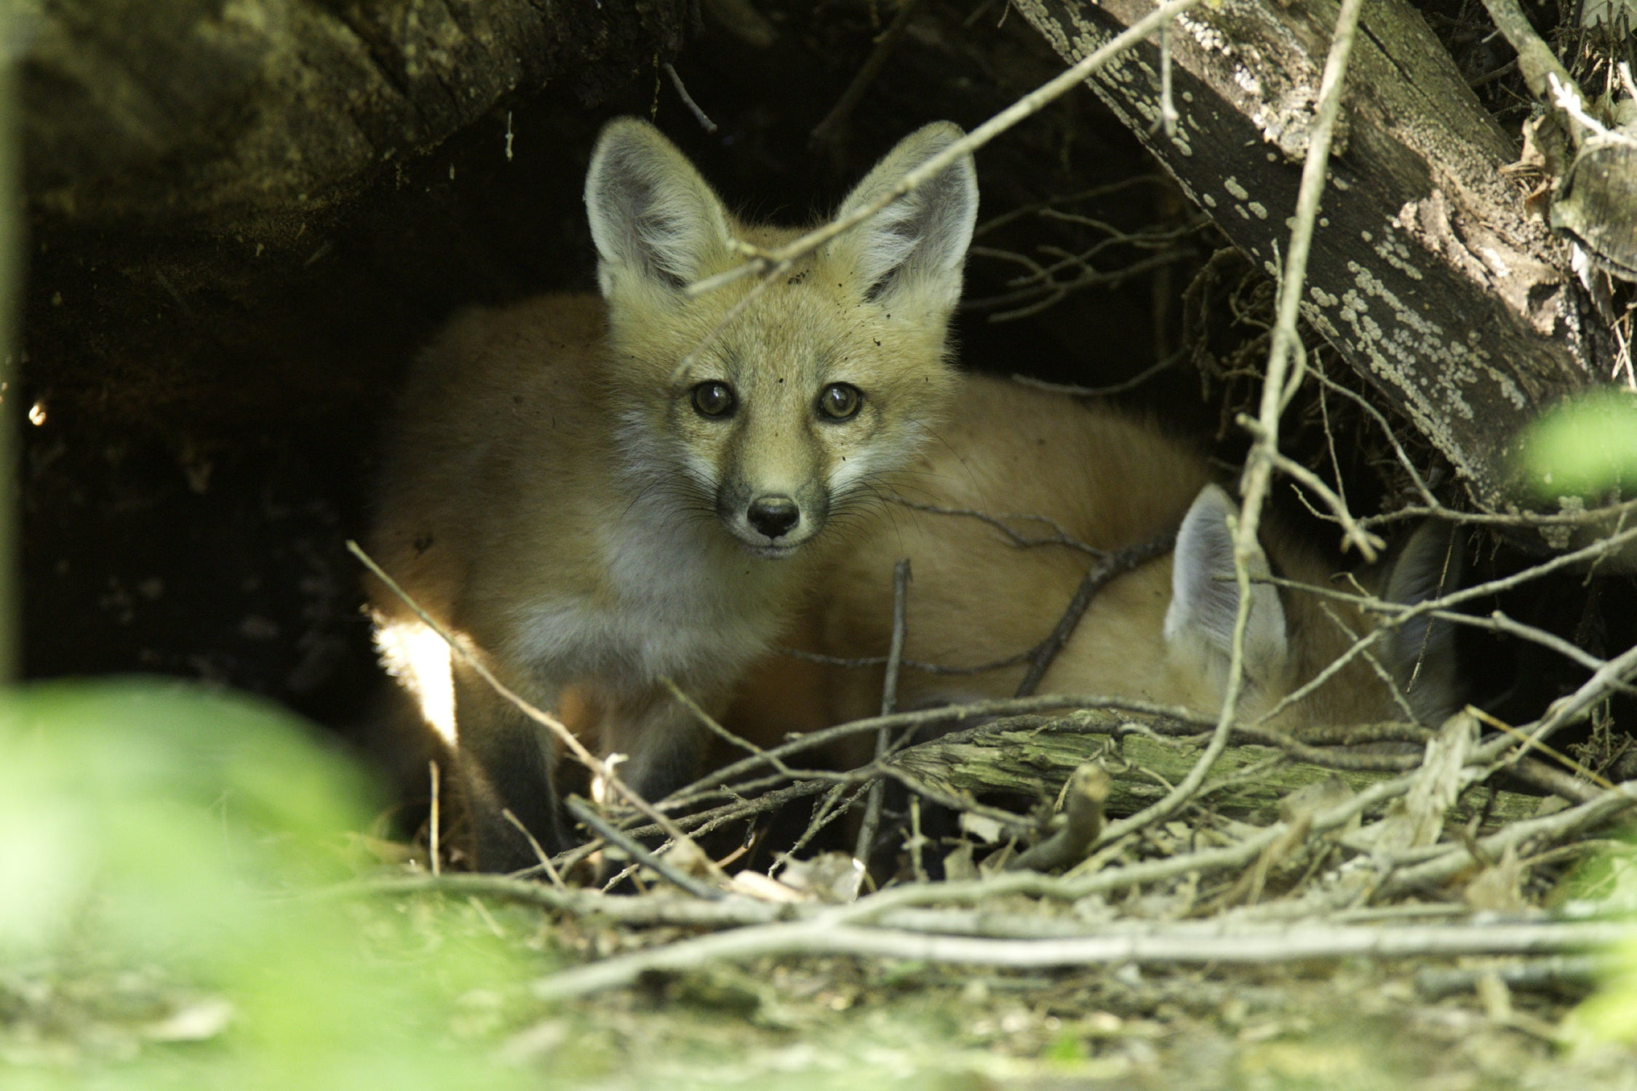
Bears through the Seasons – 2E Finding a Den: Elaborate
49
Notes:
Red fox

Slide 50
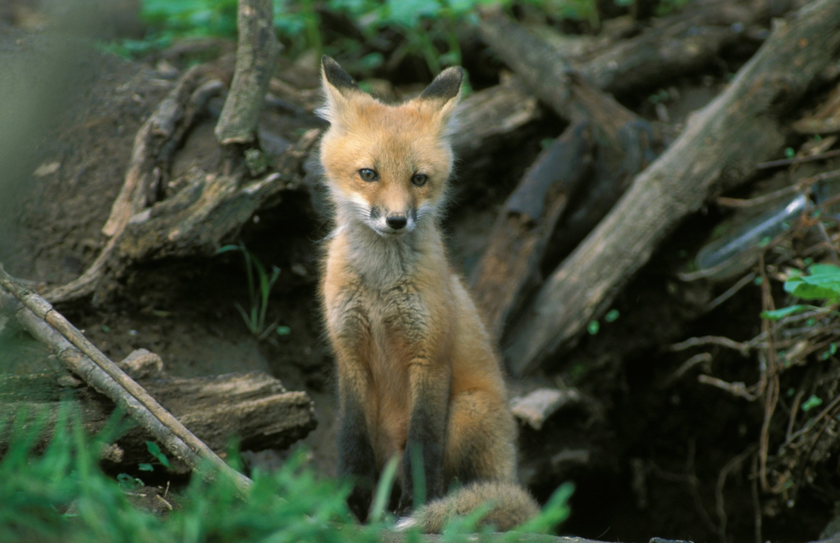
Bears through the Seasons – 2E Finding a Den: Elaborate
50
Notes:
Red Fox

Slide 51
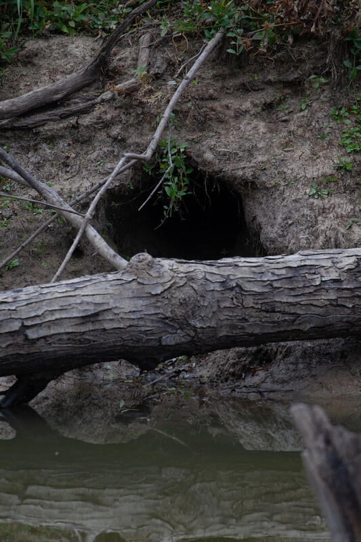
After looking at how beavers and muskrats build their dens, how do their dens compare to bear dens?
Bears through the Seasons – 2E Finding a Den: Elaborate
51
Notes:
Look at beavers or muskrats and how they build their dens. How do their dens compare to bear dens? Have students compare those dens to the dens of bears.

Slide 52
Bears through the Seasons – 2E Finding a Den: Elaborate
52
Notes:
Add student observations and/or questions to the chart as the lesson concludes in reference to the phenomenon studied.

Slide 53
Why did you design your den the way you did?
Bears through the Seasons – 2E Finding a Den: Evaluate
53
Notes:
Assess student guides with den drawings and have students explain why they designed it that way. Students should include structure understanding such as: Dens should be made of things from nature like trees, caves, rocks, leaves, and tree branches.

