Slide 1
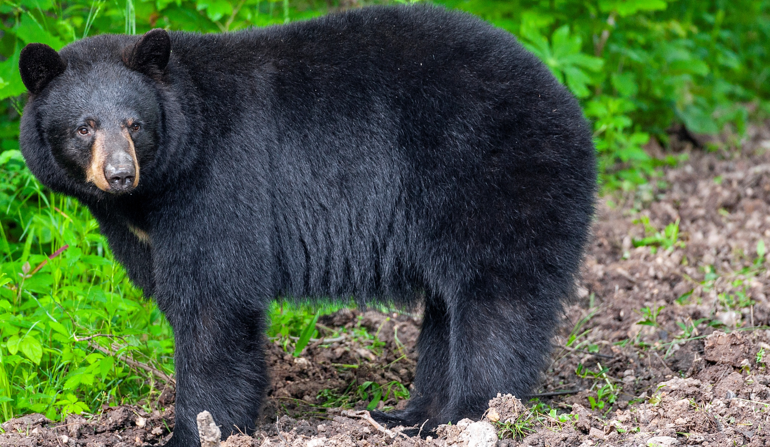
BEARS
Through the Seasons
Lesson 2D: Bear Needs a Nap

Slide 2
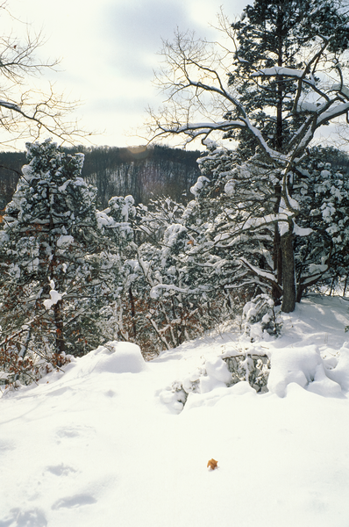
Guiding Question:
What do black bears do to get ready for the winter?
Bears through the Seasons – 2D Bear Needs a Nap: Engage
2

Slide 3
Bears through the Seasons – 2D Bear Needs a Nap: Engage
3
Notes:
Prepare and display your Noticings and Wonderings Chart for this lesson. Add student observations and/or questions to the chart as the lesson proceeds in reference to the phenomenon studied.

Slide 4
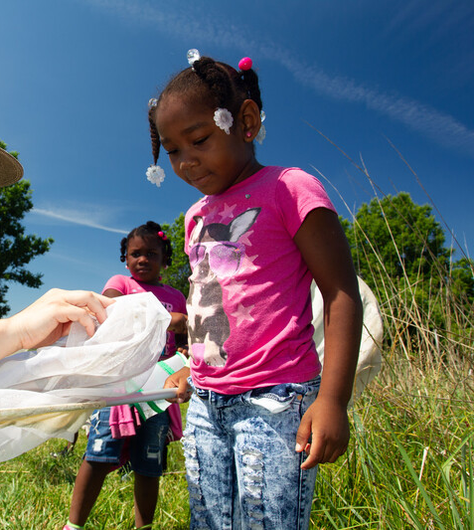
Have you noticed that some colors of clothing make you feel hotter than other colors?
Bears through the Seasons – 2D Bear Needs a Nap: Engage
4
Notes:
Give your students a few minutes to think about it.
They may say that wearing a black shirt is hotter than wearing a white or light-colored shirt in the summer. If they don’t, ask them if they are hotter wearing a black shirt or a white shirt in the summer.

Slide 5
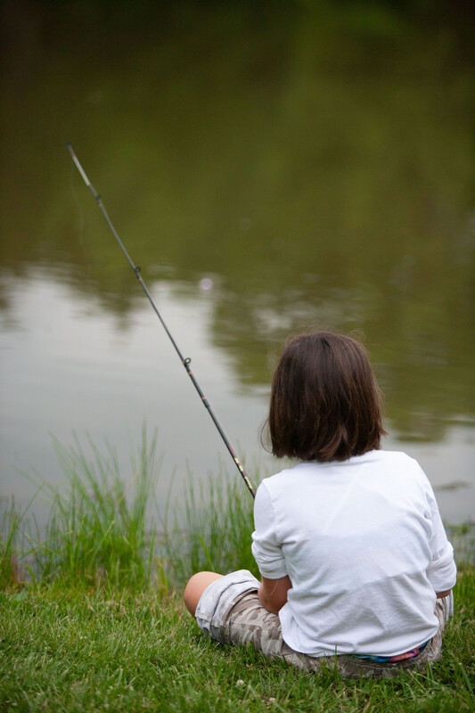
Would it be hotter to wear a black shirt or a white shirt in the summer?
Bears through the Seasons – 2D Bear Needs a Nap: Engage
5
Notes:
Give your students a few minutes to think about it.
They may say that wearing a black shirt is hotter than wearing a white or light-colored shirt in the summer. If they don’t, ask them if they are hotter wearing a black shirt or a white shirt in the summer.

Slide 6
Let's test this!
Directions:
Put one sock over each hand.
Go outside.
Bears through the Seasons – 2D Bear Needs a Nap: Explore
6
Notes:
Give each student a white sock and a black sock.
Note: Crew socks will work the best to demonstrate the heat through hands to the elbow.
Have them put one sock over each hand and up to their elbow. Take students outside on a sunny day. A heat lamp (incandescent bulb) may also be used if you do this indoors. However, you will need to place a bulb where it is hard for students to touch it and remind them that the bulb is very hot.

Slide 7
Can you tell the difference in the temperature on the socks based upon just feel?
Bears through the Seasons – 2D Bear Needs a Nap: Explore
7

Slide 8
What if we took the actual temperature of the socks while they are on our hands?
Bears through the Seasons – 2D Bear Needs a Nap: Explore
8
Notes:
Discuss how to use an infrared thermometer. Note: if an armored thermometer is used, the temperature readings will be inaccurate.

Slide 9
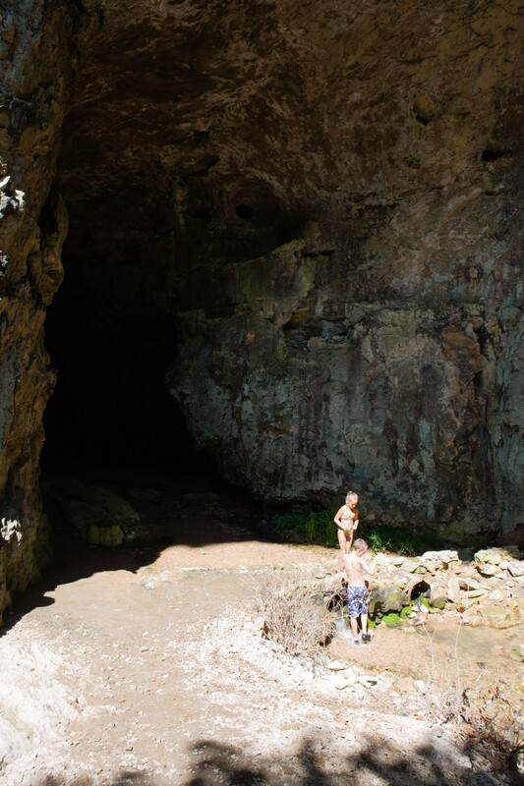
How does sunlight affect the warmth of the surface of the Earth in a sunny place versus a place in the shade where the sunlight is blocked?
Bears through the Seasons – 2D Bear Needs a Nap: Explore
9

Slide 10
Review
Where was it hottest?
Where was it coolest?
Bears through the Seasons – 2D Bear Needs a Nap: Explore
10
Notes:
Think back to when we explored sun versus shade in Lesson 1C, page 19. Refer to your student guide, Science Notebook Sun – Shade to review the data collected.

Slide 11
Is the temperature of the sock different while we were outside? Why?
Bears through the Seasons – 2D Bear Needs a Nap: Explore
11
Notes:
They should notice that the thermometer is higher (hotter) on the black sock.

Slide 12
Are All Black Bears Black?
Missouri black bears often have black fur.
Sometimes black bears are not black.
Look at the photos.
Can you spot which on is blonde?
Can you spot which one is brown?
Bears through the Seasons – 2D Bear Needs a Nap: Explain
12
Notes:
Read aloud from the student guide Read Together Are All Black Bears Black? on Page 63.

Slide 13
Look at the different colors of the different black bears.
Bears through the Seasons – 2D Bear Needs a Nap: Explain
13
Notes:
Tell students that all that work finding food makes bears tired, so they need a nap! Missouri black bears often have black bear often have black fur, but they can also be blonde, cinnamon, brown, or other darker colors. Look at the pictures of the different black bears in different color phases on the Read Together Are All Black Bears Black? on Page 63.

Slide 14
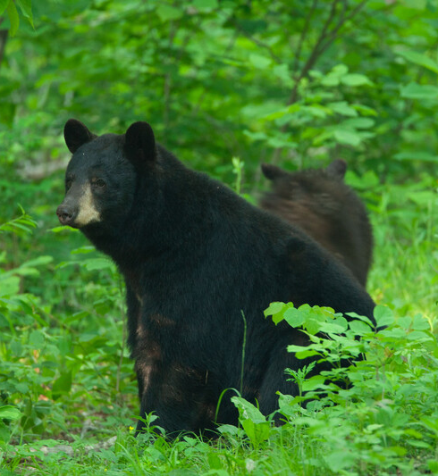
Are bears mostly dark or light colored?
Bears through the Seasons – 2D Bear Needs a Nap: Explain
14
Notes:
Missouri black bears often have black bear often have black fur, but they can also be blonde, cinnamon, brown, or other darker colors.

Slide 15
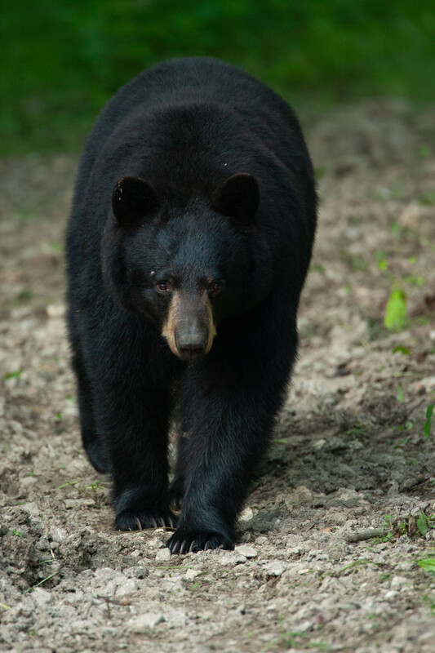
Do you think the color of a bear’s fur has an effect on whether the bear wants to nap in the sun or the shade when it is hot out?
Bears through the Seasons – 2D Bear Needs a Nap: Explain
15

Slide 16
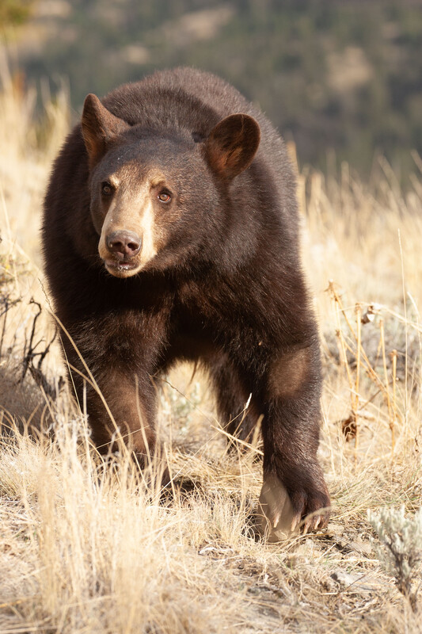
Would a bear get too hot in the sun because of the color of their fur?
Bears through the Seasons – 2D Bear Needs a Nap: Explain
16
Notes:
Relate this back to when they wore dark and light-colored socks on their arms – like if they had bear paws. Tell them that bears get hot in the sun and may prefer shade to take a nap because their dark fur absorbs more of the sunlight.

Slide 17
Which one do you think will get hotter sleeping in the sun and why?
Bears through the Seasons – 2D Bear Needs a Nap: Explain
17
Notes:
Have students look at the pictures of black bears and blonde bears again in their student guide.

Slide 18
The bear with the darkest coat will (get warmer/cooler) than the blonde bear in the sun because __________.
Bears through the Seasons – 2D Bear Needs a Nap: Explain
18
Notes:
Using what we learned when we were outside, turn and talk to your elbow partner about whether bears with darker coats get warmer or cooler and why. Share your explanation with the class.

Slide 19
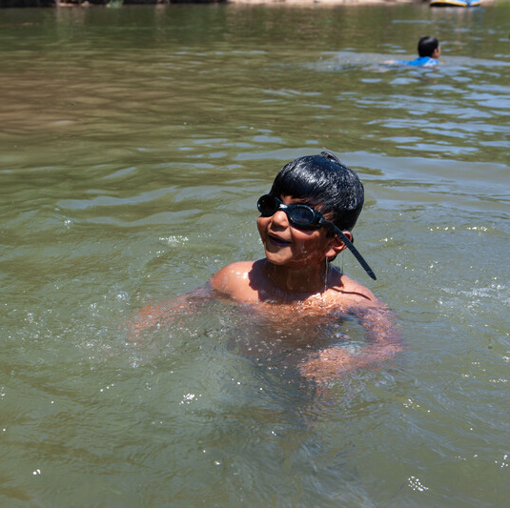
What makes you tired?
Bears through the Seasons – 2D Bear Needs a Nap: Elaborate
19

Slide 20
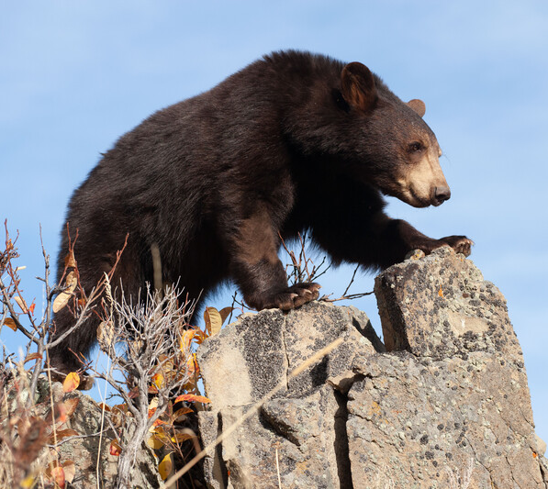
What do you think will make bears tired?
Bears through the Seasons – 2D Bear Needs a Nap: Elaborate
20
Notes:
Think back to our last lessons about why bears eat a lot in the fall. Students can reference their last student journal entry where they explained why bears eat more in the fall to prepare for winter.

Slide 21
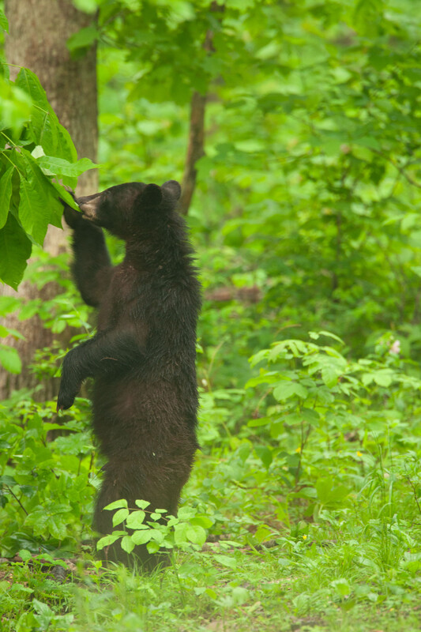
Bears spend 20 hours a day foraging for food.
Bears through the Seasons – 2D Bear Needs a Nap: Elaborate
21
Notes:
Bears will use a lot of energy walking a long way to find food and will eat more in the fall to prepare for winter.

Slide 22
Let’s become a bear in the fall time!
Bears through the Seasons – 2D Bear Needs a Nap: Elaborate
22
Notes:
Let’s become a bear in the fall time. Have students wear their bear headbands and black crew socks and tell them that they are now black bears in the fall and are looking for a place to take a nap.

Slide 23
Grab your student guides and let’s go outside!
Bears through the Seasons – 2D Bear Needs a Nap: Elaborate
23
Notes:
With their student guides, take students outside to a place with both sunny and shaded areas.

Slide 24
Is there a temperature-taking tool that would help you determine where a bear like yourselves would feel comfortable taking a nap?
Bears through the Seasons – 2D Bear Needs a Nap: Elaborate
24
Notes:
Thermometer

Slide 25
Draw the spot you chose for your bear nap and write the temperature of your spot.
Bears through the Seasons – 2D Bear Needs a Nap: Elaborate
25
Notes:
Using what they know about dark colors, have the students find the coolest place to take a nap. Give each student three minutes to find a spot and take the temperature. They need to back up their decision (claim) with evidence from the thermometer to prove the place is appropriate for themselves as a black bear. Once they have found their spot to “nap,” have the students take the temperature of the spot they chose using the infrared thermometer, write it down, and compete Science Notebook Map Your Nap on Page 64.

Slide 26
Let's compare our spots!
What are the similarities and differences of each spot? What were the top 3 coolest spots we found?
Bears through the Seasons – 2D Bear Needs a Nap: Elaborate
26
Notes:
Come together as a bear group. Ask students how they can decide, with evidence, which spot is the best (coolest) place for a bear to nap. Have students compare their temperature readings to see which spot is coolest. Visit the top three coolest spots the students discovered.
Tell them they must have evidence (temperatures) that proves one spot is better than another to keep a black bear cool.

Slide 27
Bears through the Seasons – 2D Bear Needs a Nap: Elaborate
27
Notes:
Add student observations and/or questions to the chart as the lesson proceeds in reference to the phenomenon studied.

Slide 28
My nap spot was (hotter/cooler) than another spot. I know this because _______ .
Bears through the Seasons – 2D Bear Needs a Nap: Evaluate
28
Notes:
Once inside, write this sentence prompt on the board.
My nap spot was (hotter/cooler) than another spot. I know this because __________ . Using what we just learned when we were outside, turn and talk to your elbow partner and share your explanation.

Slide 29
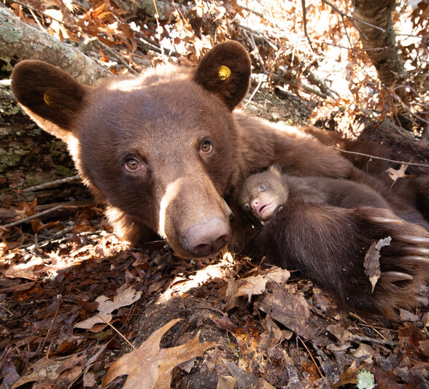
Is there more than one place that a bear would like to take a nap? Why?
Bears through the Seasons – 2D Bear Needs a Nap: Evaluate
29
Notes:
Discuss other reasons why a bear may want to nap in the sun or in another spot (for example, warmth during a cool day, closer to habitat needs, etc.)

Slide 30
Optional: Cross-Curricular Extension
What other Missouri animals like to nap in the shade?
What other Missouri animals like to nap in the sun?
Bears through the Seasons – 2D Bear Needs a Nap: Cross-Curricular Extension
30
Notes:
Introduce other Missouri animals. Based on what you know about that animal, and what we learned about how sunlight can affect the temperature of that animal, what other Missouri animals like to nap in the shade? What other Missouri animals like to nap in the sun?
Write or draw your animal napping in the shade. Write or draw another animal napping in the sun. Why do you think one animal prefers one place to nap than the other animal.

Slide 31
Optional: Cross-Curricular Extension
Write or draw your animal napping in the shade. Write of draw another animal napping in the sun.
Bears through the Seasons – 2D Bear Needs a Nap: Cross-Curricular Extension
31
Notes:
Write or draw your animal napping in the shade. Write or draw another animal napping in the sun. Why do you think one animal prefers one place to nap than the other animal.

