Slide 1
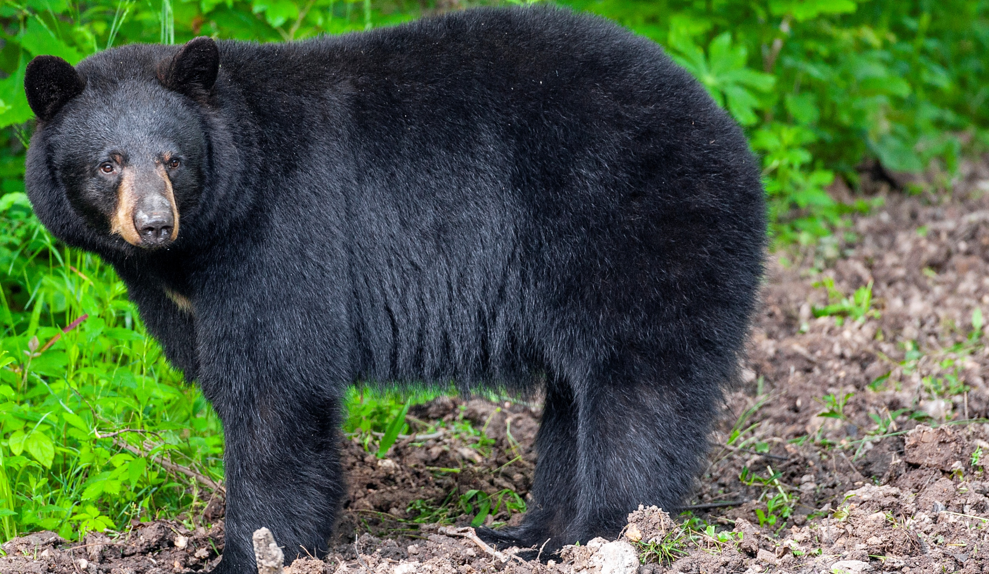
BEARS
Through the Seasons
Lesson 2C: Wow! Bears Eat a Lot!

Slide 2
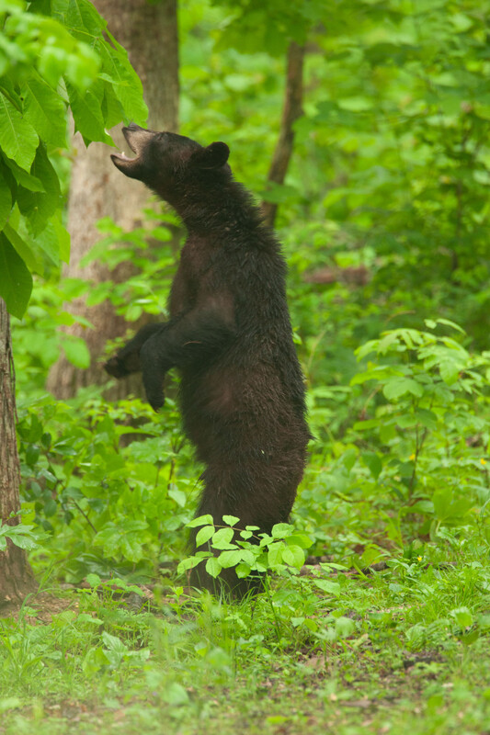
Guiding Question:
What do black bears do to get ready for the winter?
Bears through the Seasons – 2C Wow! Bears Eat a Lot: Engage
2

Slide 3
Bears through the Seasons – 2C Wow! Bears Eat a Lot: Engage
3
Notes:
Prepare and display your Noticings and Wonderings Chart for this lesson. Add student observations and/or questions to the chart as the lesson proceeds in reference to the phenomenon studied.

Slide 4
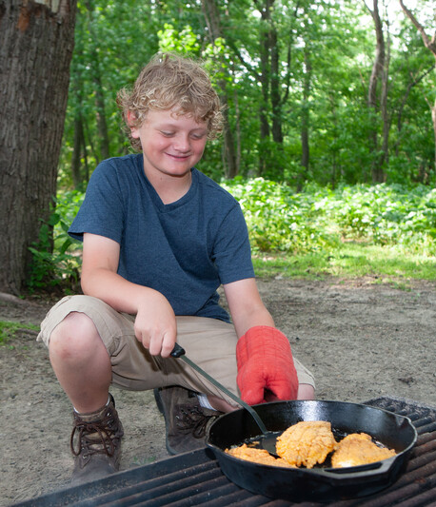
What is your favorite kind of food?
Bears through the Seasons – 2C Wow! Bears Eat a Lot: Engage
4

Slide 5
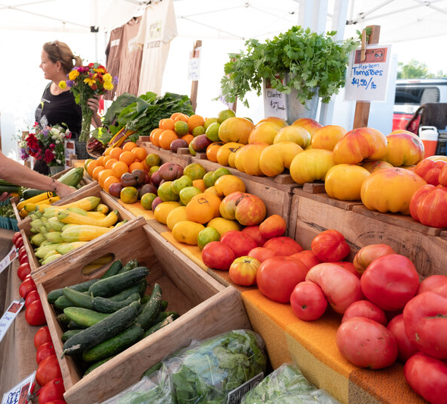
Do you like many kinds of food or just a few things?
Bears through the Seasons – 2C Wow! Bears Eat a Lot: Engage
5

Slide 6
Are there times when you eat a lot of food?
Bears through the Seasons – 2C Wow! Bears Eat a Lot: Engage
6

Slide 7
Are there times when you don’t eat much at all?
Bears through the Seasons – 2C Wow! Bears Eat a Lot: Engage
7

Slide 8
Why do you think that is?
Bears through the Seasons – 2C Wow! Bears Eat a Lot: Engage
8

Slide 9
Bears through the Seasons – 2C Wow! Bears Eat a Lot: Explore
9
Notes:
Show the video Bear Cubs – Ask MDC.

Slide 10
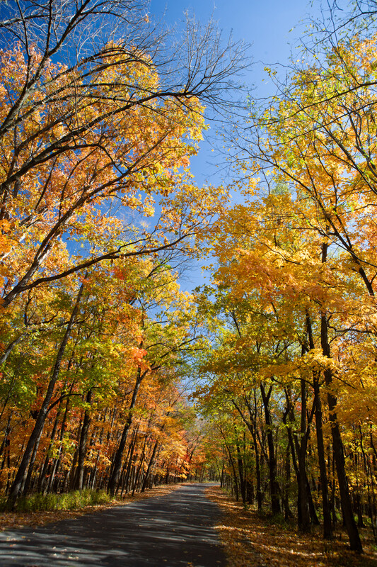
When do you think bears eat the most?
Bears through the Seasons – 2C Wow! Bears Eat a Lot: Explore
10
Notes:
Bears like all kinds of foods from plants to small animals. However, the don’t eat the same amount of food all year long.

Slide 11
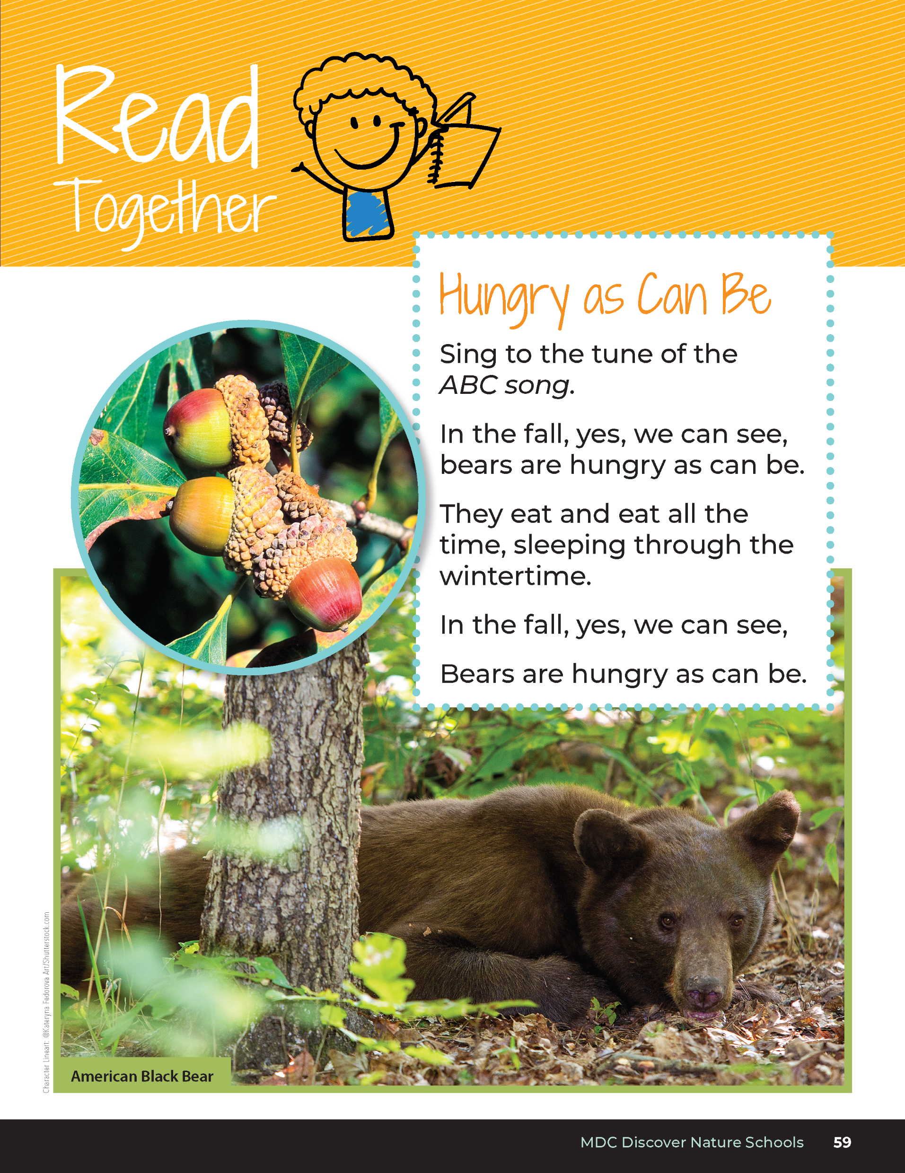
Hungry as Can Be
Sing to the tune of the ABC song.
In the fall, yes, we can see, bears are hungry as can be.
They eat and eat all the time, sleeping through the wintertime.
In the fall, yes, we can see,
Bears are hungry as can be.
Bears through the Seasons – 2C Wow! Bears Eat a Lot: Explore
11
Notes:
Read aloud from the student guide Read Together Hungry As Can Be on Page 59 to the tune of the ABC song.

Slide 12
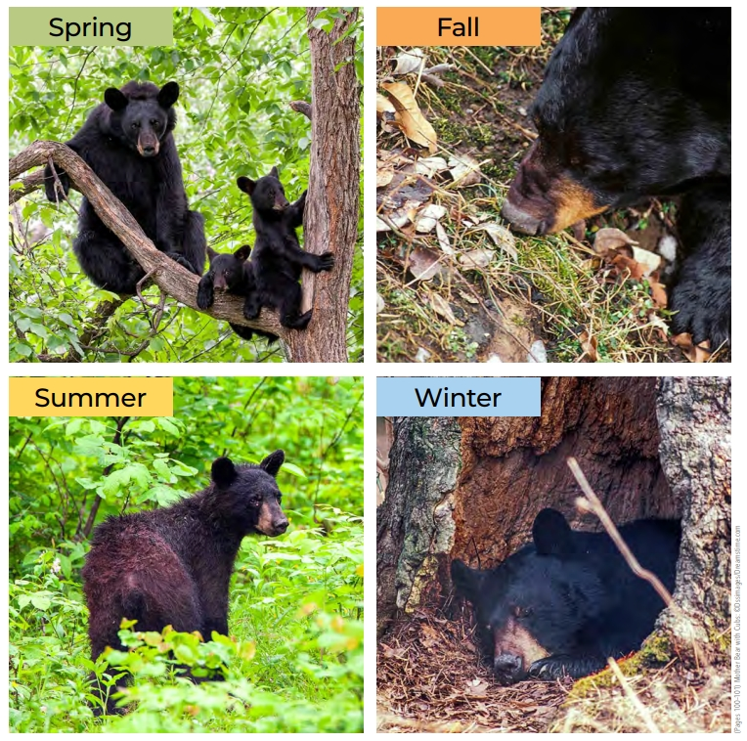
Directions:
Point to the different pictures in the different parts of the classroom.
After I ask the question, think about your answer.
Walk to the picture that you think is the answer.
Bears through the Seasons – 2C Wow! Bears Eat a Lot: Explore
12
Notes:
Display the 2C Spring, Summer, Fall, and Winter Bear Pictures on page 100 of the Teacher Guide or print from the MDC Teacher Portal. Put the one picture of each season in four different areas of the room.

Slide 13
When do bears eat the most?
Bears through the Seasons – 2C Wow! Bears Eat a Lot: Explore
13
Notes:
Students should silently ponder this question. After they silently make their choice, tell them to walk to that corner of the room. Have students discuss why they chose their answer in their group.

Slide 14
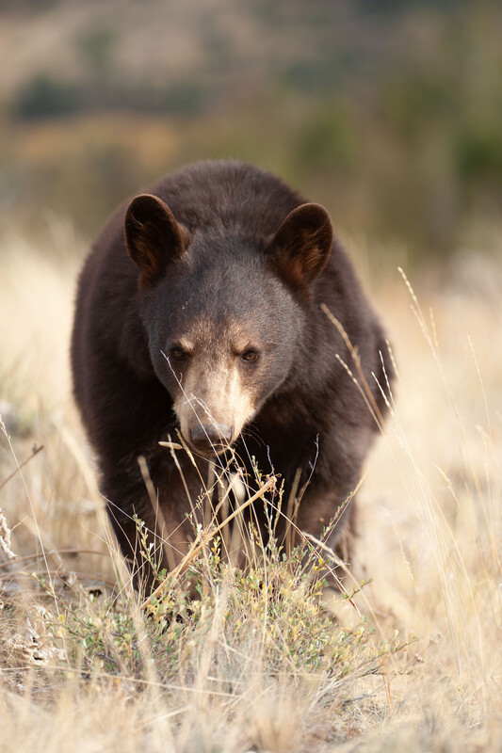
We are going to explore why bears eat different amounts of food in different seasons.
Bears through the Seasons – 2C Wow! Bears Eat a Lot: Explore
14
Notes:
Tell students that they are going to use different proportions of beans or sand in sandwich bags to learn about a bear’s pattern of eating throughout the year. The bags represent how full a bear’s stomach is after eating.
Divide students into groups of three or four. Give each group a scale and two different sandwich bags filled with two different amounts of beans, sand, or rice. One bag should be very light (1-2 beans) or empty, and one should be very heavy (full of beans)

Slide 15
Directions:
Divide into groups.
Share two bags per group. Do not open the bags!
Using the scale, weigh each bag.
Which bag is heavier?
Which bag is lighter?
Bears through the Seasons – 2C Wow! Bears Eat a Lot: Explore
15
Notes:
Tell students that they are going to use different proportions of beans or sand in sandwich bags to learn about a bear’s pattern of eating throughout the year. The bags represent how full a bear’s stomach is after eating.
Divide students into groups of three or four. Give each group a scale and two different sandwich bags filled with two different amounts of beans, sand, or rice. One bag should be very light (1-2 beans) or empty, and one should be very heavy (full of beans) Have the students weigh each sandwich bag. Students can also use a balance scale to compare the bags. Help students read the numbers on the scale or determine which has more.

Slide 16
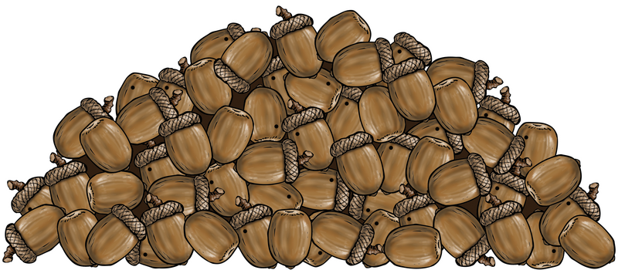
What do the sandwich bags represent?
Bears through the Seasons – 2C Wow! Bears Eat a Lot: Explore
16
Notes:
Discuss with students that the sandwich bags act as a model to represent the quantities of foods that bears eat through the seasons.

Slide 17
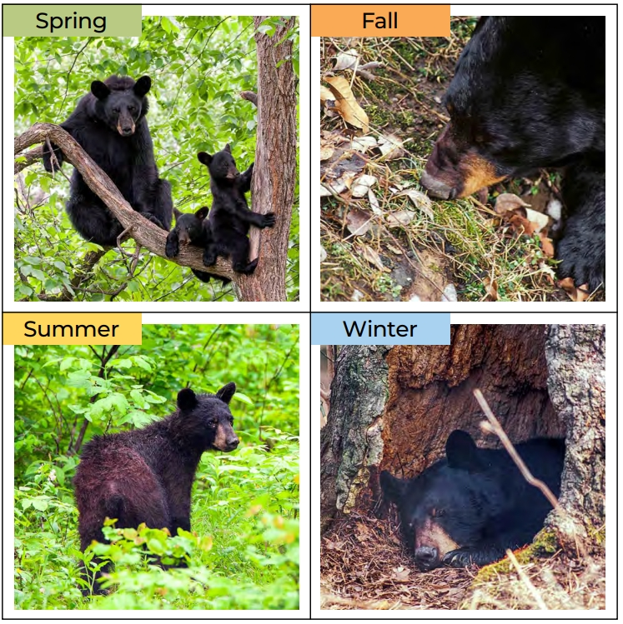
Find the pictures around the room. Walk to when you think the bear would eat the most? What about the least?
Bears through the Seasons – 2C Wow! Bears Eat a Lot: Explore
17
Notes:
Make a prediction about which bag represents the amount of food a bear eats in the spring, summer, fall, and winter. Place the bags onto 2C Guess the Season Board, page 101 in the Teacher Guide to show their predictions of when they think the bear would eat the most and the least.

Slide 18
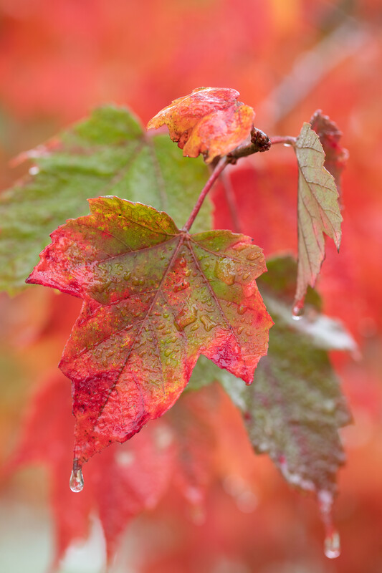
In what season is the bag the heaviest?
Bears through the Seasons – 2C Wow! Bears Eat a Lot: Explore
18

Slide 19
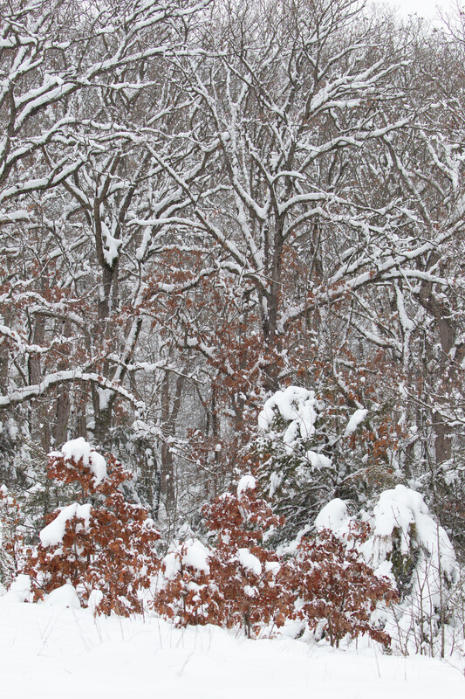
In what season is the bag the lightest?
Bears through the Seasons – 2C Wow! Bears Eat a Lot: Explore
19
Notes:
Bears generally do not eat during the winter, so the bag would be empty. Discuss how the real quantities of food that bears eat are much larger than sandwich bags. Scientists compare the weight of things to learn more.

Slide 20
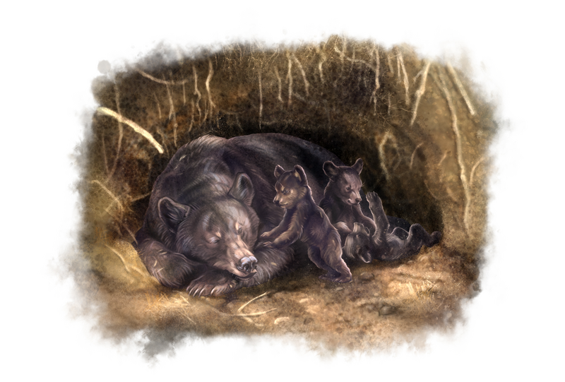
Why do bears eat a lot during a certain time of the year?
Bears through the Seasons – 2C Wow! Bears Eat a Lot: Explain
20
Notes:
Tell them that bears eat most in the fall and least in the winter because bears are hibernating.

Slide 21
Do you need to revise your guess?
Bears through the Seasons – 2C Wow! Bears Eat a Lot: Explain
21

Slide 22
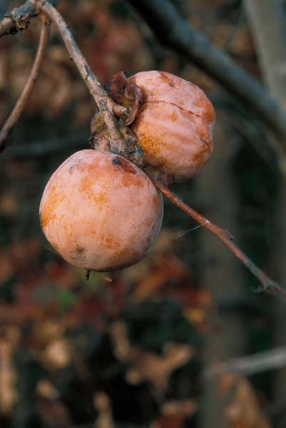
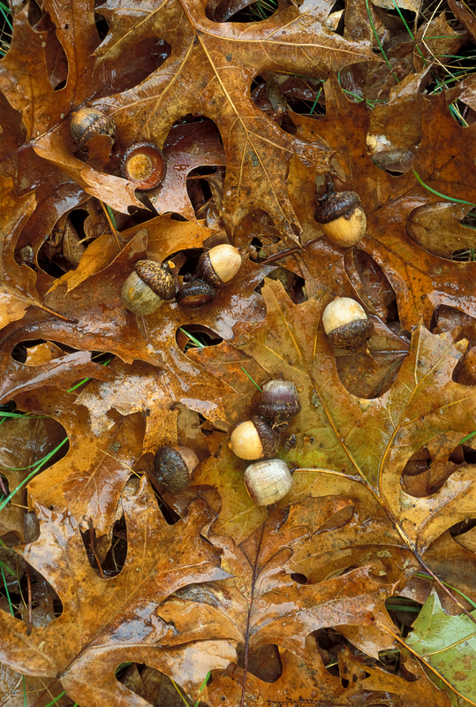
What food is available in the fall?
Bears through the Seasons – 2C Wow! Bears Eat a Lot: Explain
22
Notes:
Many plants and their parts including: acorns, persimmons, hazelnuts.

Slide 23
Why would bears eat more food, like acorns, in the fall?
Bears through the Seasons – 2C Wow! Bears Eat a Lot: Explain
23

Slide 24
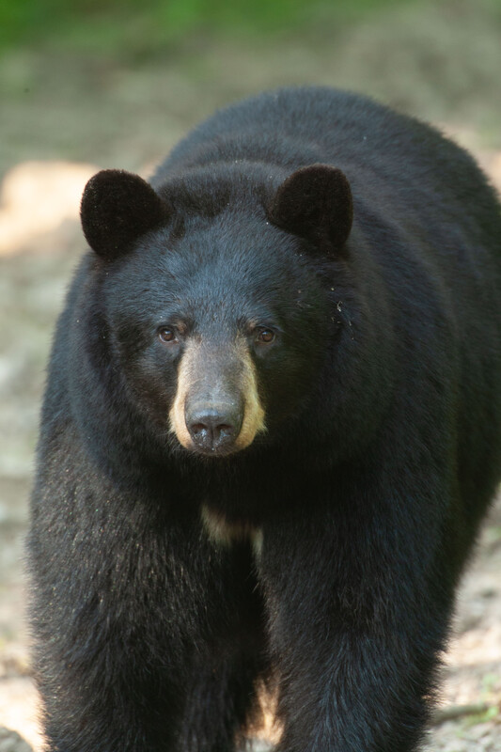
What is the effect from eating so much food?
Bears through the Seasons – 2C Wow! Bears Eat a Lot: Explain
24
Notes:
Discuss cause and effect. Bears eat the most in the fall because of the food that is available.

Slide 25
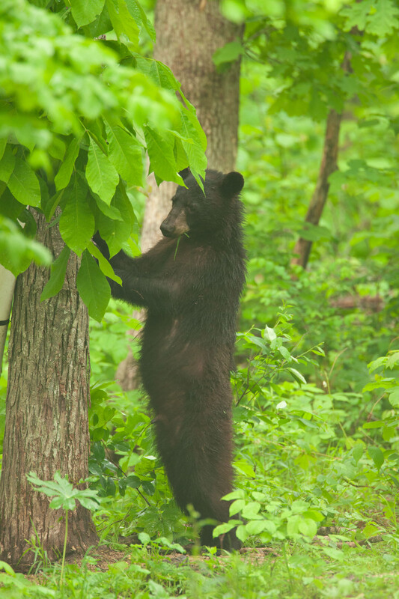
The food a bear eats is what gives it energy.
Bears through the Seasons – 2C Wow! Bears Eat a Lot: Explain
25
Notes:
The food a bear eats is what gives it energy. Bears gain a lot of weight in the fall to prepare for their long winter’s sleep, so they eat the most in the fall. Increasing how much food they eat helps bears prepare for winter.

Slide 26
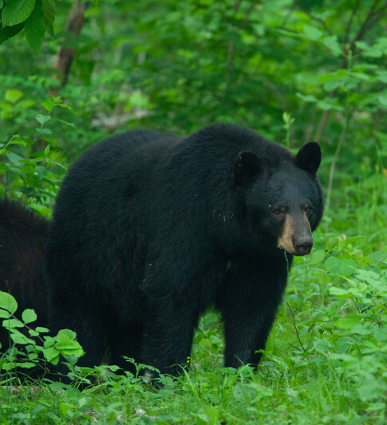
Much of the energy from this food is stored as layers of fat.
Bears through the Seasons – 2C Wow! Bears Eat a Lot: Explain
26
Notes:
Much of the energy from this food is stored as layers of fat. During winter, bears still breathe and their bodies are still working even though they may be sleeping or if they need to move for any reason. These extra fat layers also help the bear to stay warm.

Slide 27
These extra fat layers of energy help the bear survive through the winter months.
Bears through the Seasons – 2C Wow! Bears Eat a Lot: Explain
27
Notes:
It is these extra fat layers of energy that help the bear survive through the winter months.

Slide 28
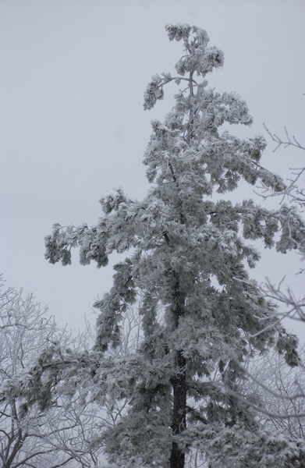
What happens to bears when they do not eat in winter, but are surviving on their energy in the form of fat?
Bears through the Seasons – 2C Wow! Bears Eat a Lot: Explain
28

Slide 29
Do they get bigger or smaller?
Bears through the Seasons – 2C Wow! Bears Eat a Lot: Explain
29

Slide 30
Do you think bears follow that pattern of eating every year or just some years?
Bears through the Seasons – 2C Wow! Bears Eat a Lot: Explain
30
Notes:
Remember a pattern is something that repeats, we talked about this when we measured the weather.

Slide 31
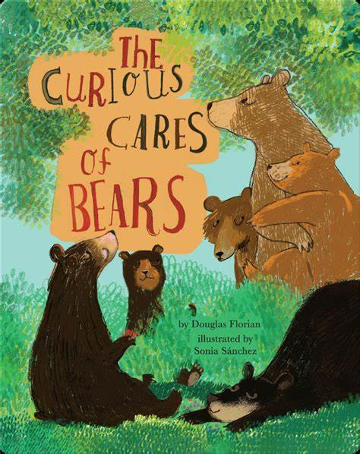
Read the book Curious Cares of Bears by Douglas Florian
Link to book on Epic!: Curious Cares of Bears by Douglas Florian
Available for free to classroom teachers on Epic! (login required)
Link to Read-Aloud: https://youtu.be/XR4MGSoMDsI?si=bna9YCGf6efcRZD7
Bears through the Seasons – 2C Wow! Bears Eat a Lot: Explain
31
Notes:
Reread the Curious Cares of Bears by Douglas Florian. Reference the activity of winter denning at the end of The Curious Cares of Bears. Tell students to pretend that it is winter, and they are very cold.

Slide 32
What could you do to get warmer? How is this like the layers of fat that bears get in the fall?
Bears through the Seasons – 2C Wow! Bears Eat a Lot: Elaborate
32
Notes:
Show students a stack of blankets. Ask students what would happen if we put one blanket on them, then two, then three, and so on. Ask for some volunteers to try it. Ask students how this is like the fat layers that bears gain in fall during when they are overeating.

Slide 33
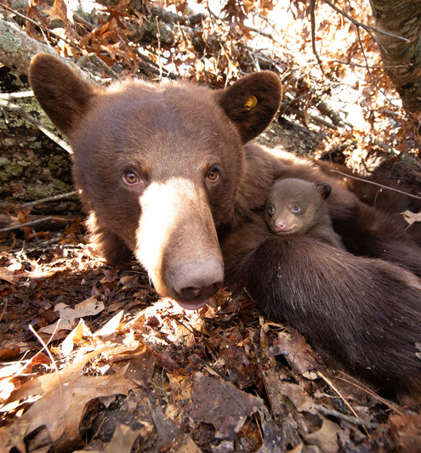
How does the warmth of bear’s fur and its layer of fat keep it warm in the wintertime?
Bears through the Seasons – 2C Wow! Bears Eat a Lot: Elaborate
33
Notes:
Tell students that bears also get a thicker coat of fur in the winter to keep them warm. Pass around a sample of fur.
Teacher Note: If you do not have a swatch of black bear fur to pass around, contact your local MDC conservation educator to reserve an available bear pelt.
Have students compare how the bear’s fur keeps it warm to how blankets keep people warm. Turn and talk to your elbow partner.

Slide 34
How does this compare to how we as humans use blankets?
Bears through the Seasons – 2C Wow! Bears Eat a Lot: Elaborate
34

Slide 35
Bears through the Seasons – 2C Wow! Bears Eat a Lot: Engage
35
Notes:
Add student observations and/or questions to the chart as the lesson proceeds in reference to the phenomenon studied.

Slide 36
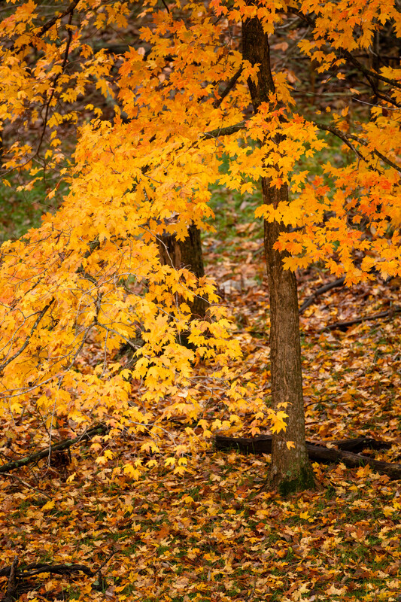
Why is fall better than winter to eat large amounts of food?
Bears through the Seasons – 2C Wow! Bears Eat a Lot: Evaluate
36
Notes:
This is what is available to the bears to eat and gain a lot of weight.

Slide 37
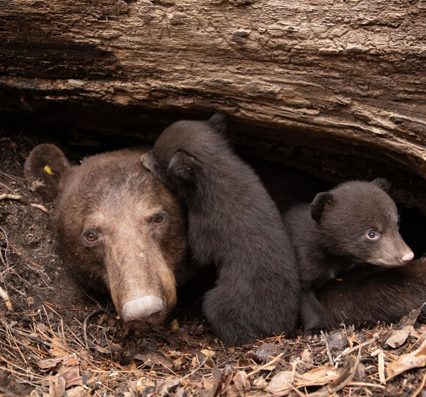
Why do bears put on those layers of fat before they go their dens?
Bears through the Seasons – 2C Wow! Bears Eat a Lot: Evaluate
37
Notes:
This helps them survive through the cold months by giving them energy.

Slide 38
Draw It!
Bears through the Seasons – 2C Wow! Bears Eat a Lot: Evaluate
38
Notes:
Have students draw the activity of bears eating in the fall in their student guide Draw It! Storing Up on Page 60.

Slide 39
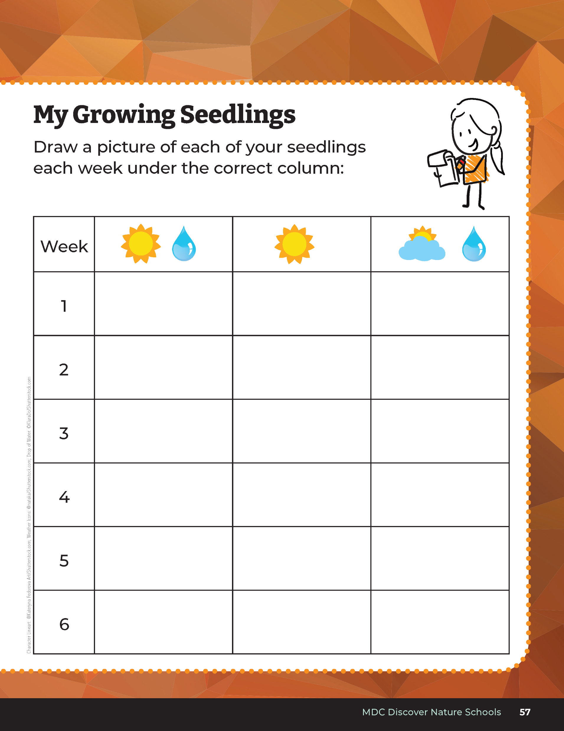
What was needed to help the acorns grow?
Bears through the Seasons – 2C Wow! Bears Eat a Lot: Evaluate
39
Notes:
Tell them that there is a cause-and-effect relationship between things in nature. Think back to the last lesson, Losing Daylight, and open their student guide to 2B Draw It! My Growing Seedlings on Page 57.
What was needed to help the acorns grow? (Water and sunlight).

Slide 40
What do you think should come first, next, and then last?
Bears through the Seasons – 2C Wow! Bears Eat a Lot: Evaluate
40
Notes:
Open your student guide to Science Notebook What Happens Next? on Page 61.
What do you think should come first, next, and then last?

Slide 41
Answers
Cause
Effect
Effect
Oak tree and acorn grows
Bear eats acorns. If more sunlight and water, more acorns
Sunlight and Water
Bears through the Seasons – 2C Wow! Bears Eat a Lot: Evaluate
41
Notes:
What do you think should come first, next, and then last?
Draw it in on the chart. Let’s discuss your answers. (Order: sunlight and water, oak tree and acorn, and a bear eating
The first box is the cause, which is the amount of sunlight and water available during the fall. The next box is the effect, which determines the amount of food available based on the amount of sunlight and water. The last box is the effect that determines how much food the bears will eat, based on the food that is available, which is based on the amount of sunlight and water.

