Slide 1
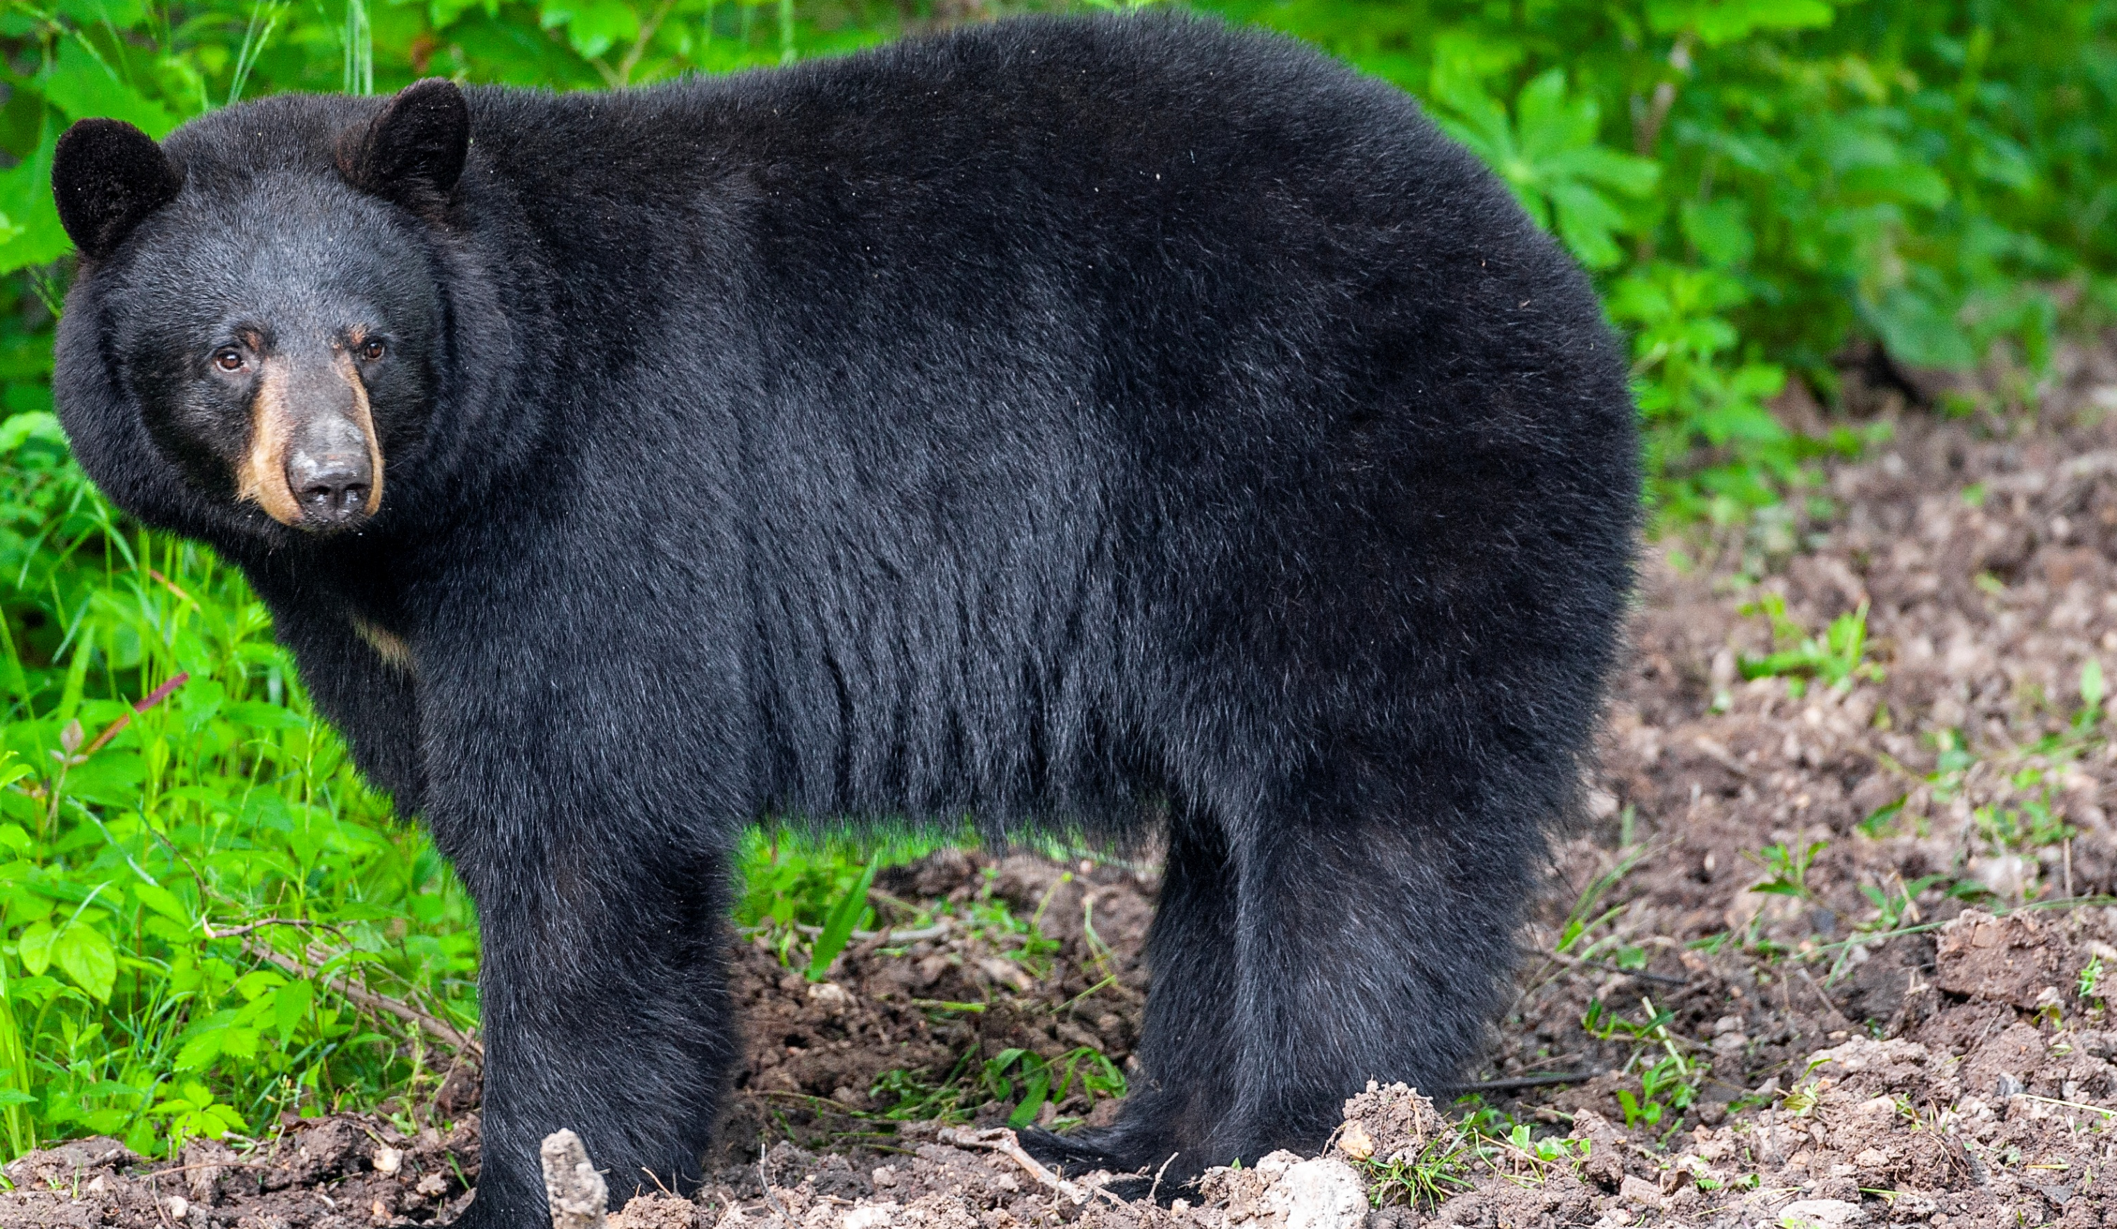

BEARS
Through the Seasons
Lesson 2B: Losing Daylight

Slide 2
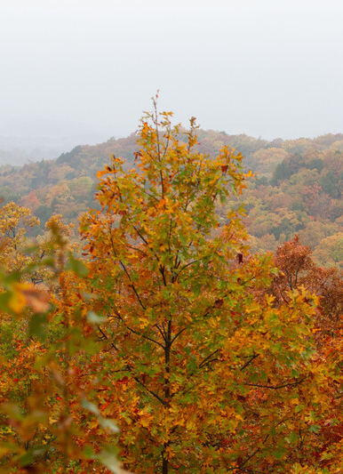

Guiding Question:
Why do trees look different in the fall?
Bears through the Seasons – 2B Losing Daylight: Engage
2

Slide 3

Bears through the Seasons – 2B Losing Daylight: Engage
3
Notes:
Prepare and display your Noticings and Wonderings Chart for this lesson. Add student observations and/or questions to the chart as the lesson proceeds in reference to the phenomenon studied.

Slide 4
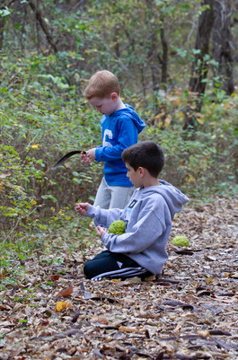
What kinds of clothes are your friends wearing?
Bears through the Seasons – 2B Losing Daylight: Engage
4
Notes:
Ask students to look around the room.

Slide 5
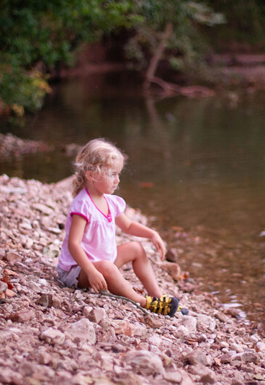
What kind of clothing were they wearing several months ago?
Bears through the Seasons – 2B Losing Daylight: Engage
5

Slide 6
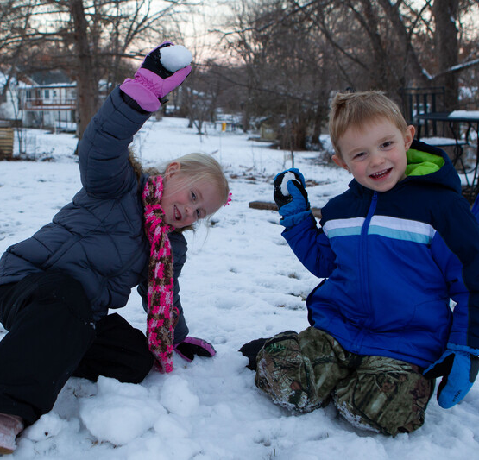
What kinds of clothing will they be wearing a few months from now?
Bears through the Seasons – 2B Losing Daylight: Engage
6

Slide 7








Bears through the Seasons – 2B Losing Daylight: Engage
7
Notes:
Show different kinds of clothing to spark their background knowledge.

Slide 8

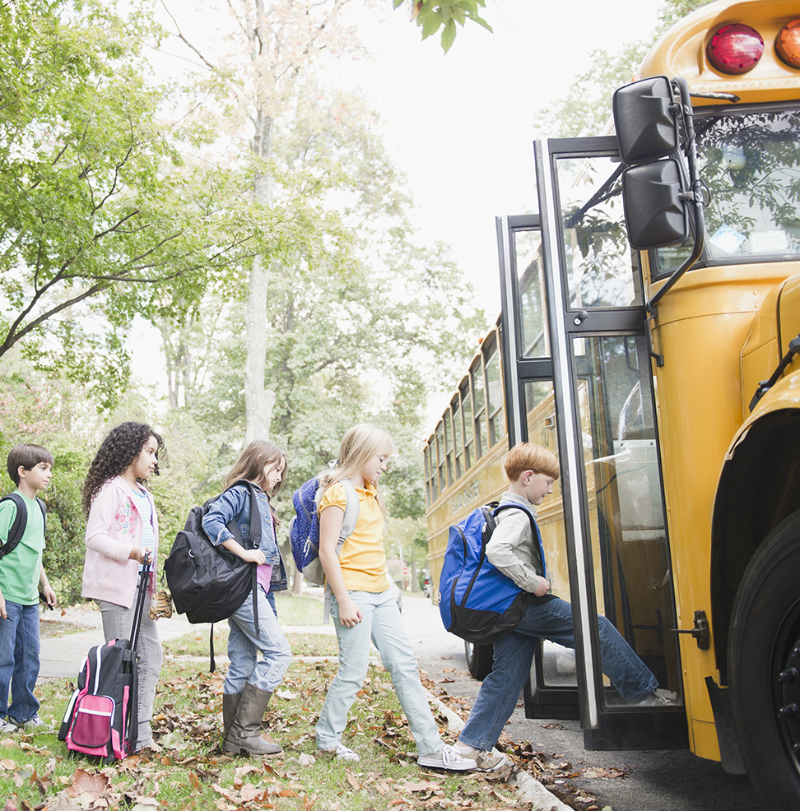
Do you notice that sometimes you go to school in the dark and sometimes you don’t?
Bears through the Seasons – 2B Losing Daylight: Engage
8

Slide 9
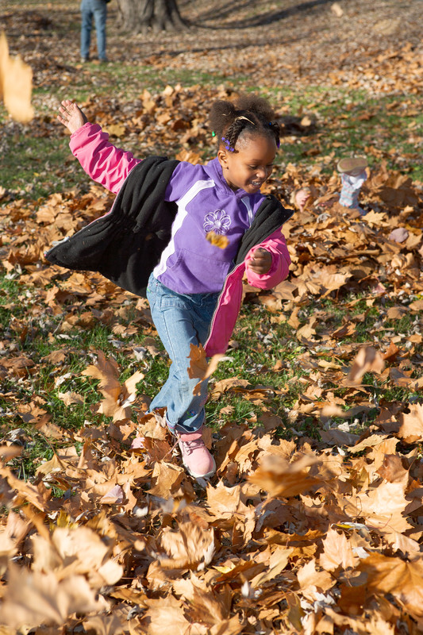
Do you notice that sometimes you have to come in earlier from playing while at other times of the year you can stay out later because the sun is out longer?
Bears through the Seasons – 2B Losing Daylight: Engage
9

Slide 10
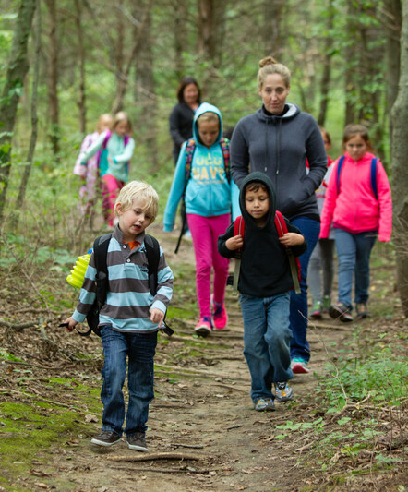
Does this relate to what you are wearing?
Bears through the Seasons – 2B Losing Daylight: Engage
10

Slide 11
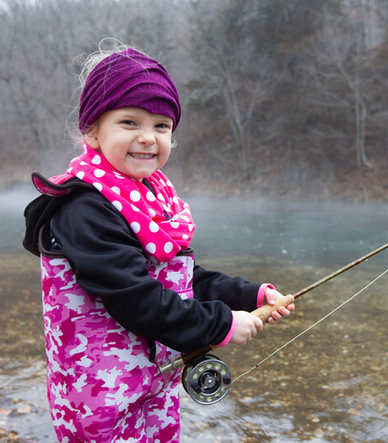
Why do we wear different kinds of clothes during different times of the year?
Bears through the Seasons – 2B Losing Daylight: Engage
11

Slide 12

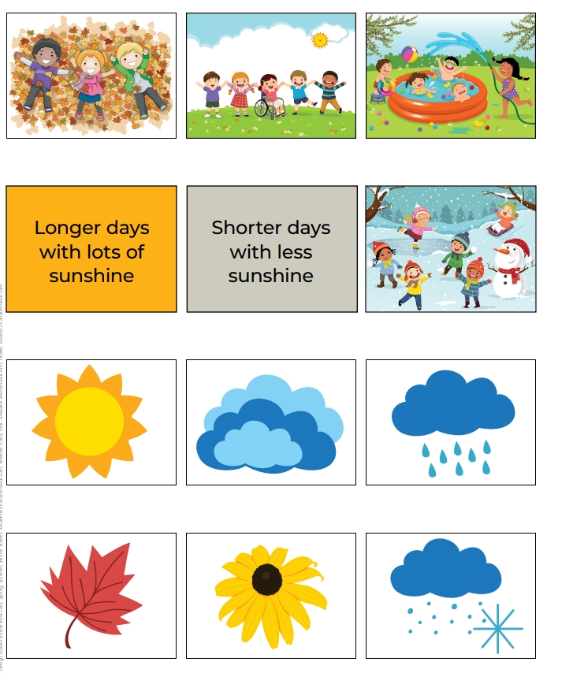
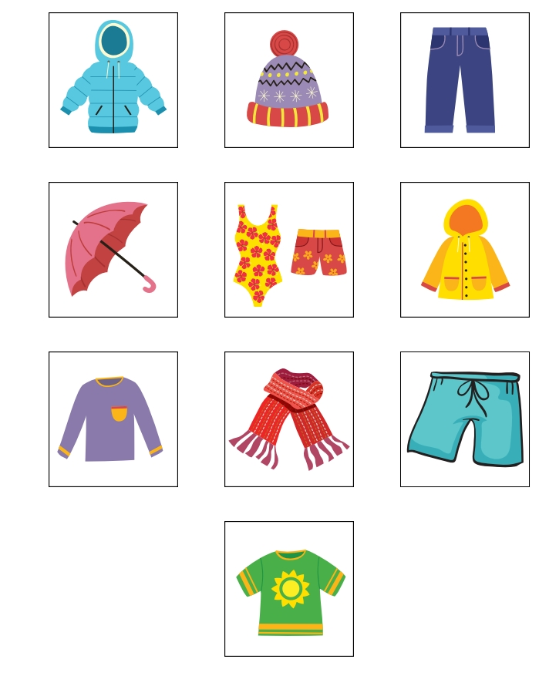
Bears through the Seasons – 2B Losing Daylight: Engage
12
Notes:
Divide students into groups of 2-3. Give each group of students the 2B Card Sort Seasonal Table located on page 92 in the Teacher Guide at the back of this lesson and on our MDC teacher Portal under Kindergarten Lesson 2B. Review that you will give them different cards to sort under each column. Hand out cards from the 2B Seasonal Clothing Cards and 2B Seasonal Activities Cards located on pages 90-91 of the Teacher Guide.

Slide 13
How did you sort your cards?
Bears through the Seasons – 2B Losing Daylight: Engage
13

Slide 14
Why did you sort them that way?
Bears through the Seasons – 2B Losing Daylight: Engage
14

Slide 15
Bears through the Seasons – 2B Losing Daylight: Engage
15
Notes:
Prepare and display your Noticings and Wonderings Chart for this lesson. Add student observations and/or questions to the chart as the lesson proceeds in reference to the phenomenon studied.

Slide 16
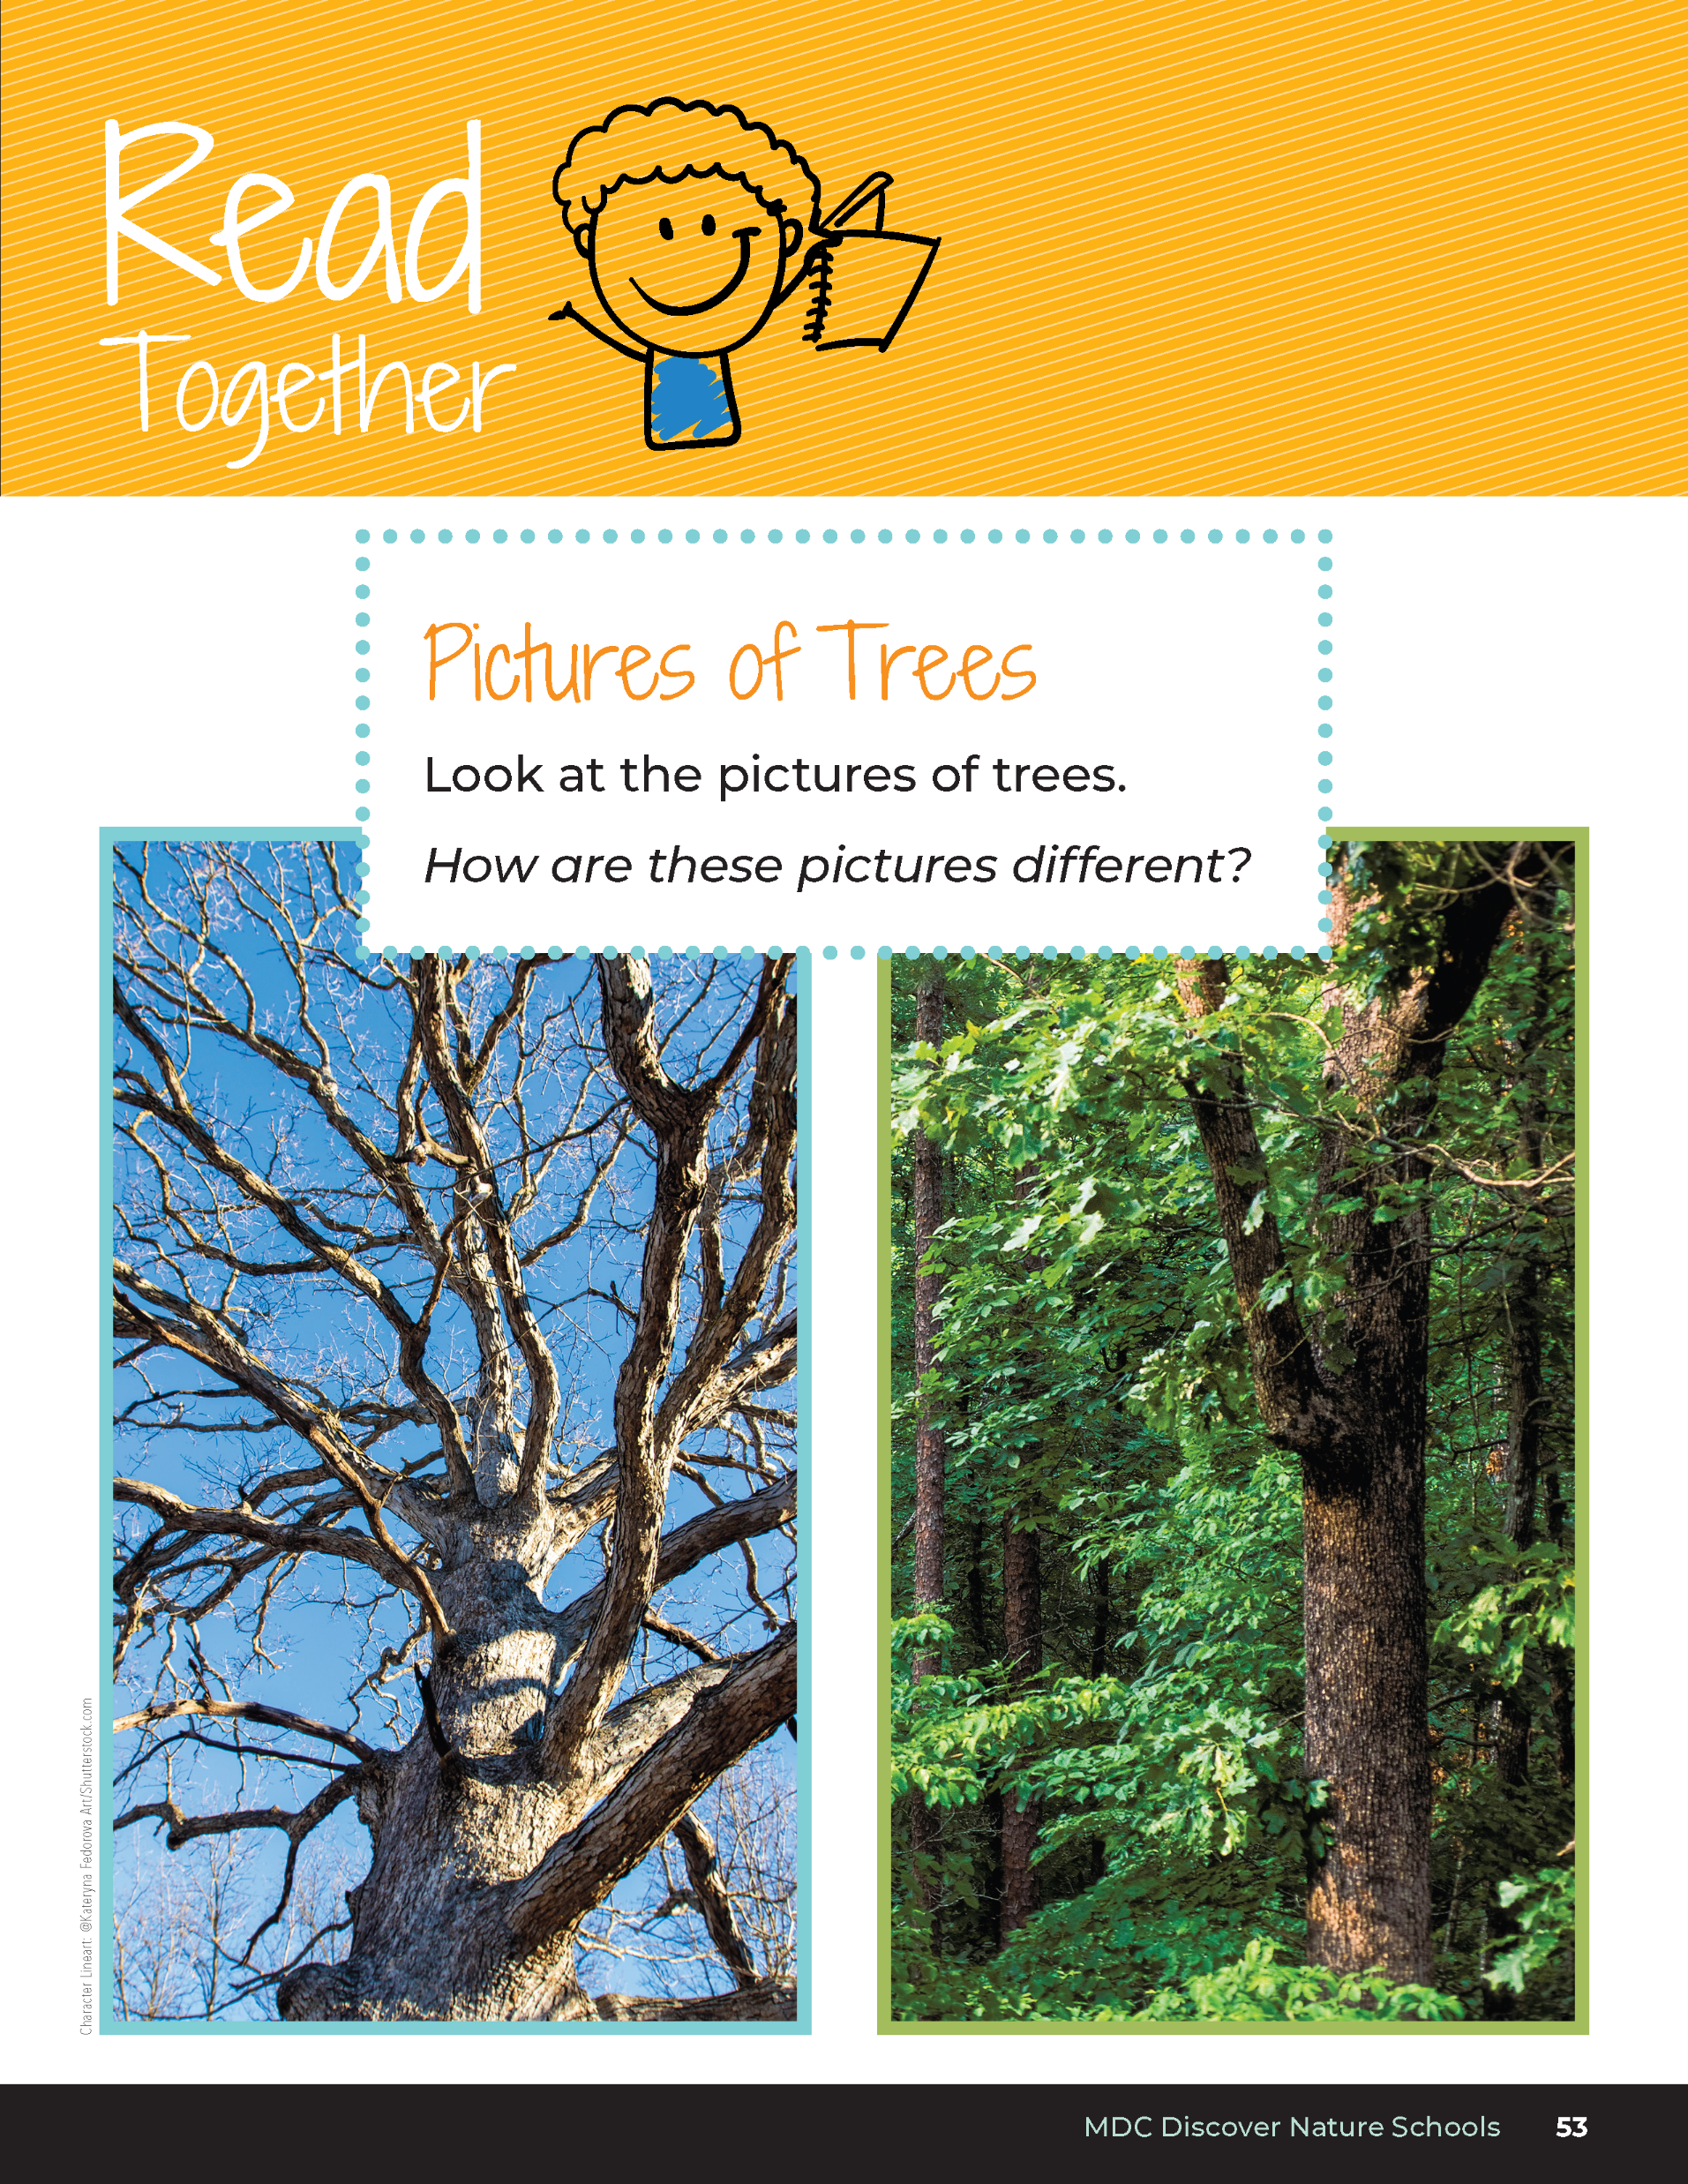
How are these pictures different?
Bears through the Seasons – 2B Losing Daylight: Explore
16
Notes:
Reference from the student guide, Read Together Pictures of Trees on Page 53.
Ask if they can identify the time of year by looking at the trees.

Slide 17
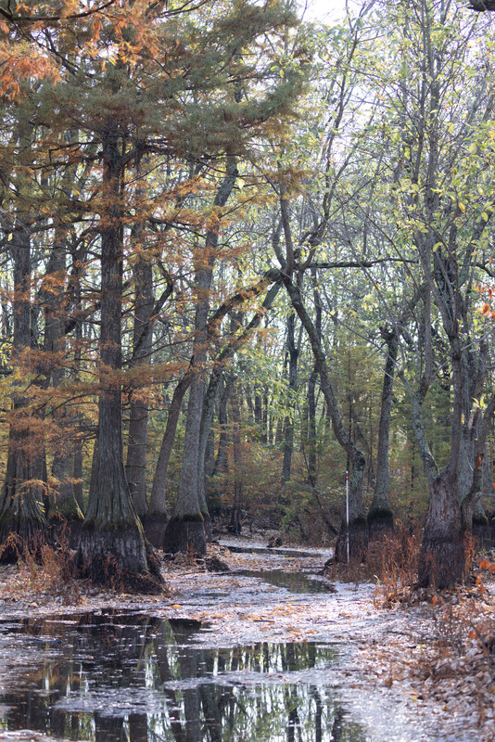
Why do you think the trees look different at different times of the year?
Bears through the Seasons – 2B Losing Daylight: Explore
17

Slide 18

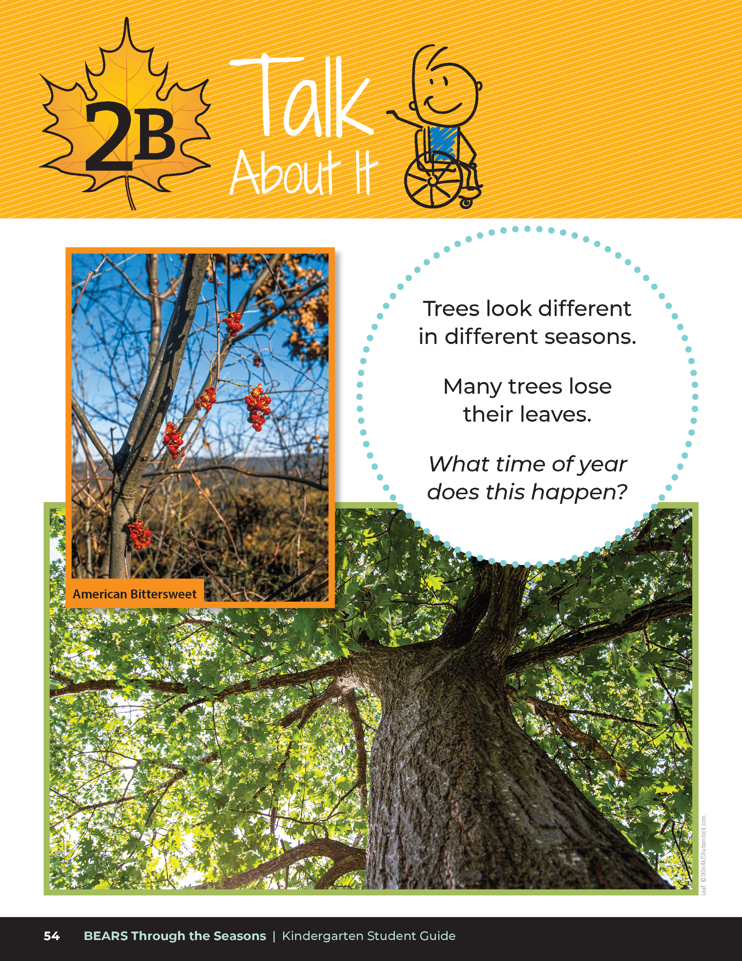
Trees look different in different seasons.
Many trees lose their leaves.
What time of year does this happen?
Bears through the Seasons – 2B Losing Daylight: Explore
18
Notes:
Have students read the Talk About It section from their student guide on Page 54.

Slide 19
We are going to explore what plants need to survive and see if we can figure out why trees look different at different times of the year.
Bears through the Seasons – 2B Losing Daylight: Explore
19

Slide 20

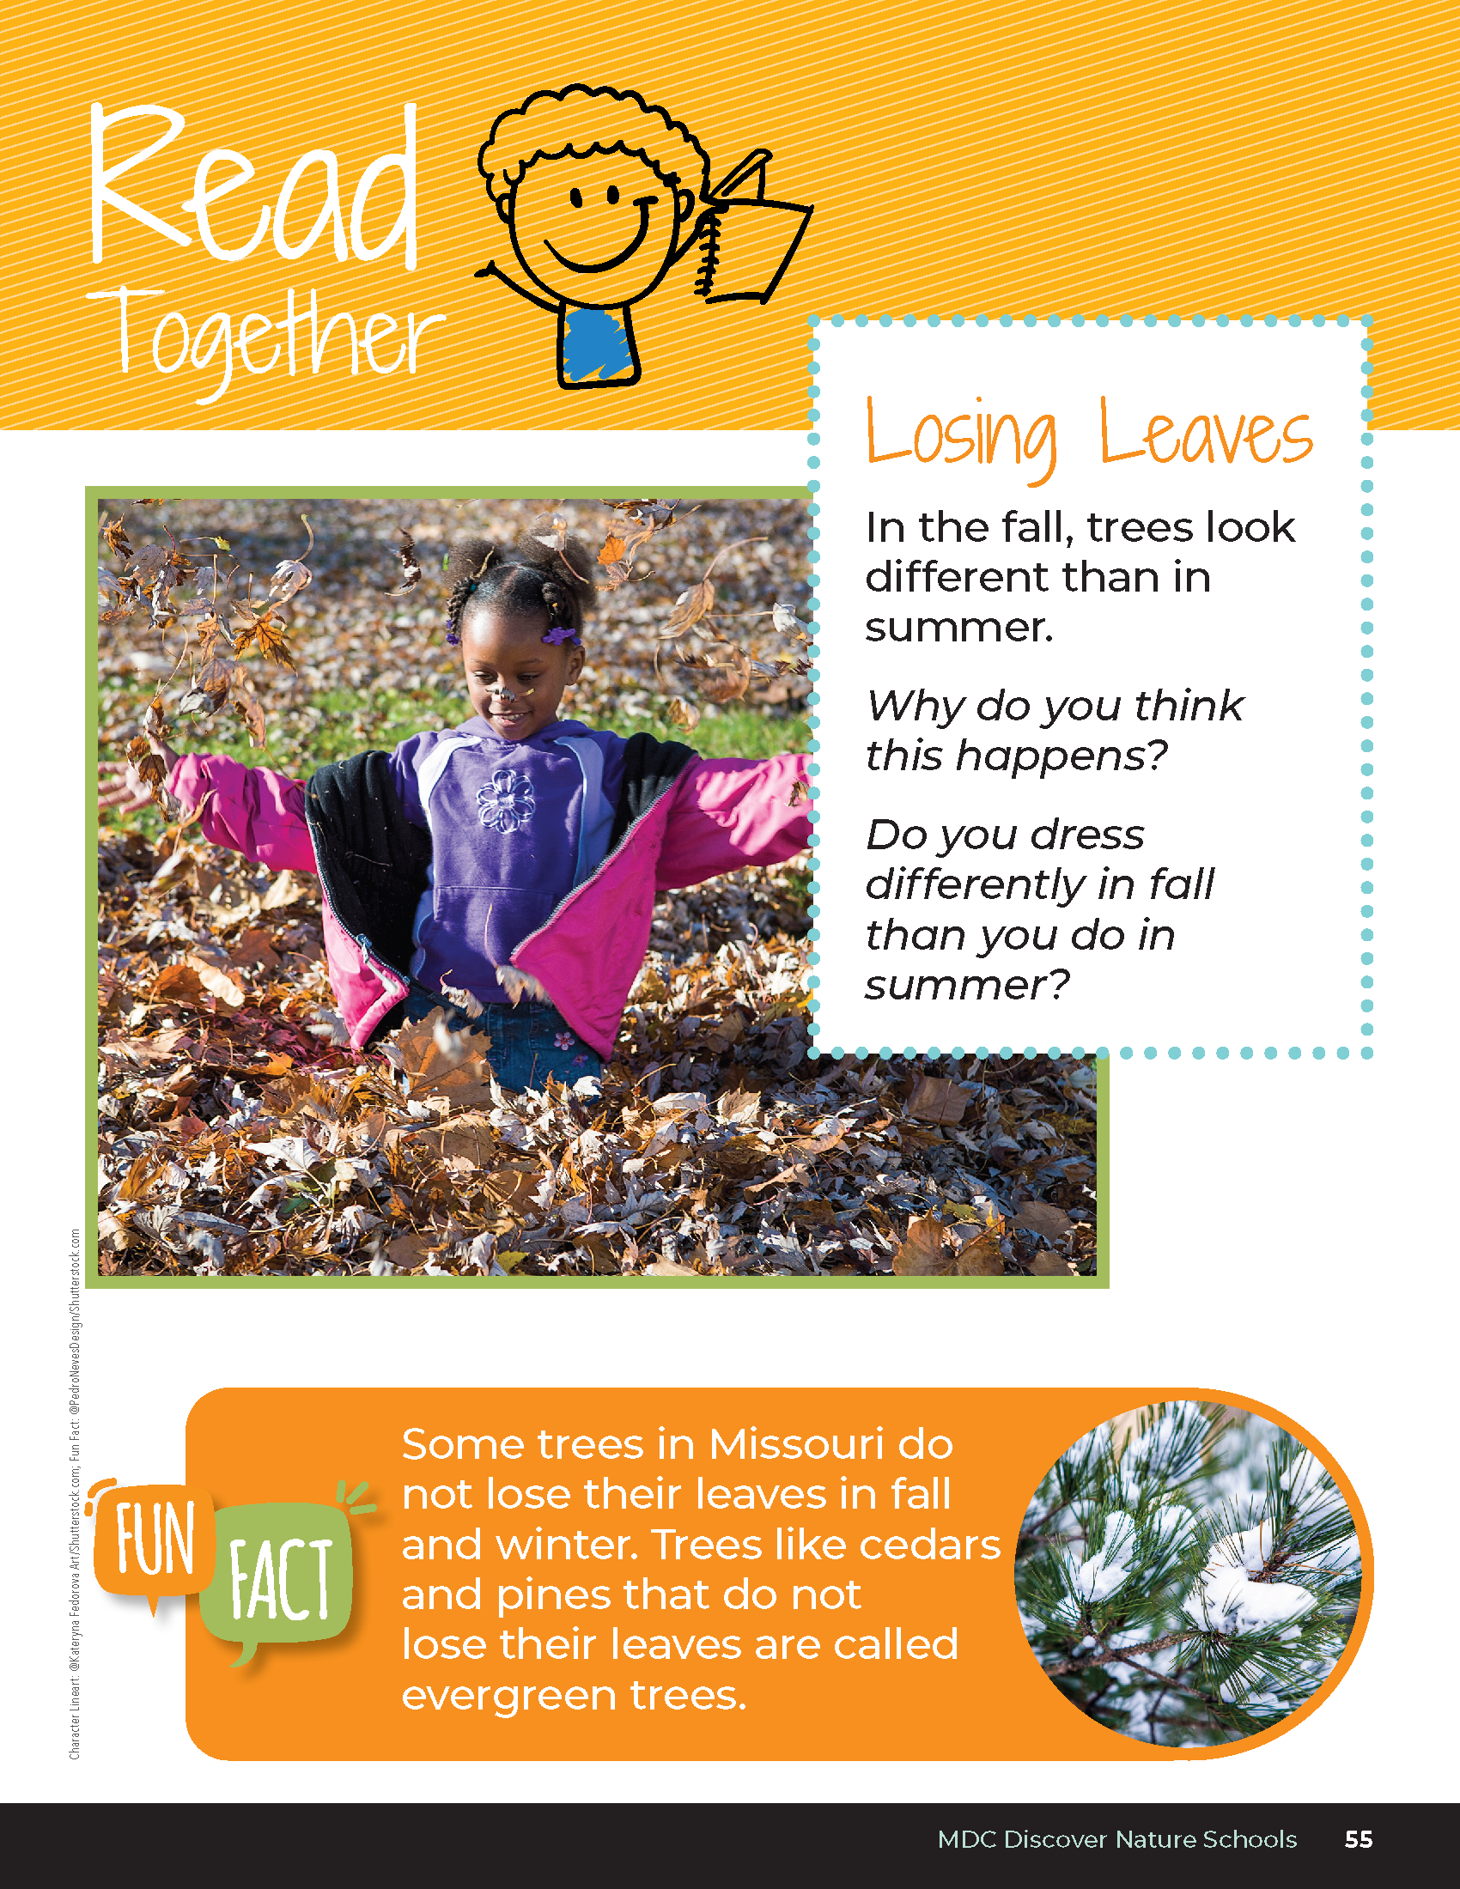
Losing Leaves
In the fall, trees look different than in summer.
Why do you think this happens?
Do you dress differently in fall than you do in summer?
Bears through the Seasons – 2B Losing Daylight: Explore
20
Notes:
Read aloud from the student guide, Read Together Losing Leaves on Page 55

Slide 21
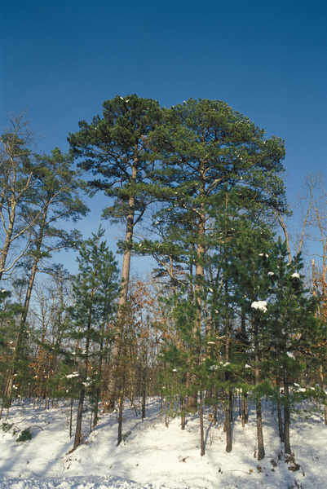
Bears through the Seasons – 2B Losing Daylight: Explore
21
Notes:
Read aloud the fun fact from the student guide on Page 55

Slide 22

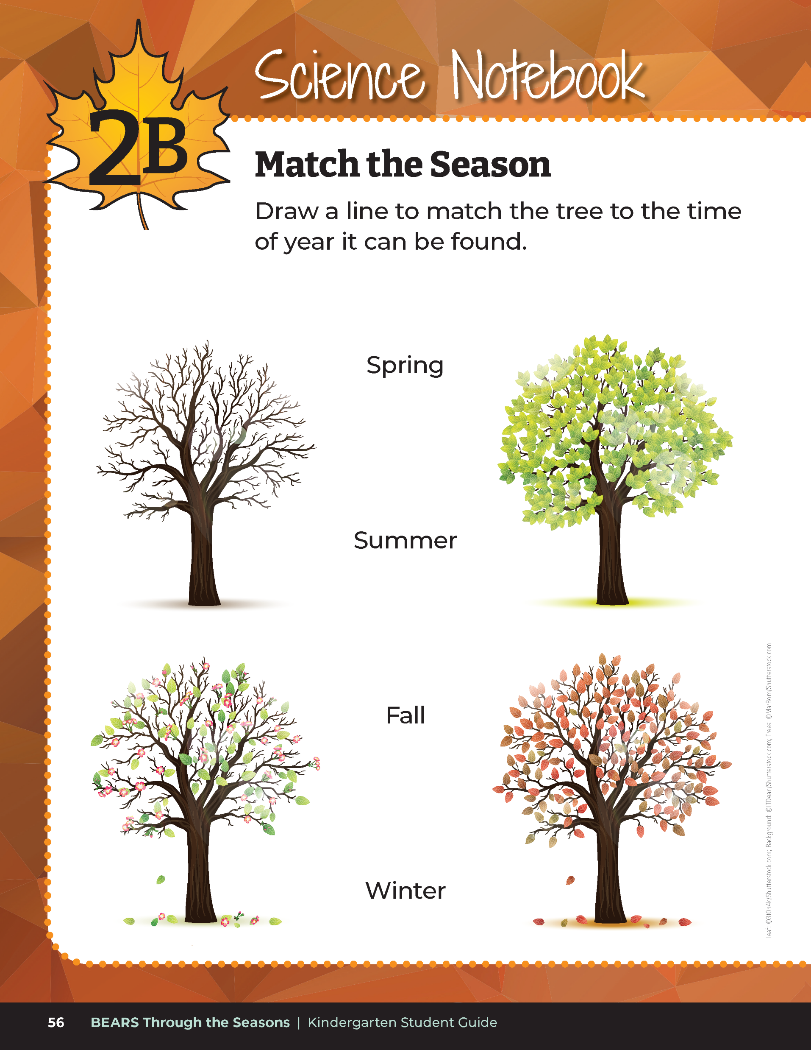
Draw a line to match the tree to the time of year it can be found.
Bears through the Seasons – 2B Losing Daylight: Explore
22
Notes:
Have students complete the student guide Science Notebook Match the Season on Page 56.

Slide 23
Answers
Bears through the Seasons – 2B Losing Daylight: Explore
23
Notes:
Have students complete the student guide Science Notebook Match the Season on Page 56.

Slide 24
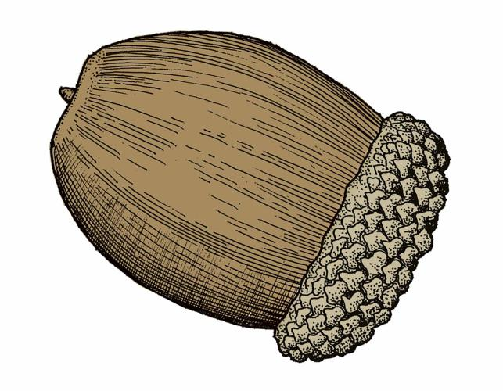
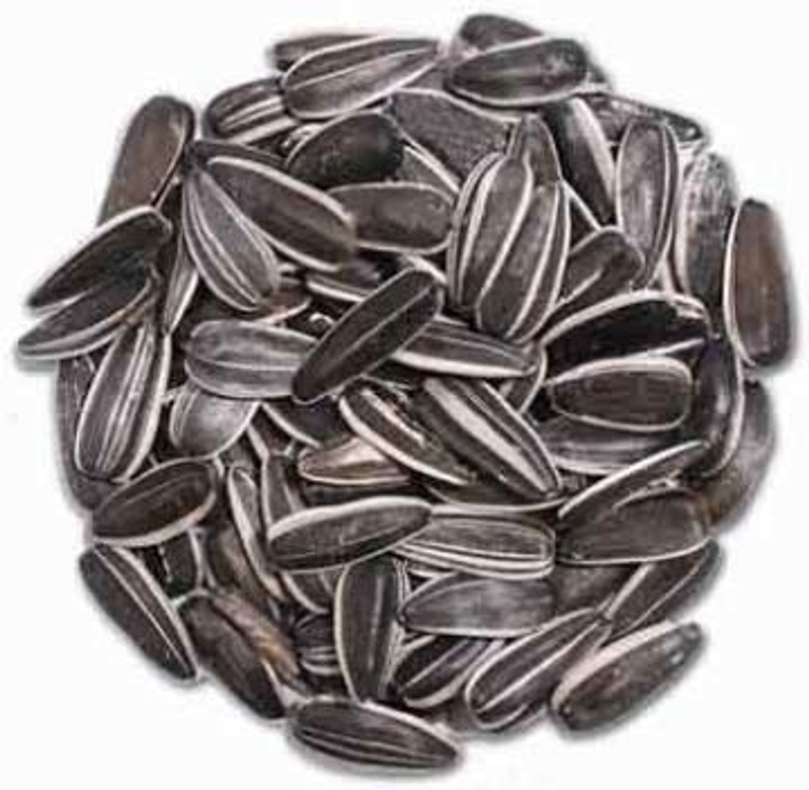
Plant seeds or (White Oak) acorns!
Directions:
Get into groups.
Plant 3 of the same seeds into 3 different cups of soil. Label the cups with your names.
Place the cups:
  In the sun with water
  In the sun without water
  Somewhere in the classroom without a lot of light. Add water.
Bears through the Seasons – 2B Losing Daylight: Explore
24
Notes:
Put students into groups of three. Have them plant sunflower seeds or white oak seeds, which is also called an acorn. It is recommended to plant white oak acorns as these will germinate each year.
Give each group three different cups filled with potting soil. Put one cup in the sun and give it water. Put another cup in the sun but do not give it water. Put the third cup somewhere in the classroom that does not get much sunlight and give it just a little water. Put the names of the group on the cups.
Tips and Gathering and Sprouting Acorns
Nature journaling is usually recognized as a personal reflection journal, and the marvels of nature are easily incorporated. Students record thoughts, possibly emotions, as well as written and/or illustrated observations.Science note-booking goes beyond the nature journal with a young scientist learning adage. The notebooks may be used to record many styles of observations, collect data, calculations, and student’s procedures. They may sketch or refine methods, design a study, as well as solutions for next steps by recording successes or failures.
Educators find note-booking to be a useful instruction and assessment tool. Phenomena in nature is abundant. The Natural History Calendar of Events that is compiled by the Missouri Department of Conservation is one way to initiate a nature journal and seek entries. One model stage for a phenomena investigation is a close examination of a forest floor…and tree regeneration is certainly accessible for urban and rural communities. Examining sprouting acorns and developing seedlings, plus recording manipulations and controlled samples provide student opportunities to apply authentic scientific practices.
Missouri’s oak trees may be separated into two groups: the red and the white oak family. There are many differences in the life histories and characteristics contrasting the families. The acorns of the white oak group are the nuts that sprout on top of the ground in the autumn. They don’t have to be buried or go through a cold spell to germinate. Trees in the white oak family range statewide. White oak (Quercus alba), swamp white oak (Quercus bicolor), Chinkapin Oak (Quercus muehlenbergii), post oak (Quercus stellata) species are a few of these which may be discovered in the wild, or may be abundant in city parks or schoolyards. Their availability and the free use of the mast makes them suitable for classroom and homeschool study.
An observation class lab may be set up indoors or out. The design of the experiment may dictate whether the teacher selects a windowsill or flowerbed. A few easy to follow procedures this October/early November are as follows:
Teachers may lead students into preliminary Missouri oak tree identification. Free tree identification materials are available from the Missouri Department of Conservation. Students might investigate the conservation department’s website for the field guide. Subject findings and distinguishing field marks are recorded in the science notebook.
Educator locates a tree suitable for the students to harvest acorns off the ground. Mast is collected. Acorns that are whole and not damaged are gathered. Science notebook entry includes date/time/location and description of the ground level micro-habitat.
The class may store them wrapped in moist paper towels to keep the acorns from drying out. Viable acorns are selected for the experiment by briefly placing all the acorns in a container of water. Acorns that sink are used for the experiment. Floating acorns will not sprout and should be discarded and composted. Reflections on floating vs. sinking acorns may be entered in the notebooks.
Selected acorns are placed on the soil surface in a flower pot, a shallow saucer of soil or an area in an outdoor classroom. Water occasionally, and within days, the adventure of the autumn forest floor takes place indoors for classroom controlled observations or on the school ground. Young seedlings will grow in miniature for the classroom situation as long as they obtain moisture and light.
Teacher Note: It takes about a week for acorns to germinate and about 6 weeks to fully sprout into a plant, so you may want to start this a few weeks in advance. You can also use a faster sprouting seeds like native flowers or milkweed. If you are lacking time, you can use seedling plants. Contact your local MDC conservation educator for help finding locally sourced seeds at mdc.mo.goc/contact-engage. If you use acorns, students will need to conduct a water test to see if the acorn will germinate. Visit the MDC Teacher Portal Kindergarten Unit 2 Lesson 2B link to learn more about how to grow oak trees.

Slide 25
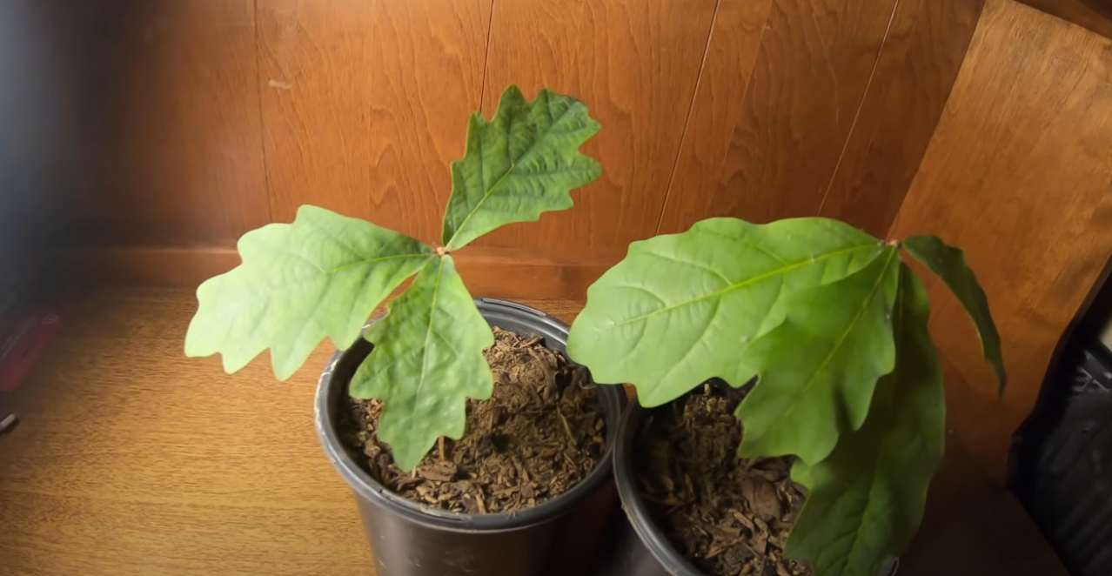
Link: How to grow a White Oak tree from acorn/seed
Bears through the Seasons – 2B Losing Daylight: Explore
25
Notes:
Link: How to grow a White Oak tree from acorn/seed - YouTube

Slide 26
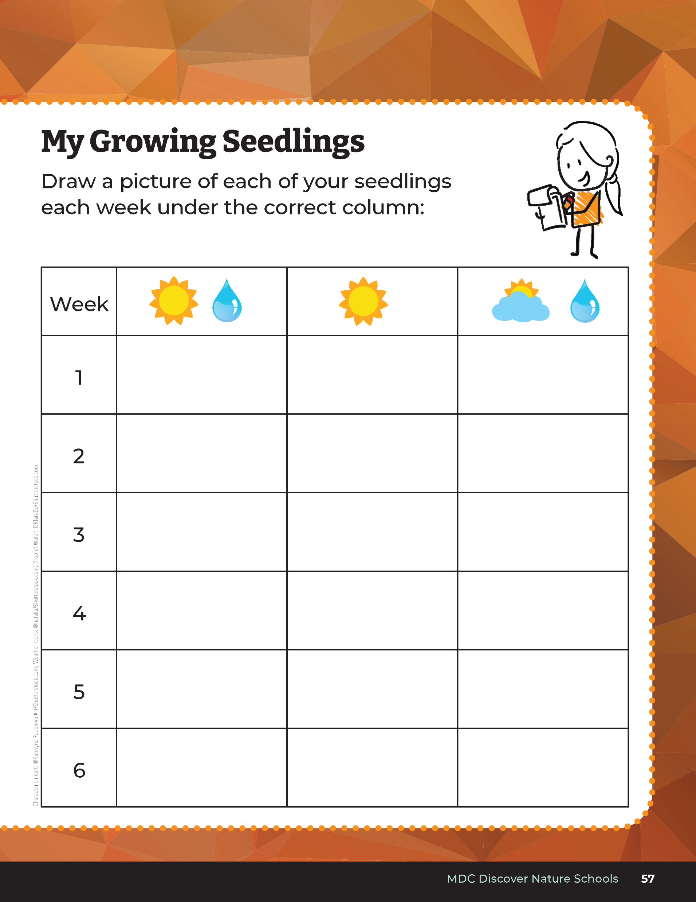

15
5
X
MINUTES
DAYS
Draw a picture of each of your seedlings each week.
Bears through the Seasons – 2B Losing Daylight: Explore
26
Notes:
Have students draw what they see for each cup in student guide Science Notebook My Growing Seedlings on Page 57.

Slide 27
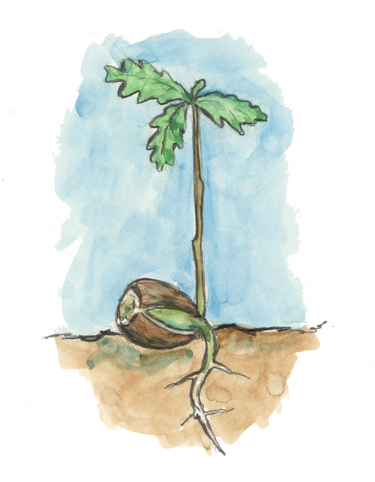
What do you observe about the seeds that you planted in each cup?
Bears through the Seasons – 2B Losing Daylight: Explore
27

Slide 28
Review our Findings
Bears through the Seasons – 2B Losing Daylight: Explain
28
Notes:
Review the student guide Science Notebook My Growing Seedlings on Page 57.

Slide 29
What did you notice over the course of our several weeks of growing our oak trees?
Bears through the Seasons – 2B Losing Daylight: Explain
29

Slide 30
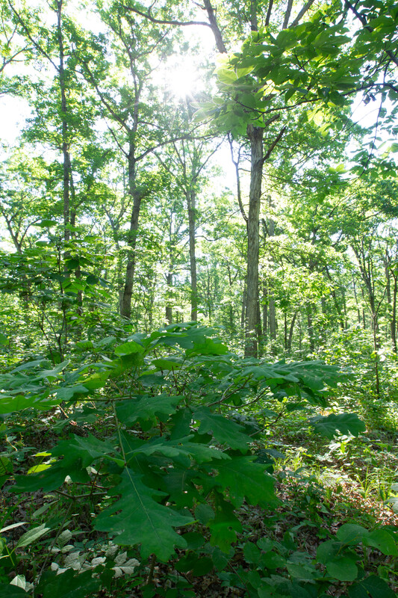
What do plants need to survive?
Bears through the Seasons – 2B Losing Daylight: Explain
30
Notes:
Soil, water, sunlight

Slide 31

Read the book Little Acorn by Melanie Joyce
Link to book on Epic!: Little Acorn by Melanie Joyce Available for free to classroom teachers on Epic! (login required)
Link to Read-Aloud: https://youtu.be/K7n-nBtCm_g?si=zC9ksFYN5J377VL6
Bears through the Seasons – 2B Losing Daylight: Explain
31
Notes:
Soil, water, sunlight

Slide 32
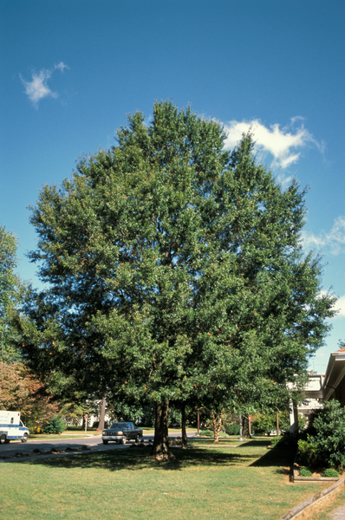
In what ways did the trees grow and change in the story?
Bears through the Seasons – 2B Losing Daylight: Explain
32
Notes:
Soil, water, sunlight

Slide 33
Look at the tree in the summer.
Bears through the Seasons – 2B Losing Daylight: Elaborate
33
Notes:
Go back to the Read Together Pictures of Trees on Page 53.
Look at the tree in the summer.

Slide 34
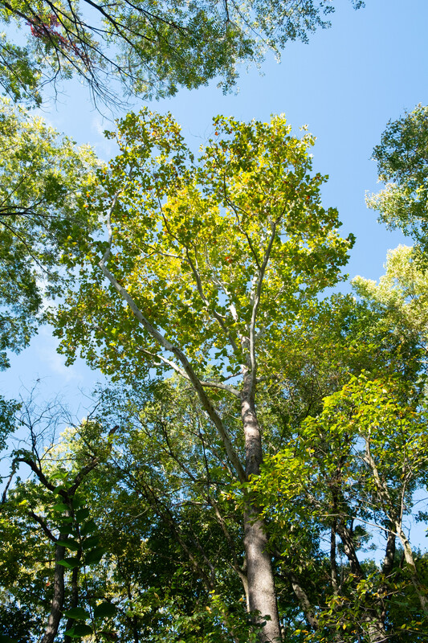
What causes the tree to look that way?
Bears through the Seasons – 2B Losing Daylight: Elaborate
34
Notes:
Getting plenty of sun and water.

Slide 35
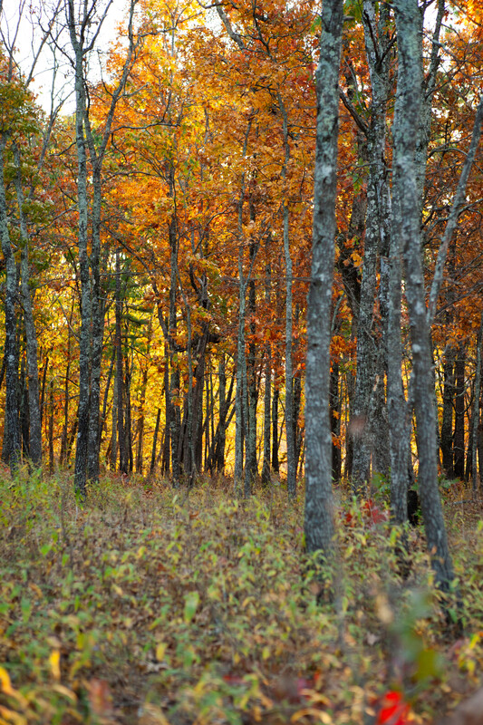
What about fall?
Bears through the Seasons – 2B Losing Daylight: Elaborate
35

Slide 36
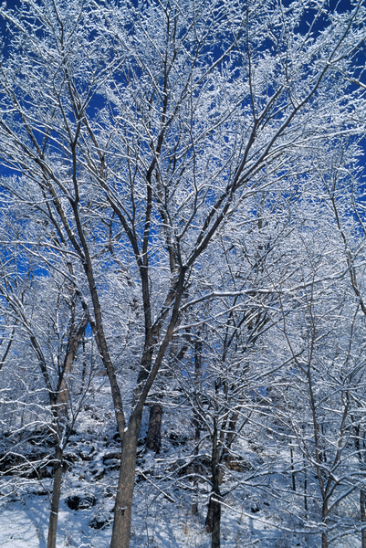
What about winter?
Bears through the Seasons – 2B Losing Daylight: Elaborate
36

Slide 37
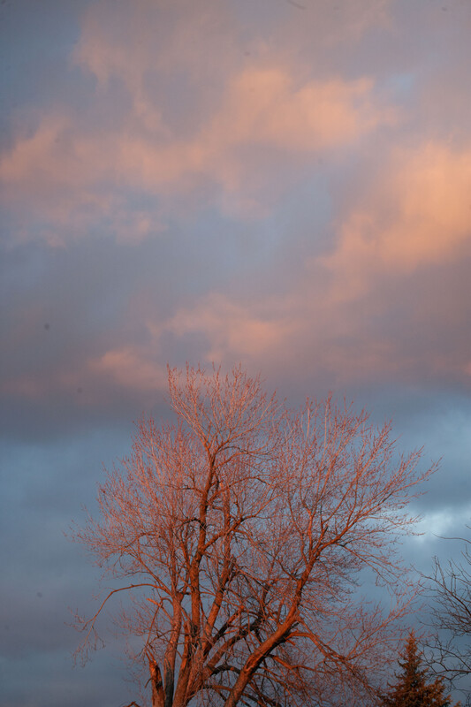
Do we get more light in the fall and winter or less light?
Bears through the Seasons – 2B Losing Daylight: Elaborate
37

Slide 38
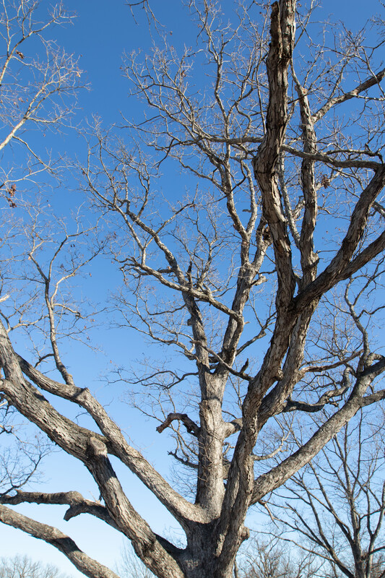
What do you think the effect of having longer or shorter amounts of daylight has on the oak tree?
Bears through the Seasons – 2B Losing Daylight: Elaborate
38

Slide 39
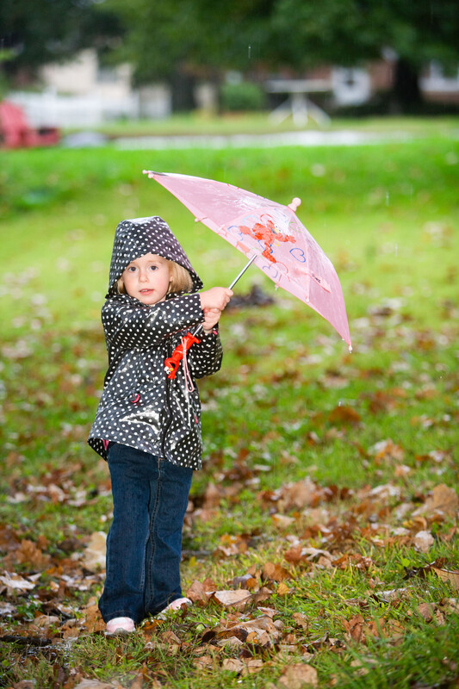
Do we get more water or less water in summer? Fall?
Bears through the Seasons – 2B Losing Daylight: Elaborate
39

Slide 40
Think back to how you sorted your cards earlier. How did you sort your cards?
Bears through the Seasons – 2B Losing Daylight: Engage
40

Slide 41
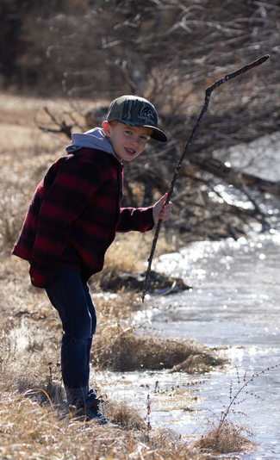
What effect do longer or shorter amounts of daylight have on what kinds of clothing we wear throughout the year?
Bears through the Seasons – 2B Losing Daylight: Elaborate
41

Slide 42
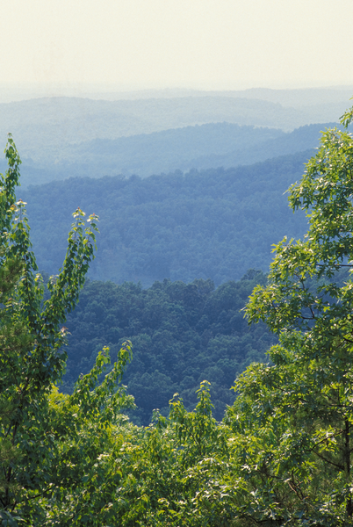
What patterns do you notice about the amount of daylight from year to year?
Bears through the Seasons – 2B Losing Daylight: Elaborate
42
Notes:
It repeats as the seasons do.

Slide 43
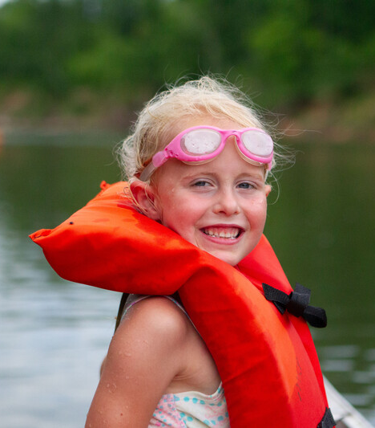
What effect does the amount of sunlight during each season have people? Trees? Bears?
Bears through the Seasons – 2B Losing Daylight: Elaborate
43

Slide 44
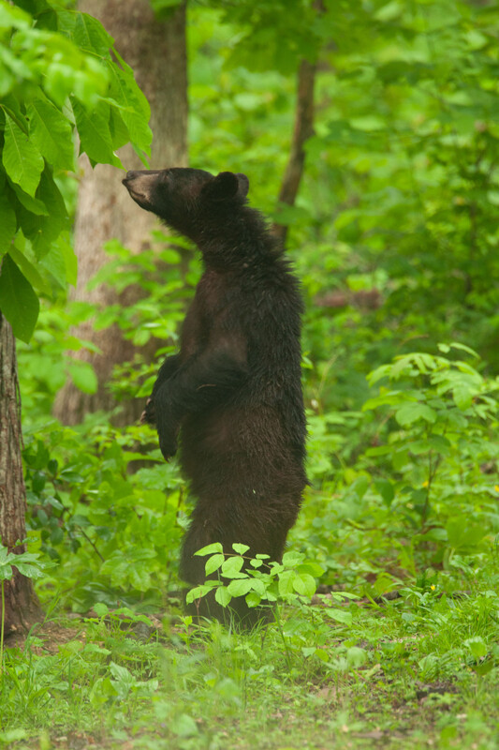
Why do bears eat so many acorns and other plants before the winter?
Bears through the Seasons – 2B Losing Daylight: Elaborate
44

Slide 45
Bears through the Seasons – 2B Losing Daylight: Elaborate
45
Notes:
Add student observations and/or questions to the chart as the lesson proceeds in reference to the phenomenon studied.

Slide 46
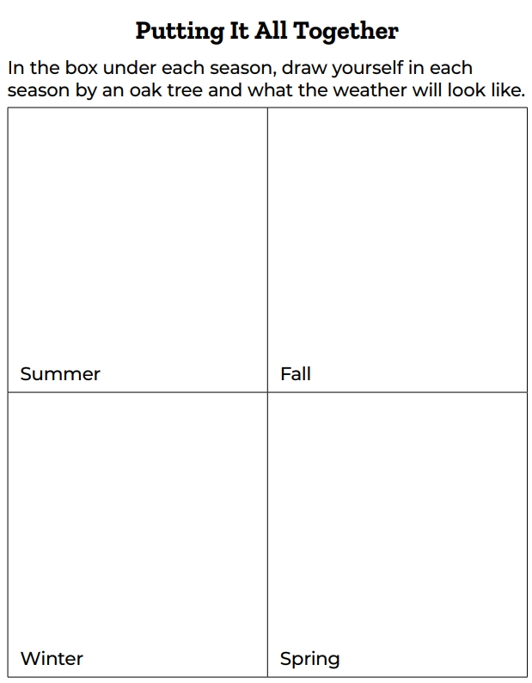
Draw yourself in each season by an oak tree and what the weather will look like.
Bears through the Seasons – 2B Losing Daylight: Evaluate
46
Notes:
Distribute 2B Putting It All Together Chart handout located after this lesson on page 93 of the Teacher Guide. In the box under each season, have students draw themselves and what the weather will look like in each season by an oak tree.

Slide 47

How are other animals in Missouri affected by the amount of daylight?
Listen to the book Sunshine Makes the Seasons by Franklyn Brawley
Link to Read-Aloud: https://youtu.be/5q8XQP0y78Y?si=OY6cE25m8D0gsHLh
Bears through the Seasons – 2B Losing Daylight: Extend
47
Notes:
Tell students that the other animals in Missouri are affected by the amount of daylight in each season. Have them read Sunshine Makes the Seasons by Franklyn Brawley or Animal Seasons by Brian Wildsmith about how frogs and insects transition from the fall to winter.

Slide 48
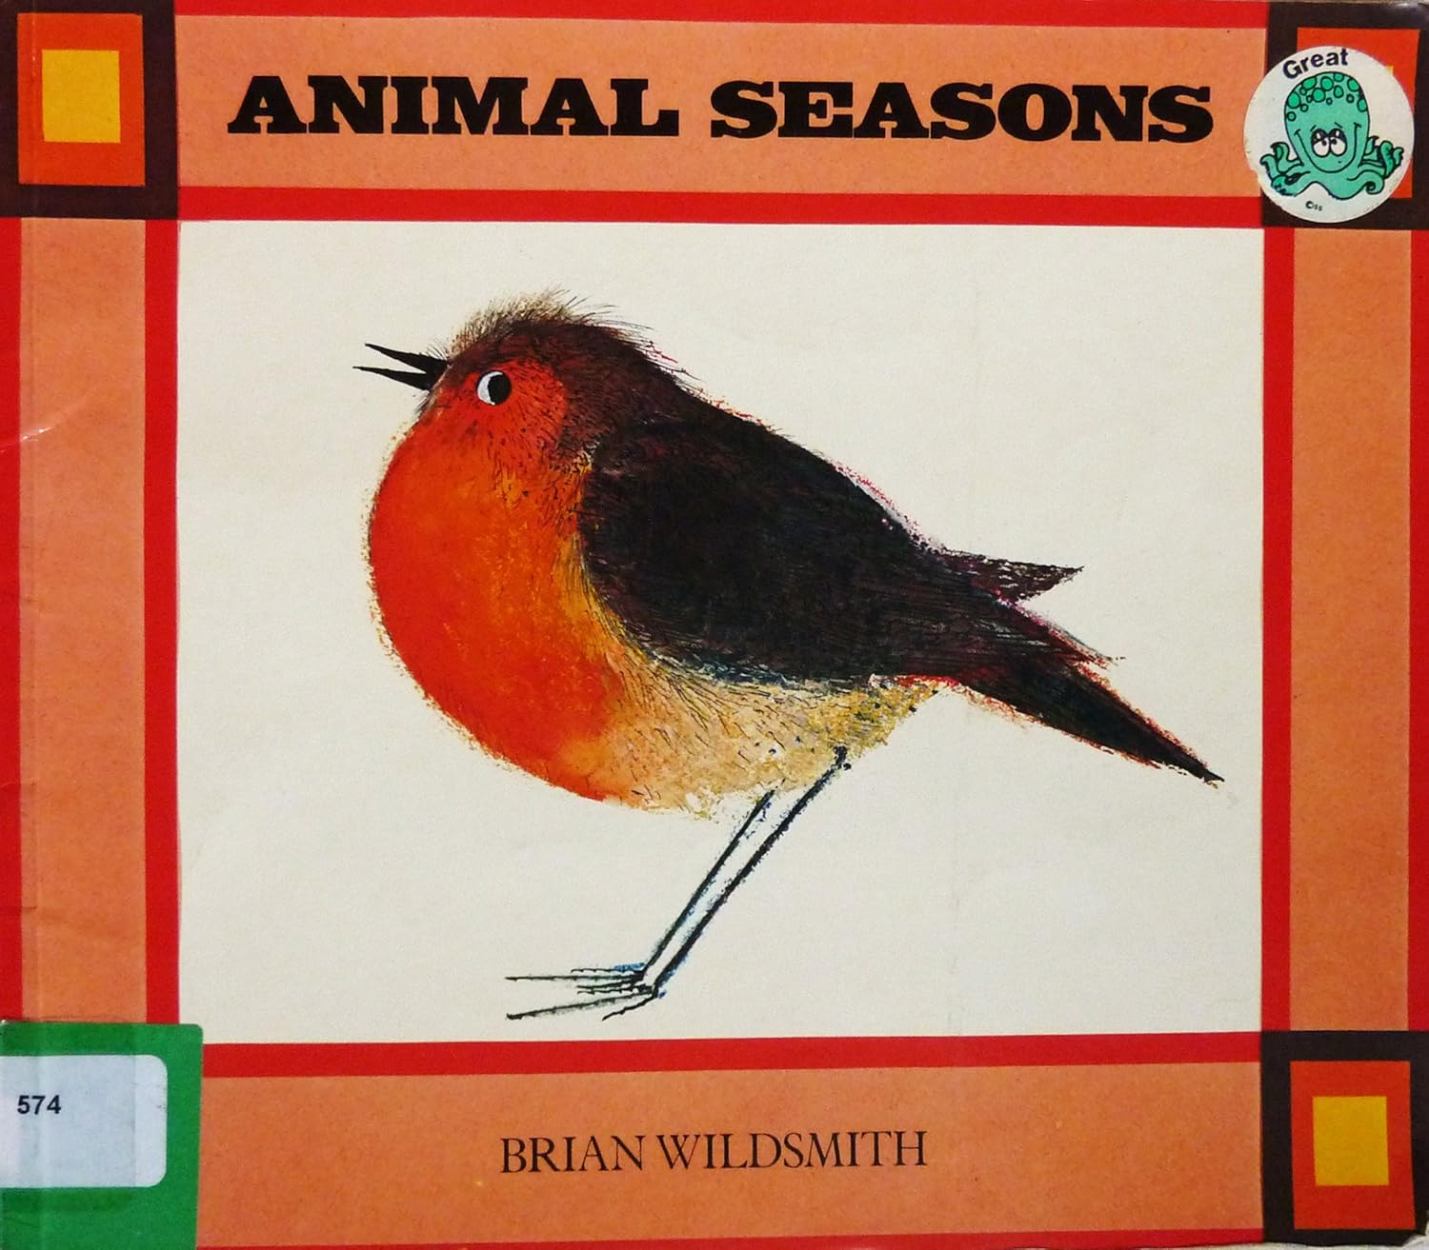
Listen to the book Animal Seasons by Brian Wildsmith
Link to Read-Aloud: https://youtu.be/HawqwDaWW8A?si=0sPwY7futtHBOIQ1
Bears through the Seasons – 2B Losing Daylight: Extend
48
Notes:
Tell students that the other animals in Missouri are affected by the amount of daylight in each season. Have them read Sunshine Makes the Seasons by Franklyn Brawley or Animal Seasons by Brian Wildsmith about how frogs and insects transition from the fall to winter.

Slide 49
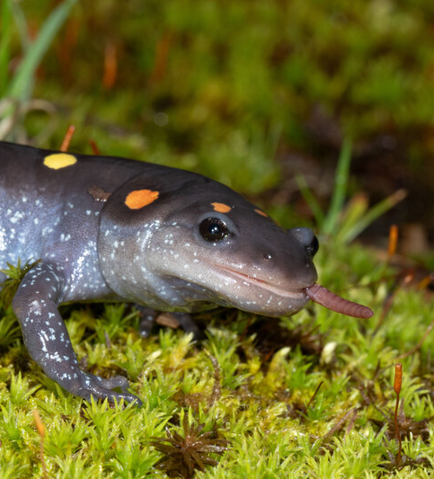
How does the time of year and the amount of sunlight affect animals?
Bears through the Seasons – 2B Losing Daylight: Extend
49

Slide 50

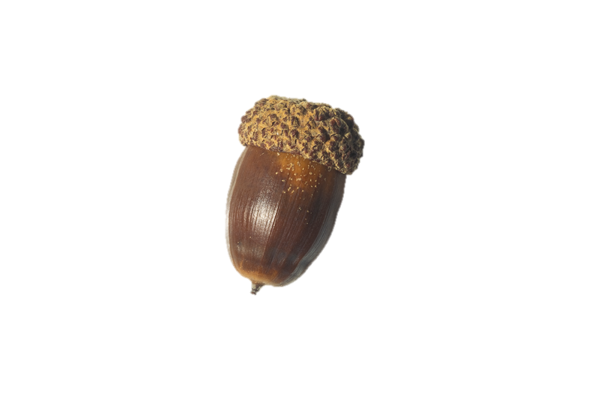
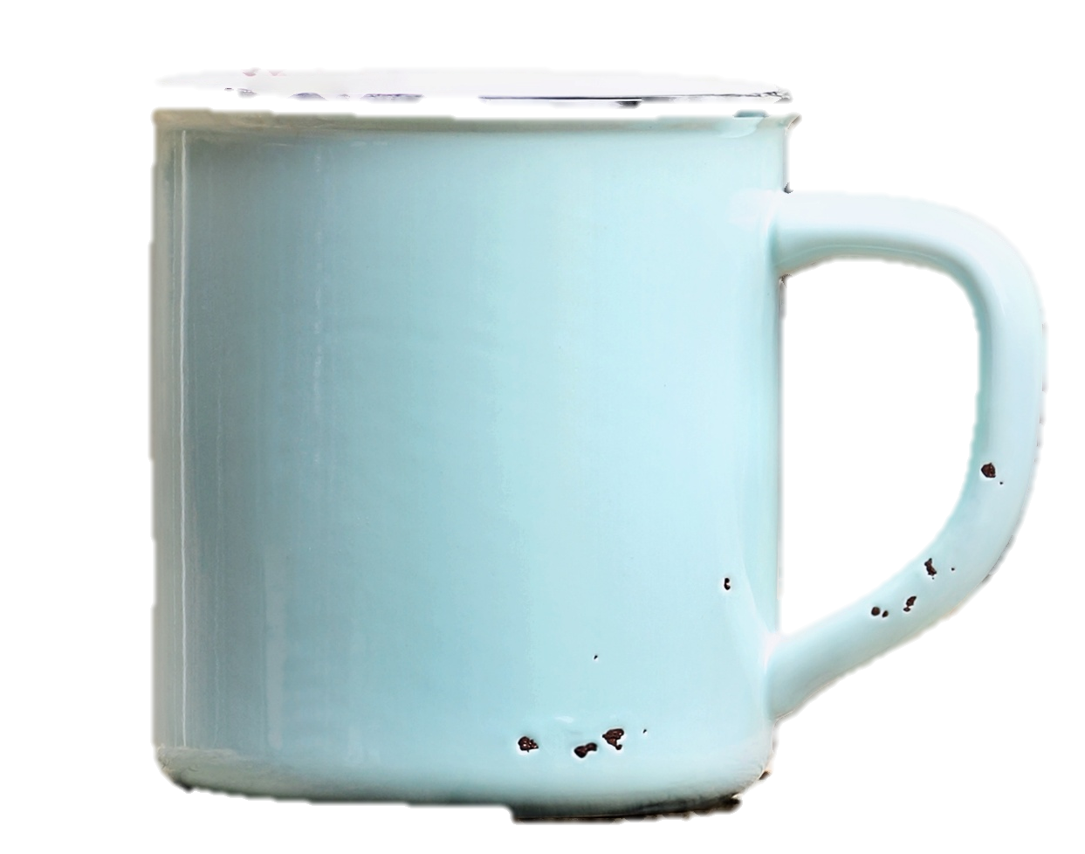
Optional: Cross-Curricular Extension
Directions:
Imagine you are a group of bears nearing winter
When it is signaled, find acorns across the room
In the second round, remove leaves from trees to signify winter
Bears through the Seasons – 2B Losing Daylight: Cross-Curricular Extension
50
Notes:
Group play acting:
Have students imagine that they are a group of bears nearing winter. Arrange several areas to designate trees in the classroom.
This can be done by drawing and taping large paper trees with separate paper leaves attached or taped to a spot on the wall.
Gather several cups full of acorns (or round items to simulate acorns if none are available) and strategically place the cups of acorns near the trees with removable leaves located all around the room. Some trees may not have a cup full of acorns placed under it, or perhaps have an empty cup with no acorns.
Tell students that when the teacher signals go, they must act as bears nearing winter and seek acorns across the room.
Upon the “bears” collecting all acorns, another round of play can be done, but indicate to students that winter is nearing.
For this round, have students remove the leaves from paper trees to signify winter and explain to children that in this round, there is less sunlight, cooler days, and trees are losing leaves.
This time, place very few ‘scattered acorns” around trees, making sure to leave many trees without acorns.
Start another round of play at the teacher’s signal and have the “bears” look for food.

Slide 51
Which round of play was food scarce?
Bears through the Seasons – 2B Losing Daylight: Cross-Curricular Extension
51
Notes:
After play, discuss with students which round of play contained more acorns.

Slide 52
What changes in sunlight affected acorn production?
Bears through the Seasons – 2B Losing Daylight: Cross-Curricular Extension
52

Slide 53
What else made finding acorns difficult?
Bears through the Seasons – 2B Losing Daylight: Cross-Curricular Extension
53

