Slide 1
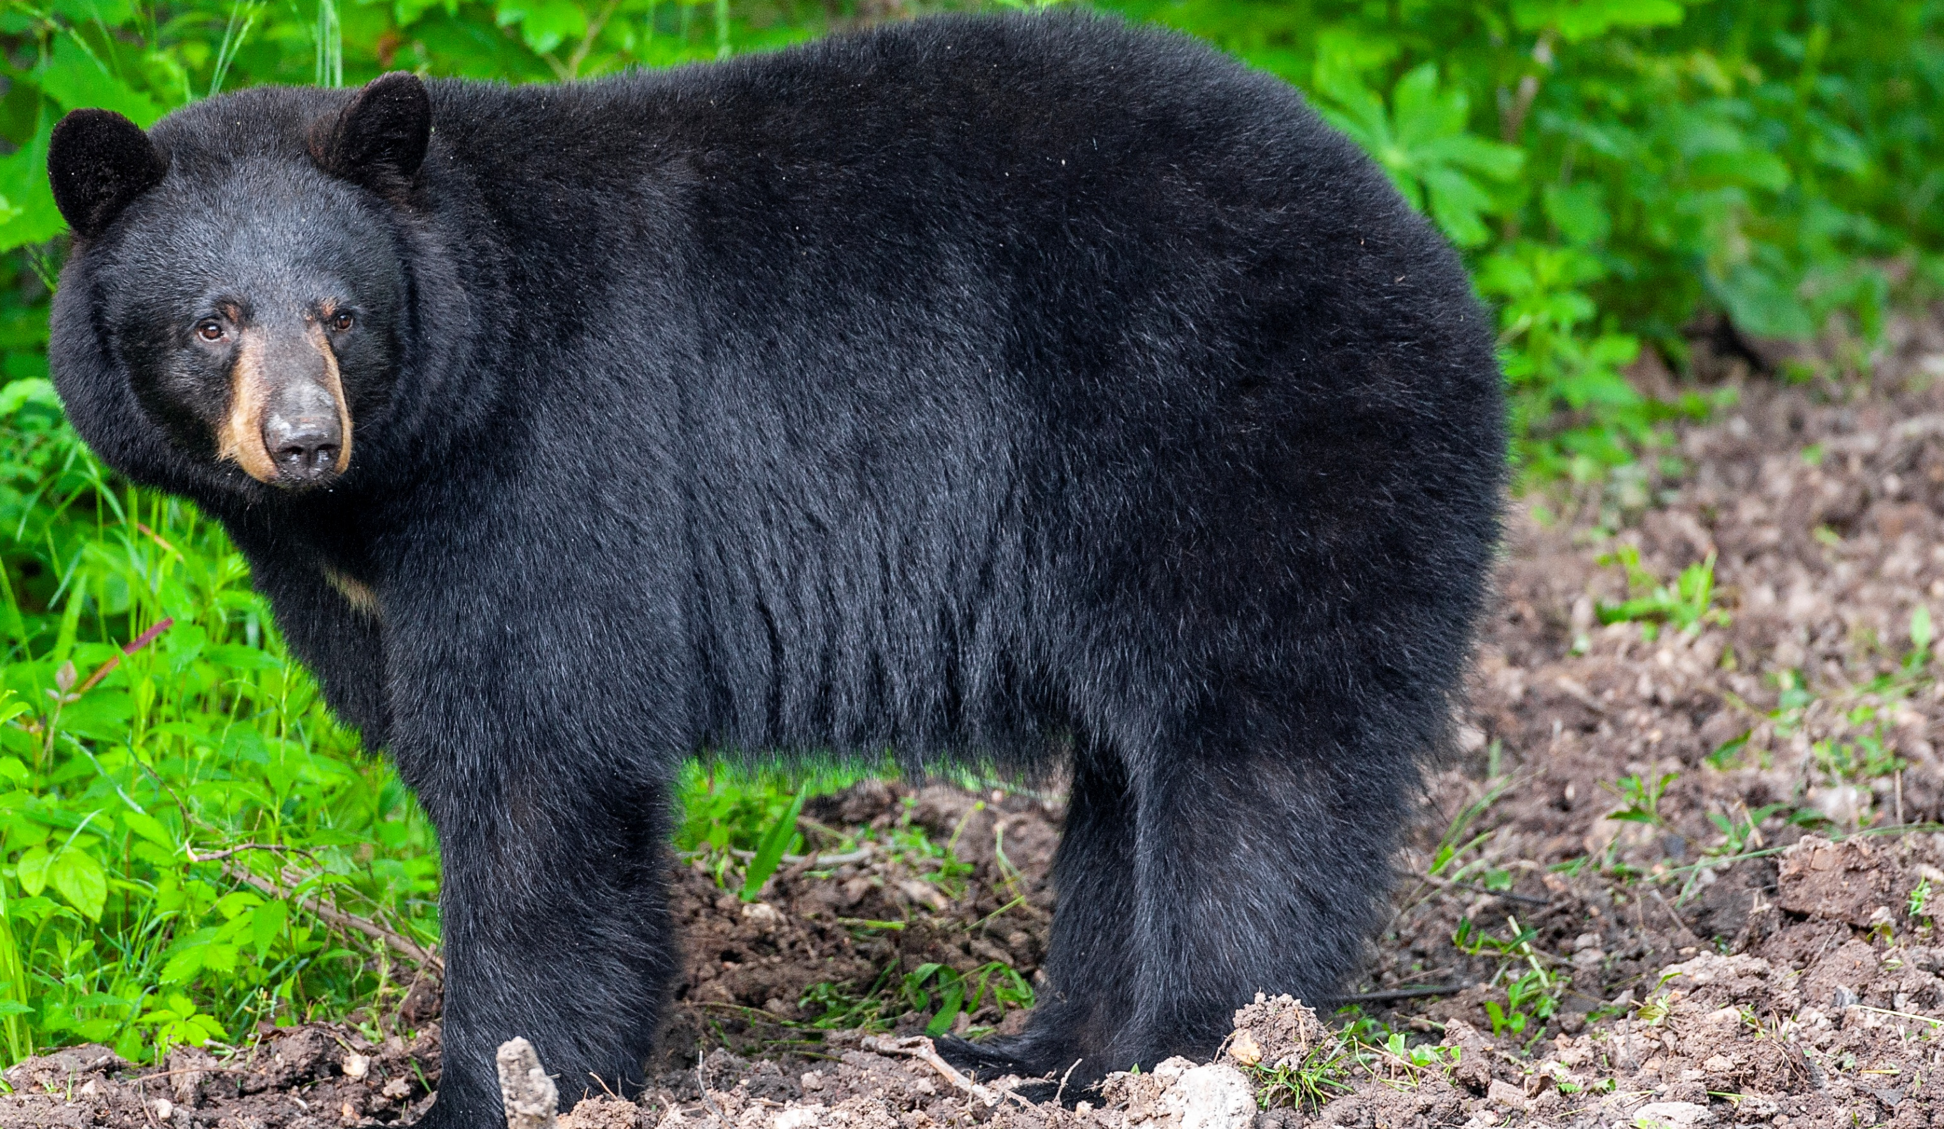
BEARS
Through the Seasons
Lesson 2A: Bear Observations

Slide 2
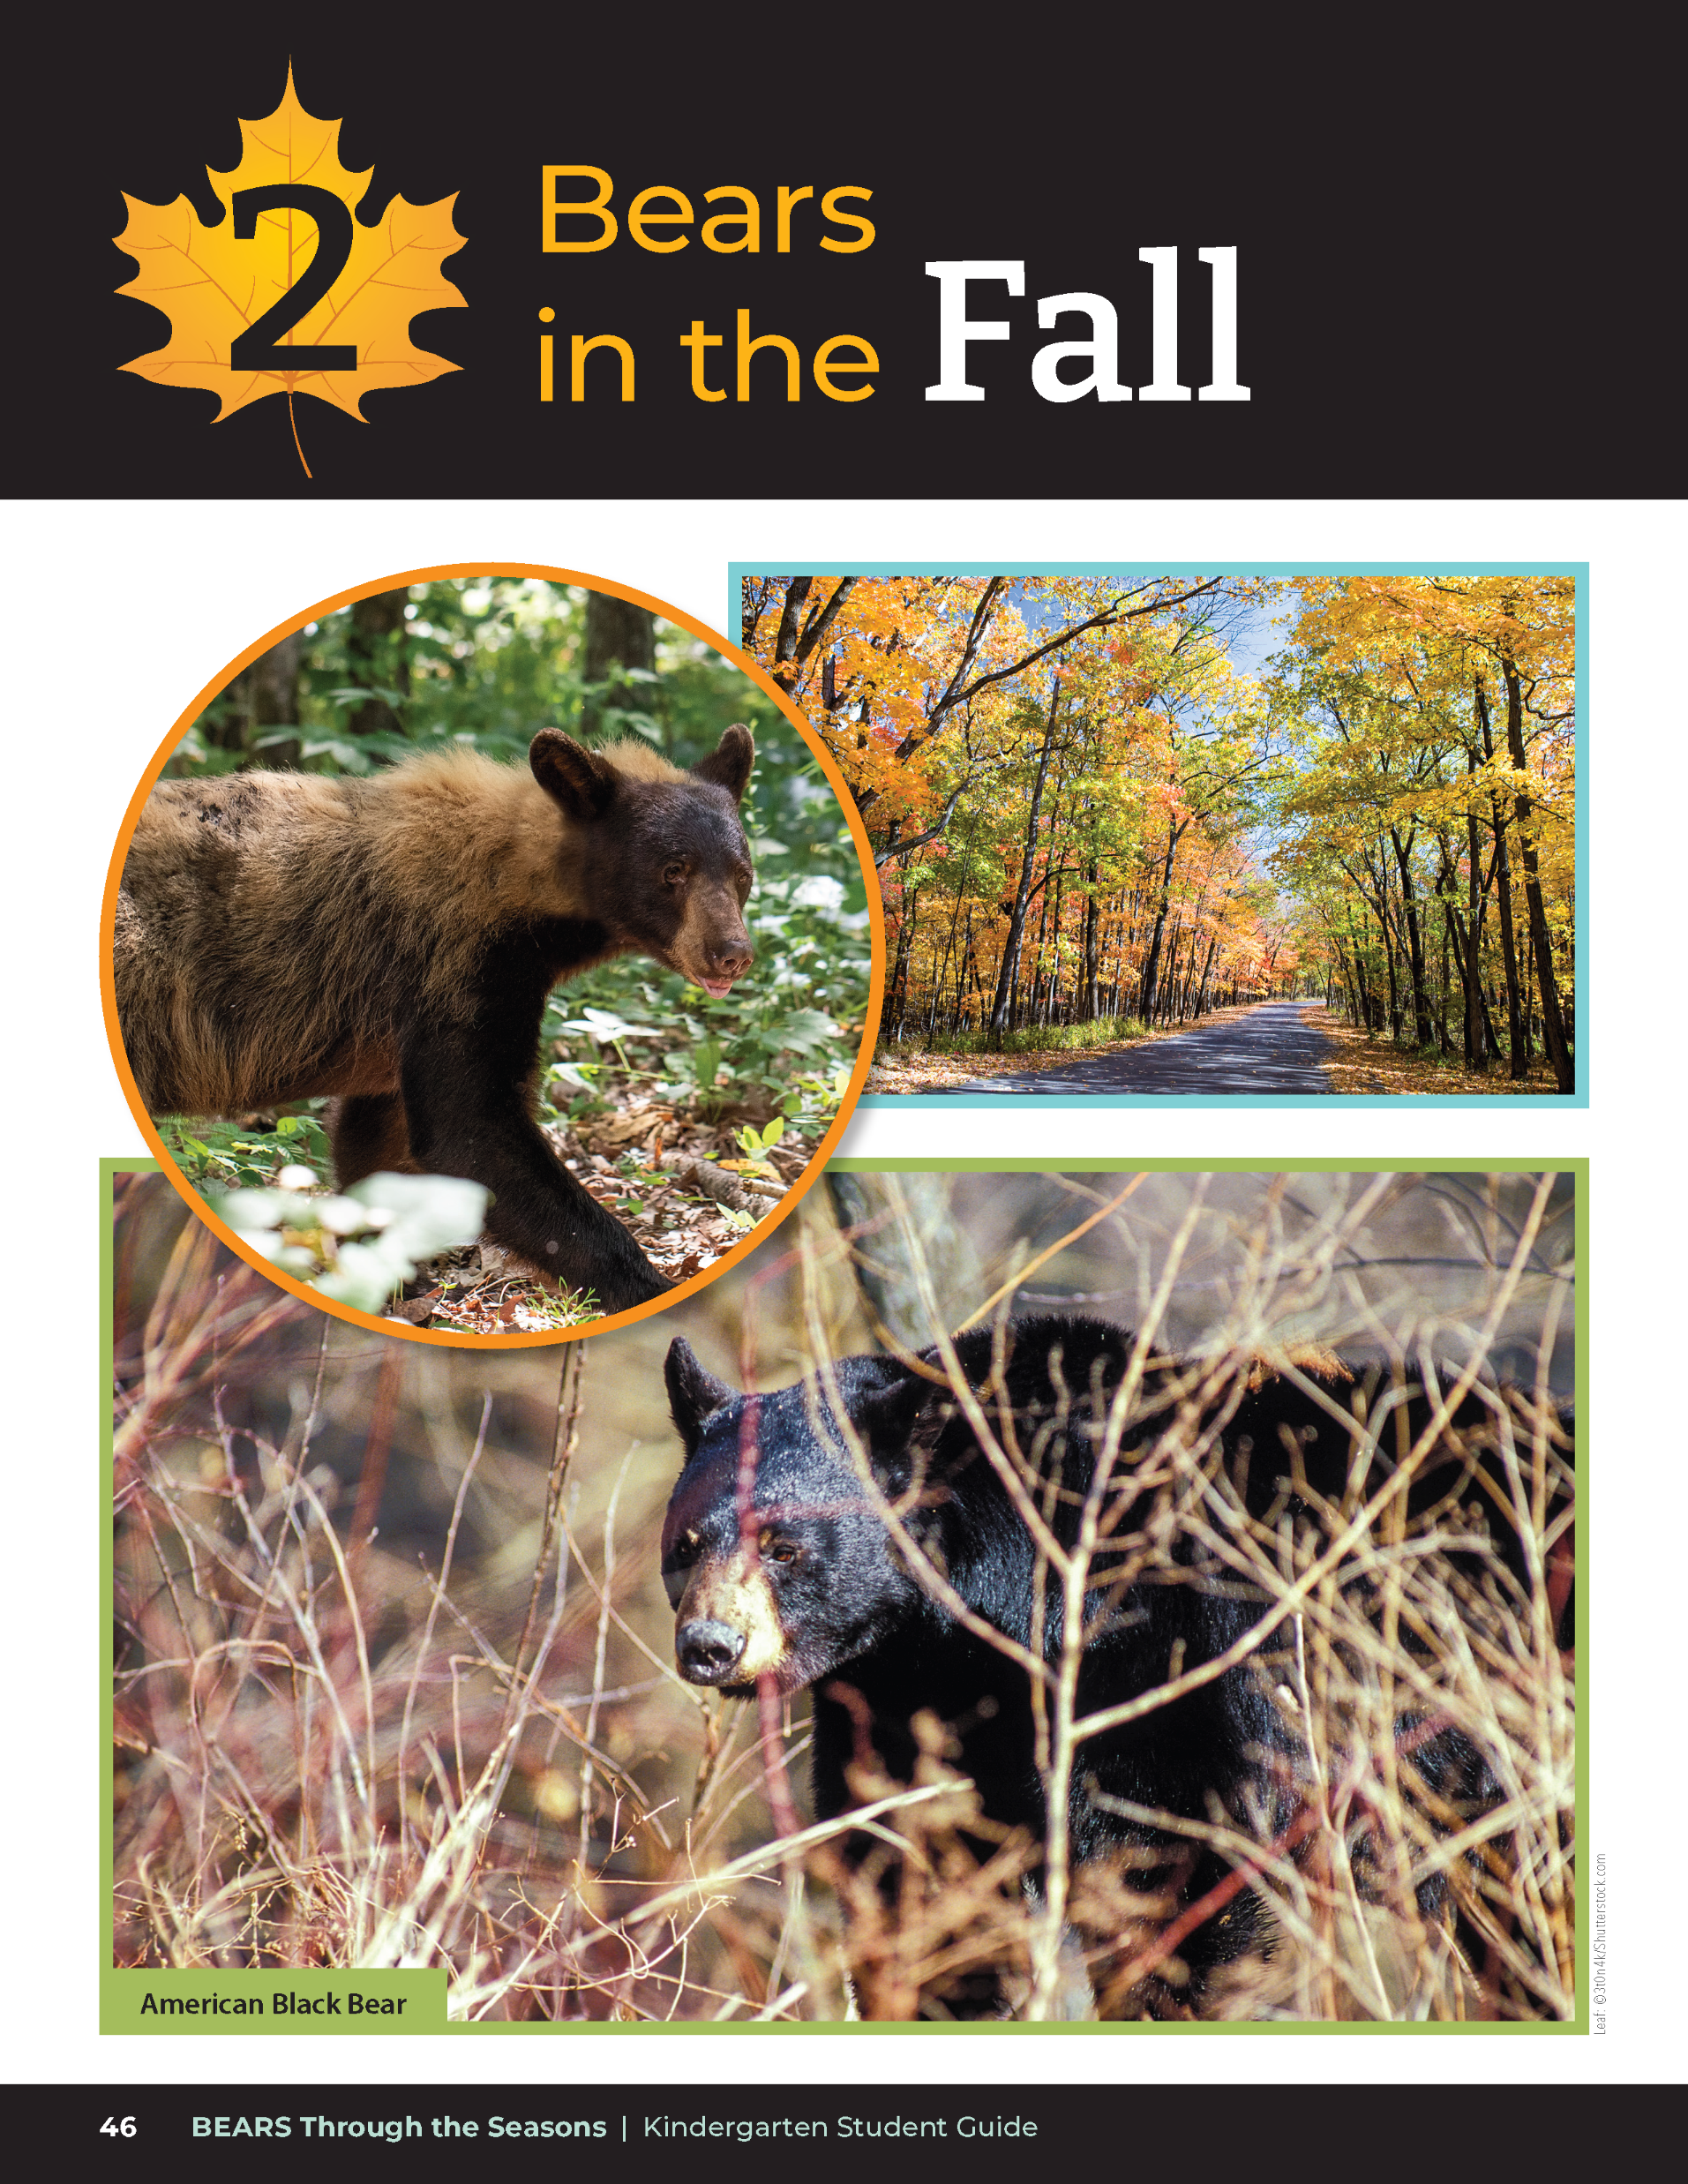
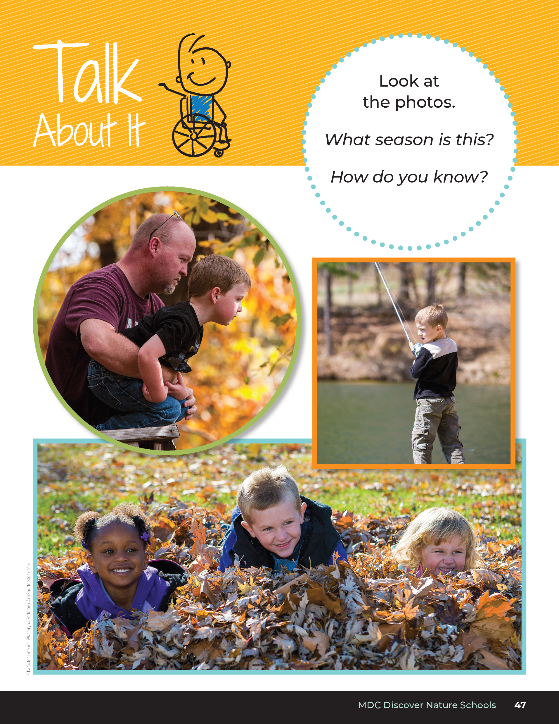
What season is this?
How do you know?
Bears through the Seasons – 2A Bear Observations: Engage
2
Notes:
Read aloud from the student guide, Exploring the Phenomenon Talk About It on Page 47. Discuss the different photos and how it compares to the pictures from Unit 1.

Slide 3
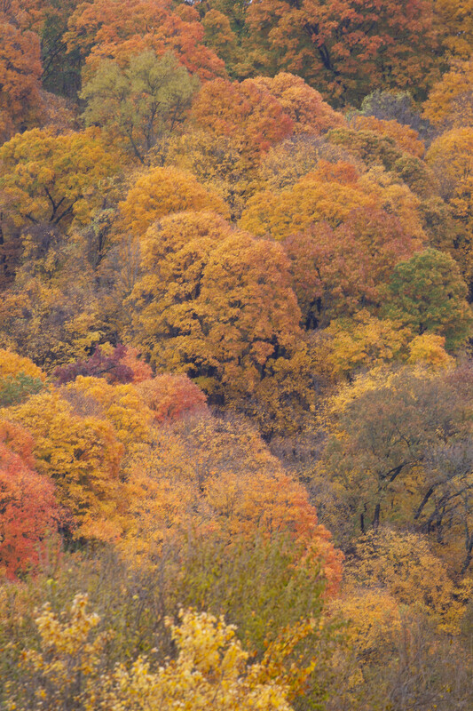
Guiding Question:
What do plants and animals do in the fall? Why?
Bears through the Seasons – 2A Bear Observations: Engage
3

Slide 4
Bears through the Seasons – 2A Bear Observations: Engage
4
Notes:
Prepare and display your Noticings and Wonderings Chart for this lesson. Add student observations and/or questions to the chart as the lesson proceeds in reference to the phenomenon studied.

Slide 5
Winter is Coming
Sing to the tune of Three Blind Mice.
Winter is coming
Winter is coming
It is getting cold
It is getting cold
Acorns will start falling
Bears will eat them up
It’s getting cold
It’s getting cold
Bears through the Seasons – 2A Bear Observations: Engage
5
Notes:
Read aloud from the student guide, Read Together Winter is Coming on Page 49.

Slide 6
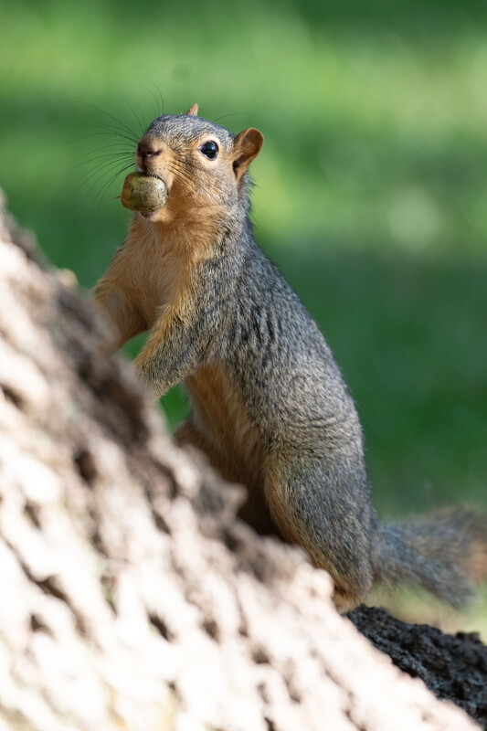
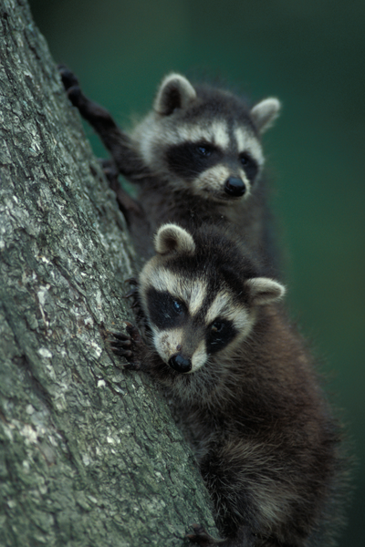
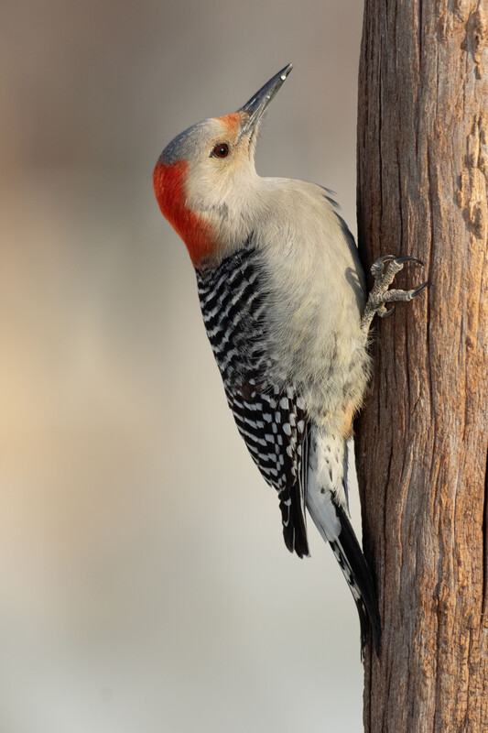
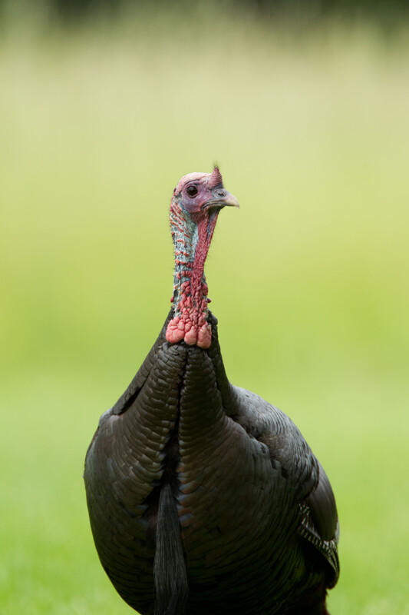
Bears through the Seasons – 2A Bear Observations: Engage
6
Notes:
Read aloud the fun fact from the student guide on Page 49.
Animals that also eat acorns include gray squirrel, raccoon, turkey, blue jays, woodpeckers and mice.
Animal: Fox squirrel, raccoon, red-bellied woodpecker, wild turkey.

Slide 7
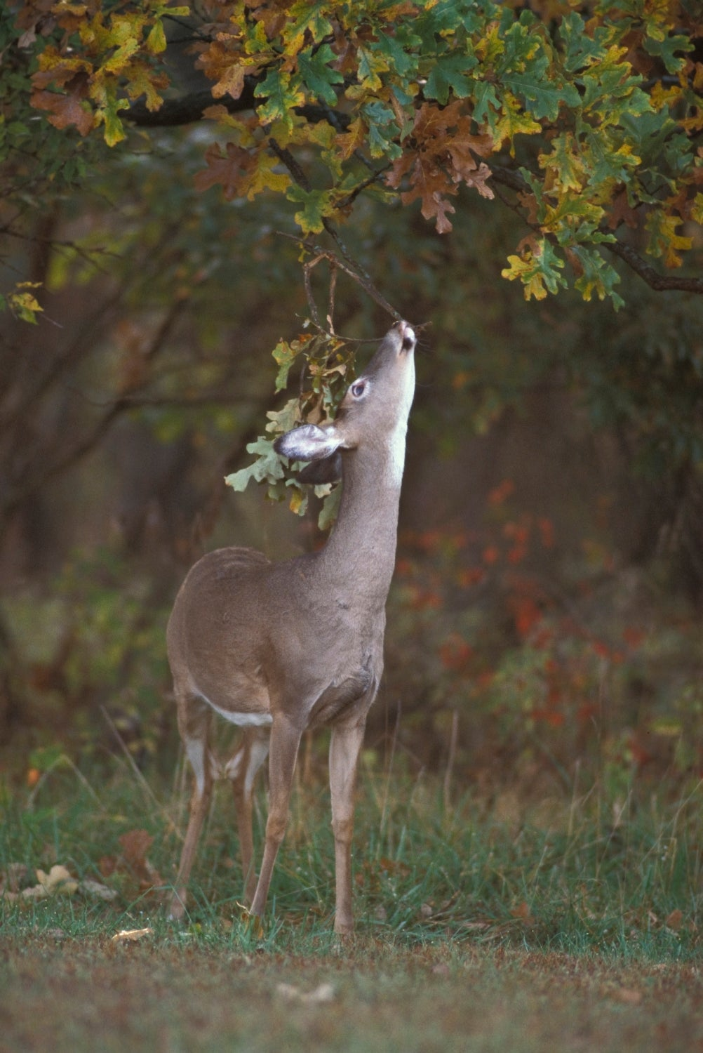
Bears through the Seasons – 2A Bear Observations: Engage
7
Notes:
Show the Oak Tree Picture with falling leaves and acorns.
Animal: White-tailed deer.

Slide 8
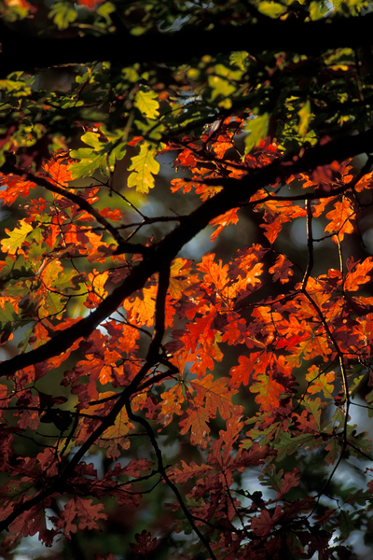
Why do you think we are observing an oak tree?
Bears through the Seasons – 2A Bear Observations: Engage
8

Slide 9
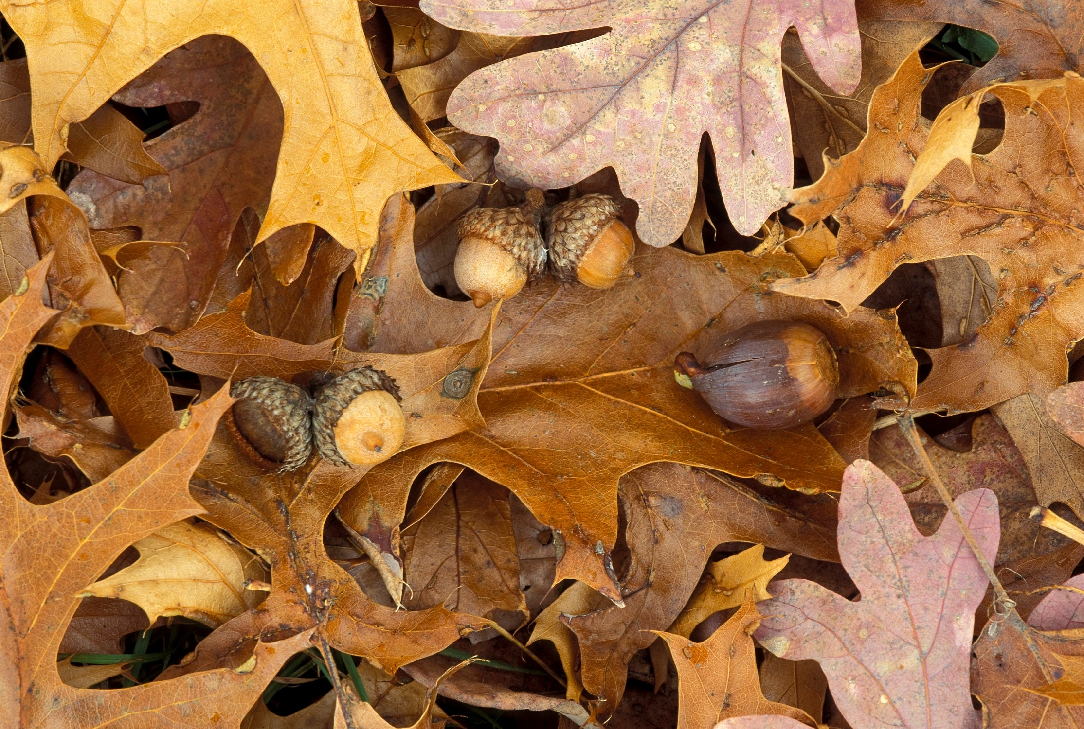
Bears through the Seasons – 2A Bear Observations: Engage
9
Notes:
Various oak leaves and acorns.

Slide 10
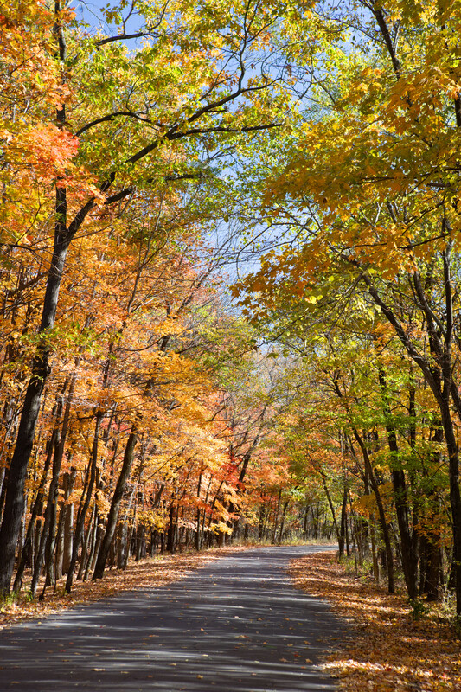
How do you know winter is coming?
Bears through the Seasons – 2A Bear Observations: Engage
10
Notes:
Answers: Getting colder, less sun, cloudy, shorter days, rainy, less food available, leaves change colors, wear warmer clothing, etc.)

Slide 11
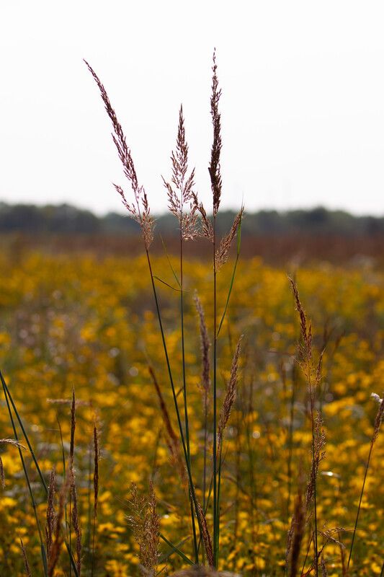
We are going to make observations about our weather like we did in the summer to see if we notice any patterns over a few weeks.
Bears through the Seasons – 2A Bear Observations: Engage
11
Notes:
Explain that weather includes the daily temperature and how much sun or rain a place may get.

Slide 12
A pattern is something that repeats.
Bears through the Seasons – 2A Bear Observations: Engage
12

Slide 13
Bears through the Seasons – 2A Bear Observations: Engage
13
Notes:
Prepare and display your Noticings and Wonderings Chart for this lesson. Add student observations and/or questions to the chart as the lesson proceeds in reference to the phenomenon studied.

Slide 14
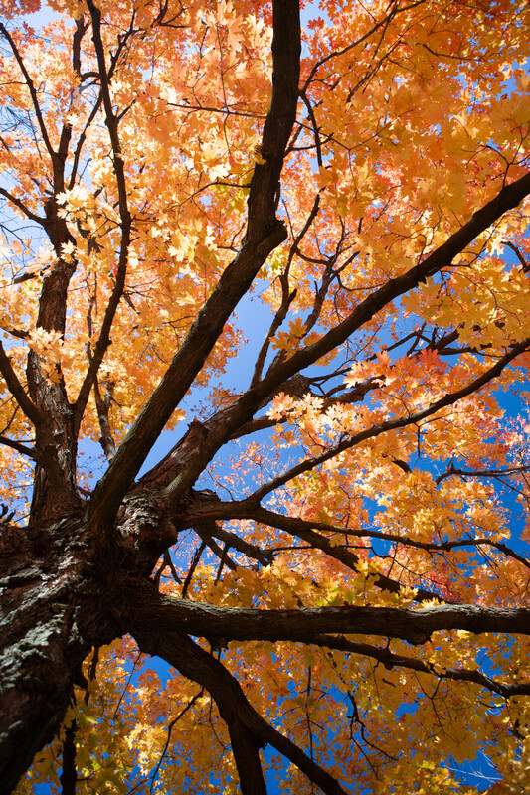
We are going to watch for patterns in our weather.
Bears through the Seasons – 2A Bear Observations: Explore
14
Notes:
Let’s look back at our weather observations from Lesson 1B What is Weather?, page 15 in Student Guide.

Slide 15
What can be measured to show patterns in our weather?
Bears through the Seasons – 2A Bear Observations: Explore
15
Notes:
Student answers: temperature, cloud cover, precipitation, etc.

Slide 16
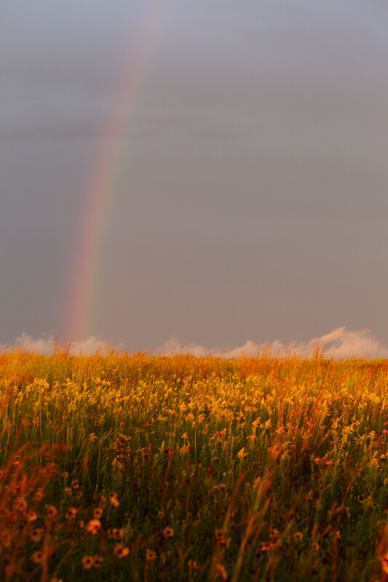
Does anyone know what we need to measure the temperature outside?
Bears through the Seasons – 2A Bear Observations: Explore
16
Notes:
We made simple weather observations earlier this year. Today we are going to continue our practice in taking and recording temperature. Over the next few weeks, we are going to measure the temperature each day. We are also going to record how sunny or cloudy it is outside.
Does anyone know what we need to measure the temperature outside? (Thermometer)
Last time we measured the temperature, we used digital thermometers. Today we are going to use a different type of thermometer.

Slide 17
Does anyone know what we need to measure the temperature outside?
Thermometer!
Bears through the Seasons – 2A Bear Observations: Explore
17
Notes:
We made simple weather observations earlier this year. Today we are going to continue our practice in taking and recording temperature. Over the next few weeks, we are going to measure the temperature each day. We are also going to record how sunny or cloudy it is outside.
Does anyone know what we need to measure the temperature outside? (Thermometer)
Last time we measured the temperature, we used digital thermometers. Today we are going to use a different type of thermometer.

Slide 18
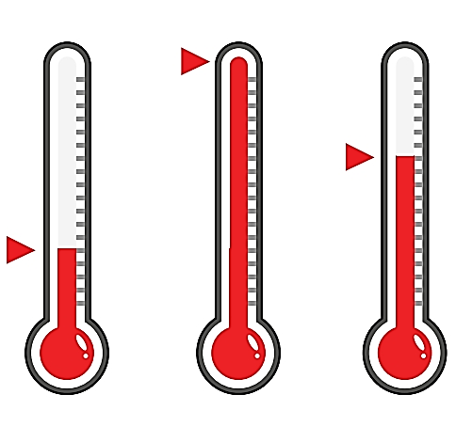
Which thermometer shows the hottest temperature?
Which one shows the coldest temperature?
Bears through the Seasons – 2A Bear Observations: Explore
18
Notes:
Distribute 2A Reading Thermometers Handout located in the Teacher Guide at the end of this lesson or display from the MDC Teacher Portal Kindergarten Unit 2 Lesson 2A link. Review the thermometers together.

Slide 19
Directions:
Pair up!
Give each group a cup of warm water and a cup of ice water.
Take turns putting the thermometer in each cup.
Bears through the Seasons – 2A Bear Observations: Explore
19
Notes:
Put students into pairs. Give each group a cup of warm water and a cup of ice water. Have the students take turns putting the thermometer in the warm water and then ice water.
Have them compare answers with one other group and then have a couple of groups share with the whole class.
State that the warmer things are, the higher the red liquid travels up the thermometer (or the higher the numbers if using digital.)

Slide 20
What happens to the red liquid in the thermometer’s tube when it is in each temperature of water?
Bears through the Seasons – 2A Bear Observations: Explore
20
Notes:
Put students into pairs. Give each group a cup of warm water and a cup of ice water. Have the students take turns putting the thermometer in the warm water and then ice water.
Have them compare answers with one other group and then have a couple of groups share with the whole class.
State that the warmer things are, the higher the red liquid travels up the thermometer (or the higher the numbers if using digital.)

Slide 21
10
15
X
Directions:
Collect weather data each day for 3 weeks.
Put a thermometer outside the window.
Look at the sky.
Record what you see.
MINUTES
DAYS
Bears through the Seasons – 2A Bear Observations: Explore
21
Notes:
(Daily for three weeks) Have students collect data each day as they did in summer. Students can make observations by putting a thermometer outside the window and looking at the sky. For the first week, take them outside if possible.
As a class, go outside with the student guides to record the temperature and collect weather data. Record findings in the student guide Science Notebook Recording Weather on Page 50.
Do this Science Notebook activity everyday this week and then continue to record in 2A Daily Temperature Chart.
Record the day’s temperature and decide as a class if it is cloudy, partly cloudy, rainy, or sunny.
Record observations onto 2A Daily Temperature Chart. Use the 2A Bear Cutouts provided after this lesson. Make 30 cutouts with a copy machine.
Use chart paper to make a bar graph of the day’s temperature. Each day have a student tape a bear cutout on the chart to indicate that day’s temperature. Tell students that the higher the bear is one the chart, the hotter it is outside.
Use a different piece of chart paper to make a graph of the cloud cover. Use the example template 2A Daily Weather Chart to record the type of weather each day. Each day put a bear under the correct column (suuny, partly cloudy, cloudy, rainy/snowy).

Slide 22
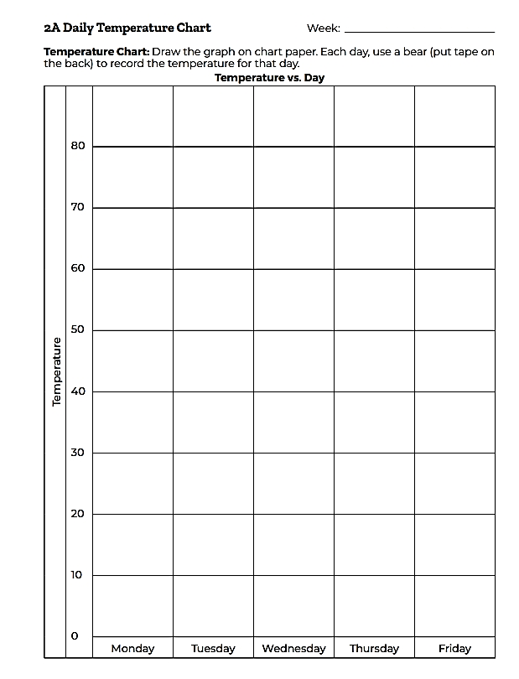
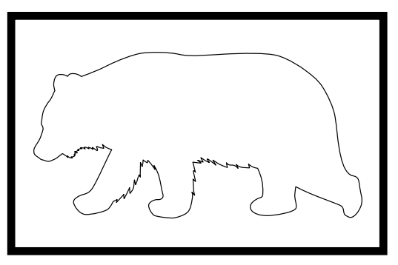
Bears through the Seasons – 2A Bear Observations: Explore
22
Notes:
(Daily for three weeks) Have students collect data each day as they did in summer. Students can make observations by outing a thermometer outside the window and looking at the sky. For the first week, take them outside if possible.
As a class, go outside with the student guides to record the temperature and collect weather data. Record findings in the student guide Science Notebook Recording Weather on Page 50.
Do this Science Notebook activity everyday this week and then continue to record in 2A Daily Temperature Chart.
Record the day’s temperature and decide as a class if it is cloudy, partly cloudy, rainy, or sunny.
Record observations onto 2A Daily Temperature Chart. Use the 2A Bear Cutouts provided after this lesson. Make 30 cutouts with a copy machine.
Use chart paper to make a bar graph of the day’s temperature. Each day have a student tape a bear cutout on the chart to indicate that day’s temperature. Tell students that the higher the bear is one the chart, the hotter it is outside.
Use a different piece of chart paper to make a graph of the cloud cover. Use the example template 2A Daily Weather Chart to record the type of weather each day. Each day put a bear under the correct column (suuny, partly cloudy, cloudy, rainy/snowy).

Slide 23
What patterns do you notice over the course of the last few weeks?
Bears through the Seasons – 2A Bear Observations: Explain
23
Notes:
At the end of the three weeks:
Show students how to read the 2A Daily Temperature Chart (the higher up the bear, the warmer it is).
What patterns do you notice over the course of the last few weeks? (Getting/staying warmer/cooler)

Slide 24
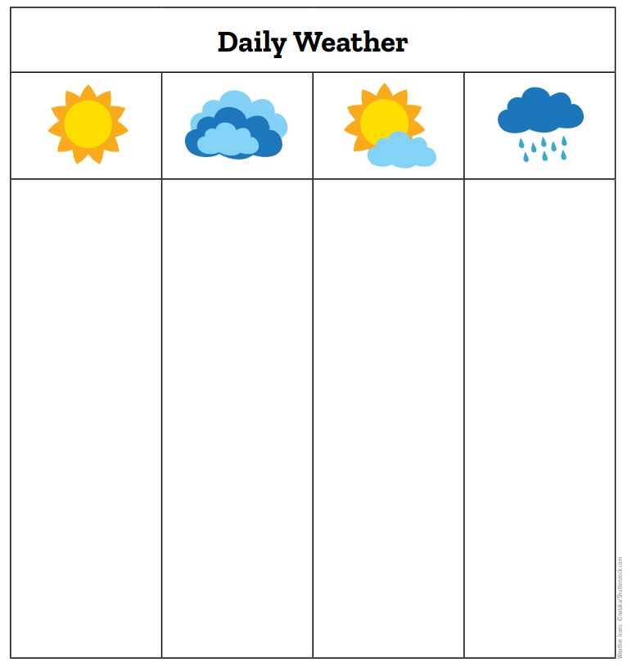
What patterns do you notice about the cloud cover over the last few weeks?
Bears through the Seasons – 2A Bear Observations: Explain
24
Notes:
Show students how to read the 2A Daily Weather Chart. (The more bears under a column, the more times it was sunny/cloudy/rainy/partly cloudy).
What patterns do you notice about the cloud cover over the last few weeks? (Mostly cloudy/sunny/partly sunny/rainy).

Slide 25
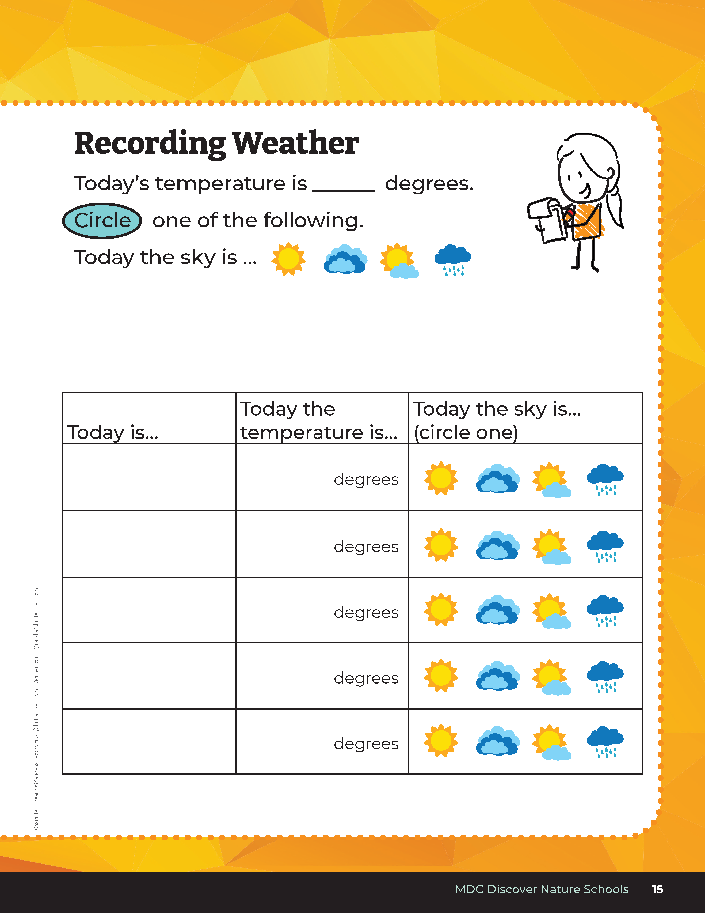
How do our observations in our student guides compare to summer?
Do we have more sunny days? Cloudier days? Rainer days?
What do you remember about the temperature in the summer?
Bears through the Seasons – 2A Bear Observations: Explain
25
Notes:
Let’s take a look back at our data sheets in the summertime in our student guides under Lesson 1B on Page 15.

Slide 26
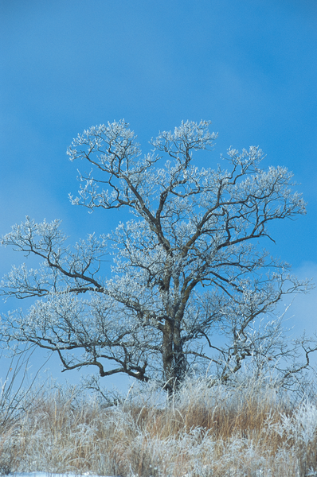
Using your observations, how do you think the weather will change over the next few weeks?
Bears through the Seasons – 2A Bear Observations: Explain
26
Notes:
Answers: It will get colder/warmer, stay the same, or get cloudier/sunnier

Slide 27
Bears through the Seasons – 2A Bear Observations: Explain
27
Notes:
Show the Oak Tree Pictures again.

Slide 28
Bears through the Seasons – 2A Bear Observations: Explain
28

Slide 29
What patterns in weather cause the white oak tree to drop its leaves and acorns?
Bears through the Seasons – 2A Bear Observations: Explain
29
Notes:
Answers: Getting colder, maybe cloudier/rainier, less sunlight

Slide 30
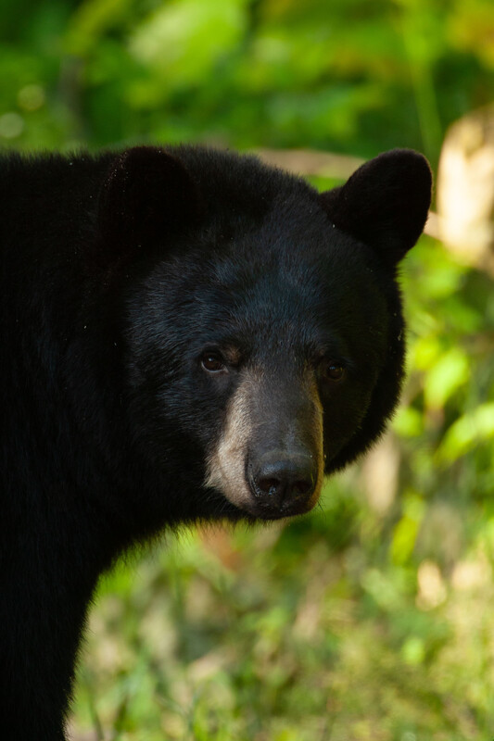
What effect would this have on bears who love to eat acorns?
Bears through the Seasons – 2A Bear Observations: Explain
30
Notes:
Answer: Since the tree is dropping the rest of its acorns and leaves, bears try to eat as much as they can before they are all gone

Slide 31
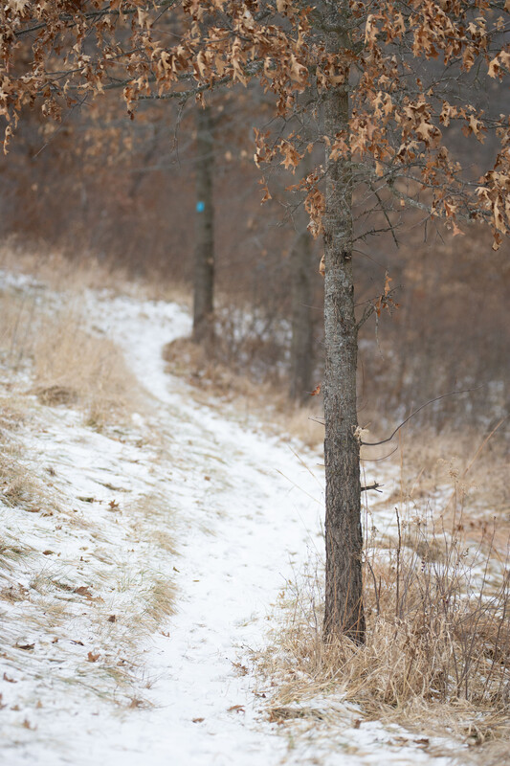
Bears notice a lack of food and that tells them that it is time to prepare for winter.
What else do bears eat?
Bears through the Seasons – 2A Bear Observations: Explain
31
Notes:
One of a bear’s favorite foods in acorns that grow on oak trees. Oak trees respond to patterns in the weather. Explain that bears notice a lack of food and that tells them that it is time to prepare for winter. Explain that oak trees start to lose their leaves and their acorns as the weather gets colder and there is less sunlight. Bears respond by searching for all the acorns that they can find. This helps them put on fat to prepare for winter. Acorns provide a lot of fat for bears which is why this is their favorite meal this season.

Slide 32
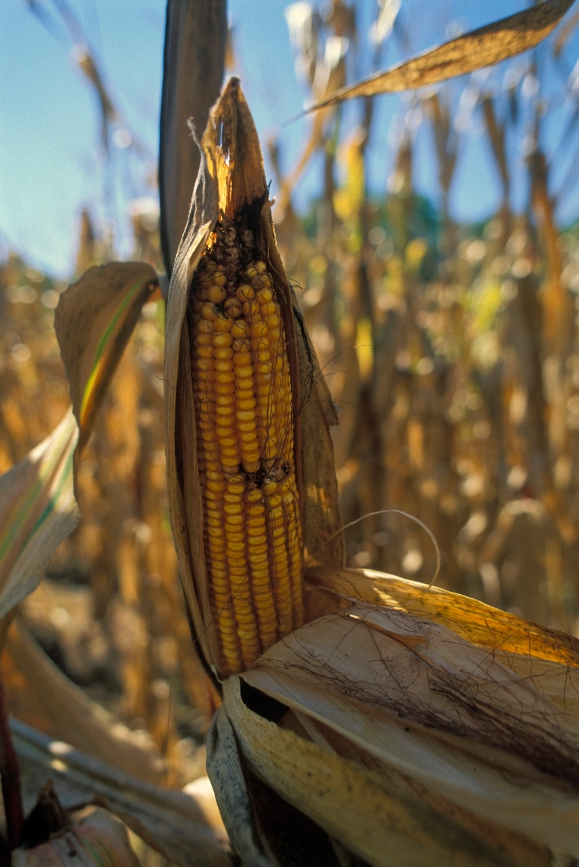
Bears through the Seasons – 2A Bear Observations: Elaborate
32
Notes:
Reference Examples of Fall Bear Foods. Corn, a food source bears eat in fall

Slide 33
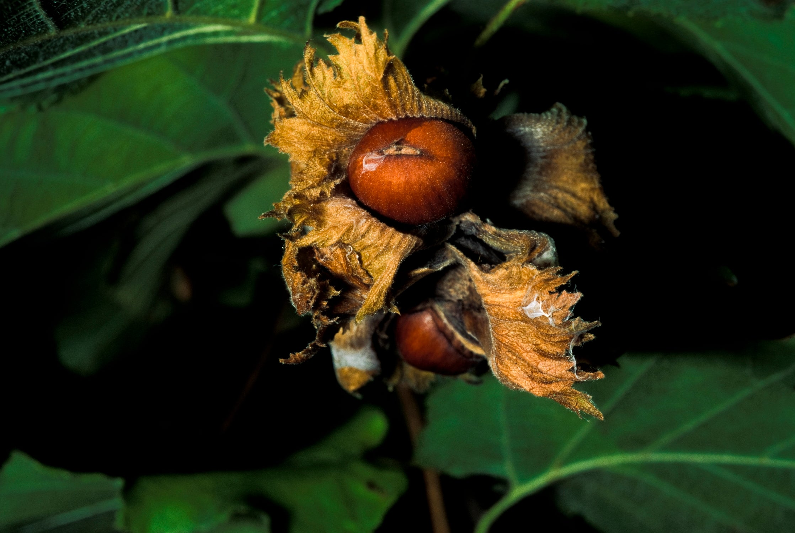
Bears through the Seasons – 2A Bear Observations: Elaborate
33
Notes:
Hazelnuts, a food source bears eat in fall

Slide 34
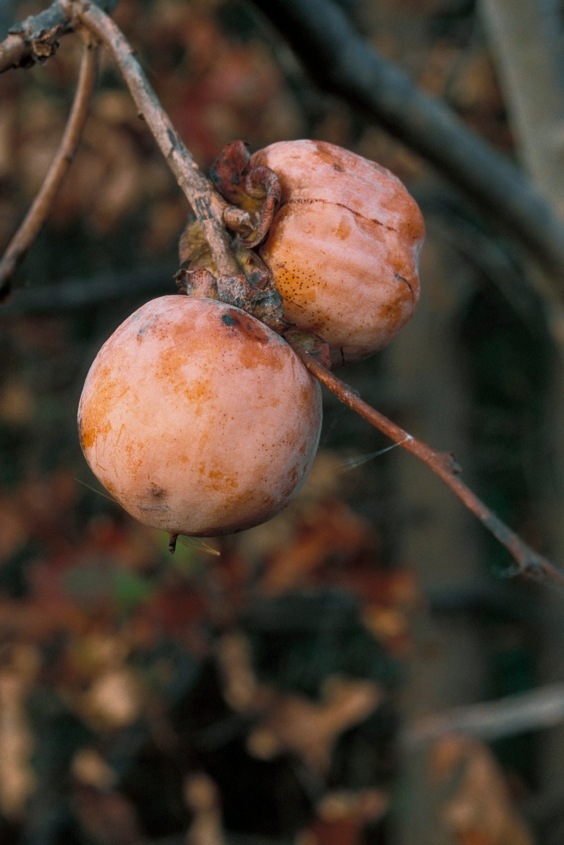
Bears through the Seasons – 2A Bear Observations: Elaborate
34
Notes:
Persimmons, a food source bears eat in fall

Slide 35
When the temperature starts to drop, what other animals in Missouri also prepare for the winter? In what way does that animal prepare for winter?
Let's compare our drawings!
Bears through the Seasons – 2A Bear Observations: Elaborate
35
Notes:
There are other animals in Missouri that love acorns as well: squirrels, blue jays, raccoons, and turkeys all eat acorns. Have students complete the student guide 2A Draw It! on Page 51.
Compare drawings and discuss what other Missouri animals may do to prepare for winter.

Slide 36
Bears through the Seasons – 2A Bear Observations: Elaborate
36
Notes:
Add student observations and/or questions to the Noticings and Wonderings Chart as the lesson concludes in reference to the phenomenon studied.

Slide 37
Which day is showing the warmest and coldest temperatures? How do you know?
Bears through the Seasons – 2A Bear Observations: Evaluate
37
Notes:
Have students look for patterns on the 2A Daily Temperature Chart and determine which day is showing the warmest and coldest temperatures. Discuss with students how they came up with their answers.

Slide 38
Bears through the Seasons – 2A Bear Observations: Extend
38
Notes:
Refer back to Noticings and Wonderings Chart and record weather observations. Predict how Missouri animals and plants may change their behavior when preparing for the winter.

Slide 39
Optional: Cross-Curricular Extension
Directions:
Go outside.
Stand shoulder-to-shoulder.
Act out the different actions that show how animals prepare for winter after I call them out.
Bears through the Seasons – 2A Bear Observations: Cross-Curricular Extensions
39
Notes:
Movement: Go outside and have students line up shoulder to shoulder. Shout out different actions that depict how animals may prepare for the winter and have the students act out those different actions such as forage, migrate (for fly south), sleep, make a den, collect acorns, etc.

