Slide 1
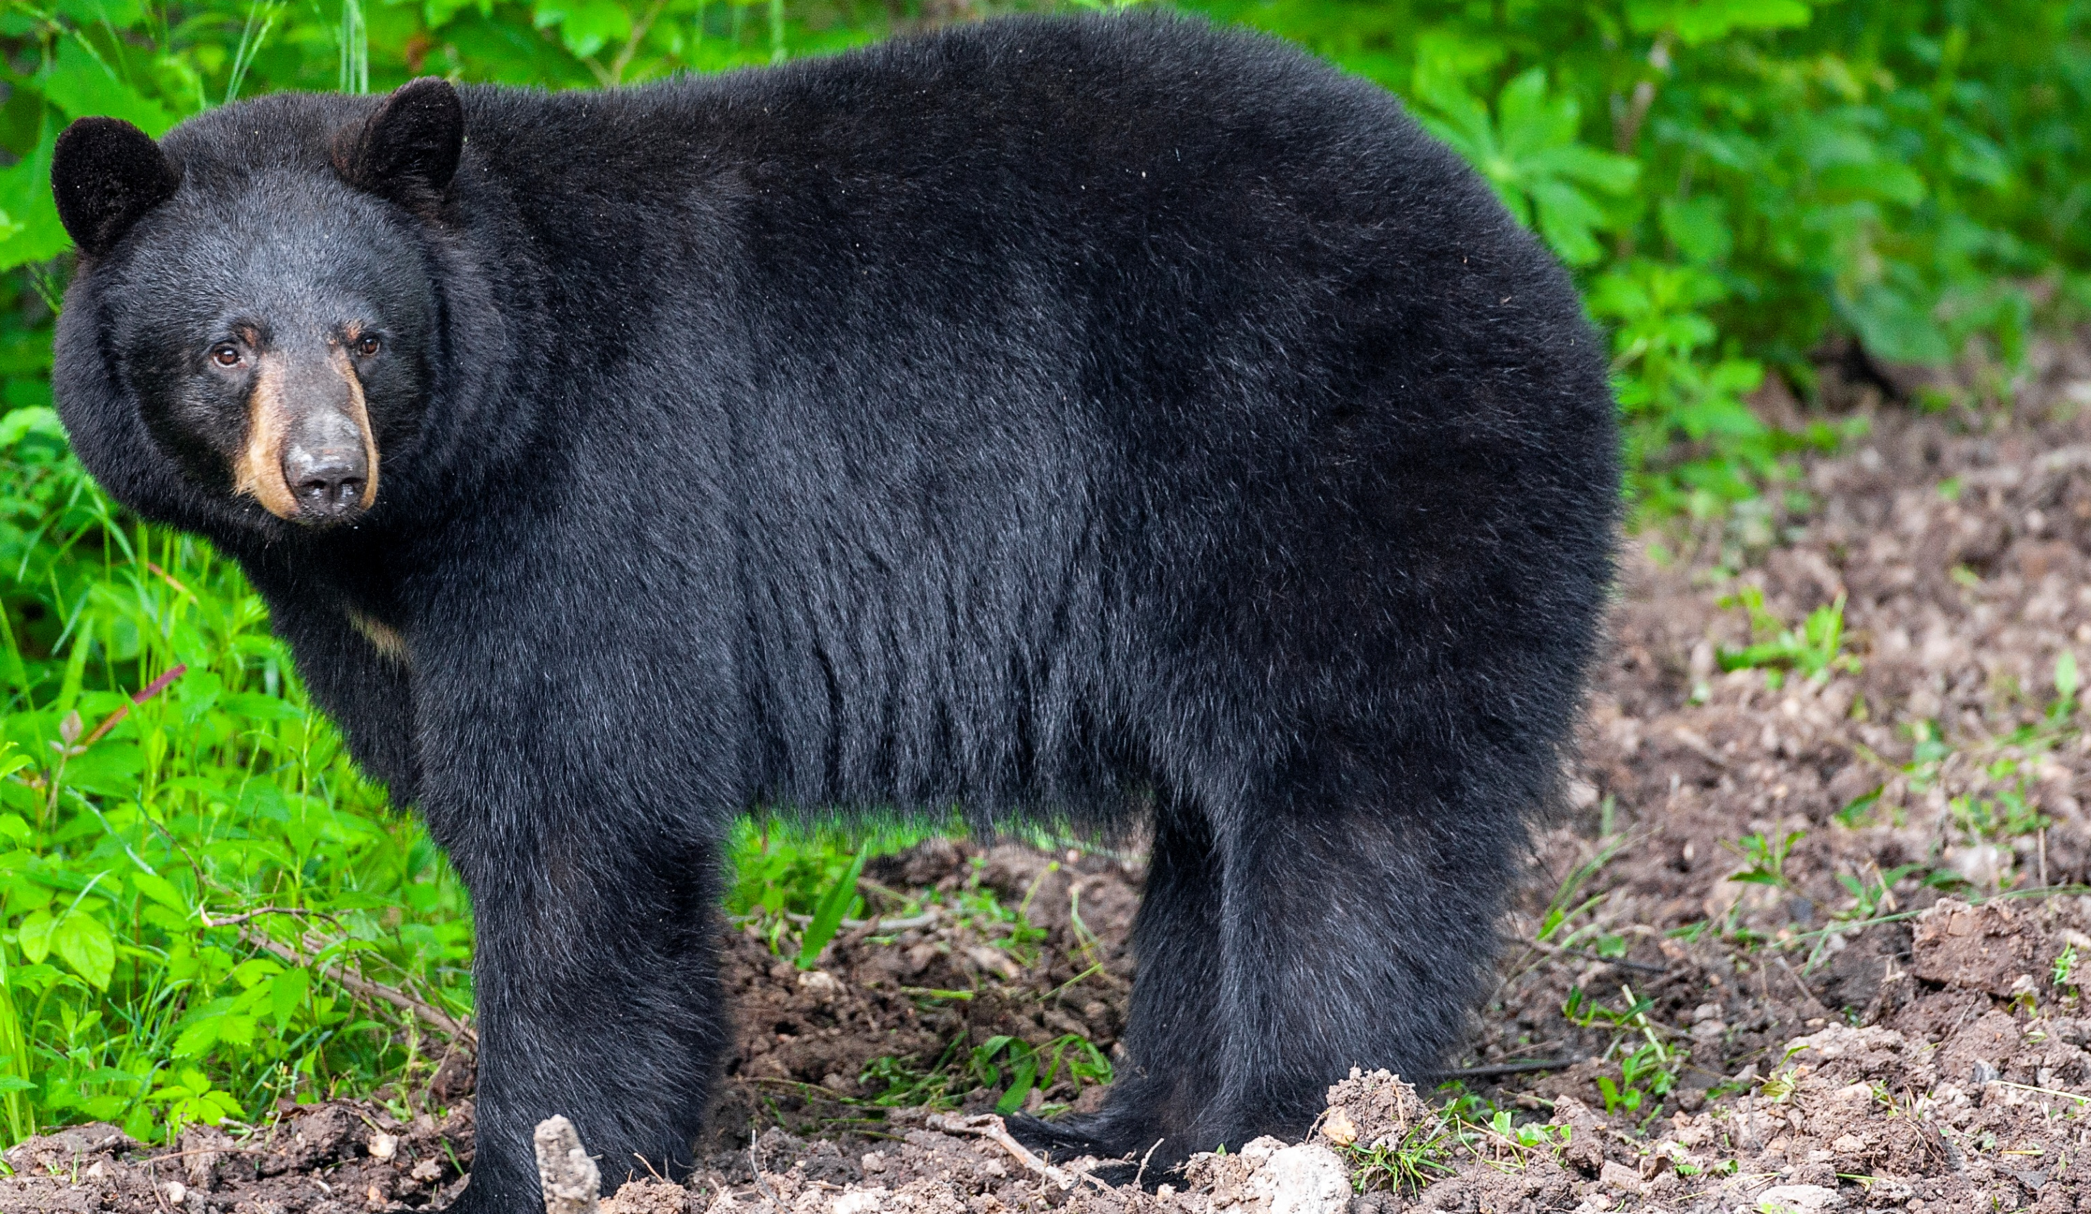

BEARS
Through the Seasons
Introduction Lesson – Bears in Missouri

Slide 2
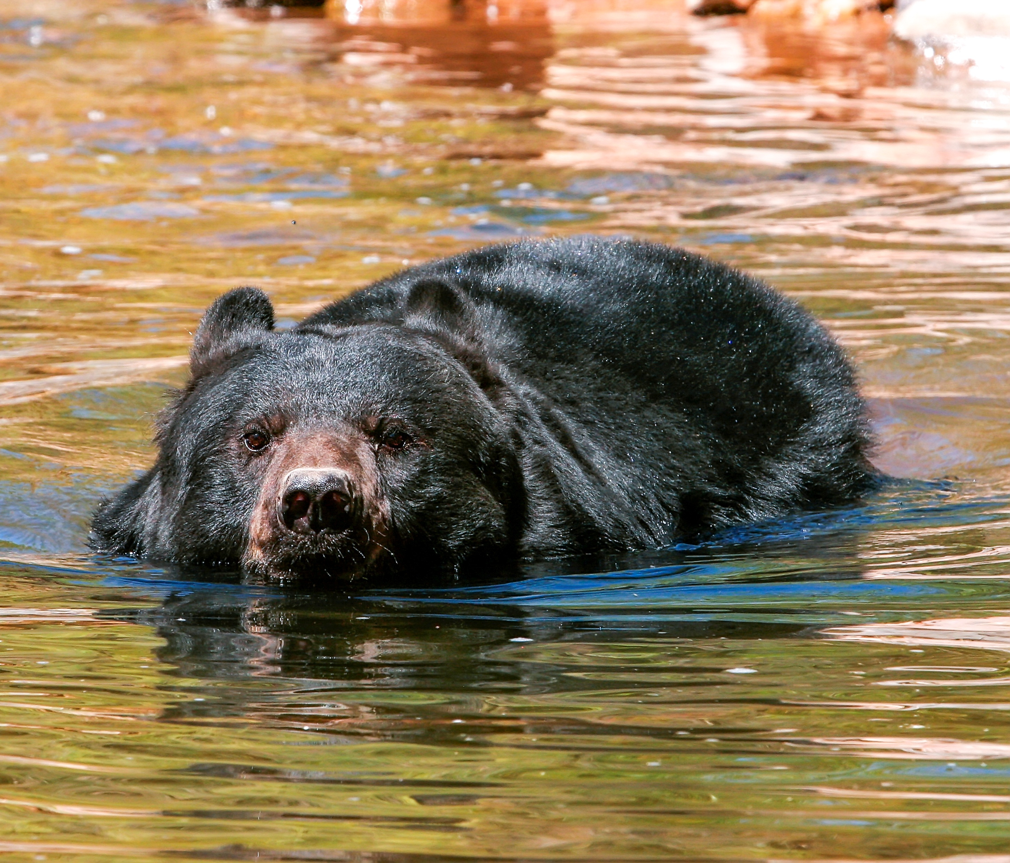

What do you know about bears?
Bears through the Seasons – Introduction Lesson – Black Bears in Missouri
2
Notes:
Have a class discussion about bears to elicit what background knowledge students have about them.

Slide 3

Bears through the Seasons – Introduction Lesson – Black Bears in Missouri
3
Notes:
Make a Noticings and Wonderings T-Chart that allows students to share noticings and wonderings on the topic. Ask students what they notice in the images on the map and from the book. Can ask students to share facts they know about bears. This may or may not be indicative of actual facts but starts the discussion of prior knowledge and/or misconceptions. Also record questions students have in the What I Wonder column.

Slide 4
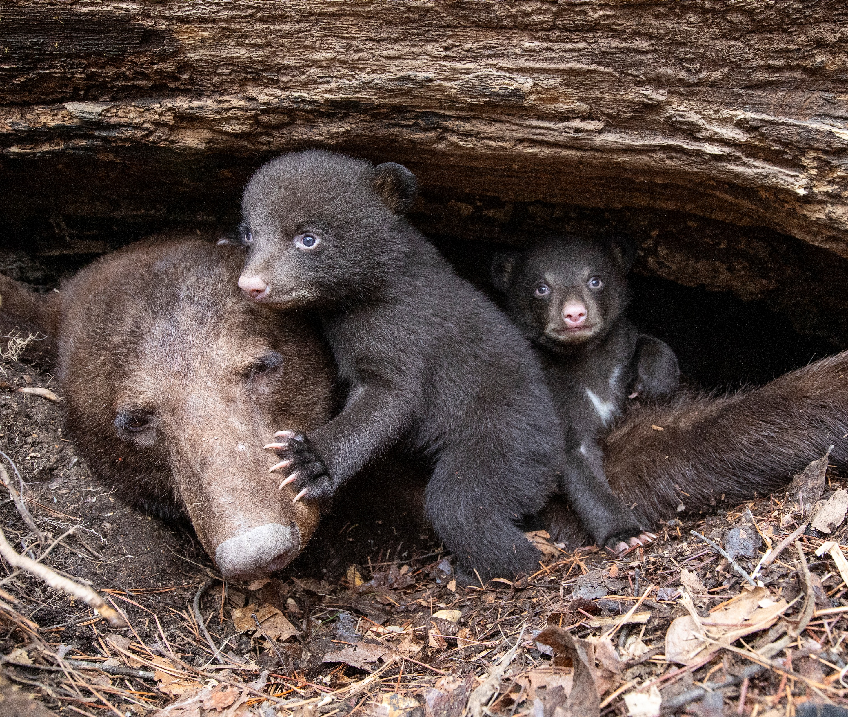
Where do you think bears live?
Bears through the Seasons – Introduction Lesson – Black Bears in Missouri
4
Notes:
Have a class discussion about where bears live to elicit what background knowledge students have about them. Students that live in different parts of Missouri that have bears will have different knowledge than students that do not live in bear country.

Slide 5

Black Bear Interactive Story Map
Link:
https://mdcgis.maps.arcgis.com/apps/Cascade/index.html?appid=712cc83bff5145808936d38a3822ebb7
What do you notice as we look through the story map?
Where do you see a lot of dots (or bears)?
Where do we live?
Are there a lot of dots near us?
What else do you notice about black bears?
Bears through the Seasons – Introduction Lesson – Black Bears in Missouri
5
Notes:
Click on the link that will take you to the Black Bear Interactive Story Map. Show students the map of Missouri with locations of black bear habitat. Keep scrolling through Story Map and show them a variety of images of black bears in Missouri in different seasons. You will need to help them analyze the map – mark the location the town or area where the school is to show where students live in comparison to where black bears live.

Slide 6

Read the book Black Bears by Jenna Lee Gleisner
Link to book on Epic!: Black bears by Jenna Lee Gleisner
Available for free to classroom teachers on Epic! (login required)
Bears through the Seasons – Introduction Lesson – Black Bears in Missouri
6
Notes:
Read: Black Bears by Jenna Lee Gleisner

Slide 7
Bears through the Seasons – Introduction Lesson – Black Bears in Missouri
7
Notes:
Continue to add to your Noticings and Wonderings T-Chart that allows students to share noticings and wonderings on the topic. Ask students what they notice in the images on the map and from the book. Can ask students to share facts they know about bears. This may or may not be indicative of actual facts but starts the discussion of prior knowledge and/or misconceptions. Also record questions students have in the What I Wonder column.

Slide 8

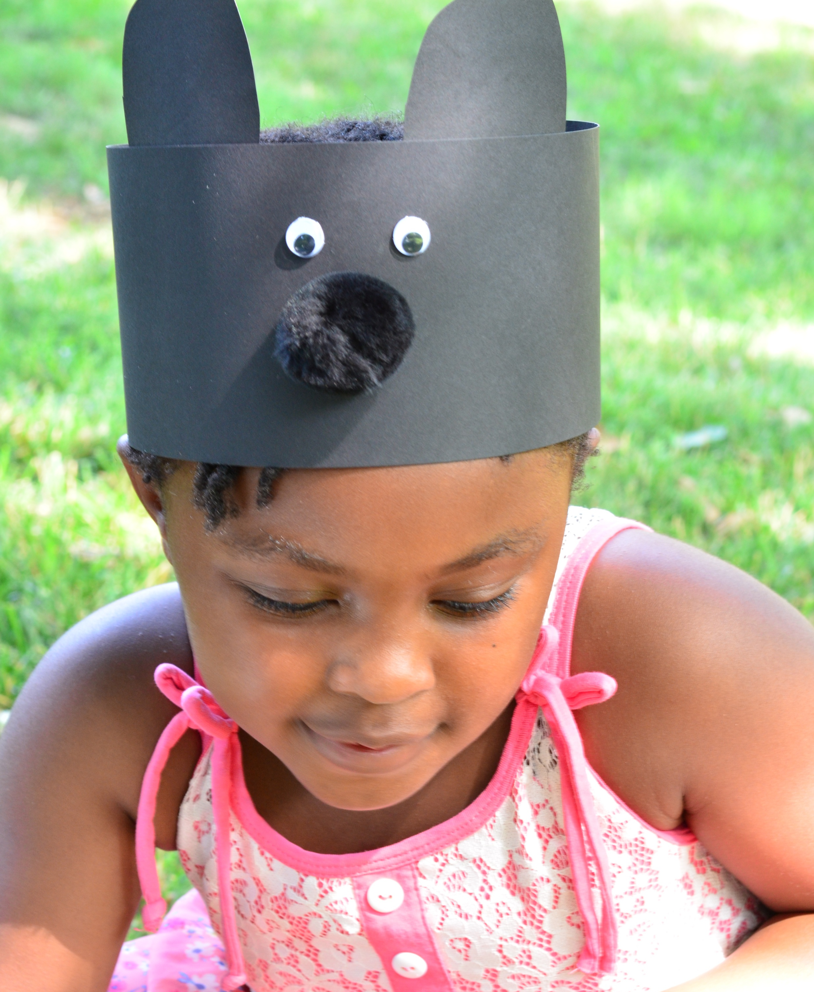
Making Bear Headbands
Bears through the Seasons – Introduction Lesson – Black Bears in Missouri
8
Notes:
Tell students they are going to experience the world around them throughout these lessons as Missouri Black Bear cubs.

Slide 9


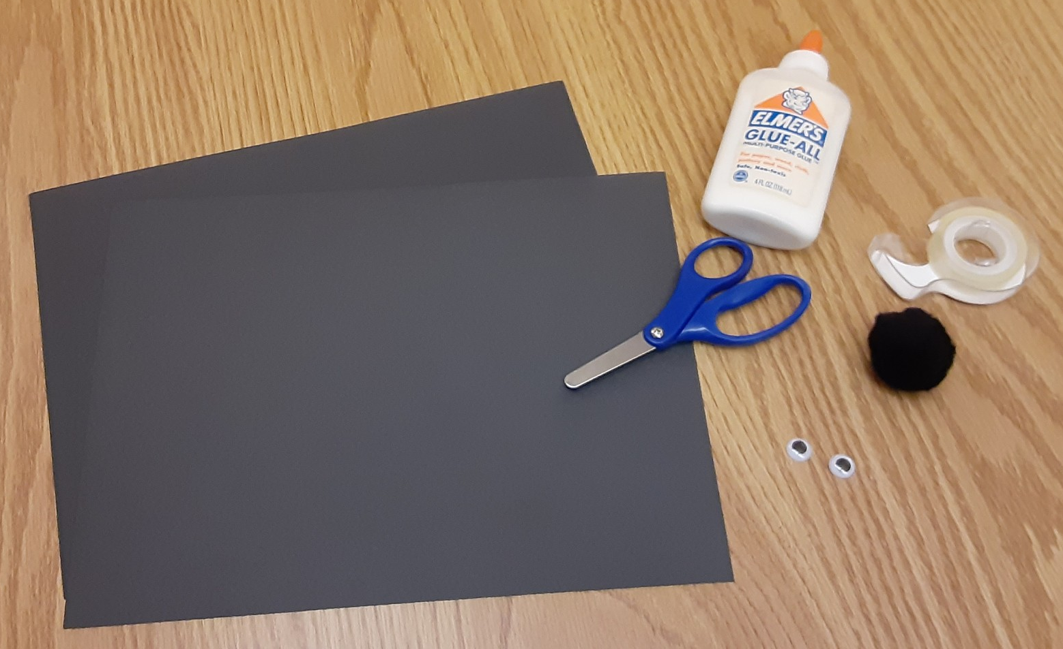
Supplies
1 pair of scissors
1 bottle of glue
Tape
1 medium black puff ball
2 small stick-on-eyes
2 pieces of black paper
Bears through the Seasons – Introduction Lesson – Black Bears in Missouri
9
Notes:
Prepare bear headband materials ahead of time. Cut black construction paper into 4-inch strips giving each student enough pieces to circle their head when taped or glued together. Cut ear pieces into 3-inch x 4-inch rectangles, each student will need two rectangular pieces. Note, 2 pieces of black construction paper, 2 stick-on eyes and 1 black puff ball is required for each student’s headband.

Slide 10


Step 1
Cut 2 paper headband pieces from black construction paper
Tape or glue two headband pieces together
Bears through the Seasons – Introduction Lesson – Black Bears in Missouri
10
Notes:
Use the pre-cut 4-inch strips of black construction paper.

Slide 11
Step 2
Cut 2 bear ears from black construction paper
Tape or glue two ears onto the headband
Bears through the Seasons – Introduction Lesson – Black Bears in Missouri
11
Notes:
Use the pre-cut 3-inch by 4-inch pieces of black paper, students will cut the rounded ear portion from each rectangle.

Slide 12


Step 3
Stick or glue on two eyes between the ears
Bears through the Seasons – Introduction Lesson – Black Bears in Missouri
12
Notes:
Draw a mouth and teeth on the headband using white or metallic colored pencils

Slide 13
Step 4
Glue on pom-pom nose beneath the eyes
Bears through the Seasons – Introduction Lesson – Black Bears in Missouri
13
Notes:
You may prefer to use a hot glue gun to adhere the puff ball nose to ensure it sticks well. If this is the case, please ensure that students do not touch the hot glue as it may burn their skin.

Slide 14

Step 5
Write name on inside of headband
Name
Bears through the Seasons – Introduction Lesson – Black Bears in Missouri
14

Slide 15

Step 6
Tape headband ends together sized to fit students head
Take care of your bear headband because we will use it throughout the entire year!
Bears through the Seasons – Introduction Lesson – Black Bears in Missouri
15
Notes:
Fit headbands on each students head and tape to fit. Take care of your bear headband because we will use it throughout the entire year!

