Slide 1
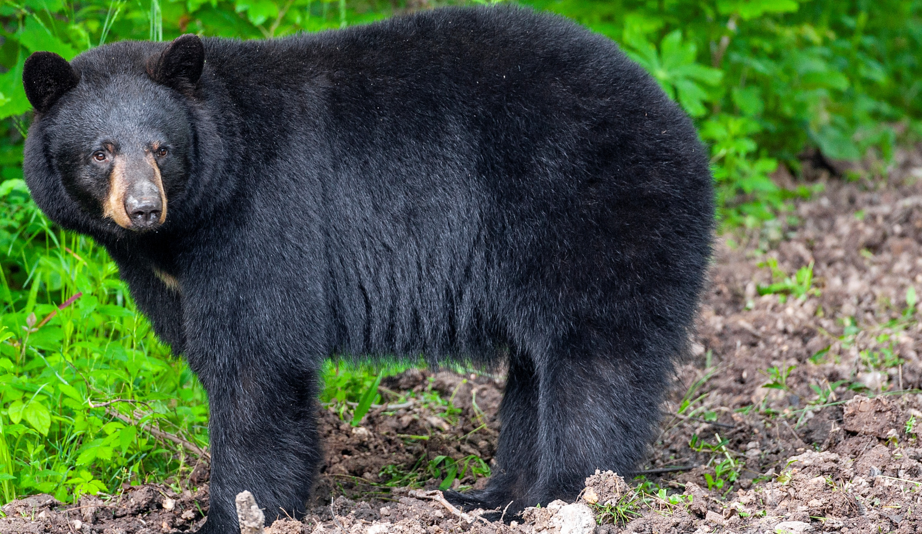

BEARS
Through the Seasons
Lesson 1H: Pushy Bear

Slide 2
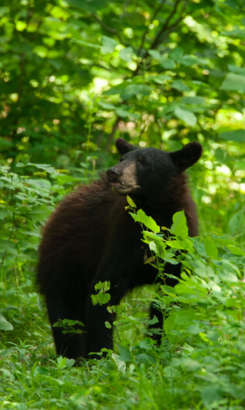

Guiding Question:
How do bears get their food?
Bears through the Seasons – 1H Pushy Bear: Engage
2

Slide 3

Bears through the Seasons – 1H Pushy Bear: Engage
3
Notes:
Prepare and display your Noticings and Wonderings Chart for this lesson. Add student observations and/or questions to the chart as the lesson proceeds in reference to the phenomenon studied.

Slide 4
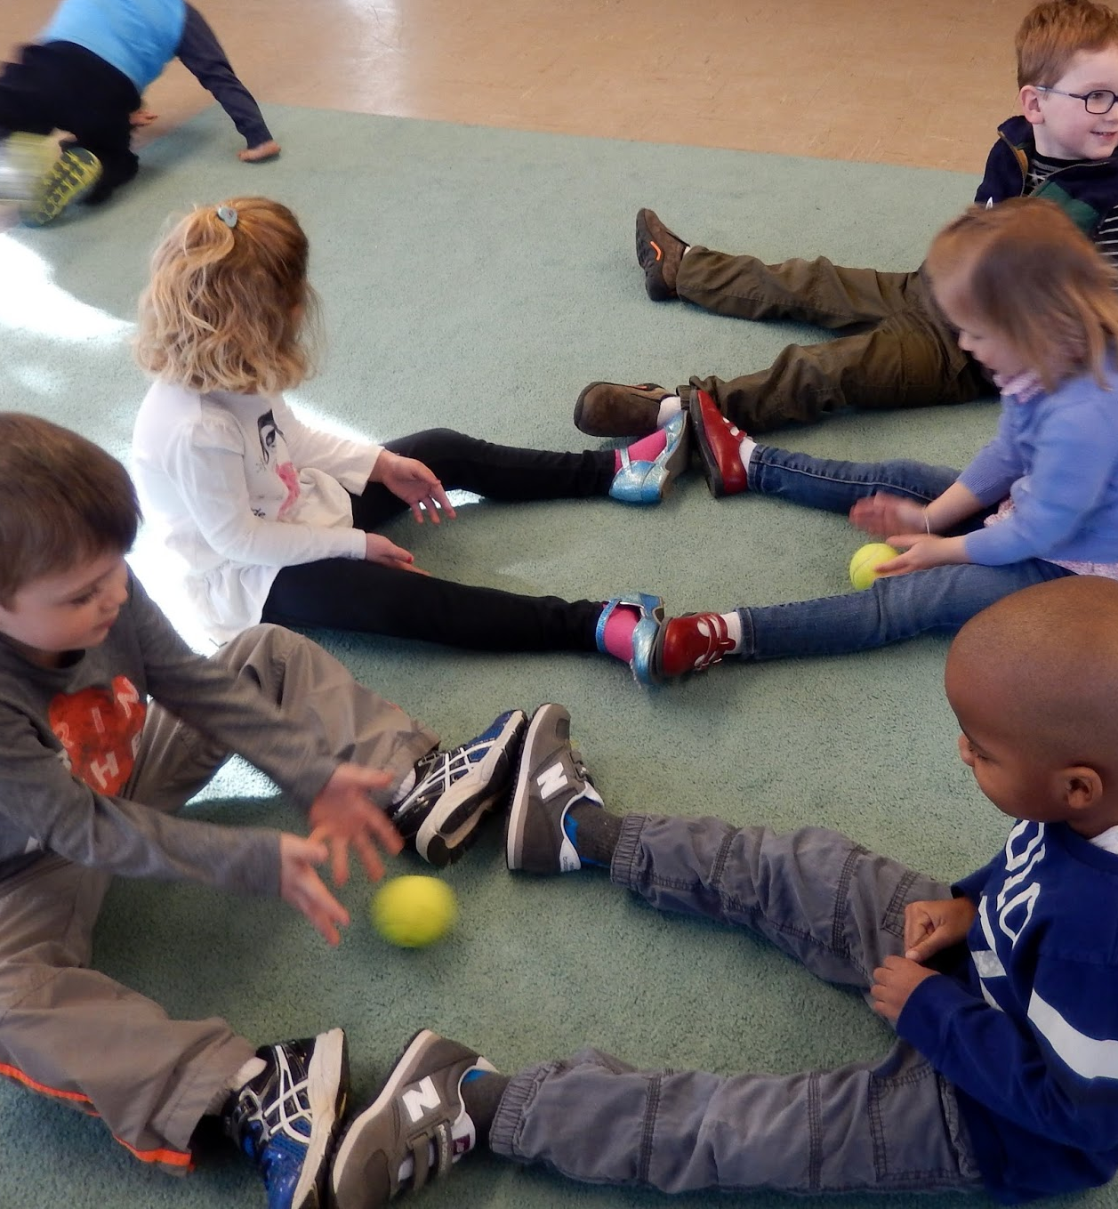
What are the ways that the ball can get to the other person?
Bears through the Seasons – 1H Pushy Bear: Engage
4
Notes:
Have two students come to the front of the room and sit facing each other a short distance apart. Give the ball to one student (in a position where he or she can roll it to the other child).

Slide 5
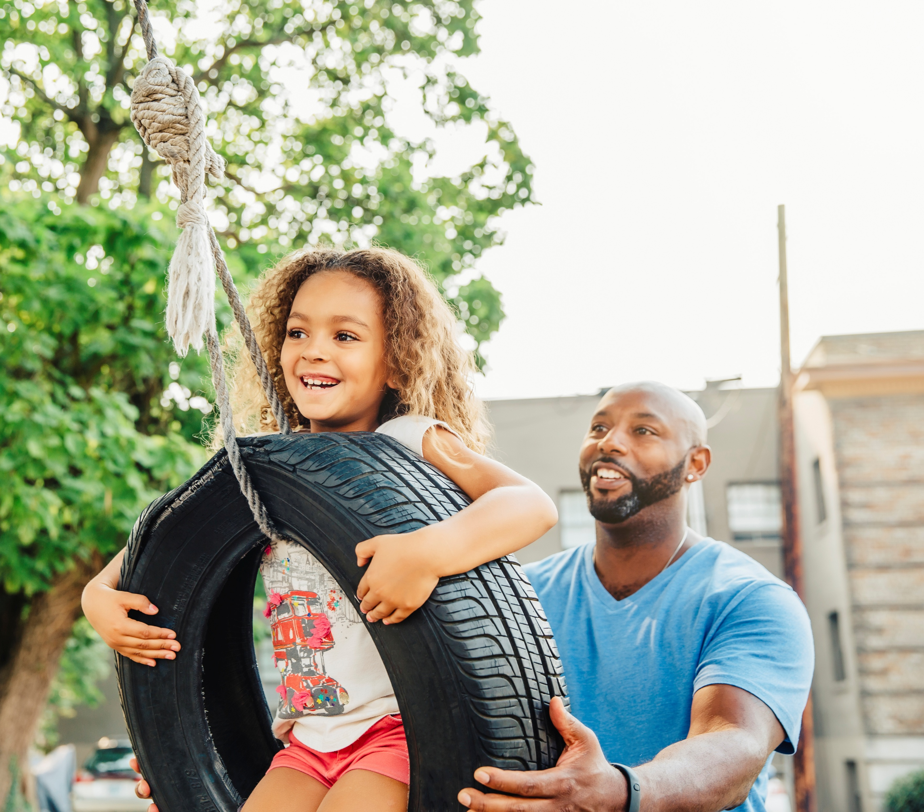
How do objects move?
Bears through the Seasons – 1H Pushy Bear: Engage
5

Slide 6
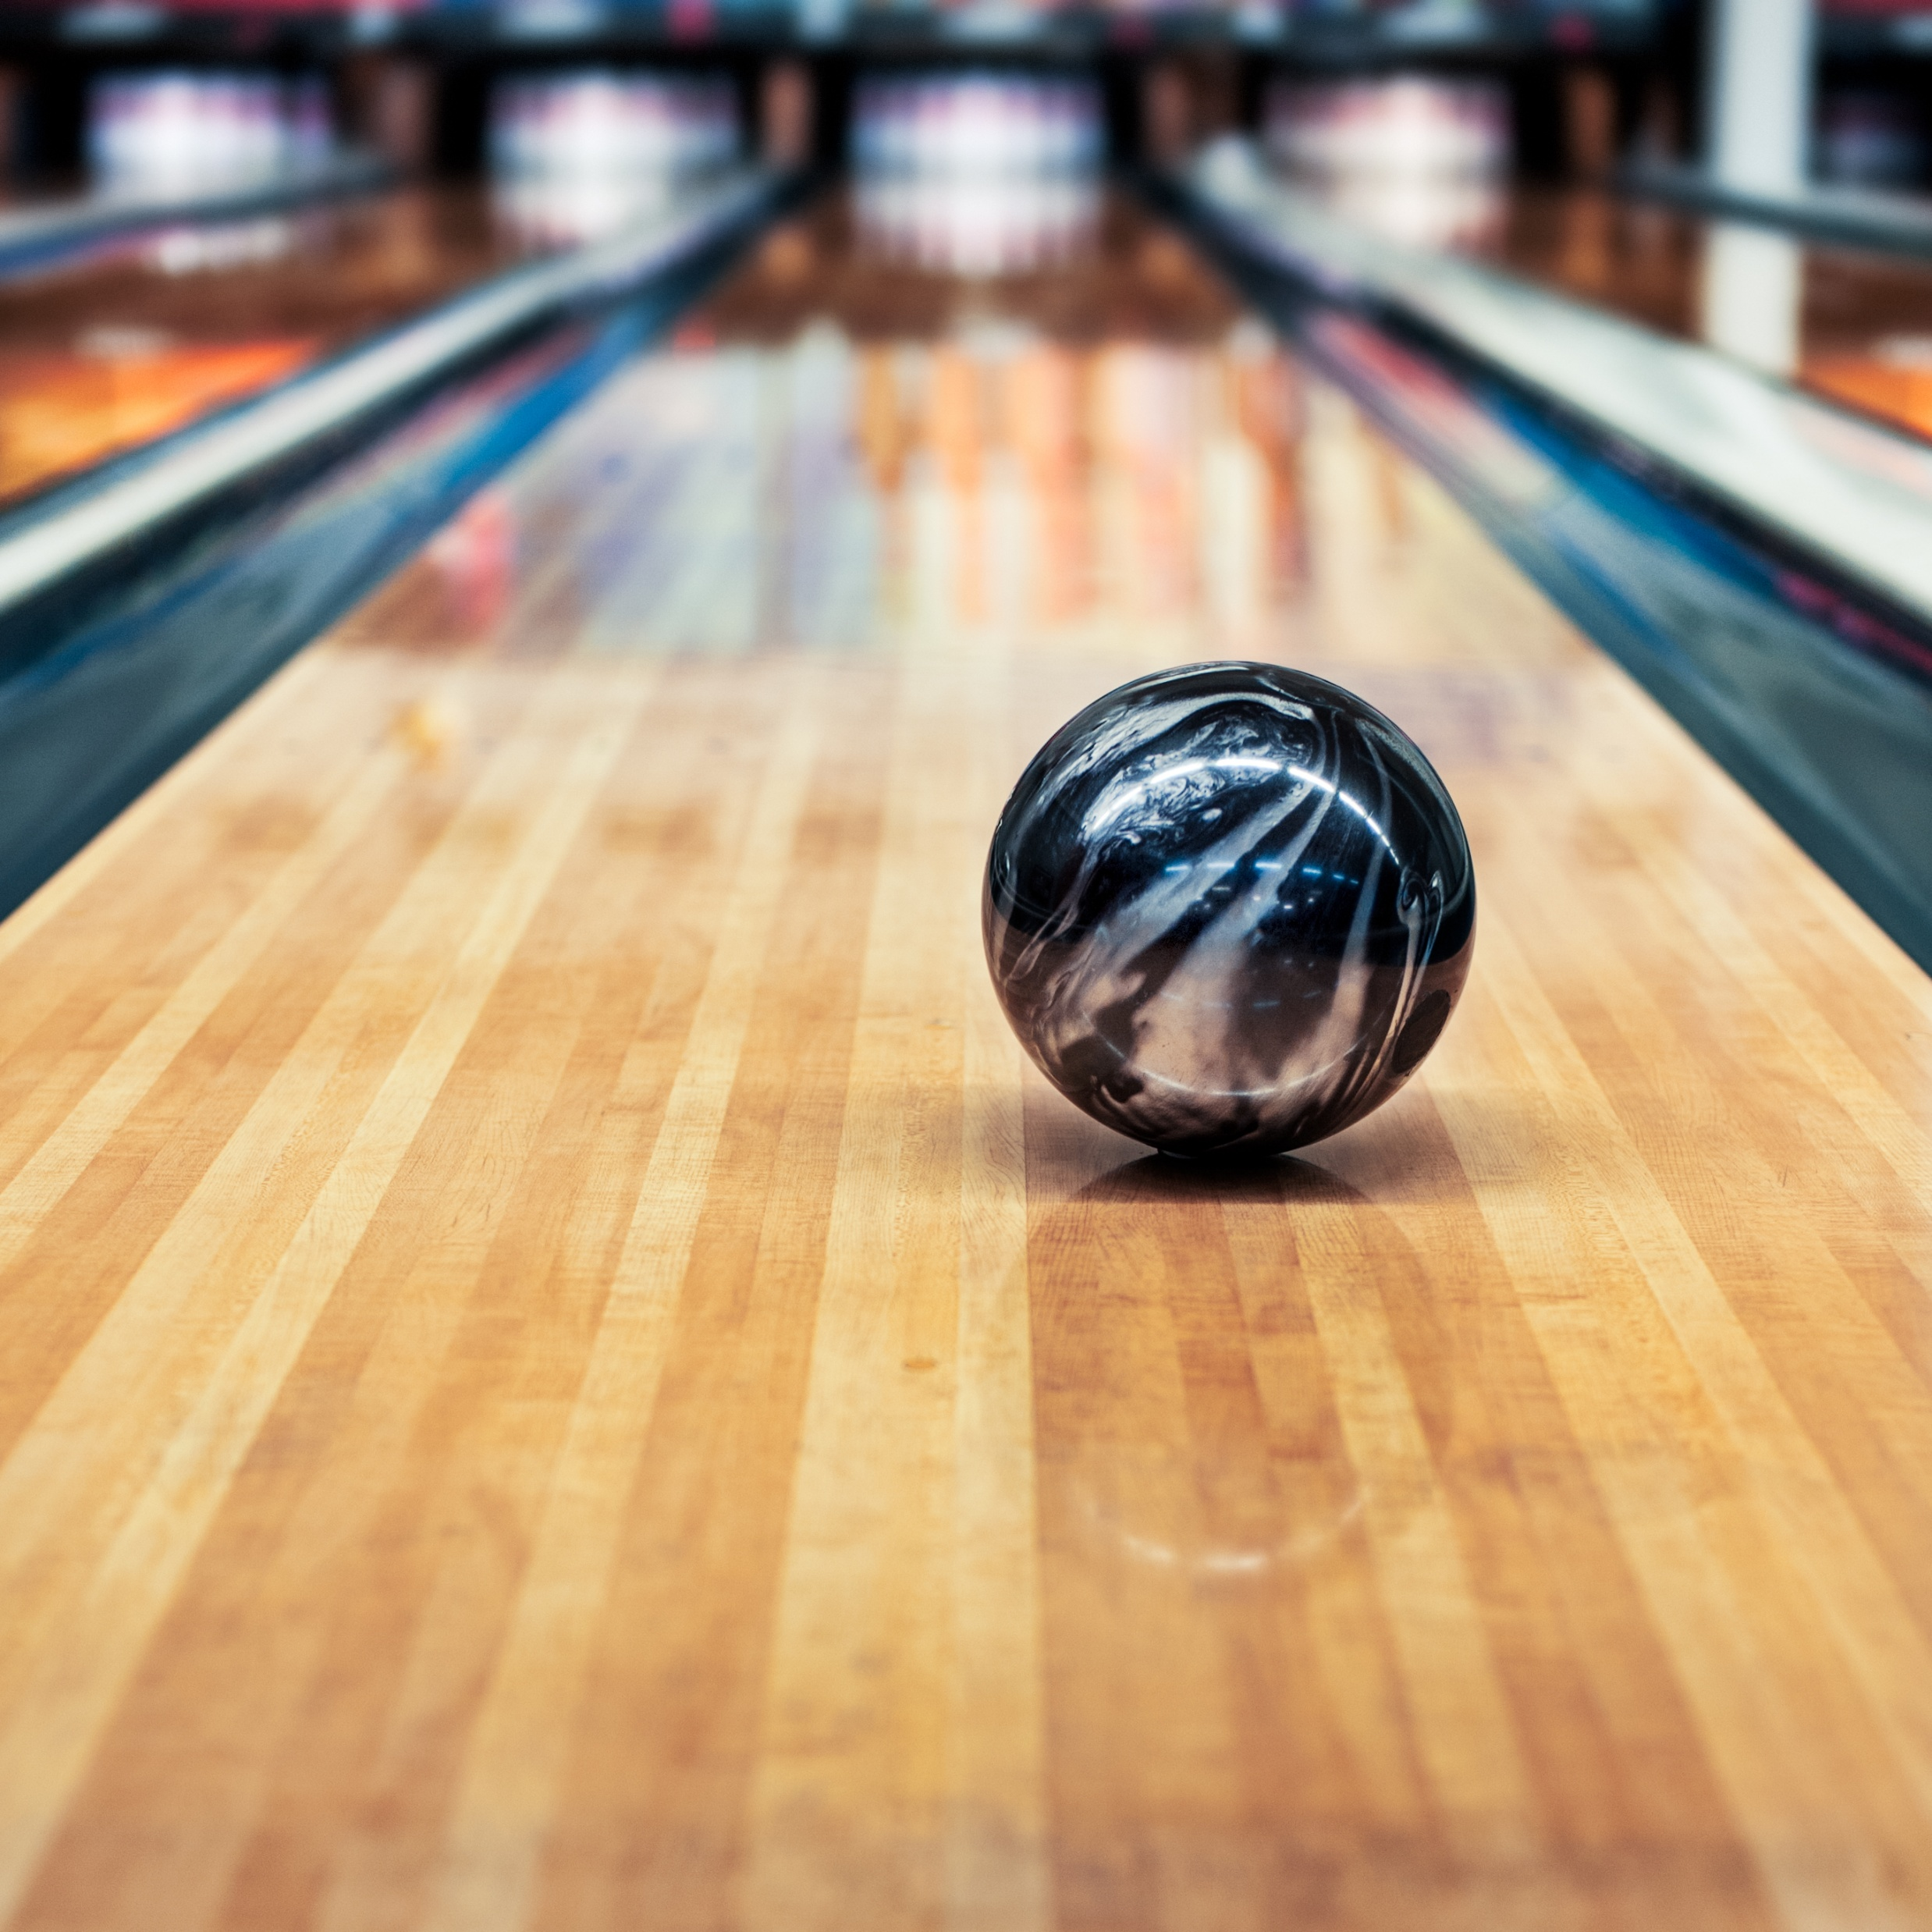
How do you move the ball?
How do you stop it?
Can you move it quickly or slowly?
Bears through the Seasons – 1H Pushy Bear: Explore
6
Notes:
Give students groups a variety of different sizes and weights of balls. You can have the balls rotate through the groups so that each group has only one ball at a time. By making groups of three, you can change the direction the ball goes when moving from child to child. Ask them to find ways without tossing (unless you go outside) to move the ball to another person in their group.

Slide 7

What observations did you make about moving the ball?
Bears through the Seasons – 1H Pushy Bear: Explain
7

Slide 8
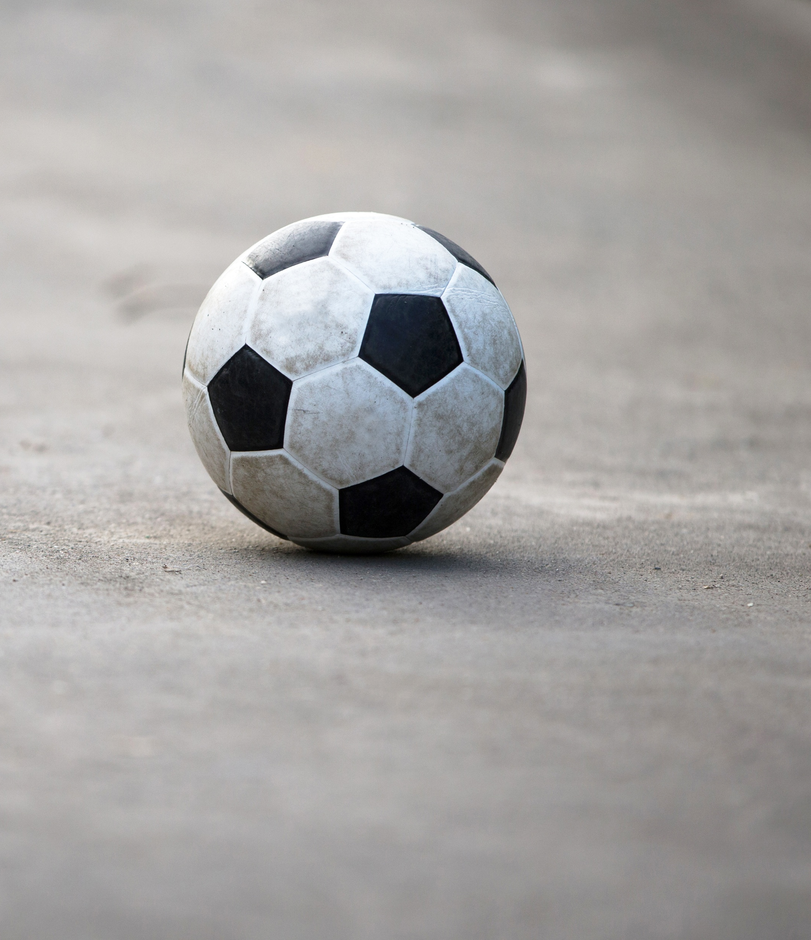
In what way did you make the ball move?
Bears through the Seasons – 1H Pushy Bear: Explain
8
Notes:
Discuss the terms push and pull.

Slide 9
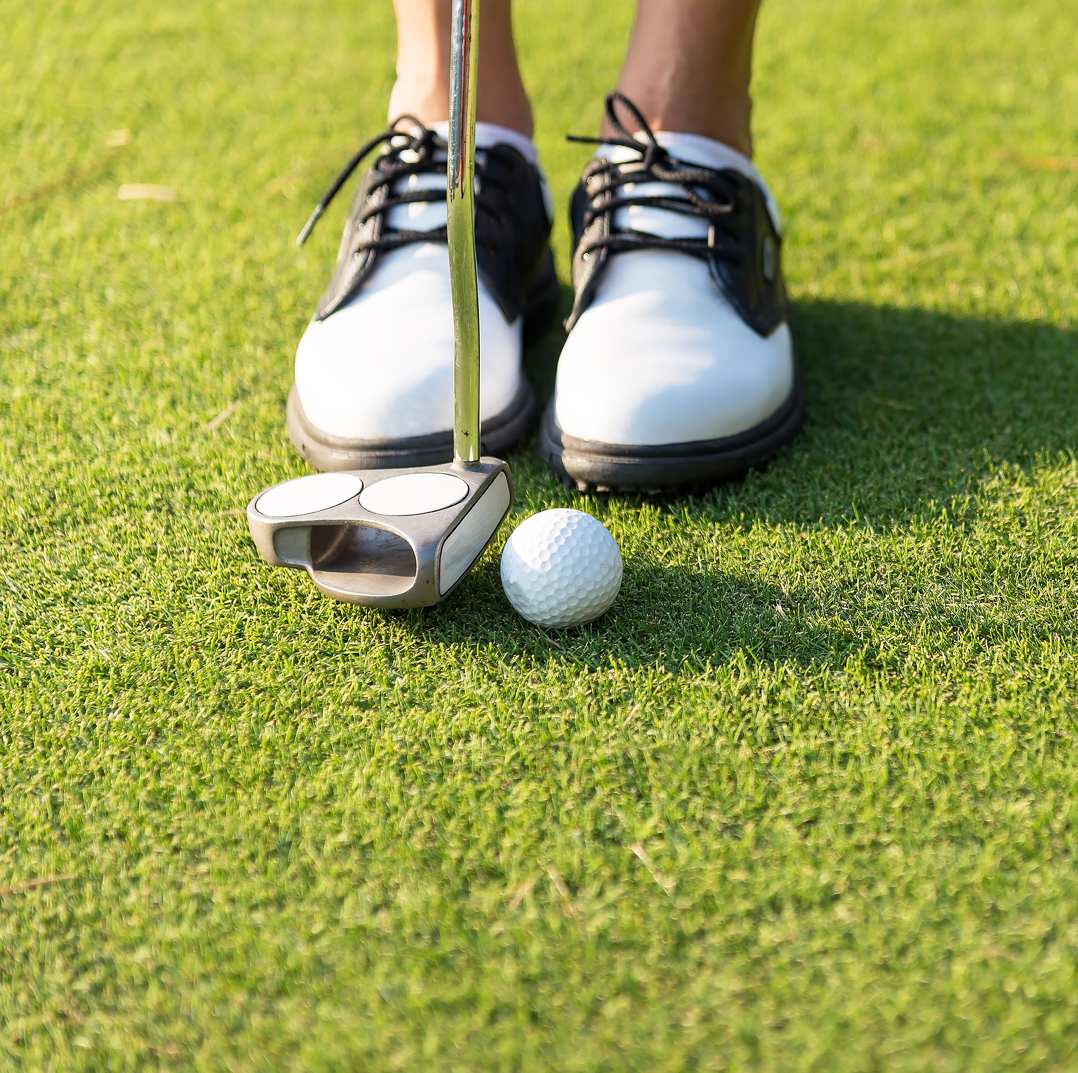
How do pushes and pulls start or stop movement?
Bears through the Seasons – 1H Pushy Bear: Explain
9

Slide 10

What observations were made about bigger or smaller balls, lighter or heavier balls?
Bears through the Seasons – 1H Pushy Bear: Explain
10

Slide 11
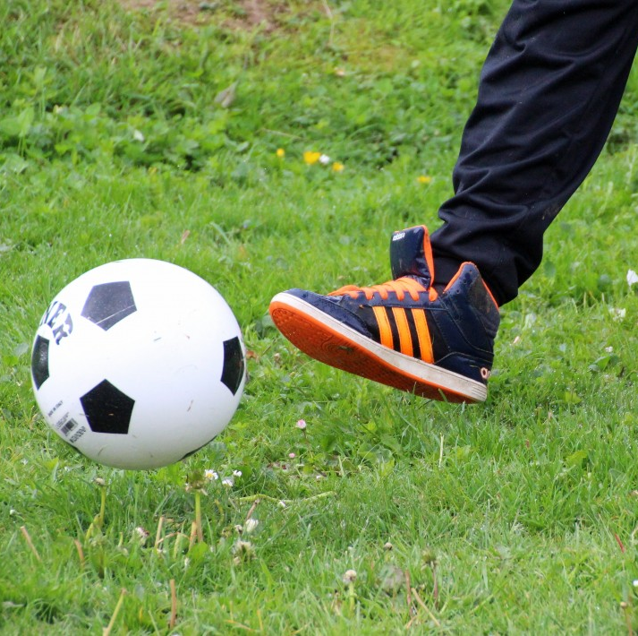
What observations did you make about stronger or weaker pushes and pulls?
Bears through the Seasons – 1H Pushy Bear: Explain
11

Slide 12
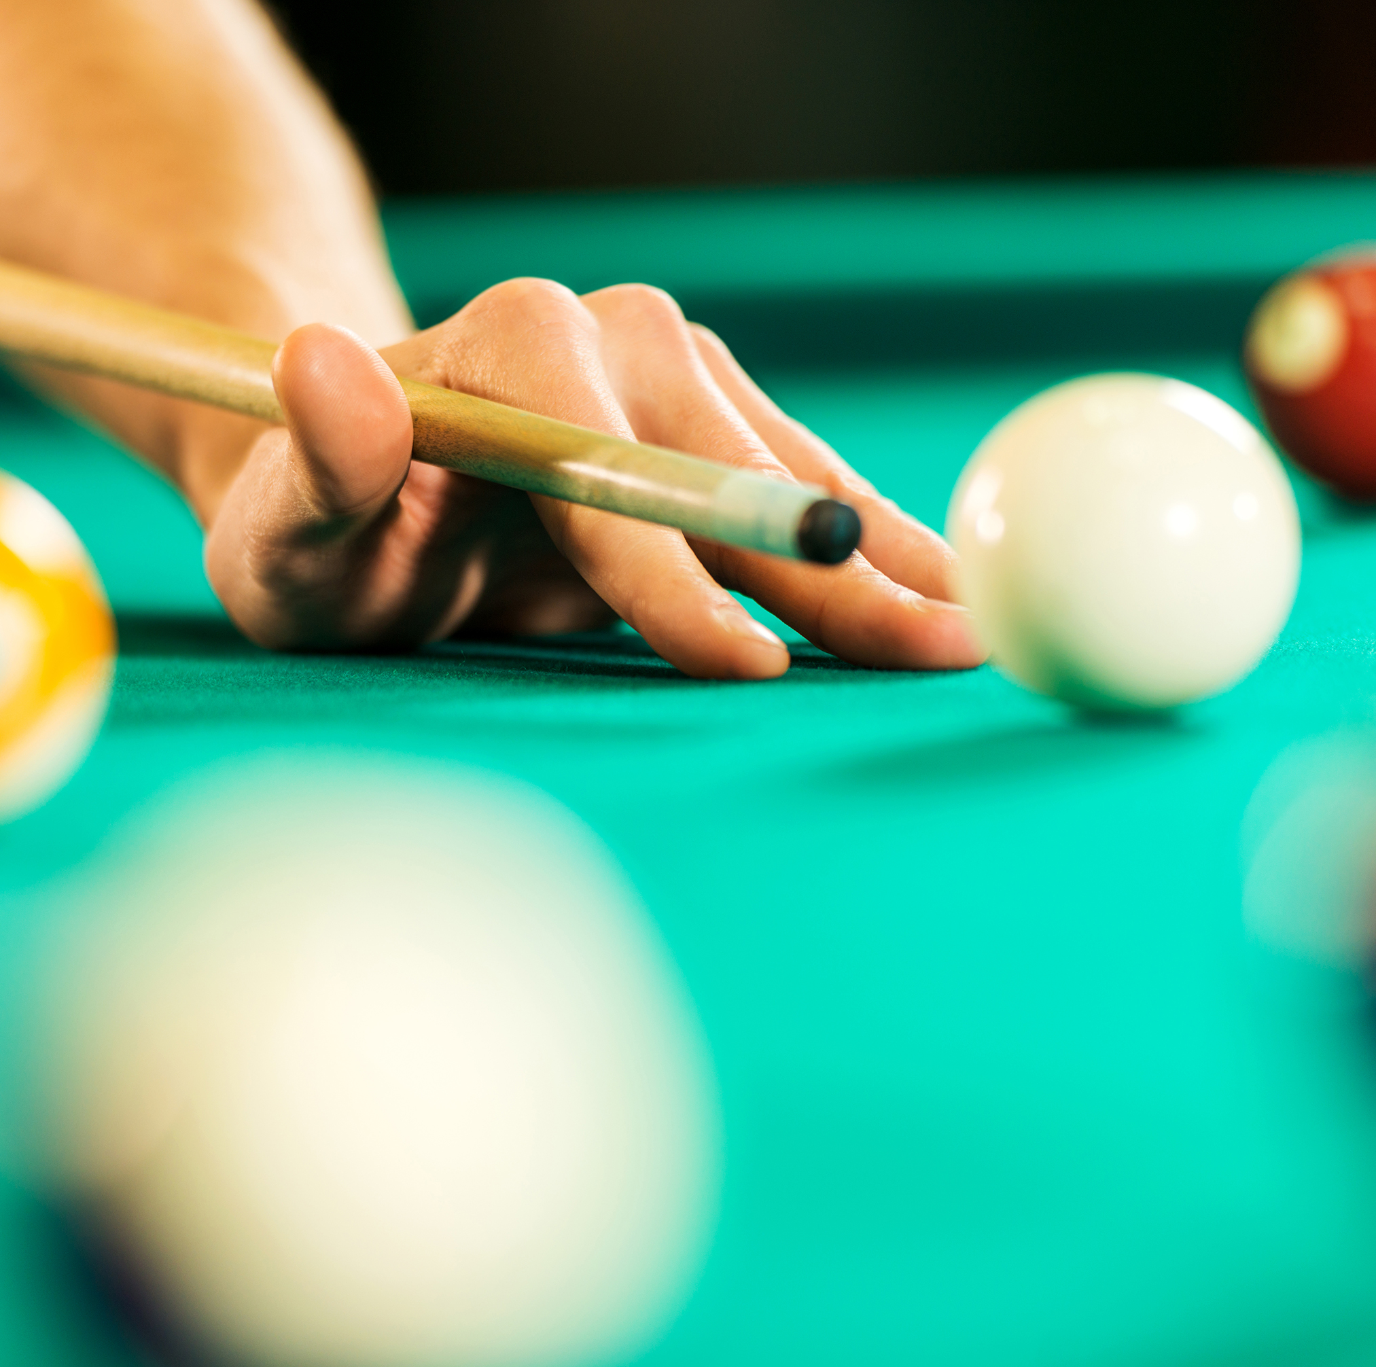
What happens if a ball hits and object or another ball in motion?
Bears through the Seasons – 1H Pushy Bear: Explain
12

Slide 13
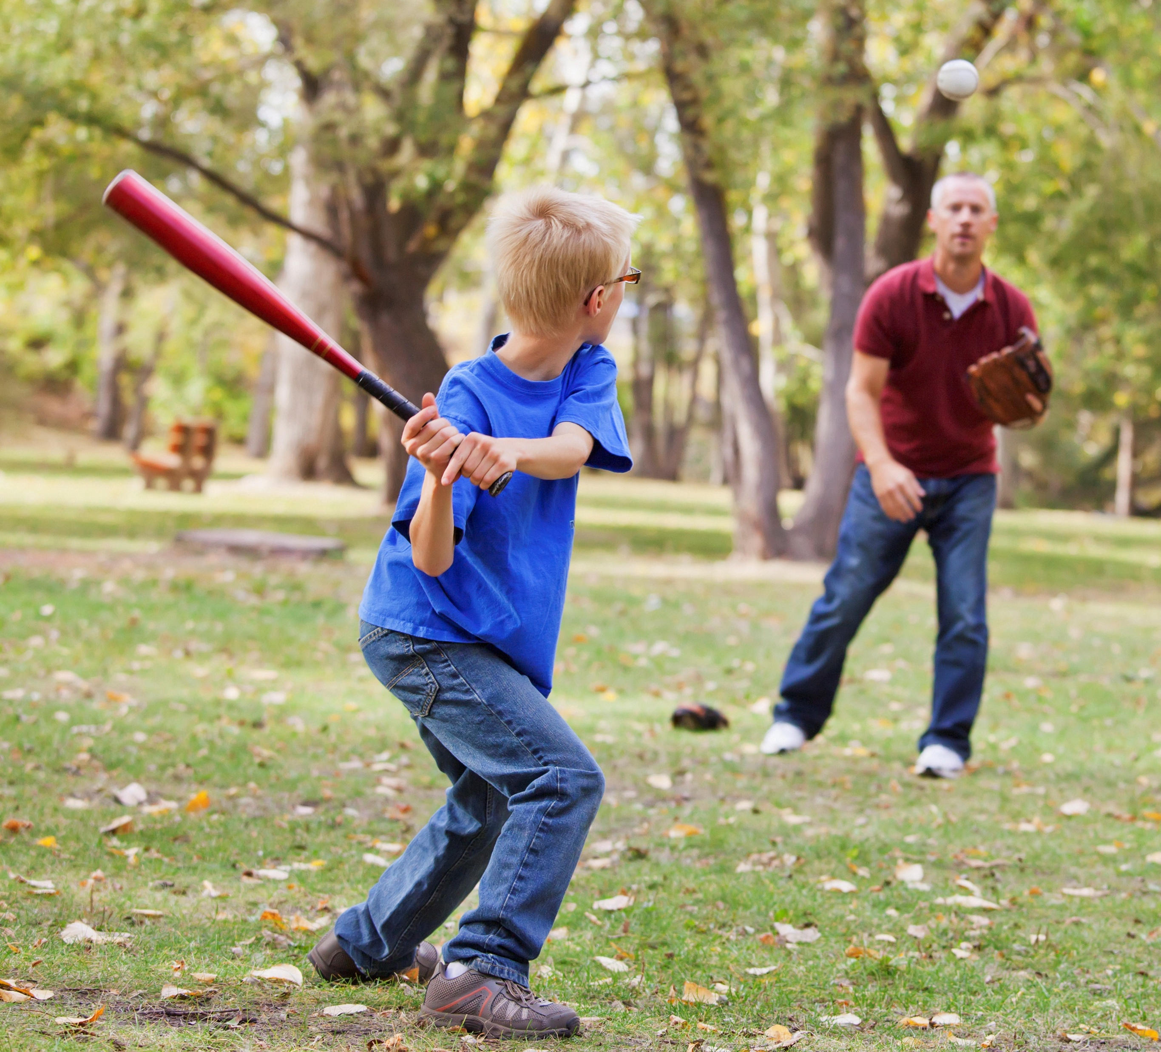
How do you make a ball change direction when it is moving?
Bears through the Seasons – 1H Pushy Bear: Explain
13

Slide 14
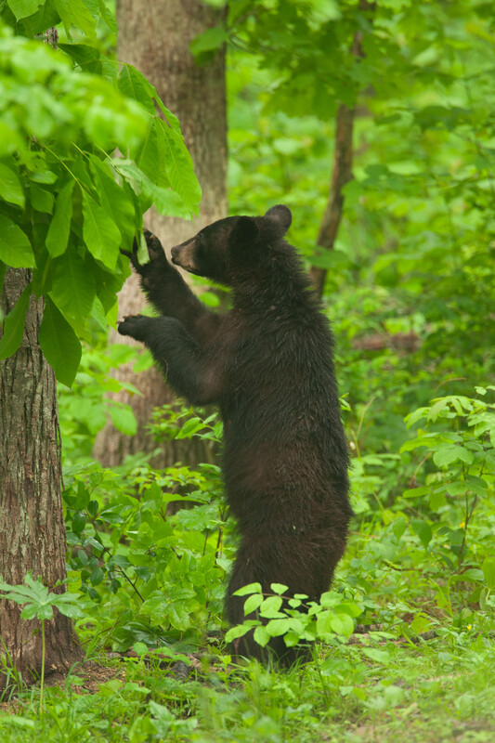
When do bears need to push and pull objects?
Bears through the Seasons – 1H Pushy Bear: Explore
14

Slide 15
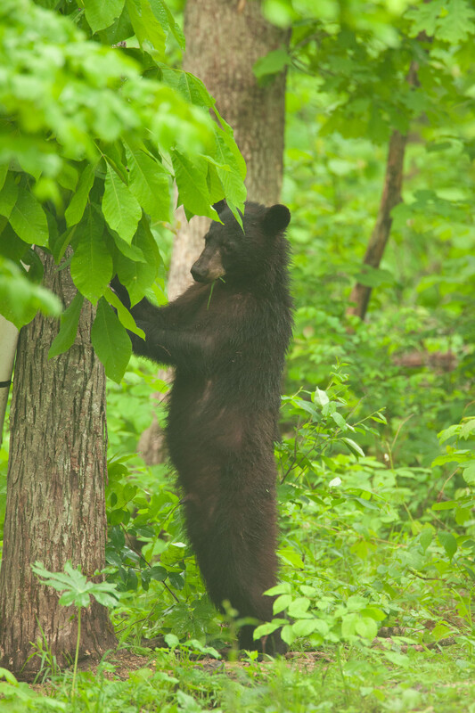
Imagine you are a bear. You look for food and shelter, and scratch on trees. How do you think you make your dens? How do you think you get your food?
Bears through the Seasons – 1H Pushy Bear: Explore
15

Slide 16
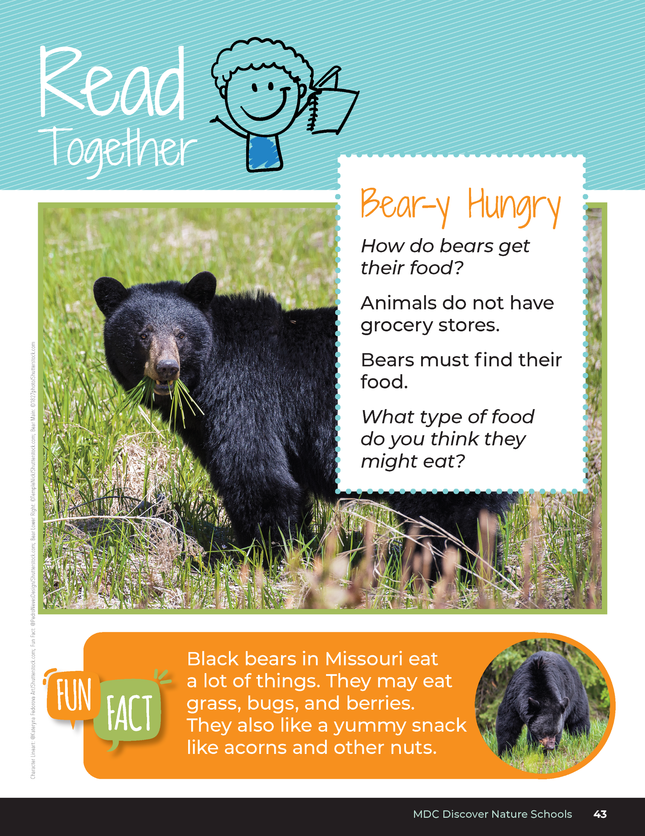

Bear-y Hungry​
How do bears get their food?
Animals do not have grocery stores.
Bears must find their food.
What type of food do you think they might eat?
Bears through the Seasons – 1H Pushy Bear: Explore
16
Notes:
Read aloud from the student guide Read Together Bear-y Hungry on Page 43.

Slide 17
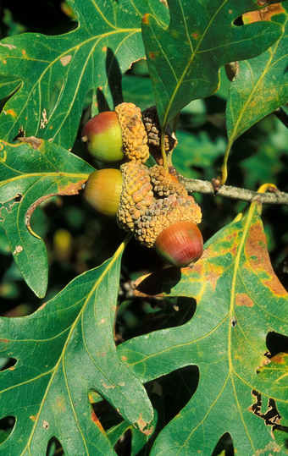
​
Bears through the Seasons – 1H Pushy Bear: Explore
17
Notes:
Read the fun fact together in the student guide on Page 43.

Slide 18

You are going to become a bear! Grab your Black Bear headbands before we head outside so you can “become” a bear.
Bears through the Seasons – 1H Pushy Bear: Explore
18
Notes:
Note: Reference the Introduction Lesson: Black Bears in Missouri for the directions to make black bear headbands. Bear headband template can be found on the MDC Teacher Portal under Discover Nature Schools Kindergarten Introduction Lesson: Black Bears in Missouri.

Slide 19
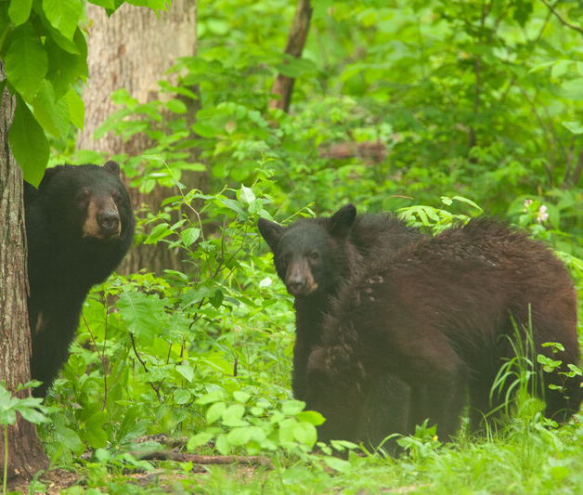
How would you explore this area like a bear?
Bears through the Seasons – 1H Pushy Bear: Explore
19
Notes:
Take students to the schoolyard to investigate the area, while pretending they are a bear.

Slide 20
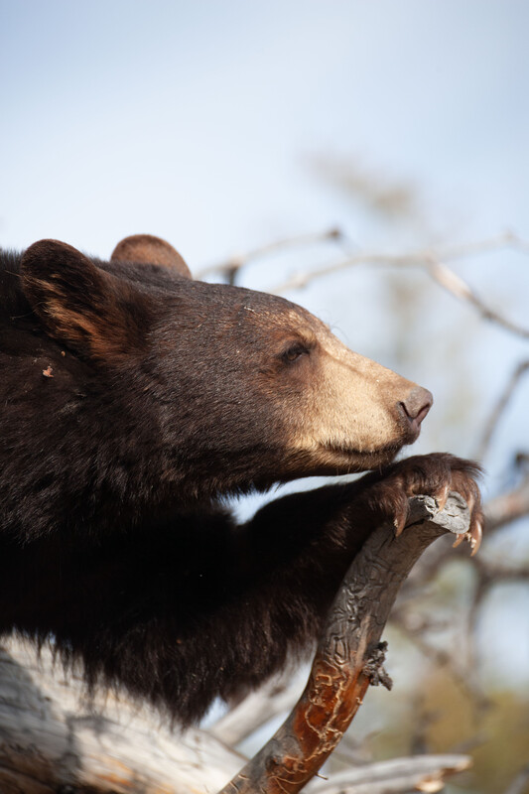
What would you do to use your push and pulls as a bear?
Bears through the Seasons – 1H
20
Notes:
Have students shout what motion they are doing to complete as action as they are doing it.
For example: “I am pushing on this swing, and I am getting my berries from the wild grapevines!”
“I am pushing on this tree to knock it down to make it my home!”

Slide 21
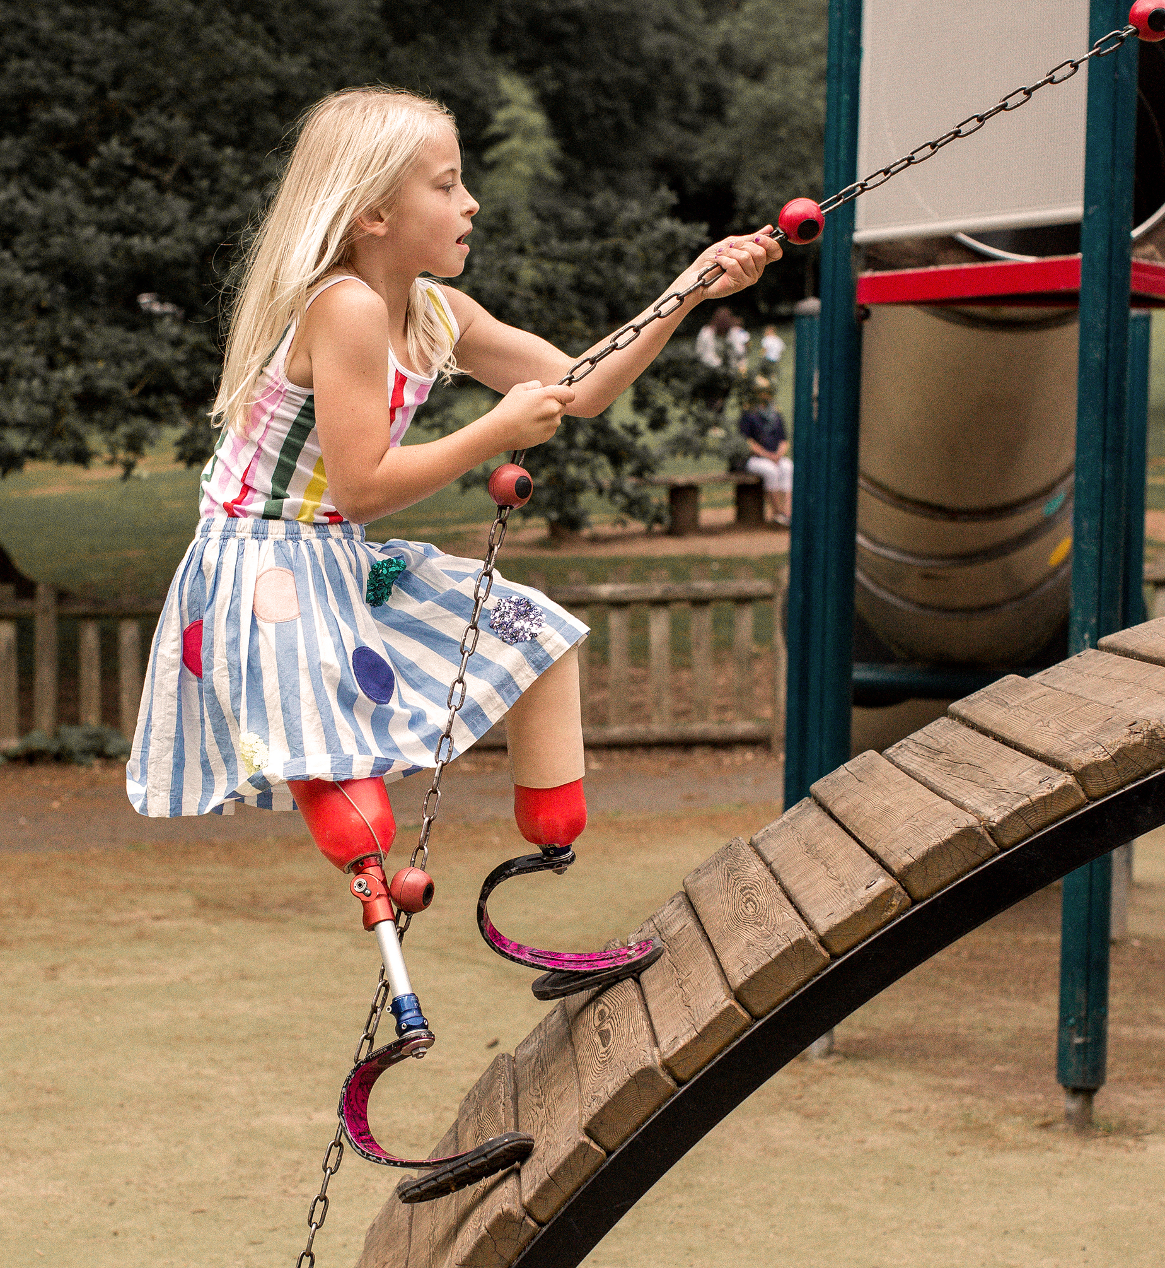
How does the strength of the push or pull change the motion?
Bears through the Seasons – 1H Pushy Bear: Explore
21
Notes:
Have them partner to explore the playground for pushes and pulls.

Slide 22

How can you test your ideas about strength of pushes and pulls or what happens when there are collisions?
Bears through the Seasons – 1H Pushy Bear: Explore
22
Notes:
Examples to share with class:
Bears rolling a log to get insects underneath. Students could simulate by rolling larger objects and smaller objects.
Younger bears pushing and pulling when they play.
Black bears rubbing against trees.

Slide 23
Cause-and-effect relationship of push and pull strength, direction, and collisions
Bears through the Seasons – 1H Pushy Bear: Explain
23
Notes:
Upon returning to the classroom, have students explore the cause-and-effect relationship of push and pull strength, direction, and collisions. Students should be able to respond to others’ arguments about causes and effects of pushes and pulls and decide as a class if each idea might result in a successful push or pull.
Optional Activity: To actively teach push and pull relationships, see Cross-Curricular Extension at the end of this lesson for the Tug for a Bug activity that is similar to the tug of war game in which groups of bears tug the opposing team to capture imaginary bugs.

Slide 24
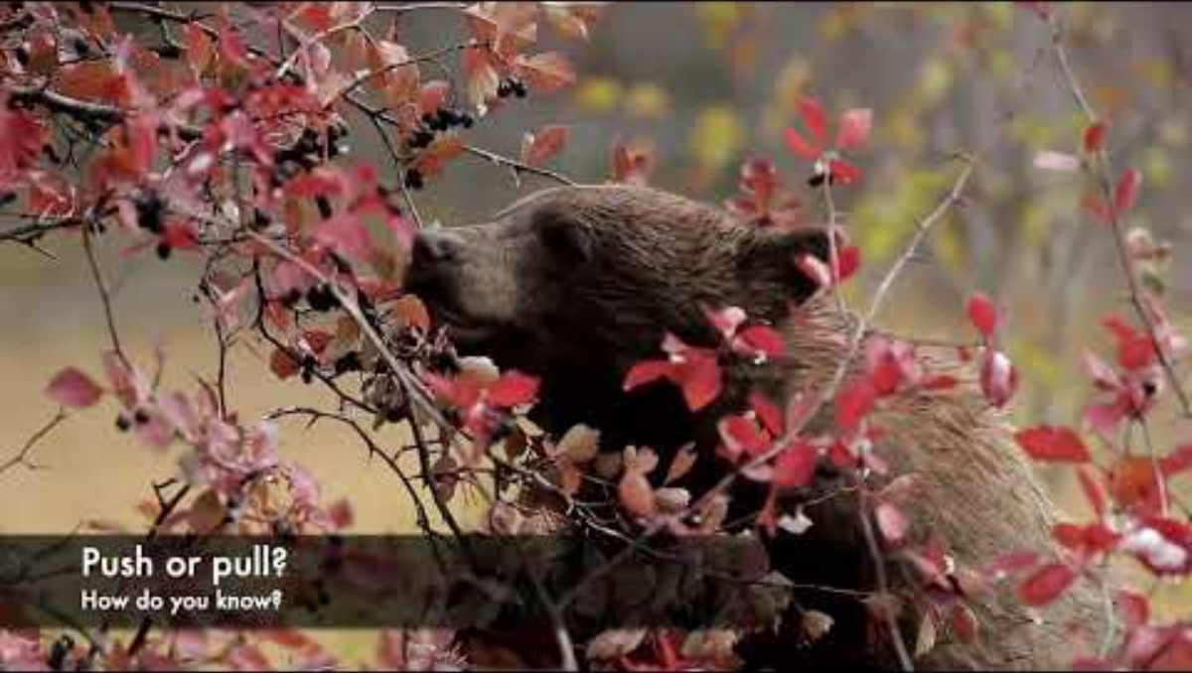
Bears through the Seasons – 1H Pushy Bear: Elaborate
24
Notes:
Open the MDC Teacher Portal to Kindergarten Lesson 1H and play the Bears Eating video.

Slide 25
What actions are the bears doing in the video to get their food?
Bears through the Seasons – 1H Pushy Bear: Elaborate
25

Slide 26
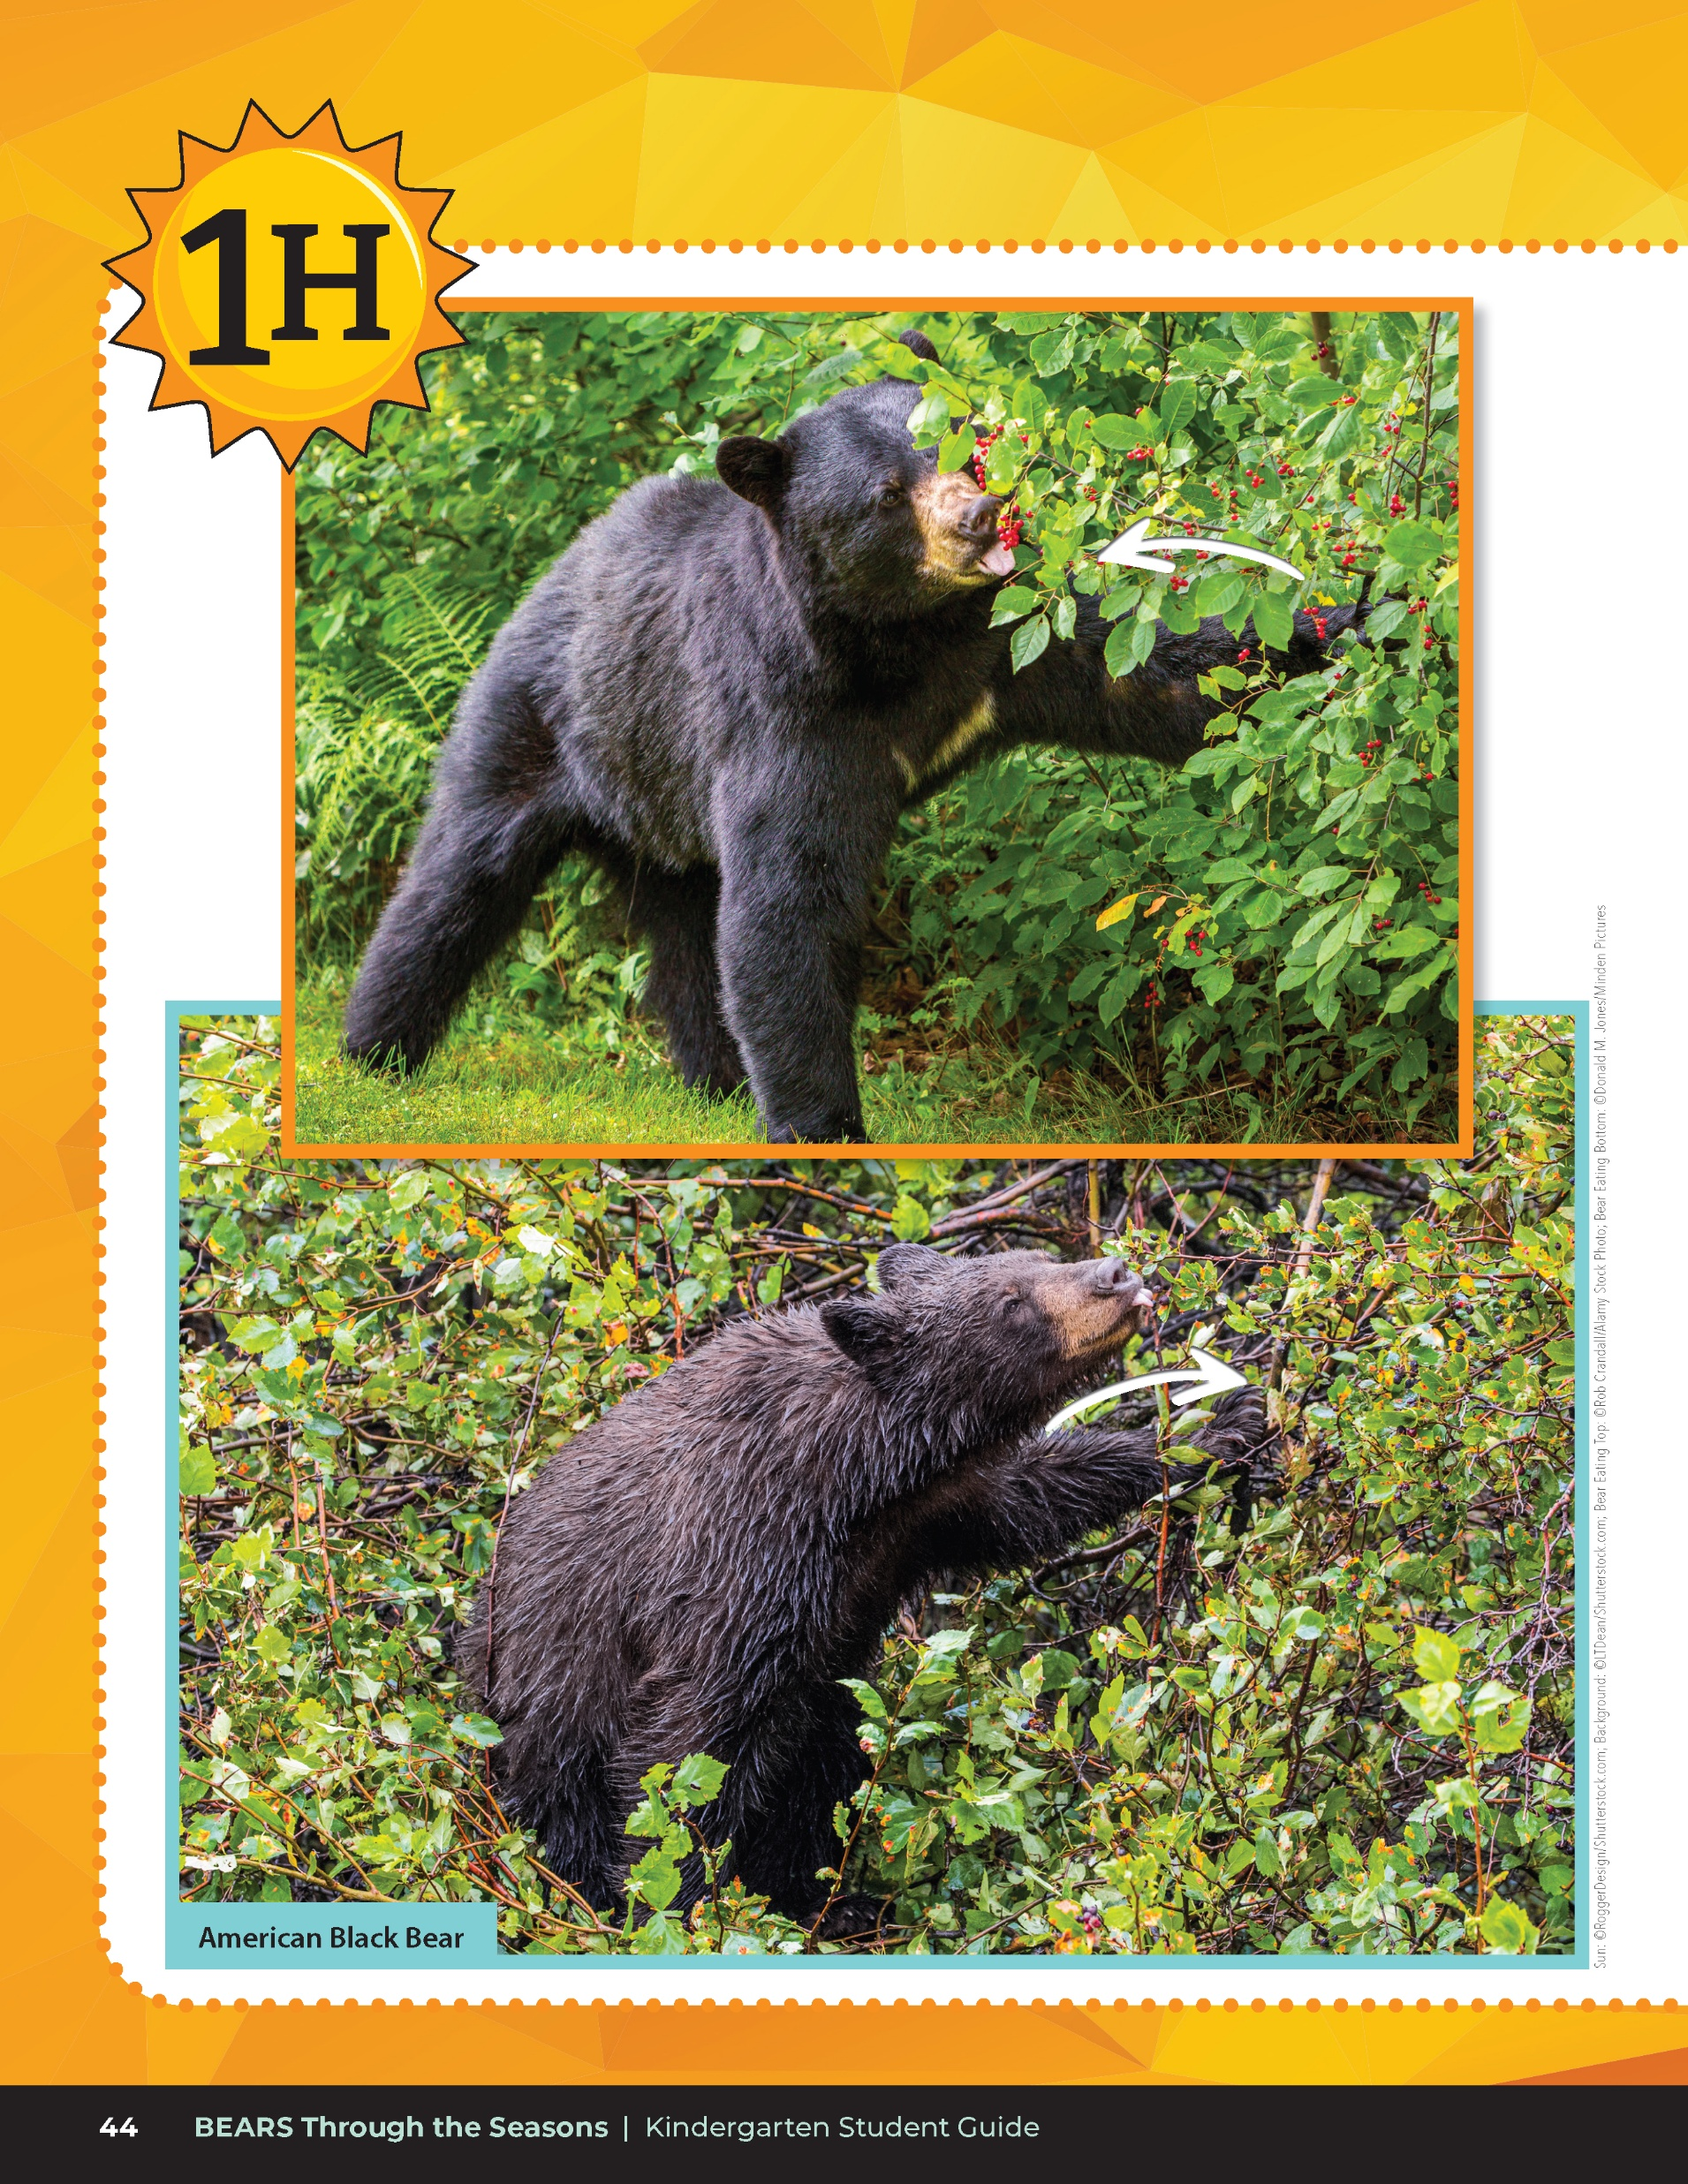
How are they using the action of pushing and pulling?
Bears through the Seasons – 1H Pushy Bear: Elaborate
26

Slide 27

Read the book Curious Cares of Bears by Douglas Florian
Link to book on Epic!: The Curious Cares of Bears by Douglas Florian
Available for free to classroom teachers on Epic! (login required)
Link to Read-Aloud: https://youtu.be/XR4MGSoMDsI?si=bna9YCGf6efcRZD7
Bears through the Seasons – 1H Pushy Bear: Elaborate
27
Notes:
Reread the Curious Cares of Bears by Douglas Florian

Slide 28
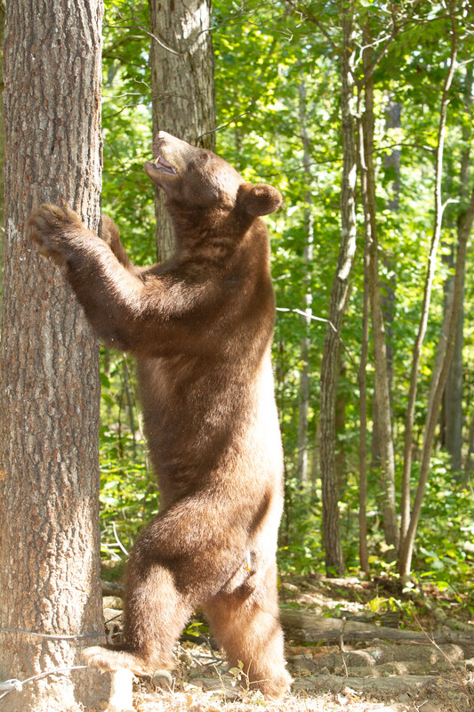
If there is a cause-and-effect relationship between the actions the bear makes in pushes and pulls how it gets its food?
Bears through the Seasons – 1H Pushy Bear: Elaborate
28
Notes:
Think-Pair-Share your observations with the person next to you. Bring your observations to the whole class.

Slide 29
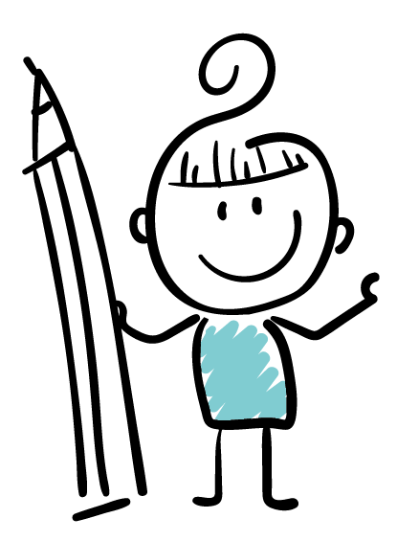
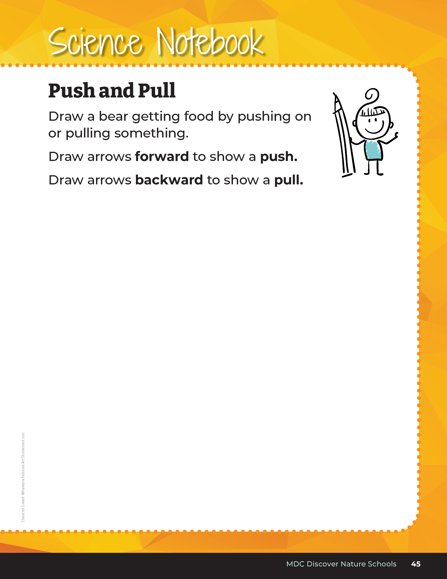
If we were to draw an arrow to show the direction of a push, what direction would the arrow be pointing? What about for a pull?
Bears through the Seasons – 1H Pushy Bear: Elaborate
29

Slide 30
Bears through the Seasons – 1H Pushy Bear: Elaborate
30
Notes:
Display the Bears Eating video again and pause on a bear pushing and draw or show the direction of the arrow pointing towards the object it is pushing on. Pause on a bear pulling and draw or show the direction of the arrow pointing towards the bear.

Slide 31
Bears through the Seasons – 1H Pushy Bear: Elaborate
31
Notes:
Add student observations and/or questions to the Noticings and Wonderings Chart as the lesson concludes in reference to the phenomenon studied.

Slide 32

Optional: Cross-Curricular Extension
Tug for a Bug Activity
Bears through the Seasons – 1H Pushy Bear: Cross-Curricular Extension
32
Notes:
Tug for a Bug Activity
In this game, pairs of students will take turns playing Tug for a Bug (aka tug a war) to depict a bear pulling on a stick to get a bug, but meeting resistance from the tree. A jump rope or along string or yarn can be used. A large, clear space is needed for this game.
Before starting Tug for a Big, tell students they will be playing a game of strength. One group of students on one end of the rope will imagine they are a bear tugging on a tree limb. The other group of students will be acting as the tree limb and pulling back in resistance.
Practice different numbers of students end of the rope, string, jump rope, or yarn.
Students can discuss how the motion of the rope (changes with pull or resistance from the other side) changed the direction of the rope.

