Slide 1
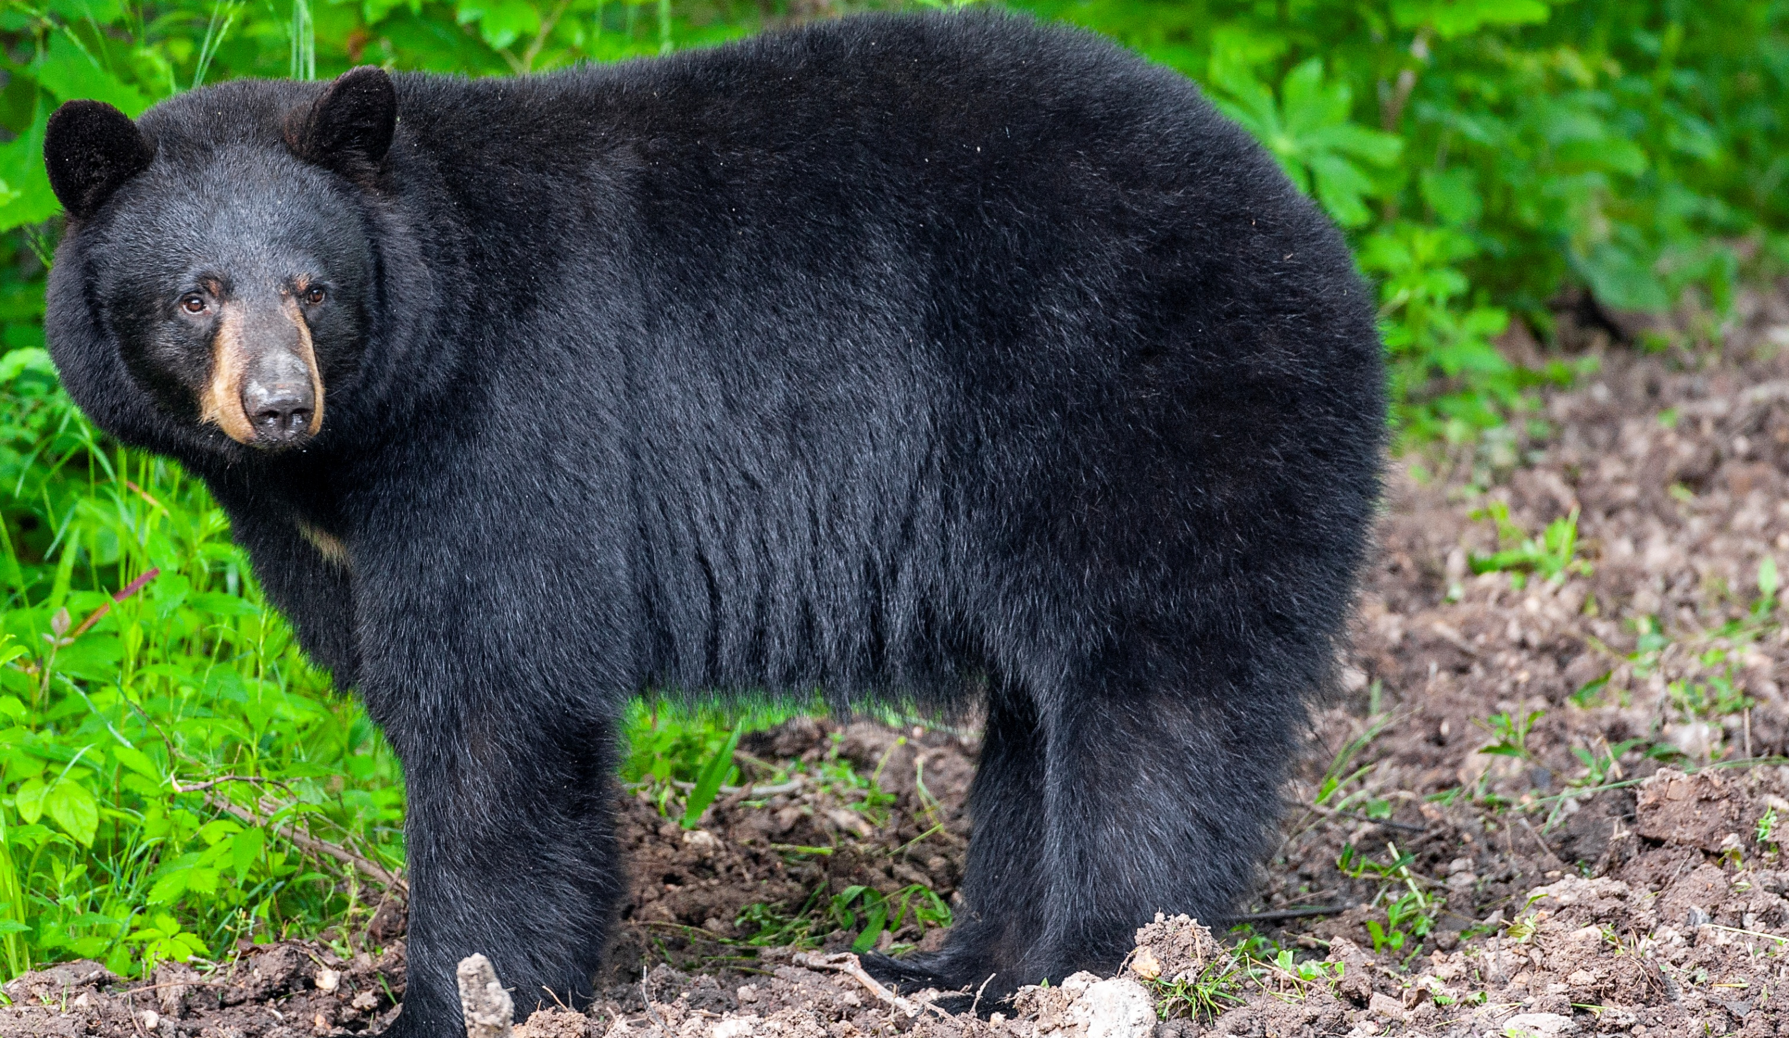

BEARS
Through the Seasons
Lesson 1E: Keep It Cool, Bear!

Slide 2
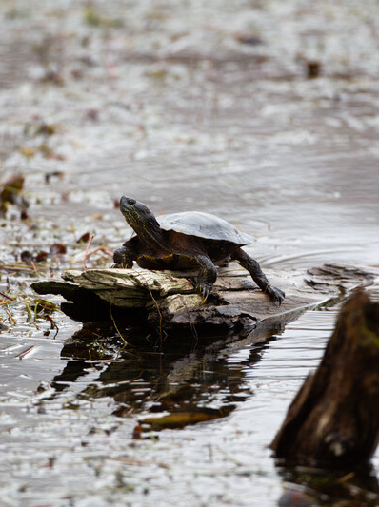

Guiding Question:
It is a hot day and you are outside playing.
How might you cool off?
How do animals cool off?
Bears through the Seasons – 1E Keep It Cool, Bear: Engage
2
Notes:
Animal: Western Painted Turtle

Slide 3

Bears through the Seasons – 1E Keep It Cool, Bear: Engage
3
Notes:
Prepare and display your Noticings and Wonderings Chart for this lesson. Add student observations and/or questions to the chart as the lesson proceeds in reference to the phenomenon studied.

Slide 4
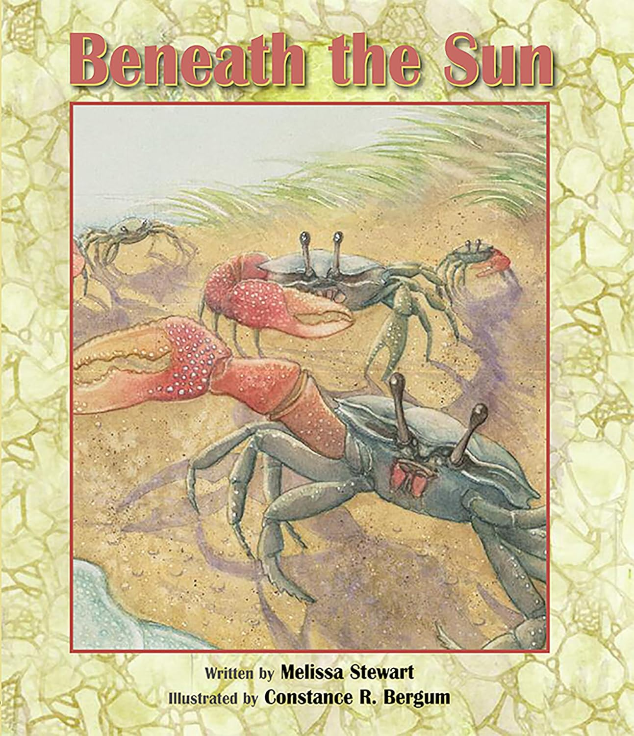
Read the book Beneath the Sun by Melissa Stewart
Link to book on Epic!: Beneath the Sun by Melissa Stewart
Available for free to classroom teachers on Epic! (login required)
Link to Read-Aloud: https://youtu.be/AYqDoop1Ik0?si=qIpK5IRt2Vck8Is0
Bears through the Seasons – 1E Keep It Cool, Bear: Engage
4
Notes:
Read the book Beneath the Sun by Melissa Stewart

Slide 5

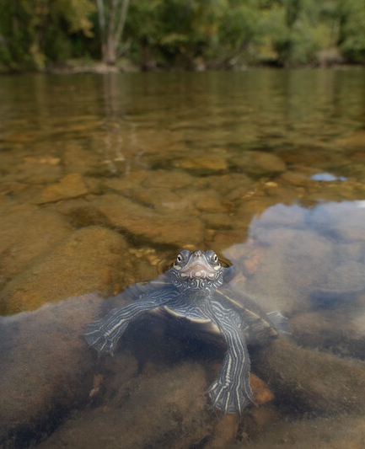
How do animals survive and get cool on very hot days?
Bears through the Seasons – 1E Keep It Cool, Bear: Engage
5
Notes:
Animal: Oucahita Map Turtle

Slide 6
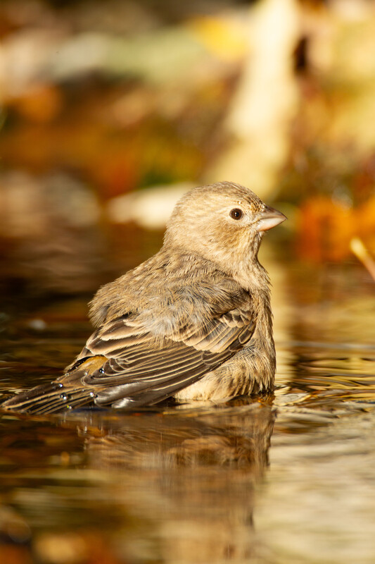
Let’s go outside for hike in our schoolyard. As we hike where do you think these different critters would go to stay cool?
Bears through the Seasons – 1E Keep It Cool, Bear: Engage
6
Notes:
Animal: House Finch

Slide 7
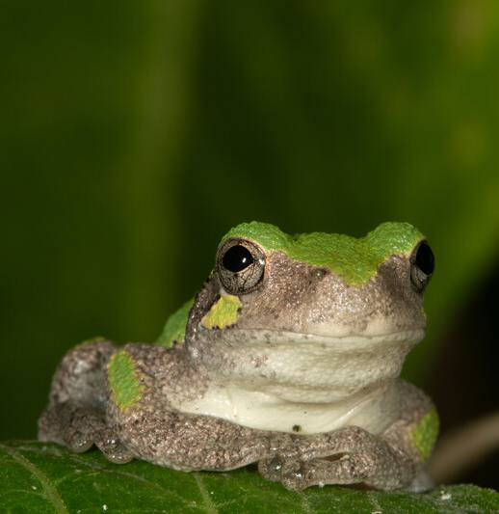
How do animals that live in our area stay cool on hot summer days?
Bears through the Seasons – 1E Keep It Cool, Bear: Explore
7
Notes:
Animals in the book: turkey vulture, woodchuck, earthworm, spittlebug, black swallowtail, caterpillar, osprey, frogs, crayfish
Animal in Picture: Grey Treefrog

Slide 8
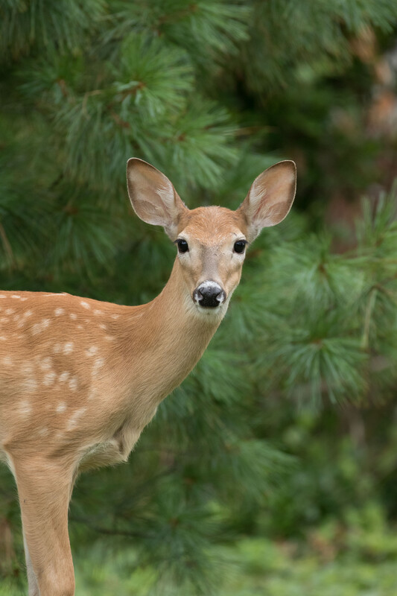
Let’s go outside for a hike in our schoolyard. As we hike, where do you think these critters would go to stay cool?
Bears through the Seasons – 1E Keep It Cool, Bear: Explore
8
Notes:
Let’s go outside for a hike in our schoolyard. As we are hiking, where do you think these critters would go to stay cool? White-tailed deer

Slide 9
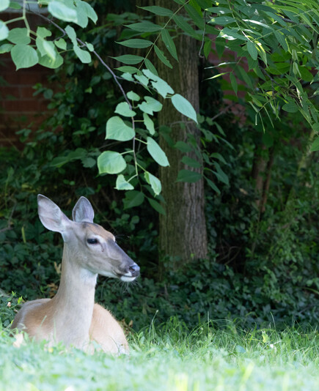
How are the ways animals cool off the same?
How are they different?
Bears through the Seasons – 1E Keep It Cool, Bear: Explain
9

Slide 10
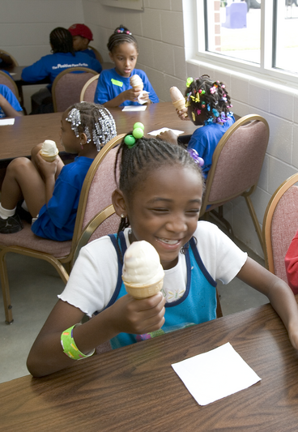
What ways do we, as humans, cool off?
Bears through the Seasons – 1E Keep It Cool, Bear: Explain
10

Slide 11
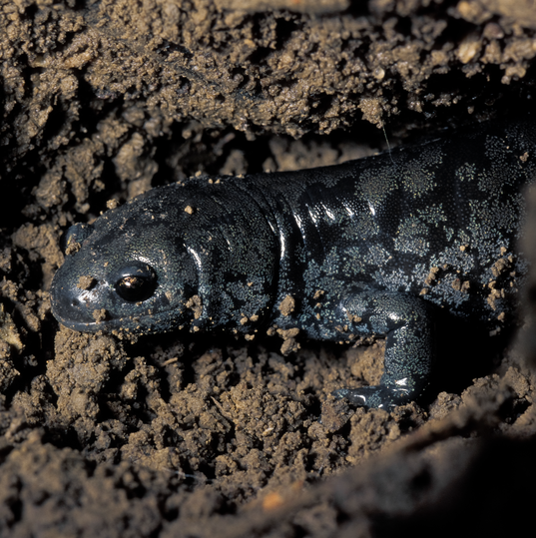
How are our ways as human the same or different than wild animals?
Bears through the Seasons – 1E Keep It Cool, Bear: Explain
11
Notes:
Animal: Mole Salamander

Slide 12
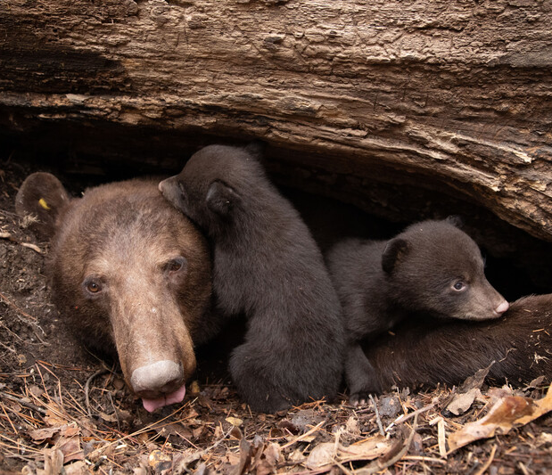
How do bears cool off? What do they do to warm up?
Bears through the Seasons – 1E Keep It Cool, Bear: Explain
12

Slide 13
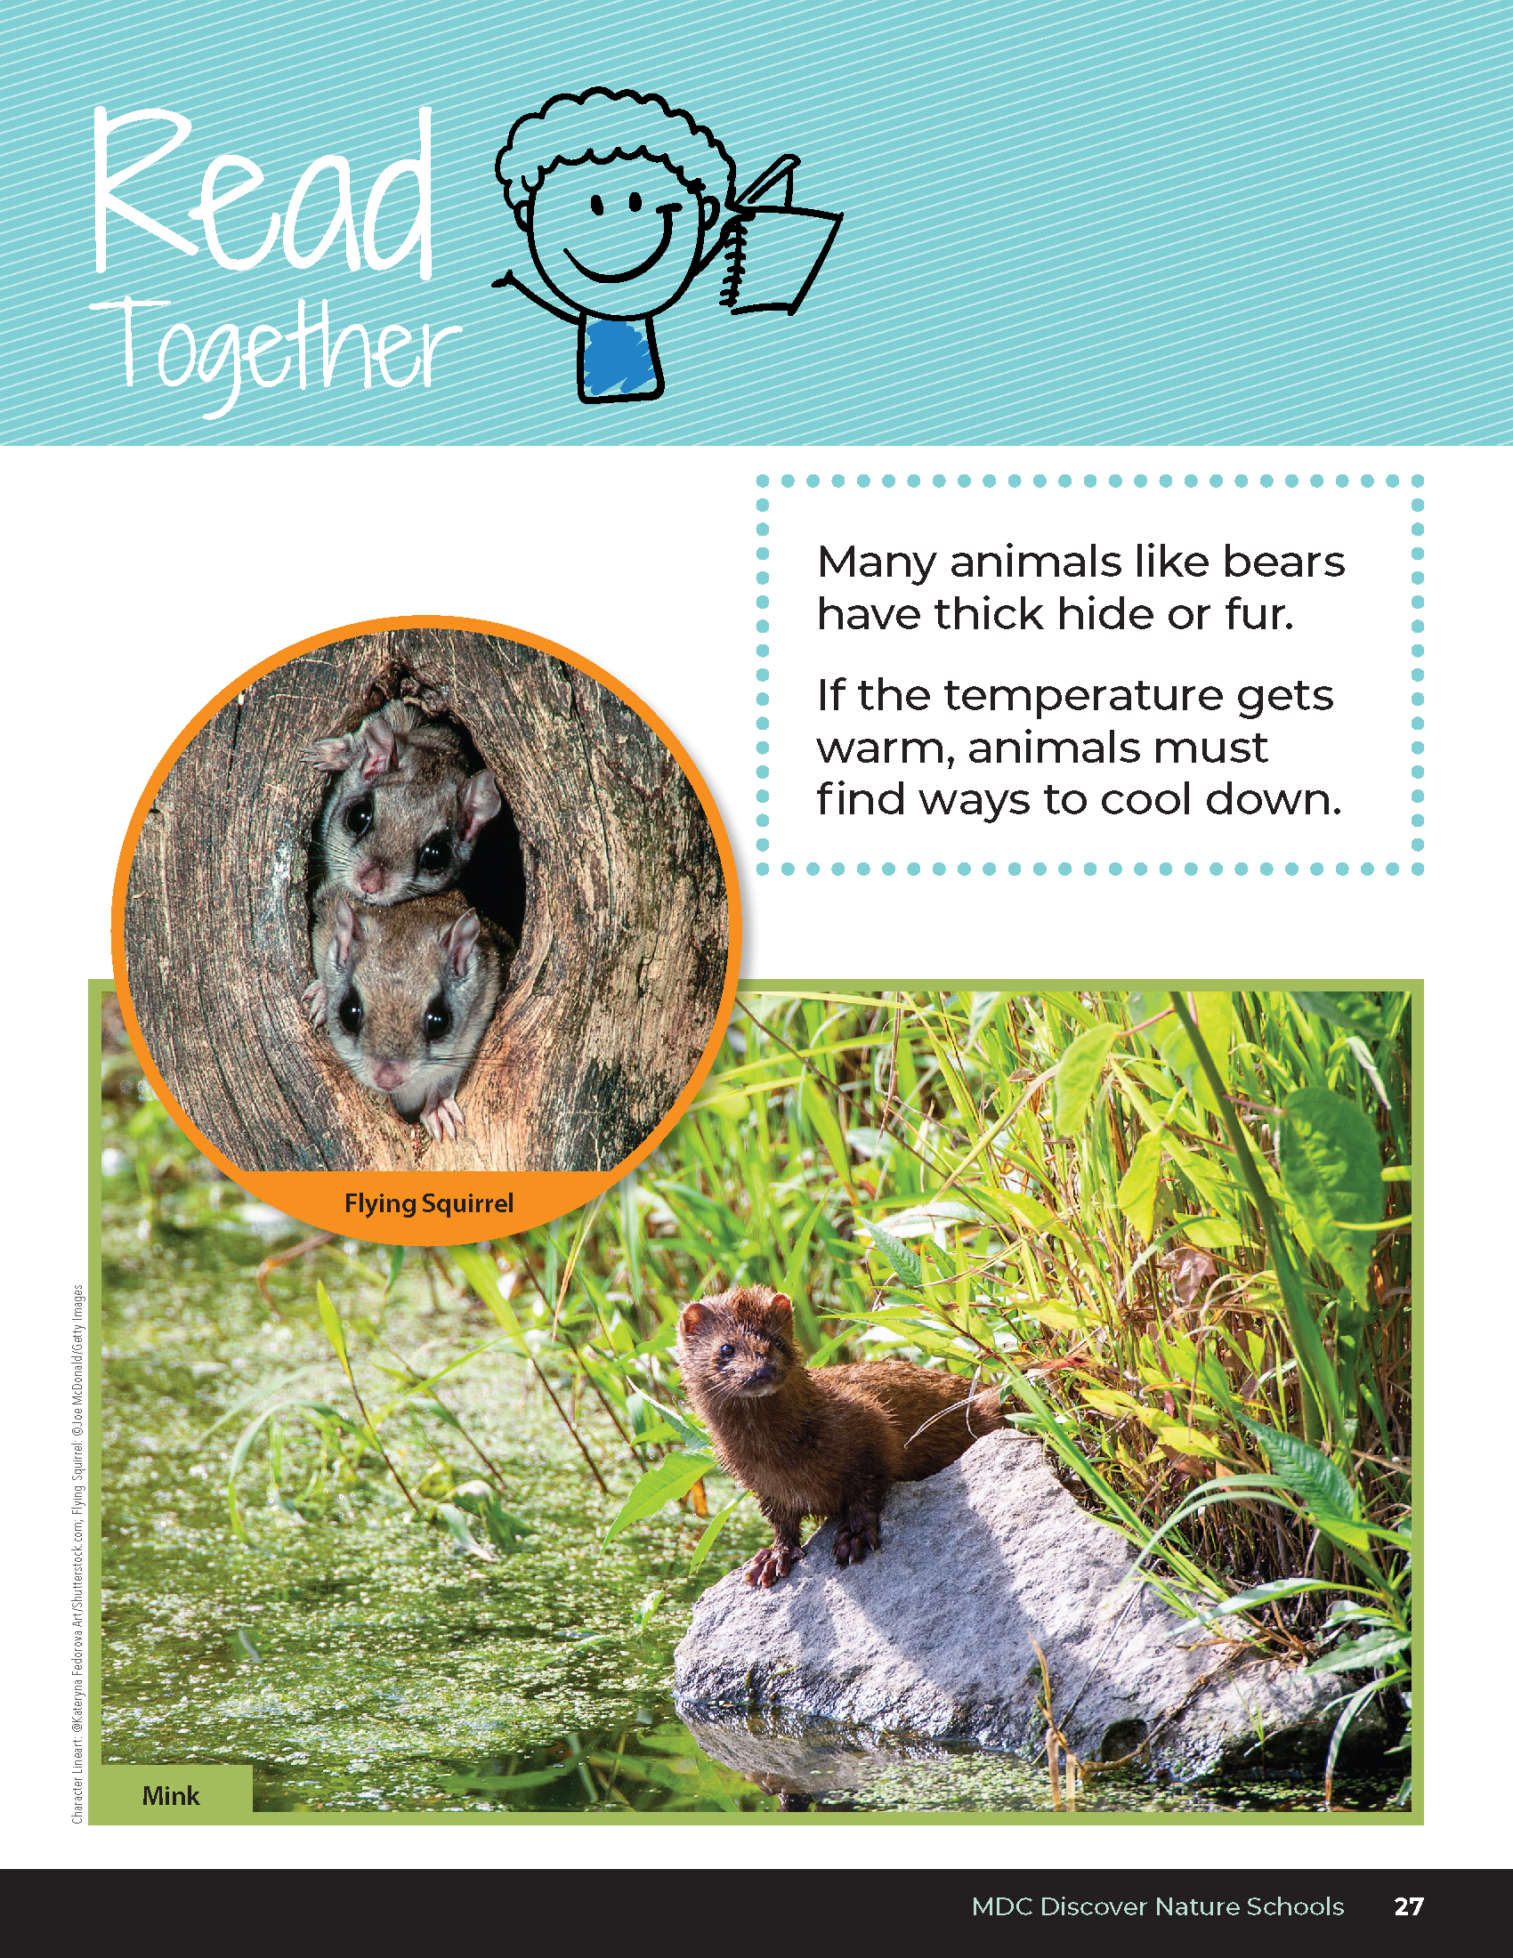

Many animals like bears have thick hide or fur
If the temperature gets warm, animals must find ways to cool down
Bears through the Seasons – 1E Keep It Cool, Bear: Explain
13
Notes:
Read together from student guide, Read Together on Page 27

Slide 14
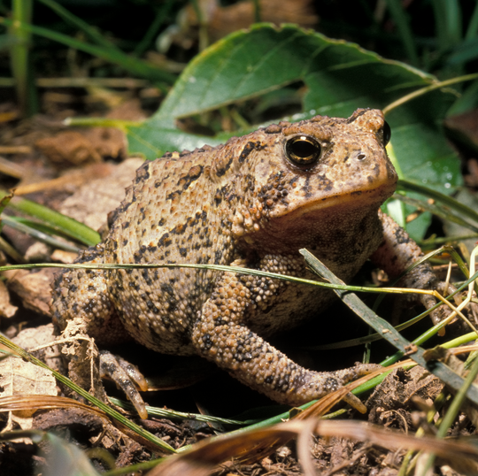
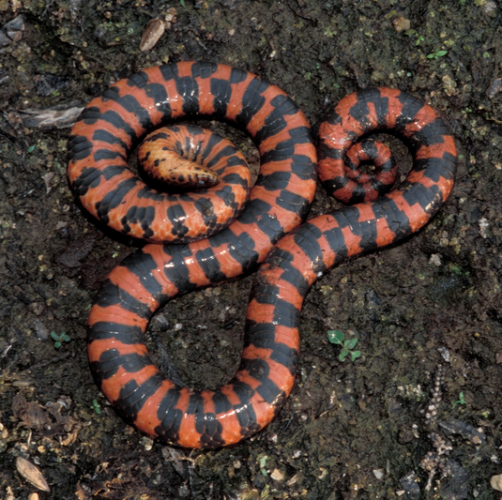
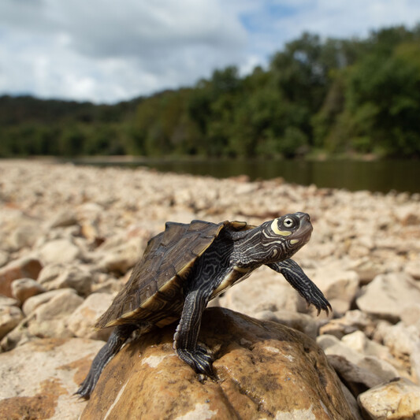
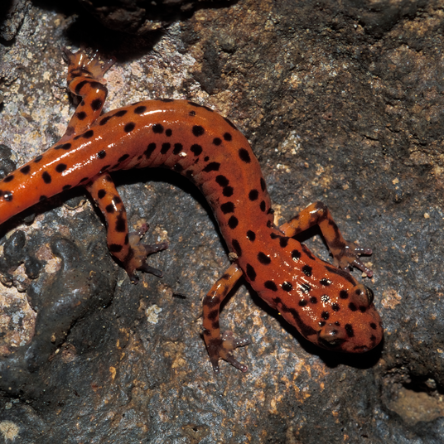
How might an animal cool down?
Are the ways similar?
Bears through the Seasons – 1E Keep It Cool, Bear: Explain
14
Notes:
Read the Talk About It on Page 28
Animals (pictured upper left, upper right, bottom left, bottom right): American Toad, Western Mud Snake, Oucahita Map Turtle, Cave Salamander

Slide 15

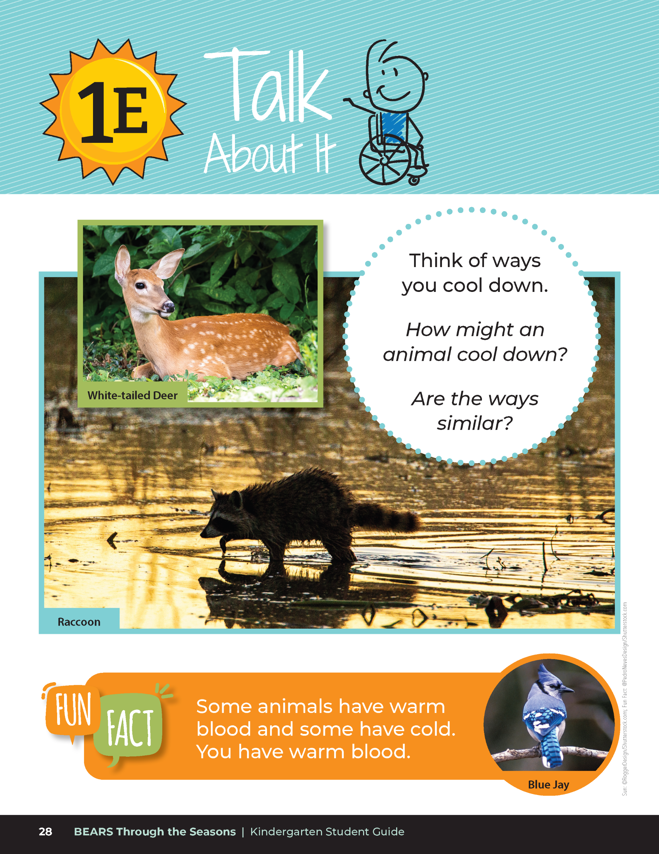
Some animals have warm blood, and some have cold blood.
You have warm blood.
Why would animals with cold blood need the sun?
Bears through the Seasons – 1E Keep It Cool, Bear: Explain
15

Slide 16
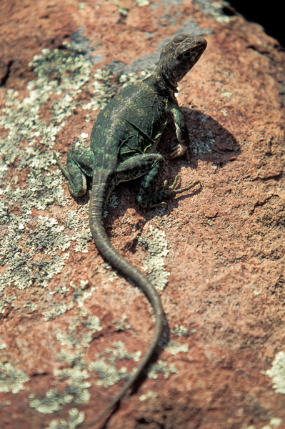
Bears through the Seasons – 1E Keep It Cool, Bear: Explain
16
Notes:
Read the Fun Fact on Page 28
Animal: Eastern Collard Lizard

Slide 17
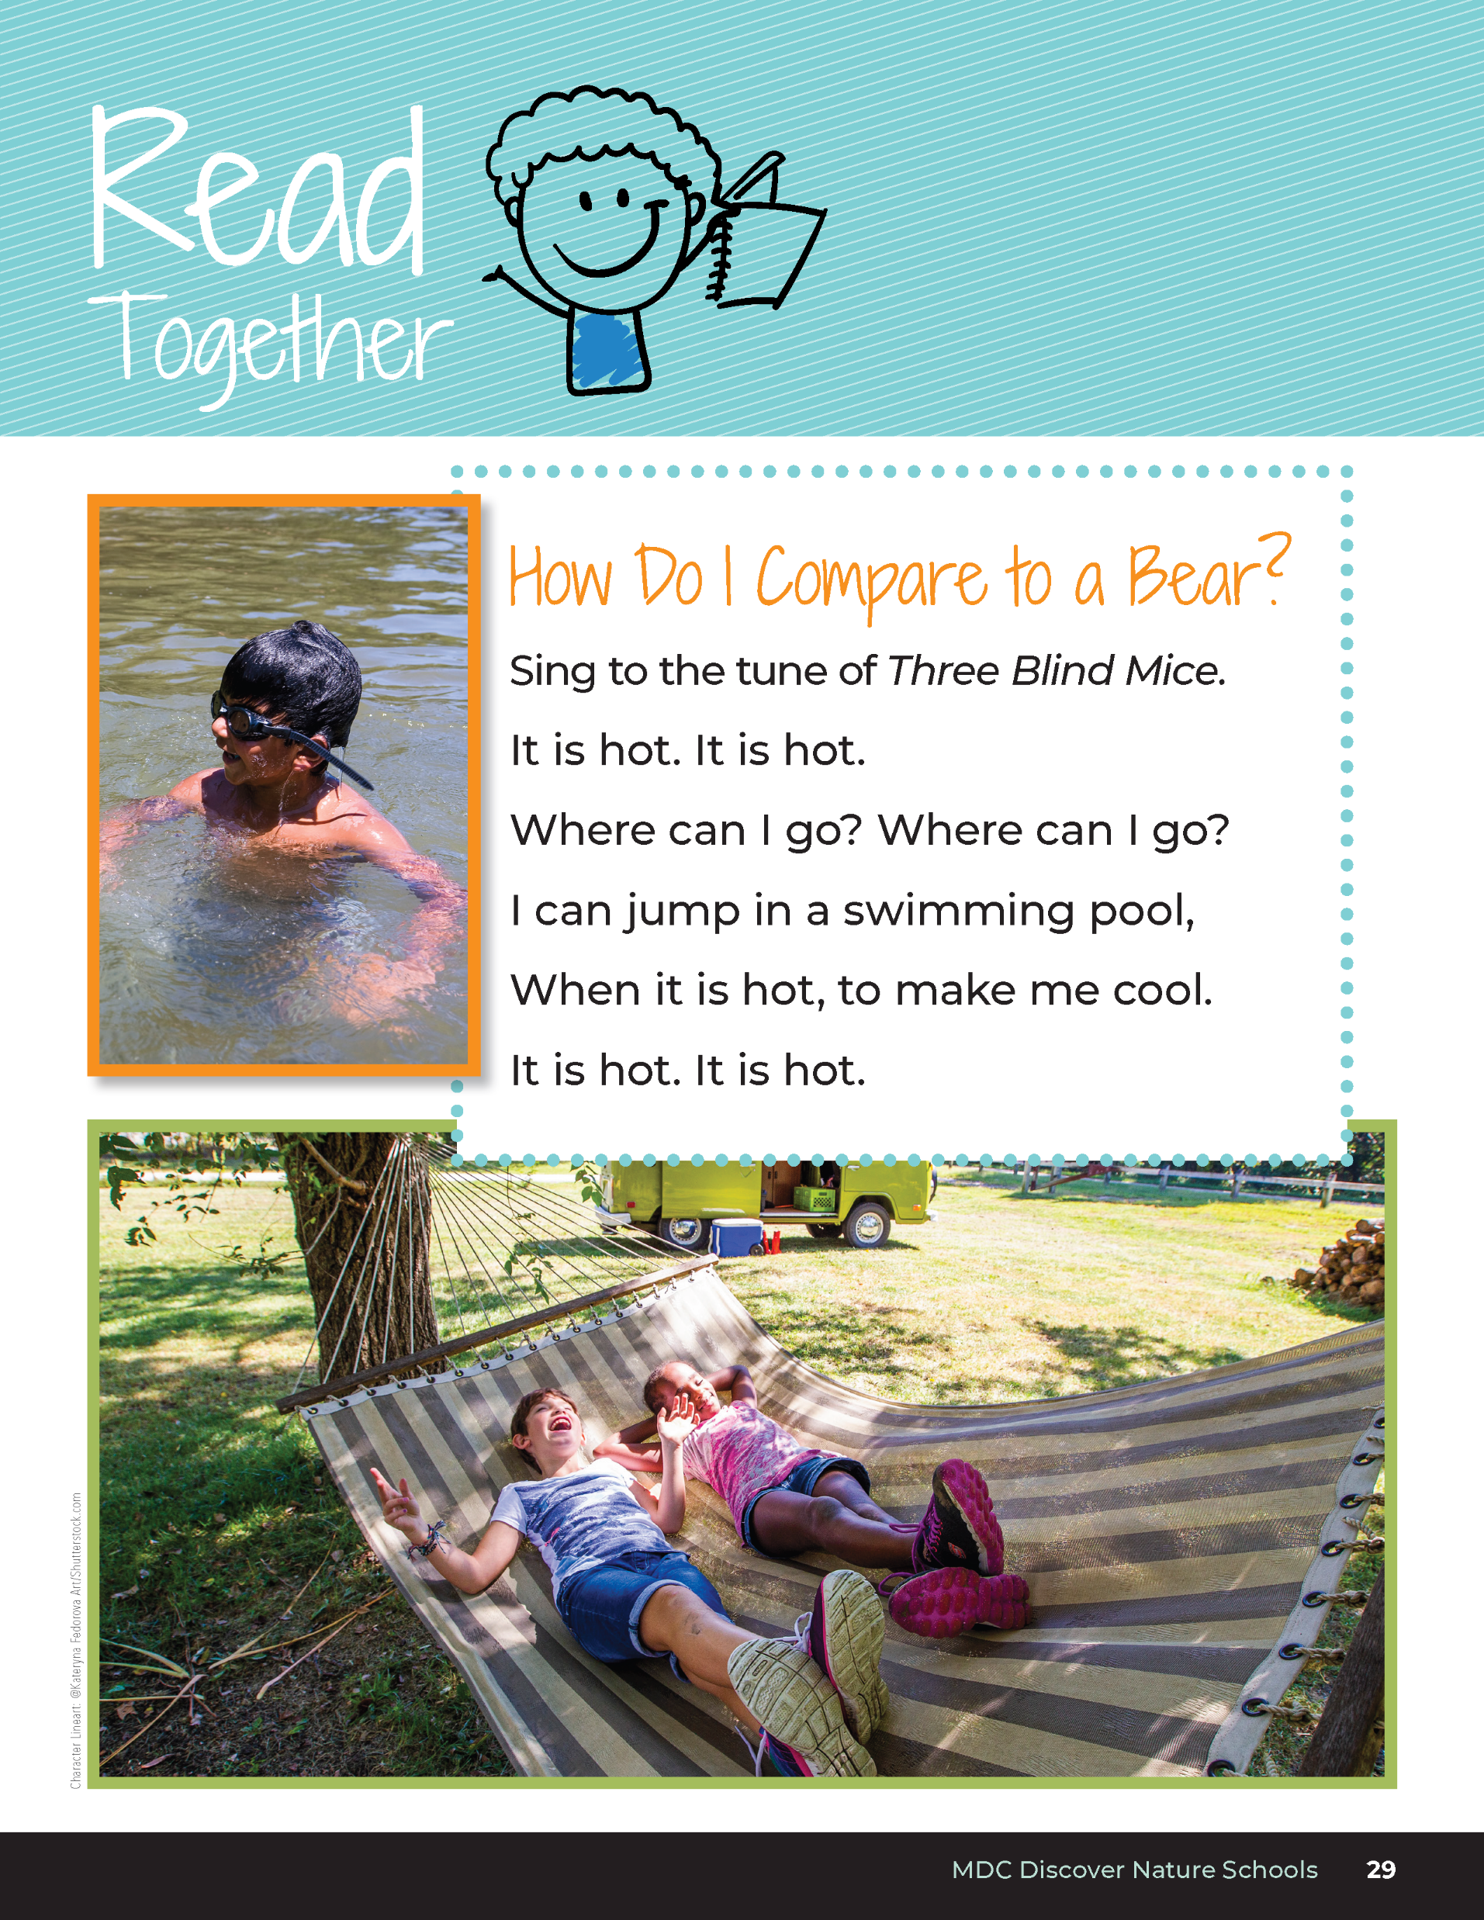
How Do I Compare to a Bear?
Sing to the tune of Three Blind Mice
It is hot. It is hot.
Where can I go? Where can I go?
I can jump in a swimming pool,
When it is hot, to make me cool.
It is hot. It is hot.
Bears through the Seasons – 1E Keep It Cool, Bear: Explain
17
Notes:
Read the Read Together How Do I Compare to a Bear? on Page 29. Sing to the tune of Three Blind Mice for each poem.

Slide 18
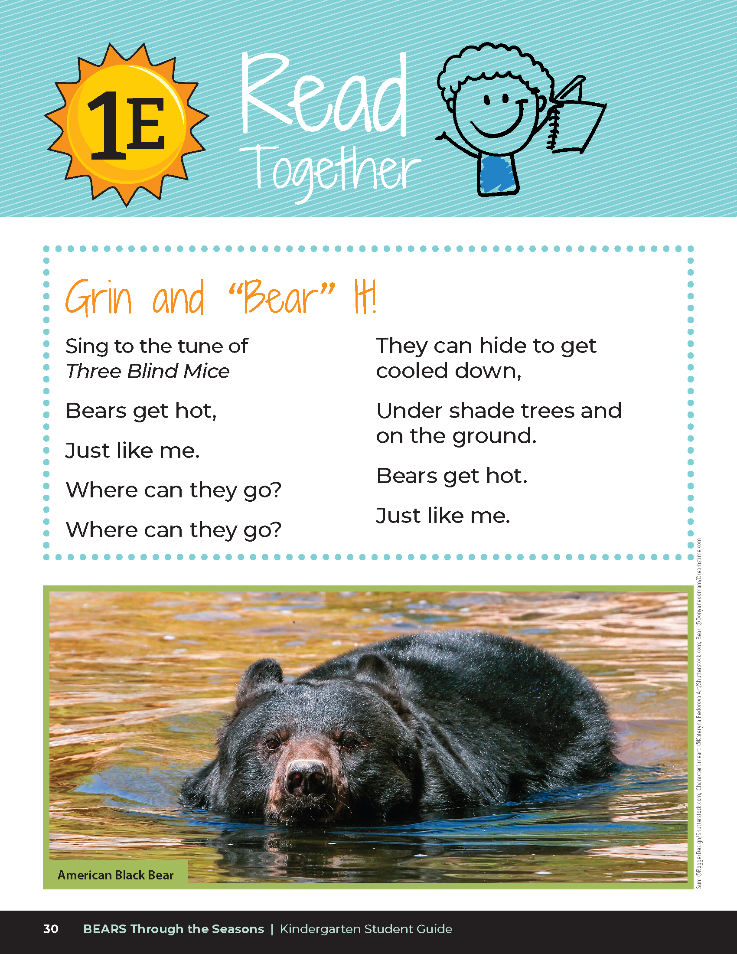
Grin and “Bear” It!
Sing to the tune of Three Blind Mice
Bears get hot,
Just like me.
Where can they go?
Where can they go?
They can hide to get cooled down,
Under shade trees and on the ground.
Bears get hot.
Just like me.
Bears through the Seasons – 1E Keep It Cool, Bear: Explain
18
Notes:
Read the Grin and Bear It on Page 30. Sing to the tune of Three Blind Mice for each poem. Then have students complete the following student guide, 1E Draw It!

Slide 19
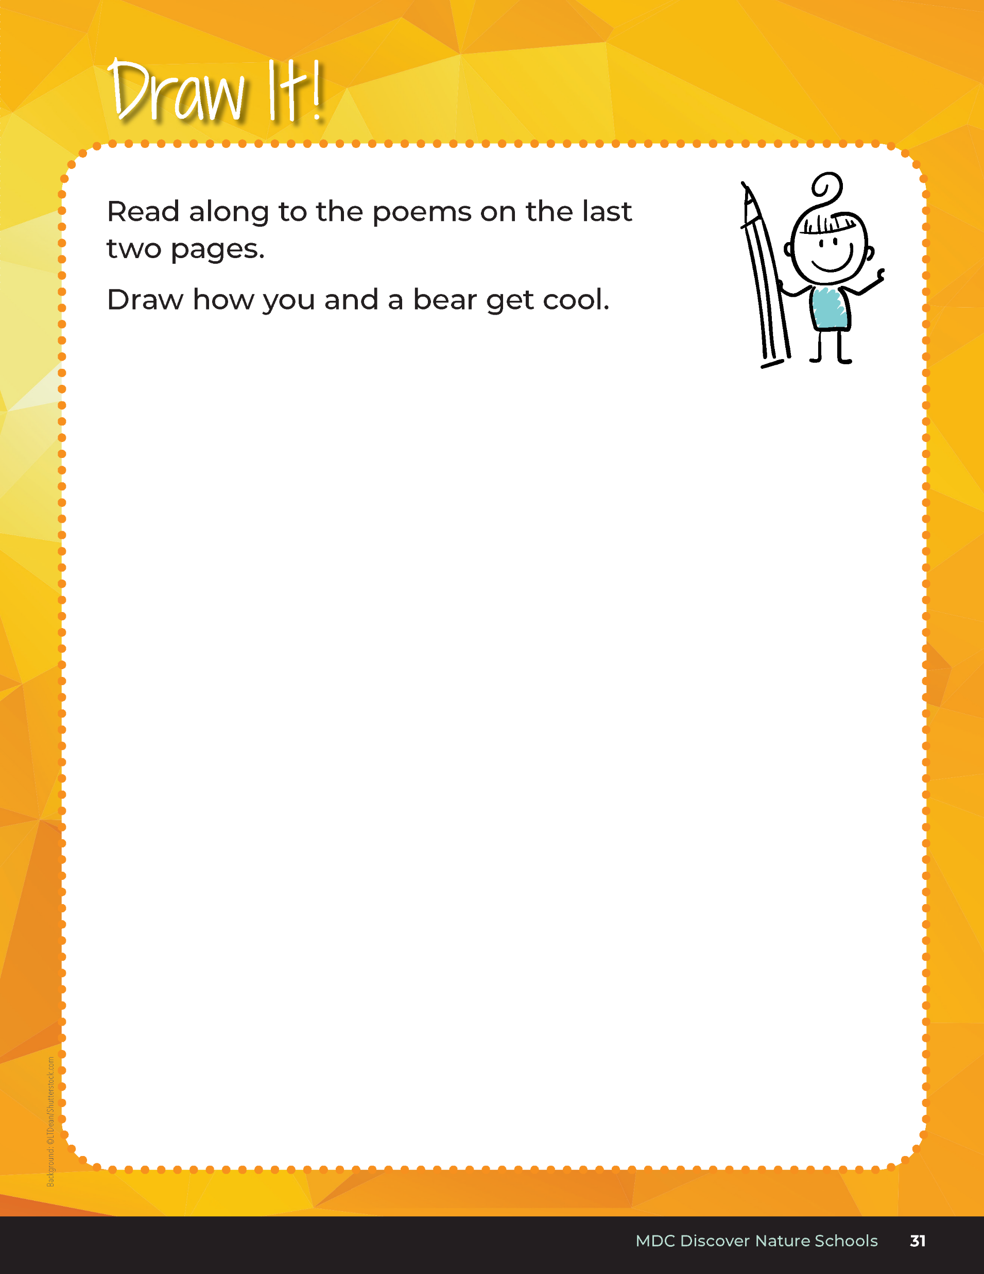

Draw how you and a bear get cool.
Bears through the Seasons – 1E Keep It Cool, Bear: Explain
19
Notes:
Then have students complete the following student guide, 1E Draw It!

Slide 20
How do bears and other animals cool down? Based on our observations and what we know, let's explore the different ways that bears and other animals may cool down.
Bears through the Seasons – 1E Keep It Cool, Bear: Explain
20
Notes:
Explore the different ways that bears and other animals may cool down.

Slide 21
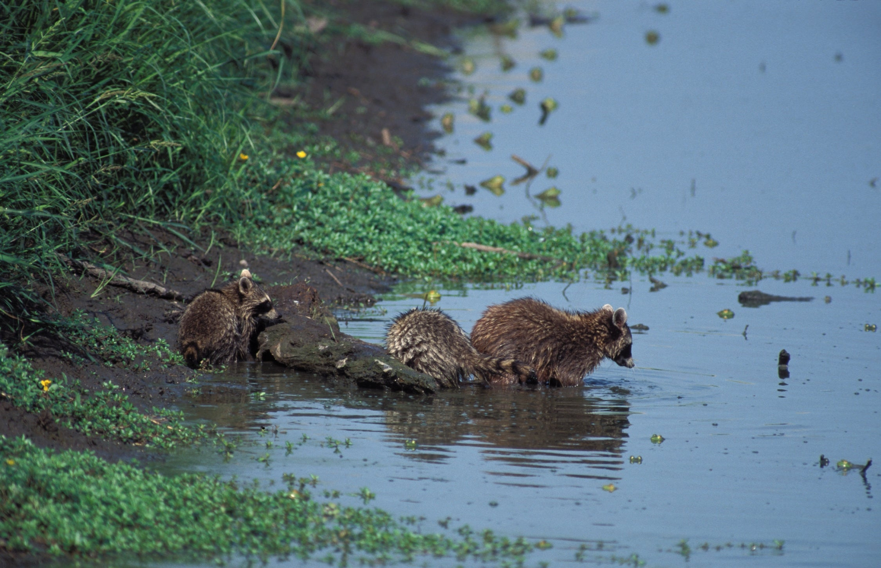
Bears through the Seasons – 1E Keep It Cool, Bear: Explain
21
Notes:
Explore the different ways that bears and other animals may cool down.
Animal: Family of raccoons

Slide 22
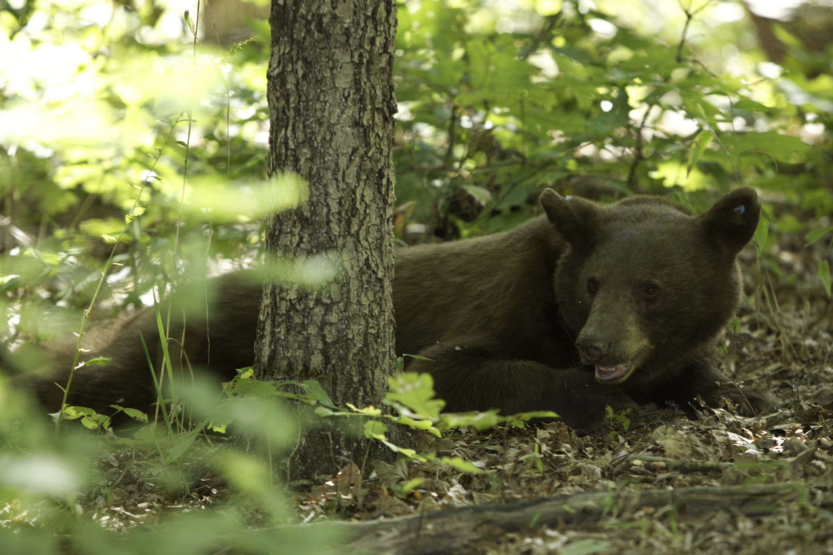
Bears through the Seasons – 1E Keep It Cool, Bear: Explain
22
Notes:
Explore the different ways that bears and other animals may cool down.

Slide 23
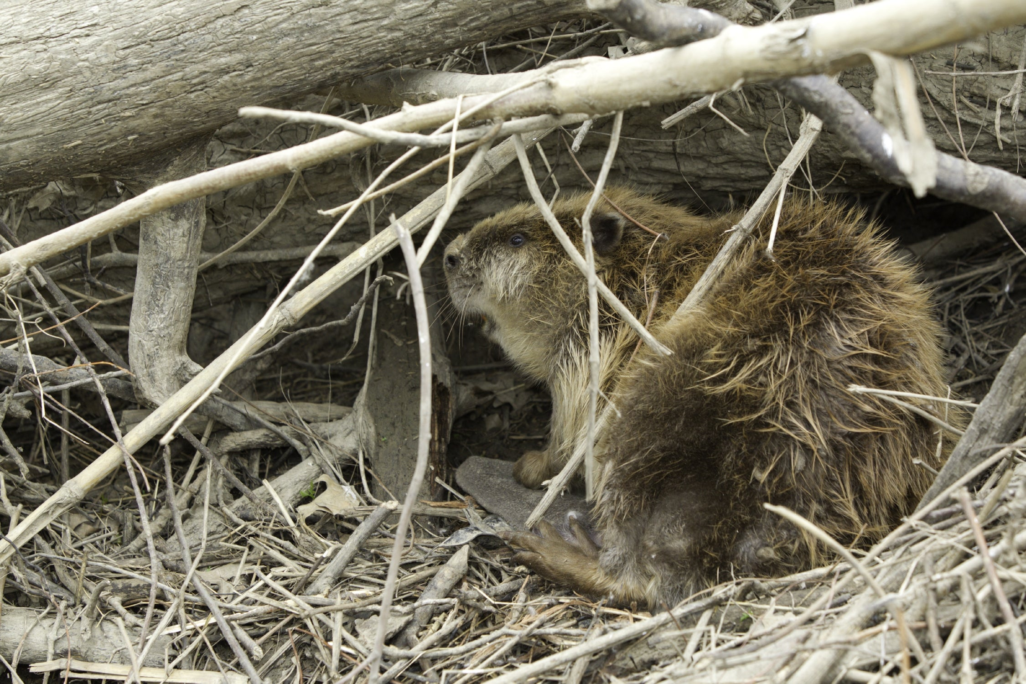
Bears through the Seasons – 1E Keep It Cool, Bear: Explain
23
Notes:
Explore the different ways that bears and other animals may cool down. Beaver
Animal: American Beaver

Slide 24
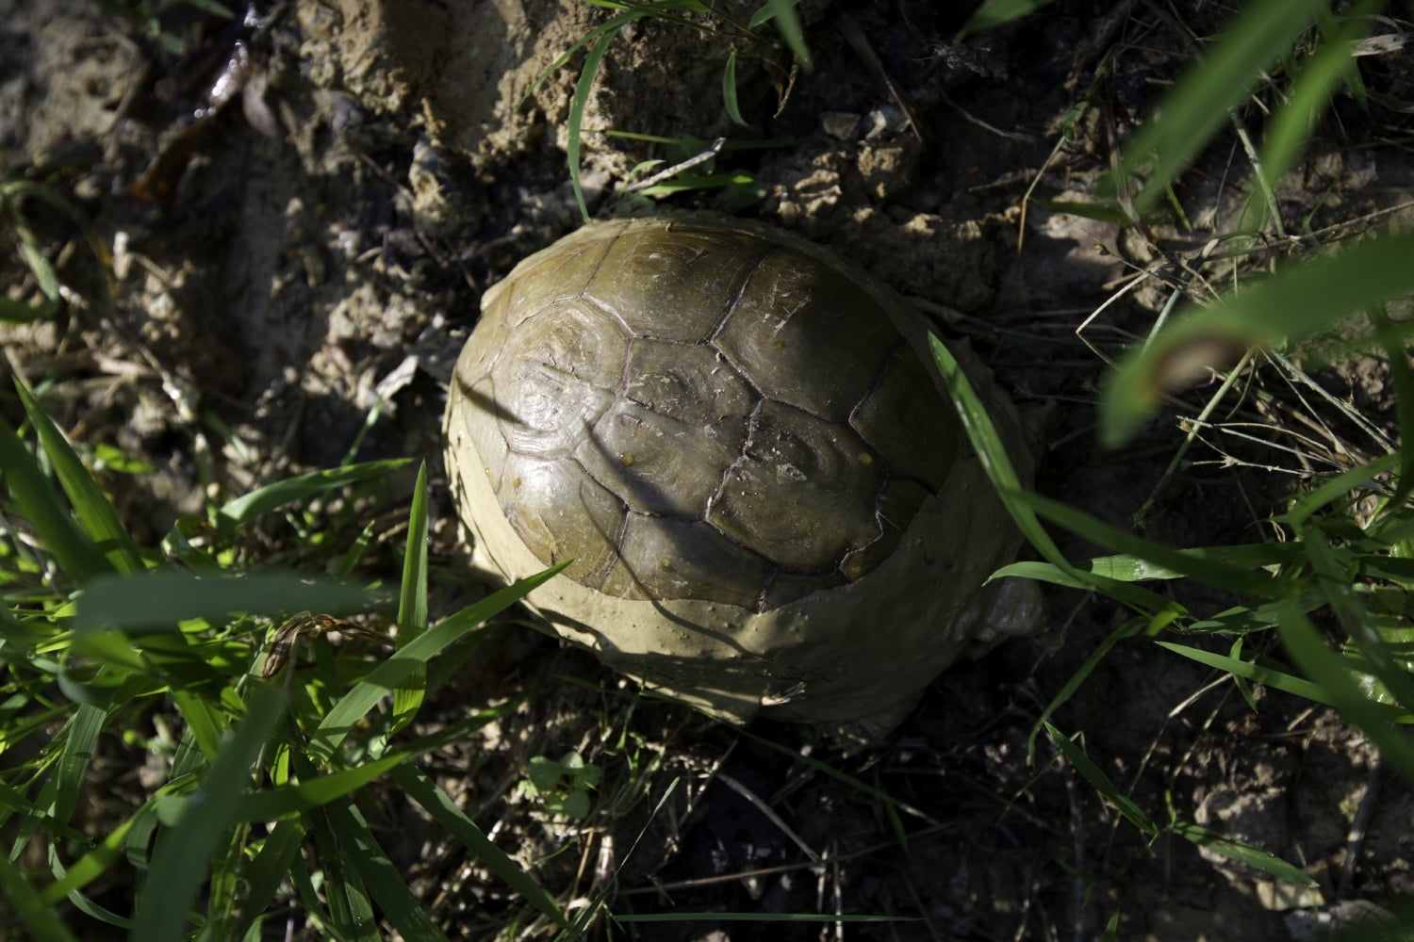
Bears through the Seasons – 1E Keep It Cool, Bear: Explain
24
Notes:
Explore the different ways that bears and other animals may cool down.
Animal: Box Turtle

Slide 25
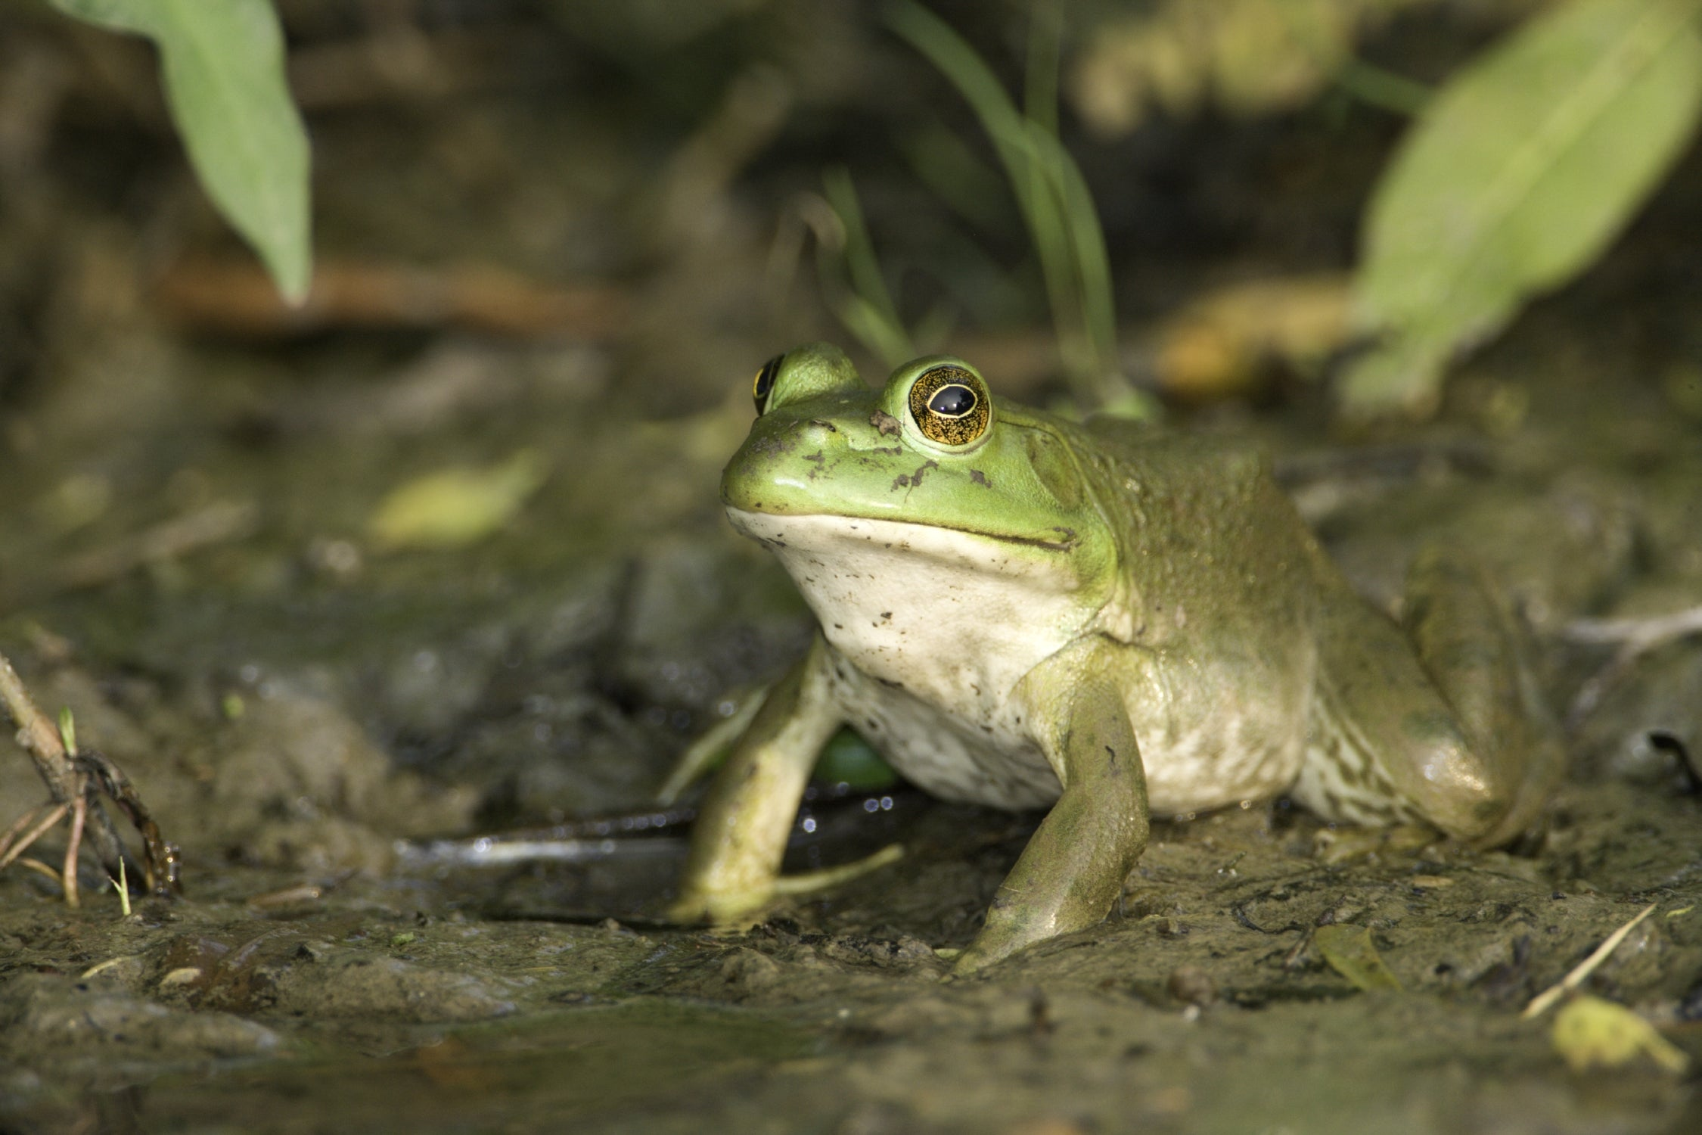
Bears through the Seasons – 1E Keep It Cool, Bear: Explain
25
Notes:
Explore the different ways that bears and other animals may cool down.
Animal: Bullfrog

Slide 26
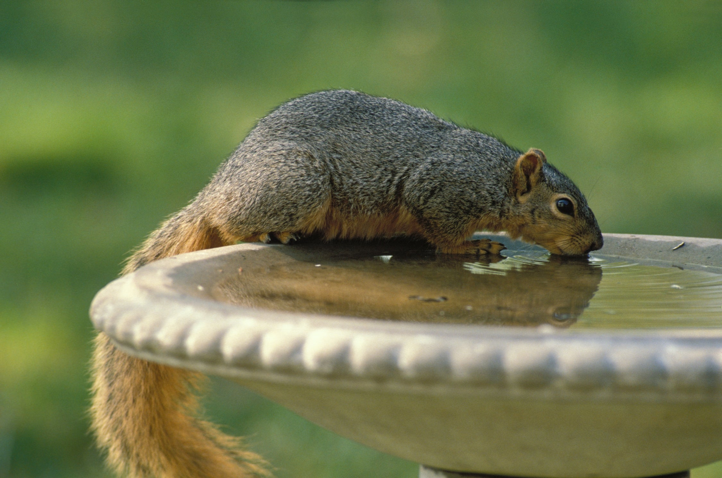
Bears through the Seasons – 1E Keep It Cool, Bear: Explain
26
Notes:
Explore the different ways that bears and other animals may cool down.
Animal: Fox Squirrel

Slide 27
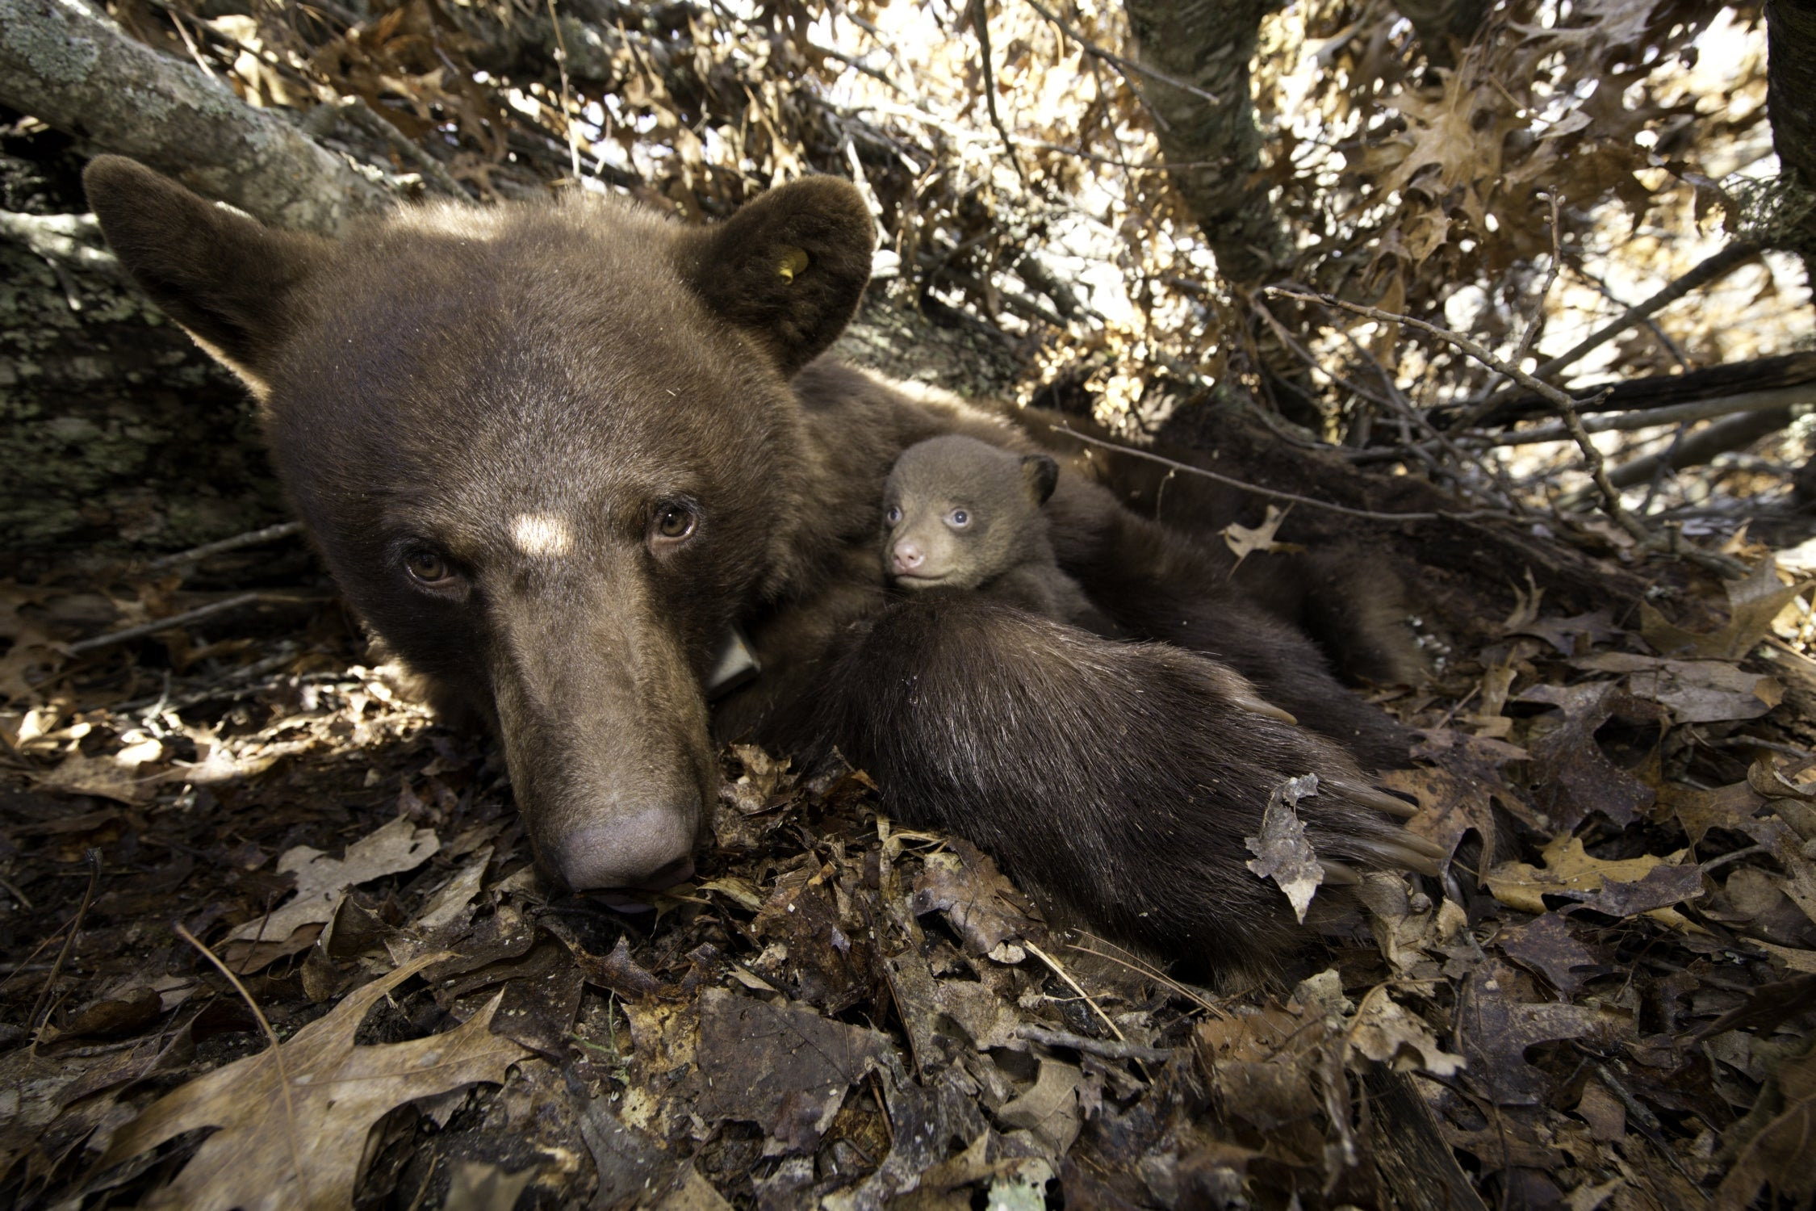
Bears through the Seasons – 1E Keep It Cool, Bear: Explain
27
Notes:
Explore the different ways that bears and other animals may cool down.

Slide 28
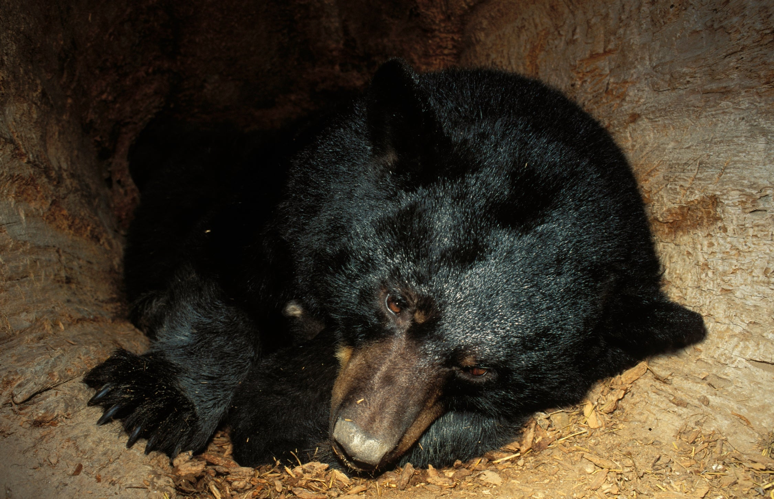
Bears through the Seasons – 1E Keep It Cool, Bear: Explain
28
Notes:
Explore the different ways that bears and other animals may cool down.

Slide 29
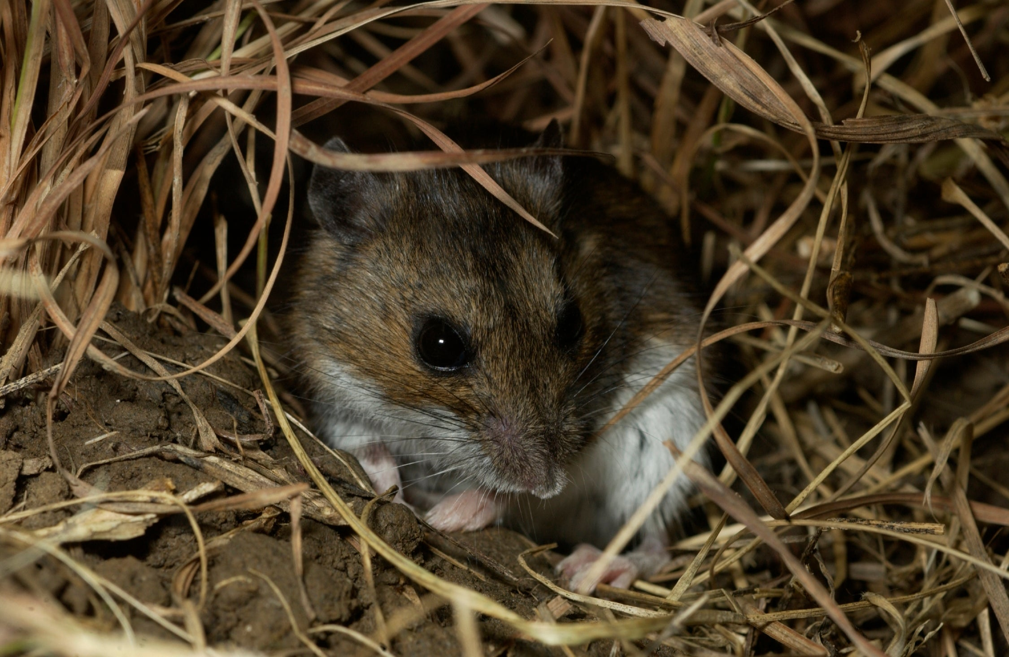
Bears through the Seasons – 1E Keep It Cool, Bear: Explain
29
Notes:
Explore the different ways that bears and other animals may cool down.
Animal: Deer Mouse

Slide 30
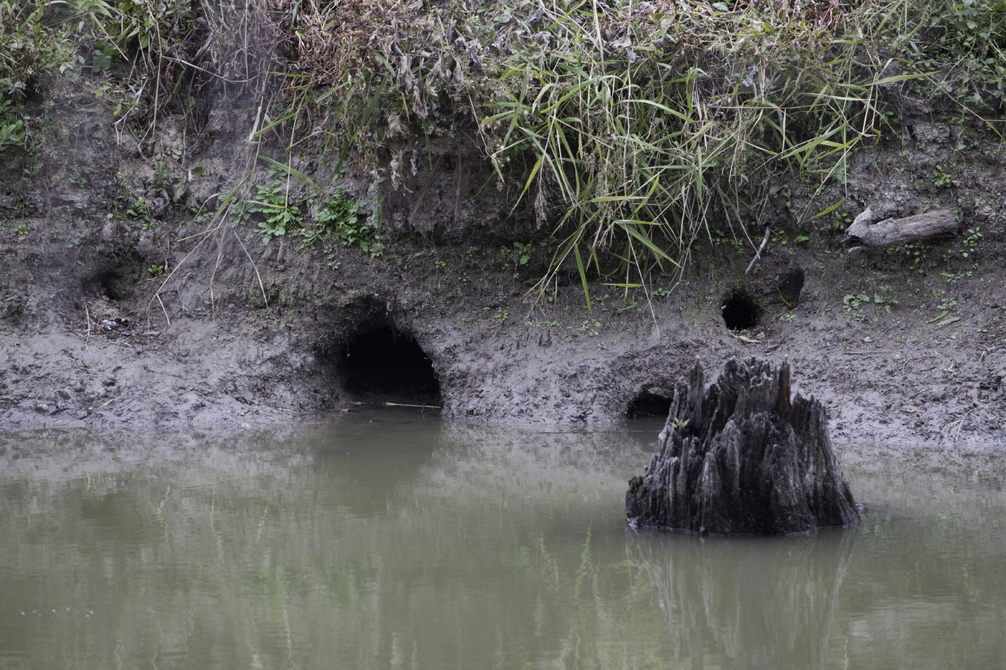
Bears through the Seasons – 1E Keep It Cool, Bear: Explain
30
Notes:
Explore the different ways that bears and other animals may cool down.

Slide 31
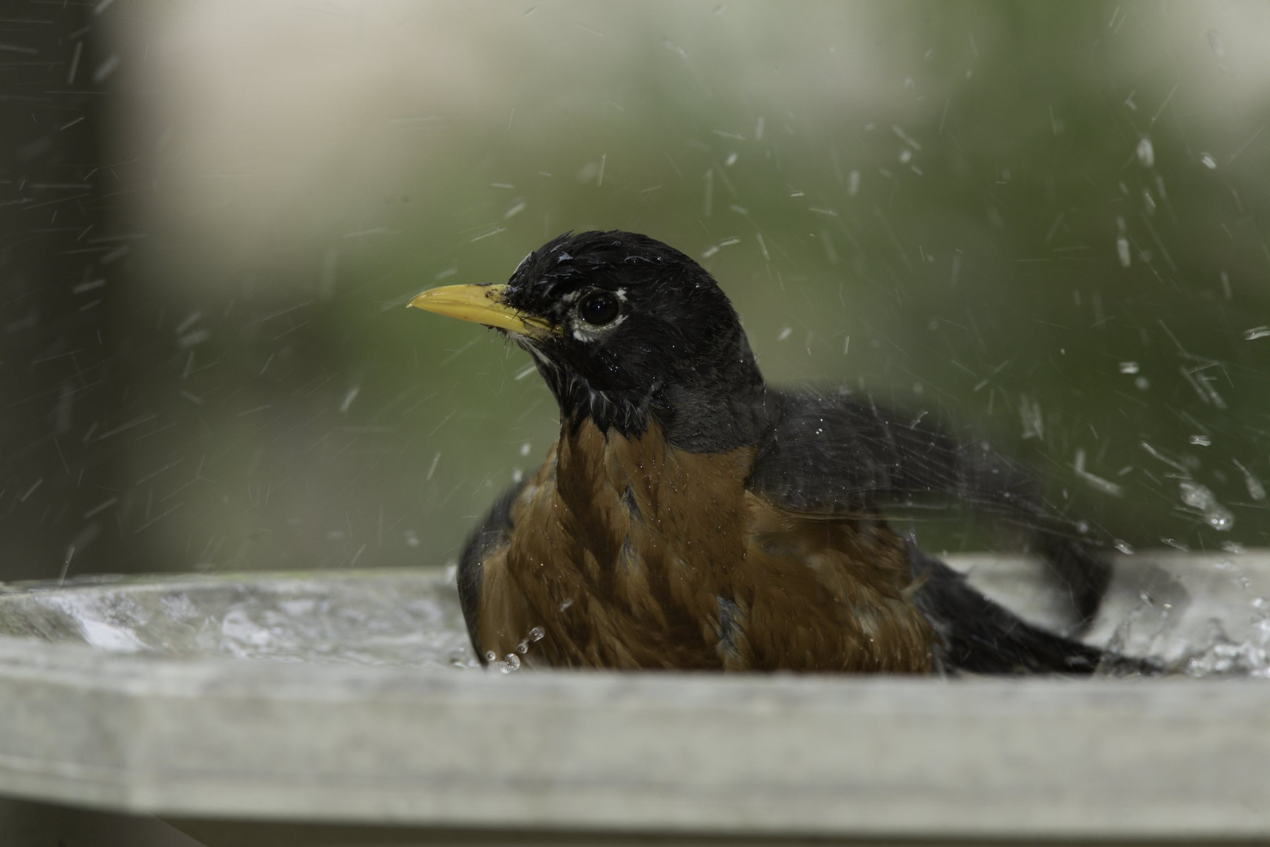
Bears through the Seasons – 1E Keep It Cool, Bear: Explain
31
Notes:
Explore the different ways that bears and other animals may cool down.
Animal: American Robin

Slide 32
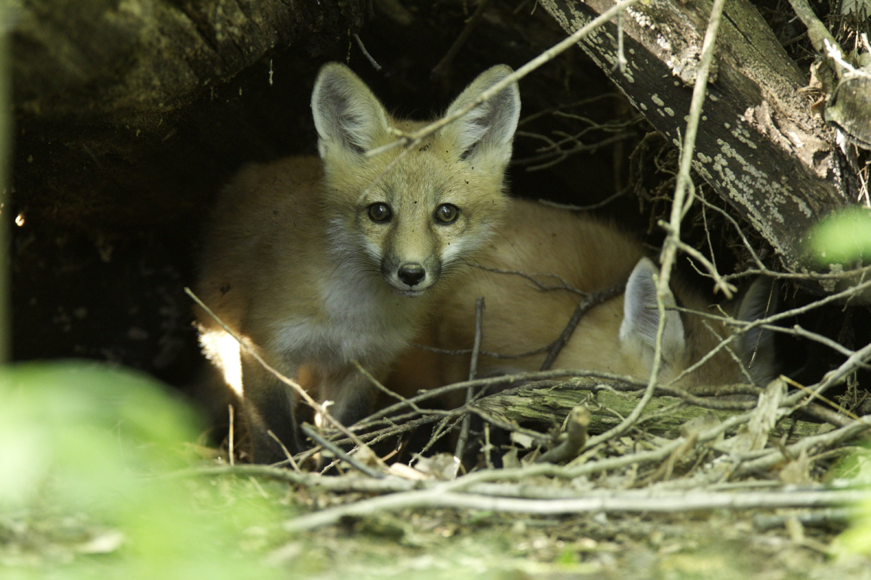
Bears through the Seasons – 1E Keep It Cool, Bear: Explain
32
Notes:
Explore the different ways that bears and other animals may cool down.
Animal: Red fox

Slide 33
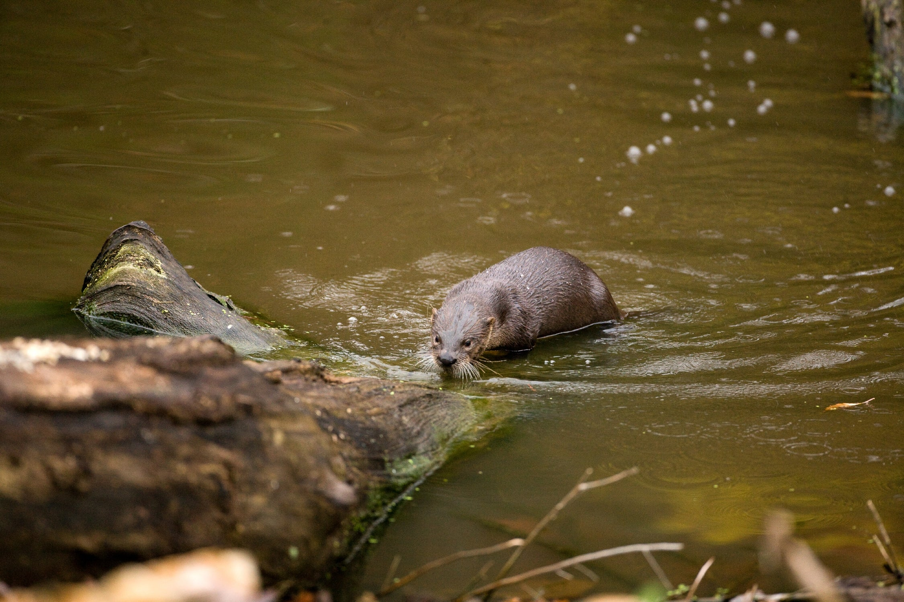
Bears through the Seasons – 1E Keep It Cool, Bear: Explain
33
Notes:
Explore the different ways that bears and other animals may cool down.
Animal: River otter

Slide 34
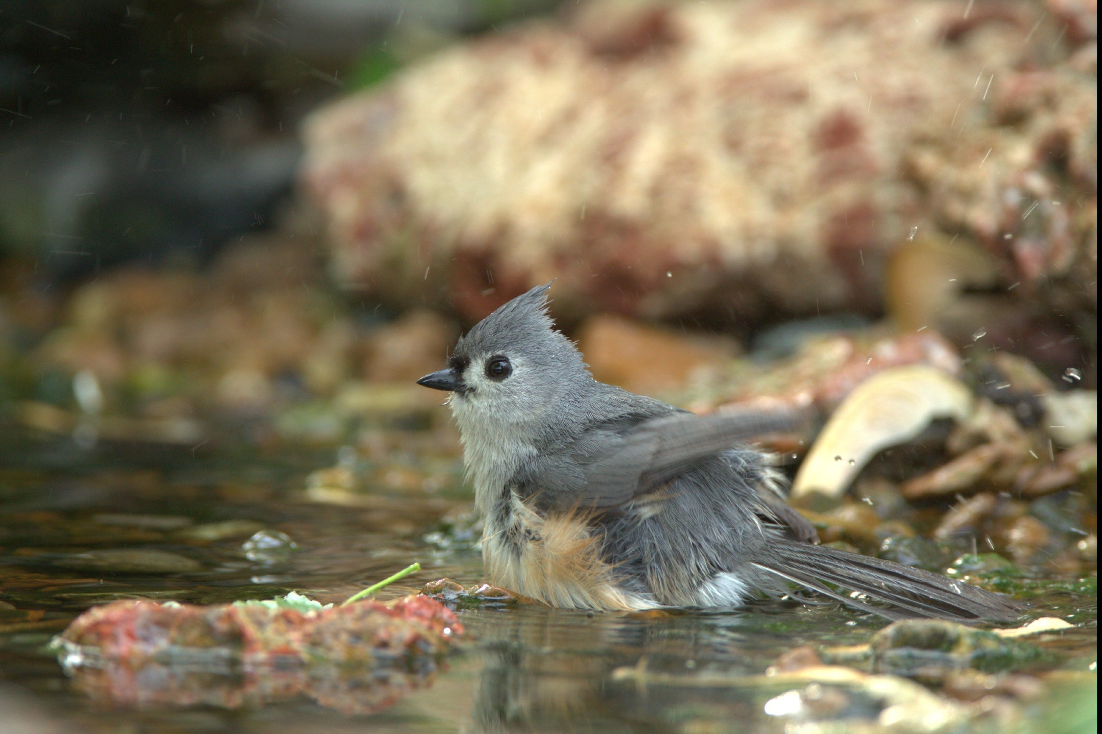
Bears through the Seasons – 1E Keep It Cool, Bear: Explain
34
Notes:
Explore the different ways that bears and other animals may cool down.
Animal: Tufted titmouse

Slide 35
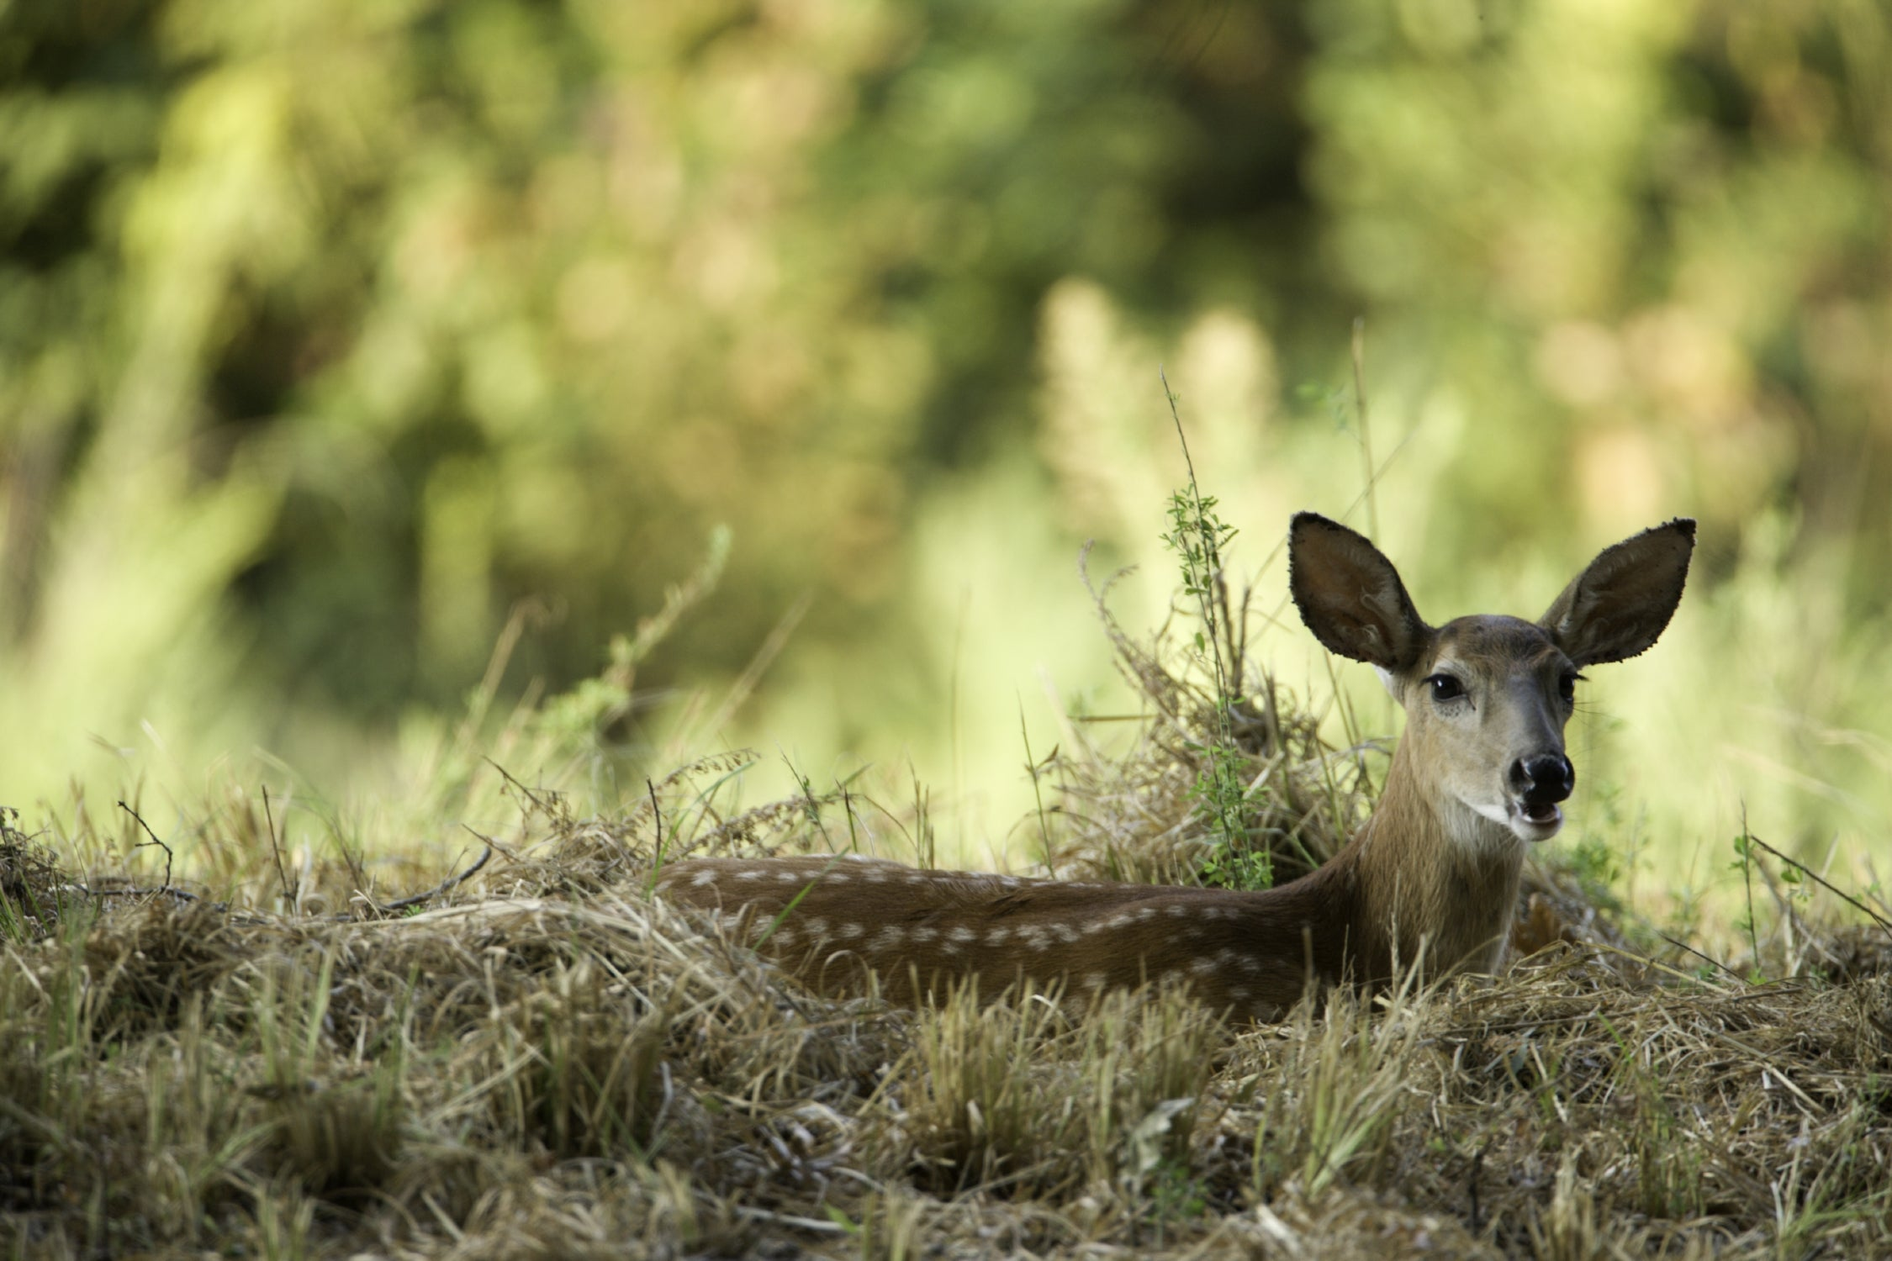
Bears through the Seasons – 1E Keep It Cool, Bear: Explain
35
Notes:
Explore the different ways that bears and other animals may cool down.
Animal: White-tailed deer fawn

Slide 36
How do bears and other animals cool down?
30
Bears through the Seasons – 1E Keep It Cool, Bear: Explain
36
Notes:
After viewing the different photos, ask the question: How do bears and other animals cool down?

Slide 37
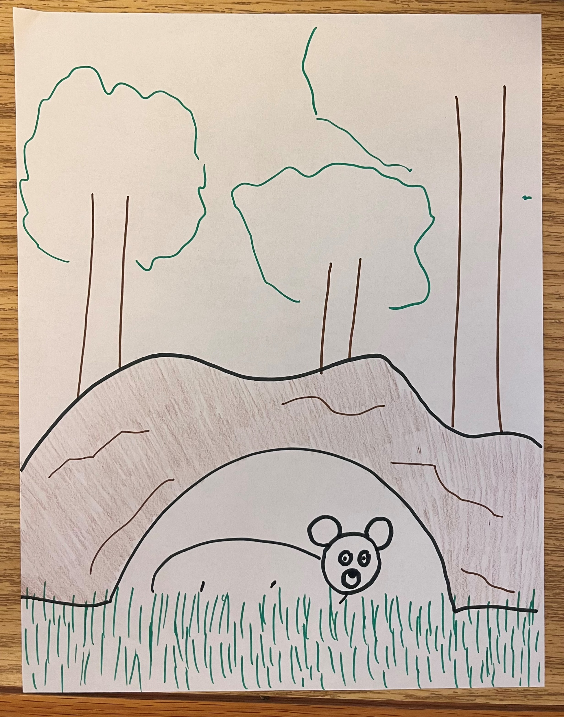
Make a model of something bears or another Missouri animal may find in nature to cool down
Bears through the Seasons – 1E Keep It Cool, Bear: Elaborate
37
Notes:
- Instruct students they are to make a model of something bears or another Missouri animal may find in nature to cool down, using natural or craft materials. They should use what was learned about animal behavior and temperature. Teacher discretion can be used as to the type of model students will make. It can be a diagram or a physical model. The materials for a physical model can vary – craft materials and/or natural materials (craft sticks, twigs, rocks, etc.).
- Note: The decision to do a paper diagram model or a physical model may be made based on the amount of time available.
- Add student observations and/or questions to the Noticings and Wonderings Chart as the lesson concludes in reference to the phenomenon studied

Slide 38

How does the shape of your model help to cool off the bears? What else needs to be added to our Noticing and Wonderings Chart?
Bears through the Seasons – 1E Keep It Cool, Bear: Evaluate
38
Notes:
Share designs with the class. Instruct student to tell how and why their design will be effective and how the design mimics what was seen earlier in the Keep It Cool, Bear! Presentation

Slide 39
Bears through the Seasons – 1E Keep It Cool, Bear: Evaluate
39
Notes:
Reference the Noticings and Wonderings Chart: Ask students:
What else needs to be added to the chart?
Ask students what should be added to represent what was learned about bear behavior and bear dens.

Slide 40
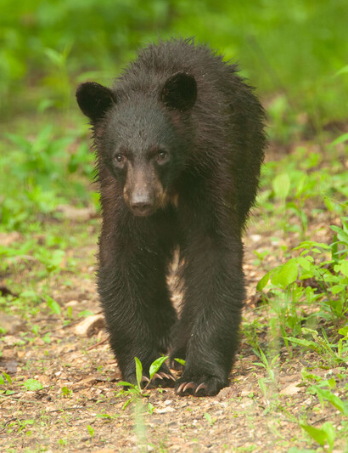
What should be added to represent what was learned about bear behavior and bear dens?
Bears through the Seasons – 1E Keep It Cool, Bear: Evaluate
40
Notes:
Young back bear.

