Slide 1
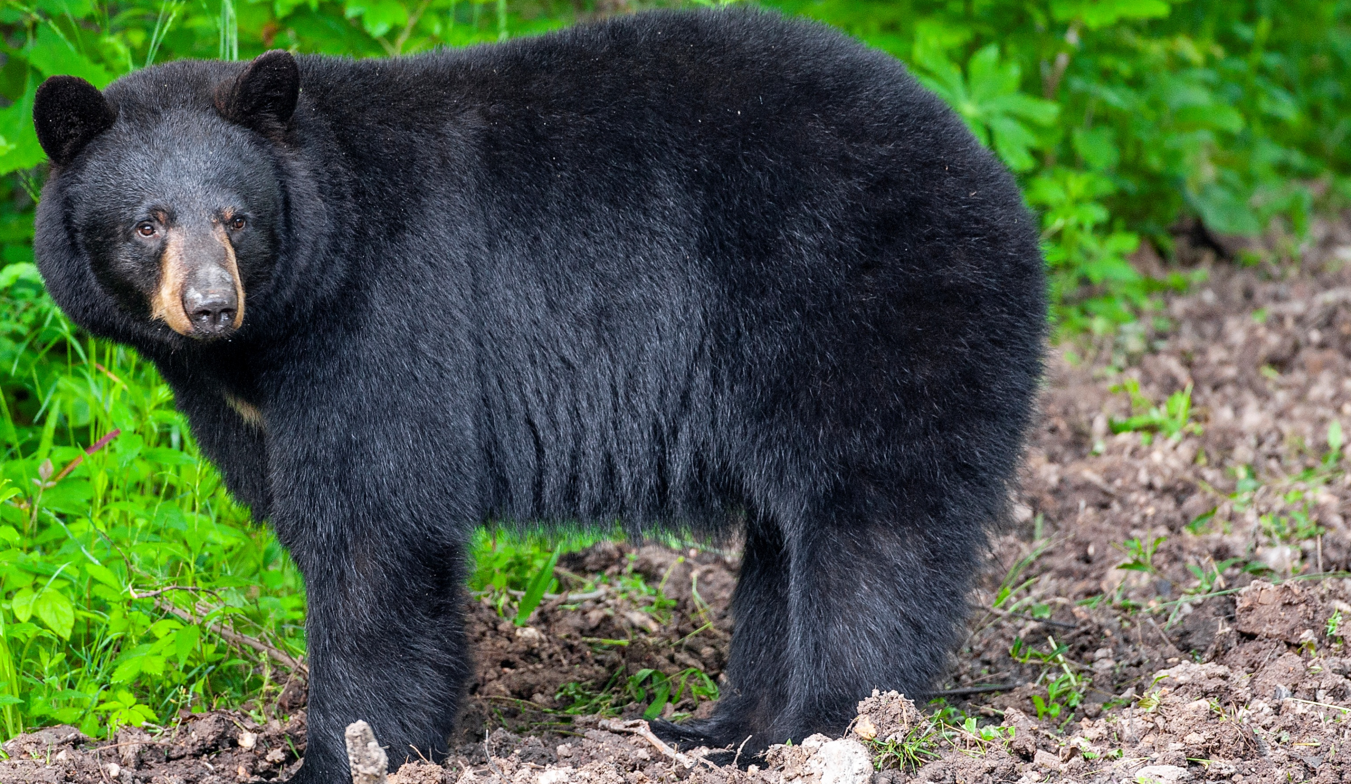

BEARS
Through the Seasons
Lesson 1B: What is Weather?

Slide 2
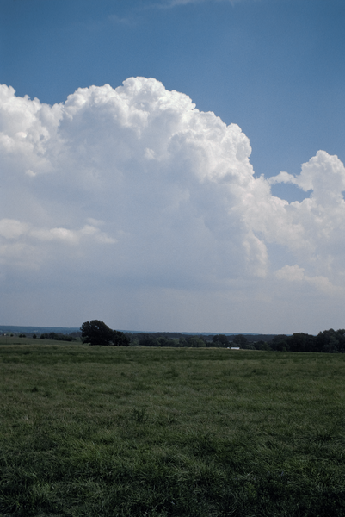

Guiding Question:
How do we study weather?
Bears through the Seasons – 1B What is Weather: Engage
2

Slide 3

Bears through the Seasons – 1B What is Weather: Engage
3
Notes:
Prepare and display your Noticings and Wonderings Chart for this lesson. Add students observations and/or questions to the chart as the lesson proceeds in reference to the phenomenon studied.

Slide 4
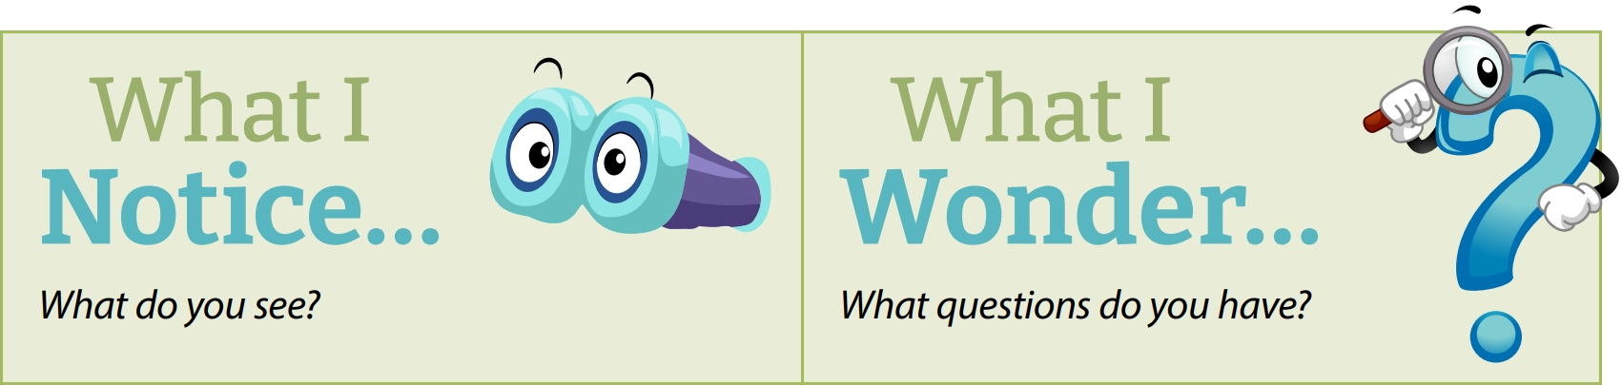
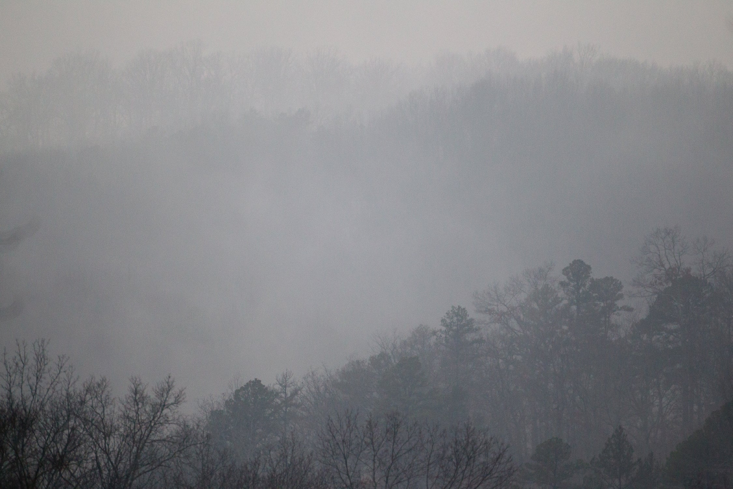
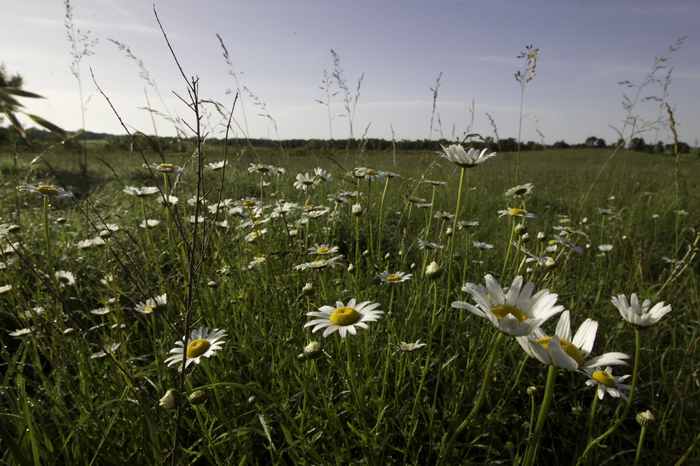
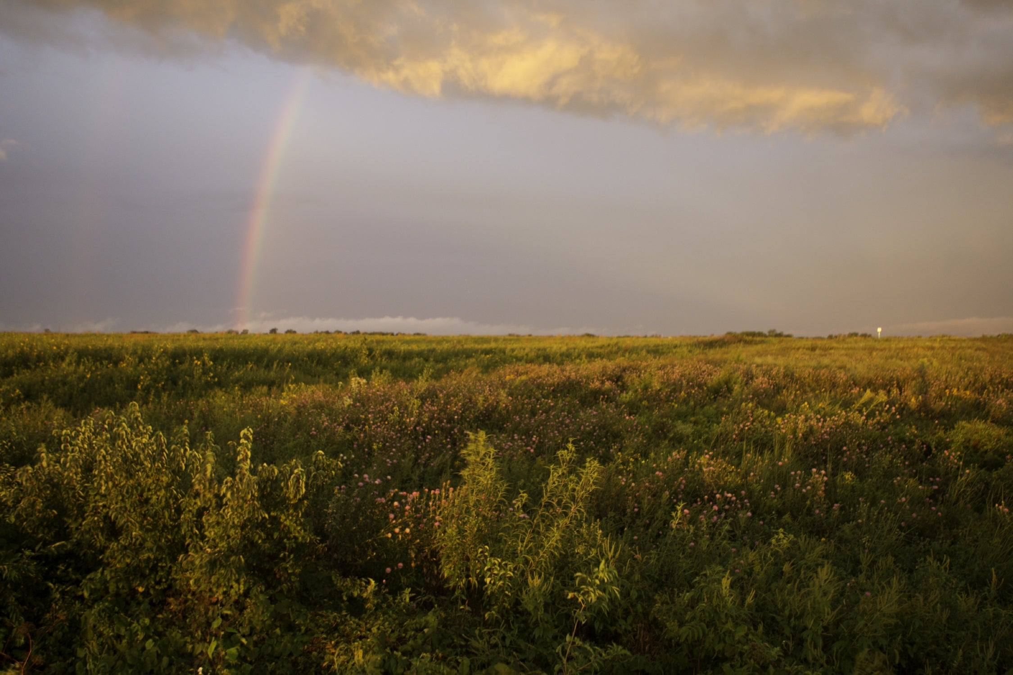
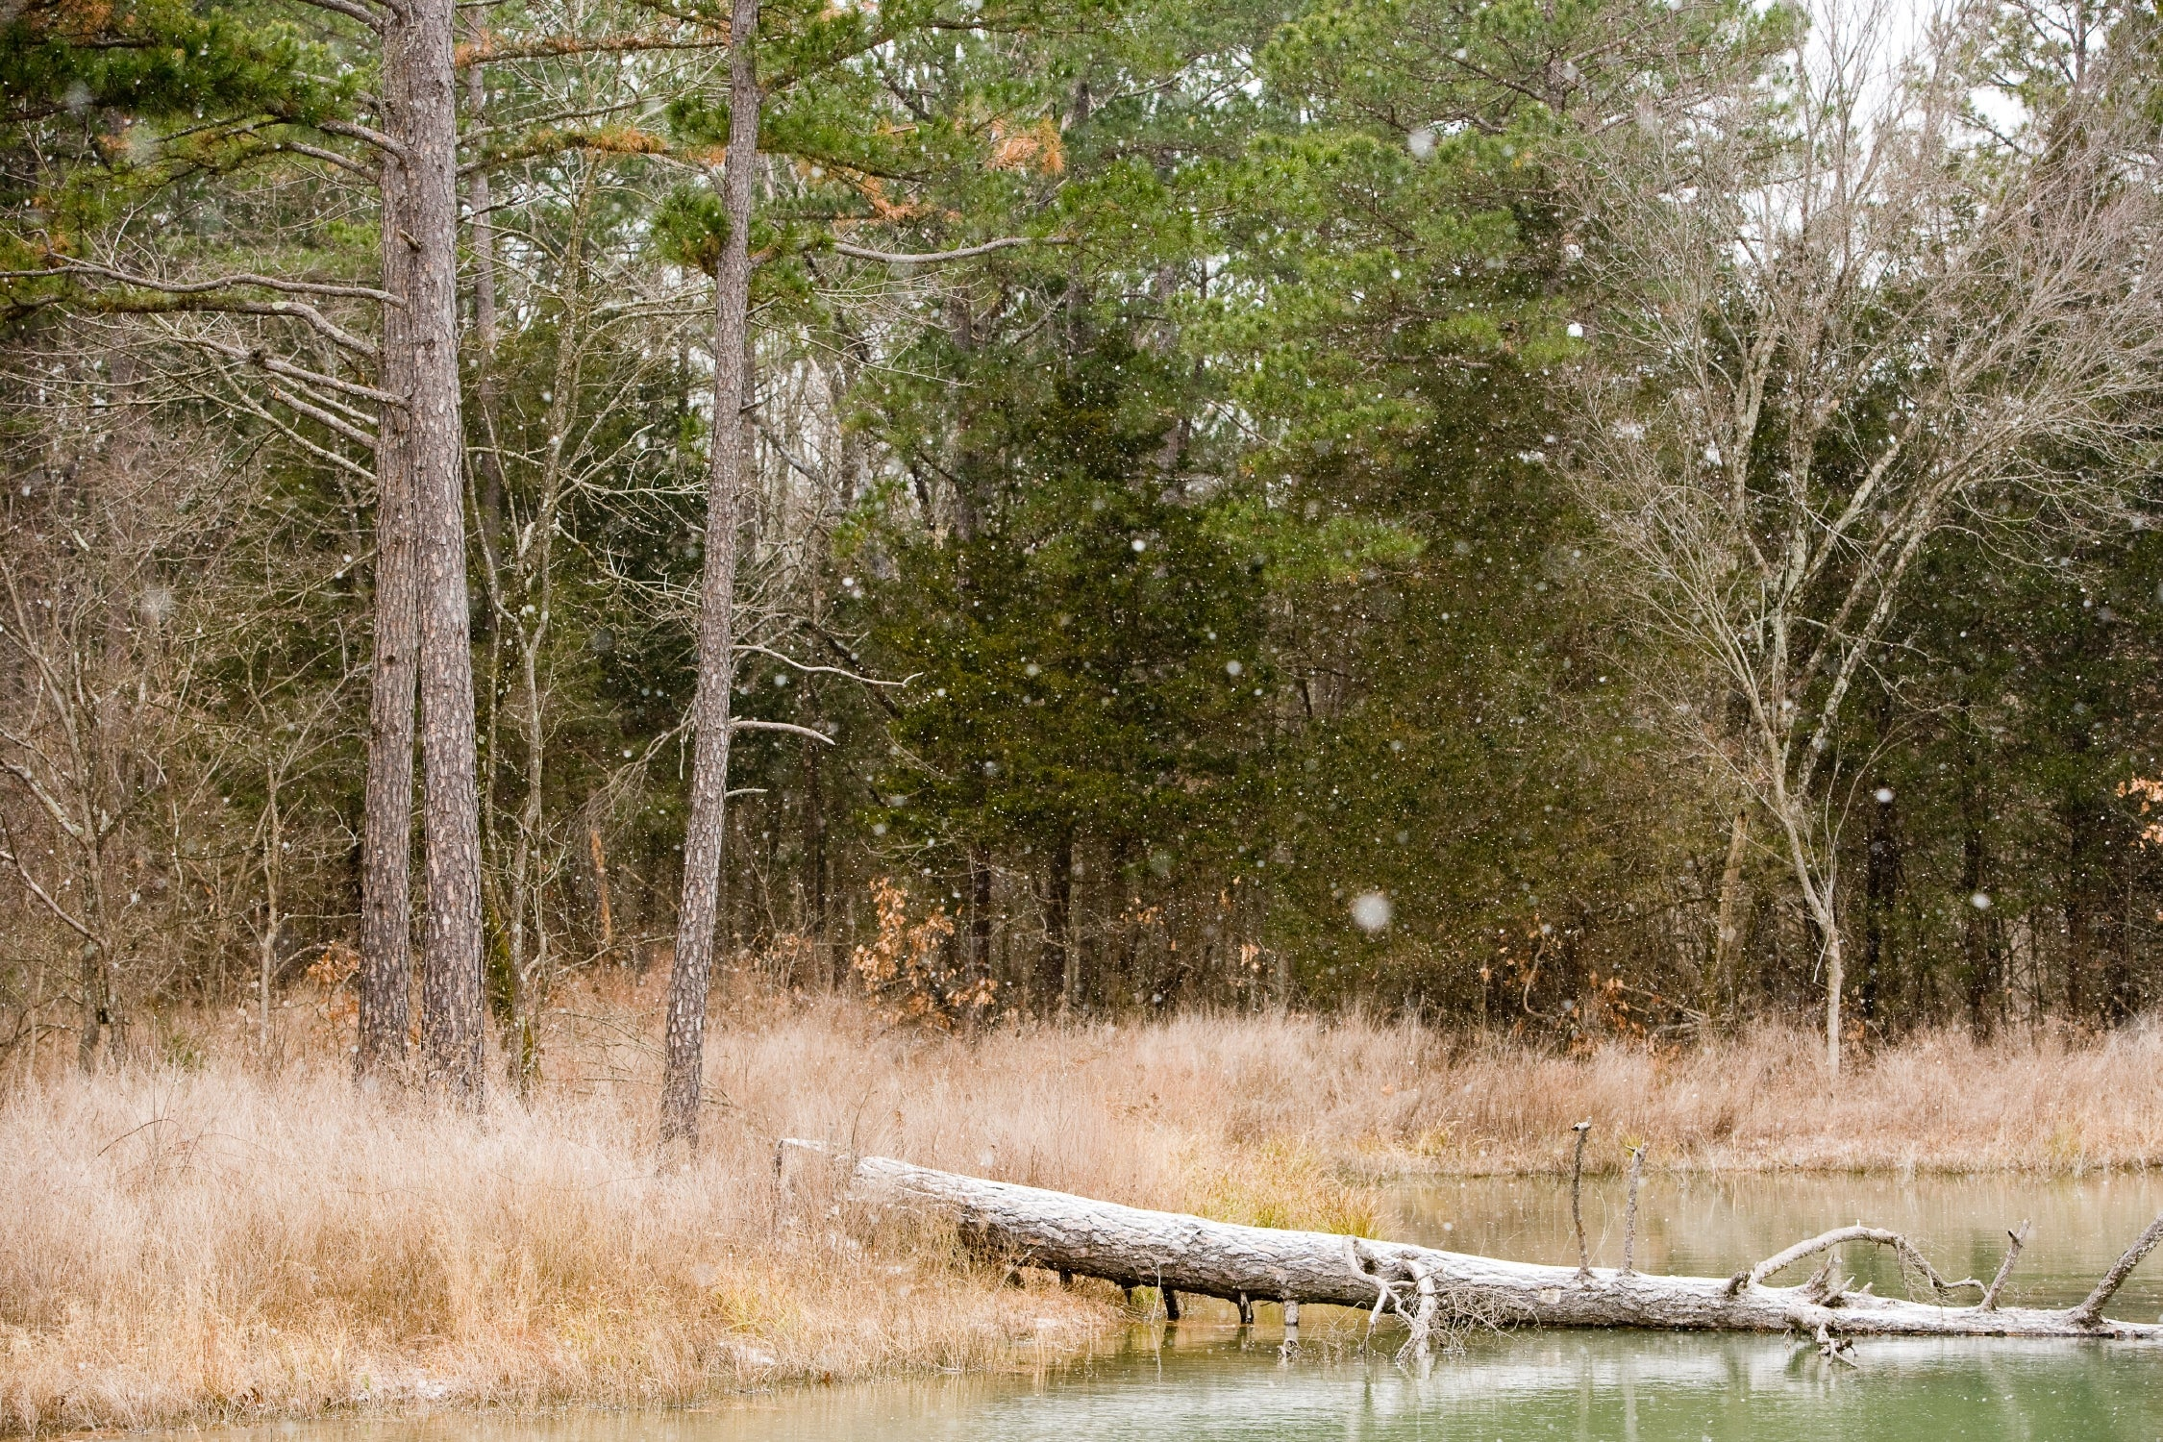
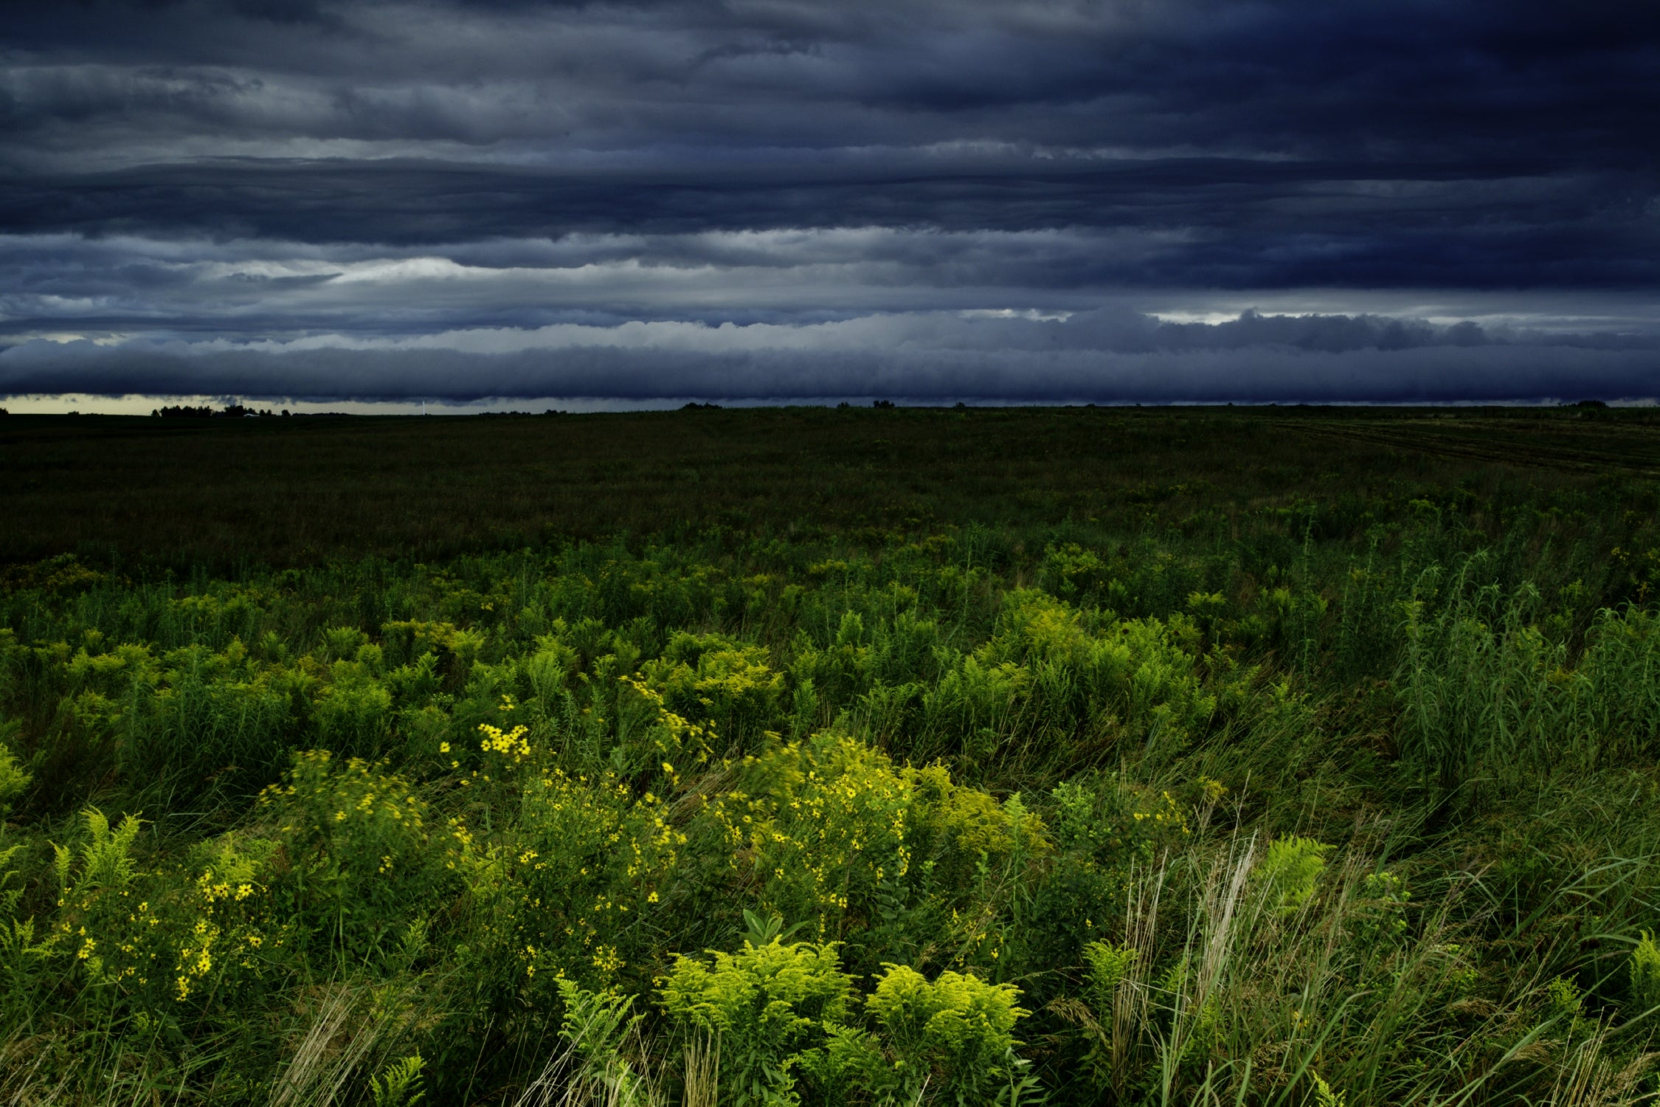
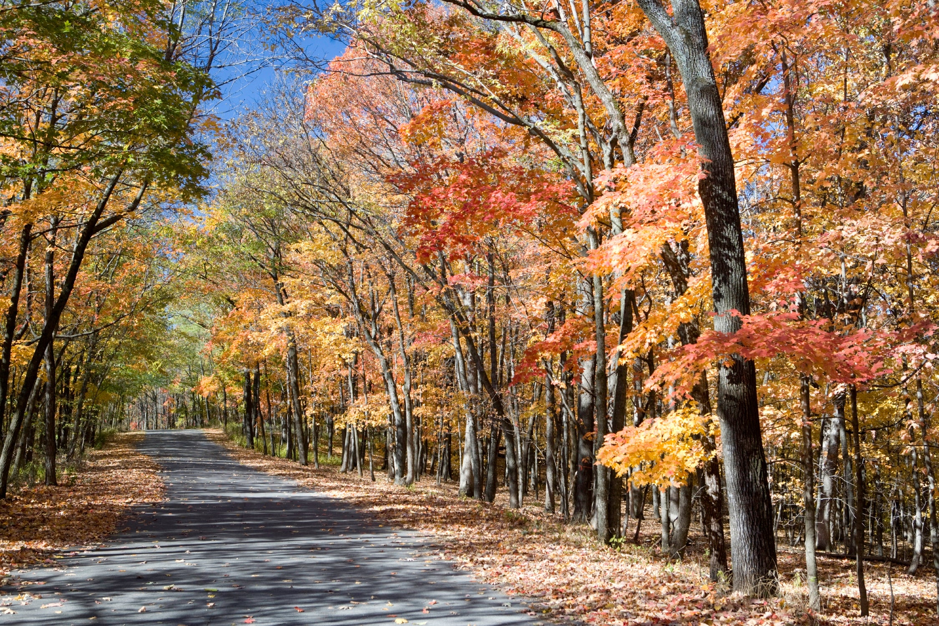
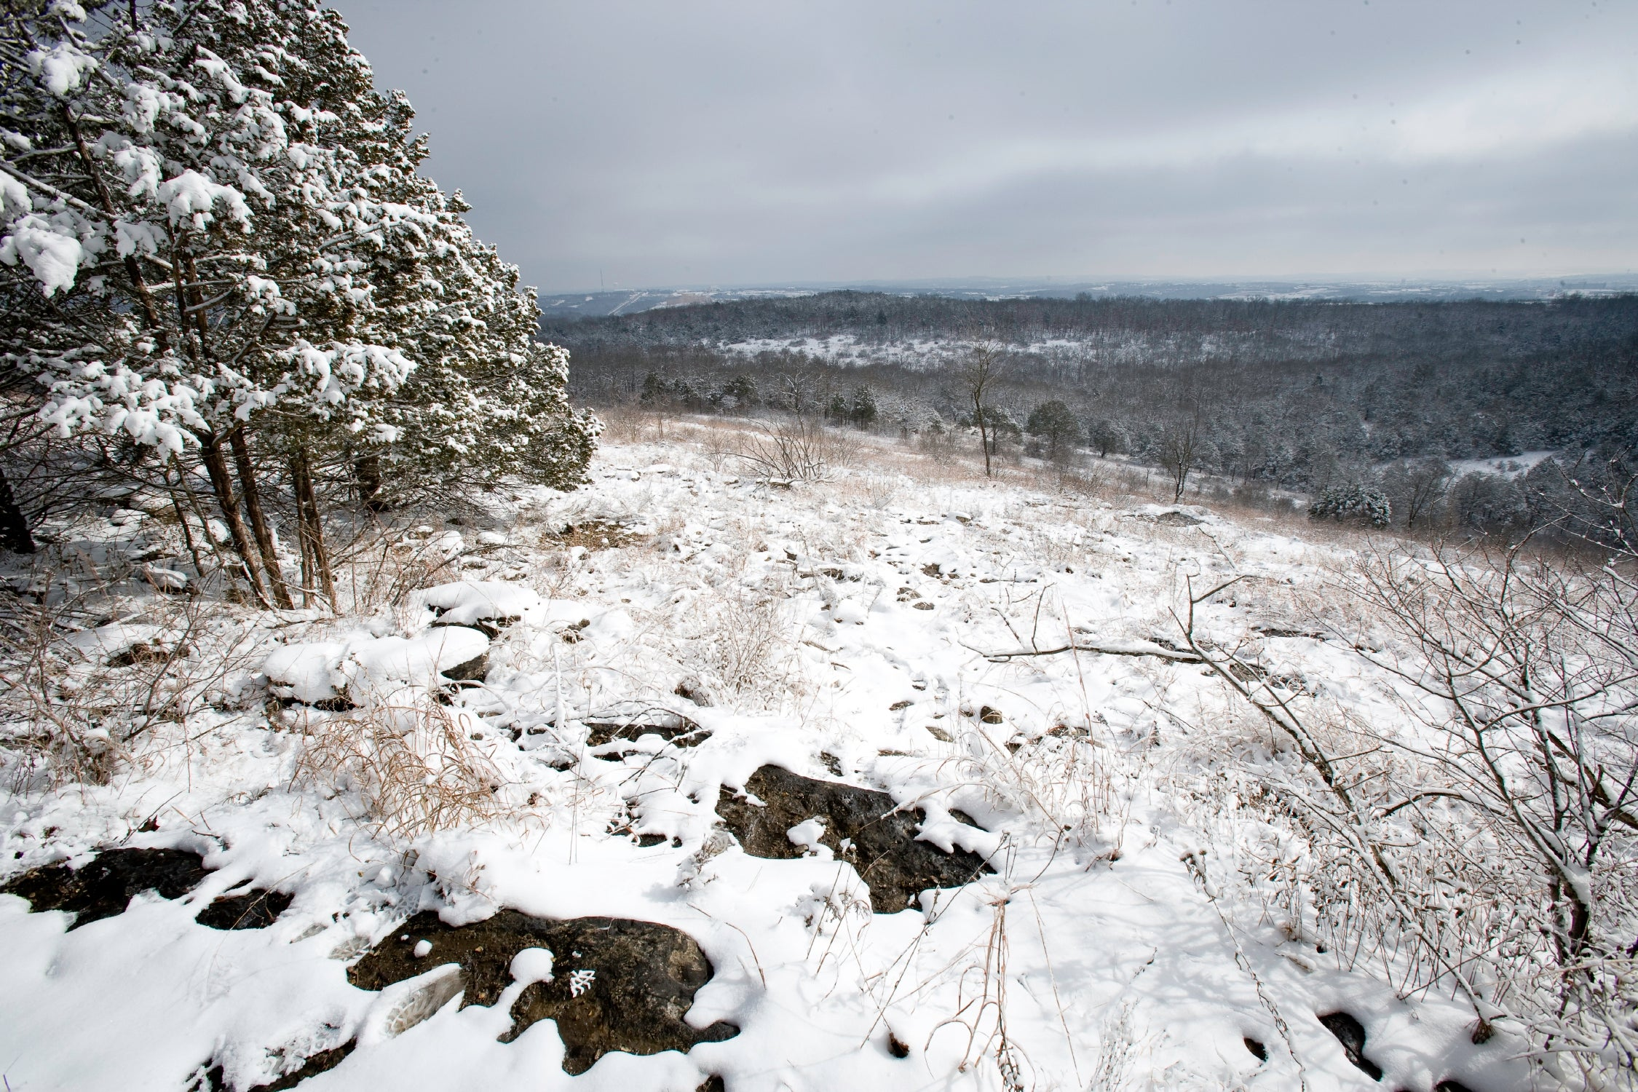
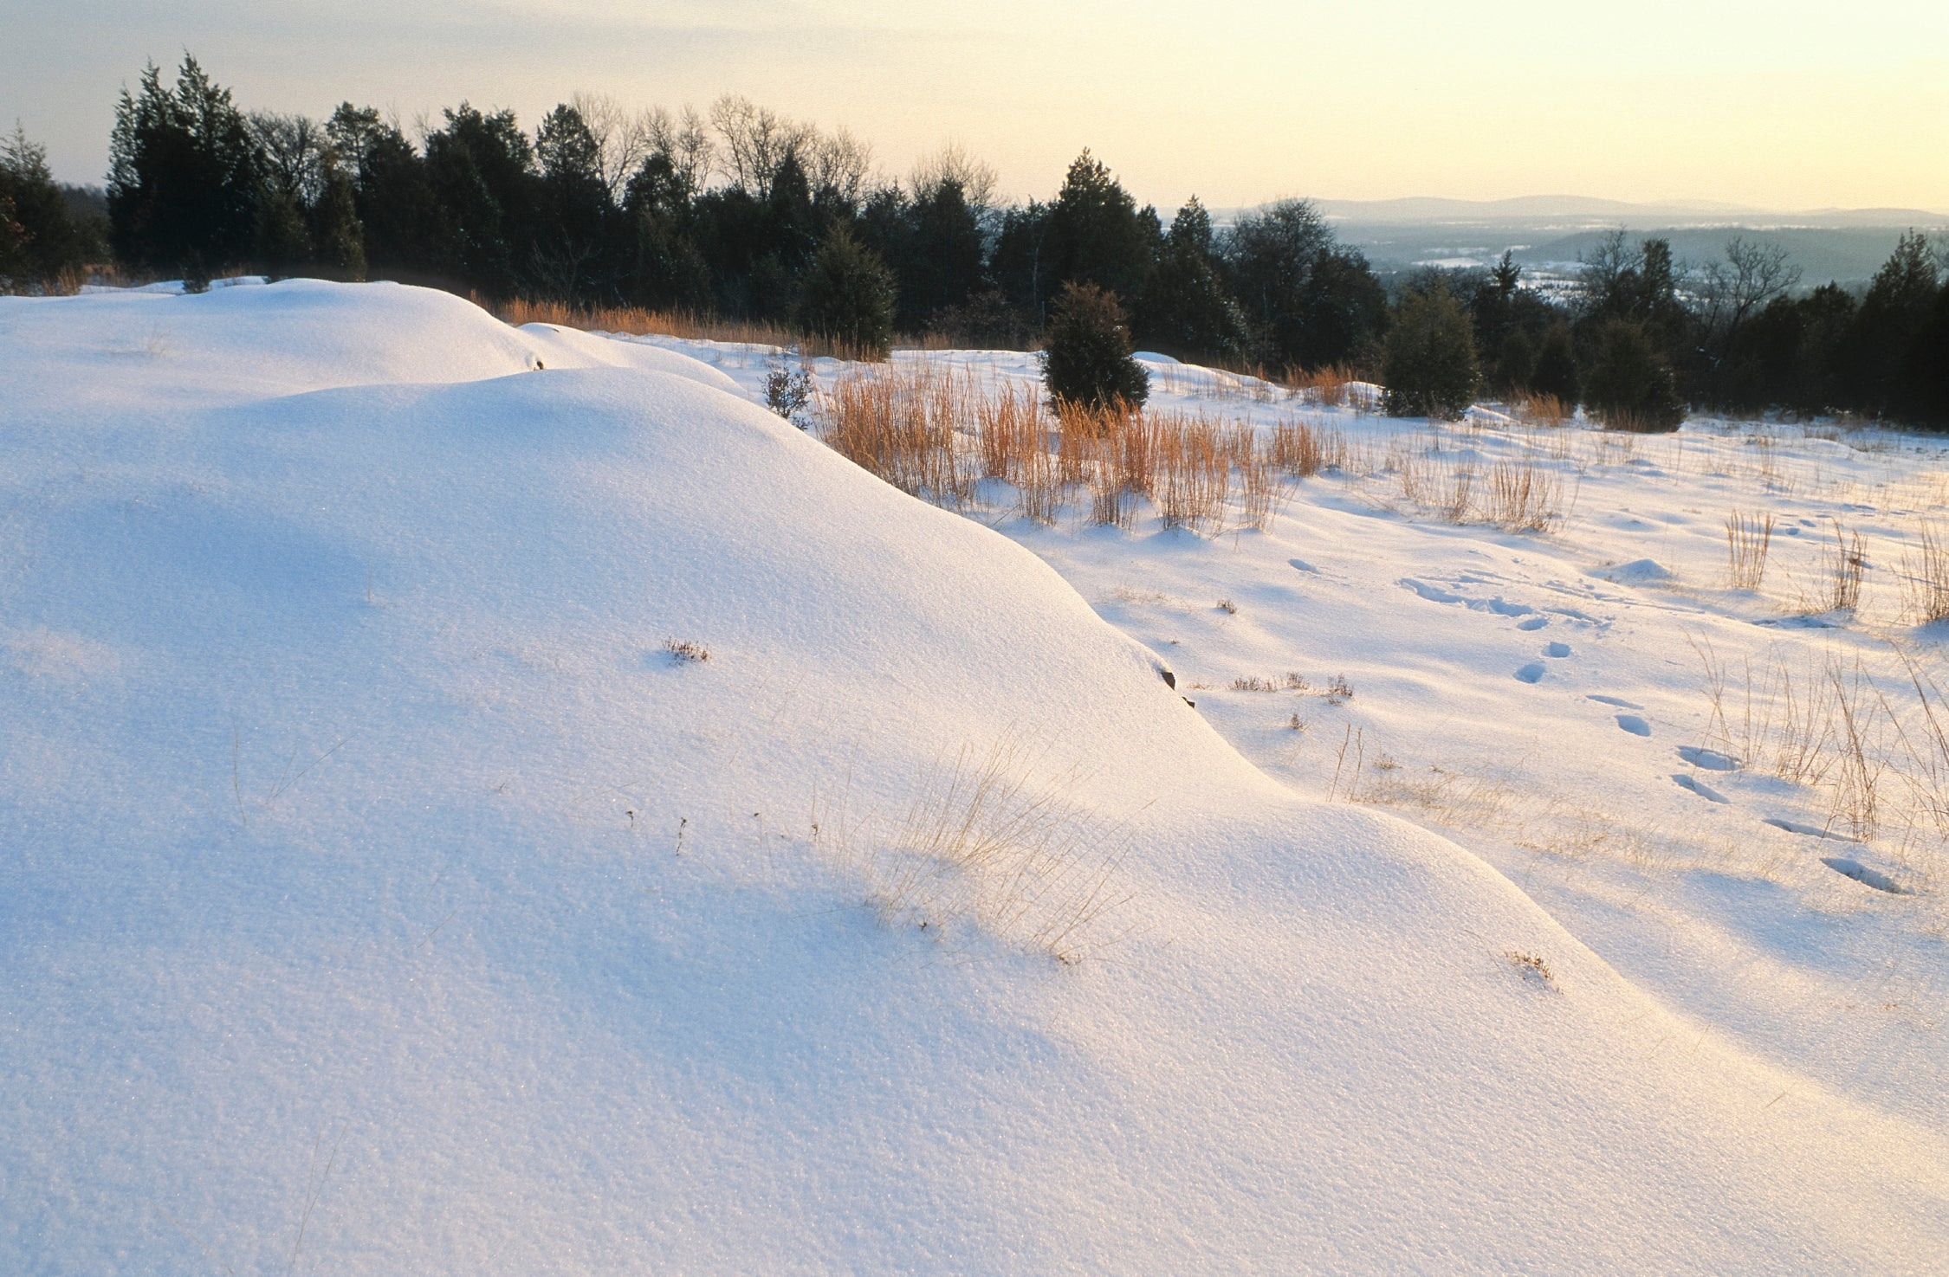
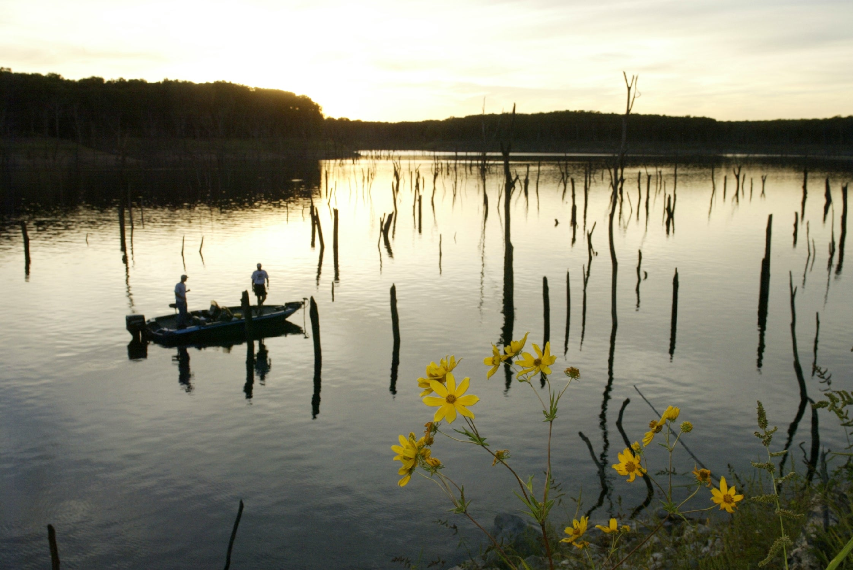
In what ways is weather different day to day?
Bears through the Seasons – 1B What is Weather: Engage
4
Notes:
Show students the pictures of different kinds of weather. Tell students: When we look at these pictures, we determined that we would wear different clothing depending on the weather. In what ways is weather different day to day?

Slide 5
Bears through the Seasons – 1B What is Weather: Engage
5
Notes:
How would this weather feel? What would we wear in weather like this? How is this different from our weather today?

Slide 6
Bears through the Seasons – 1B What is Weather: Engage
6
Notes:
How would this weather feel? What would we wear in weather like this? How is this different from our weather today?

Slide 7
Bears through the Seasons – 1B What is Weather: Engage
7
Notes:
How would this weather feel? What would we wear in weather like this? How is this different from our weather today?

Slide 8
Bears through the Seasons – 1B What is Weather: Engage
8
Notes:
How would this weather feel? What would we wear in weather like this? How is this different from our weather today?

Slide 9
Bears through the Seasons – 1B What is Weather: Engage
9
Notes:
How would this weather feel? What would we wear in weather like this? How is this different from our weather today?

Slide 10
Bears through the Seasons – 1B What is Weather: Engage
10
Notes:
How would this weather feel? What would we wear in weather like this? How is this different from our weather today?

Slide 11
Bears through the Seasons – 1B What is Weather: Engage
11
Notes:
How would this weather feel? What would we wear in weather like this? How is this different from our weather today?

Slide 12
Bears through the Seasons – 1B What is Weather: Engage
12
Notes:
How would this weather feel? What would we wear in weather like this? How is this different from our weather today?

Slide 13
Bears through the Seasons – 1B What is Weather: Engage
13
Notes:
How would this weather feel? What would we wear in weather like this? How is this different from our weather today?

Slide 14
Bears through the Seasons – 1B What is Weather: Engage
14
Notes:
Prepare and display your Noticings and Wonderings Chart for this lesson. Add students observations and/or questions to the chart as the lesson proceeds in reference to the phenomenon studied.

Slide 15
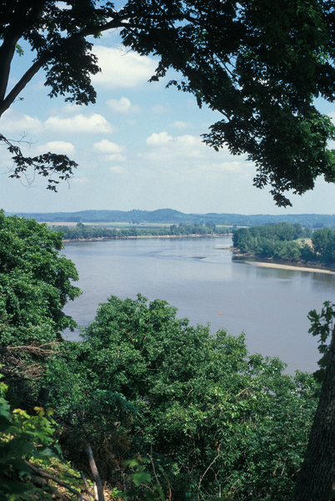
How would you describe the weather today?
Bears through the Seasons – 1B What is Weather: Explore
15
Notes:
Look outside today and then answer questions. Refer to the Noticings and Wonderings Chart and fill in the following student answers under the appropriate category.

Slide 16
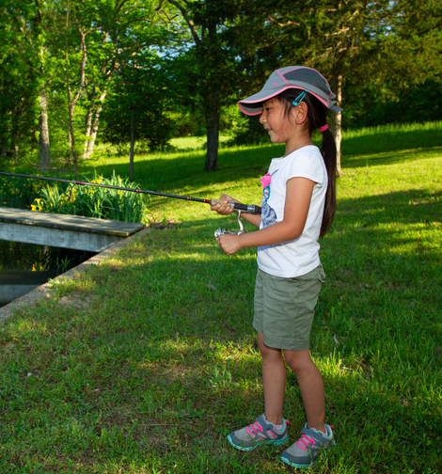
Are you dressed for the weather outside today? Why or why not?
Bears through the Seasons – 1B What is Weather: Explore
16

Slide 17
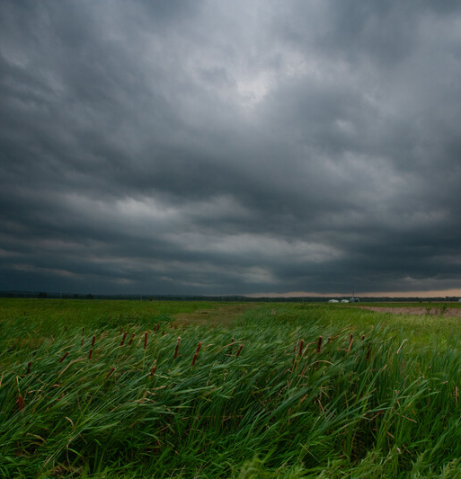
What do you need to know about the weather before getting dressed?
Bears through the Seasons – 1B What is Weather: Explore
17

Slide 18
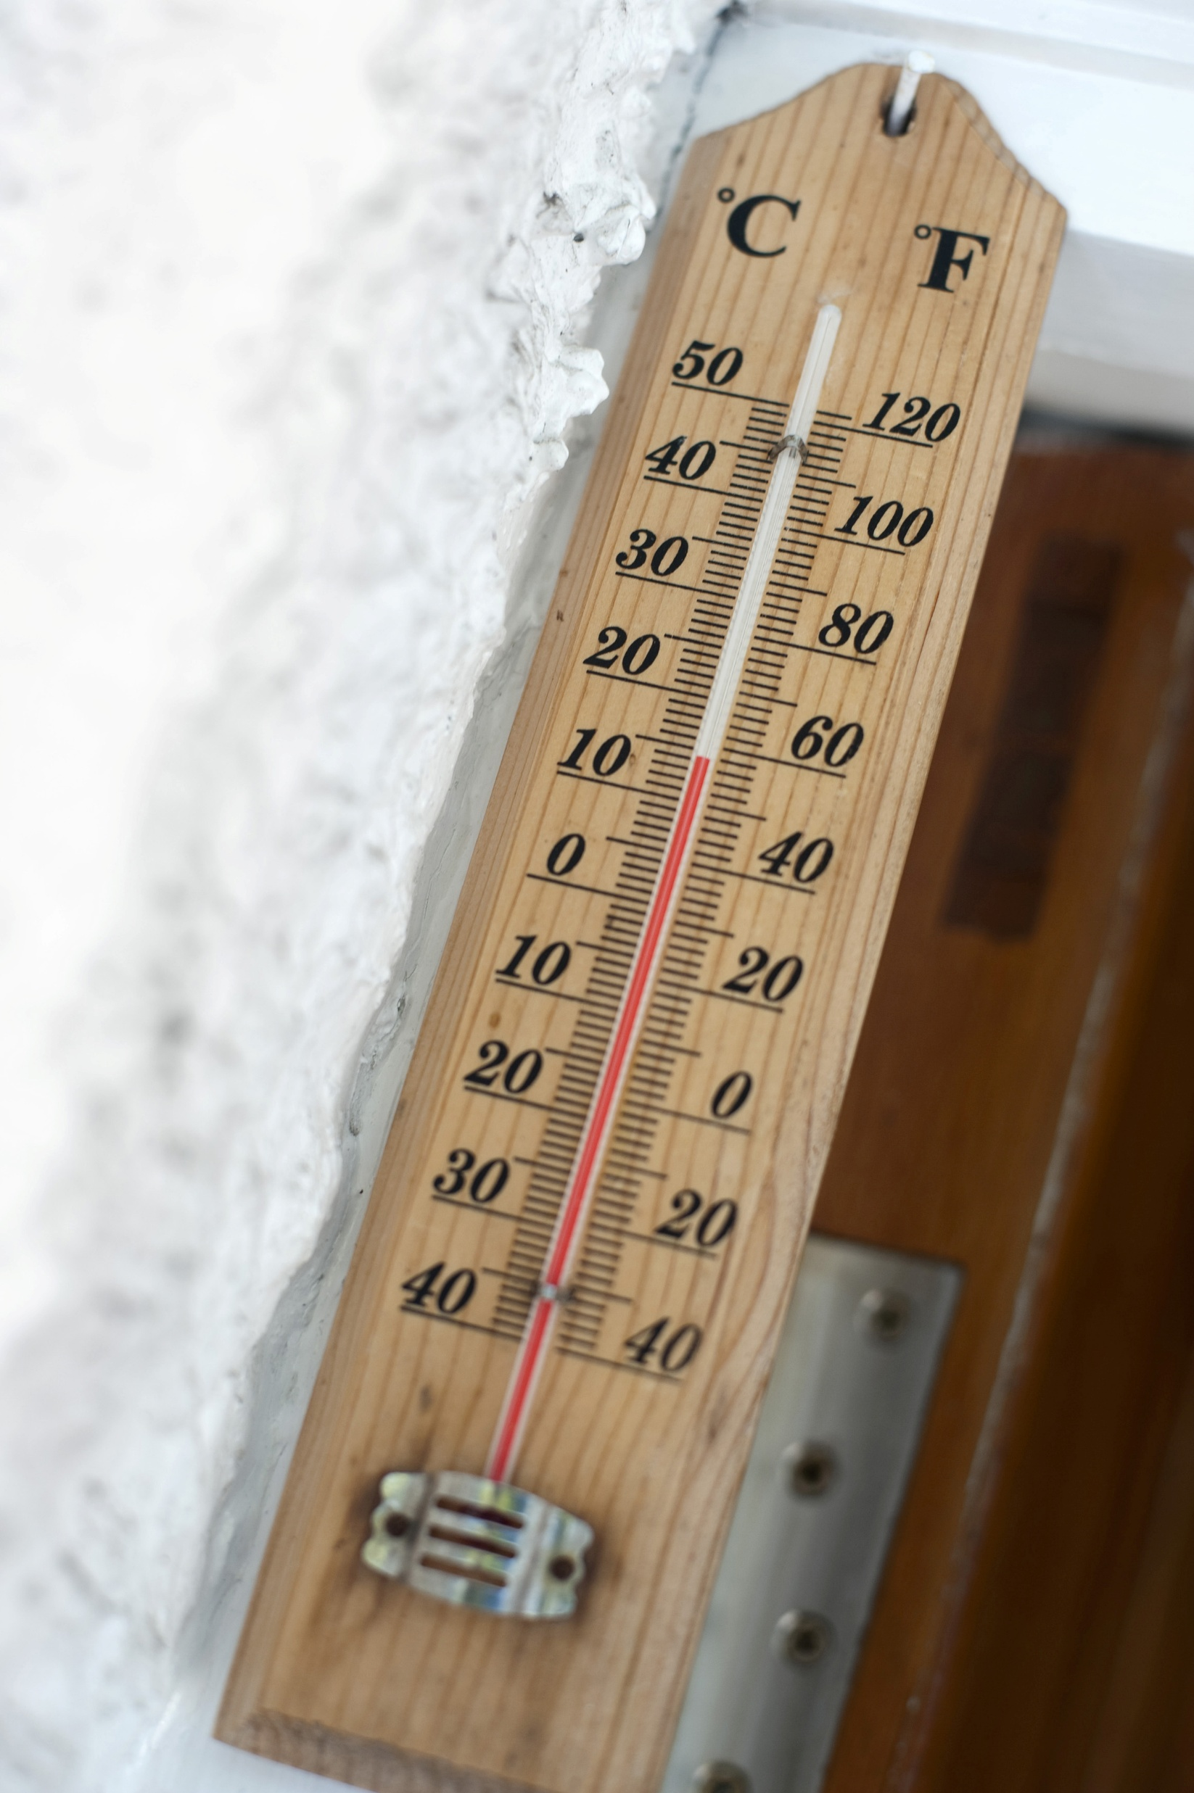
What can we observe and measure about weather? Let’s share our ideas!
Bears through the Seasons – 1B What is Weather: Explain
18
This Photo by Unknown Author is licensed under CC BY
Notes:
Chart student ideas. Talk with students about the following ways to measure weather:
Sunlight or clouds or mixture
Precipitation (rain, snow)
Temperature (warm, cold)

Slide 19
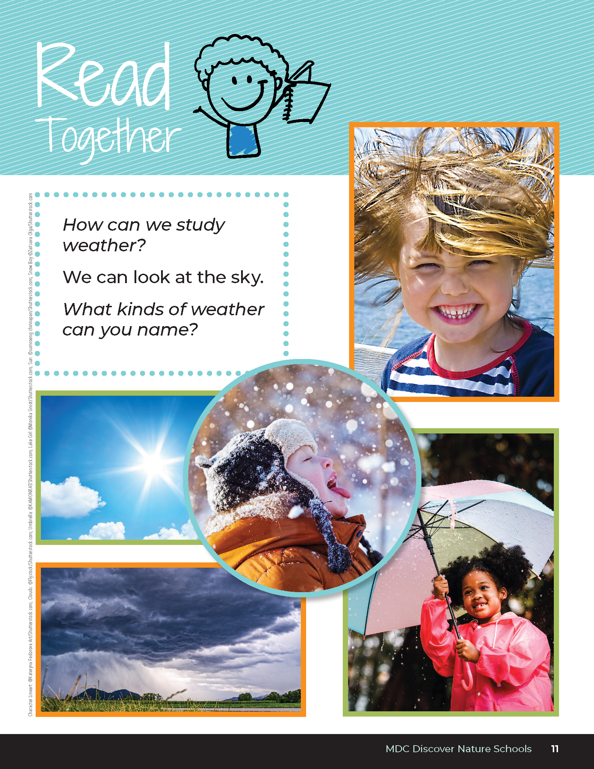

How can we study weather?
What kinds of weather can you name?
Bears through the Seasons – 1B What is Weather: Explain
19
Notes:
Have students open student guides to the Read Together section on Page 11.
Read with class, have them follow along and/or read depending on ability level. As a class, what kinds of weather can you name?

Slide 20

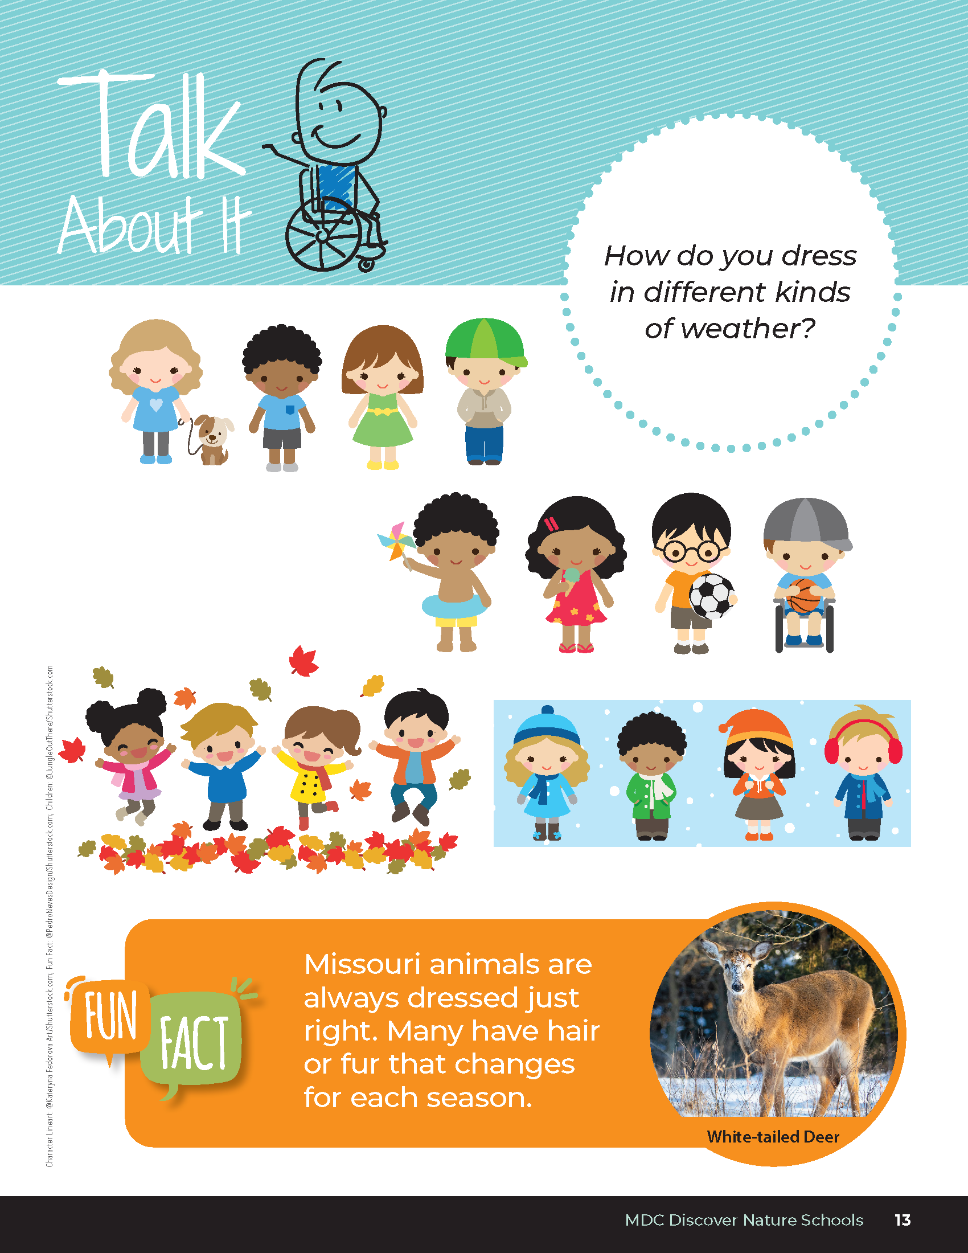
What kinds of clothing would you wear during the different kinds of weather? What about animals?
Bears through the Seasons – 1B What is Weather: Explain
20
Notes:
Look at the different kinds of weather in the student guide, Talk About It on Page 13.

Slide 21
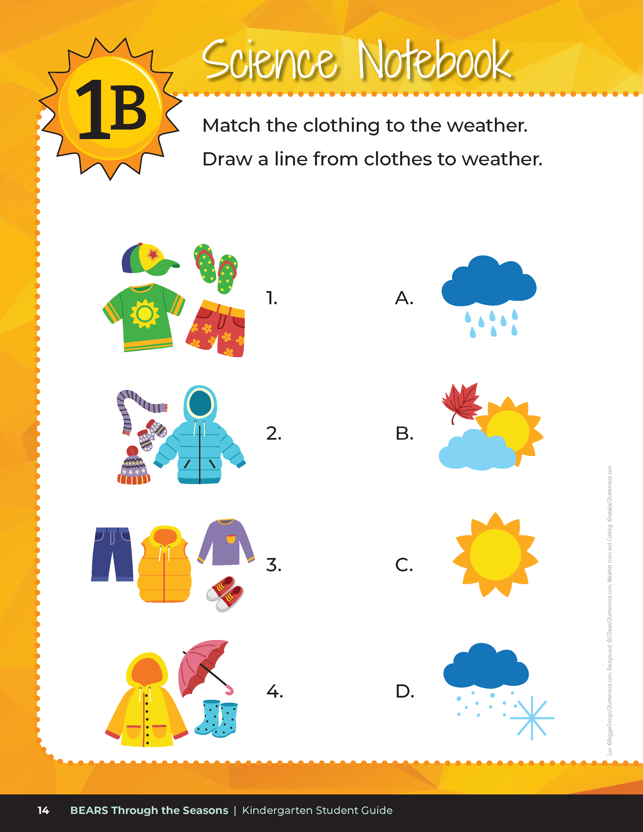

Match the clothing to the weather. Draw a line from clothes to weather.
Bears through the Seasons – 1B What is Weather: Explain
21
Notes:
Have students complete student guide Science Notebook section and match the correct clothing to the weather on Page 14.

Slide 22
Answers
Bears through the Seasons – 1B What is Weather: Explain
22

Slide 23
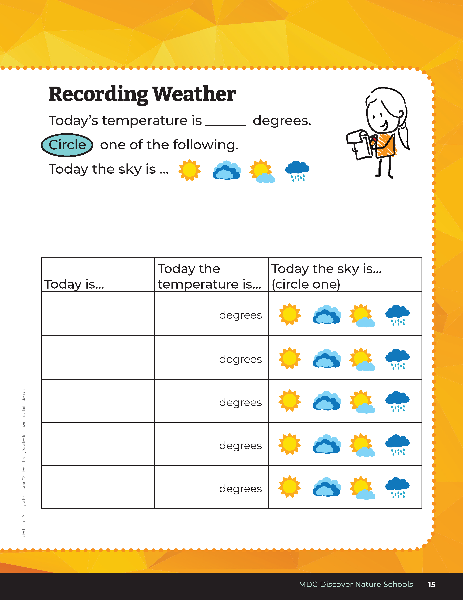
When should we collect our weather data?
Who will collect and share the data?
Bears through the Seasons – 1B What is Weather: Elaborate
23
Notes:
Introduce the concept of collecting weather data. For this lesson, weather data will be collected as a class.
Note: The first time students collect weather data, show them how to use a digital thermometer, and choose how to record weather for that day on data collection sheets.
Record findings in the student guide Science Notebook Recording Weather on Page 15.
The student guide Recording Weather Data Page will be a repeating page in the student guide under lessons 2A, 3A, and 4A. It is strongly recommended to complete these lessons as this will further address the standard: K.ESS1.B.1 Make observations during different seasons to relate the amount of daylight to the time of year.
For future data collection days, set up protocols for collecting weather data each day or week.
What time of day will you collect outside weather data?
Will you go as a class or designate alternating students to take a digital thermometer and report findings to the class to record in their books?
Refer to the 1B Daily Weather Data Chart on Page 41 of this guide. Each day, week, or designated time data is collected as a class, have students record findings on the Daily Weather Data Chart. You may post a larger version of this chart to the front of the class. If additional copies are needed throughout the year, photocopies can be made and distributed to students.
Collect additional data and determine when it will be filled out each day. How will days that have some rain or some sun be reported?
Add student observations and/or questions to the Noticings and Wonderings Chart as the lesson concludes in reference to the phenomenon studied

Slide 24

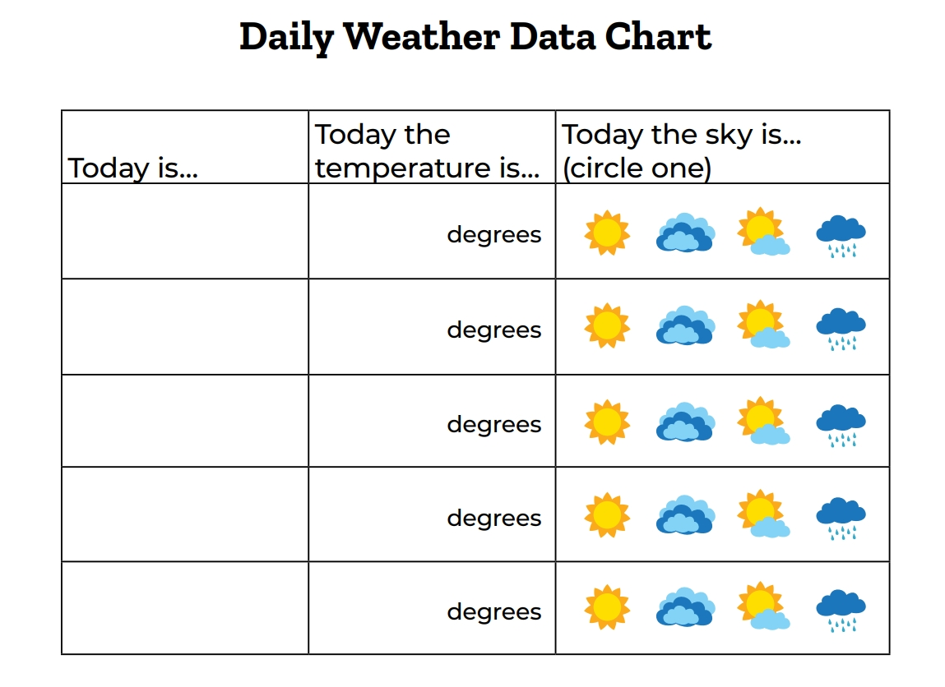
15
4
X
MINUTES
DAYS
Has there been a lot of change or little change?
Has it occurred quickly or slowly?
Bears through the Seasons – 1B What is Weather: Elaborate
24
Notes:
Optional – Collect data for 4 weeks. If this option is chosen, continue to use the Daily Weather Data Chart, a 4-week data collection tool. Students can draw the weather and record the temperature in the boxes – decide what symbols to use for recording. Ask student why they should use the same symbols to record. After a week of data collection, discuss how the weather has changed over the course of the week. Has there been a lot of change or a little change? Has it occurred quickly or slowly? There may be rapid change in weather when storm systems come in. Seasonal changes occur more slowly.

Slide 25
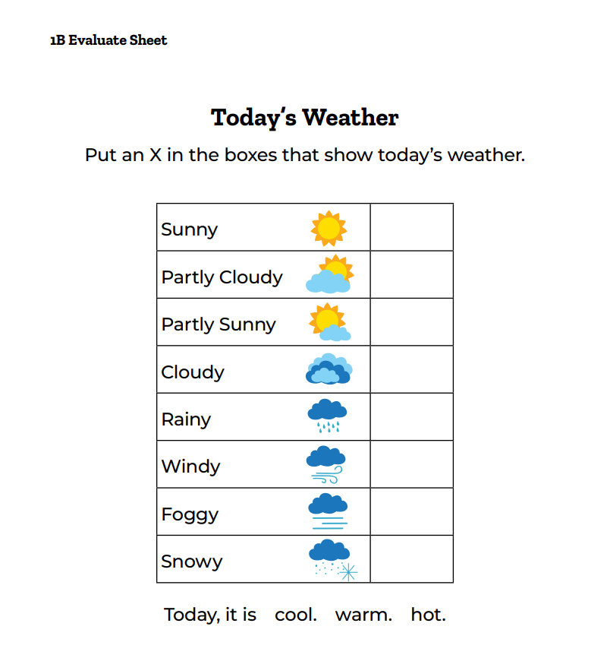
Fill Out Today’s Weather Sheet
Bears through the Seasons – 1B What is Weather: Evaluate
25
Notes:
Have the students fill out the 1B Evaluate Sheet by themselves to describe the day’s weather

Slide 26
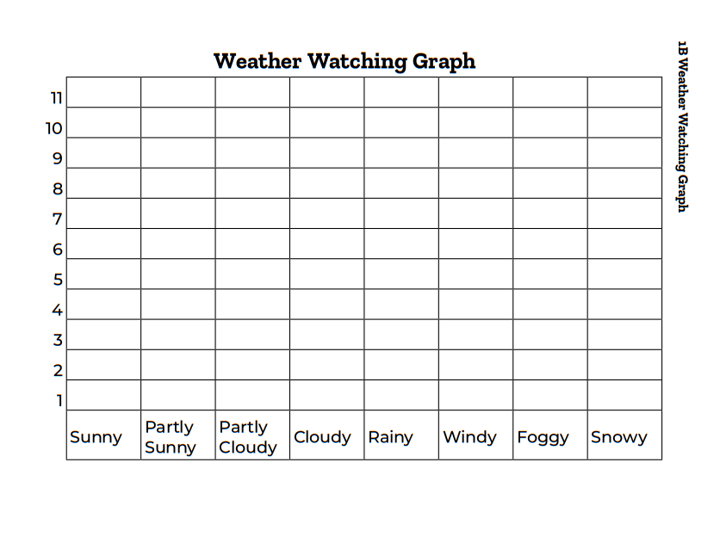
Let's put our data into a graph!
Bears through the Seasons – 1B What is Weather: Evaluate
26
Notes:
Have the students fill out the 1B Evaluate Sheet by themselves to describe the day’s weather

Slide 27
What does the graph tell us?
Bears through the Seasons – 1B What is Weather: Evaluate
27
Notes:
Reference 1B Weather Watching Graph and record the different answers from the 1B Evaluate Sheet and from the week’s student recordings from their student guide. Discuss the classroom graph as a whole. Record answers into Noticings and Wonderings Chart.

Slide 28
Let’s count the different days of weather.
What weather did we have the most of?
What weather was the least?
How does the graph show us the most and least?
Bears through the Seasons – 1B What is Weather: Evaluate
28
Notes:
Reference 1B Weather Watching Graph and record the different answers from the 1B Evaluate Sheet and from the week’s student recordings from their student guide. Discuss the classroom graph as a whole. Record answers into Noticings and Wonderings Chart.

Slide 29
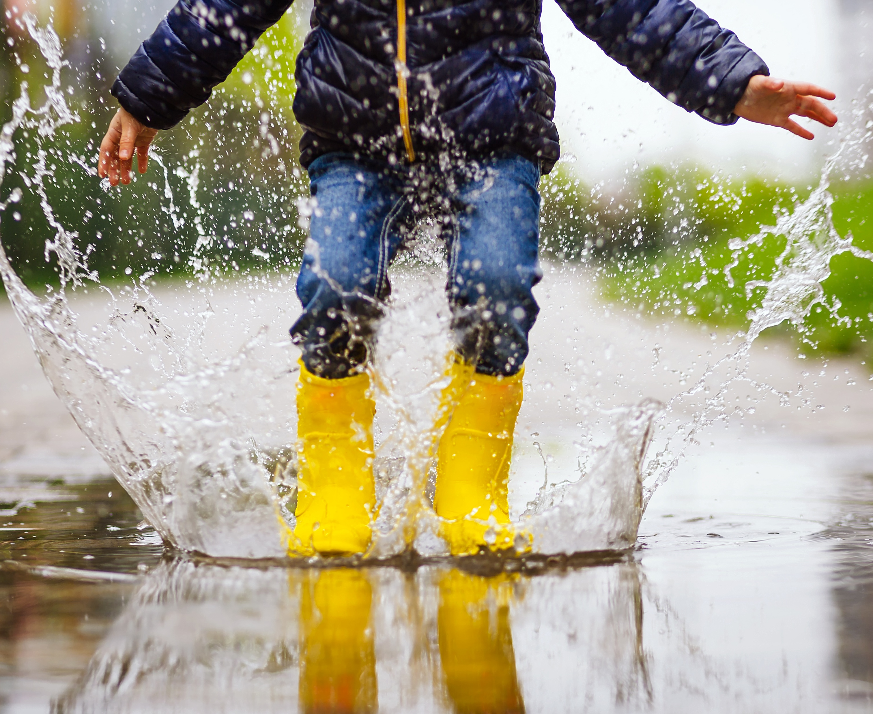
How did you know the weather had changed over several days?
How did we record this?
Bears through the Seasons – 1B What is Weather: Evaluate
29
Notes:
This is why we graph. All graphs show us a picture through numbers, and we can use these numbers to see the most and the least of what we are studying.

Slide 30
This is why we graph. All graphs show us a picture through numbers, and we can use these numbers to see the most and the least of what we are studying
Bears through the Seasons – 1B What is Weather: Evaluate
30
Notes:
This is why we graph. All graphs show us a picture through numbers, and we can use these numbers to see the most and the least of what we are studying.

Slide 31
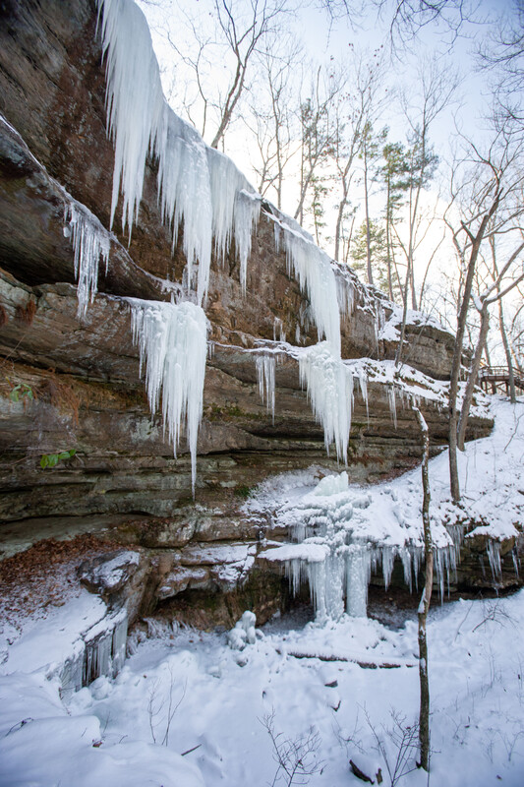
How does our weather change over the seasons?
What are the patterns of change that occur for each season?
How would we record this?
Bears through the Seasons – 1B What is Weather: Evaluate
31
Notes:
The data collection and discussion in this lesson needs to be revisited each season. You can continue to collect data all year or do it for 4 weeks each season. Continue the discussion about patterns of weather for the season.

Slide 32
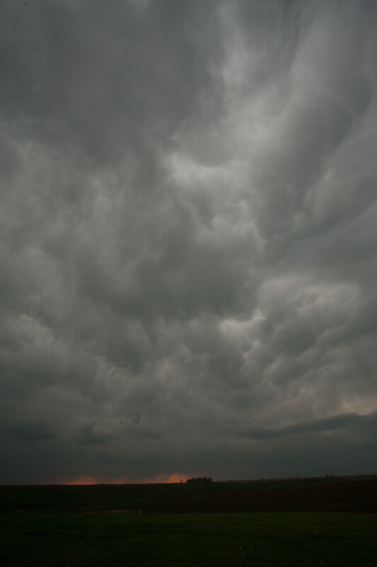
Are there more sunny days than cloudy days?
Is the precipitation the same in each season?
How does temperature change?
How would we know the answers to these questions?
Bears through the Seasons – 1B What is Weather: Evaluate
32
Notes:
The data collection and discussion in this lesson needs to be revisited each season. You can continue to collect data all year or do it for 4 weeks each season. Continue the discussion about patterns of weather for the season.

Slide 33


Optional: Cross-Curricular Extension
Create a summer flip book that depicts all things found in summer.
Items to include: What I wear in summer, What types of weather happens in summer.
Bears through the Seasons – 1B What is Weather: Cross-Curricular Extension
33
Notes:
Have students (in groups or individually) create a summer flip book that depicts all things found in summer. Items to include: What I wear in summer, What types of weather happens in summer.

