Slide 1
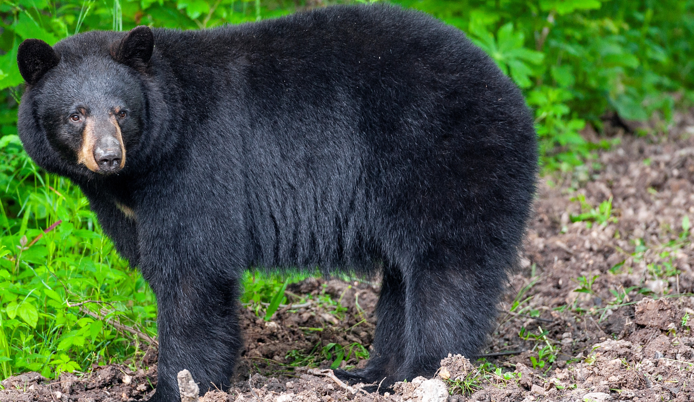

BEARS
Through the Seasons
Lesson 1A: Signs of Summer

Slide 2
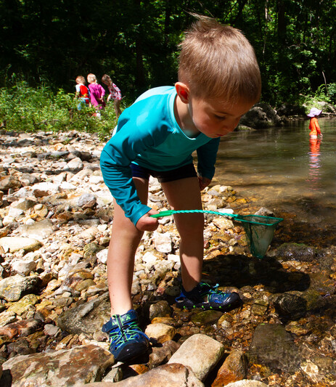

Guiding Question:
What do we do and see in summer?
Bears through the Seasons – 1A Signs of Summer: Engage
2
Notes:
Student answers will vary.

Slide 3

Bears through the Seasons – 1A Signs of Summer: Engage
3
Notes:
Prepare and display your Noticings and Wonderings Chart for this lesson. Add student observations and/or questions to the chart as the lesson proceeds in reference to the phenomenon studied.

Slide 4

Read the book Hello Summer! by Shelley Rotner
Link to book on Epic!: https://www.getepic.com/app/read/65861
Available for free to classroom teachers on Epic! (login required)
Link to Read-Aloud: https://youtu.be/lvYmYghNOOc?si=bKKT2bkqbT5atdu1
Bears through the Seasons – 1A Signs of Summer: Engage
4
Notes:
Read: Hello Summer! By Shelley Rotner

Slide 5

What are the characteristics of summer?
Bears through the Seasons – 1A Signs of Summer: Engage
5
Notes:
Student answers will vary.

Slide 6
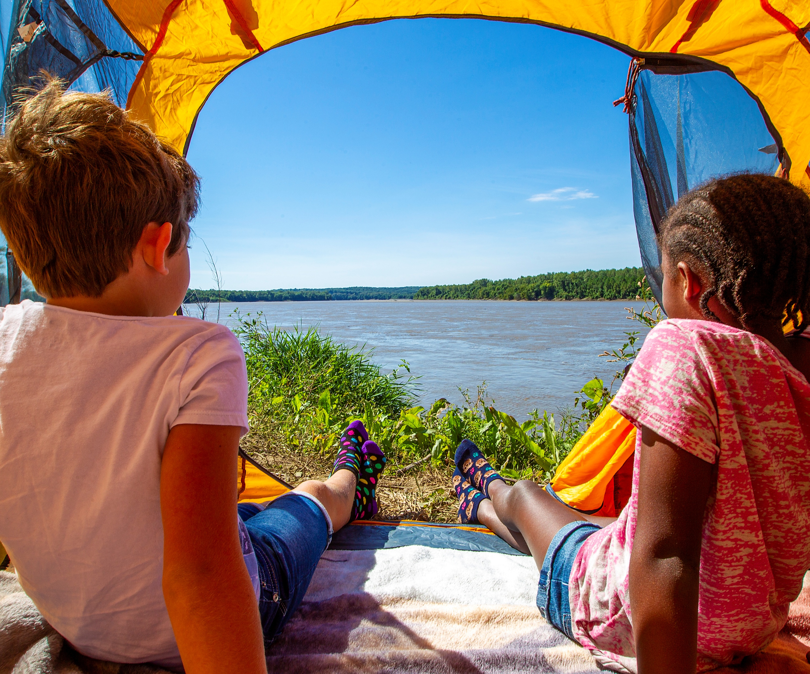
What does summer look like?
Bears through the Seasons – 1A Signs of Summer: Engage
6
Notes:
Student answers will vary.

Slide 7
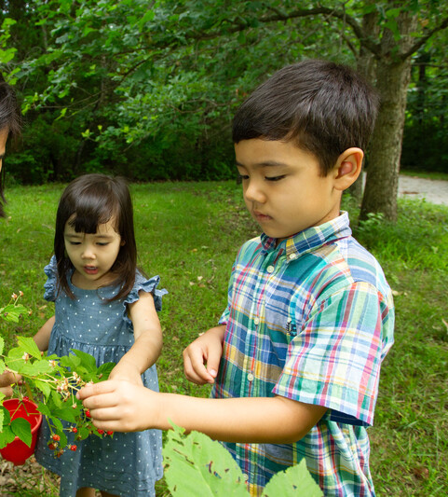
What does summer feel like?
Bears through the Seasons – 1A Signs of Summer: Engage
7
Notes:
Student answers will vary.

Slide 8
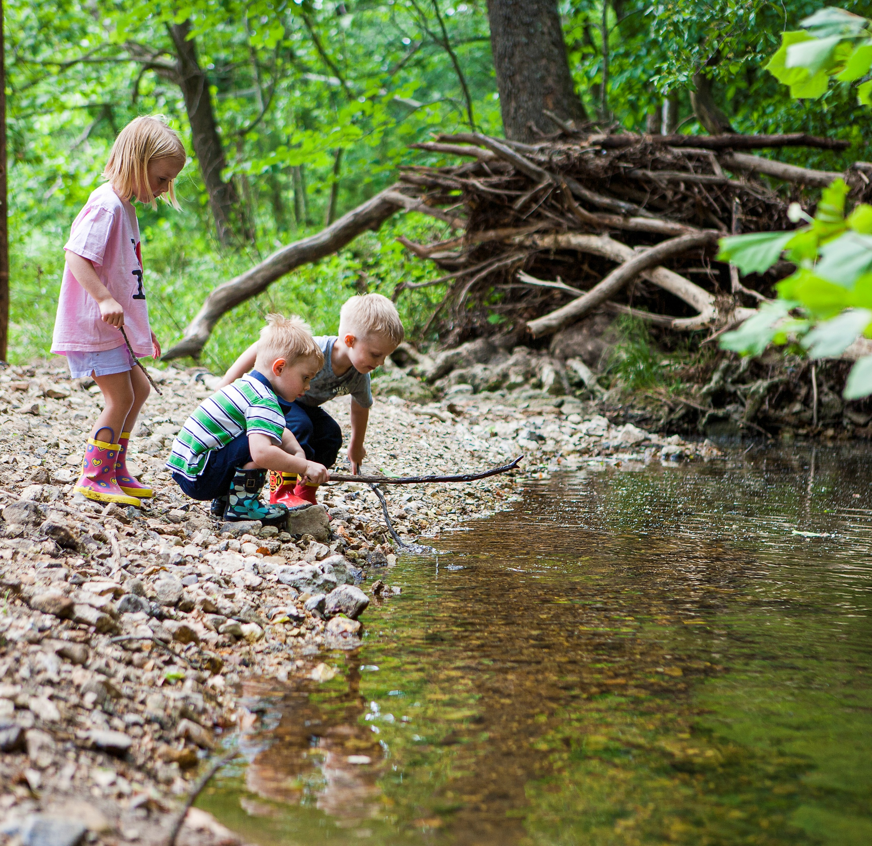
What do we do and wear in summer?
Bears through the Seasons – 1A Signs of Summer: Engage
8
Notes:
Student answers will vary.

Slide 9
Bears through the Seasons – 1A Signs of Summer: Engage
9
Notes:
Prepare and display your Noticings and Wonderings Chart for this lesson. Add student observations and/or questions to the chart as the lesson proceeds in reference to the phenomenon studied.

Slide 10
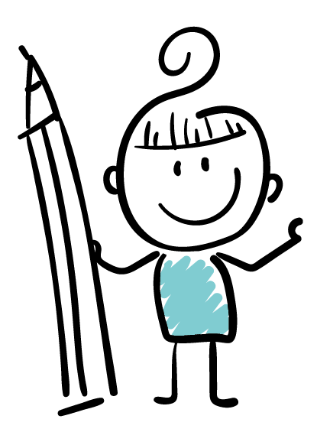

Draw a picture of something you do in summer
Bears through the Seasons – 1A Signs of Summer: Explore
10
Notes:
Give each student a piece of paper and colored pencils, markers, or crayons. Each student will draw a picture of something they do in the summer. They need to include what they wear and their surroundings, including weather outside. The students will create a collage or mural of their drawings. Give each student a piece of paper and colored pencils, markers, or crayons. Each student will draw a picture of something they do in the summer. They need to include what they wear and their surroundings, including weather outside. The students will create a collage or mural of their drawings.

Slide 11
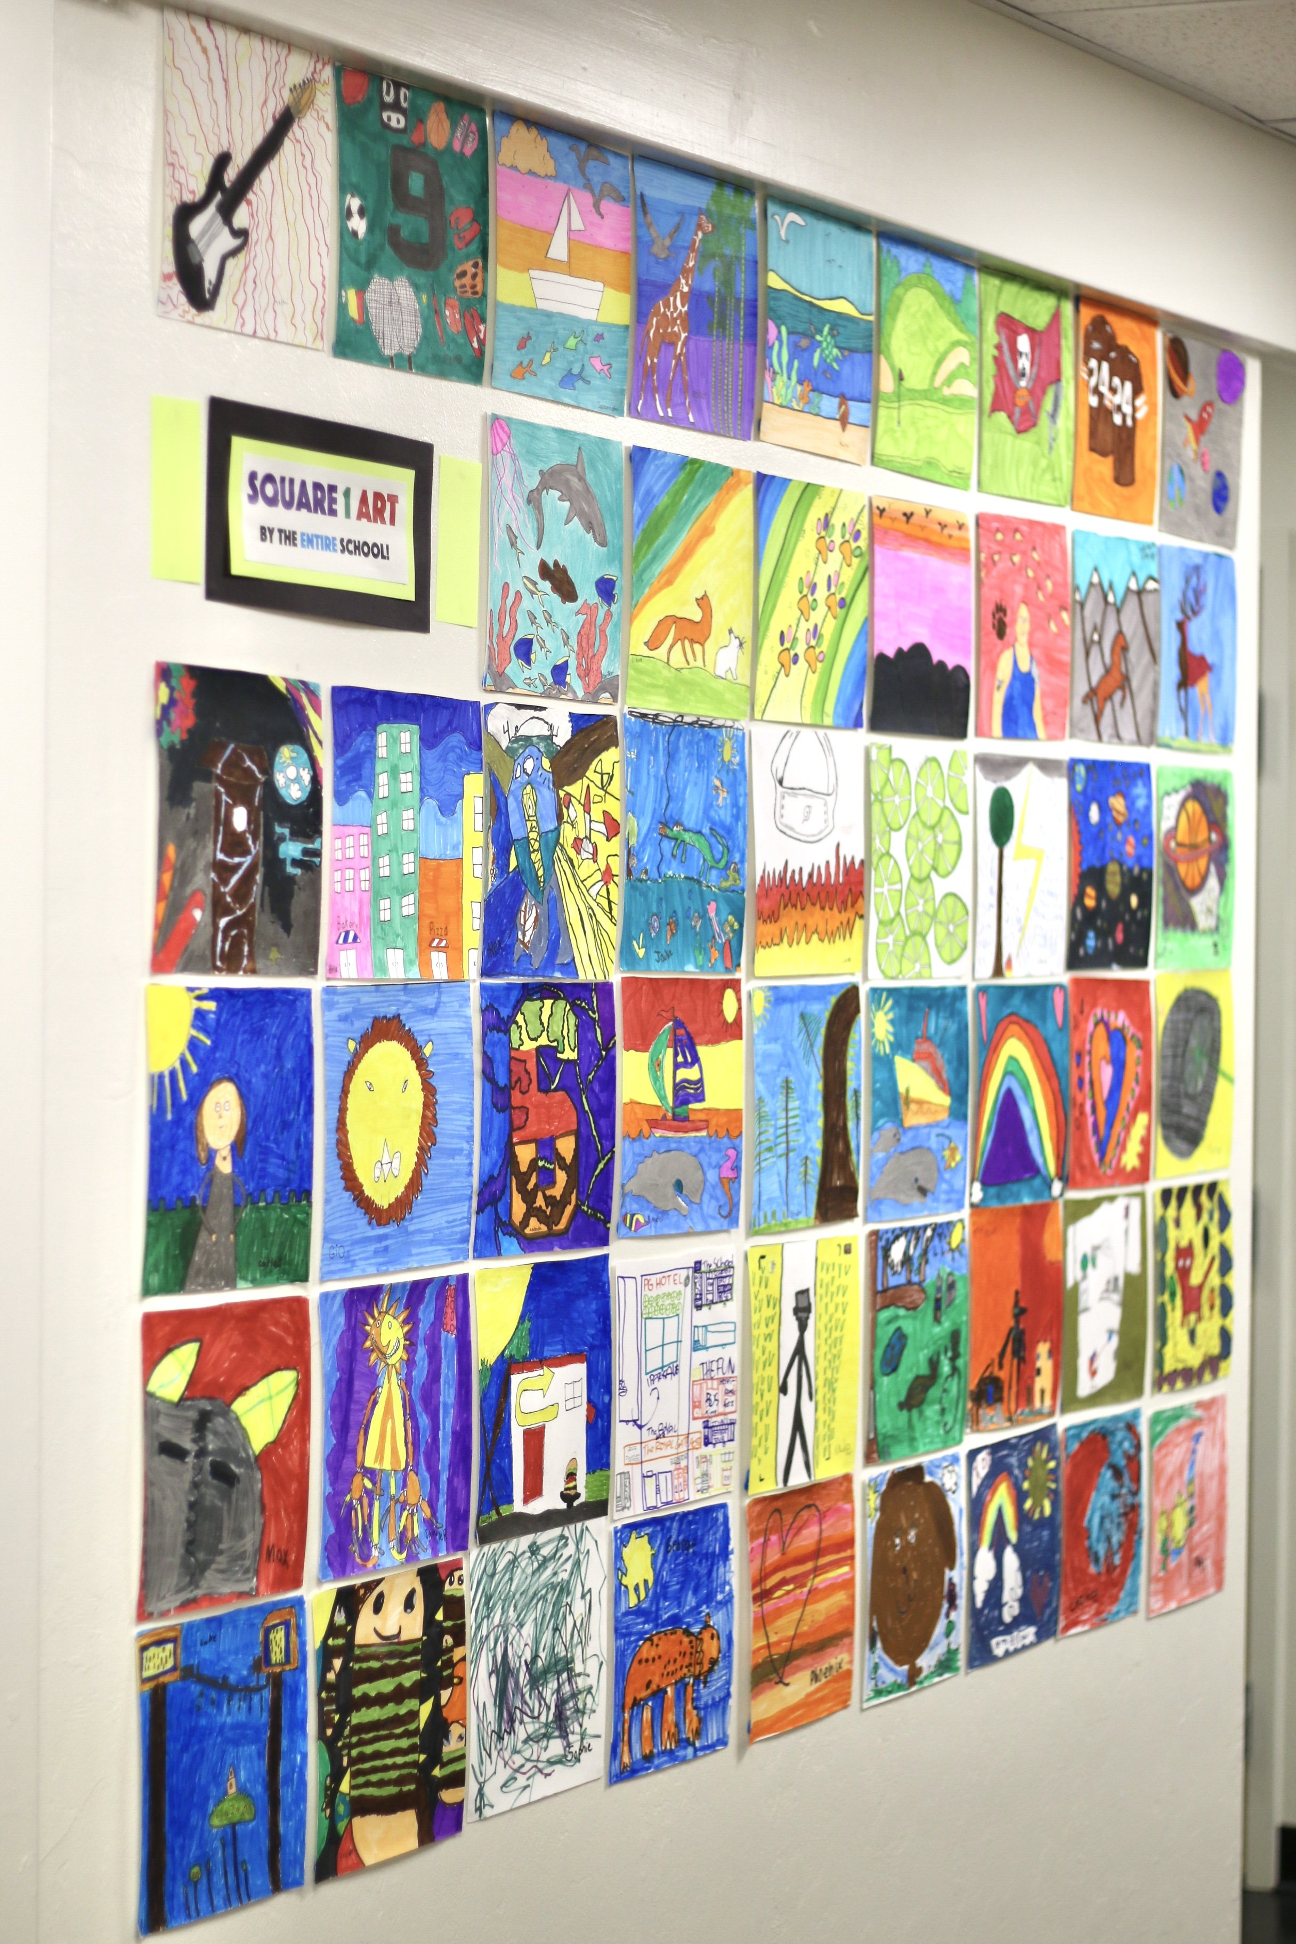
What do we wear in the summer?
What are activities that we do in summer?
Why do we do these activities?
Bears through the Seasons – 1A Signs of Summer: Explain
11
Notes:
After creating the mural ask:
What do we wear in the summer?
What are activities that we do in summer?
Why do we do these activities?

Slide 12
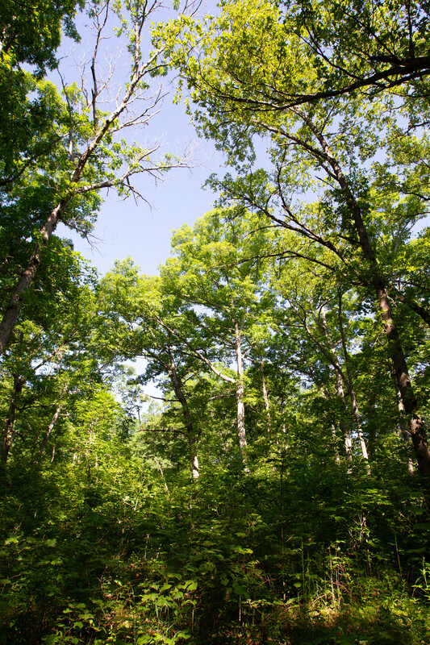
When it is summer at our house and school, is it also summer in the woods and wild places of Missouri?
Bears through the Seasons – 1A Signs of Summer: Explain
12

Slide 13
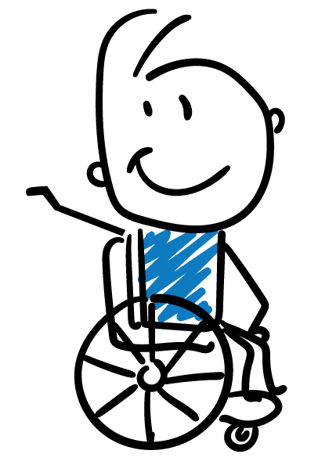


What are things that you would do in the summertime?
Bears through the Seasons – 1A Signs of Summer: Explain
13
Notes:
Open your student guide, Unit 1 Exploring the Phenomenon Talk About It! On Page 3

Slide 14
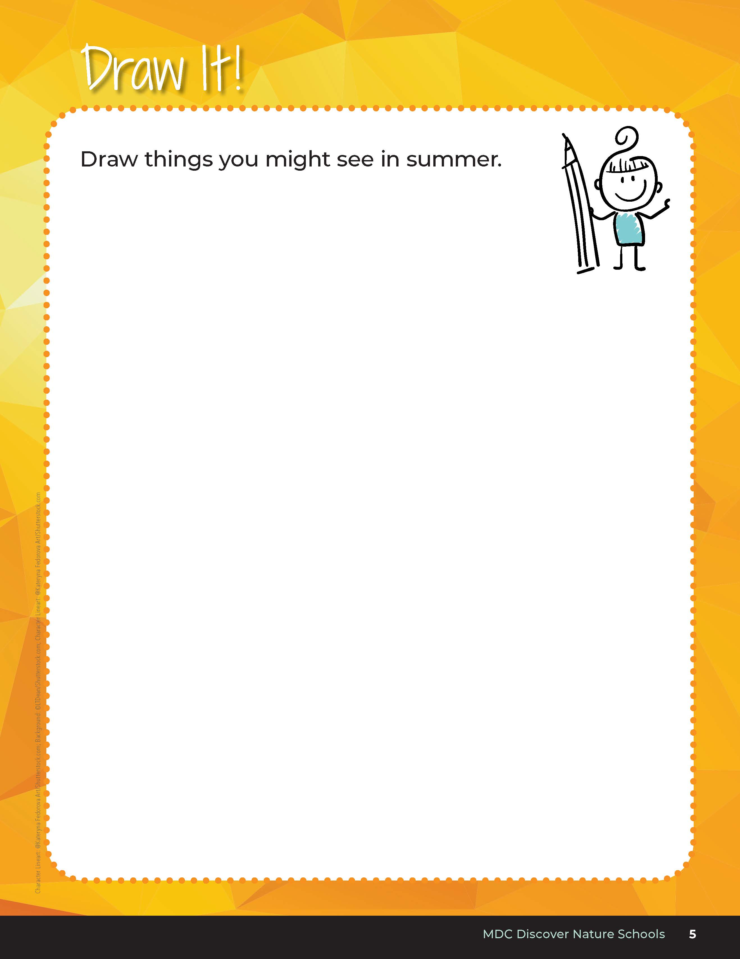
Draw things you might see in summer
Bears through the Seasons – 1A Signs of Summer: Explain
14
Notes:
Now it’s time for us to think about what we see in summer. Draw what you think you may see in your student guide, 1A Draw It! on Page 3. Reference page 5.

Slide 15
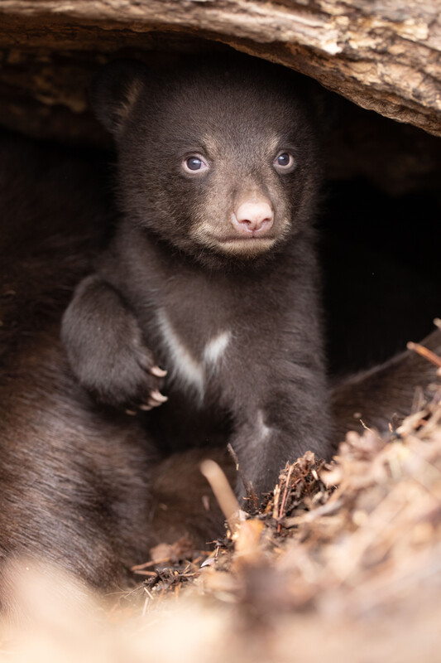
Do you think bears experience summer in the same way you and I do?
Bears through the Seasons – 1A Signs of Summer: Explain
15
Notes:
Student answers may vary

Slide 16

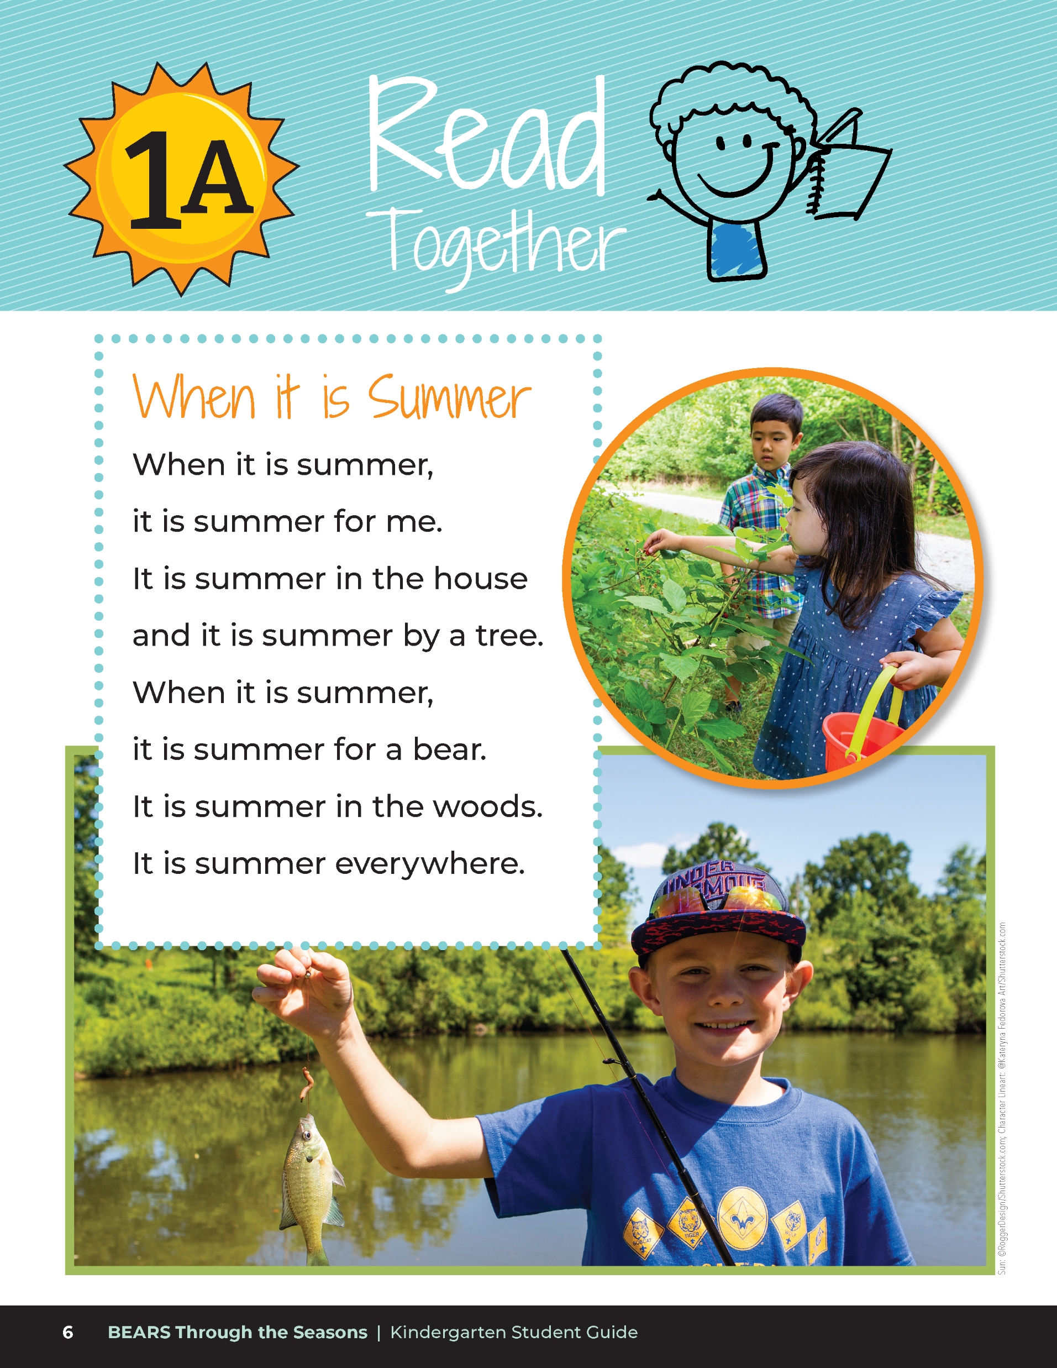
When it is Summer
When it is summer,
it is summer for me.
It is summer in the house
and it is summer by a tree.
When it is summer,
it is summer for a bear.
It is summer in the woods.
It is summer everywhere.
Bears through the Seasons – 1A Signs of Summer: Explain
16
Notes:
Read Together When it is Summer on Page 6 in the student guide.

Slide 17
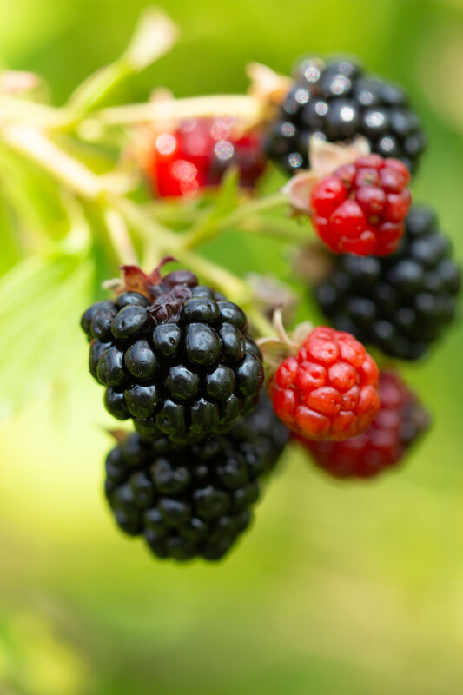
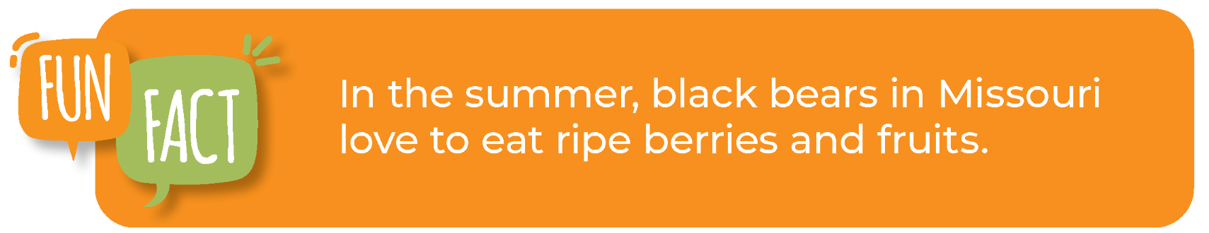
Bears through the Seasons – 1A Signs of Summer: Explain
17
Notes:
Read the fun fact on Page 7 in the student guide.

Slide 18

Which of these images show the season of summer? How do you know?
Bears through the Seasons – 1A Signs of Summer: Elaborate
18
Notes:
Add student observations and/or questions to the Noticings and Wonderings Chart as the lesson concludes in reference to the phenomenon studied.

Slide 19

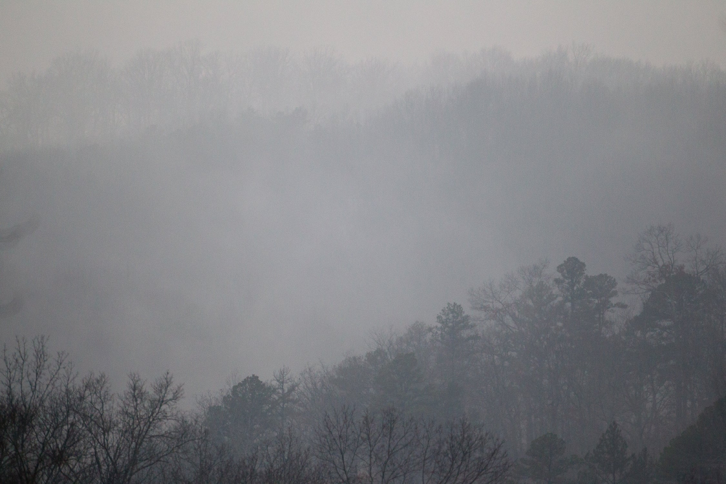
Bears through the Seasons – 1A Signs of Summer: Elaborate
19
Notes:
Add student observations and/or questions to the Noticings and Wonderings Chart as the lesson concludes in reference to the phenomenon studied.

Slide 20
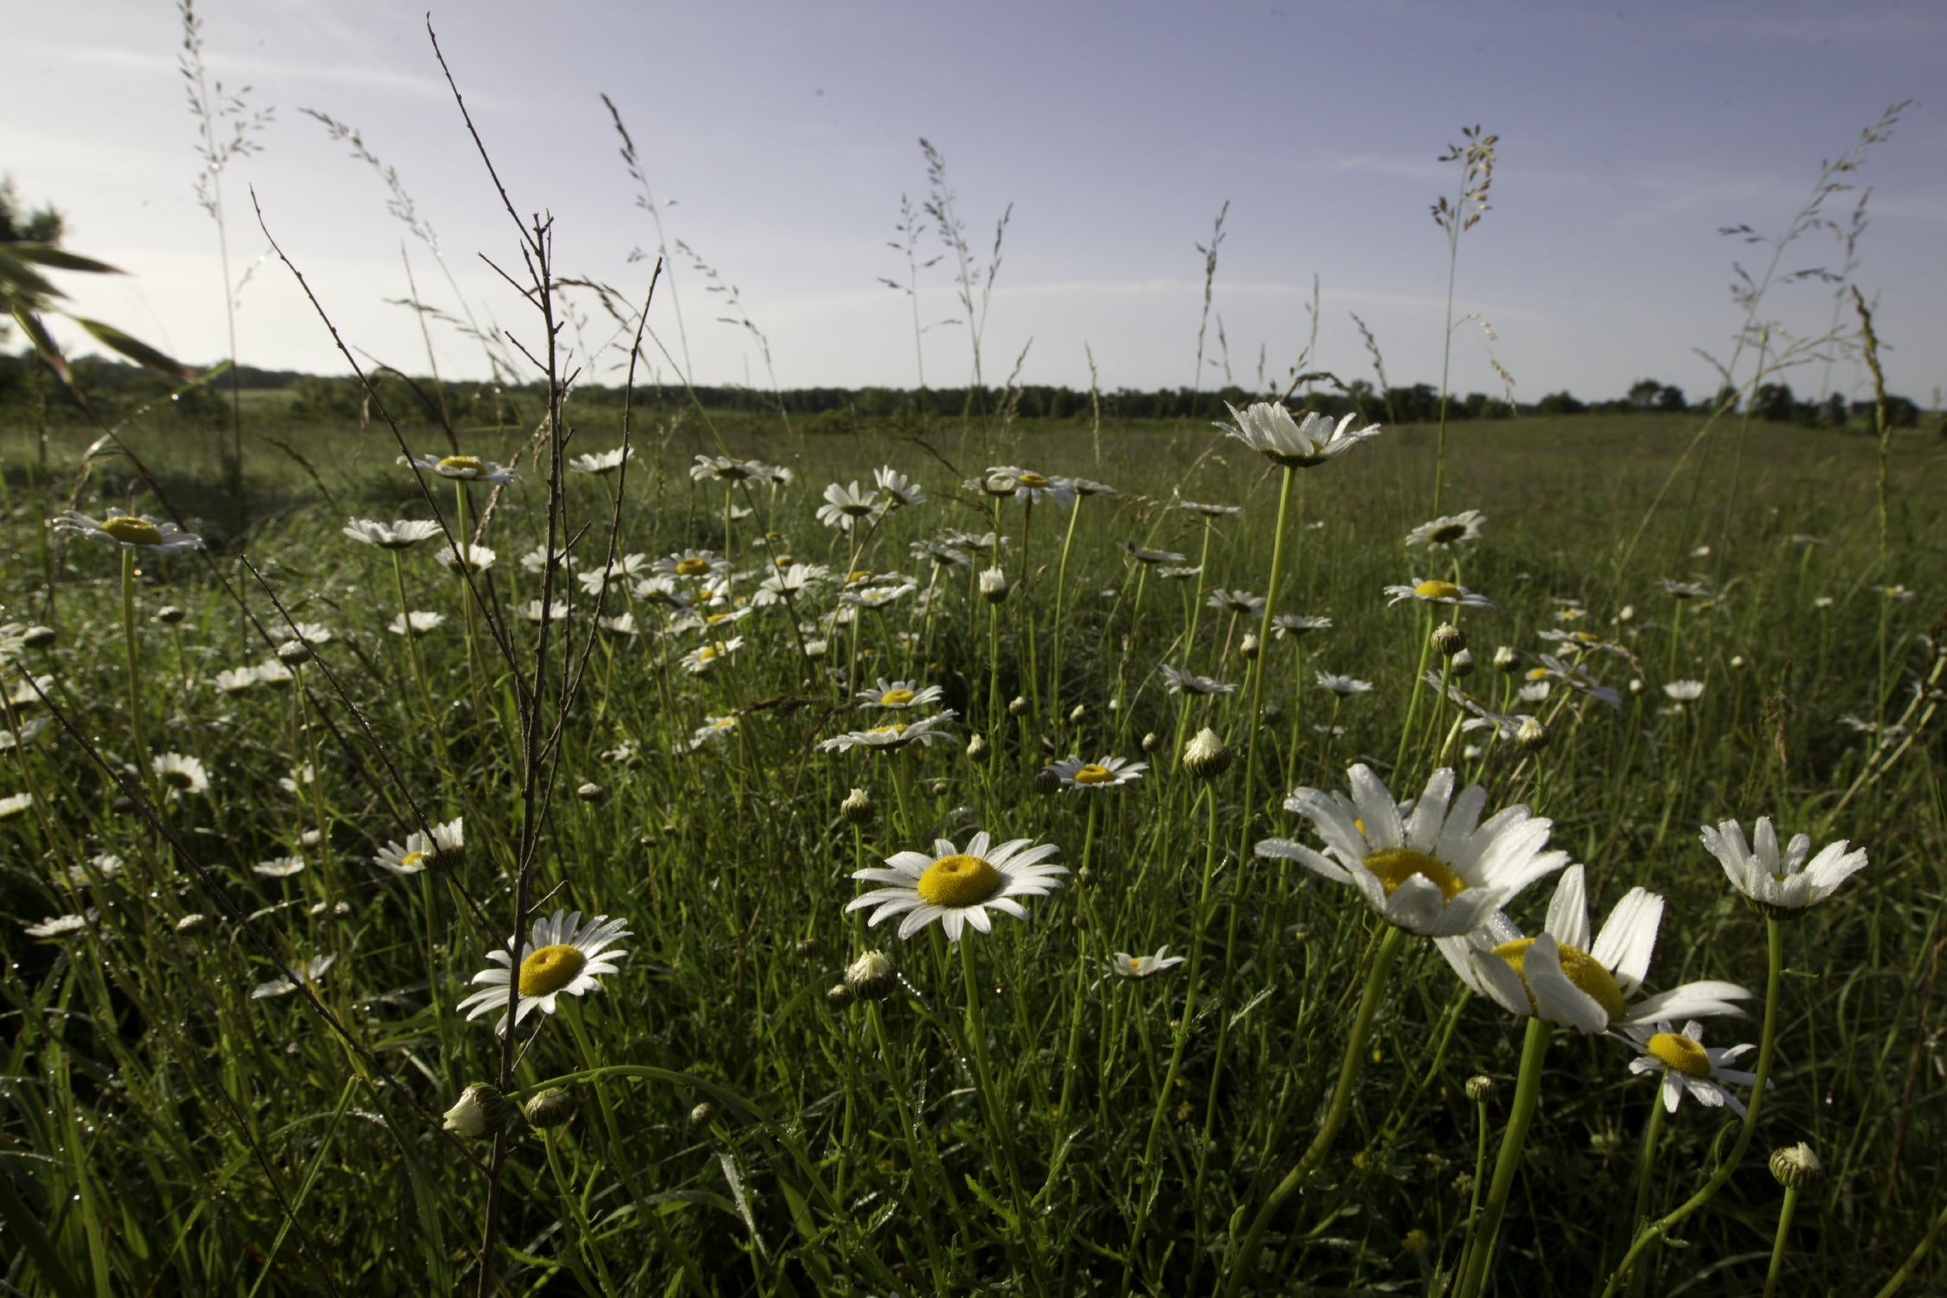
Bears through the Seasons – 1A Signs of Summer: Elaborate
20
Notes:
Add student observations and/or questions to the Noticings and Wonderings Chart as the lesson concludes in reference to the phenomenon studied.

Slide 21
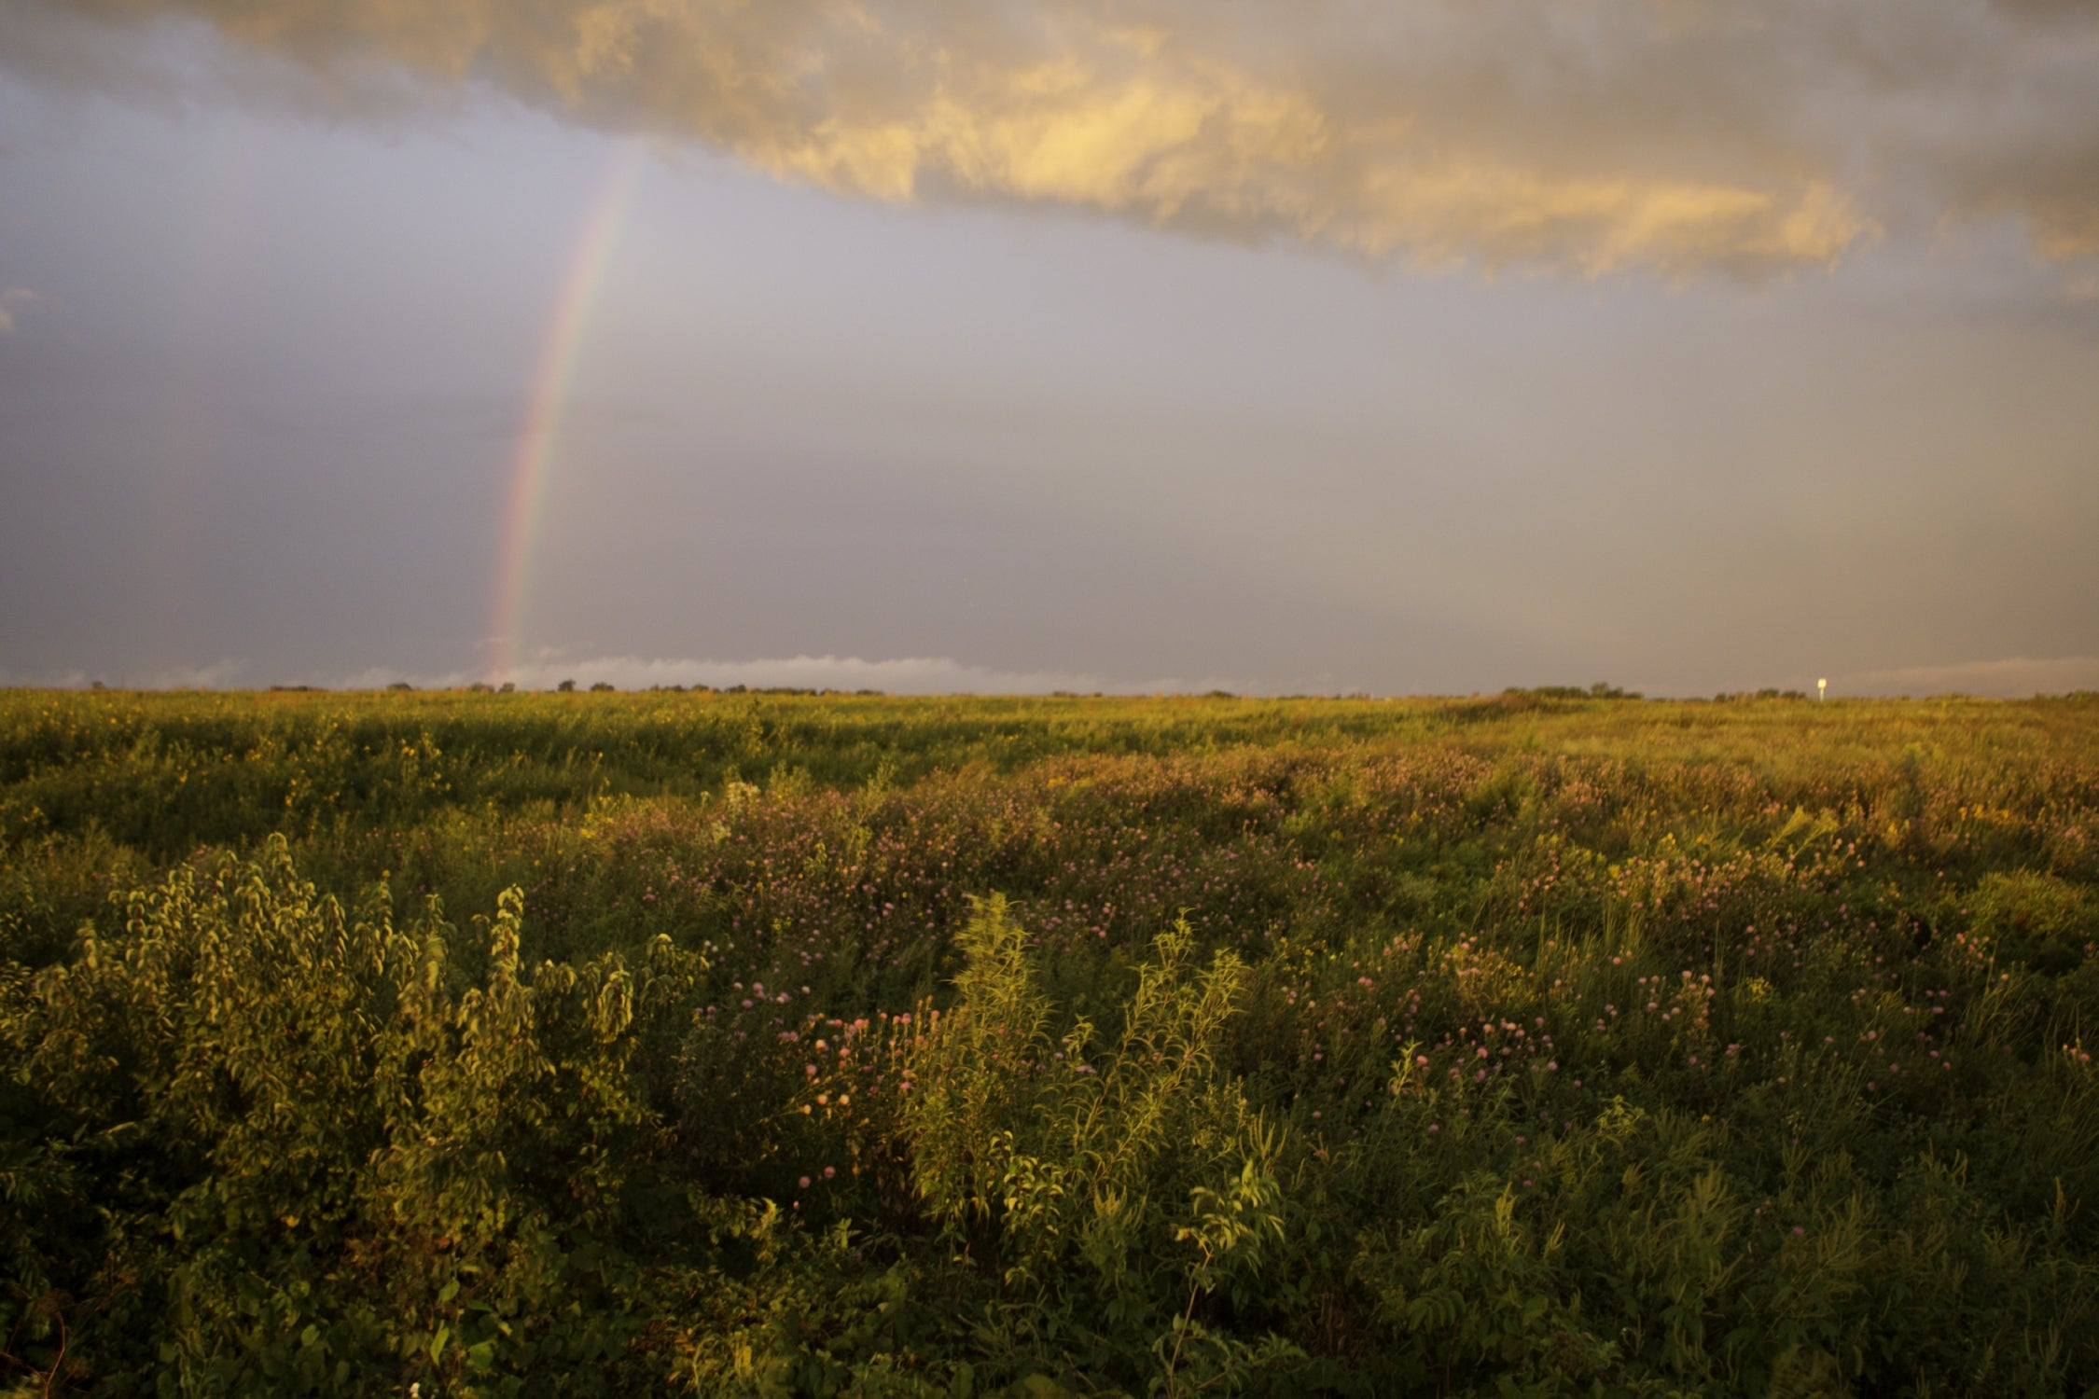
Bears through the Seasons – 1A Signs of Summer: Elaborate
21
Notes:
Add student observations and/or questions to the Noticings and Wonderings Chart as the lesson concludes in reference to the phenomenon studied.

Slide 22
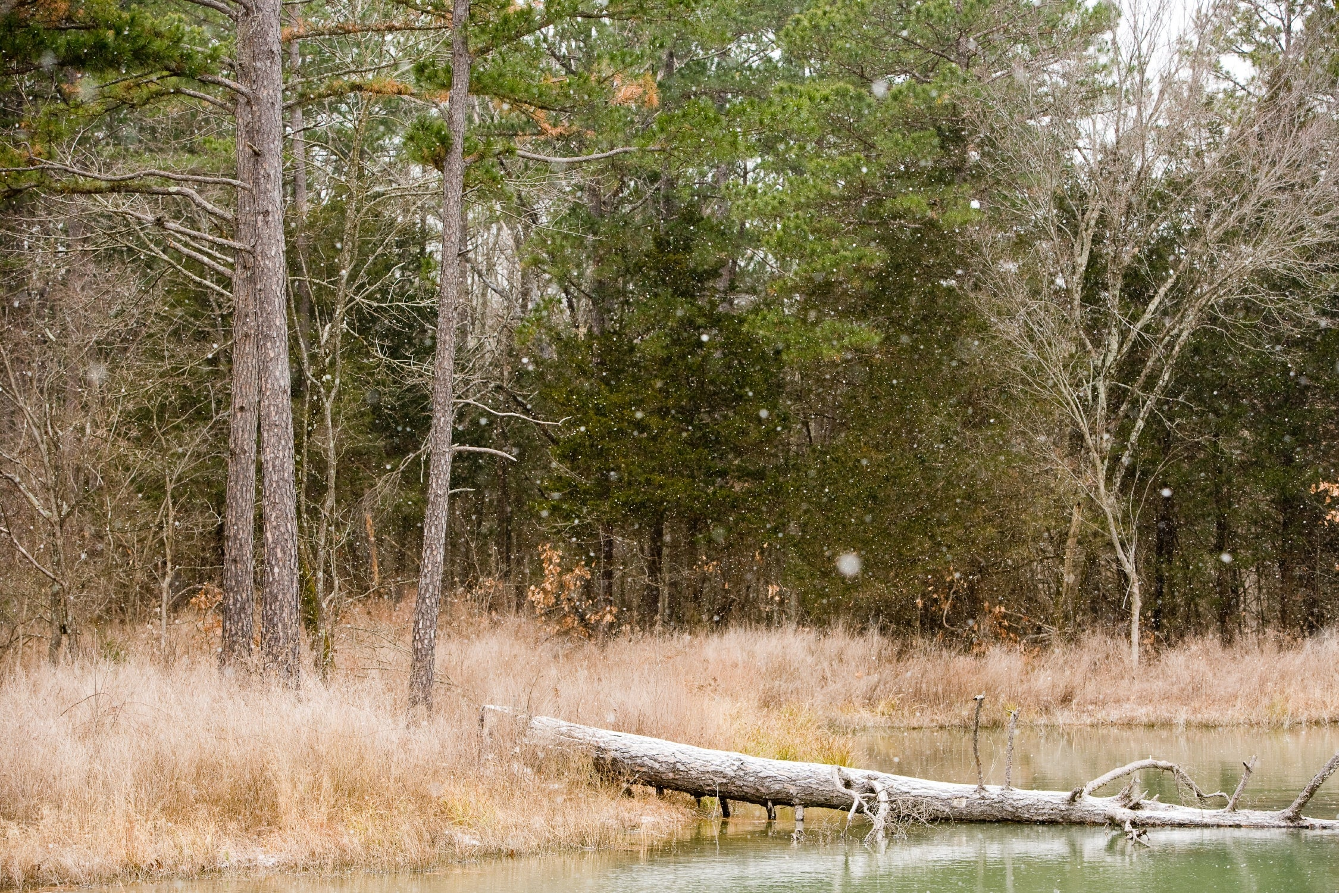
Bears through the Seasons – 1A Signs of Summer: Elaborate
22
Notes:
Add student observations and/or questions to the Noticings and Wonderings Chart as the lesson concludes in reference to the phenomenon studied.

Slide 23
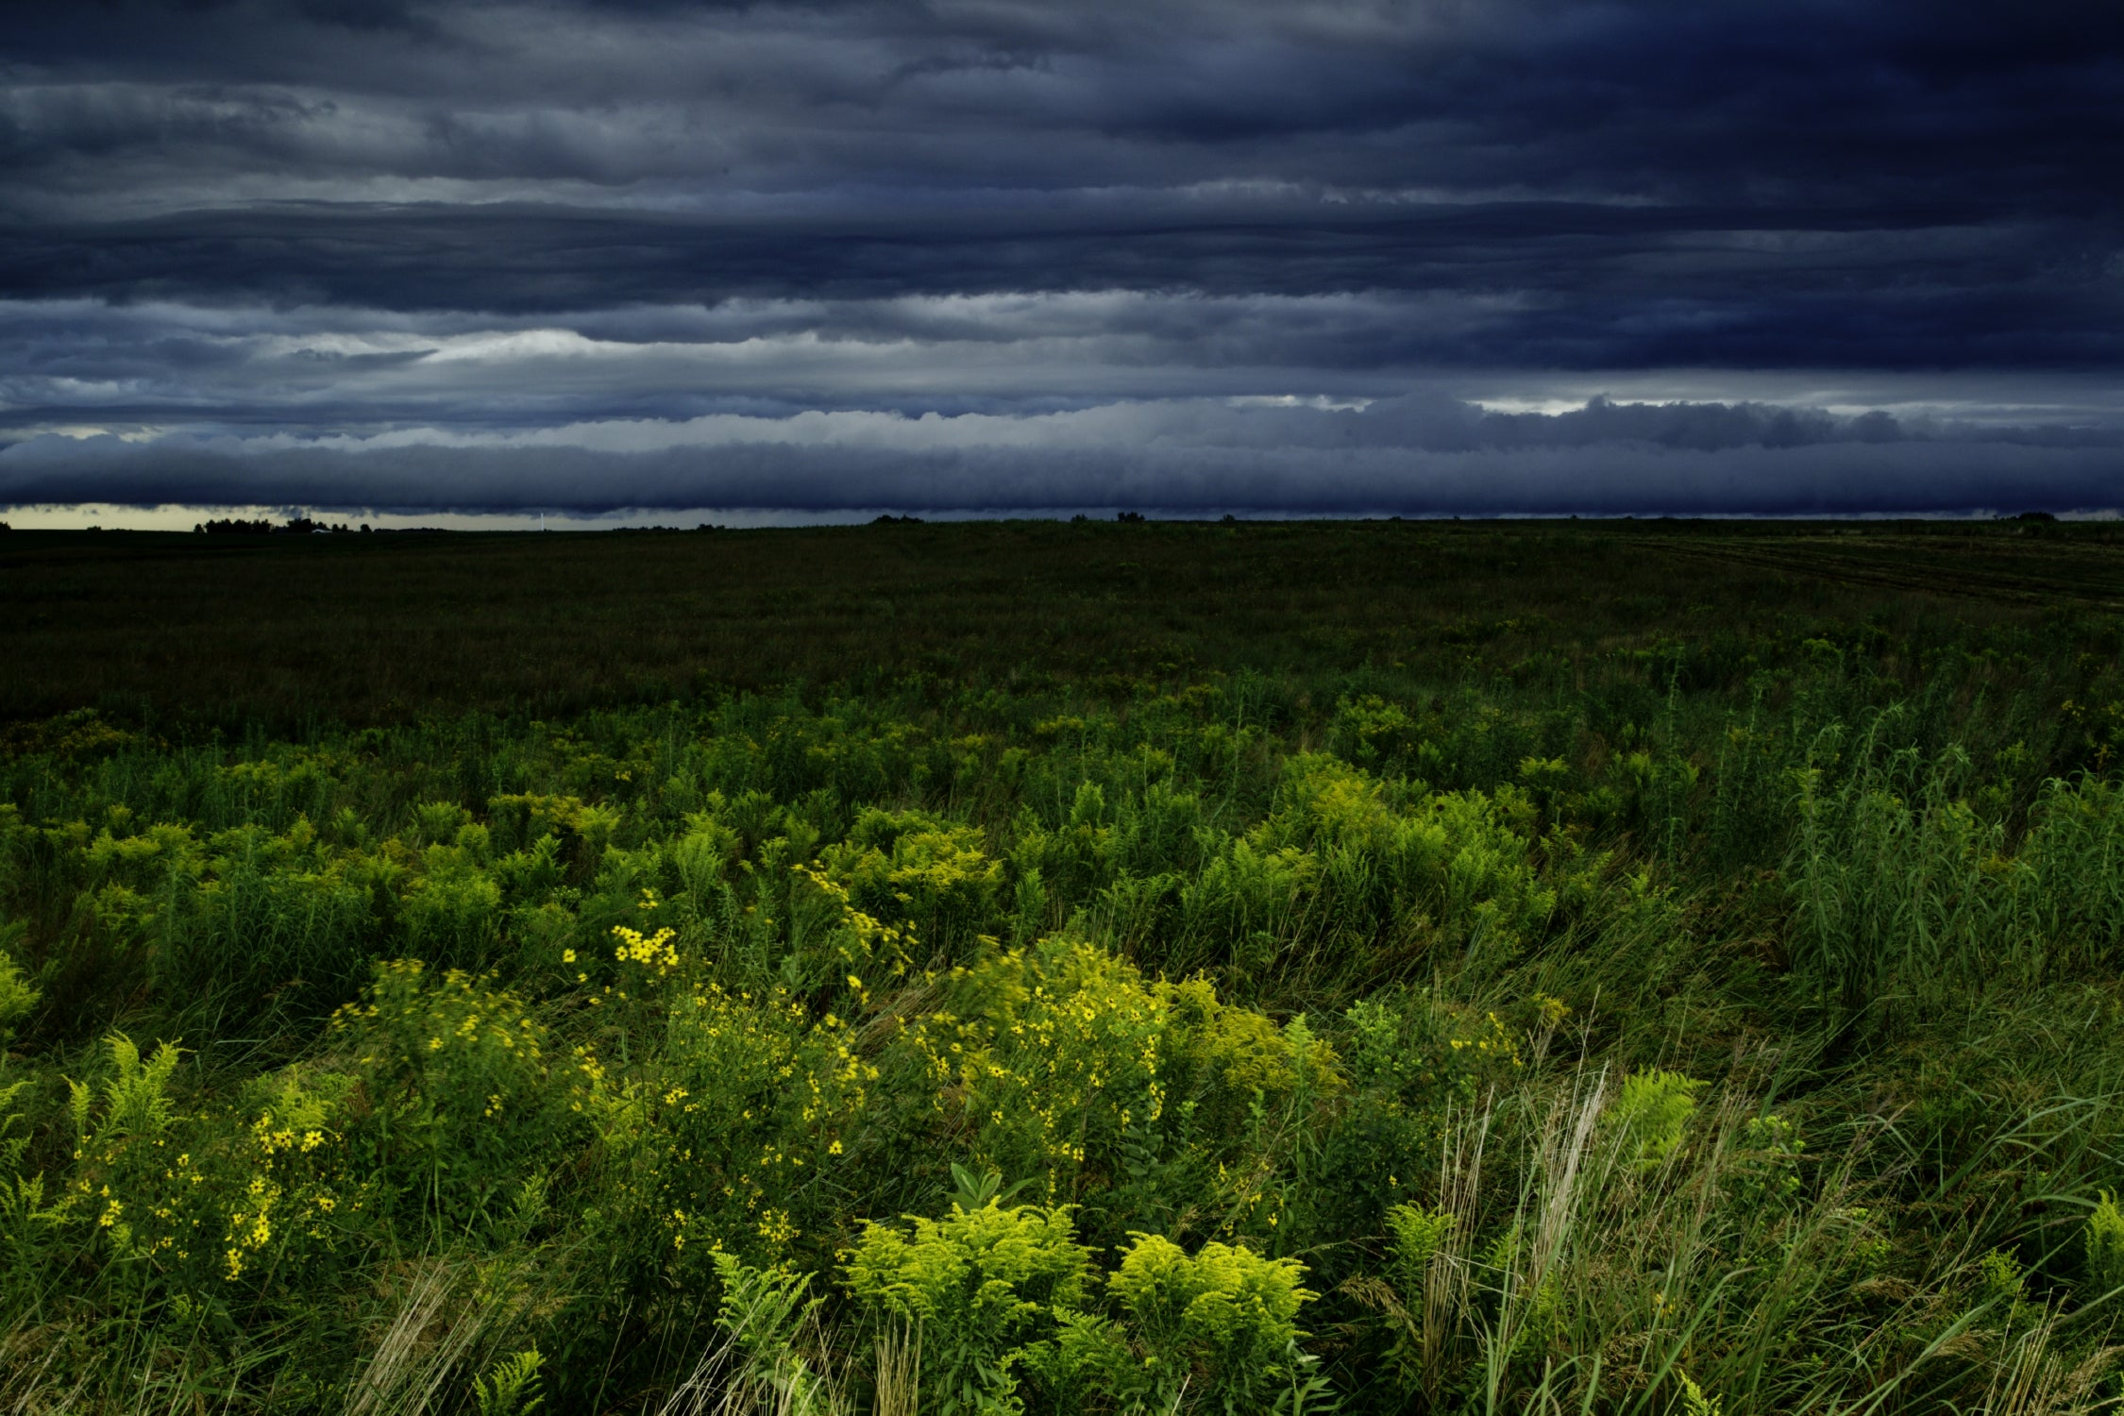
Bears through the Seasons – 1A Signs of Summer: Elaborate
23
Notes:
Add student observations and/or questions to the Noticings and Wonderings Chart as the lesson concludes in reference to the phenomenon studied.

Slide 24
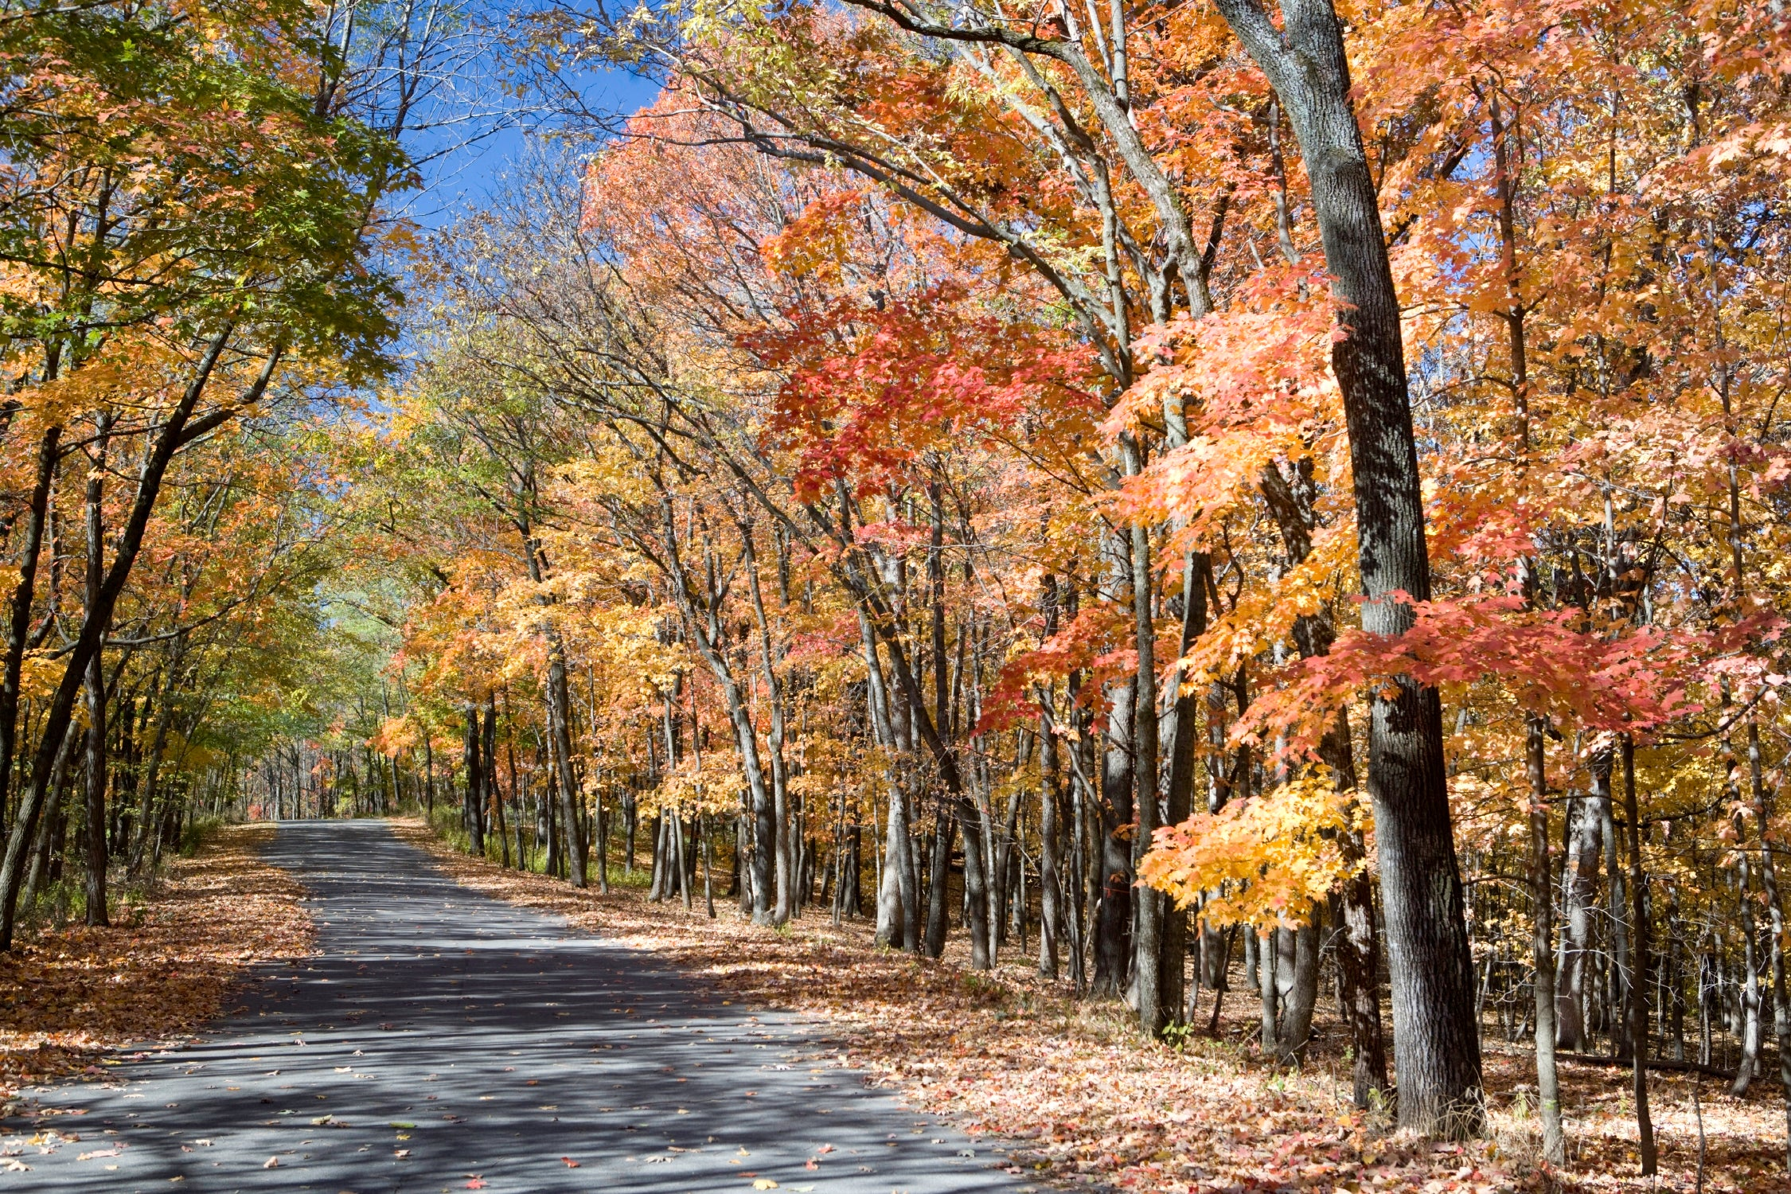
Bears through the Seasons – 1A Signs of Summer: Elaborate
24
Notes:
Add student observations and/or questions to the Noticings and Wonderings Chart as the lesson concludes in reference to the phenomenon studied.

Slide 25
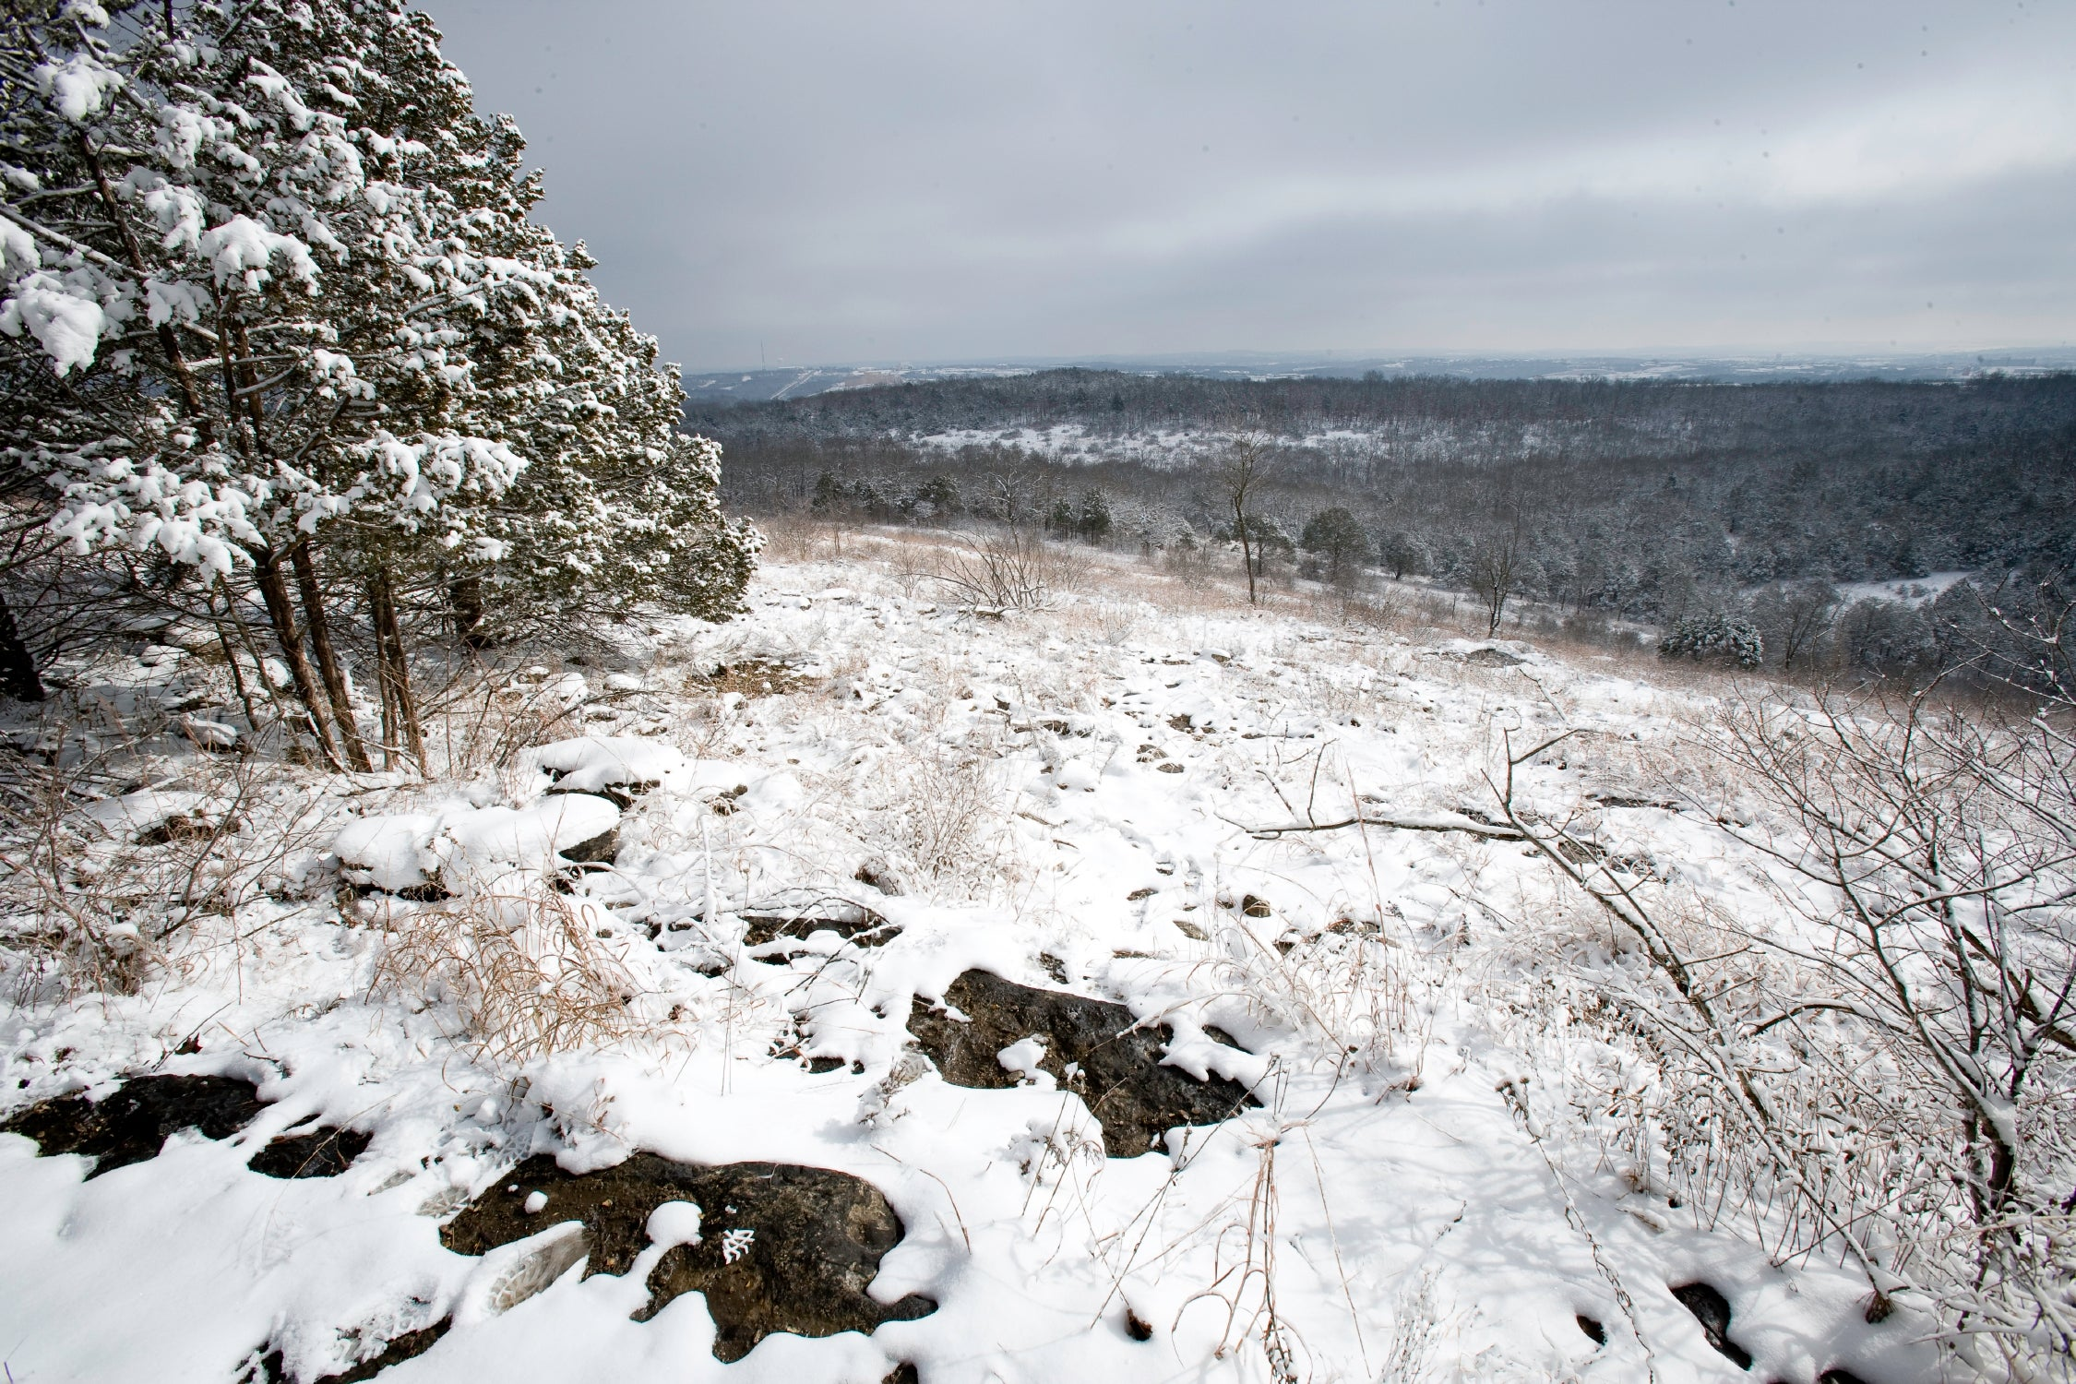
Bears through the Seasons – 1A Signs of Summer: Elaborate
25
Notes:
Add student observations and/or questions to the Noticings and Wonderings Chart as the lesson concludes in reference to the phenomenon studied.

Slide 26
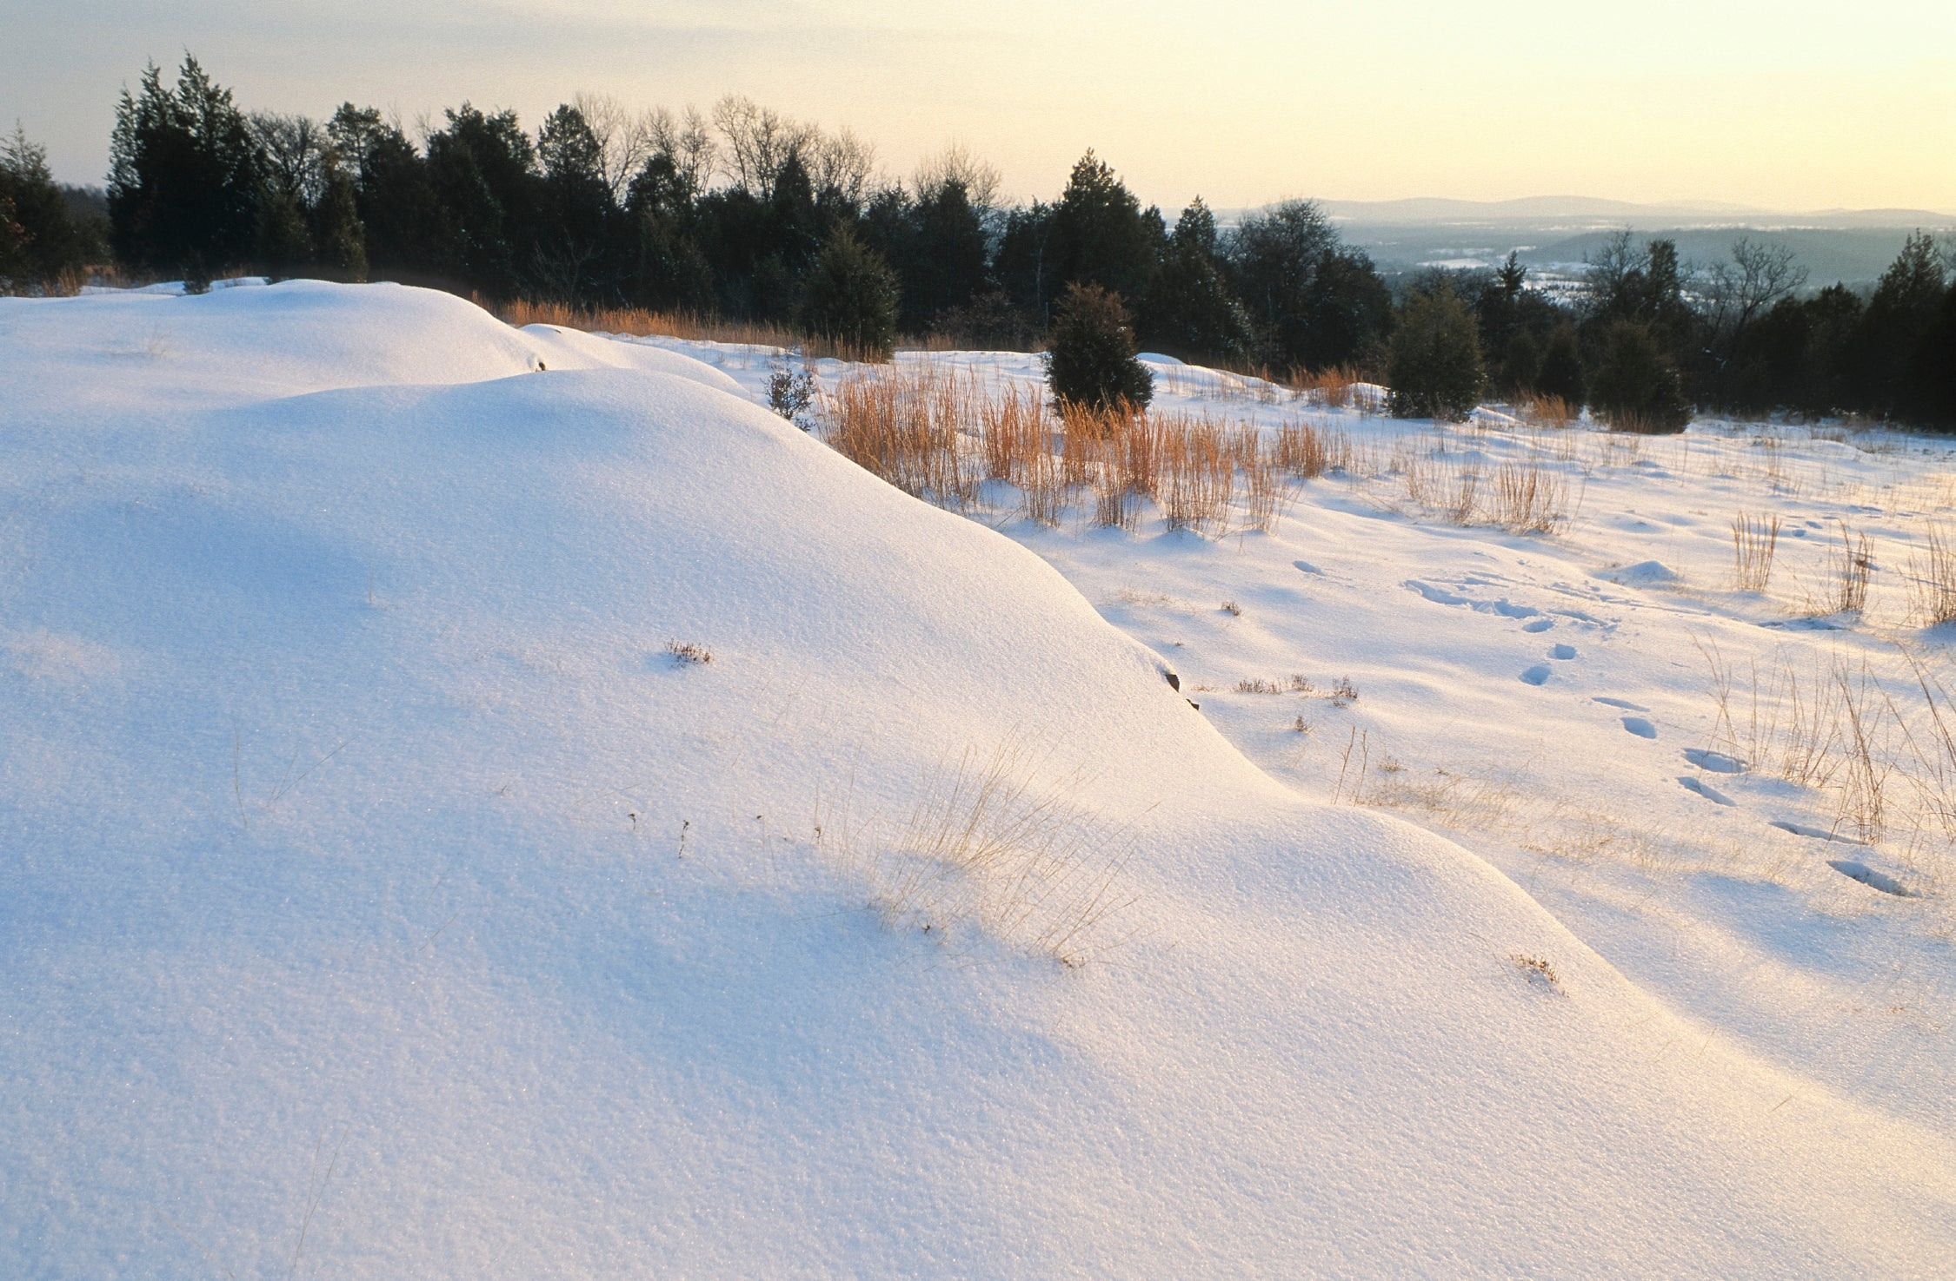
Bears through the Seasons – 1A Signs of Summer: Elaborate
26
Notes:
Add student observations and/or questions to the Noticings and Wonderings Chart as the lesson concludes in reference to the phenomenon studied.

Slide 27
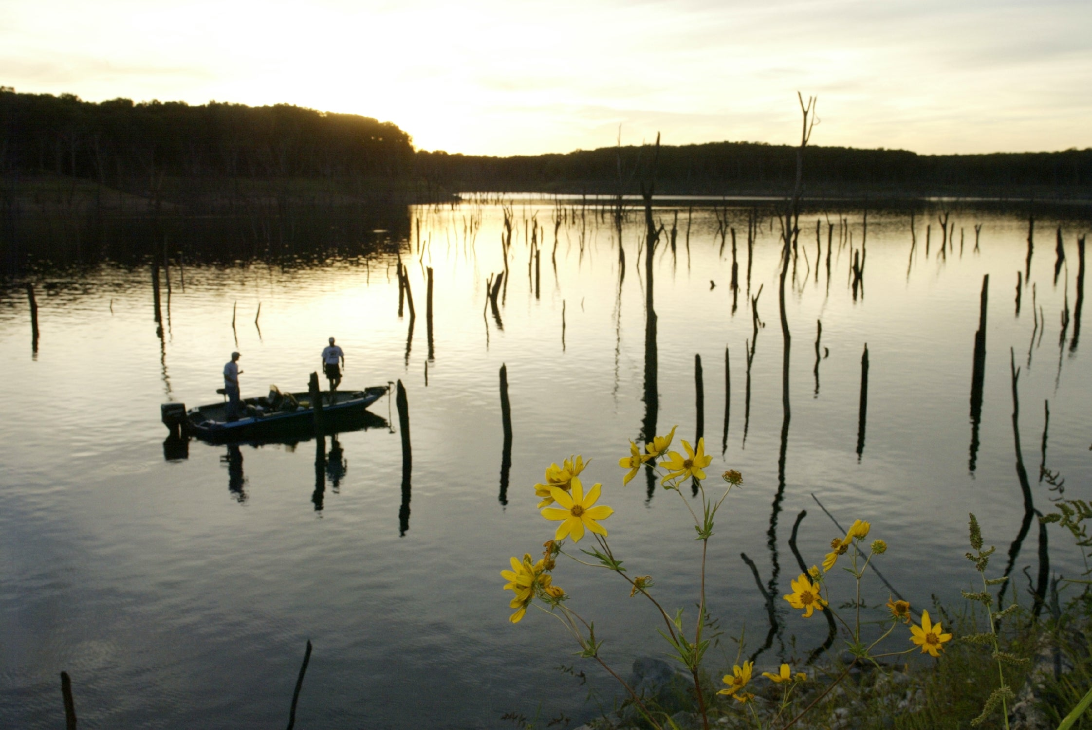
Bears through the Seasons – 1A Signs of Summer: Elaborate
27
Notes:
Add student observations and/or questions to the Noticings and Wonderings Chart as the lesson concludes in reference to the phenomenon studied.

Slide 28
Bears through the Seasons – 1A Signs of Summer: Engage
3
Notes:
Prepare and display your Noticings and Wonderings Chart for this lesson. Add student observations and/or questions to the chart as the lesson proceeds in reference to the phenomenon studied.

Slide 29

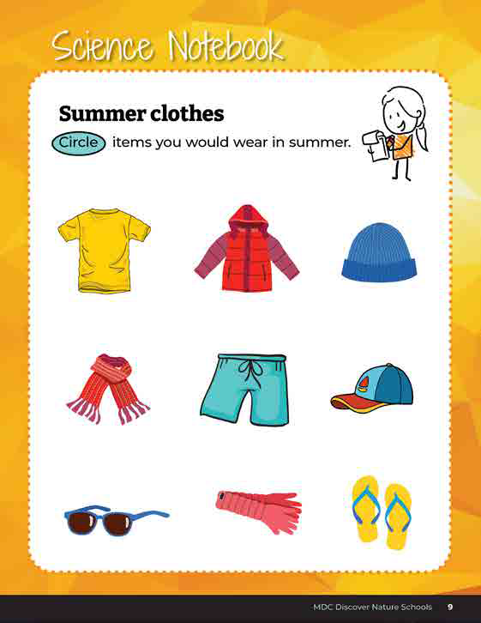
Circle the items you would wear in summer.
Why would you wear this in summer?
Bears through the Seasons – 1A Signs of Summer: Evaluate
28
Notes:
Have students complete student guide Science Notebook on Page 9, and circle items you would wear in summer.
As an assessment, students should be able to verbally explain their choices and provide evidence (justification) of what makes the clothing appropriate, using patterns from Science Notebook on Page 9.

Slide 30
Answers
Bears through the Seasons – 1A Signs of Summer: Evaluate
29
Notes:
Explain why these items are circled. Note that all clothing circles allows our heat to escape so we can stay cool or protects us from the sun.

Slide 31
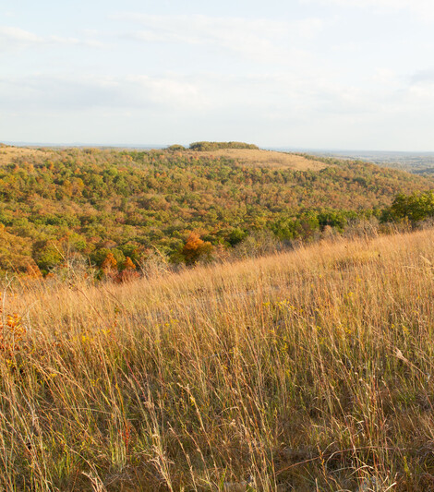
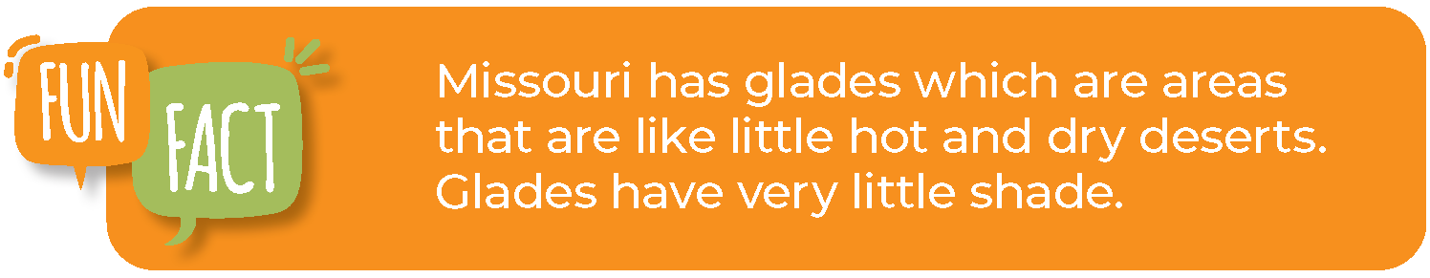
Bears through the Seasons – 1A Signs of Summer: Evaluate
30
Notes:
Read the fun fact together on Page 8 in the student guide.

Slide 32
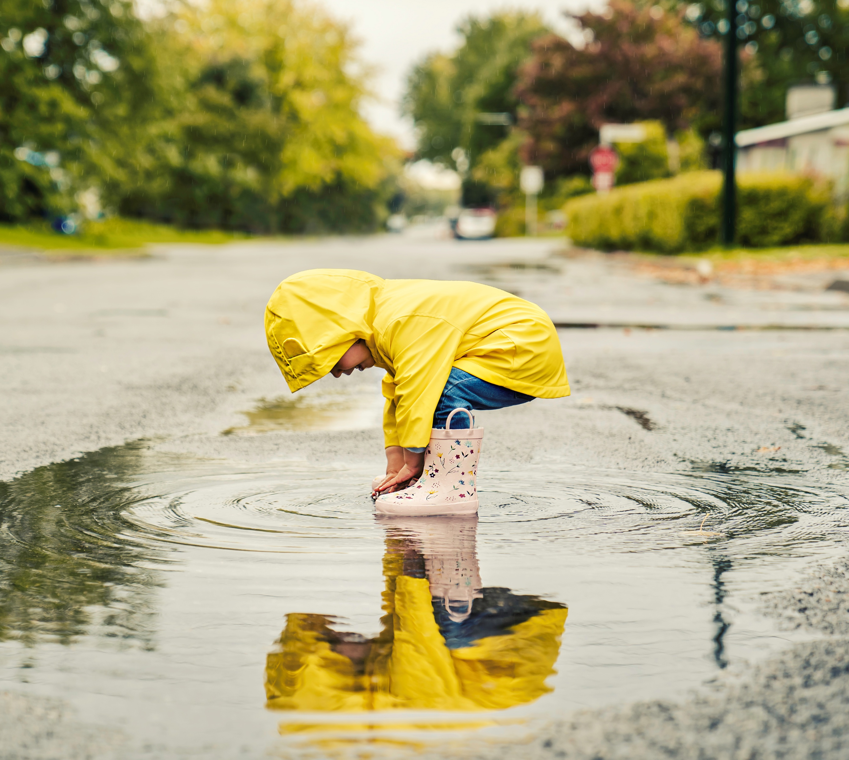
What material does our rain gear feel like?
Bears through the Seasons – 1A Signs of Summer: Evaluate
31
Notes:
Think about what an umbrella or rain jacket may be made out of and why.

Slide 33

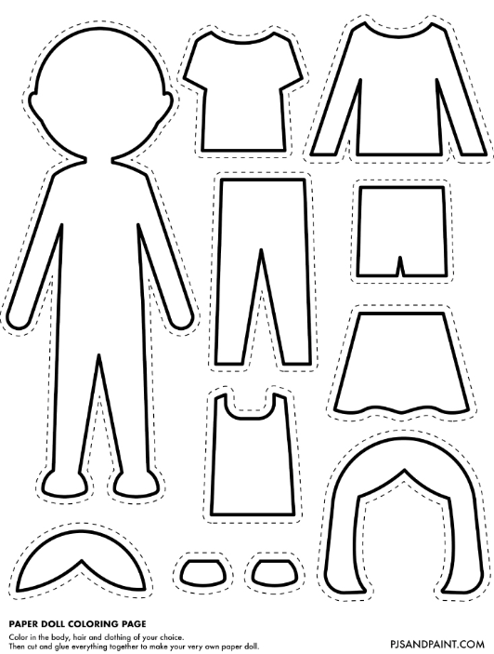
Optional: Cross Curricular Extension
Cut out a cardboard model of yourself and create paper clothing for summer gear and rain gear.
Items to include: shorts, shirts, rain gear, umbrellas, hats, etc.
Bears through the Seasons – 1A Signs of Summer: Cross-Curricular Extension
32
Notes:
Provide students with cardboard to make Season Paper Dolls. Help them to draw and cut out a cardboard model of themselves and create paper clothing for summer gear and rain gear. Items to include: shorts, shirts, rain gear, umbrellas, hats, etc.

