Slide 1
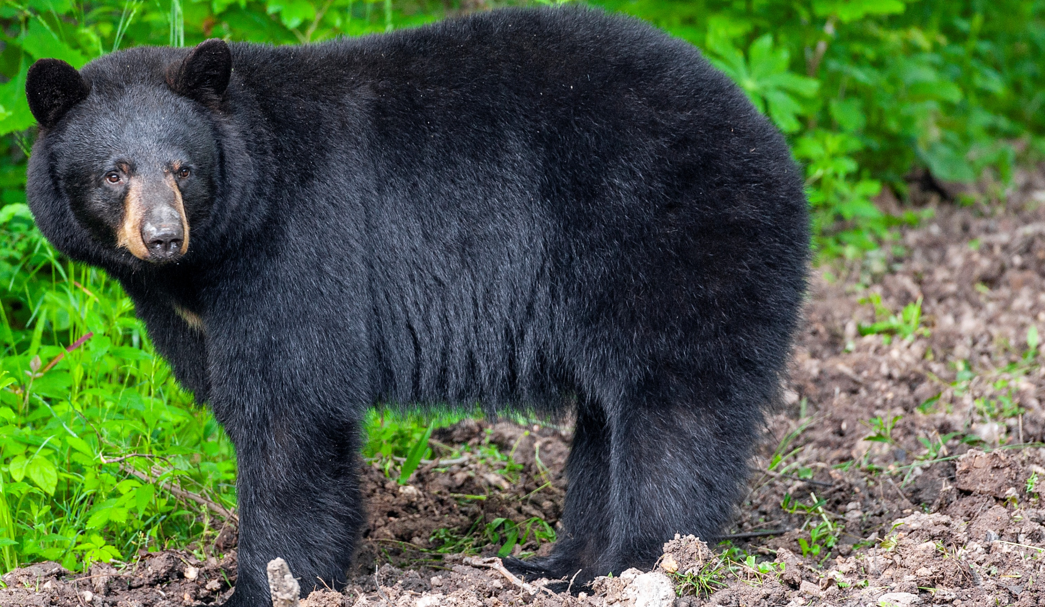

BEARS
Through the Seasons
Lesson 1G: Bear-y Good Habitat

Slide 2
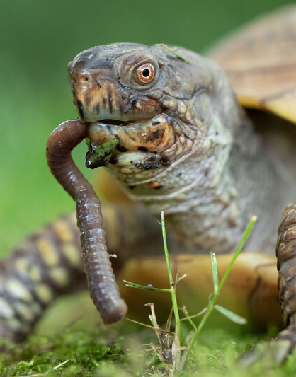

Guiding Question:
What do animals need to live?
Bears through the Seasons – 1G Bear-y Good Habitat: Engage
2
Notes:
Animal: Ornate Box Turtle eating a worm

Slide 3

Bears through the Seasons – 1G Bear-y Good Habitat: Engage
3
Notes:
Prepare and display your Noticings and Wonderings Chart for this lesson. Add student observations and/or questions to the chart as the lesson proceeds in reference to the phenomenon studied.

Slide 4

What do you notice about the animals in the video?
Bears through the Seasons – 1G Bear-y Good Habitat: Engage
4

Slide 5
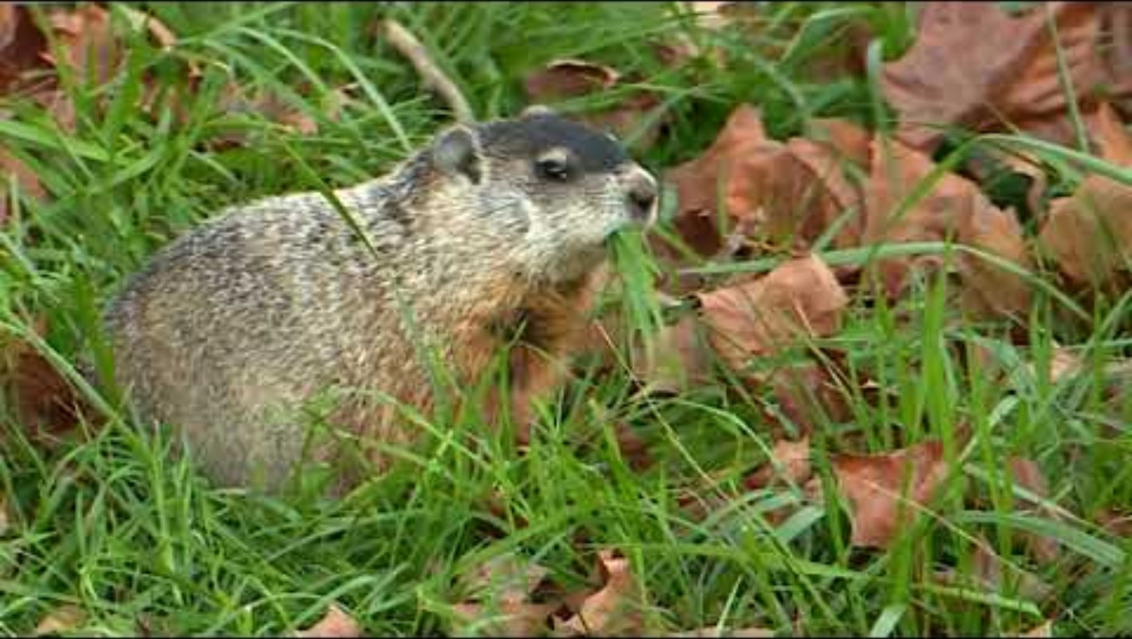
Bears through the Seasons – 1G Bear-y Good Habitat: Engage
5
Notes:
Watch the Missouri Animals Eating video. Groundhog.

Slide 6

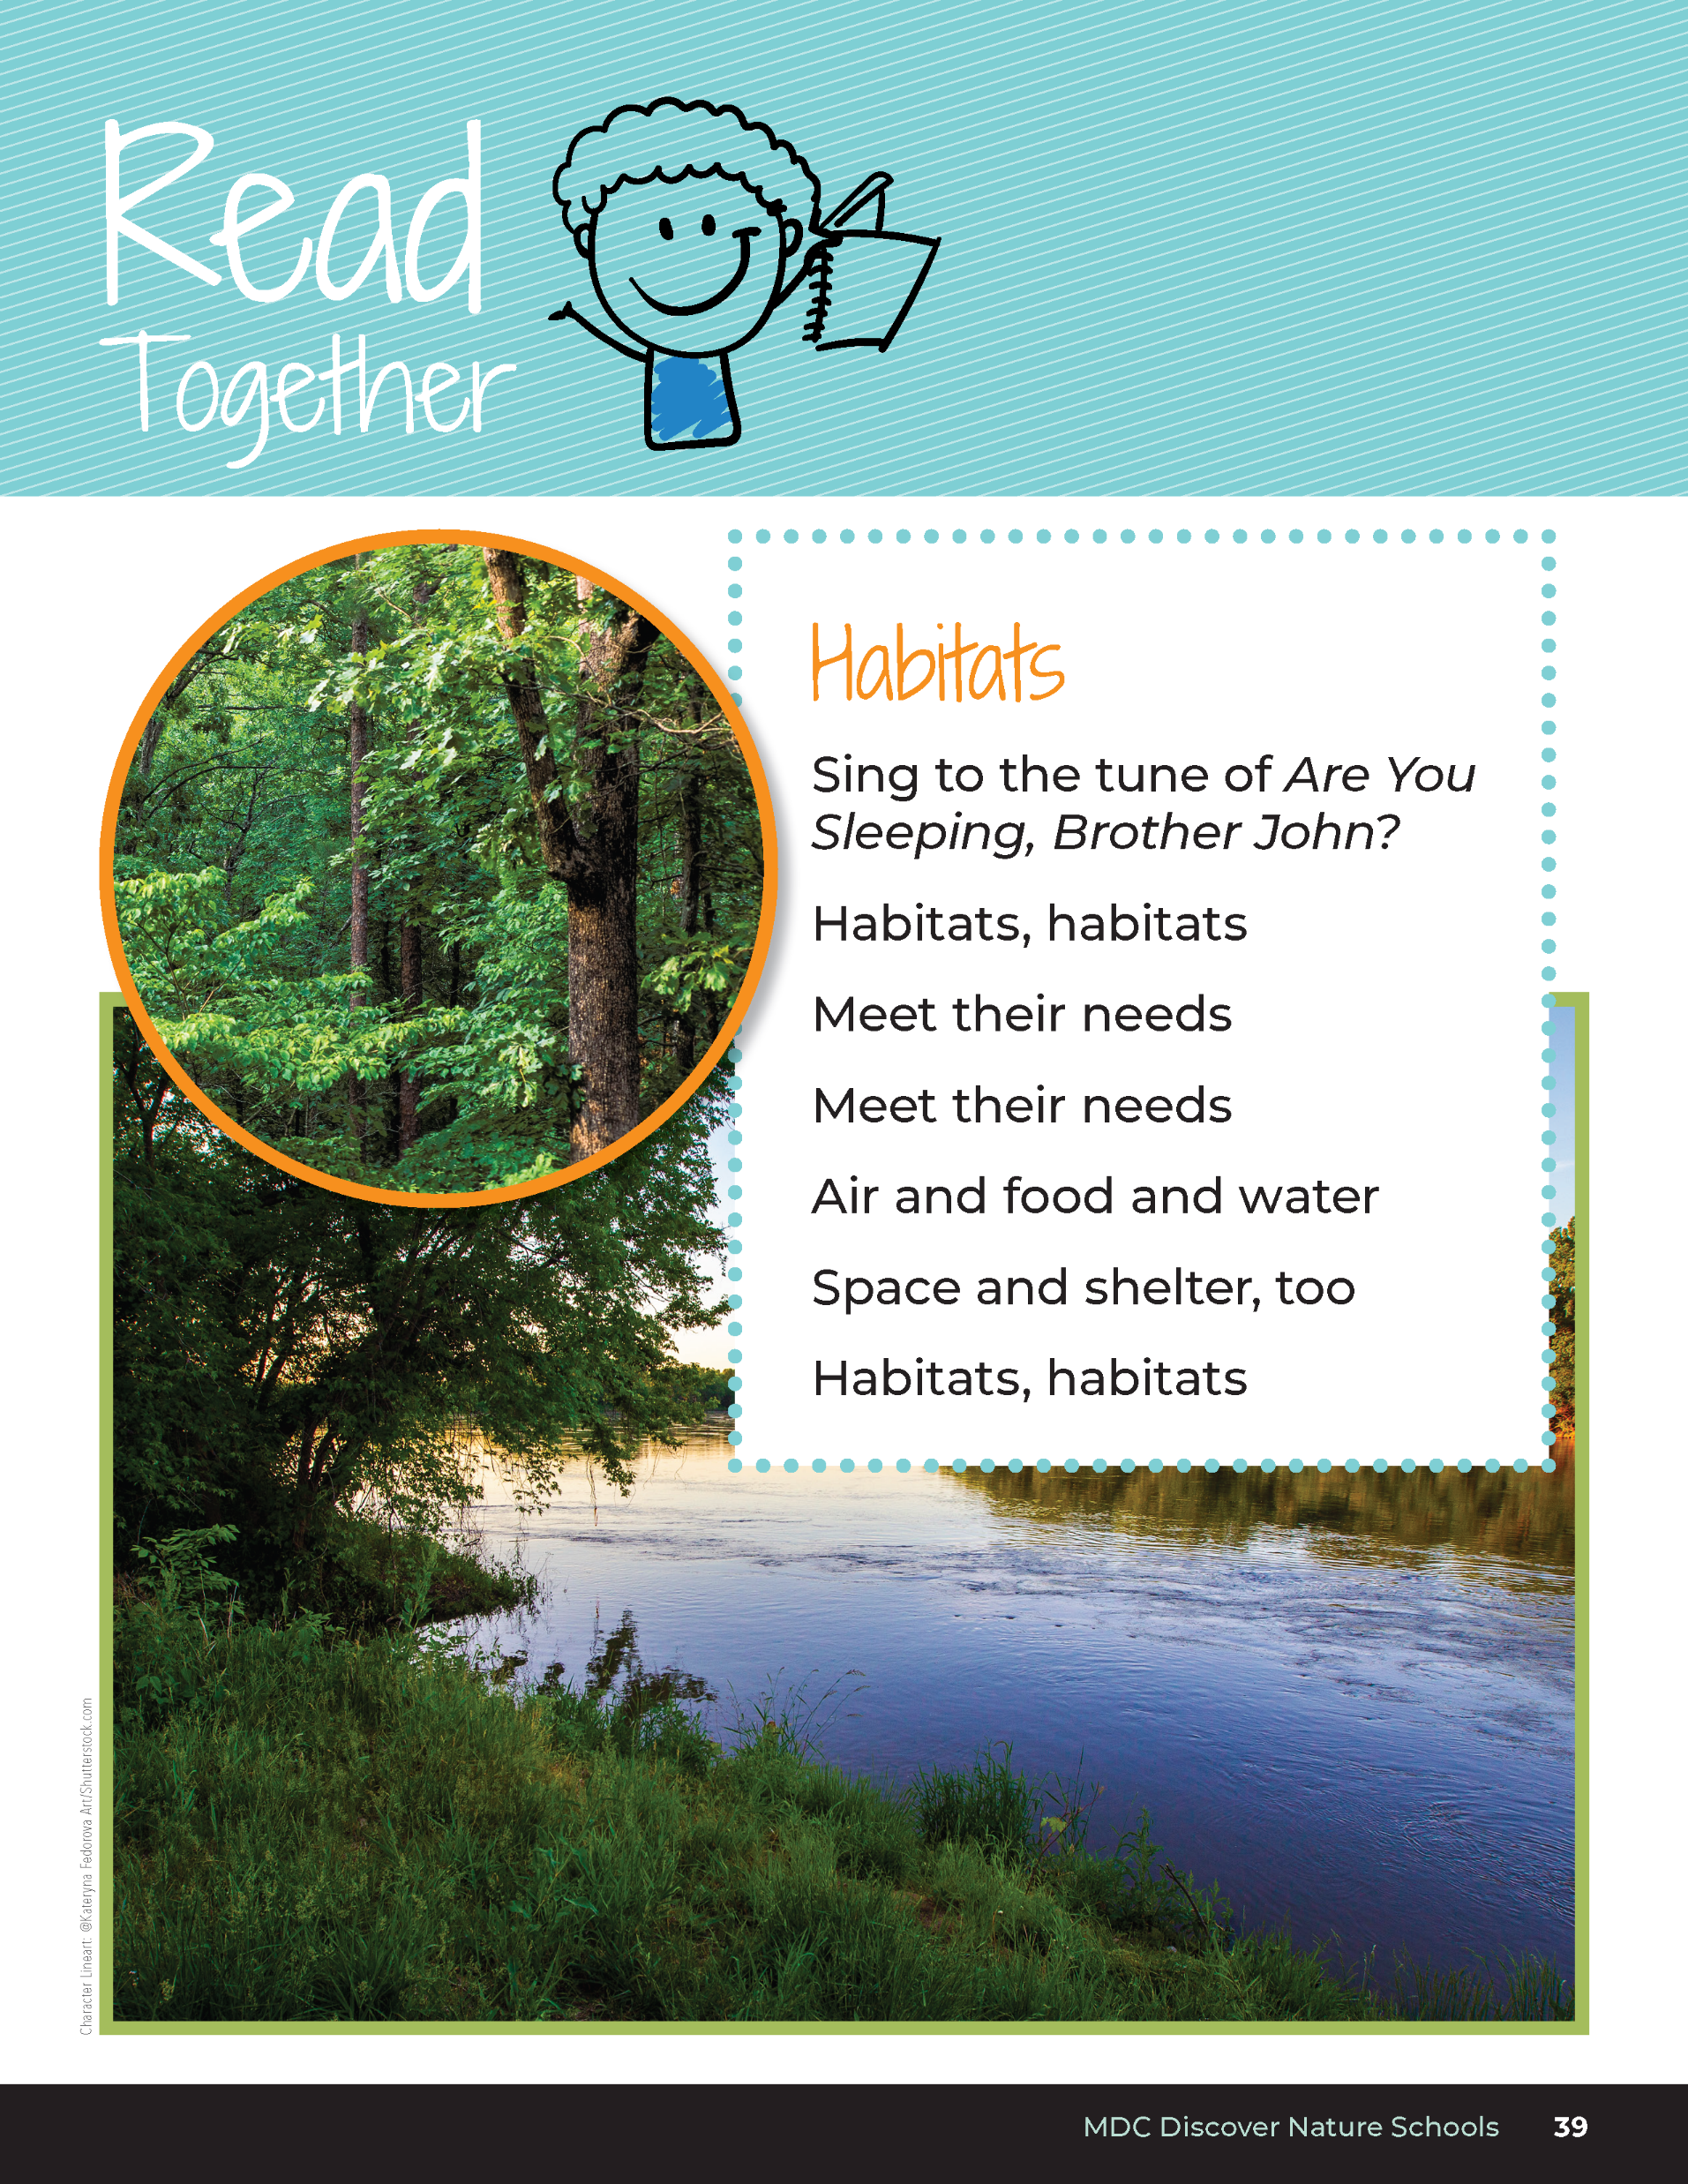
Habitats​
Sing to the tune of Are You Sleeping, Brother John?
Habitats, habitats
Meet their needs
Meet their needs
Air and food and water
Space and shelter, too
Habitats, habitats
Bears through the Seasons – 1G Bear-y Good Habitat: Engage
6
Notes:
Read aloud from the student guide Read Together Habitats on Page 39.

Slide 7
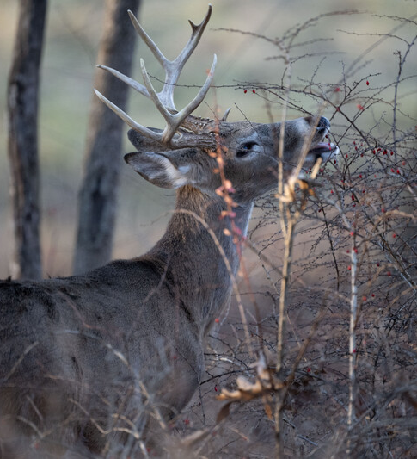
What do animals need to stay alive?
Bears through the Seasons – 1G Bear-y Good Habitat: Explore
7
Notes:
White-tailed deer buck ( antlers show it's male)

Slide 8

You are going to create a poster of what your group's animal needs to survive.
Bears through the Seasons – 1G Bear-y Good Habitat: Explore
8
Notes:
Make groups of two to three students. Assign each group a Missouri animal such as bird, squirrel, deer, mouse, fish, butterfly, honeybee, crayfish, etc. Make sure to assign invertebrates as well as vertebrates. Place an image of the animal assigned in the center of chart paper for each group. Each group will create a poster drawing of what each animal needs to survive.

Slide 9
Work with 2-3 group members.
2. Draw the animal you are researching in the middle of your poster.
3. Research what your given animal needs to survive.
4. Write or draw each animal need.
5. Hang your poster on the wall.
Bears through the Seasons – 1G Bear-y Good Habitat: Explore
9
Notes:
Make groups of two to three students. Assign each group a Missouri animal such as bird, squirrel, deer, mouse, fish, butterfly, honeybee, crayfish, etc. Make sure to assign invertebrates as well as vertebrates. Place an image of the animal assigned in the center of chart paper for each group. Each group will create a poster drawing of what each animal needs to survive.

Slide 10
What do you notice about all the drawn items on the poster?
Are there similarities?
Bears through the Seasons – 1G Bear-y Good Habitat: Explain
10
Notes:
Have students do a gallery walk of all the posters. Hang them or put them on tables in an area where all groups can see them.

Slide 11
Fill in the blanks.
Animals need...
___________
___________
___________
___________
Bears through the Seasons – 1G Bear-y Good Habitat: Explain
11

Slide 12
Fill in the blanks.
Animals need...
___________
___________
___________
___________
food
water
air
shelter or space
Bears through the Seasons – 1G Bear-y Good Habitat: Explain
12

Slide 13
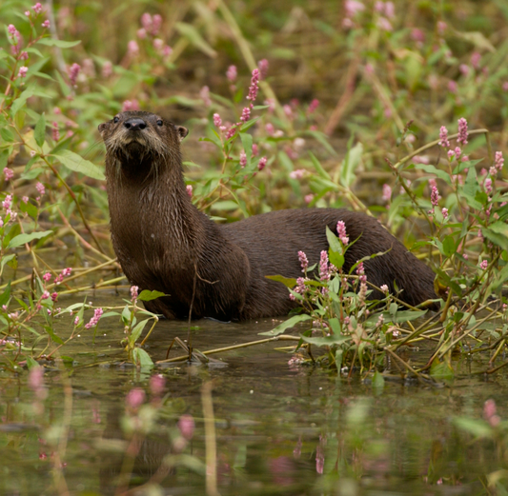
What is a habitat?
The place where plants and animals live and have their needs met.
Bears through the Seasons – 1G Bear-y Good Habitat: Explain
13
Notes:
The discussion should bring them to an agreement on what animals need to survive – air, food, water, space/shelter. The place where animals live and have their needs met is called a habitat, or a habitat is a system that has many parts an animal needs to survive.

Slide 14

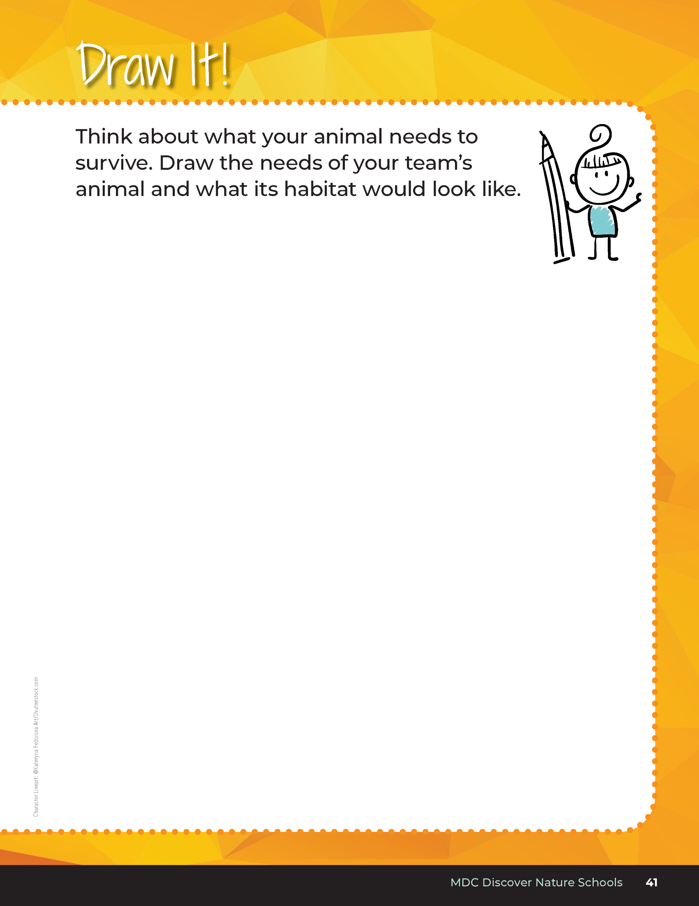
Think about what your animal needs to survive. Draw the needs of your team’s animal and what its habitat would look like.
Bears through the Seasons – 1G Bear-y Good Habitat: Explain
14
Notes:
Have each student complete student guide, Draw It! Activity on Page 41.

Slide 15
Habitats​
Sing to the tune of Are You Sleeping, Brother John?
Habitats, habitats
Meet their needs
Meet their needs
Air and food and water
Space and shelter, too
Habitats, habitats
Bears through the Seasons – 1G Bear-y Good Habitat: Explain
15
Notes:
Read aloud from the student guide Read Together Habitats on Page 39.

Slide 16
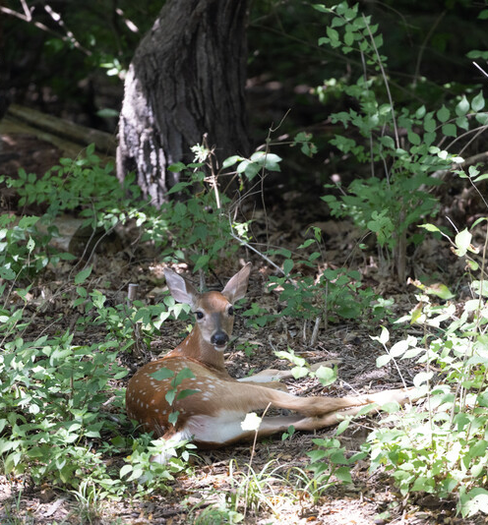
Parts of a habitat: Pick one poster. What parts of this habitat do you see? (think about how much space, types of food and if water is there)
Bears through the Seasons – 1G Bear-y Good Habitat: Explain
16
Notes:
Choose one student poster and review the animal’s habitat as determined by the students. Discuss the parts of the specific habitat, like space, food, and water.
Animal: White-tailed deer

Slide 17
Imagine you are an animal found in your schoolyard. What animal are you?
Now, imagine what you might need to survive. As humans, we often create a grocery list of things we need to buy to live comfortably.
Bears through the Seasons – 1G Bear-y Good Habitat: Elaborate
17
Notes:
Distribute a piece of white paper and crayons.
Imagine you are an animal found in your schoolyard. What animal are you?
Now, imagine what you might need to survive. As humans, we often create a grocery list of things we need to buy to live comfortably.
Create a “grocery list” of things you might need as your chosen animal by drawing your animal’s needs. Include more than just food items (for example, air, water, and shelter).

Slide 18

Create a “grocery list” of things you might need as your chosen animal by drawing your animal’s needs.
Bears through the Seasons – 1G Bear-y Good Habitat: Elaborate
18
Notes:
Distribute a piece of white paper and crayons.
Imagine you are an animal found in your schoolyard. What animal are you?
Now, imagine what you might need to survive. As humans, we often create a grocery list of things we need to buy to live comfortably.
Create a “grocery list” of things you might need as your chosen animal by drawing your animal’s needs. Include more than just food items (for example, air, water, and shelter).

Slide 19
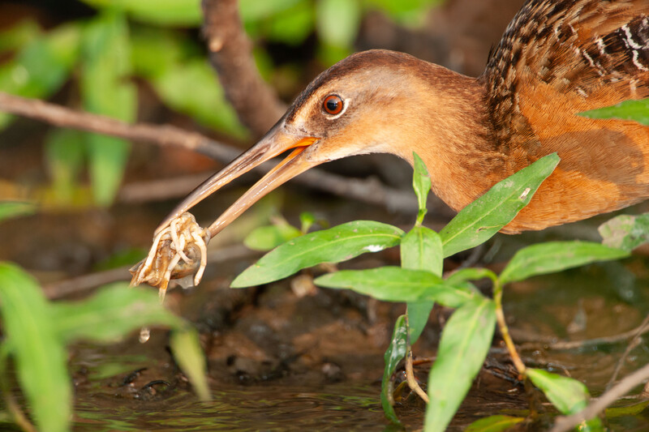
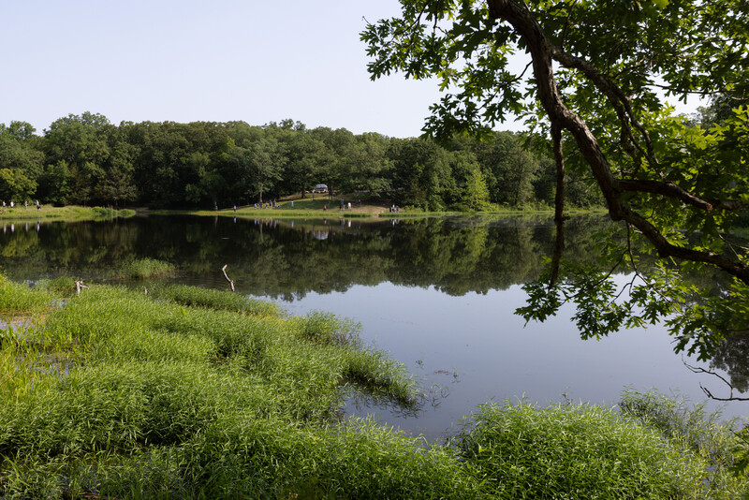
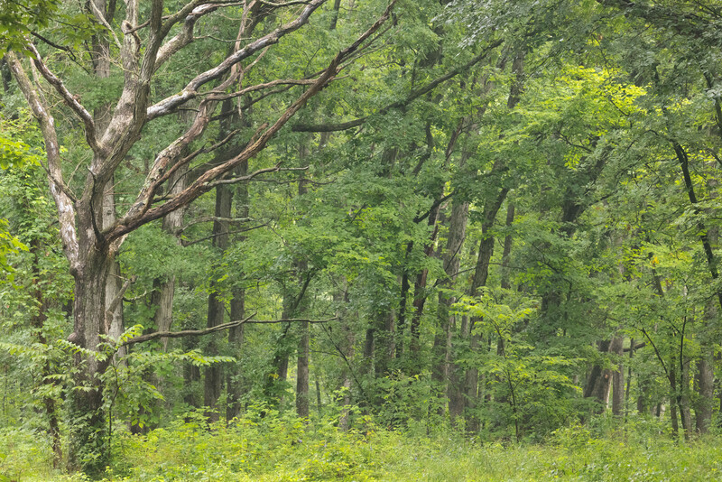
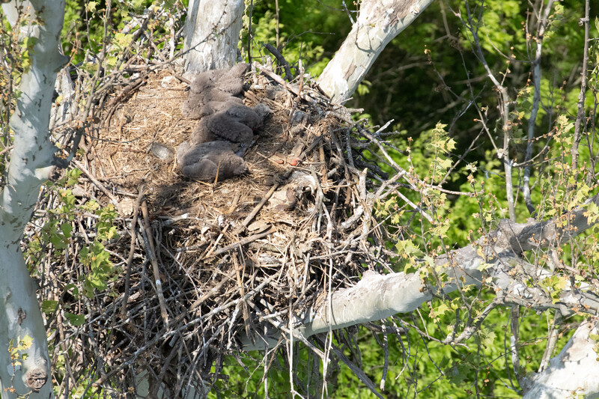
Let's take a Habitat Walk!
What types of habitats do you see? What are the different needs of animals?
Bears through the Seasons – 1G Bear-y Good Habitat: Elaborate
19
Notes:
Have students tape their drawings to the walls around the classroom. Take a Habitat Walk to identify different habitats on the posters and what each animal needs.
Have students brainstorm possible habitat areas in their schoolyard based on availability of air, food, water and space or shelter. Answers will vary depending on what type of animal the habitat may be suitable for.

Slide 20
What habitats can we find in our schoolyard?
Is there enough available space/shelter, food, water, and air for these animals in the whole schoolyard to survive?
Bears through the Seasons – 1G Bear-y Good Habitat: Elaborate
20
Notes:
Have students brainstorm possible habitat areas in their schoolyard based on availability of air, food, water and space or shelter. Answers will vary depending on what type of animal the habitat may be suitable for.

Slide 21
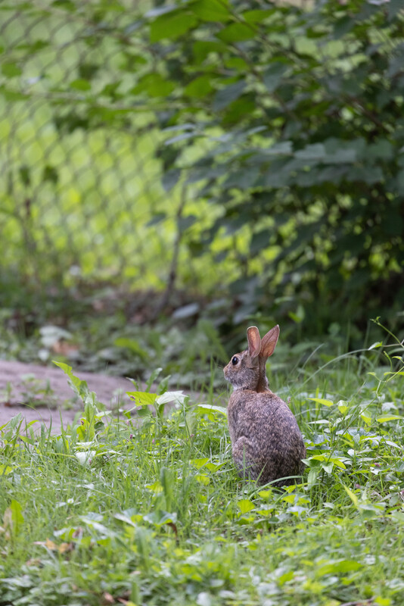
Brainstorm possible habitat areas in your schoolyard based on availability of air, food, water, and space or shelter.
Bears through the Seasons – 1G Bear-y Good Habitat: Elaborate
21

Slide 22
Bears through the Seasons – 1G Bear-y Good Habitat: Elaborate
22
Notes:
Add student observations and/or questions to the Noticings and Wonderings Chart as the lesson concludes.

Slide 23
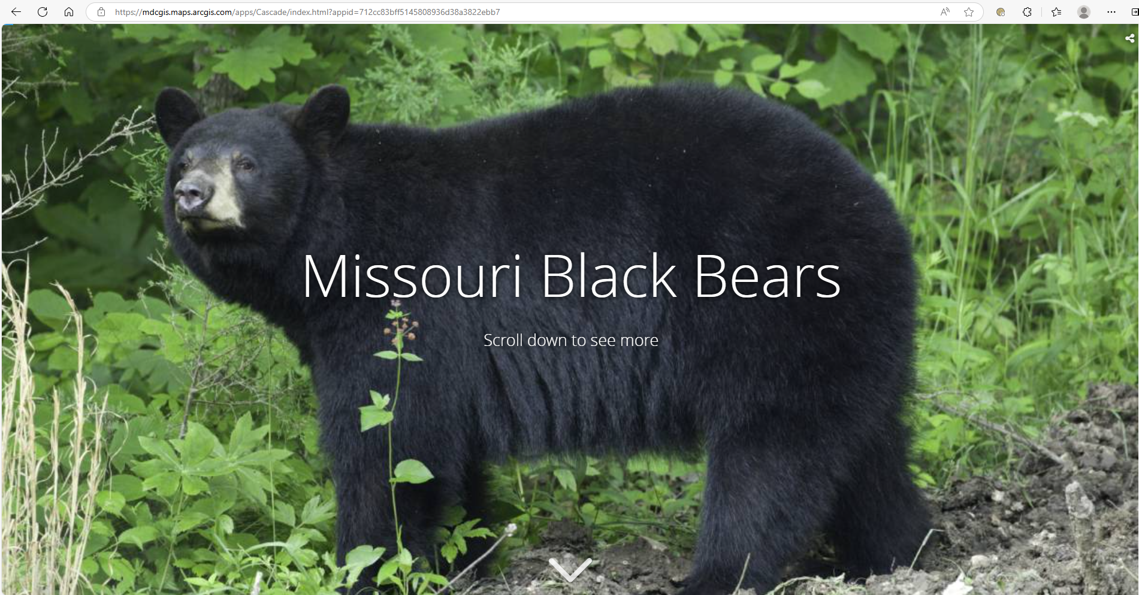
Black Bear Interactive Story Map
Link:
https://mdcgis.maps.arcgis.com/apps/Cascade/index.html?appid=712cc83bff5145808936d38a3822ebb7
Bears through the Seasons – 1G Bear-y Good Habitat: Evaluate
23
Notes:
Visit Lesson 1G at education.mdc.mo.gov/Kindergarten, and browse to the interactive Bear Story Map. Display the den types again. Students should identify the components of the system that the bear needs to survive.

Slide 24
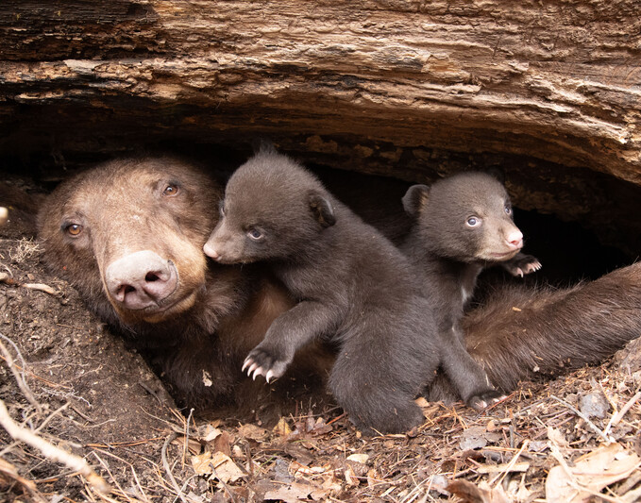
What habitat is surrounding this den?
Bears through the Seasons – 1G Bear-y Good Habitat: Evaluate
24
Notes:
Forest

Slide 25
What habitat is surrounding this den?
a forest
Bears through the Seasons – 1G Bear-y Good Habitat: Evaluate
25
Notes:
Forest

Slide 26
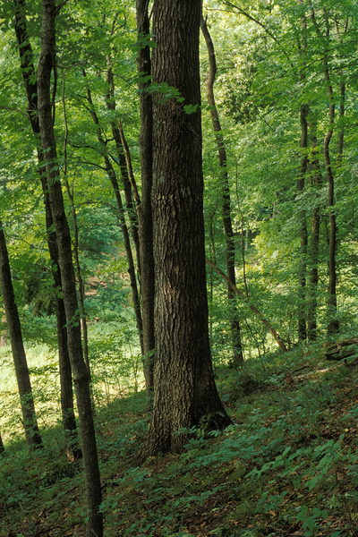
Why is the forest habitat important for bears to survive?
Bears through the Seasons – 1G Bear-y Good Habitat: Evaluate
26
Notes:
The forest habitat provides food, water, shelter and space for bears. In the forest, black bears can find everything they need to survive.

Slide 27
Why is the forest habitat important for bears to survive?
The forest habitat provides food, water, shelter and space for bears. In the forest, black bears can find everything they need to survive.
Bears through the Seasons – 1G Bear-y Good Habitat: Evaluate
27
Notes:
The forest habitat provides food, water, shelter and space for bears. In the forest, black bears can find everything they need to survive.

Slide 28
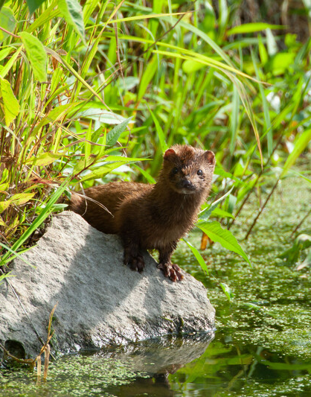
How are these different parts similar or different to the needs of the animals we explored earlier?
Bears through the Seasons – 1G Bear-y Good Habitat: Evaluate
28
Notes:
Student answers will vary, but all answers should include that every animal must find food, water, shelter and space within their own habitat.

Slide 29
How are these different parts similar or different to the needs of the animals we explored earlier?
Every animal must find food, water, shelter and space within their own habitat.
Bears through the Seasons – 1G Bear-y Good Habitat: Evaluate
29
Notes:
Student answers will vary, but all answers should include that every animal must find food, water, shelter and space within their own habitat.

Slide 30

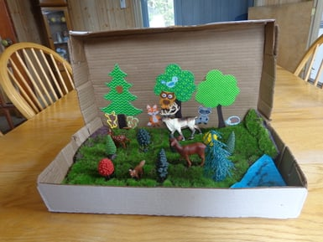
Optional: Cross-Curricular Extension
Optional: Cross-Curricular Extension
Bring your habitat to life! Create a diorama of your animal’s habitat using a discarded shoebox and items found outside.
Bears through the Seasons – 1G Bear-y Good Habitat: Cross-Curricular Extensions
30
Notes:
Bring your habitat to life! Create a diorama of your animal’s habitat using a discarded shoebox and items found outside.

