Slide 1
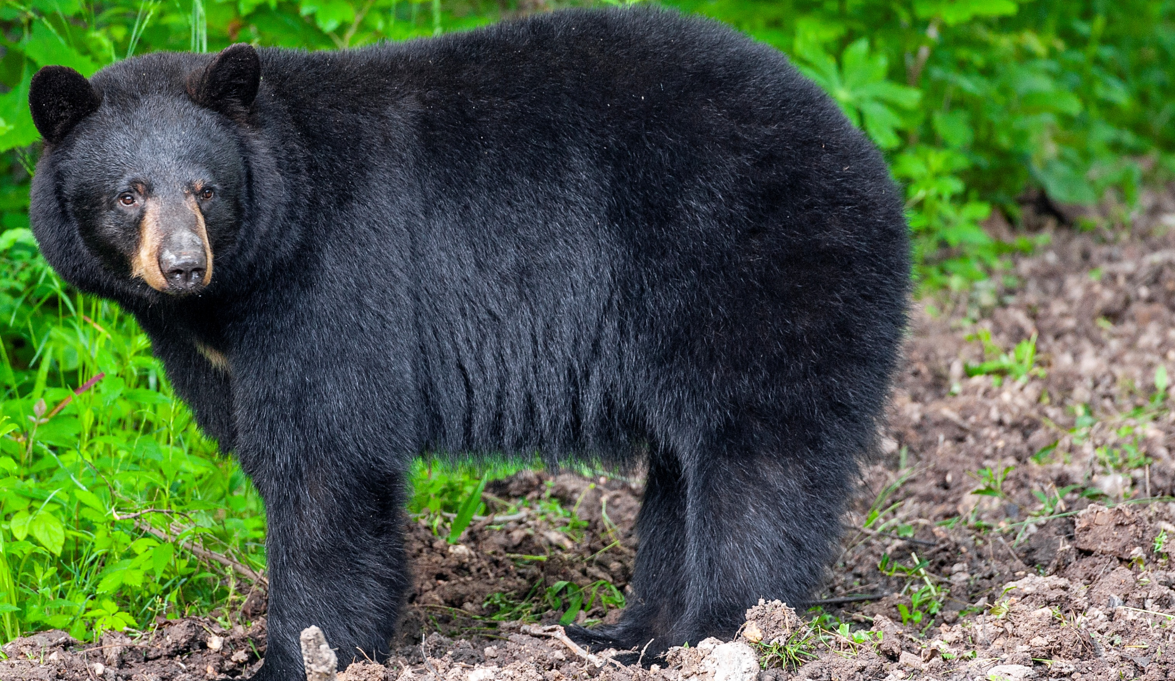

BEARS
Through the Seasons
Lesson 1F: What Lives in My Schoolyard?

Slide 2
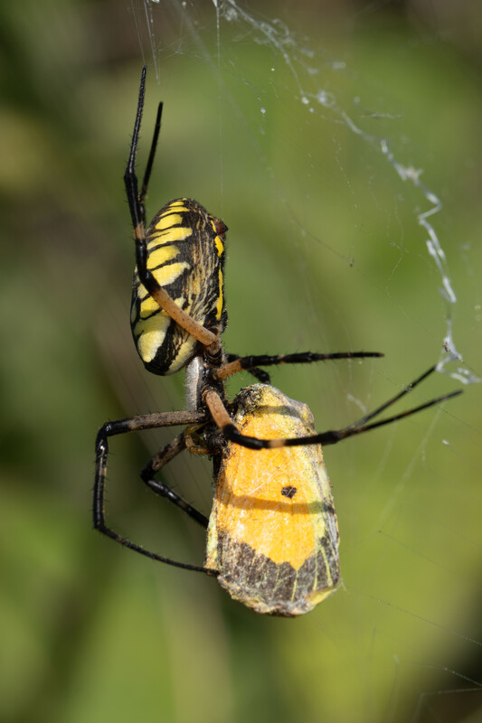

Guiding Question:
What lives in my schoolyard?
Bears through the Seasons – 1F What Lives in My Schoolyard: Engage
2
Notes:
Garden spider with captured insect.

Slide 3

Bears through the Seasons – 1F What Lives in My Schoolyard: Engage
3
Notes:
Prepare and display your Noticings and Wonderings Chart for this lesson. Add student observations and/or questions to the chart as the lesson proceeds in reference to the phenomenon studied.

Slide 4
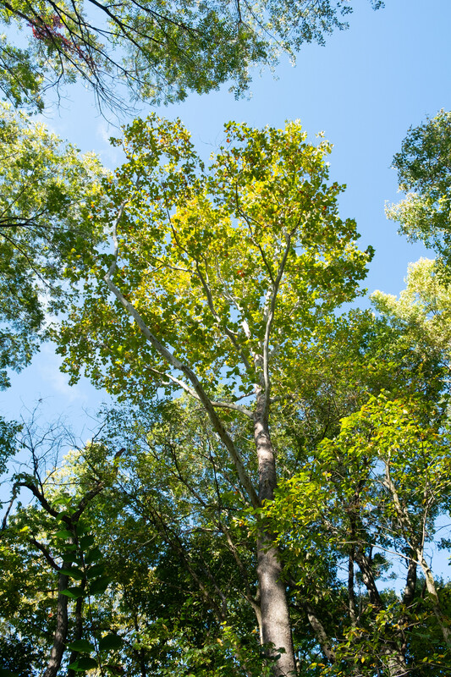
What do you expect to find in the schoolyard when you go outside?
Bears through the Seasons – 1F What Lives in My Schoolyard: Engage
4

Slide 5

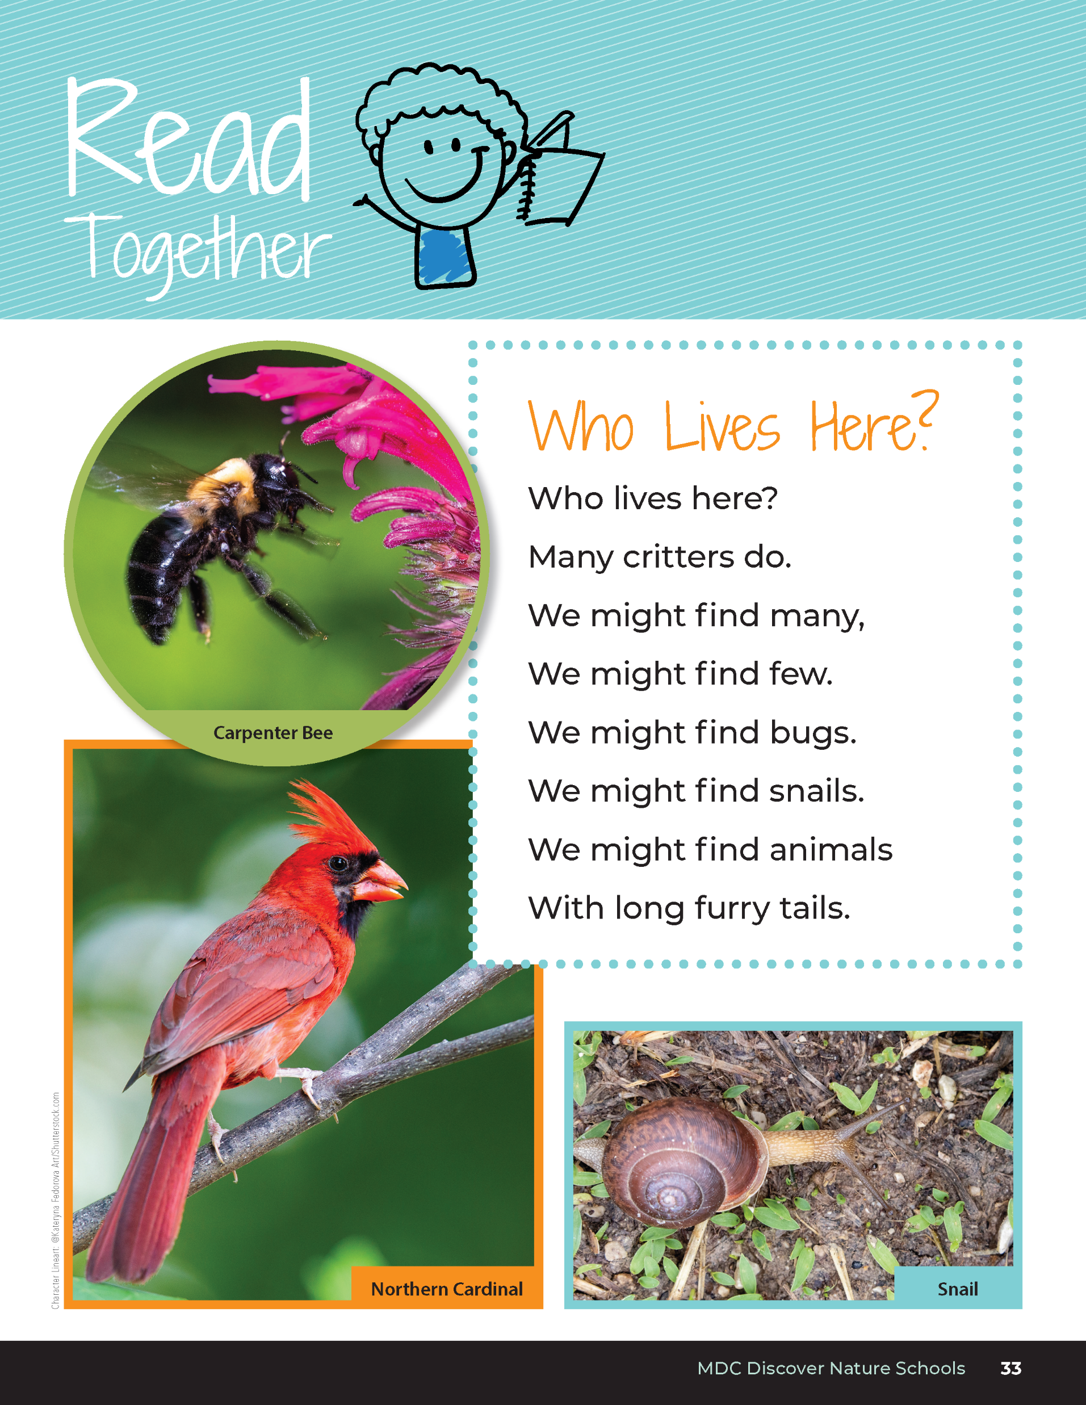
Who Lives Here?
Who lives here?
Many critters do.
We might find many,
We might find a few.
We might find bugs.
We might find snails.
We might find animals
With long furry tails.
Bears through the Seasons – 1F What Lives in My Schoolyard: Engage
5
Notes:
Read aloud from the student guide Read Together Who Lives Here? on Page 33.

Slide 6

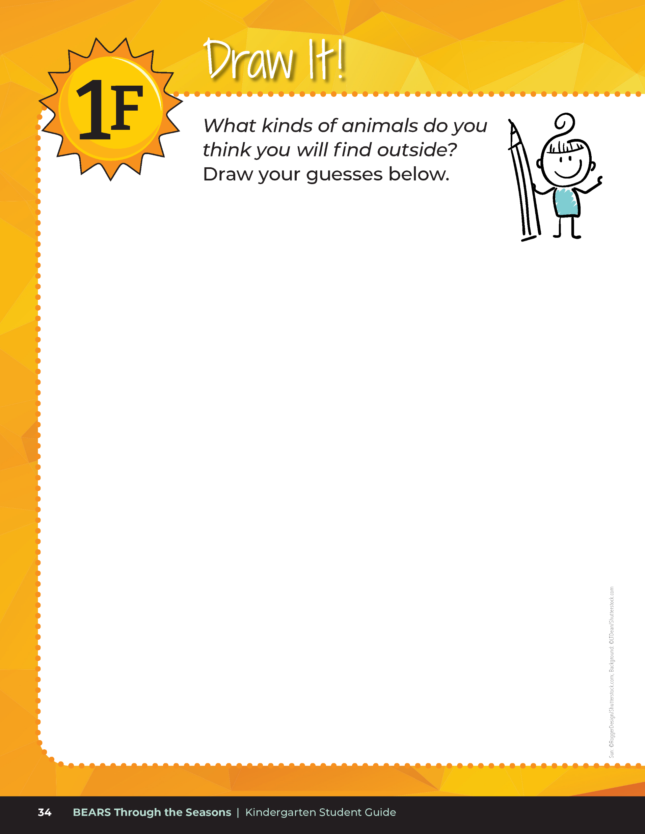
What kinds of things do you think you will find in your schoolyard? Draw your guesses!
Bears through the Seasons – 1F What Lives in My Schoolyard: Engage
6
Notes:
Next have students prepare for going into the schoolyard with a warmup activity from the student guide, Draw It! on Page 34.

Slide 7
Time to go outside! When we go out, follow the directions below:
1. Stay with your partner or group.
2. Go to your area I give you.
3. Lay down your boundary (like a hula hoop)
4. Draw what you find in your area using your notebook. (You can draw a map, things you find, things you see)
Bears through the Seasons – 1F What Lives in My Schoolyard: Explore
7
Notes:
For this activity students will be going into the schoolyard. Prior to going out, make a small plot boundary device by laying a hula hoop, square meter, square foot or other size PVC quadrat, yarn (with or without golf tees to secure). Anything that will measure out small student areas will work.​
​
Decide if students will partner or be in larger groups based on the size of the boundary made for observation. Student will find a location in the schoolyard for their observation and place their boundary. Try to find places that have been as undisturbed as possible. After students place their boundary, have them record what they observe within the boundary on student guide, Draw It! My Area on Page 35.​
​
Students may draw a diagram or map of their plot and draw as many things as they observe. Have them include as many things as they can. Ask students:​
What covers the ground in your area?​
Do you see a lot of grass?​
Flowers? Soil? Roots?​
Are there any animals in your small area?

Slide 8
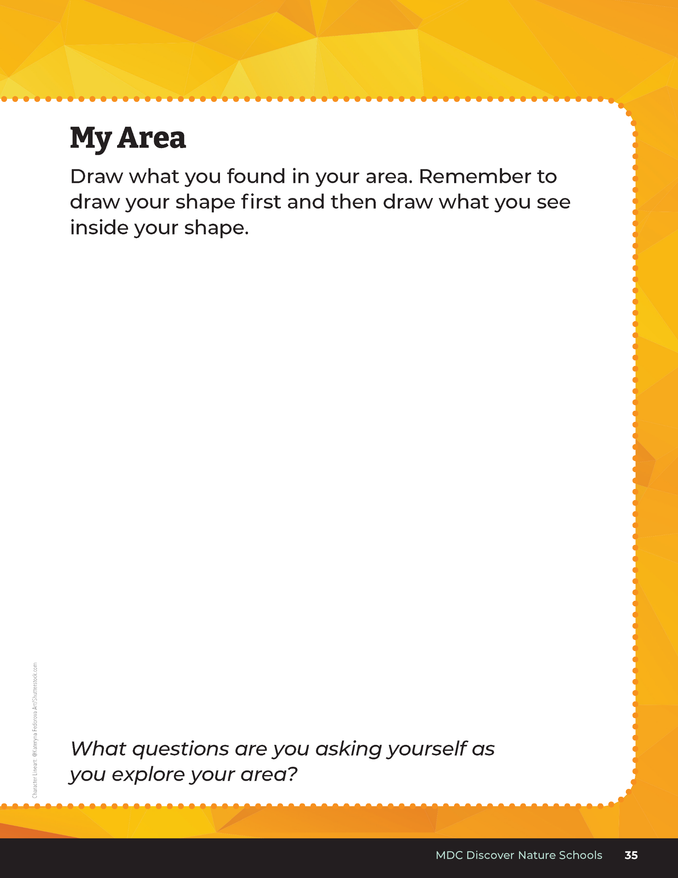
Draw what you find in your area
Bears through the Seasons – 1F What Lives in My Schoolyard: Explore
8
Notes:
Note: Teacher may provide students with hand lenses or devices to take pictures.
For this activity students will be going into the schoolyard. Prior to going out, make a small plot boundary device by laying a hula hoop, square meter, square foot or other size PVC quadrat, yarn (with or without golf tees to secure). Anything that will measure out small student areas will work.
Decide if students will partner or be in larger groups based on the size of the boundary made for observation. Student will find a location in the schoolyard for their observation and place their boundary. Try to find places that have been as undisturbed as possible. After students place their boundary, have them record what they observe within the boundary on student guide, Draw It! My Area on Page 35.
Students may draw a diagram or map of their plot and draw as many things as they observe. Have them include as many things as they can. Ask students:
What covers the ground in your area?
Do you see a lot of grass?
Flowers? Soil? Roots?
Are there any animals in your small area?

Slide 9
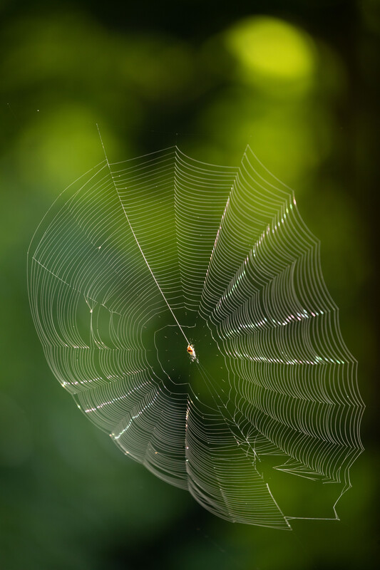
Think about...
Is there evidence that an animal has been there (but may not there right now)?
Bears through the Seasons – 1F What Lives in My Schoolyard: Explore
9
Notes:
Ask students to think about what questions they may have while they are making observations

Slide 10
Bears through the Seasons – 1F What Lives in My Schoolyard: Explore
10
Notes:
When back in class, discuss the findings and place them in the Noticings and Wonderings Chart.

Slide 11

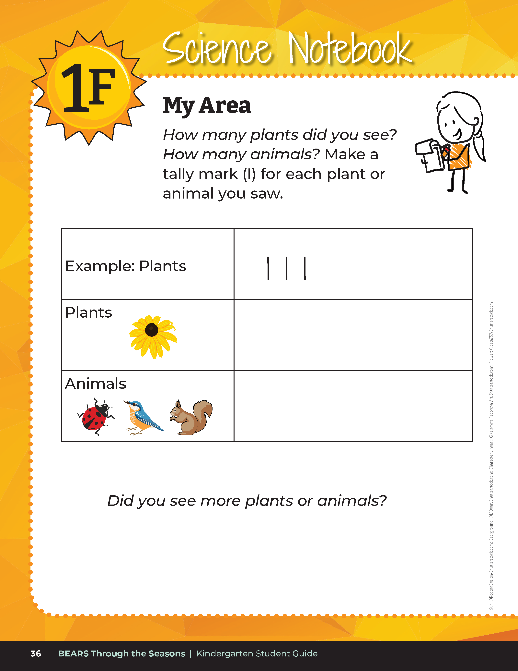
Let's put our findings into a table!
How many plants did you see?
How many animals?
Did you see more plants or animals?
Bears through the Seasons – 1F What Lives in My Schoolyard: Explore
11
Notes:
Have them draw or write the number of animals or insects that the find (for example, ladybugs: 4; grasshoppers: 2, ants: 20, etc.) in the student guide, Science Notebook on Page 36

Slide 12
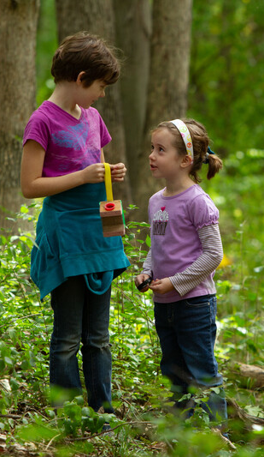
Share and Chart
Bears through the Seasons – 1F What Lives in My Schoolyard: Explain
12
Notes:
Students will share what they found. Chart the similarities on large paper or white board for class totals and differences in class data.

Slide 13
Think back to your first guess...
How does it compare to what you actually found?
What questions do you have?
Bears through the Seasons – 1F What Lives in My Schoolyard: Explain
13
Notes:
Refer back to their first guess of what they think they would find.
Ask:
How does it compare to what they actually found?
What questions do they have.
Chart the questions.

Slide 14
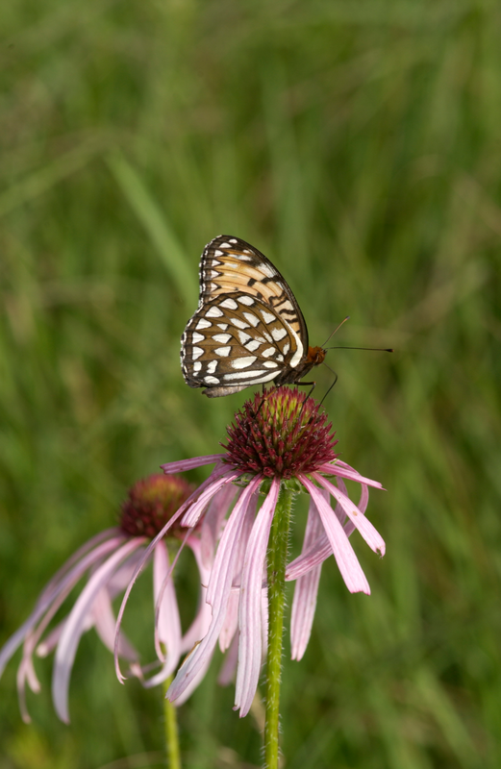

Do these animals have what they need to survive in the little areas we had outside? Why or why not?
Bears through the Seasons – 1F What Lives in My Schoolyard: Explain
14
Notes:
Pale purple coneflower with butterfly.

Slide 15
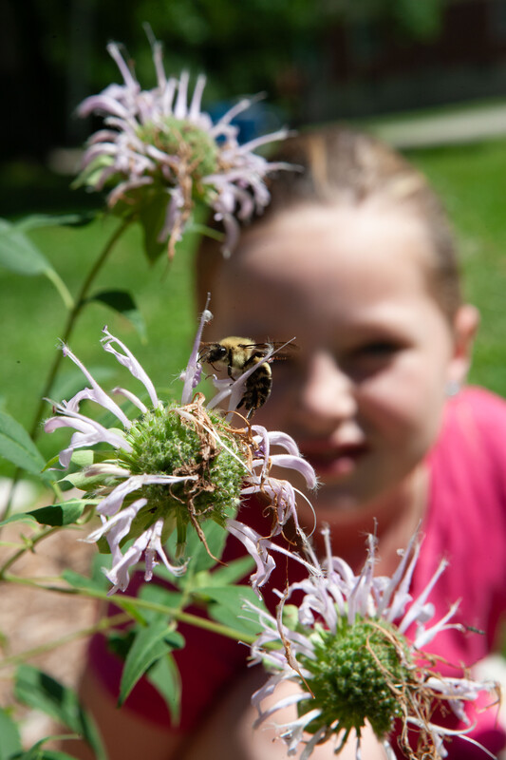
Observe and Investigate: What questions did you have? How would you investigate this?
Bears through the Seasons – 1F What Lives in My Schoolyard: Elaborate
15
Notes:
Use this portion of the lesson to make more observations or plan an investigation to answer a question generated in the Explain section. An option would be to see if there is more or less animal activity at different times of day. The animals would likely be insects or other invertebrates unless you have a diverse schoolyard that might include frogs, birds, squirrels, etc.
Add student observations and/or questions to the Noticings and Wonderings Chart as the lesson concludes in reference to the phenomenon studied.
Beebalm plant.

Slide 16
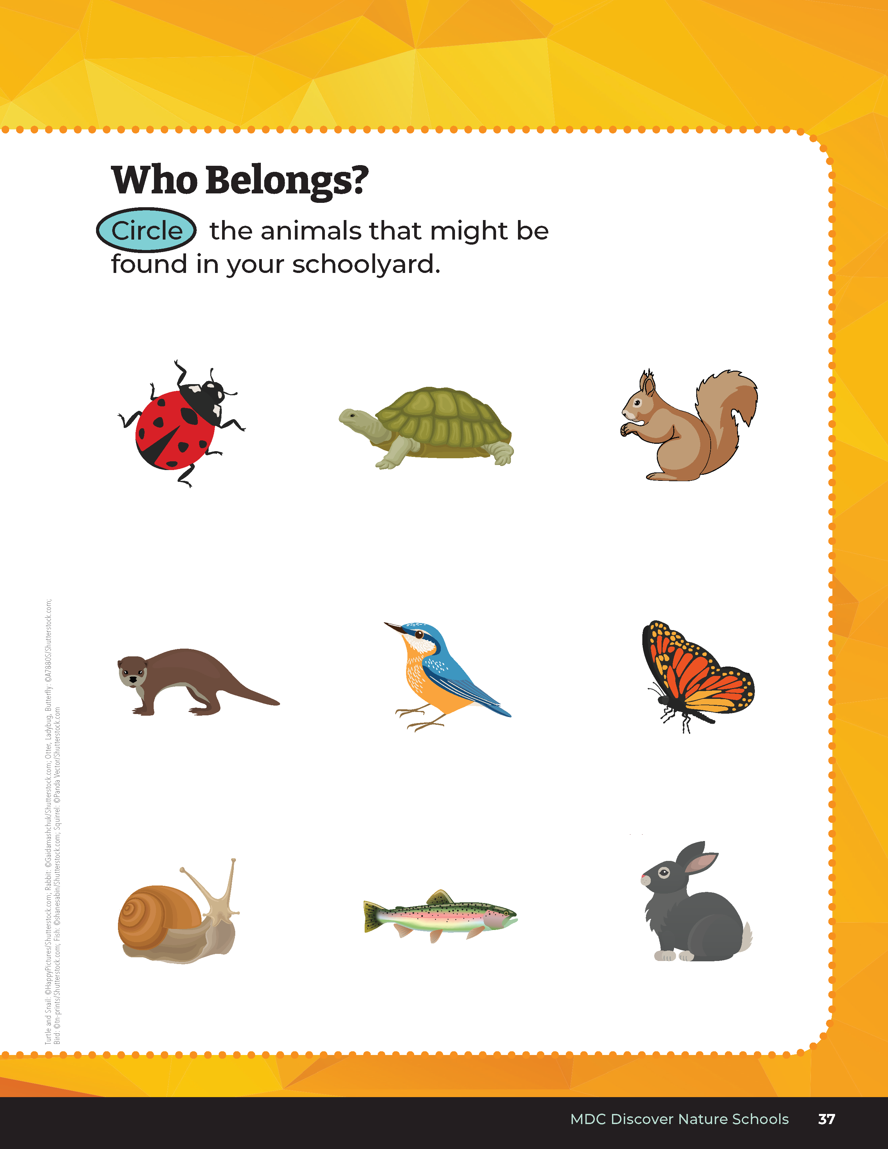
Circle the animals that might be found in your schoolyard. Based on what we learned, why would these animals survive? Why would the other animals not survive?
Bears through the Seasons – 1F What Lives in My Schoolyard: Evaluate
16
Notes:
For assessment, have students complete the student guide, Science Notebook Who Belongs? Page 37 and circle the animals that may be found in their schoolyard.

