Slide 1
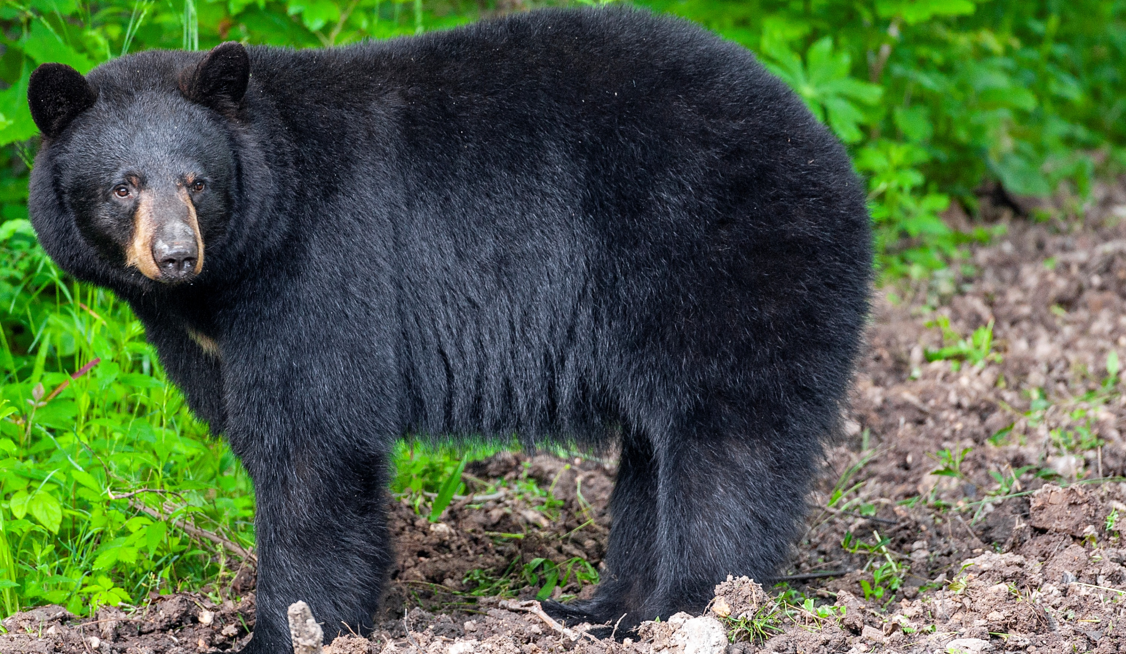

BEARS
Through the Seasons
Lesson 1D: Tracking Temperature

Slide 2
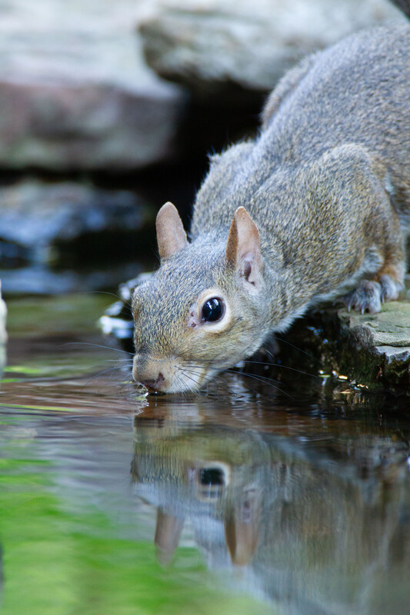

Guiding Question:
It is a hot day and you are outside playing.
How might you cool off?
How do animals cool off?
Bears through the Seasons – 1D Tracking Temperature: Engage
2
Notes:
Open you student guide to Lesson 1D Tracking Temperature on Page 20 to the picture of the Missouri animal sunning itself on the rock.
Animal: Gray Squirrel

Slide 3

Bears through the Seasons – 1D Tracking Temperature: Engage
3
Notes:
Prepare and display your Noticings and Wonderings Chart for this lesson. Add student observations and/or questions to the chart as the lesson proceeds in reference to the phenomenon studied.

Slide 4

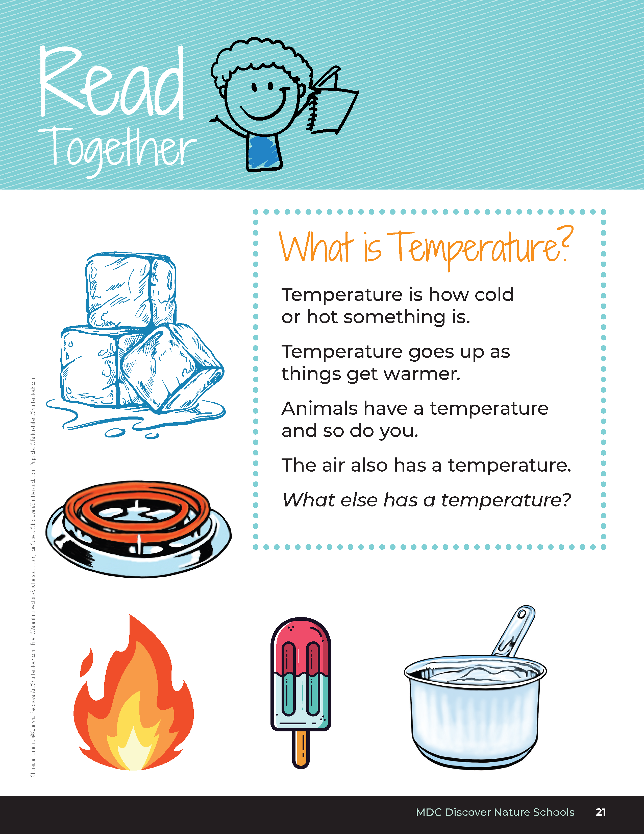
What is Temperature?
Temperature is how cold or hot something is.
Temperature goes up as things get warmer.
Animals have a temperature and so do you.
The air also has a temperature.
What else has a temperature?
Bears through the Seasons – 1D Tracking Temperature: Engage
4
Notes:
Read together from student guide, Read Together What is Temperature? on Page 21

Slide 5

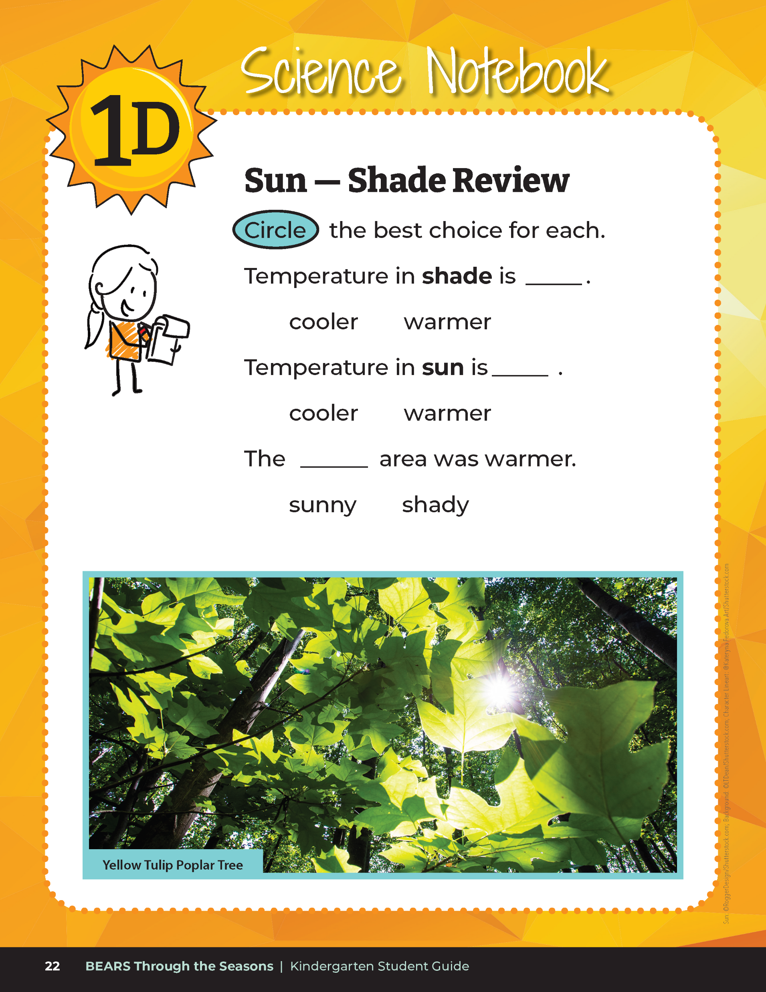
Review
Bears through the Seasons – 1D Tracking Temperature: Engage
5
Notes:
In the student guide, complete Science Notebook Sun – Shade Review on Page 22.

Slide 6
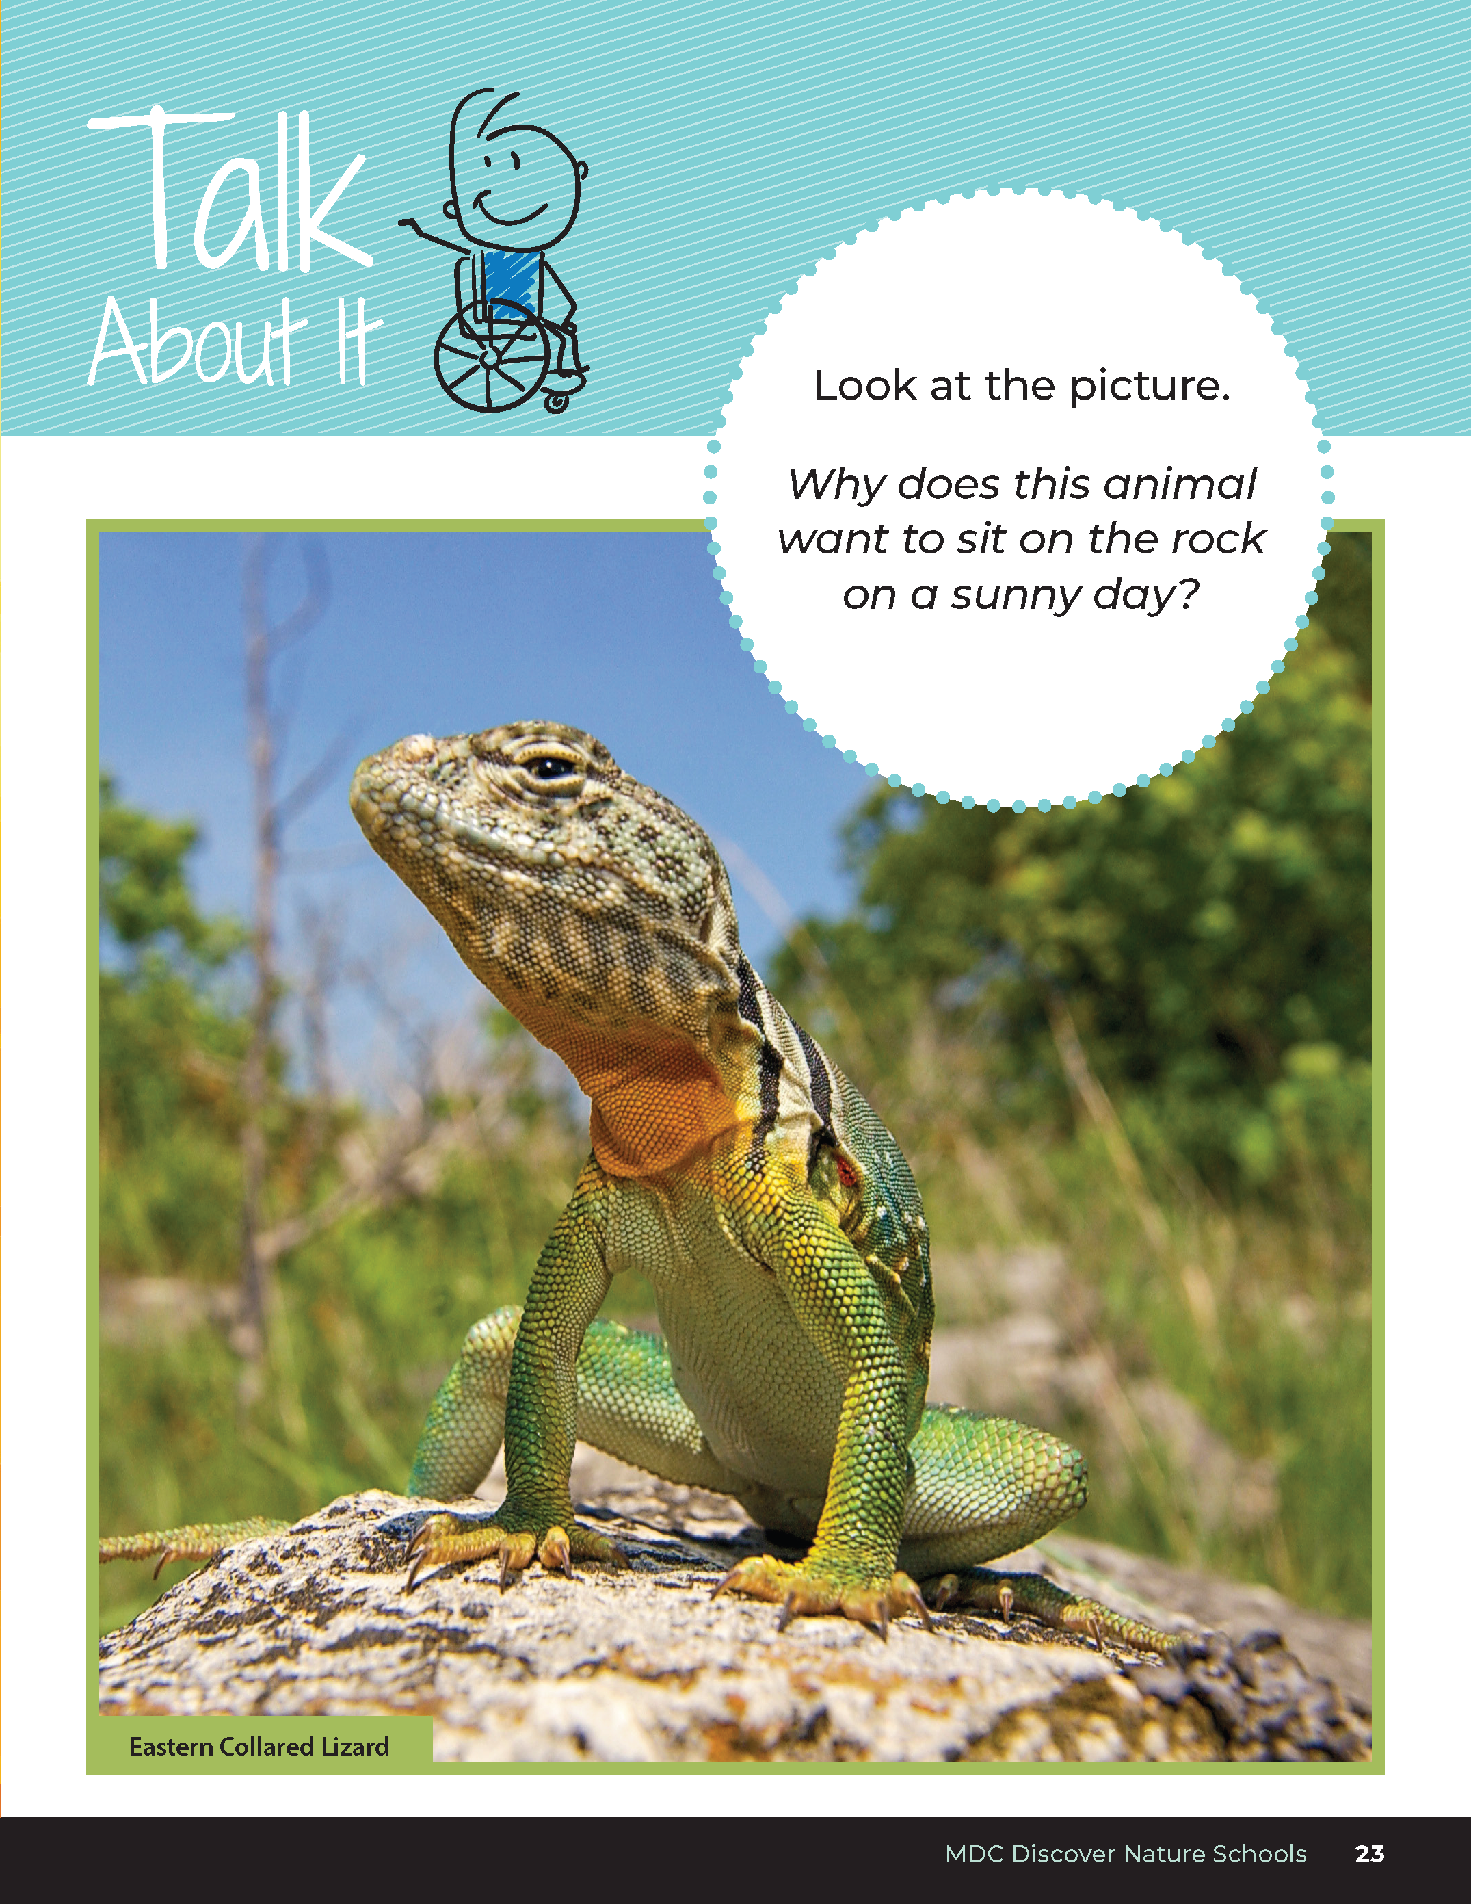

Why does this animal want to sit on the rock on a sunny day?
Bears through the Seasons – 1D Tracking Temperature: Explore
6
Notes:
Discuss why animals such as turtles and lizards may sit in sunny areas.
Animal: Eastern Collard Lizard

Slide 7
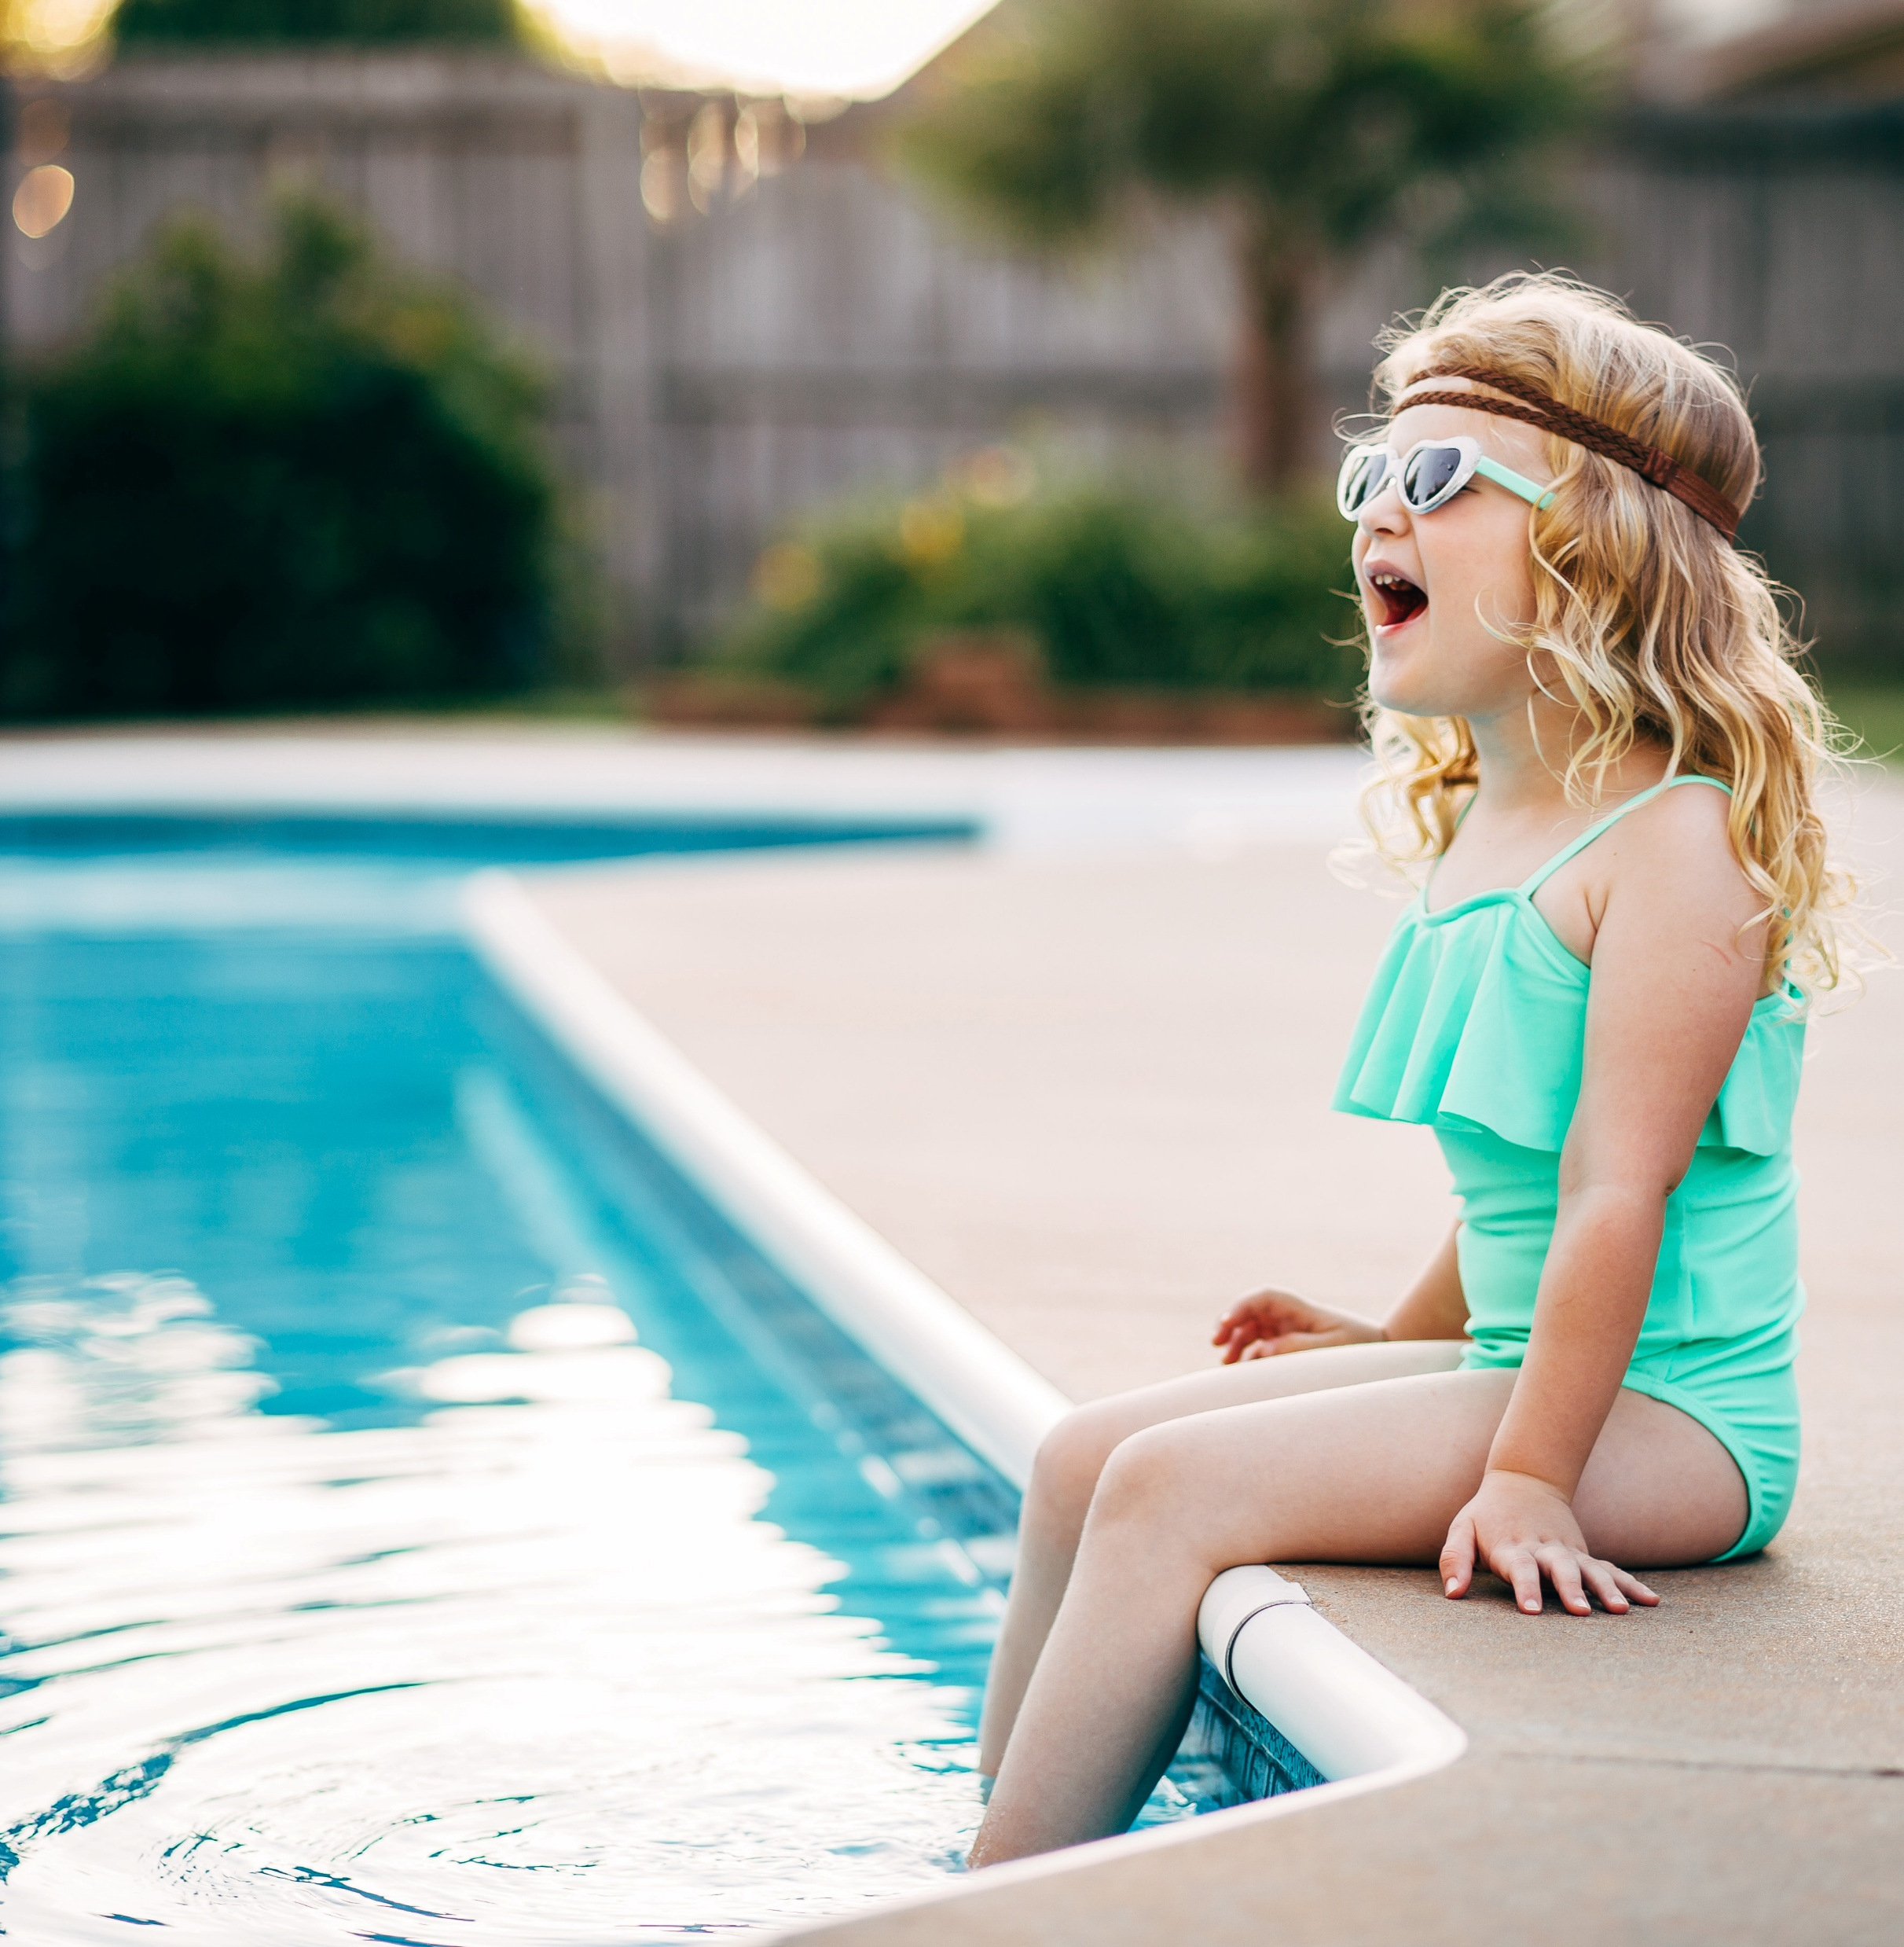
Why do outdoor pools open later in the morning or in the afternoon?
Bears through the Seasons – 1D Tracking Temperature: Explore
7

Slide 8


How can we test our ideas?
Bears through the Seasons – 1D Tracking Temperature: Explore
8

Slide 9
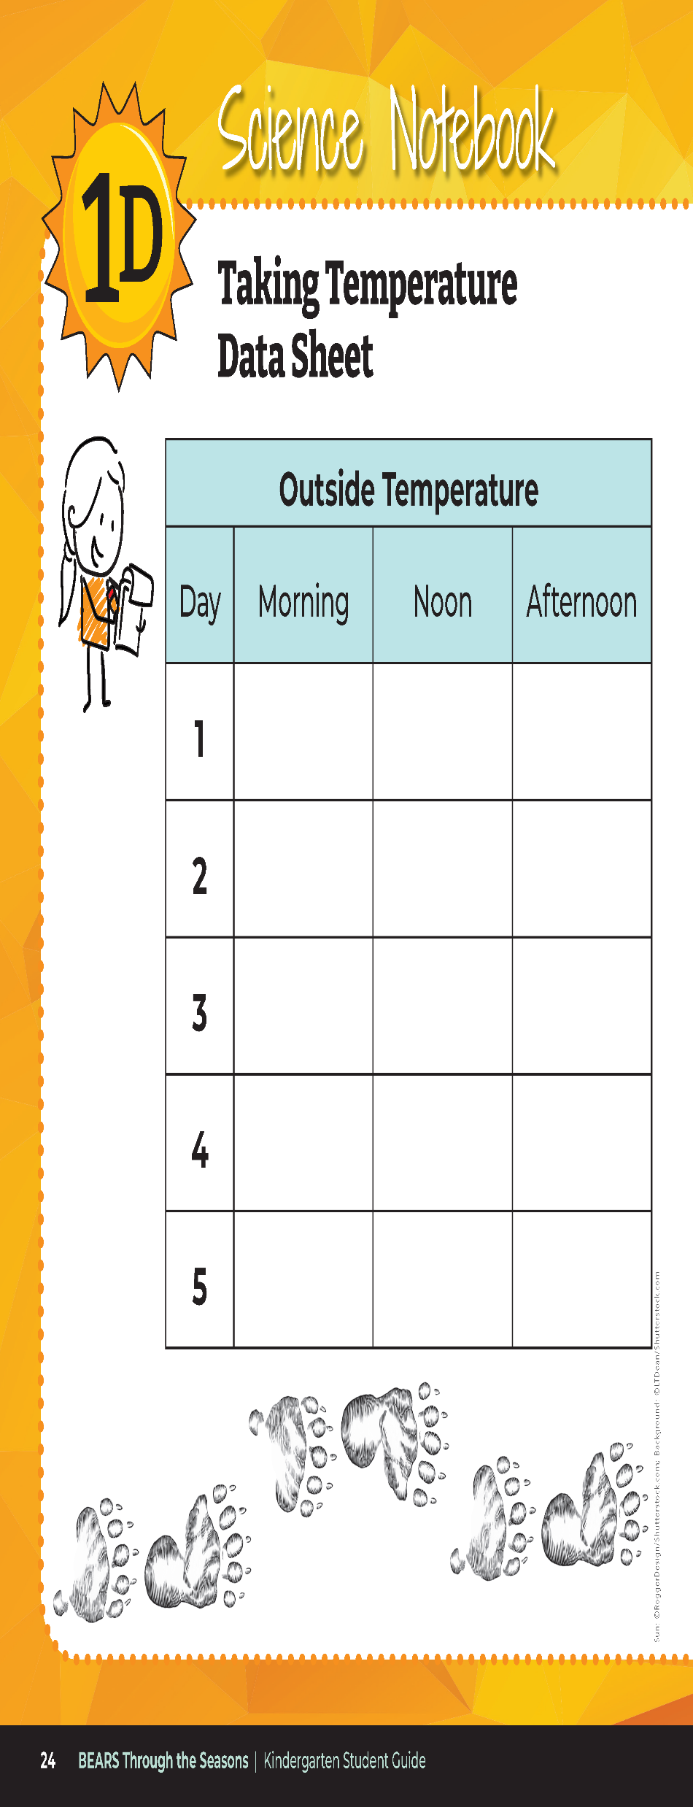
Investigation: We are going to take air temperatures outside 3 times a day. How and when will we do this?
How does this test our ideas?
Bears through the Seasons – 1D Tracking Temperature: Explore
9
Notes:
Help students set up an investigation in which they will air temperature outside three times a day for four to five days. Use the Science Notebook Taking Temperatures Data Sheet in the student guide or on chart paper inside the classroom. You can also make copies of 1D Taking Temperature Data Sheet following this lesson.
At the end of the data collection period of five days, discuss what students notice about the data in their chart.

Slide 10
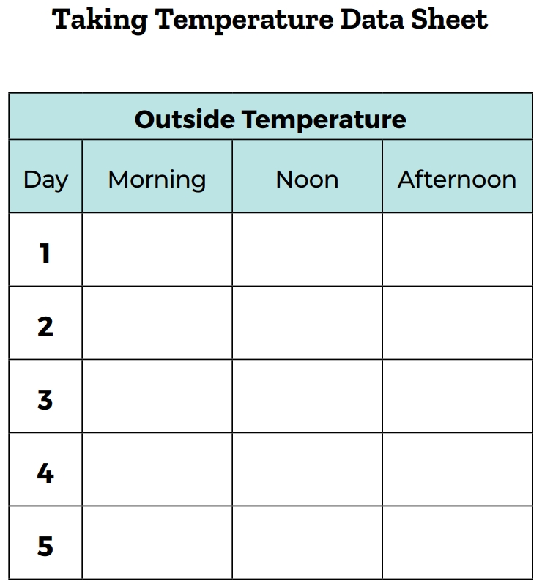
How do we know if a temperature reading is higher than another?
L
H
Bears through the Seasons – 1D Tracking Temperature: Explain
10
Notes:
Look at the numbers for each day and discuss which numbers are highest and which are lowest. Have students put an H on the high data and L on the low data entries for each day.

Slide 11
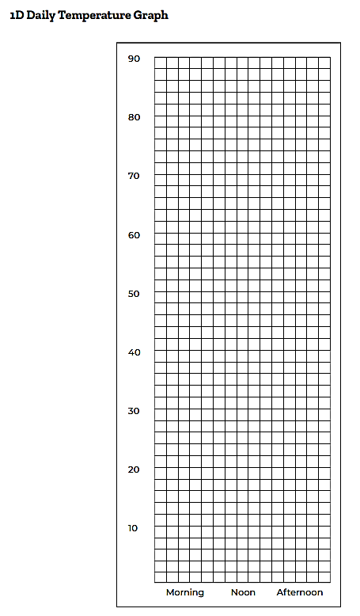
How else can we write the data? (Remember what we did last lesson! What is this called?)
Are the patterns the same each day?
Bears through the Seasons – 1D Tracking Temperature: Elaborate
11
Notes:
Assist students in creating bar graphs for each day using sticky notes and partial sticky notes or some other similar method as shown on 1D Daily Temperature Graph Example.
Students can then discuss the patterns on the blank 1D Daily Temperature Graph for each day.
Add student observation and/or questions to the Noticings and Wonderings Chart as the lesson concludes in reference to the phenomenon studied.

Slide 12

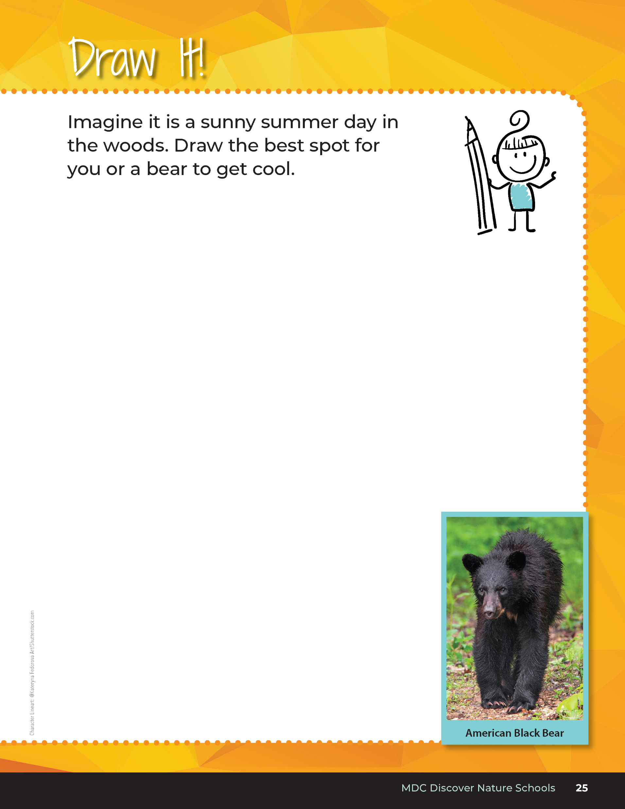
Where might a bear rest and get cool?
How do you know?
Bears through the Seasons – 1D Tracking Temperature: Evaluate
12
Notes:
Based upon what we have learned about sun and shade, where might a bear rest and get cool? Why? Have students complete the student guide, Draw it! Activity on Page 25. Check for comprehension and ask students to justify their drawing location.

Slide 13

Optional: Cross-Curricular Extension
1
Draw the area that a black bear might be found on a hot day.
Draw the area a bear might be found during a cloudy, cool day.
2
Bears through the Seasons – 1D Tracking Temperature: Cross-Curricular Extension
13
Notes:
Have students create a line down the center of a plain piece of paper. Have them create a drawing for each of the following two prompts, place one drawing on each side to compare and contrast.
Draw the area that a black bear might be found on a hot day. (Pictures should reflect understanding of a bear seeking shady areas, away from sun or perhaps under trees.)
Draw the area a bear might be found during a cloudy, cool day. Why is a bear more likely to be found here? (Answers should reflect that a bear is more likely to be seen roaming out in the open when heat and direct sunlight are less intense than on full-sun days when they would typically seek shade)

