Slide 1
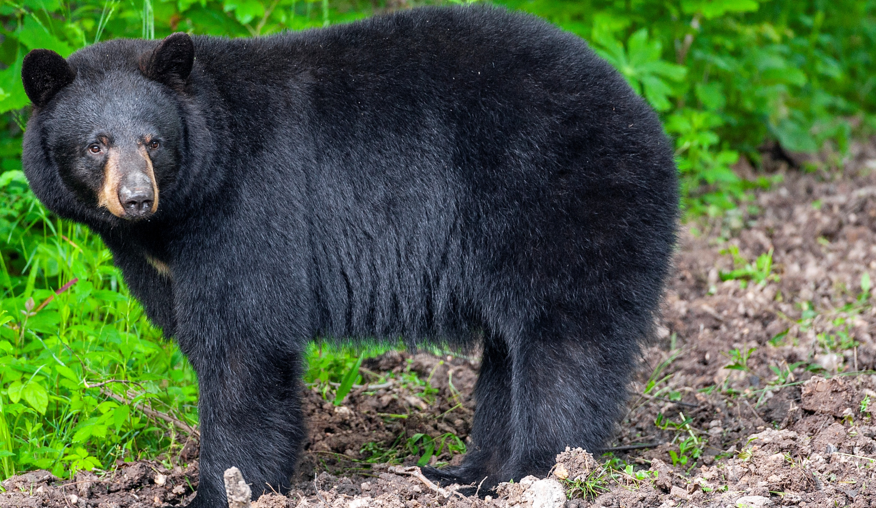

BEARS
Through the Seasons
Lesson 1C: Testing Our Cool

Slide 2
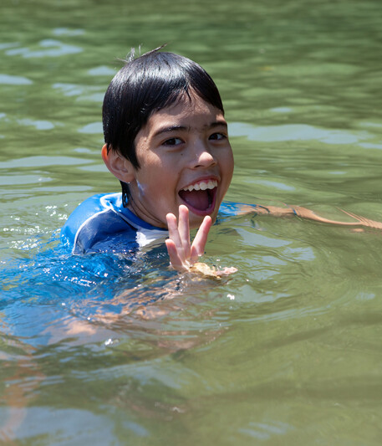

Guiding Question:
It is a hot day and you are outside playing.
How might you cool off?
How might an animal cool off?
Bears through the Seasons – 1C Testing Our Cool: Engage
2

Slide 3

Bears through the Seasons – 1C Testing Our Cool: Engage
3
Notes:
Prepare and display your Noticings and Wonderings chart for this lesson. Add student observations and/or questions to the chart as the lesson proceeds in reference to the phenomenon studied.

Slide 4
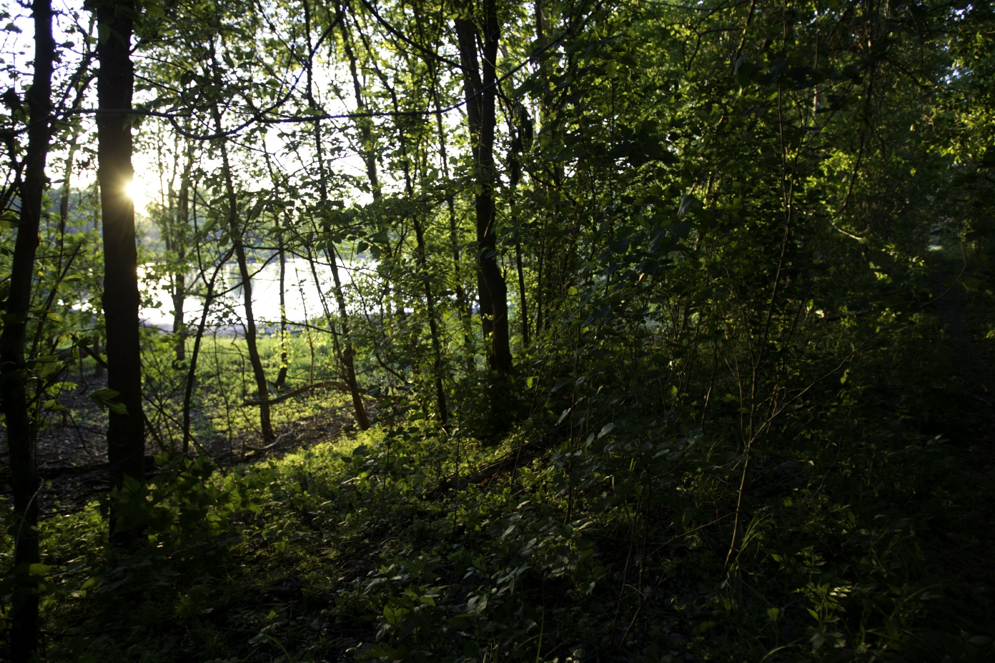
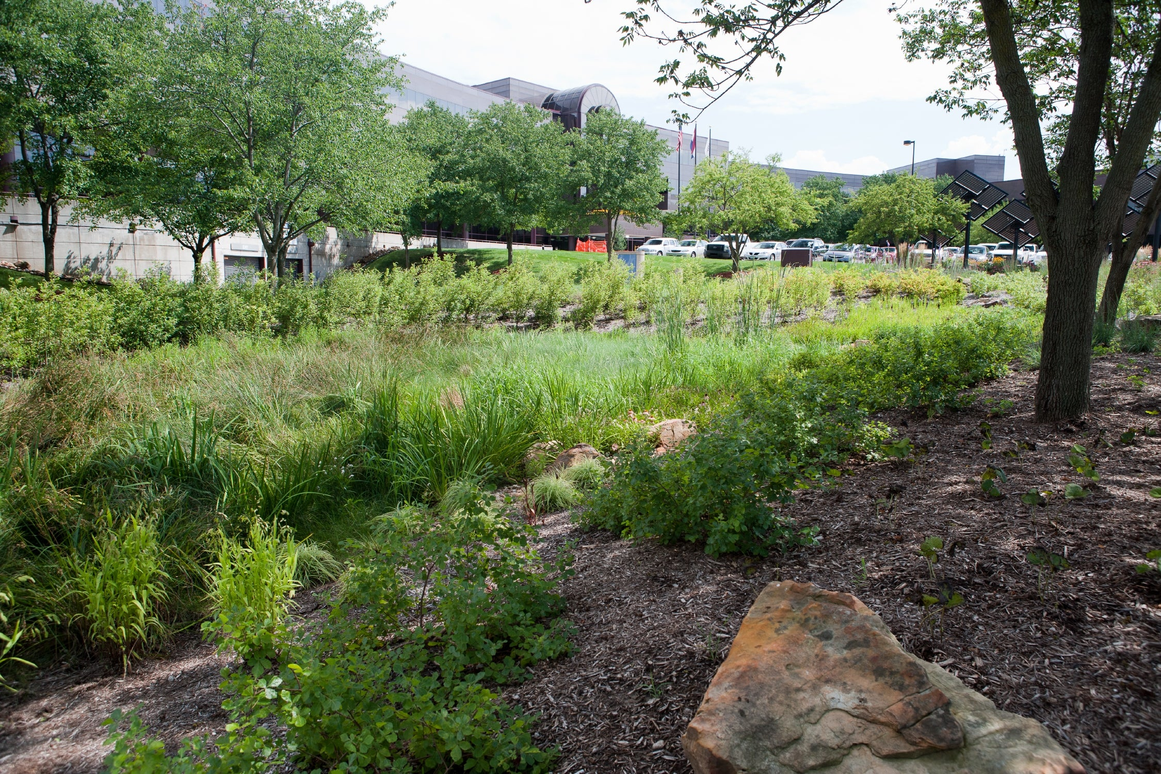
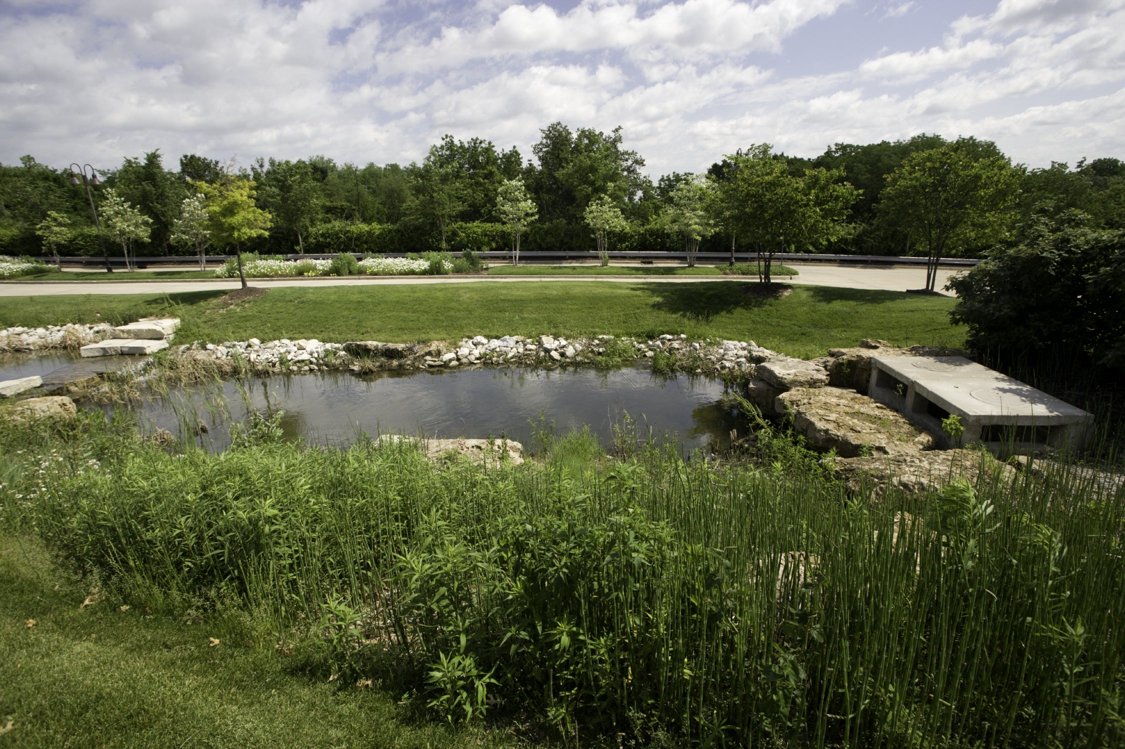
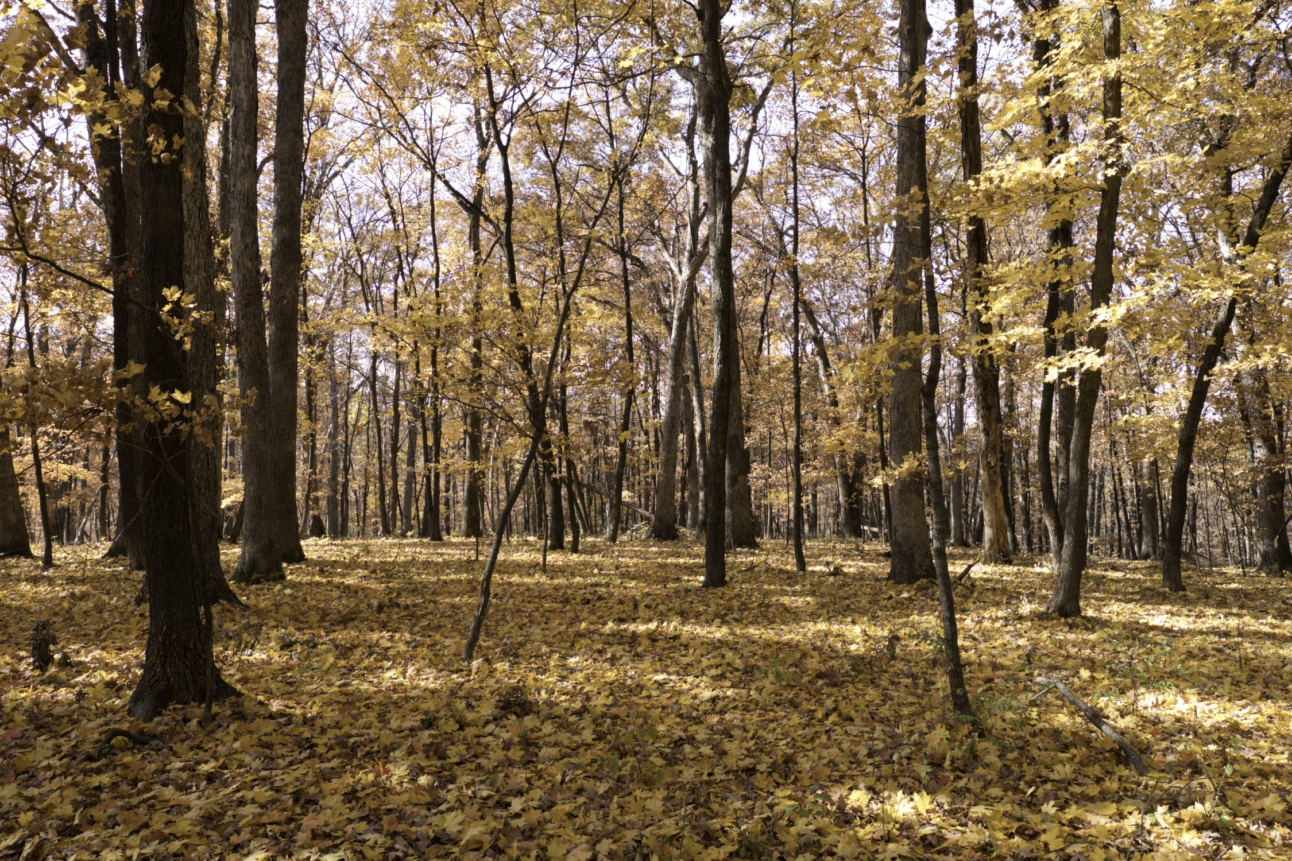
Where in the photos would you be warm or hot and where in the pictures would you be cooler?
Bears through the Seasons – 1C Testing Our Cool: Engage
4
Notes:
Discuss with students where in the photo they would be warm or hot and where in the picture they would be cooler.

Slide 5
Bears through the Seasons – 1C Testing Our Cool: Engage
5
Notes:
Discuss with students where in the photo they would be warm or hot and where in the picture they would be cooler.

Slide 6
Bears through the Seasons – 1C Testing Our Cool: Engage
6
Notes:
Discuss with students where in the photo they would be warm or hot and where in the picture they would be cooler.

Slide 7
Bears through the Seasons – 1C Testing Our Cool: Engage
7
Notes:
Discuss with students where in the photo they would be warm or hot and where in the picture they would be cooler.

Slide 8
Bears through the Seasons – 1C Testing Our Cool: Engage
8
Notes:
Discuss with students where in the photo they would be warm or hot and where in the picture they would be cooler.

Slide 9

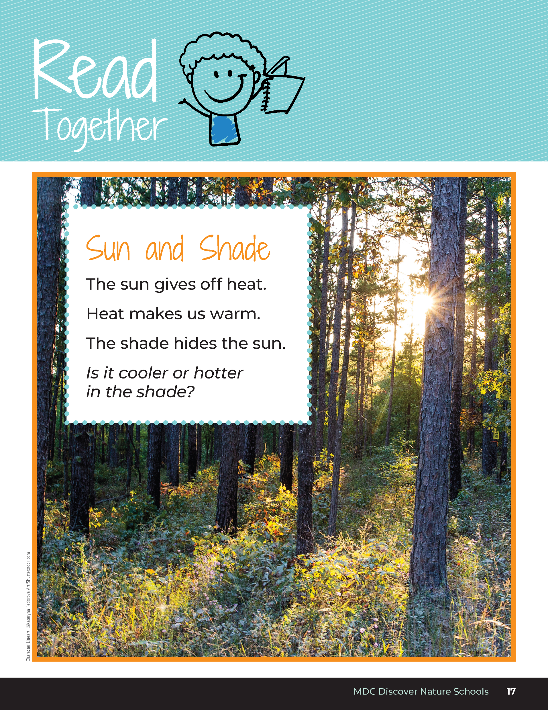
Sun and Shade
The sun gives off heat.
Heat makes us warm.
The shade hides the sun.
Is it cooler or hotter in the shade?
Bears through the Seasons – 1C Testing Our Cool: Explore
9
Notes:
As a class, read the Read Together sections from the student guide Sun and Shade on Page 17.

Slide 10
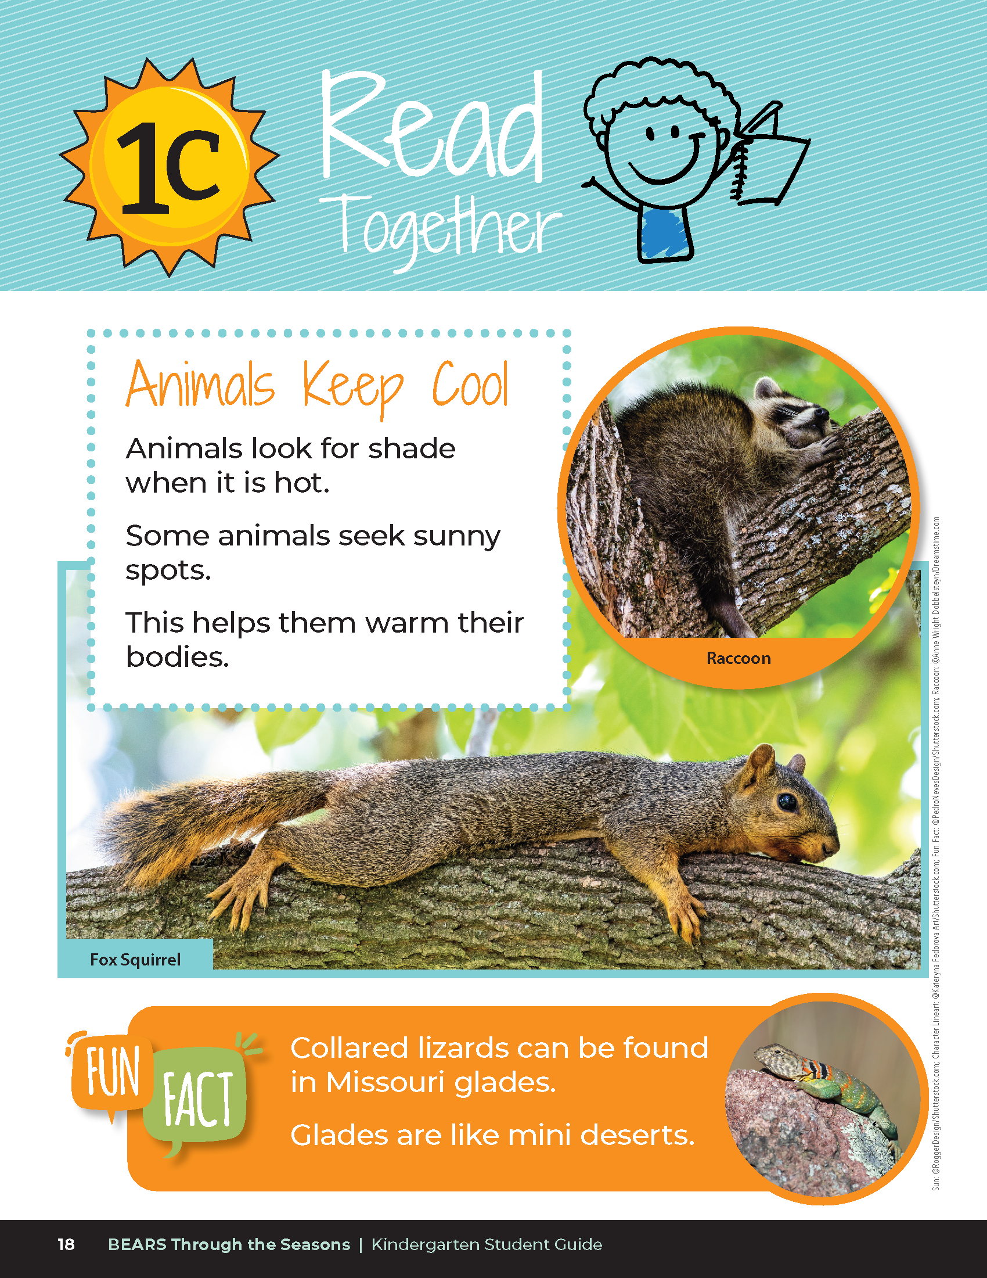
Animals Keep Cool
Animals look for shade when it is hot.
Some animals seek sunny spots.
This helps them warm their bodies.
Bears through the Seasons – 1C Testing Our Cool: Explore
10
Notes:
As a class, read the Read Together sections from the student guide How Animals Keep Cool on Page 18.

Slide 11
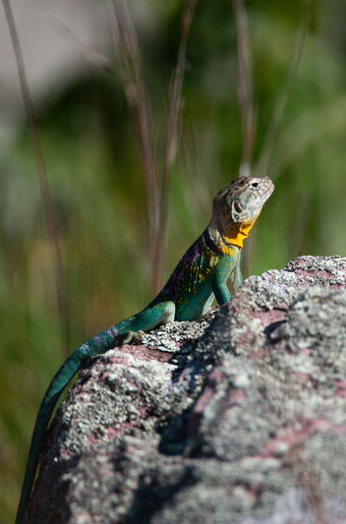
Bears through the Seasons – 1C Testing Our Cool: Explore
11
Notes:
Read together the fun fact in the student guide on Page 18.
Animal: Eastern Collared Lizard

Slide 12

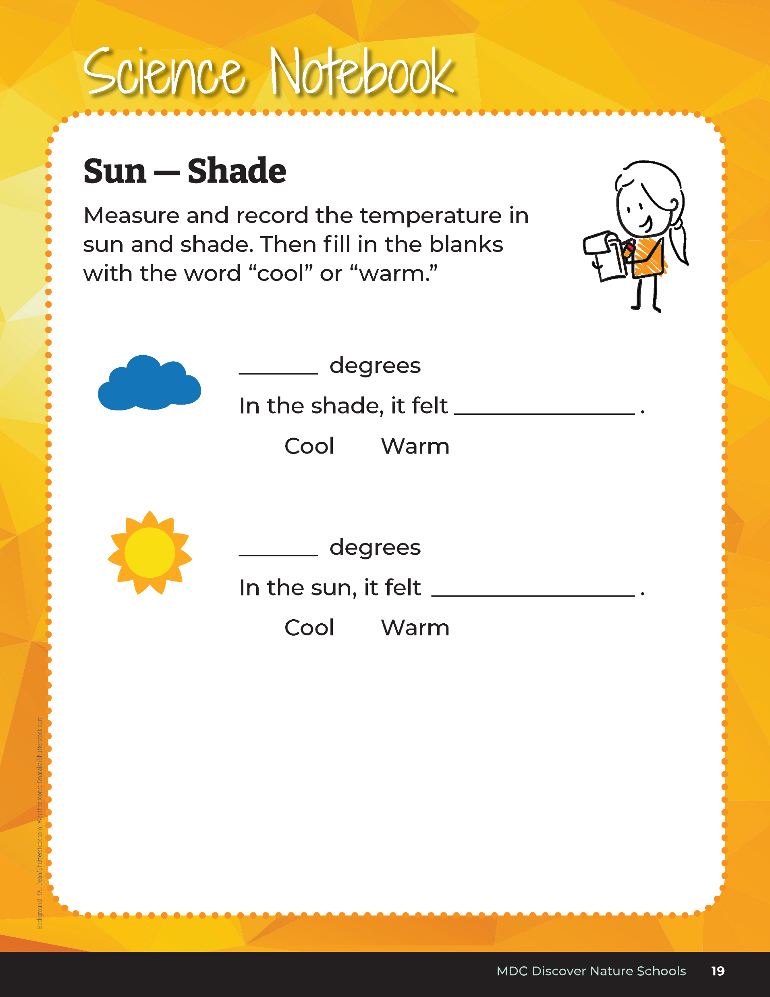
We are going outside to the schoolyard. Find both a sunny and a shady location.
Bears through the Seasons – 1C Testing Our Cool: Explore
12
Notes:
- Go outside to the schoolyard and find both a sunny and shady location. Students should have their student guides open to Science Notebook Sun – Shade on Page 19.
- Students find two locations in the schoolyard for sun and shade to collect temperature data for a sunny location and a shady one. With digital thermometer, teacher or student groups can take temperatures with the students recording the data in Science Notebook Sun – Shade
- Can students make a claim about how it feels in the sun compared to how it feels in the shade? In their student guide on the same Science Notebook Sun – Shade page, have students fill in the blanks. “In the shade, it felt _____ “ or “In the sun, it felt ______.” They can choose warm or cool from the word list in their student guides.

Slide 13
Class Review:
What were our two temperatures?
Make a Claim
In the shade, it felt _____.
In the sun, it felt _____.
Bears through the Seasons – 1C Testing Our Cool: Explain
13

Slide 14
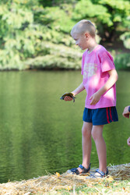
What causes it to be warmer in the sun?
Bears through the Seasons – 1C Testing Our Cool: Explore
14

Slide 15

How might a cloudy day change how we feel?
Bears through the Seasons – 1C Testing Our Cool: Explain
15

Slide 16
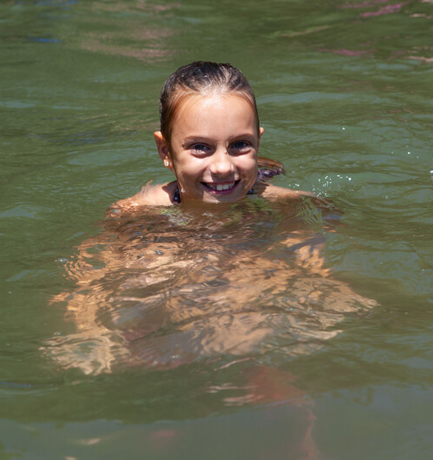
What are other ways of cooling off in the summer?
Bears through the Seasons – 1C Testing Our Cool: Elaborate
16

Slide 17
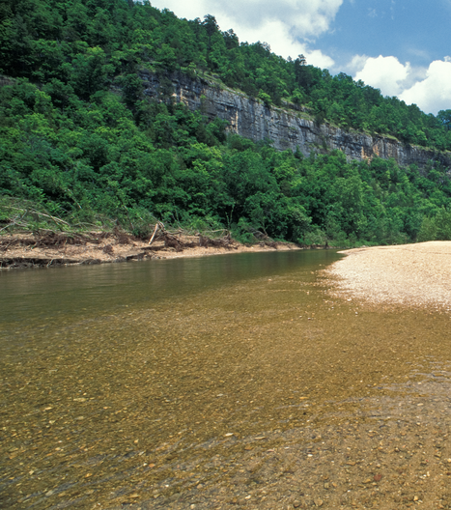
Do you think water in the sun or water in the shade is cooler?
Bears through the Seasons – 1C Testing Our Cool: Elaborate
17

Slide 18
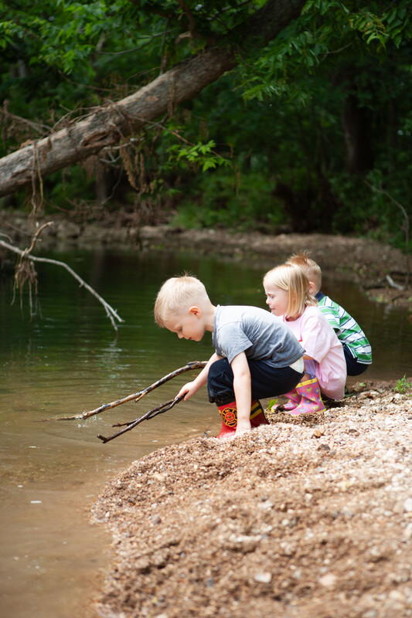
How can we test our ideas?
Bears through the Seasons – 1C Testing Our Cool: Elaborate
18

Slide 19
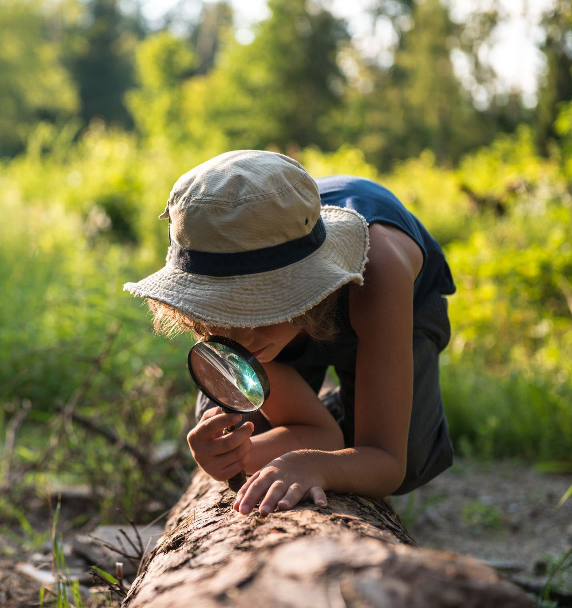
Let's plan an investigation to answer this question:
Do you think water in the sun or water in the shade is cooler? What should we do to test this? What do we need?
Bears through the Seasons – 1C Testing Our Cool: Elaborate
19
Notes:
Guide students in planning an investigation where they will collect evidence to answer this question. An idea would be to put a container of water, such as a plastic cup, in the sun and one in the shade. They should determine how long the water will stay there until they measure the temperature of both.

Slide 20
What did we find out after doing our investigation?
Which water stayed warmer? Cooler? How do you know?
Was there a pattern (does this happen every time?)
Bears through the Seasons – 1C Testing Our Cool: Elaborate
20
Notes:
Add student observations and/or questions to the Noticings and Wonderings Chart as the lesson concludes in reference to the phenomenon studied.

Slide 21
What claim can be made?
Bears through the Seasons – 1C Testing Our Cool: Elaborate
21

Slide 22
Are the results the same as when we tested the air in both locations? Is that a pattern?
Bears through the Seasons – 1C Testing Our Cool: Elaborate
22

Slide 23
Based on what you learned, which part of the picture is warmer? Which part is cooler? How do you know?
Bears through the Seasons – 1C Testing Our Cool: Evaluate
23
Notes:
Once in the classroom, repeat the Engage portion of the lesson and display the pictures of the park or landscape showing sun or shade. Students discuss their understanding of which part of the image is warmer and cooler and why based on what they learned. They can reference the Noticings and Wonderings Chart as a reminder of the concepts learned.

Slide 24
Bears through the Seasons – 1C Testing Our Cool: Evaluate
24

Slide 25
Bears through the Seasons – 1C Testing Our Cool: Evaluate
25

Slide 26
Bears through the Seasons – 1C Testing Our Cool: Evaluate
26

Slide 27
Bears through the Seasons – 1C Testing Our Cool: Evaluate
27

Slide 28


Optional: Cross-Curricular Extension
Create two separate paintings: one of a tree in the sun and one of a tree in the shade.
Use only warm colors on the tree in the sun painting and cool colors on the tree in the shade painting.
Bears through the Seasons – 1C Testing Our Cool: Cross-Curricular Extension
28
Notes:
Discuss warm and cool colors with students. Have them create two separate paintings: one of a tree in the sun and one of a tree in the shade.
Ask students to only use warm colors on the tree in the sun painting and cool colors on the tree in the shade painting.

